Slide 1

The Maths of Predators and Preys Don’t get Eaten by the Wolf
Dr John Butler TU Dublin (Lecturer in Mathematics and Statistics)

Slide 2
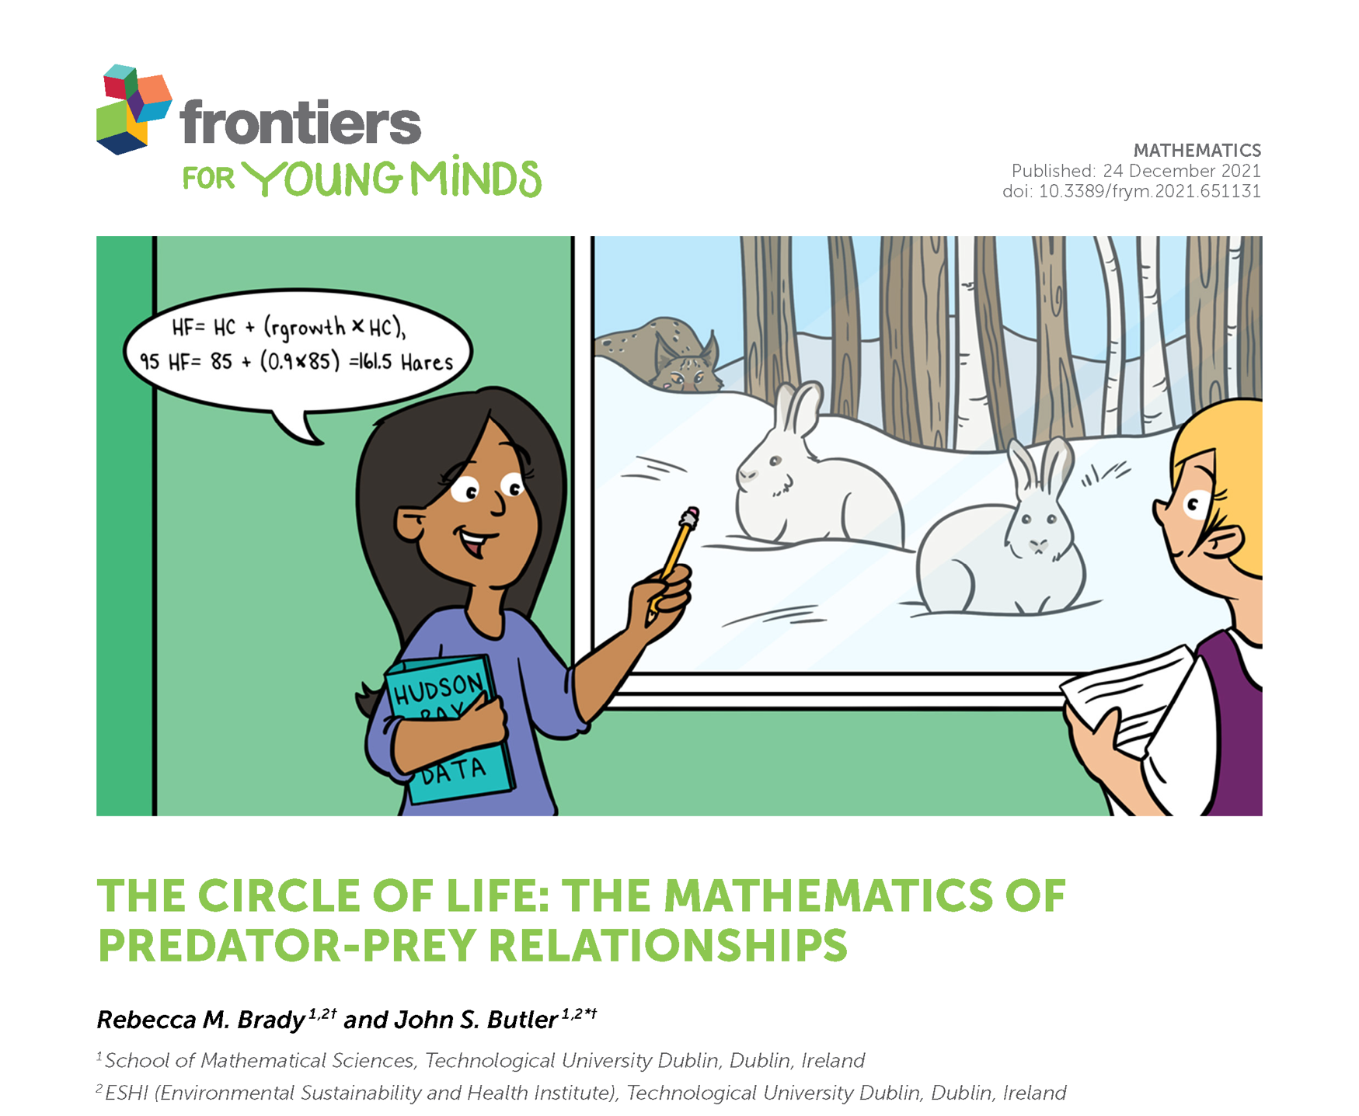

Slide 3
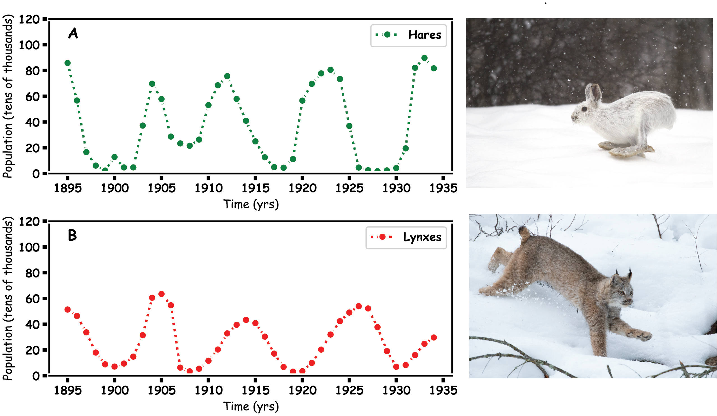
Predator Prey
Hares and Lynx

Slide 4
Prey Hares

Slide 5
Predator

Slide 6
Predator and Prey

Slide 7
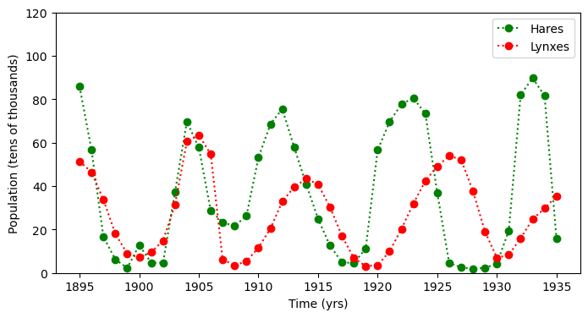
Predator and Prey

Slide 8
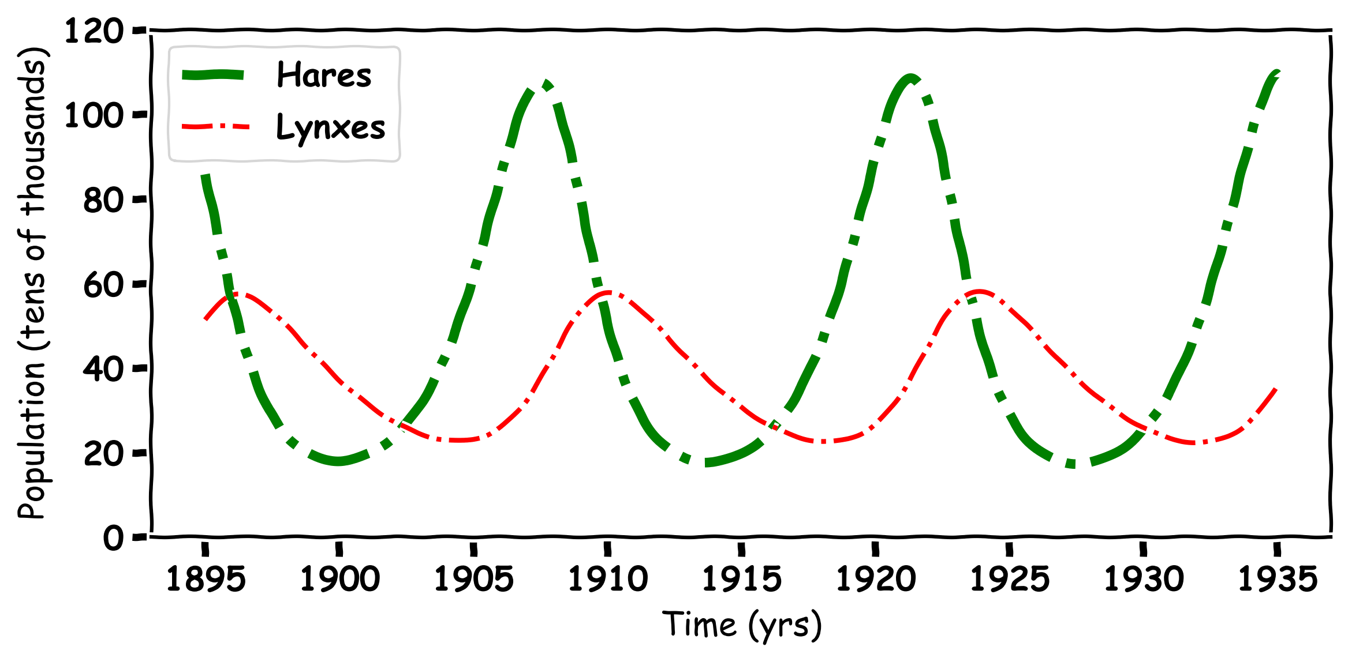
Predator and Prey

Slide 9
Mathematics

Slide 10

Hare Population Simulation
To make a computational model for a Hare population.
Some assumptions and simplifications must be made.
Here we make two assumptions:
Hares have no predators
Hares have unlimited food
We can now move from the real world to the simulation

Slide 11
Predicting One Year in the Future
To predict the future hare population from the current hare population.
To do this we need a birth rate, which is the amount the Hare population will increase per year
Now we need a simple formula using multiplication and addition to predict the future population:
current population plus the birth rate times current population

Slide 12
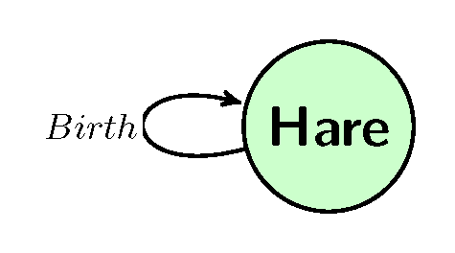
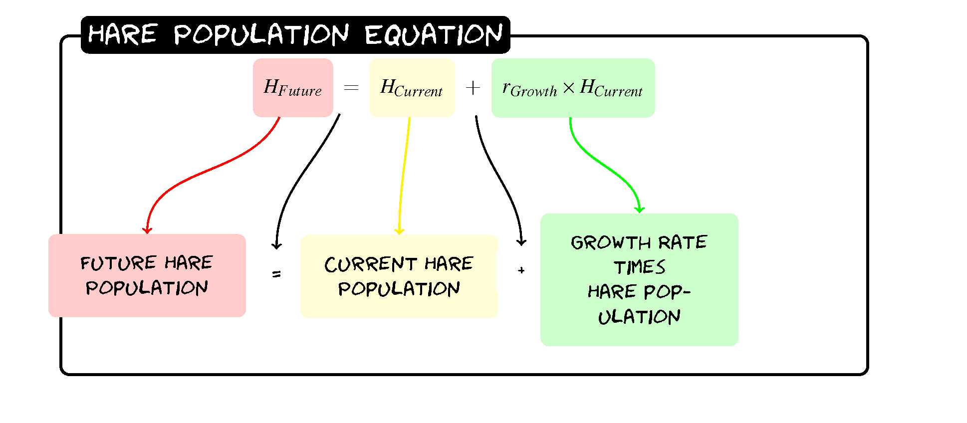
Hares
H_{Future}=H+0.2(H)

Slide 13
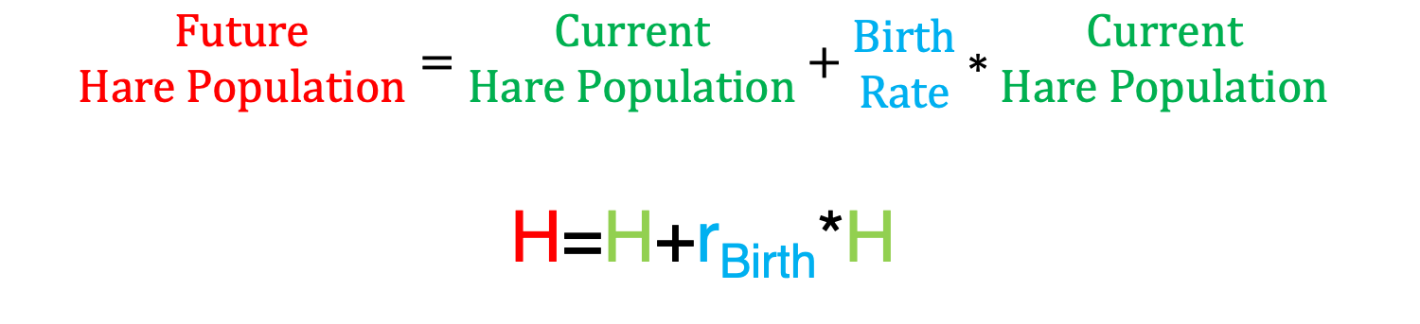
Exercise 1: Predicting Three Years
$$\begin{matrix}Future \\ Hare Population\end{matrix}=\begin{matrix}Current \\ Hare Population\end{matrix}+\begin{matrix}Birth \\ Rate\end{matrix}∗\begin{matrix}Current \\ Hare Population\end{matrix}$$
H=H+r_{Birth}*H
Given the Hare population in Year 0 is 60 implement the formula three times to get the population in Year 3.

Slide 14
Exercise 1: Predicting Three Years
$$\begin{matrix}Future \\ Hare Population\end{matrix}=\begin{matrix}Current \\ Hare Population\end{matrix}+\begin{matrix}Birth \\ Rate\end{matrix}∗\begin{matrix}Current \\ Hare Population\end{matrix}$$
H=H+r_{Birth}*H
Year | Hare Population
0 | 60
1
2
3

Slide 15
Exercise 1.1: Predicting One Year
H_{Future}=H+0.2(H)
Year | Hare Population
0 | 60
1
2
3

Slide 16
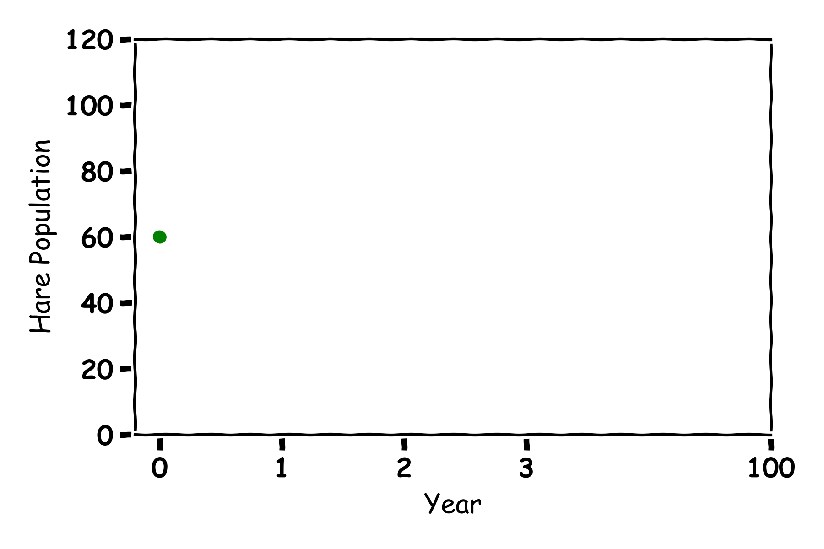
Exercise 1.1: Predicting One Year
H_{Future}=H+0.2(H)
Year | Hare Population
0 | 60
1 | 60+0.2(60)=72
2
3

Slide 17
Exercise 1.2: Predicting Three Years
H_{Future}=H+0.2(H)
Year | Hare Population
0 | 60
1 | 60+0.2(60)=72
2 | 72+0.2(72)=86
3

Slide 18
Exercise 1.2: Predicting Three Years
H_{Future}=H+0.2(H)
Year | Hare Population
0 | 60
1 | 60+0.2(60)=72
2 | 72+0.2(72)=86
3 | 86+0.2(86)=103

Slide 19
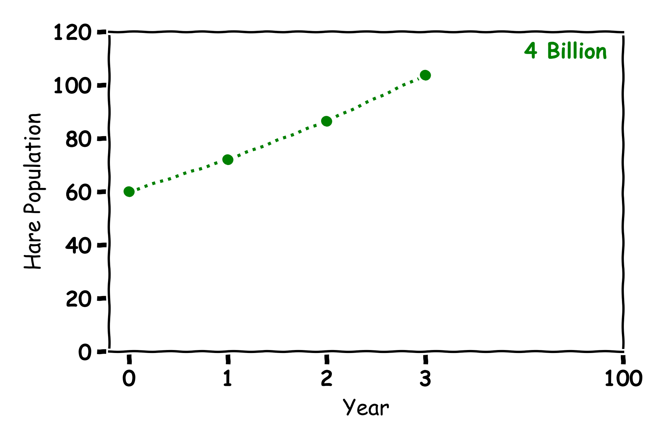
Exercise 2: Plotting Three Years
Year | Hare Population
0 | 60
1 | 72
2 | 86
3 | 103

Slide 20
Exercise 3: Predicting 100 Years
Year | Hare Population
0 | 60
1 | 72
2 | 86
3 | 103

Slide 21
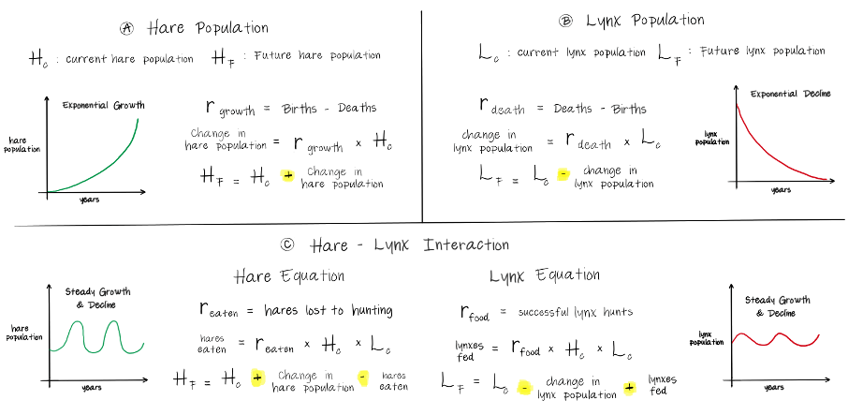
Hare Population

Slide 22
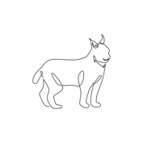
Lynx Population Simulation
To make a mathematical model for a Lynx population.
Some assumptions and simplifications must be made.
Here we make one assumptions:
Lynxes have no food
We can now move from the real world to the simulation

Slide 23
Predicting One Year in the Future
To predict the future lynx population from the current lynx population.
To do this we need a death rate, which is the amount the lynx population will decrease per year
Now we need a simple formula:
current population minus the death rate times current population

Slide 24
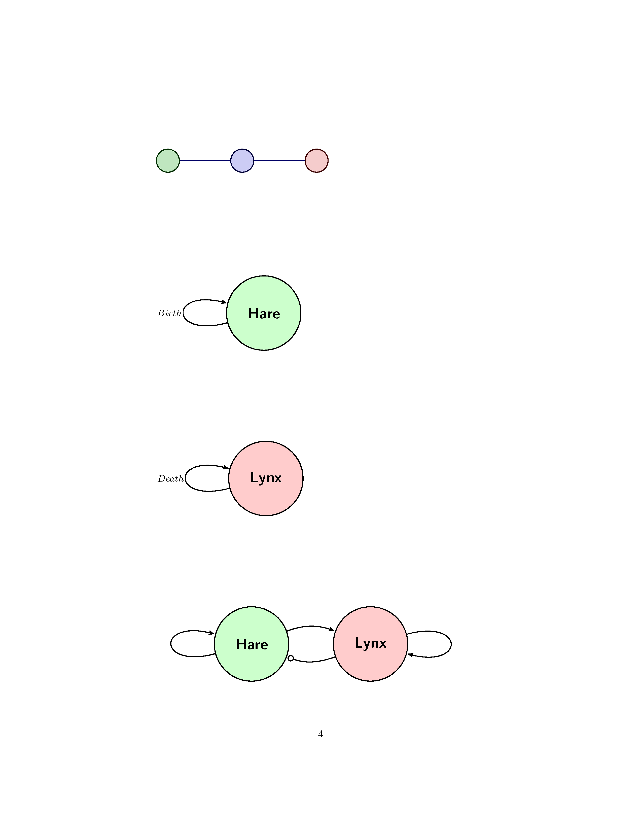

Lynx Population
L_{Future}= L-0.1(L)

Slide 25
Exercise 4.1: Predicting One Year
Year | Lynx Population
0 | 30
1
2
3

Slide 26
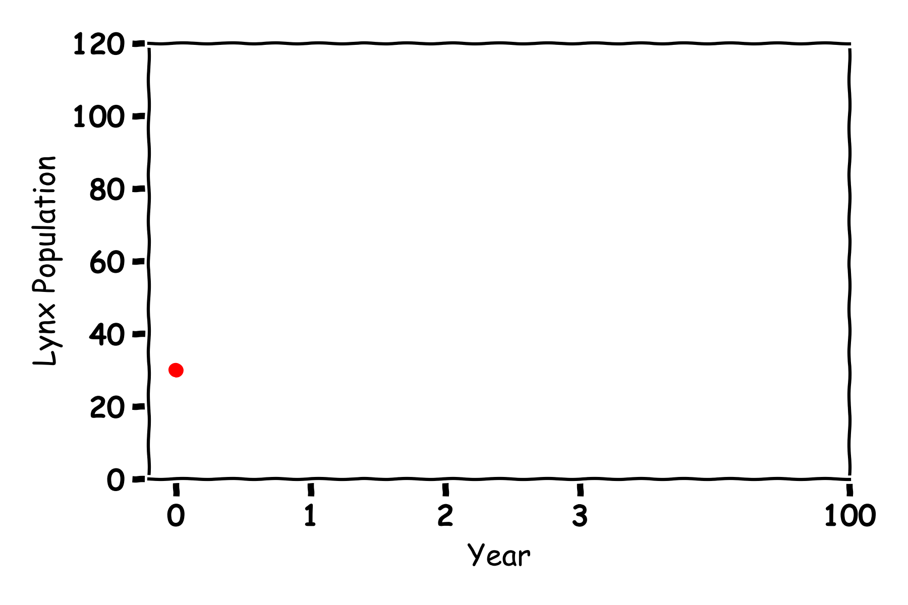
Lynx
L_{Future}= L-0.1(L)
Year | Lynx Population
0 | 30
1
2
3

Slide 27
Exercise 4.1: Predicting One Year
L_{Future}= L-0.1(L)
Year | Lynx Population
0 | 30
1 | 30-0.1(30)=27
2
3

Slide 28
Exercise 4.: Predicting Three Years
L_{Future}= L-0.1(L)
Year | Lynx Population
0 | 30
1 | 30-0.1(30)=27
2 | 27-0.1(27)=24
3

Slide 29
Exercise 5: Plotting Three Years
L_{Future}= L-0.1(L)
Year | Lynx Population
0 | 30
1 | 30-0.1(30)=27
2 | 27-0.1(27)=24
3 | 24-0.1(24)=22

Slide 30
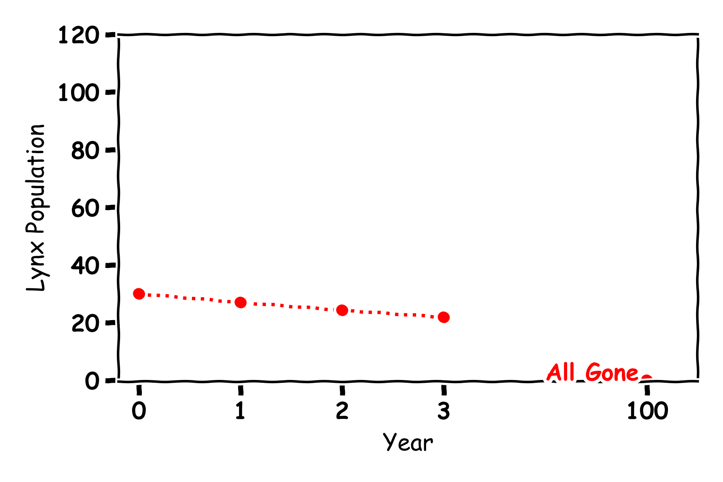
Exercise 5: Plotting Three Years
Year | Lynx Population
0 | 30
1 | 27
2 | 24
3 | 22

Slide 31
Exercise 6: Predicting 100 Years
Year | Lynx Population
0 | 30
1 | 27
2 | 24
3 | 22

Slide 32
Lynx

Slide 33
Predator and Prey

Slide 34
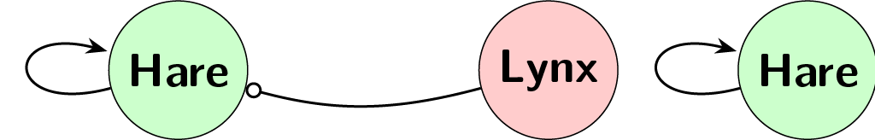
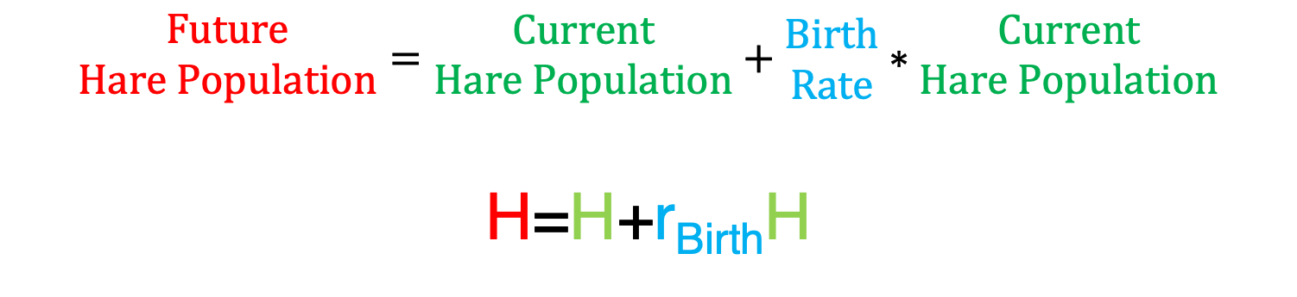
Predicting Future Hare Populations with Lynxes
$$\begin{matrix}Future \\ Hare Population\end{matrix}=\begin{matrix}Current \\ Hare Population\end{matrix}+\begin{matrix}Birth \\ Rate\end{matrix}∗\begin{matrix}Current \\ Hare Population\end{matrix}$$
H=H+r_{Birth}H
r_{Birth}

Slide 35
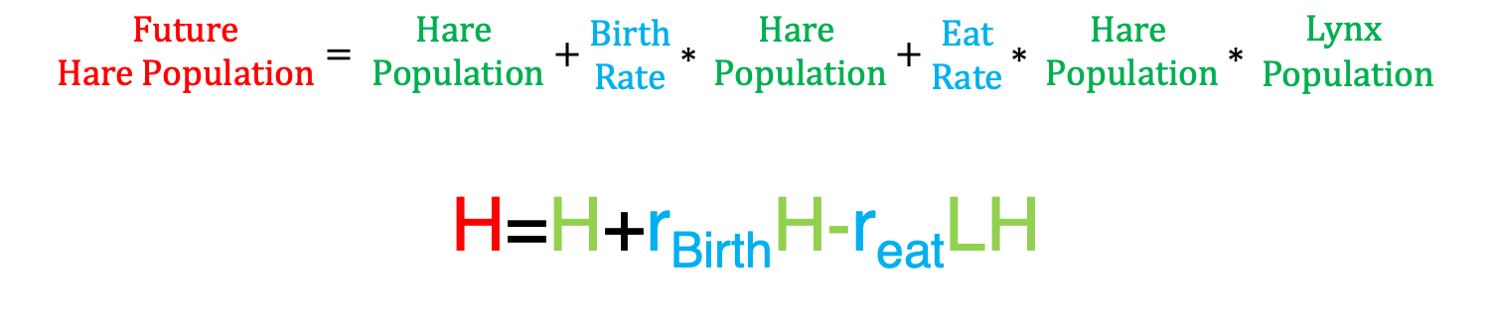
Predicting Future Hare Populations with Lynxes
$$\begin{matrix}Future \\ Hare Population\end{matrix}=\begin{matrix}Hare \\ Population\end{matrix}+\begin{matrix}Birth \\ Rate\end{matrix}∗\begin{matrix}Hare \\ Population\end{matrix}+\begin{matrix}Eat \\ Rate\end{matrix}∗\begin{matrix}Hare \\ Population\end{matrix}∗\begin{matrix}Lynx \\ Population\end{matrix}$$
H=H+r_{Birth}H-r_{eat}LH
r_{Birth}
r_{eat}

Slide 36
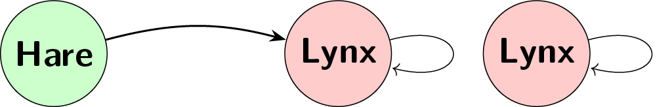
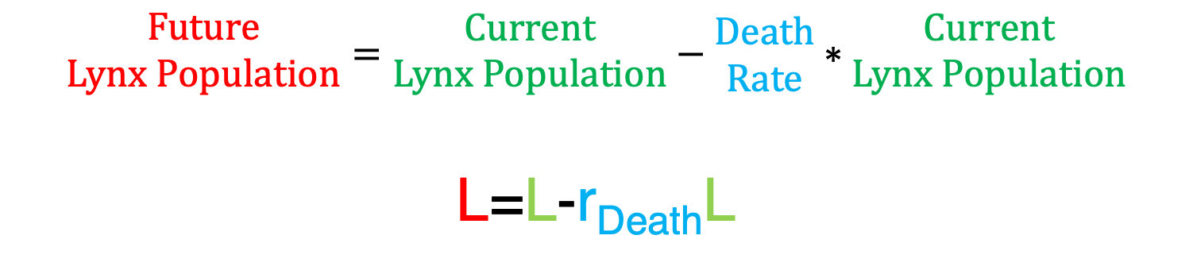
Predicting Future Hare Populations with Lynxes
$$\begin{matrix}Future \\ Lynx Population\end{matrix}=\begin{matrix}Current \\ Lynx Population\end{matrix}−\begin{matrix}Death \\ Rate\end{matrix}∗\begin{matrix}Current \\ Lynx Population\end{matrix}$$
L=L-r_{Death}L
r_{Death}

Slide 37
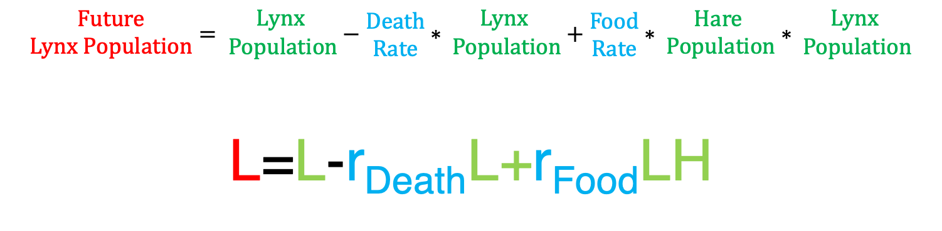
Predicting Future Lynx Populations with Hares
$$\begin{matrix}Future \\ Lynx Population\end{matrix}=\begin{matrix}Lynx \\ Population\end{matrix}−\begin{matrix}Death \\ Rate\end{matrix}∗\begin{matrix}Lynx \\ Population\end{matrix}+\begin{matrix}Food \\ Rate\end{matrix}∗\begin{matrix}Hare \\ Population\end{matrix}∗\begin{matrix}Lynx \\ Population\end{matrix}$$
L=L-r_{Death}L+r_{Food}LH
r_{Food}
r_{Death}

Slide 38

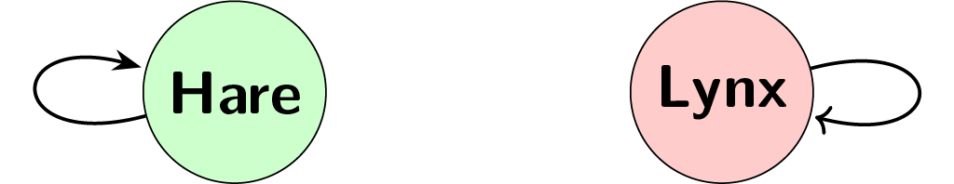
Predicting Future Hare and Lynx Populations
Hare
H=H+r_{Birth}*H
Lynx
L=L-r_{Death}*L

Slide 39
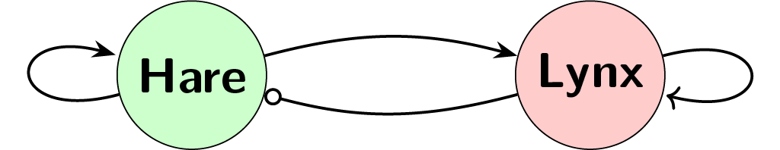
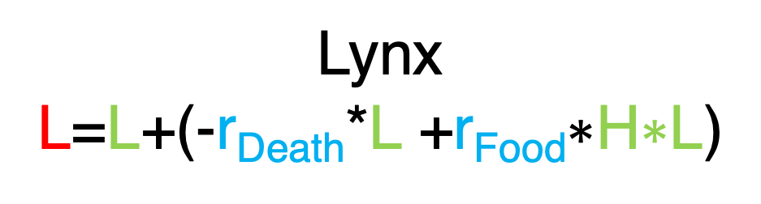
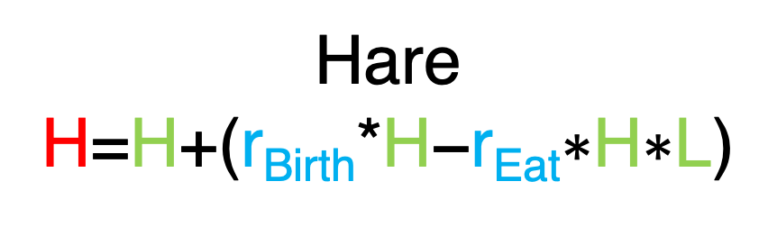
Predicting Many Years in the Future a year at a time
Hare
H=H+(r_{Birth}*H$\text{−}\text{r}\text{Eat}\text{∗}\text{H}\text{∗}\text{L}\text{)}$
$$\text{r}\text{Food}$$
r_{Birth}
r_{Death}
$$\text{r}\text{Eat}$$
Lynx
L=L+(-r_{Death}*L $\text{+}\text{r}\text{Food}\text{∗}\text{H}\text{∗}\text{L}$)

Slide 40
Exercise 7: Label the Graph
Food Rate
Birth rate
Death rate
Eat Rate

Slide 41
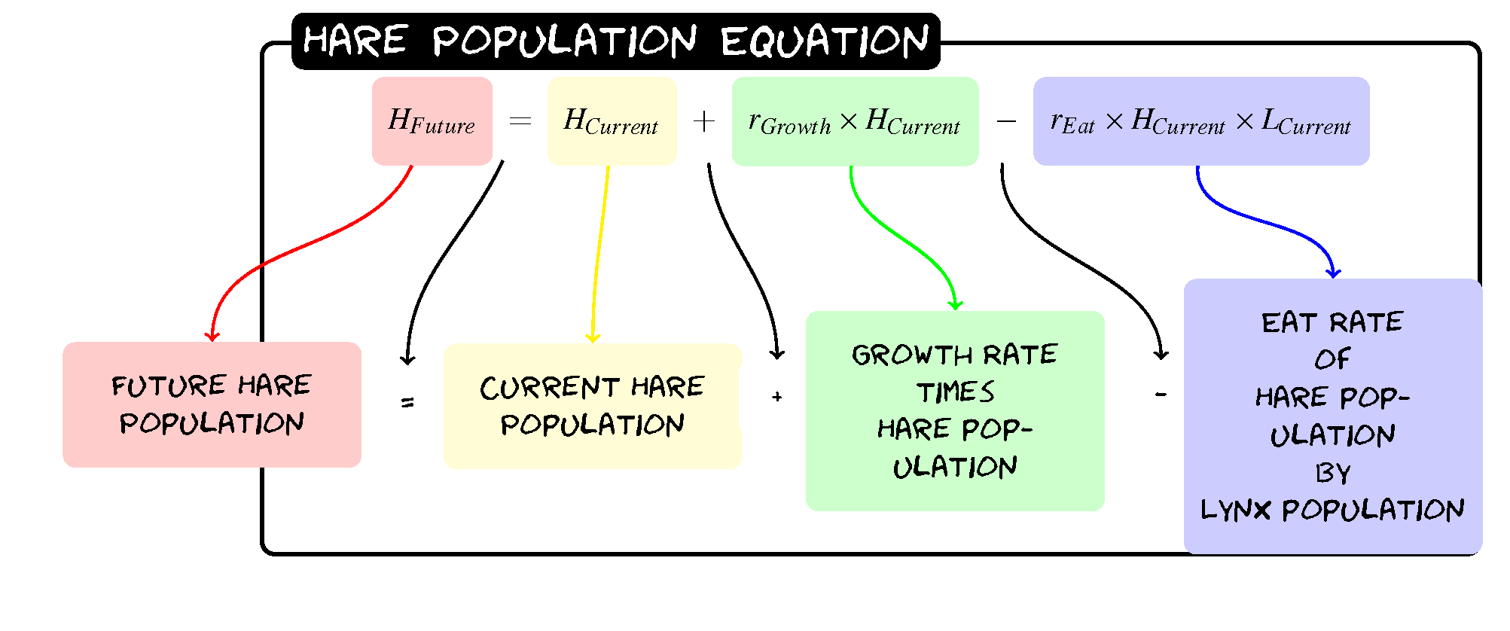
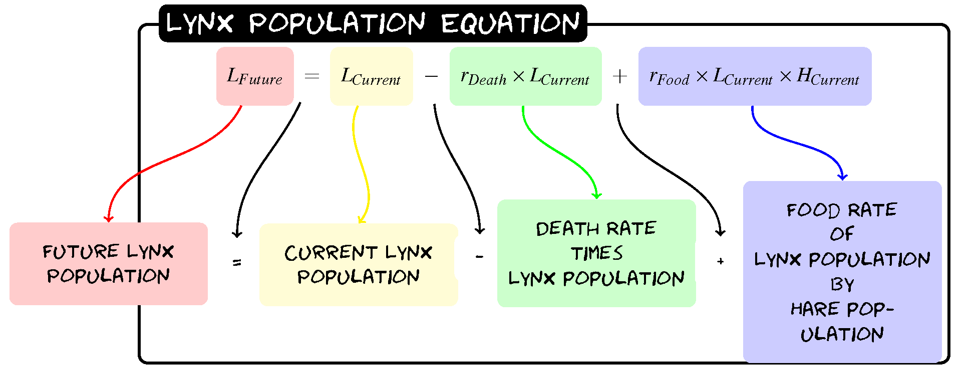
Predator and Prey

Slide 42
Predator and Prey
H_{Future}=H+0.2(H)-0.005(H)(L)
L_{Future}= L-0.1(L)+0.002(L)(H)

Slide 43
Exercise 8.1: Predicting One Year
H_{Future}=H+0.2(H)-0.005(H)(L)
L_{Future}= L-0.1(L)+0.002(L)(H)
Year | Hare Population | Lynx Population
0 | 60 | 30
1
2
3

Slide 44
Exercise 8.1: Predicting One Year
H_{Future}=H+0.2(H)-0.005(H)(L)
L_{Future}= L-0.1(L)+0.002(L)(H)
Year | Hare Population | Lynx Population
0 | 60 | 30
1 | 60+0.2(60)-0.005(60)(30)=63 | 30-0.1(30)+0.002(30)(60)=30.6
2
3

Slide 45
Exercise 8.2: Predicting Three Years
H_{Future}=H+0.2(H)-0.005(H)(L)
L_{Future}= L-0.1(L)+0.002(L)(H)
Year | Hare Population | Lynx Population
0 | 60 | 30
1 | 60+0.2(60)-0.005(60)(30)=63 | 30-0.1(30)+0.002(30)(60)=30.6
2 | 63+0.2(63)-0.005(63)(30.6)=65.9 | 30.6-0.1(30.6)+0.002(30.6)(63)=31.3
3

Slide 46
Exercise 8.2: Predicting Three Years
H_{Future}=H+0.2(H)-0.005(H)(L)
L_{Future}= L-0.1(L)+0.002(L)(H)
Year | Hare Population | Lynx Population
0 | 60 | 30
1 | 60+0.2(60)-0.005(60)(30)=63 | 30-0.1(30)+0.002(30)(60)=30.6
2 | 63+0.2(63)-0.005(63)(30.6)=65.9 | 30.6-0.1(30.6)+0.002(30.6)(63)=31.3
3 | 65.9+0.2(65.9)-0.005(65.9)(31.3)=68.8 | 31.3-0.1(31.3)+0.002(31.3)(65.9)=32.4

Slide 47
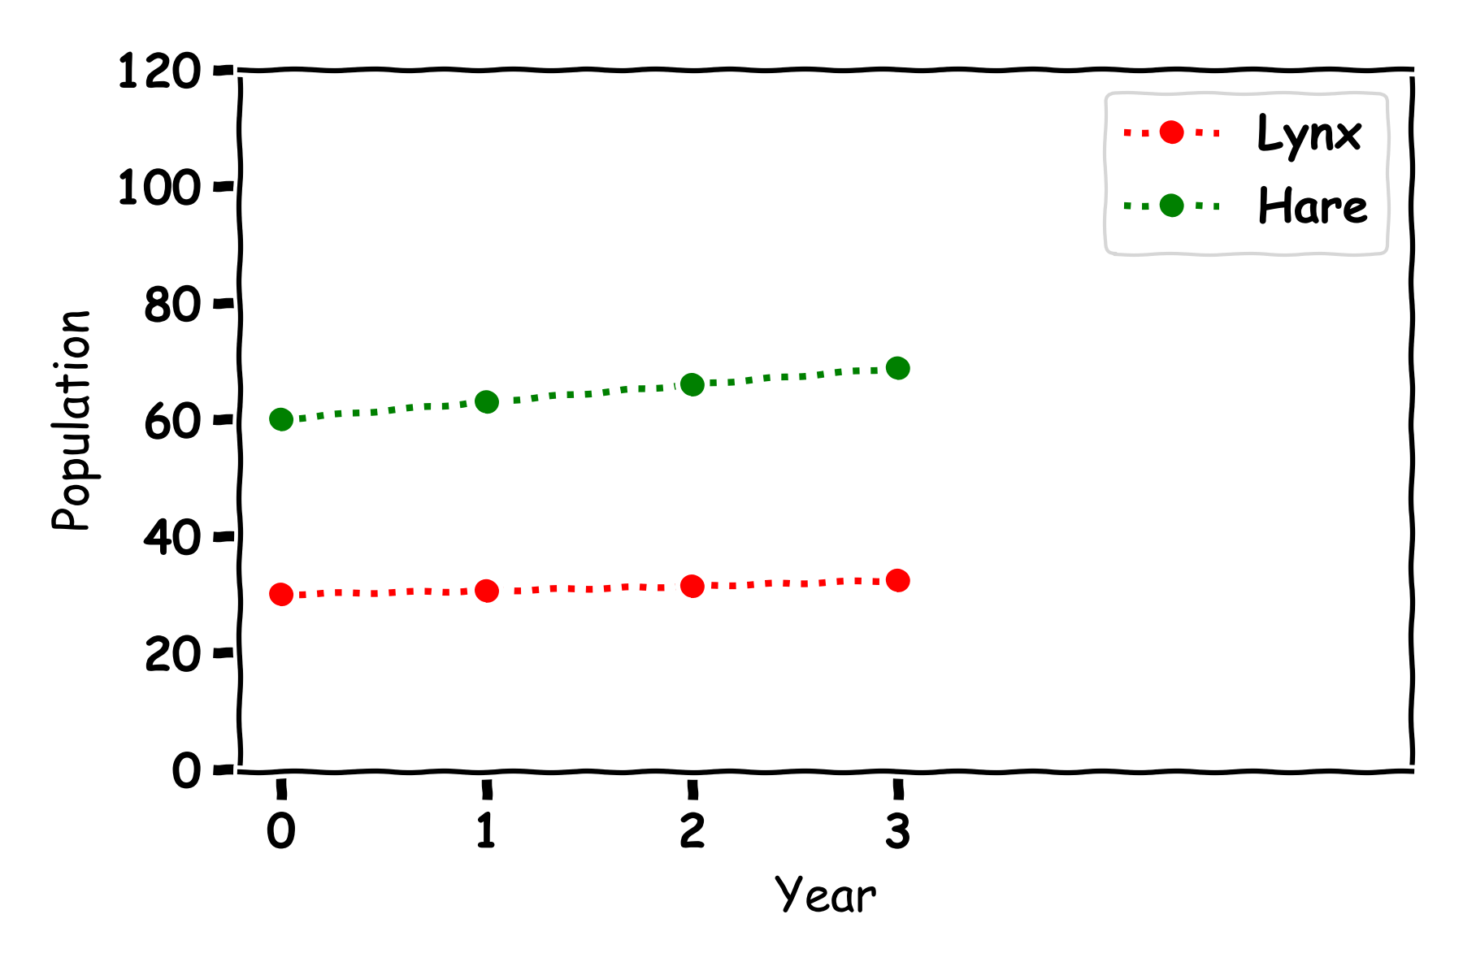
Exercise 9: Plotting Three Years
Year | Hare Population | Lynx Population
0 | 60 | 30
1 | 63 | 30.6
2 | 65.9 | 31.3
3 | 68.8 | 32.4

Slide 48
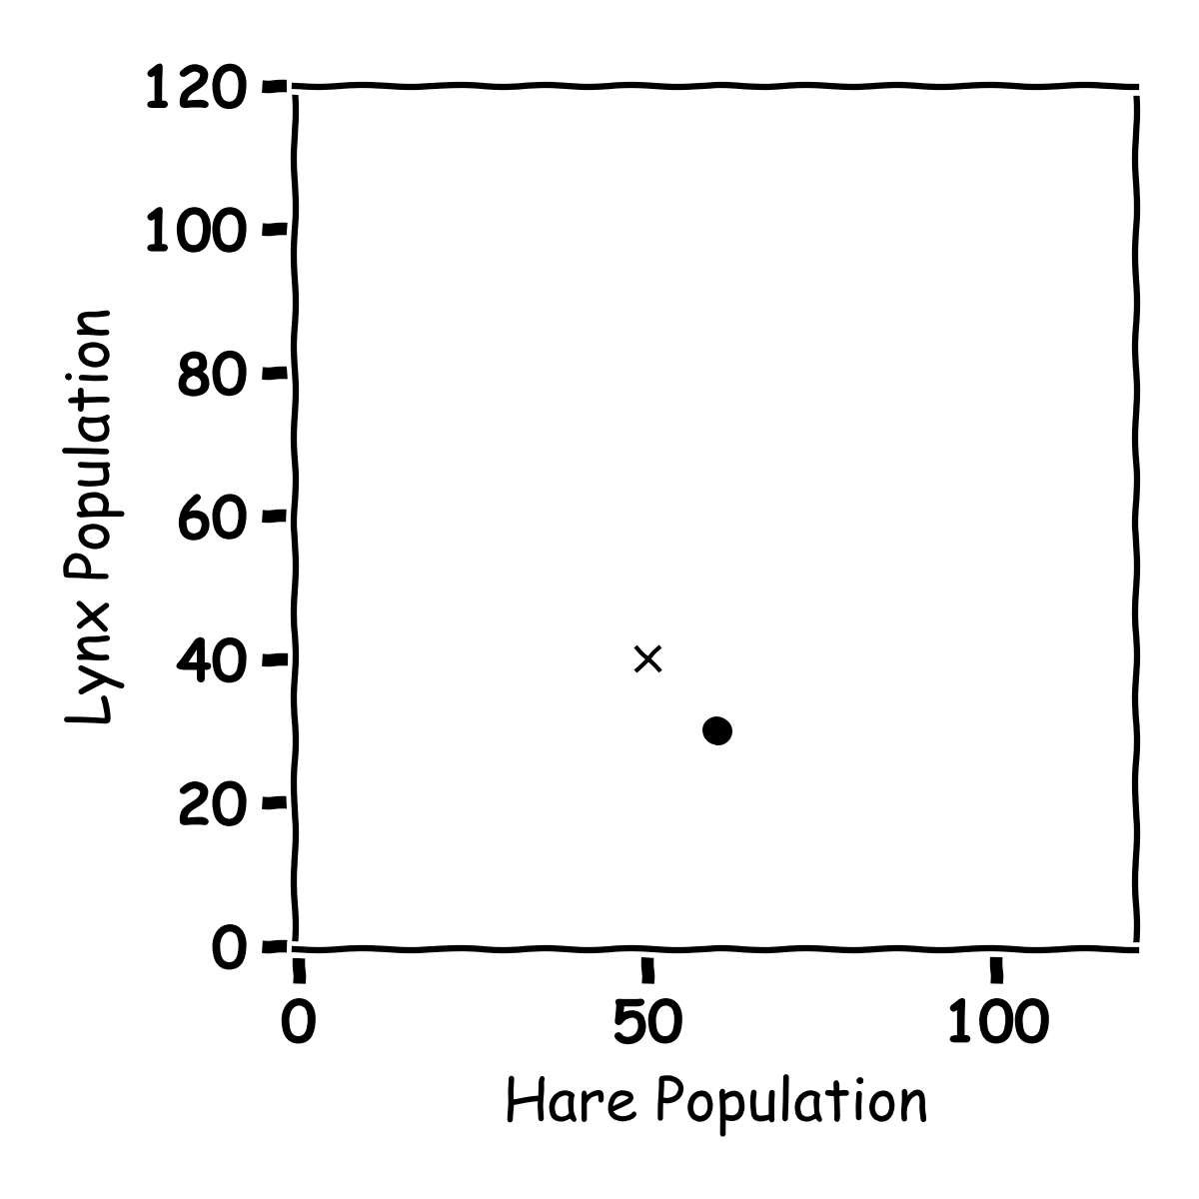
Exercise 10: Plotting Hares and Lynxes
Year | Hare Population | Lynx Population
0 | 60 | 30
1
2
3

Slide 49
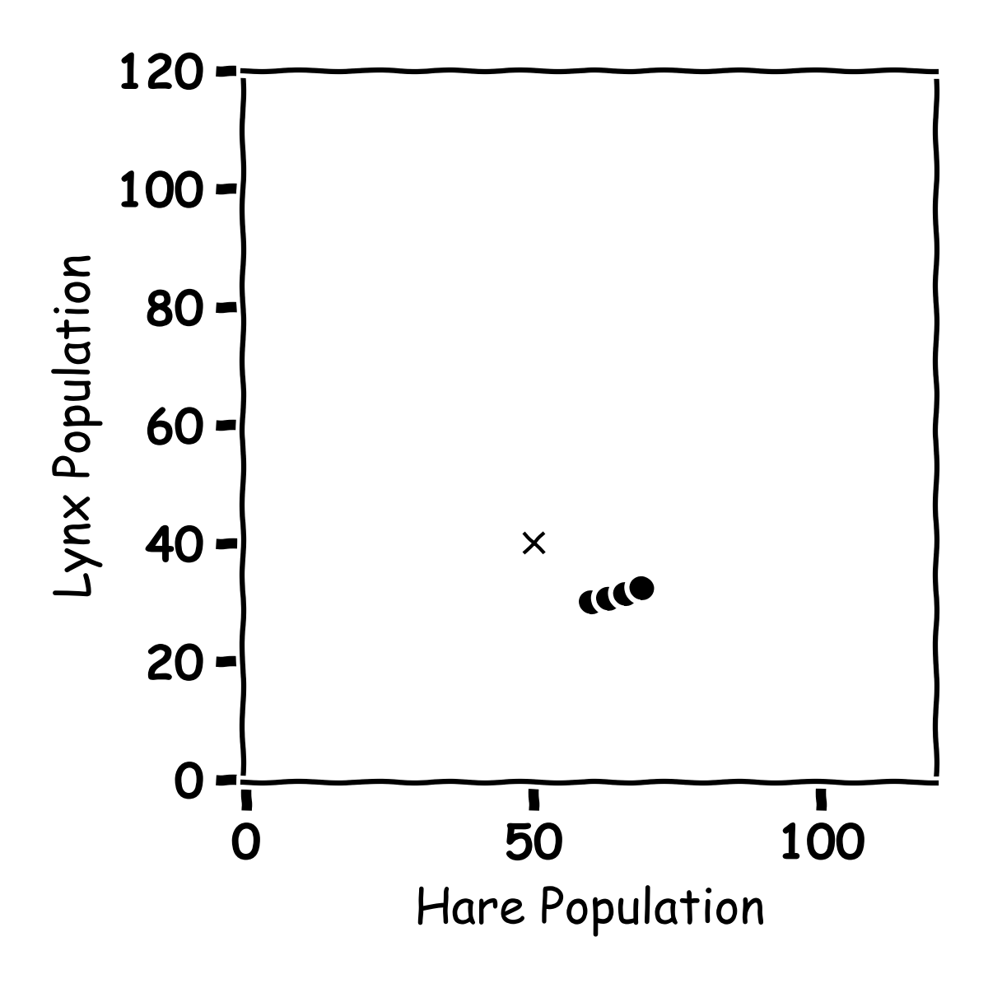
Exercise 10: Plotting Hares and Lynxes
Year | Hare Population | Lynx Population
0 | 60 | 30
1 | 63 | 30.6
2 | 65.9 | 31.3
3 | 68.8 | 32.4

Slide 50
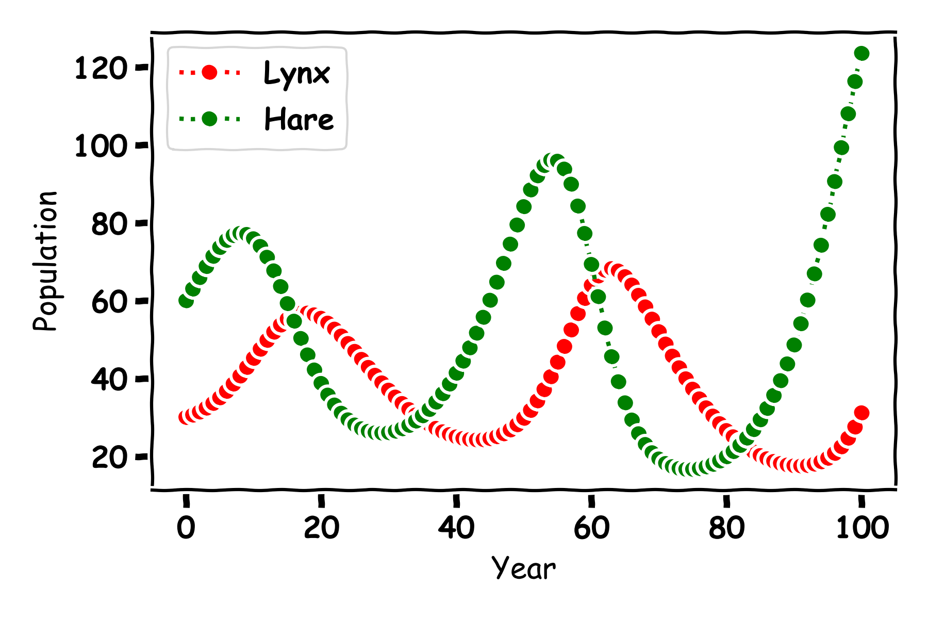
Predator and Prey

Slide 51
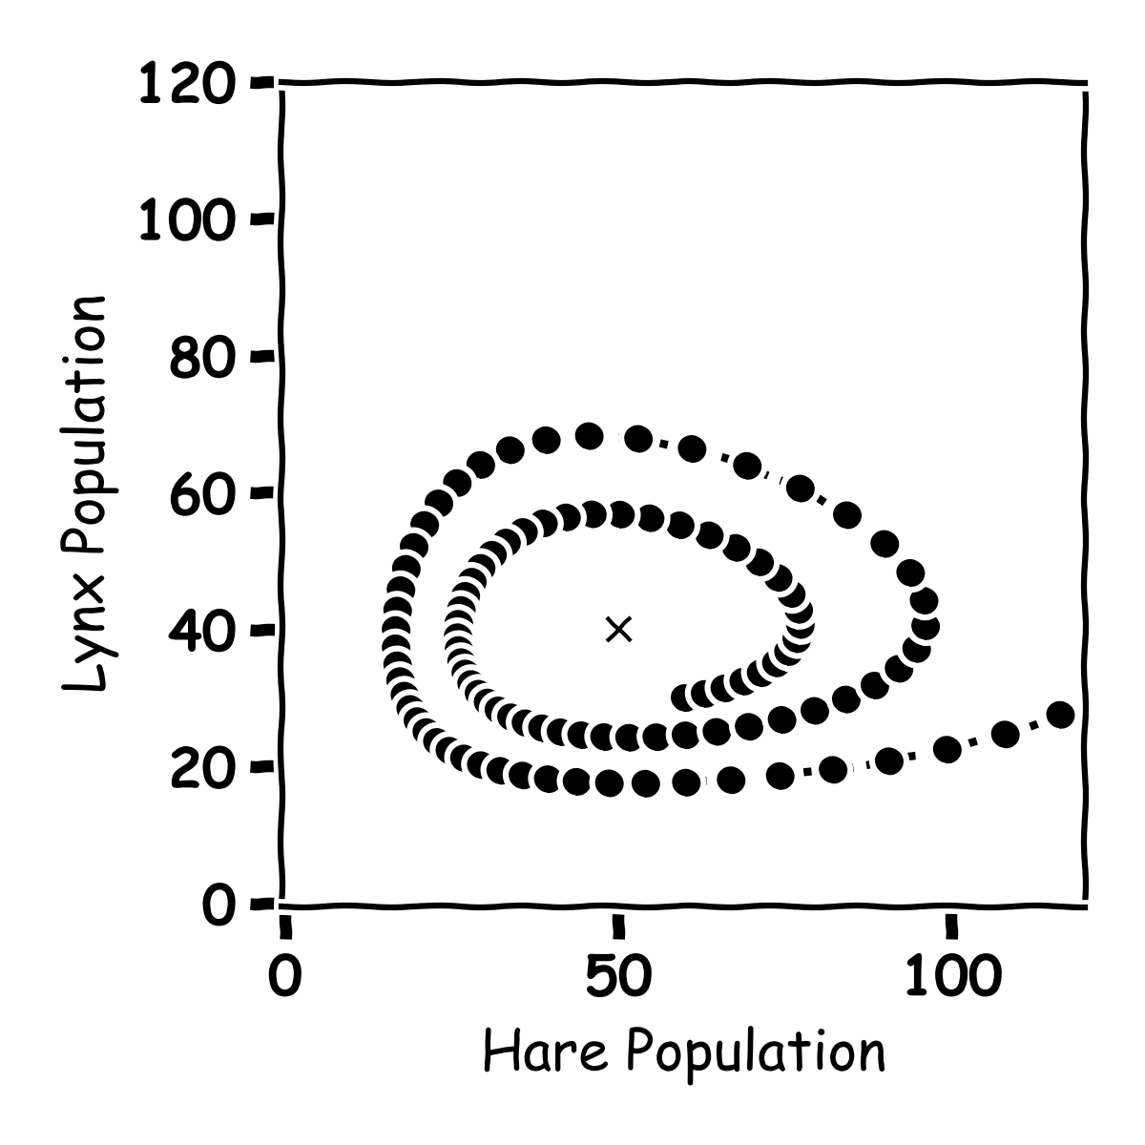
Predator and Prey

Slide 52
Predator and Prey

Slide 53
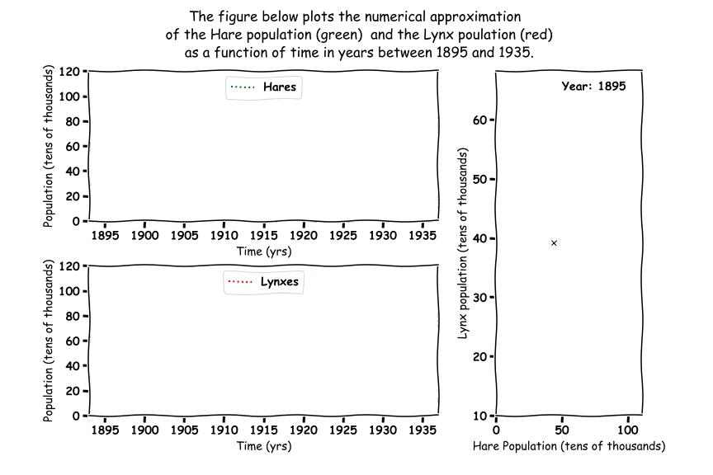
Predator and Prey

Slide 54
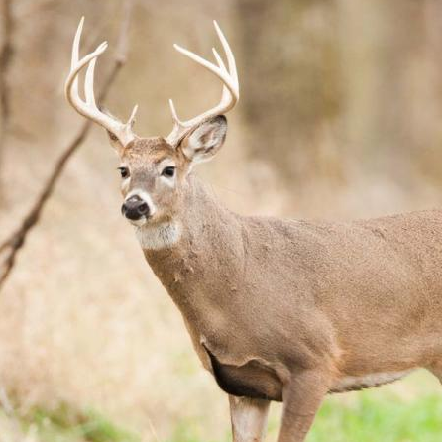
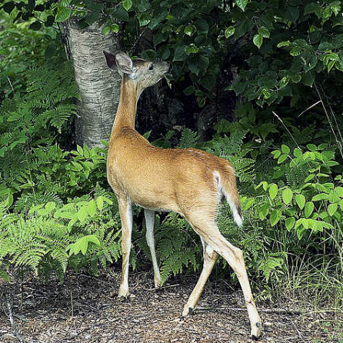
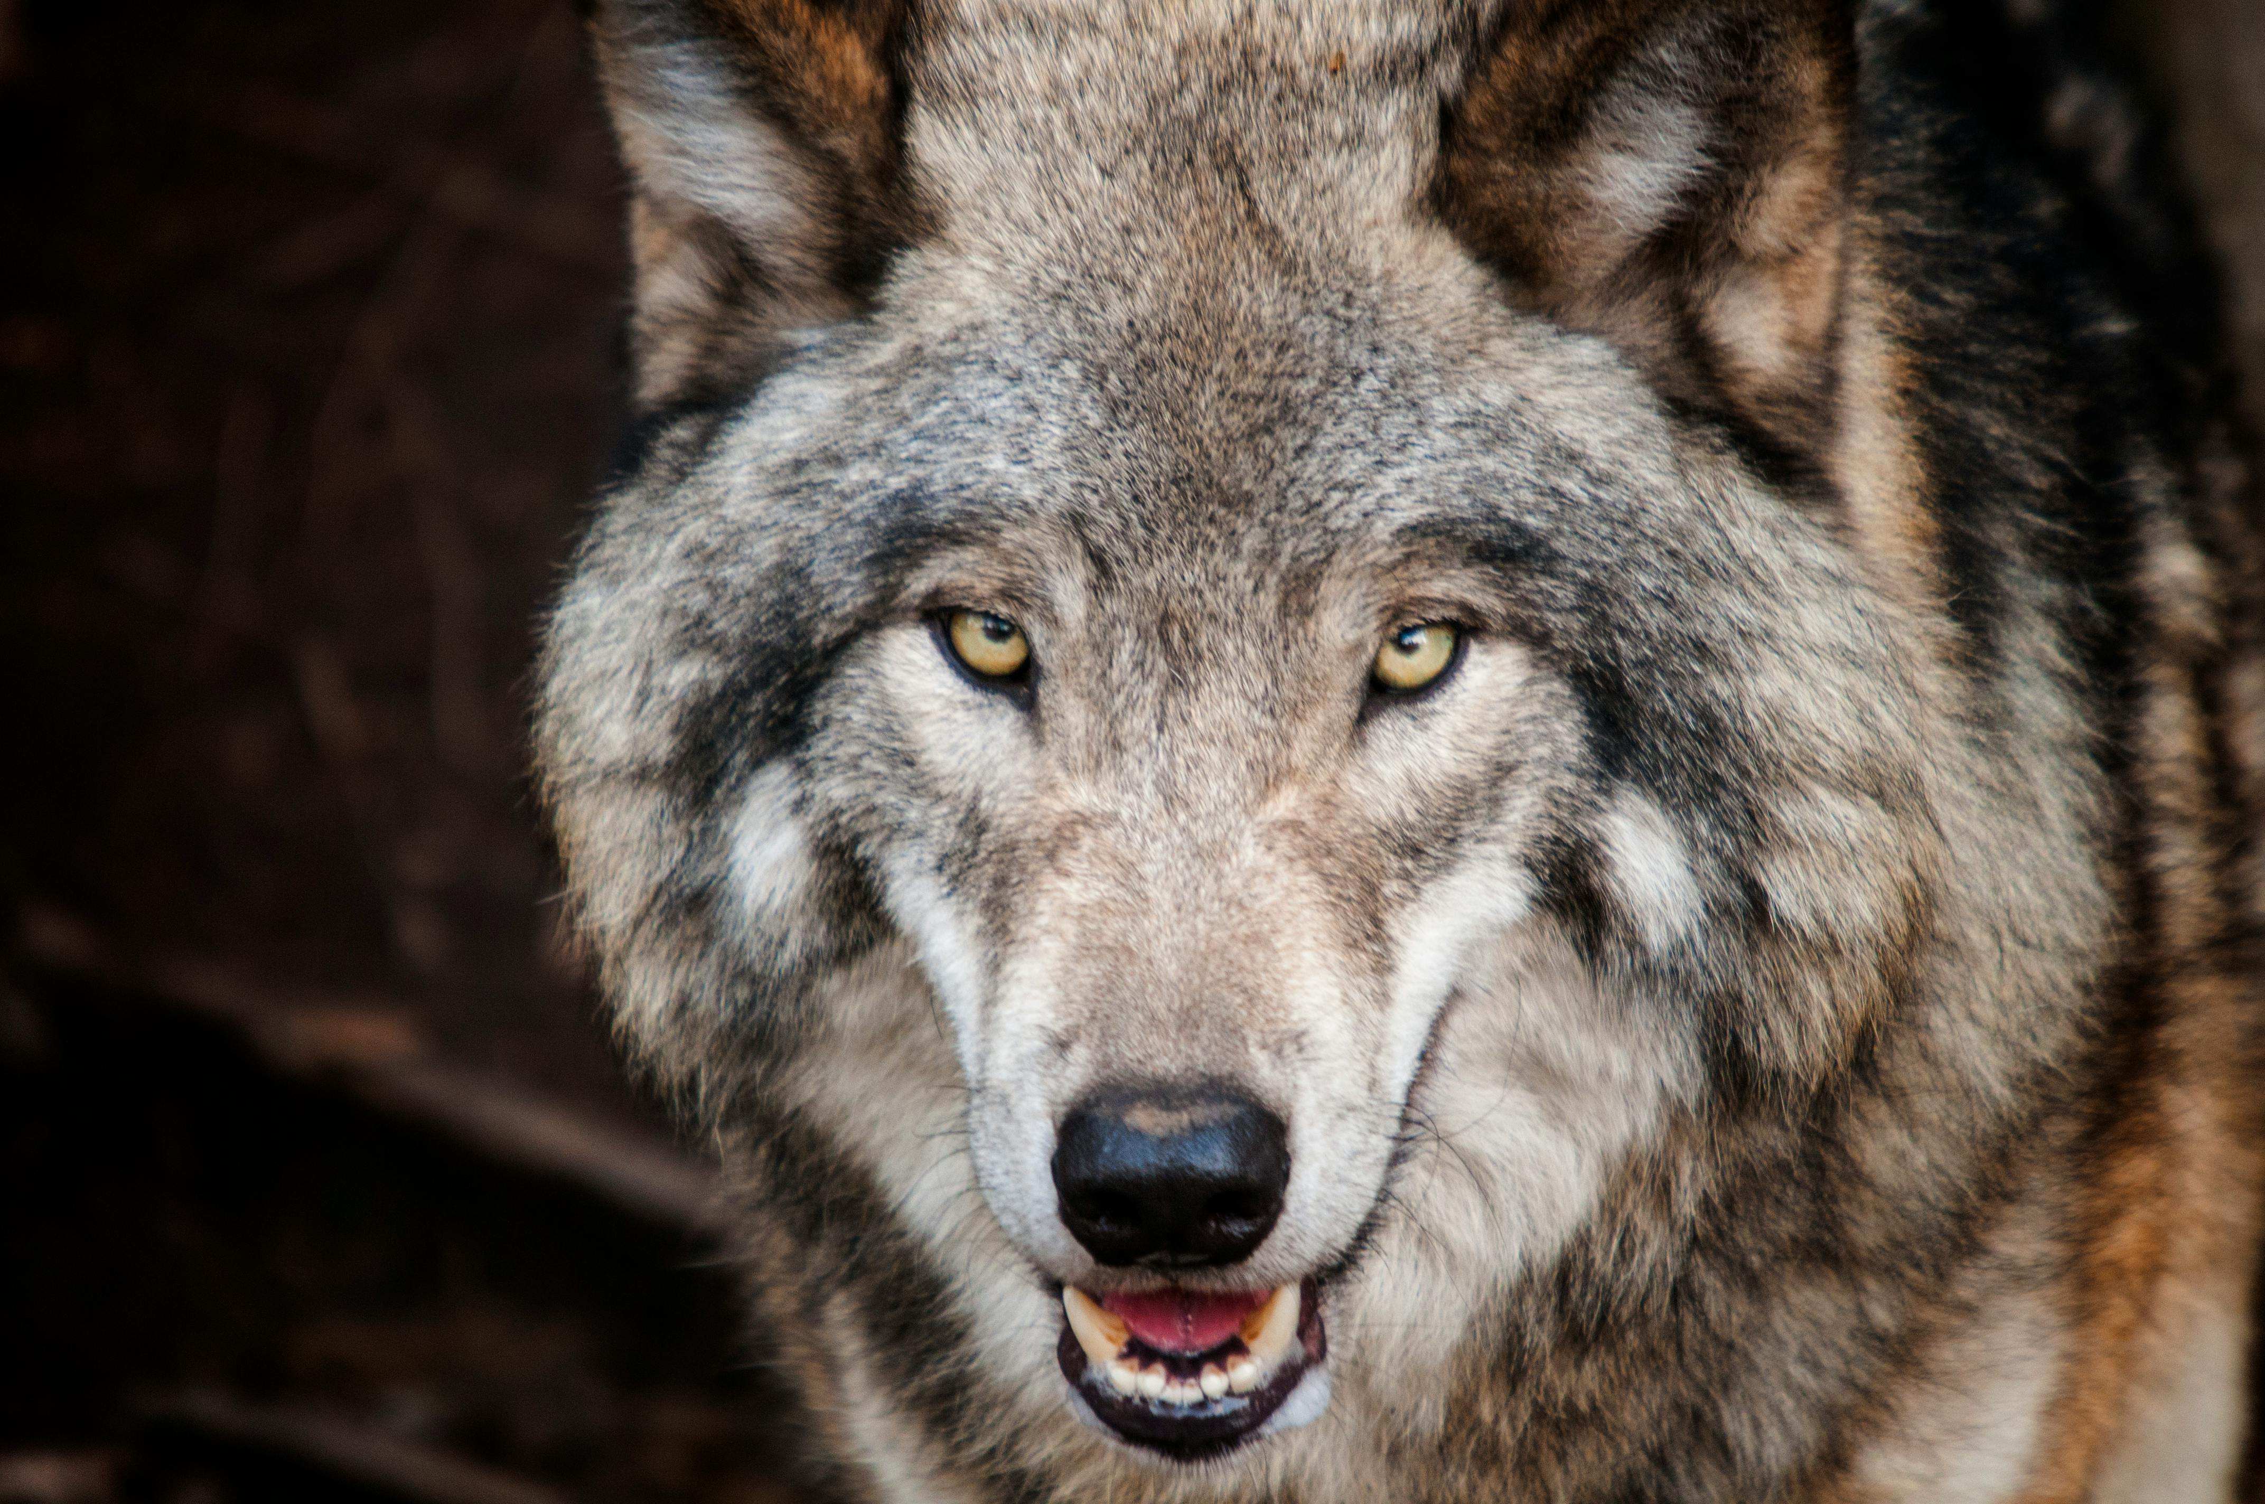
Predator Prey
Deer, Plants and Wolves

Slide 55
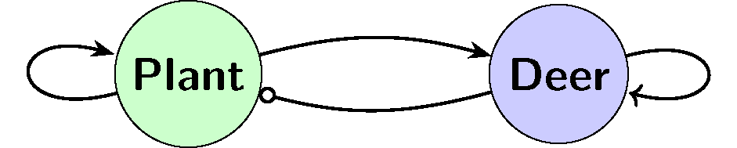

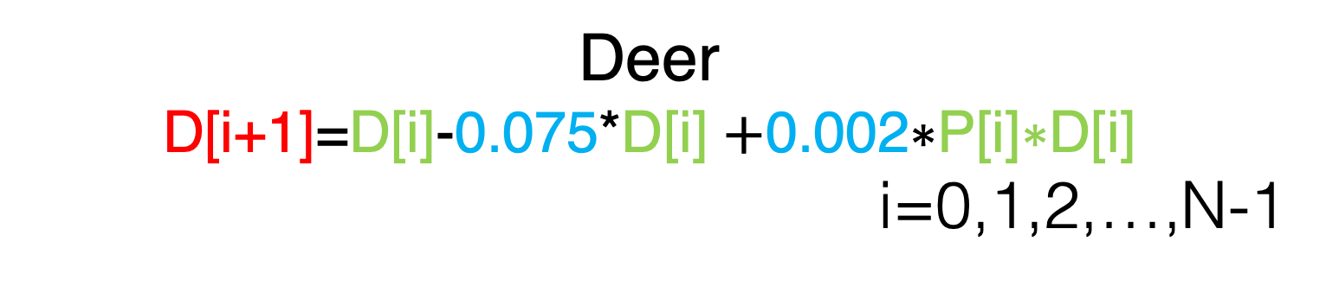
Plants and Deer
Plants
P[i+1]=P[i]+0.9*P[i]$\text{−}\text{0.02}\text{∗}\text{P}\text{[}\text{i}\text{]∗}\text{D}\text{[}\text{i}\text{])}$
Deer
D[i+1]=D[i]-0.075*D[i] $\text{+}\text{0.00}\text{2}\text{∗}\text{P}\text{[}\text{i}\text{]∗}\text{D}\text{[}\text{i}\text{]}$
i=0,1,2,…,N-1

Slide 56
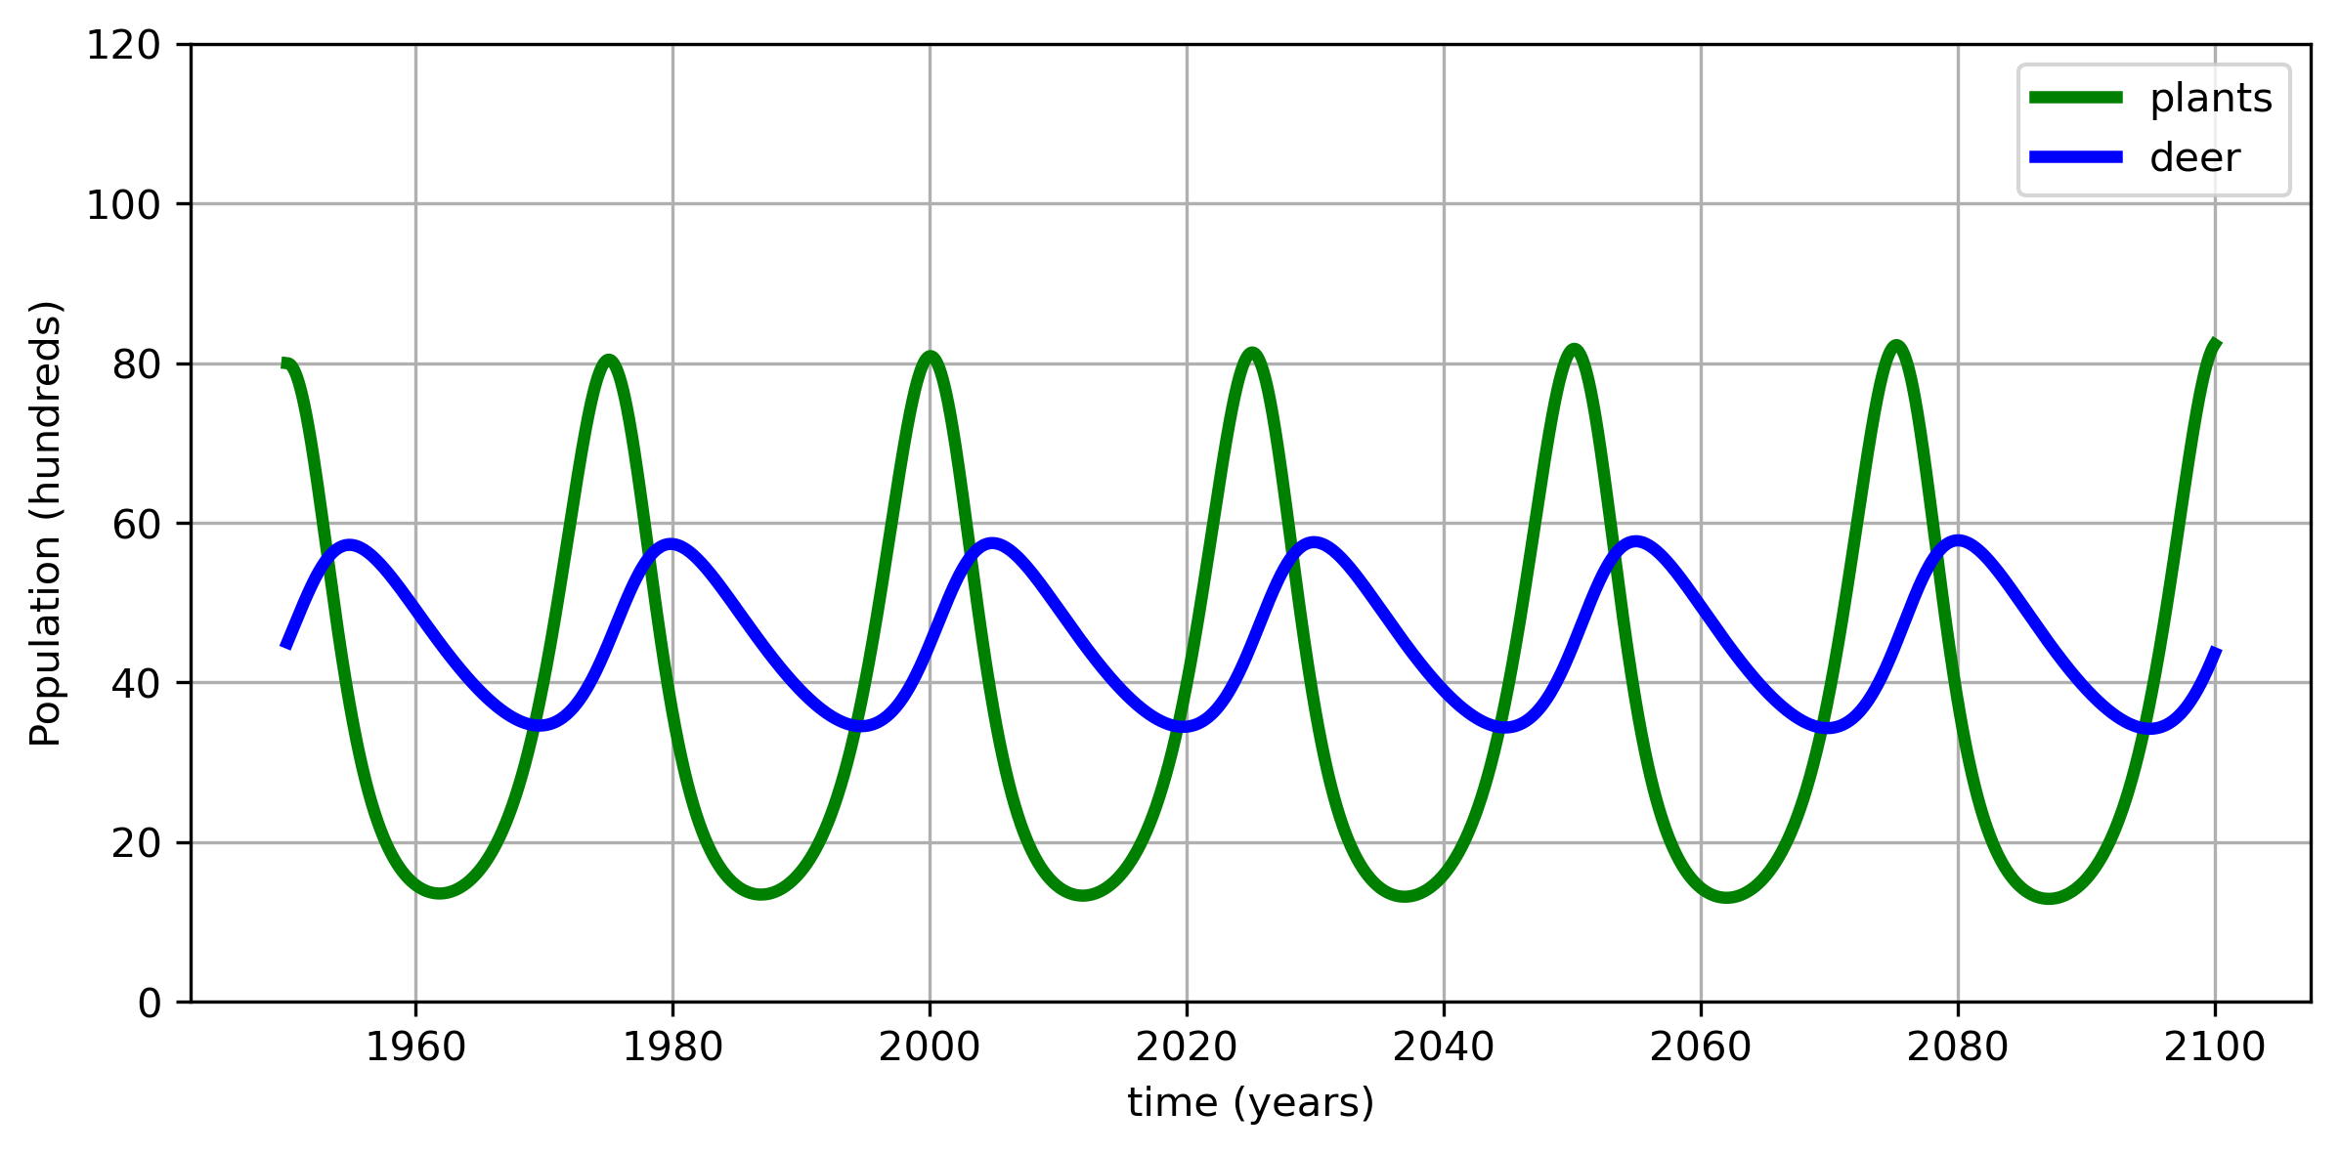
Plants and Deer

Slide 57
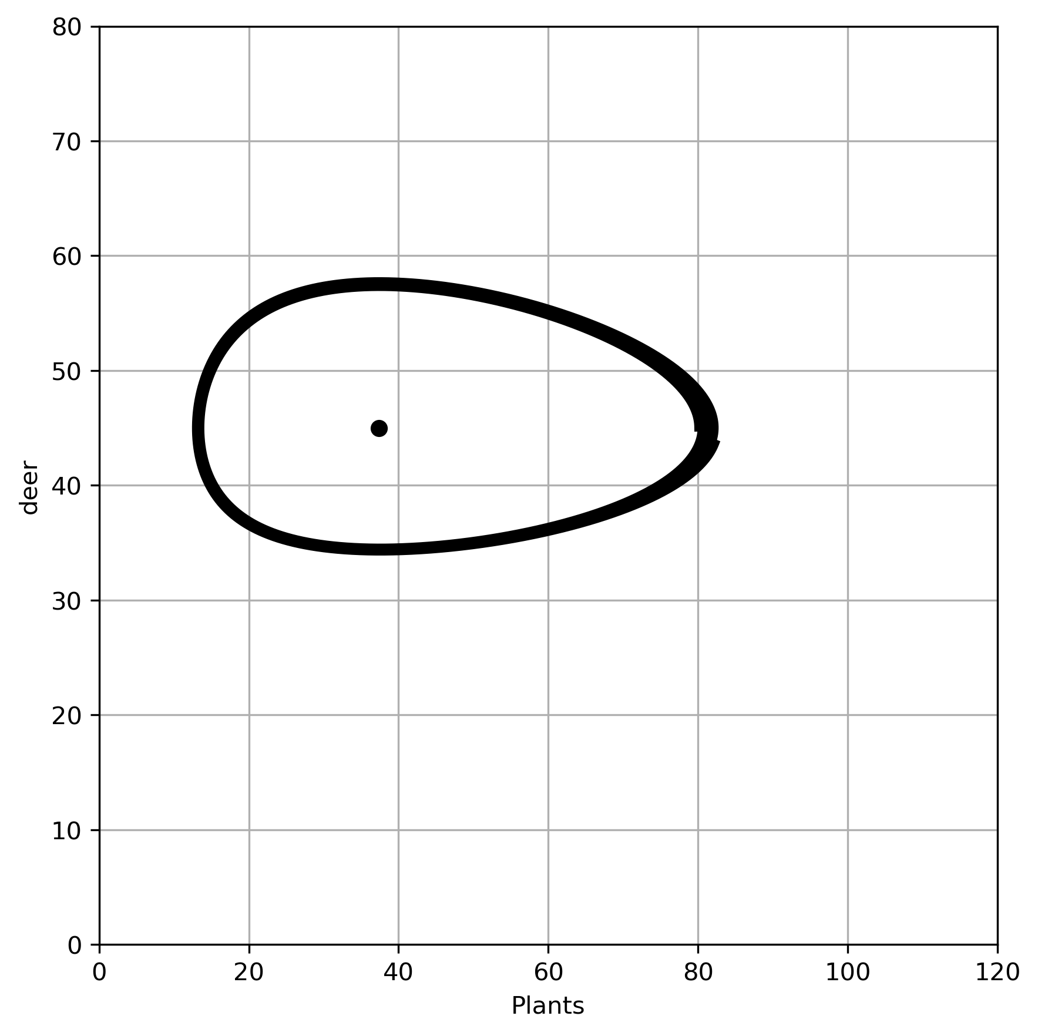
Deer vs Plant

Slide 58
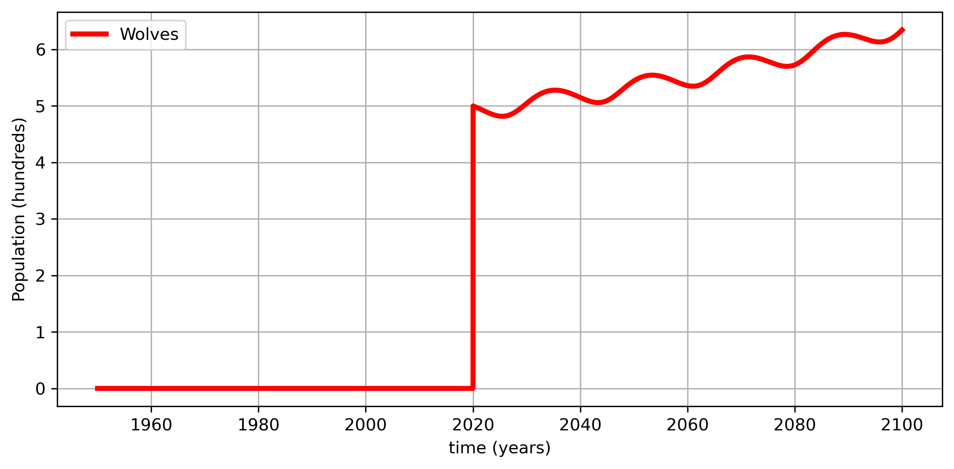
Wolves

Slide 59
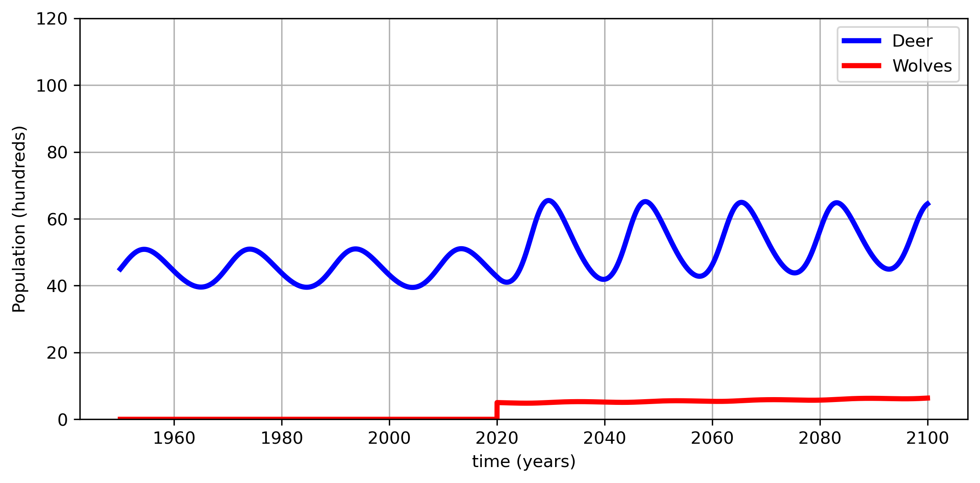
Wolves and Deer

Slide 60
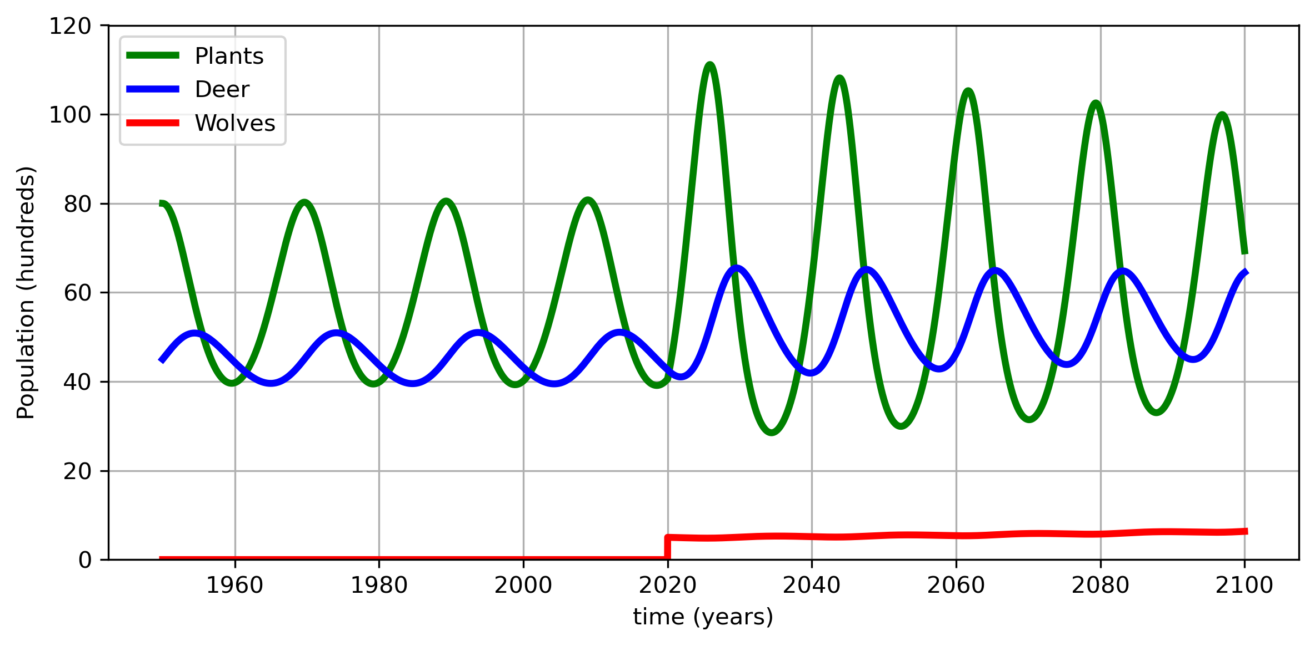
Wolves and Deer and Plants

Slide 61
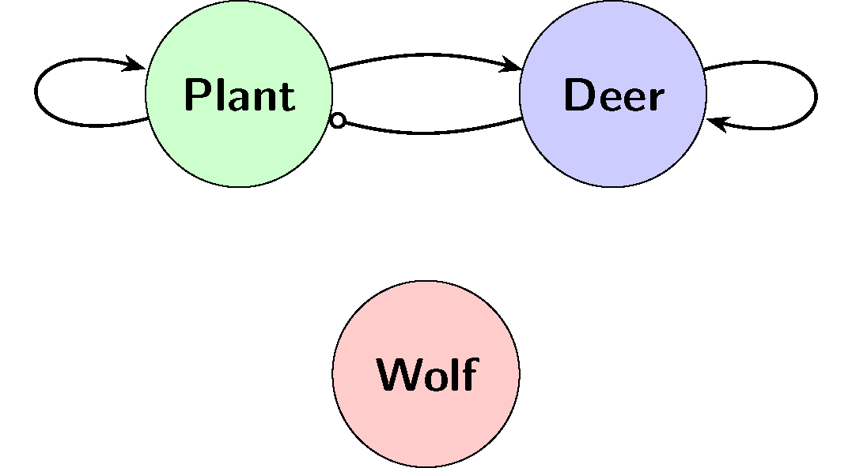
Directed Graph

Slide 62
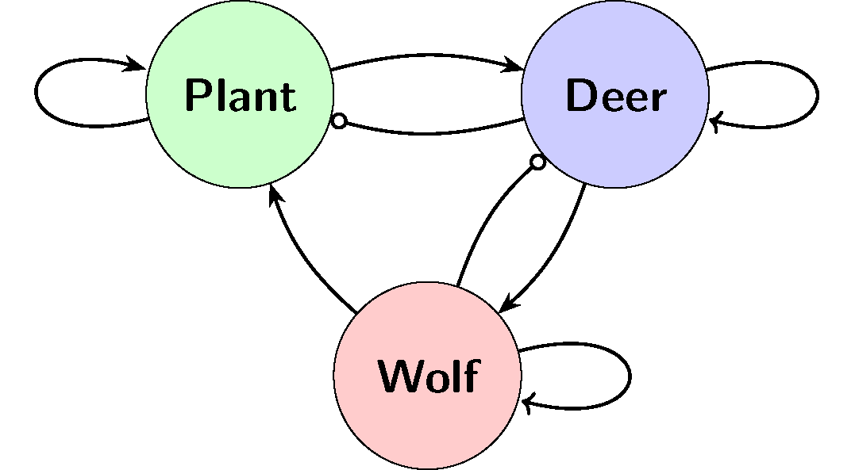
Exercise 11: Label the Graph

Slide 63
Directed Graph
Food for deer
Death Rate Deer
More Plants Grow
Deer eat plants
Death rate Wolves

Slide 64
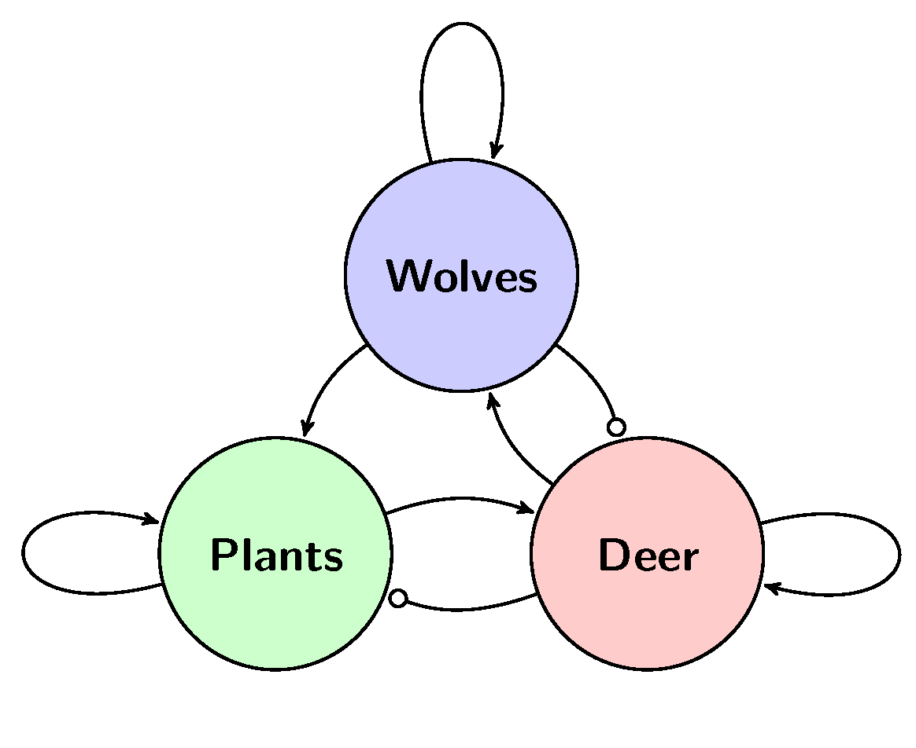
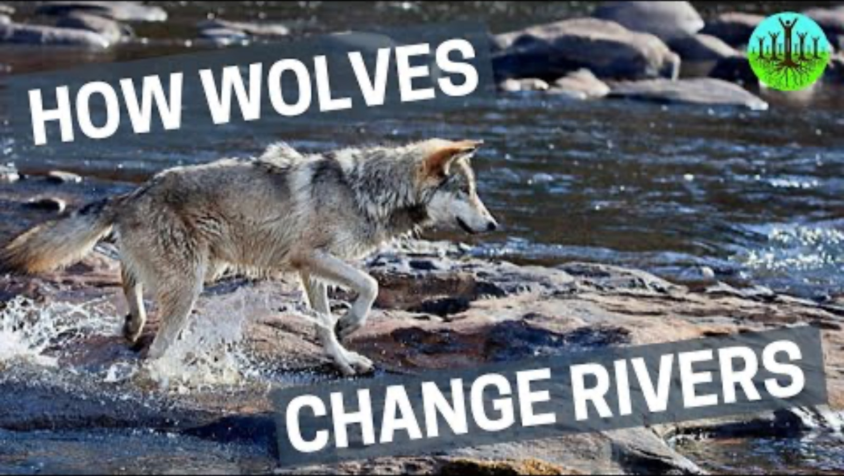
Three Animals

Slide 65
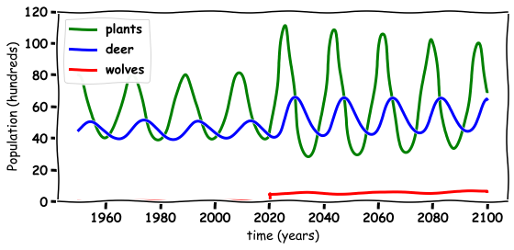
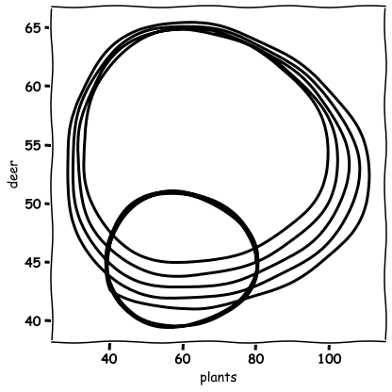
Exercise 12: Describe what is happening in the below graph

Slide 66
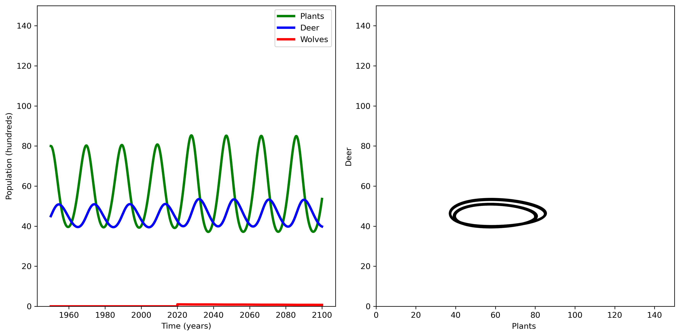
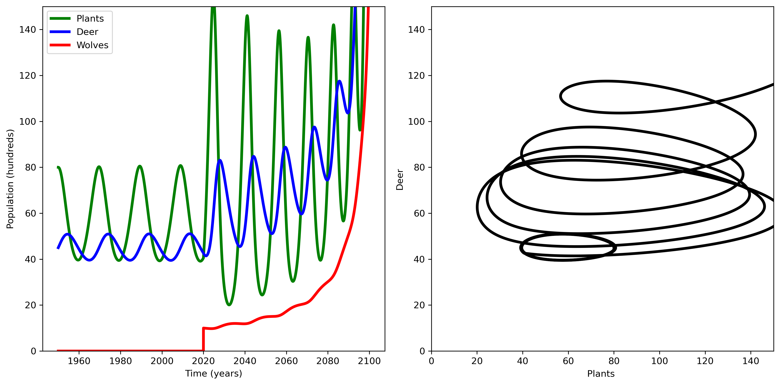
Do we have Enough Wolves

Slide 67
Discussion Questions
What happened to the environment when the wolves are re-introduced?
What happened to the wolf population when they are re-introduced?
What happened to the deer population when the wolves are re-introduced?
Do you think the wolves should have been re-introduced in Ireland?
What else could you model with these Equations?

Slide 68




Thank you for Listening
TCD
Albert Einstein College of Medicine
TU Dublin
Max Planck Institute Germany

