Slide 1
Data Types
Dr. John S. Butler

Slide 2
Types of Data
Categorical
Ordinal
Interval
Ratio

Slide 3
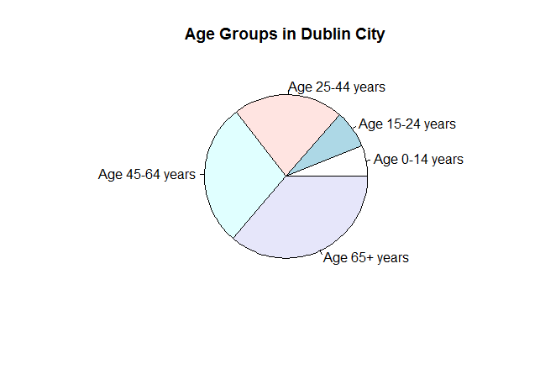
Categorical Data
Puts people and things in categories
EG Age group
Each person is only in one age group
http://www.jstatsoft.org/v53/i07/paper
http://cran.us.r-project.org/web/packages/vcdExtra/vignettes/vcd-tutorial.pdf

Slide 4
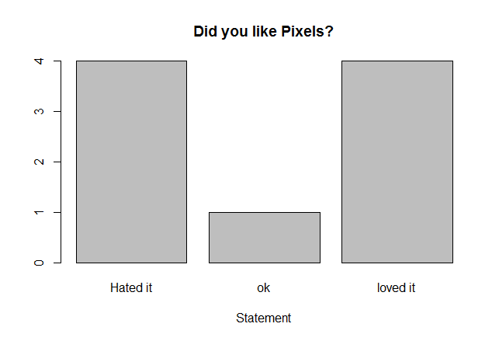
Ordinal Data
Allows ranking of information
E.G. Do you like Marmite
There is a highly subjective nature
HATED IT | OK | LOVED IT
1 | 2 | 3

Slide 5
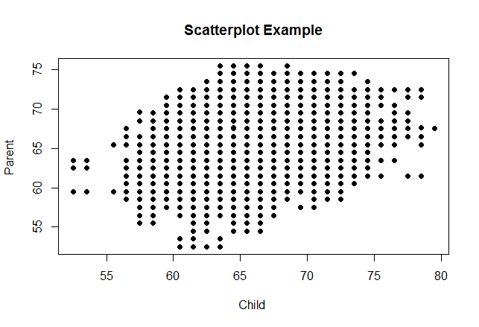
Interval Data
Ordered Scale differences between numbers are meaningful
Height of child with respect to height of parent
https://vincentarelbundock.github.io/Rdatasets/doc/HistData/PearsonLee.html

Slide 6
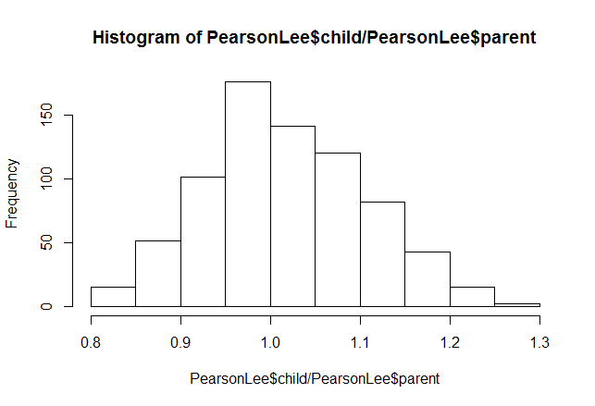
Ratio Data
Ratio data is the same as interval data but it has been transformed

Slide 7
Data Sets
Data sets consist of Variables and Records (Observations)
Variables: Recorded attributes of experimental units in the data set
Record (observation): A collection of variables that refer to one experimental unit in the data set which generally is given in rows

Slide 8
Example

Slide 9
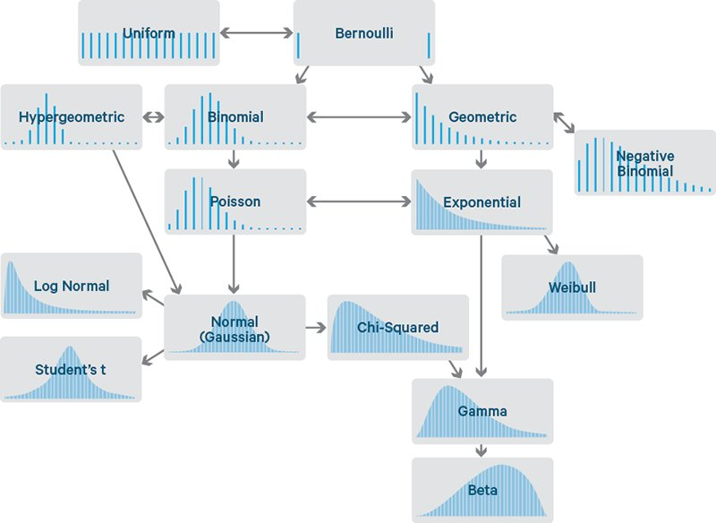
Types of Distributions
A picture is worth a thousand numbers

