Slide 1
Probability and Statistical Inference
Dr. John S. Butler

Slide 2
Lecturer
John Butler
e-mail: john.s.butler@tudublin.ie

Slide 3
Syllabus
Motivation for formal statistical Analysis
Data Visualisation
Data summary, measures of location and dispersion and their meaning, higher order measures
Hypothesis testing
Data prediction and categorisation

Slide 4
Learning outcomes
Formulate probability models for discrete and continuous data
Perform statistical hypothesis testing
Perform statistical hypothesis testing on contingency tables
Fit (linear and logistic) regression models
Interpret the results of regression models
Perform classification using regression type models
Use a statistical analysis software package

Slide 5
Course outline
Probability (week 1-3)
Hypothesis testing (week 4-8)
Regression analysis (week 9-12)
Course summary (week 13)
The R programming language (week 1-13)

Slide 6
Assessment
Assessment | Percent | Time | Attempts
MCQ 1 | 5% | 1 hour | 2
MCQ 2 | 5% | 1 hour | 2
Short Answer Test 1 | 20% | 1 hour | 1
MCQ 3 | 5% | 1 hour | 2
MCQ 4 | 5% | 1 hour | 2
Short Answer Test 2 | 20% | 1 hour | 1

Slide 7
Case Study
40%
Use all your learning to analyse and interpret a dataset.
More detail in second half of module.

Slide 8
Programming
R programming
No prior knowledge required
Free statistical package
We will use R-studio
Shiny (for apps with R)
http://shiny.rstudio.com/tutorial/video/

Slide 9
Websites of Interest
http://www.cyclismo.org/tutorial/R/scripting.html
http://www.johndcook.com/blog/r_language_for_programmers/
http://manuals.bioinformatics.ucr.edu/home/programming-in-r
http://ftp.heanet.ie/mirrors/cran.r-project.org/
https://cran.r-project.org/doc/contrib/Torfs+Brauer-Short-R-Intro.pdf
https://www3.nd.edu/~mclark19/learn/Introduction_to_R.pdf
http://csg.sph.umich.edu/abecasis/class/815.04.pdf
https://www.datacamp.com/courses/free-introduction-to-r
https://www.coursera.org/course/rprog
https://www.youtube.com/watch?v=HKjSKtVV6GU
https://www.youtube.com/watch?v=32o0DnuRjfg
https://cran.r-project.org/doc/manuals/r-release/R-intro.pdf
https://en.wikibooks.org/wiki/R_Programming/Introduction

Slide 10
Statistics
Statistics is the Science of data analysis
Descriptive Statistics + Probability Theory give Inferential Statistics
The purpose of inferential statistics is to allow decisions based on the data

Slide 11
Applications
Neuroscience
Neurology
Cancer Treatment
Psychology
Social Science
History
Economics
Marketing
Physics
Chemistry
Biology
Genetics
Film Making
Engineering
Computer Science
Religion
Everywhere

Slide 12
The goal of Statistics
To summaries and visual data
To simplify data
To model data
To compare data

Slide 13
The goal of Statistics
"Lies, damned lies, and statistics“
Mark Twain
“Lies, damned lies, and the misuse statistics“
John Butler

Slide 14
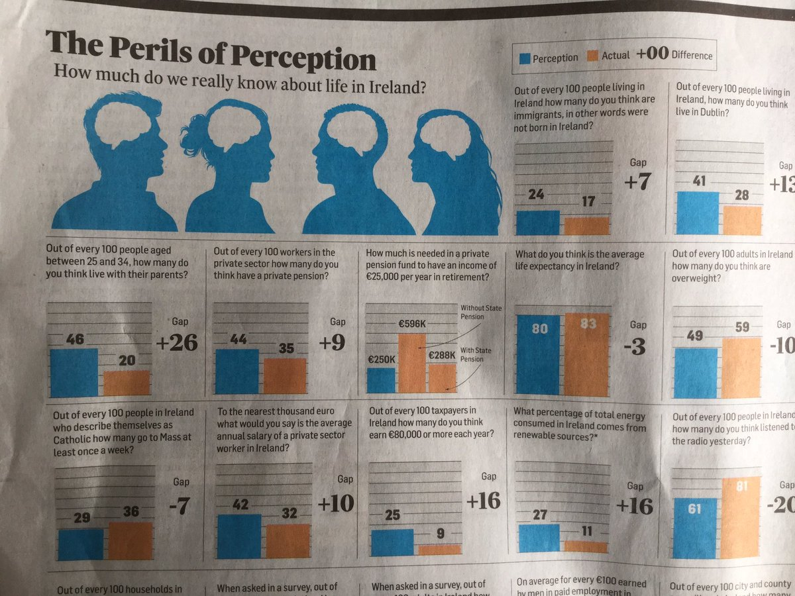
Perils of Perception
Conor Pope Irish Times 22 August 2020
Some letters to the Irish Times about the article and the Perils of this kind of survery

