Slide 1
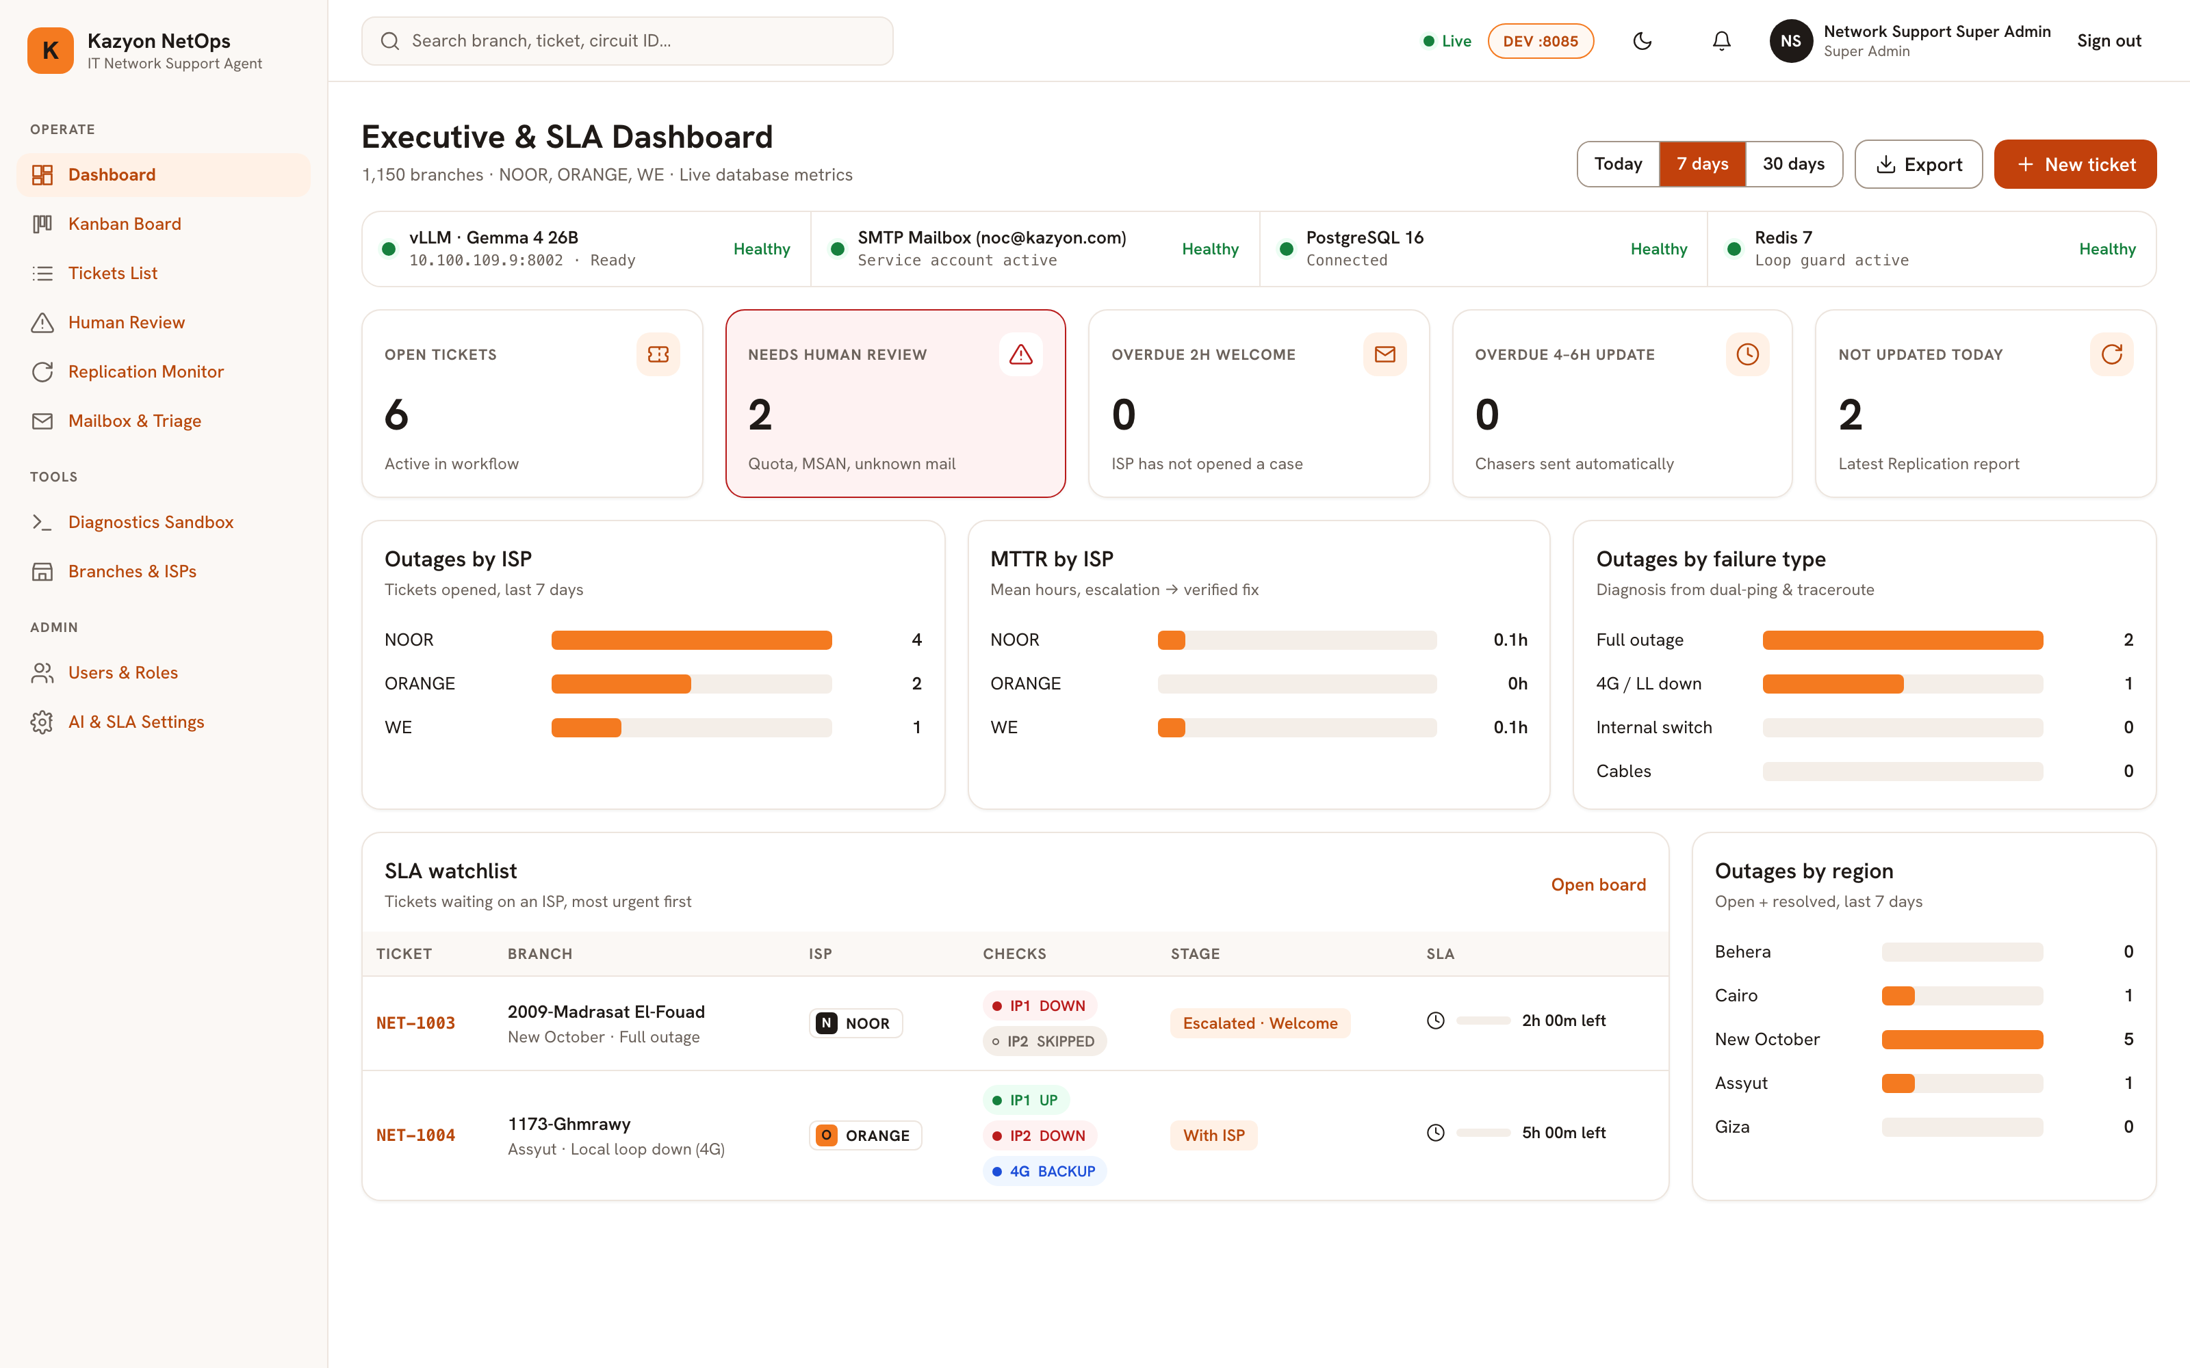
KAZYON NETOPS · AUTONOMOUS AI HARNESS
IT Network Support AI Agent & Ticketing System
Step-by-Step Workflow Sequence & Live Console Decryption Across All 12 Screens
● ● ● LIVE SYSTEM RUNNING — Executive & SLA Dashboard
1,150+
Monitored Branches
Across 5 Egyptian regions (Behera, Cairo, New October, Assyut, Giza)
3 ISPs
NOOR · ORANGE · WE
Automated escalation, 2h Welcome SLA & 4–6h Follow-Up Chaser
Gemma 4
26B Multimodal Vision
Self-hosted on vLLM (:8002) with Guided-JSON & router photo check
ARCHITECTURE & PRODUCTION STACK
Backend: Python 3.12, FastAPI (async), SQLAlchemy 2.0, Alembic
AI Engine: Gemma 4 26B A4B (NVFP4) on vLLM (10.100.109.9:8002)
State & Guard: PostgreSQL 16 + Redis 7 Locks & Loop Guard (6/hr)
Web Console: React 18, TypeScript, Vite & Tailwind CSS
12 Views
Full RBAC Web Console
Live Kanban, 360° Ticket View, Mail Simulator & Diagnostics Suite

Slide 2
MASTER SEQUENCE BLUEPRINT
KAZYON NETOPS · AI HARNESS
End-to-End Autonomous Operations Sequence (Steps 1 → 9)
How an incident flows from email ingestion through vision, diagnostics, ISP SLA loops, and final verification.
STEP 1
Dual Trigger Ingestion
STEP 2
5-Tier Thread Correlation
STEP 3
Gemma 4 Guided-JSON Triage
Path A: Regional IT emails branch code & router photo to noc@kazyon.com.
Path B: Daily Replication HTML report flags 'Not Updated' stores.
Matches In-Reply-To, [NET-XXXX] tag, ISP Case #, Circuit ID, or SAP code.
Isolates BRANCH_THREAD vs ISP_THREAD to prevent cross-leakage.
Strips quoted replies so the newest message turn is classified first.
Queues raw .eml for retry (LLM_RETRY_QUEUE_DIR) if vLLM is busy.
STEP 4
Multimodal Router Vision
STEP 5
Dual-Ping & 4G Traceroute
STEP 6
ISP Escalation & 2h SLA
Inspects attached router photos for seated cables & Power/WAN LEDs.
Requests cable reseating from Regional IT if unplugged.
Pings Router IP1 (10.<AB>.<CD>.1) & Store Switch IP2 (10.<AB>.<CD>.2).
Runs 4G Hub traceroute on ORANGE/WE when IP1 is UP & IP2 is DOWN.
Sends provider-formatted escalation to NOOR, ORANGE, or WE.
Starts the 2-Hour Welcome SLA timer awaiting an ISP Case #.
STEP 7
4–6h Chaser & Mediation
STEP 8
Final Fix Verification
STEP 9
Human Review & Guardrails
Records ISP Case # and starts the 4–6h automated follow-up loop.
Relays updated branch contact numbers & enforces 6 emails/hr guard.
Re-runs live Dual-Ping + 4G Hub Traceroute upon ISP closure claim.
Auto-closes ticket on PASS or rejects premature closure on FAIL.
Escalates Quota, MSAN, Cabling, or Loop Guard trips to on-call engineer.
Supports Approval Mode, per-ticket Pause AI & Master Kill-Switch.
IT Network Support AI Agent & Ticketing System · Step-by-Step Sequence & Live Console
Slide 2 / 17

Slide 3
ARCHITECTURE & CONTRACTS
KAZYON NETOPS · AI HARNESS
Domain-Driven Architecture, Frozen Contracts & Dual Deployment
Strict package boundaries, deterministic state transitions, and isolated DEV (:8085) / PROD (:8084) containers.
THE 4 FROZEN CONTRACTS (common/contracts.py)
7 ISOLATED BACKEND PACKAGES (backend/app/)
1. DiagnosticScriptContract (DiagnosticInput → DiagnosticOutput)
Standardized JSON I/O returning PASS | FAIL | DEGRADED | ERROR, check pills, step analysis, and CLI logs.
2. EmailEnvelope Immutable MIME Schema
Normalizes Message-ID, In-Reply-To, References, sender, recipients, body, and image attachments before triage.
3. LLMClassificationContract (Guided-JSON Schemas)
Forces Gemma 4 26B to emit validated JSON schemas; free-form prose never mutates ticket state.
4. TicketStatus & ALLOWED_TRANSITIONS Machine
11 statuses mapped to 8 Kanban columns (0..7) enforced centrally by transition_ticket().
common/ & auth/: Config, JSONVariant, Redis locks, Fernet crypto, JWT & 8×5 RBAC
directory/: 1,150-Store & 3-ISP registry, IP derivation & idempotent Excel seeder
ticketing/: Ticket state machine, 360° detail view, Replication HTML parser & SLAs
email_engine/: Inbound SMTP listener (:2525), STARTTLS sender & Redis Loop Guard
diagnostics/ & agent/: Subprocess ICMP runner, vLLM coordinator & /ws/tickets bus
DUAL-ENVIRONMENT ISOLATION ON 10.100.109.9
DEV Stack (deploy.sh --env dev): App :8085 | PG :5435 | Redis :6385 | SMTP :2525
PROD Stack (deploy.sh --env prod): App :8084 | PG :5434 | Redis :6384 | SMTP :2524
Shared On-Prem AI: http://10.100.109.9:8002 serving Gemma 4 26B A4B (NVFP4)
Fail-Fast Startup: Blocks production boot if default placeholder secrets are present.
IT Network Support AI Agent & Ticketing System · Step-by-Step Sequence & Live Console
Slide 3 / 17

Slide 4
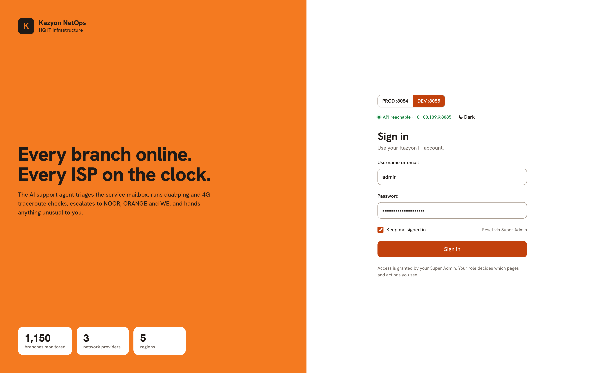
STEP 0 · AUTHENTICATION & ENTRY
KAZYON NETOPS · AI HARNESS
Page 1: Login, Environment Selector & Health Probe
Decryption of LoginView.tsx & app/auth/ — How operators authenticate and connect to DEV (:8085) or PROD (:8084).
STEP 0A
Live Environment & Health Probe
● ● ● LIVE RUNNING SYSTEM · page_01_login.png
Auto-Probes /api/health: Verifies API status, active environment (PROD :8084 vs DEV :8085), and vLLM readiness.
Fleet Counters: Displays 1,150 monitored branches, 3 ISPs (NOOR, ORANGE, WE), and 5 regions upfront.
STEP 0B
JWT Sign-In & Role Bootstrap
Role Seeding: Bootstraps super_admin, support_engineer, and viewer roles plus the initial Super Admin on startup.
Signed HS256 JWT: Verifies bcrypt password hash, logs auth.login with IP, and issues a 24h Bearer token.
STEP 0C
Redis Permission Cache & Theme
Cache-Aside Auth: Caches user permissions in Redis (it_net:auth:user:{id}) with instant invalidation on role updates.
Theme Toggle: Switches seamlessly between Kazyon warm-ivory light mode and high-contrast NOC dark mode.
LIVE STATE: Page 1 showing live API reachability (10.100.109.9:8085), PROD/DEV toggle, and monitored fleet scale.
IT Network Support AI Agent & Ticketing System · Step-by-Step Sequence & Live Console
Slide 4 / 17

Slide 5
STEP 1 · FLEET & SLA OBSERVABILITY
KAZYON NETOPS · AI HARNESS
Page 2: Executive & Live SLA Dashboard
Decryption of DashboardView.tsx & GET /api/v1/dashboard/summary — Real-time NOC health bar, KPIs, and SLA countdowns.
STEP 1A
4-Service Health Bar & 5 Live KPIs
● ● ● LIVE RUNNING SYSTEM · page_02_dashboard.png
Core Service Strip: Live status for vLLM Gemma 4 26B, SMTP Mailbox (noc@kazyon.com), PostgreSQL 16, and Redis 7.
5 Actionable KPIs: Open Tickets (6), Needs Human Review (2), Overdue 2h Welcome (0), Overdue 4–6h Update (0), Not Updated (2).
STEP 1B
Outage & MTTR Analytics Charts
Time-Window Slicing: Toggle between Today (24h), 7 Days, and 30 Days with one-click CSV summary export.
4 Live Breakdowns: Outages by ISP, Mean Time To Resolution (MTTR by ISP), Failure Type, and Region.
STEP 1C
Urgent SLA Watchlist & Drill-Down
Countdown Sorting: Ranks active ISP tickets by remaining SLA time with live IP1, IP2, and 4G status pills.
Instant Action: Click any row to open its 360° Ticket Detail view or launch '+ New ticket' for manual triage.
LIVE STATE: Page 2 showing 4 healthy services, 6 open tickets, 2 Human Review items, ISP/Region charts, and live SLA watchlist.
IT Network Support AI Agent & Ticketing System · Step-by-Step Sequence & Live Console
Slide 5 / 17

Slide 6
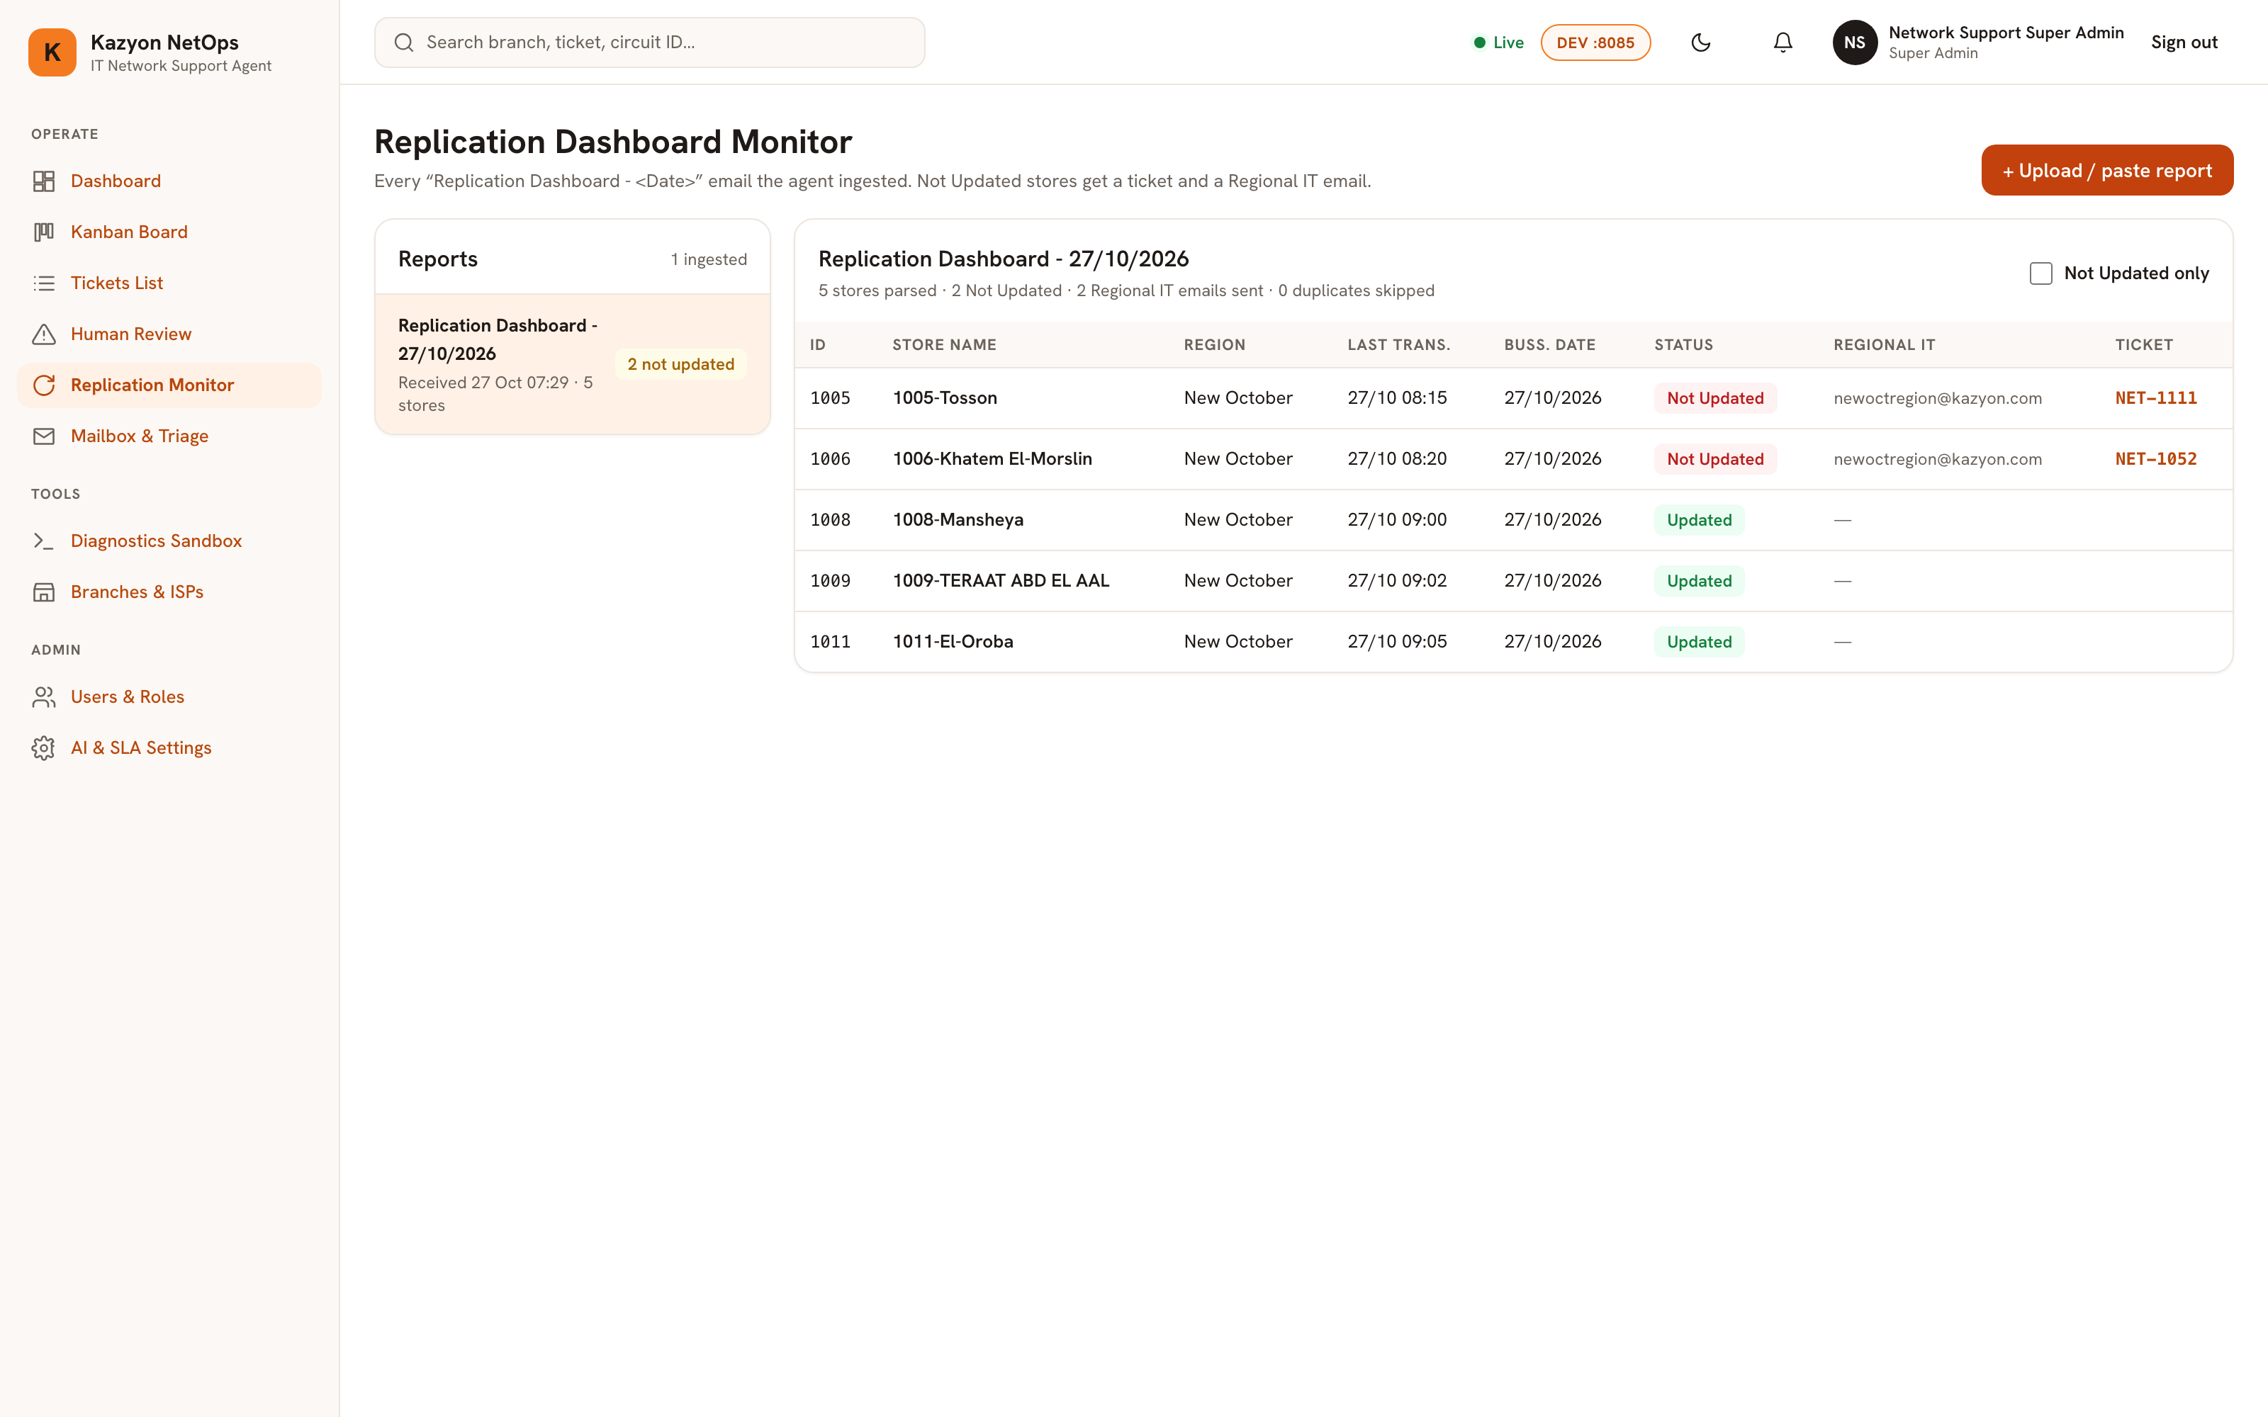
STEP 2 · PROACTIVE INGESTION (PATH B)
KAZYON NETOPS · AI HARNESS
Page 6: Replication Dashboard Monitor & HTML Parser
Decryption of ReplicationMonitorView.tsx & process_replication_dashboard_report() — Catching offline stores automatically.
STEP 2A
HTML Table Ingestion & Parsing
● ● ● LIVE RUNNING SYSTEM · page_06_replication_monitor.png
Automated or Pasted Reports: Parses daily 'Replication Dashboard - <Date>' HTML tables via _SimpleHTMLTableParser.
Store Resolution: Extracts SAP ID, Store Name, Region, Last Transaction time, and Updated vs Not Updated status.
STEP 2B
Open-Ticket Deduplication Guard
Prevents Duplicate Tickets: Checks if an active ticket already exists for each 'Not Updated' branch.
Smart Linking: Links existing open tickets and increments duplicates_skipped_count without re-emailing Regional IT.
STEP 2C
Pre-Ticket & Regional IT Alert
Opens AWAITING_REGIONAL_IT Ticket: Places new pre-tickets (NET-1111, NET-1052) in Kanban Column 0.
Notifies Regional IT: Emails the branch's Regional IT mailbox requesting a router photo and active site phone.
LIVE STATE: Page 6 showing parsed 'Replication Dashboard - 27/10/2026' with 2 Not Updated stores linked to NET-1111 & NET-1052.
IT Network Support AI Agent & Ticketing System · Step-by-Step Sequence & Live Console
Slide 6 / 17

Slide 7
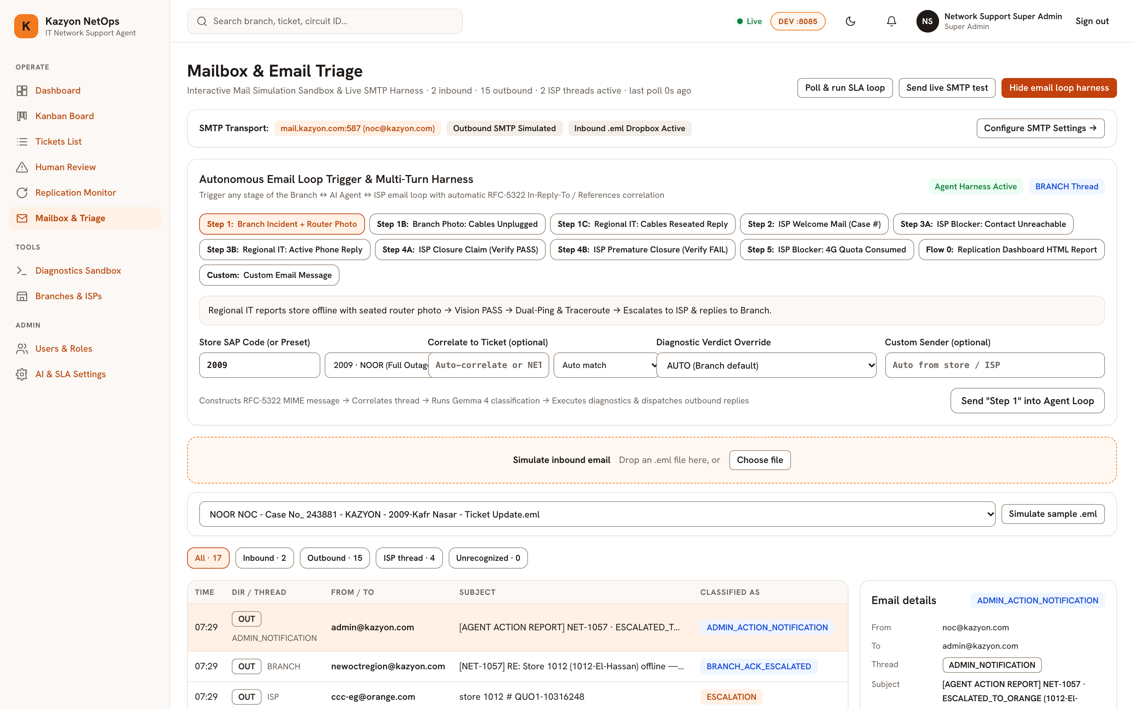
STEP 3 · INBOUND TRIAGE & EMAIL LOOP
KAZYON NETOPS · AI HARNESS
Page 8: Mailbox Triage, Correlation & Loop Simulator
Decryption of MailboxTriageView.tsx, smtp_listener.py & classifier.py — Multi-turn thread correlation and AI classification.
STEP 3A
SMTP Listener & 5-Tier Correlation
● ● ● LIVE RUNNING SYSTEM · page_08_mailbox_triage.png
Built-In SMTP Listener: Receives mail on port 2525 (DEV) / 2524 (PROD) with IP allowlist and fsync-before-250 durability.
5-Tier Matching: Correlates via (1) In-Reply-To, (2) [NET-XXXX], (3) ISP Case #, (4) Circuit ID, or (5) 4-digit SAP code.
STEP 3B
Two-Stage Gemma 4 Guided-JSON
Quote Stripping: Splits reply chains so Gemma 4 classifies the newest turn first alongside prior DB thread messages.
Retry Queue Safety: Enqueues raw .eml files to data/imports/llm_retry/ (3 cycles) if vLLM is temporarily unreachable.
STEP 3C
Interactive 10-Step Loop Simulator
Role-Play Harness: Trigger Branch Incident, Unplugged Photo, ISP Welcome, Unreachable Contact, or ISP Closure in one click.
65 Real .eml Samples: Test live triage against actual NOOR, ORANGE, and WE email threads from Info/.
LIVE STATE: Page 8 showing live SMTP transport (mail.kazyon.com:587), 10-step role-play simulator, and classified email log.
IT Network Support AI Agent & Ticketing System · Step-by-Step Sequence & Live Console
Slide 7 / 17

Slide 8
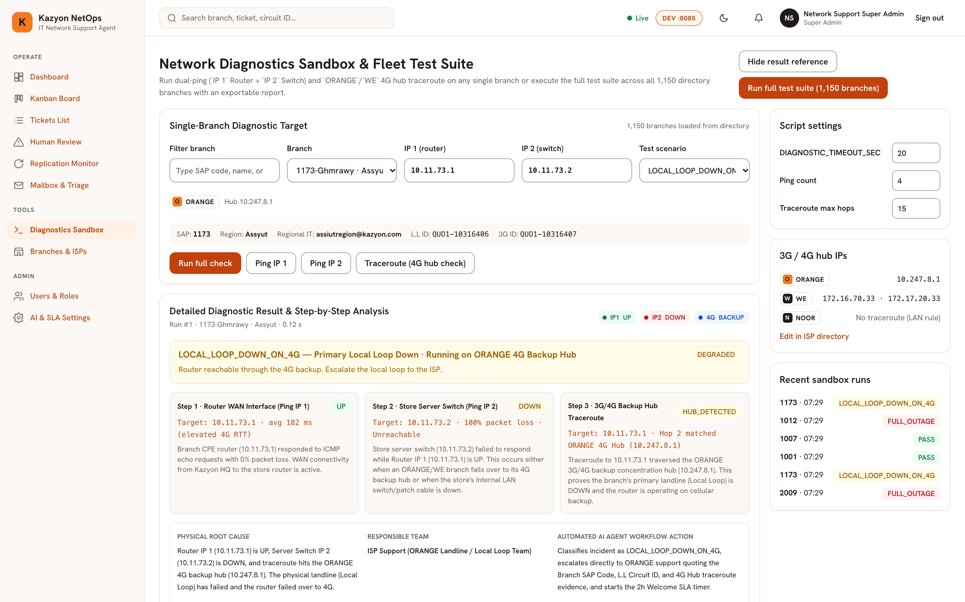
STEP 4 · TROUBLESHOOTING HARNESS
KAZYON NETOPS · AI HARNESS
Page 9: Network Diagnostics Sandbox & Fleet Test Suite
Decryption of DiagnosticsSandboxView.tsx & diagnostics/executor.py — Dual-Ping (IP1/IP2) and 4G Hub Traceroute.
STEP 4A
Derived IPs & Sandboxed Execution
● ● ● LIVE RUNNING SYSTEM · page_09_diagnostics_sandbox.png
Formulaic Store IPs: Derives Router IP1 (10.<AB>.<CD>.1) and Switch IP2 (10.<AB>.<CD>.2) from the 4-digit SAP code.
Isolated Subprocess: Runs asyncio.create_subprocess_exec (no shell=True) with a 20s timeout and scrubbed environment.
STEP 4B
3-Step Decision Matrix & 4G Check
Dual-Ping Verdict: IP1+IP2 UP = PASS (auto-closes); IP1 DOWN (IP2 skipped) = FULL_OUTAGE (escalates to ISP).
4G Hub Traceroute: If IP1 is UP & IP2 is DOWN on ORANGE/WE, hitting 10.247.8.1 or 172.16.70.33/172.17.20.33 proves LOCAL_LOOP_DOWN_ON_4G.
STEP 4C
1,150-Branch Fleet Test Suite
Concurrent Audit: Executes 64-way parallel Dual-Ping + Traceroute checks across all 1,150 branches in seconds.
Exportable Report: Generates per-ISP and per-Region health percentages and records an audit log entry.
LIVE STATE: Page 9 diagnosing 1173-Ghmrawy: IP1 UP, IP2 DOWN, Hop 2 matched ORANGE 4G Hub 10.247.8.1 -> LOCAL_LOOP_DOWN_ON_4G.
IT Network Support AI Agent & Ticketing System · Step-by-Step Sequence & Live Console
Slide 8 / 17

Slide 9
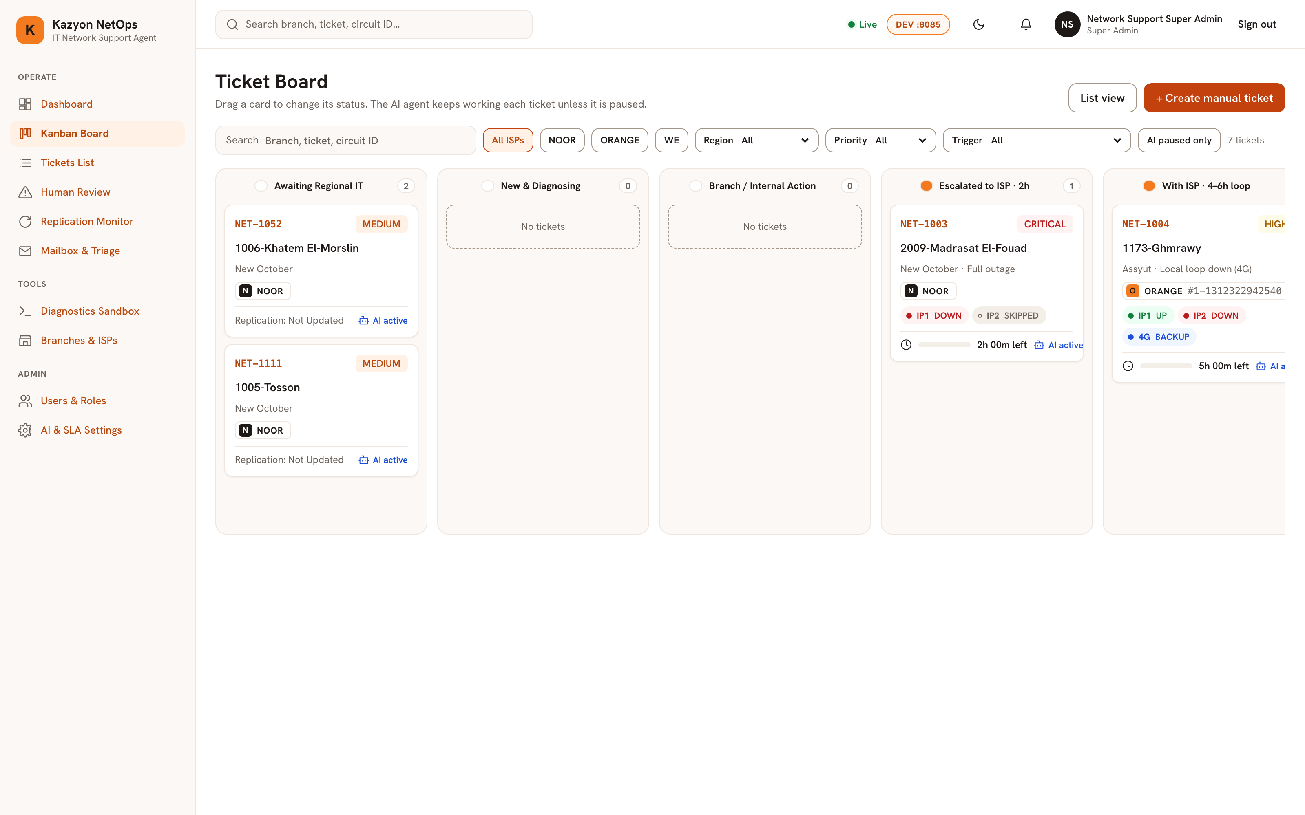
STEP 5 · LIFECYCLE & SLA BOARD
KAZYON NETOPS · AI HARNESS
Page 3: 8-Column Ticket Kanban Board & State Machine
Decryption of KanbanBoardView.tsx & ticketing/state_machine.py — Real-time lifecycle tracking across 8 stages.
STEP 5A
11 Statuses Mapped to 8 Columns
● ● ● LIVE RUNNING SYSTEM · page_03_kanban_board.png
Columns 0–2 (Branch/Triage): Awaiting Regional IT (Col 0), New & Diagnosing (Col 1), Branch / Internal Action (Col 2).
Columns 3–7 (ISP & Closure): Escalated · 2h (Col 3), With ISP · 4–6h (Col 4), Verifying (Col 5), Human Review (Col 6), Closed (Col 7).
STEP 5B
Live Telemetry Cards & WebSockets
Rich Status Cards: Shows Ticket ID, Priority, Branch, ISP badge, Case #, IP1/IP2/4G pills, and SLA countdown bar.
Real-Time Sync: Streams ticket.created and ticket.updated events over /ws/tickets for instant board movement.
STEP 5C
Audited Drag-and-Drop & Filters
Guarded Transitions: AI obeys ALLOWED_TRANSITIONS; manual drag-and-drop sets force=True and logs ticket.status_forced.
Quick Slicing: Filter cards by search text, ISP (NOOR/ORANGE/WE), Region, Priority, Trigger, or 'AI paused only'.
LIVE STATE: Page 3 Kanban Board showing tickets in Awaiting Regional IT, Escalated to ISP (2h SLA), and With ISP (4–6h loop).
IT Network Support AI Agent & Ticketing System · Step-by-Step Sequence & Live Console
Slide 9 / 17

Slide 10
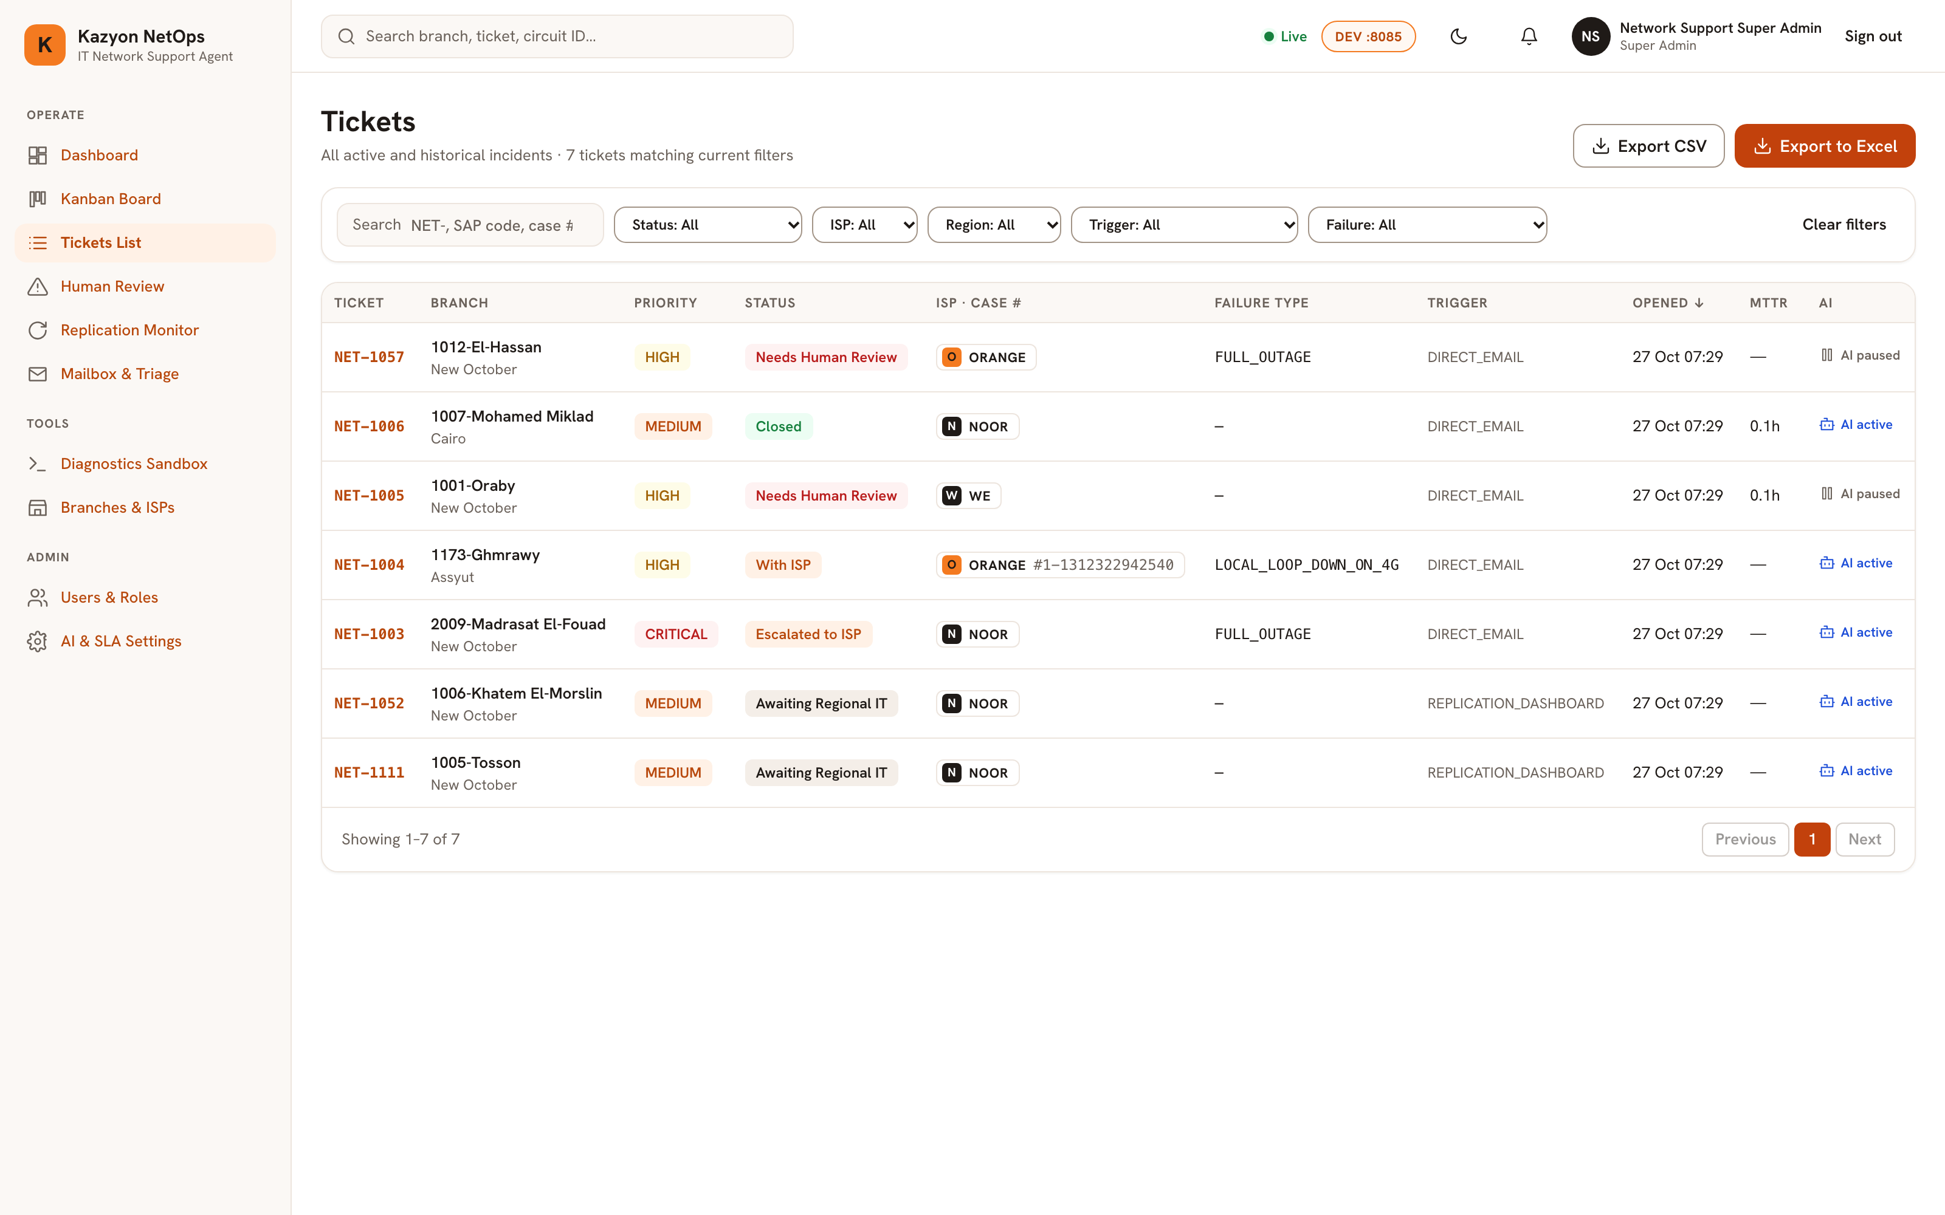
STEP 6 · FLEET INCIDENT LEDGER
KAZYON NETOPS · AI HARNESS
Page 4: Master Tickets List, Multi-Filter & Export
Decryption of TicketsListView.tsx & GET /api/v1/tickets — Tabular incident search, MTTR tracking, and Excel export.
STEP 6A
9-Column Incident Ledger
● ● ● LIVE RUNNING SYSTEM · page_04_tickets_list.png
Complete Row Context: Displays Ticket ID, Branch & Region, Priority, Status stage, ISP & Case #, Failure Type, Trigger, Opened time, and MTTR.
AI Automation Badge: Clearly indicates whether AI is actively managing the ticket or paused for human review.
STEP 6B
6-Dimensional Search & Filtering
Instant Search: Query by NET- ticket number, 4-digit SAP code, store name, or ISP case reference number.
Combinable Filters: Slice by Status, ISP (NOOR, ORANGE, WE), Region, Trigger Source, and Failure Type.
STEP 6C
Automated MTTR & Excel Export
One-Click Export: Download filtered incidents as CSV or formatted Excel (.xlsx) for weekly ISP SLA reviews.
Exact MTTR Tracking: Automatically calculates resolution duration in hours (resolved_at - created_at).
LIVE STATE: Page 4 showing 7 incidents across NOOR, ORANGE, and WE with ISP Case #, Failure Type, Trigger Source, MTTR, and AI state.
IT Network Support AI Agent & Ticketing System · Step-by-Step Sequence & Live Console
Slide 10 / 17

Slide 11
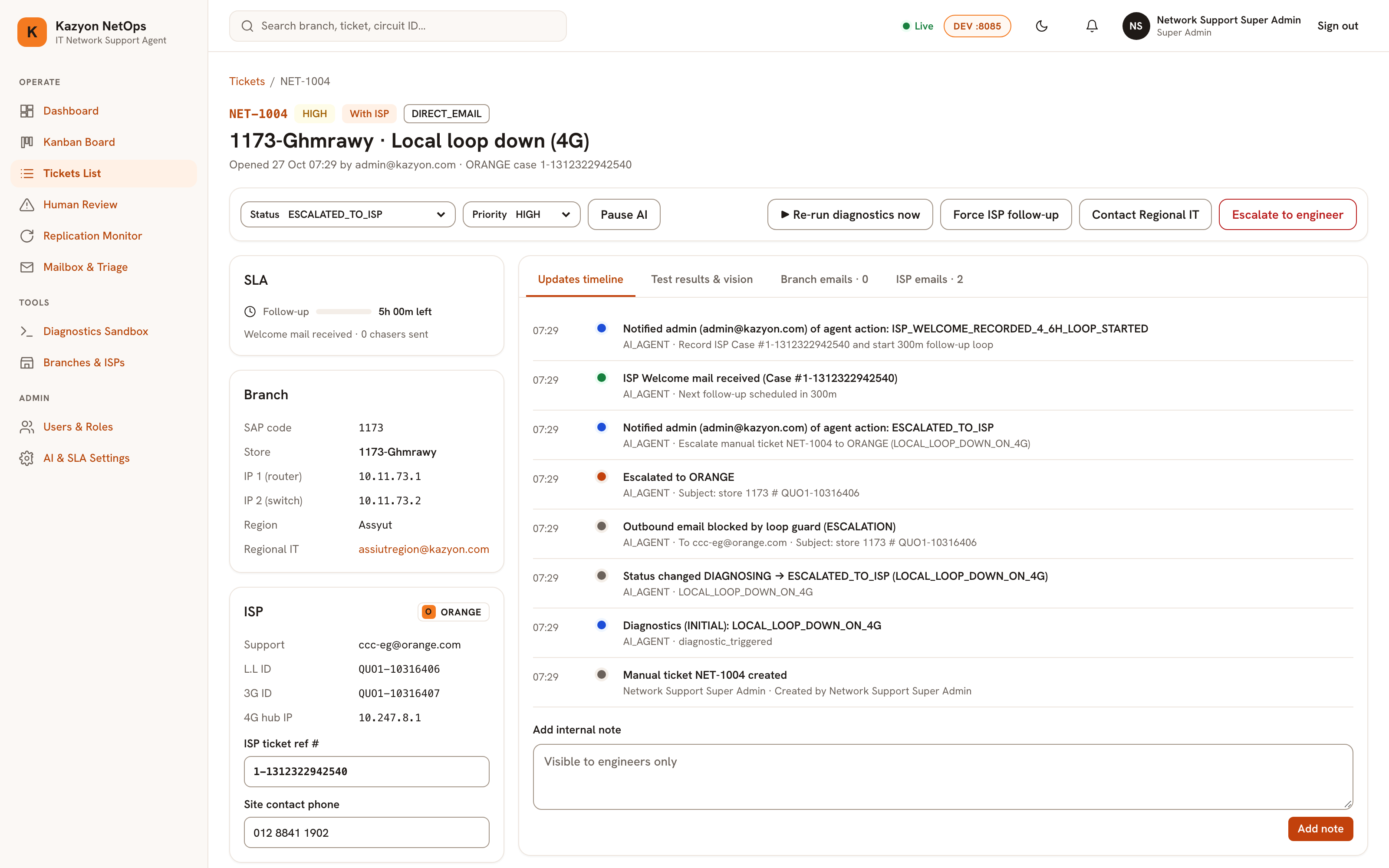
STEP 7 · 360° INCIDENT COMMAND
KAZYON NETOPS · AI HARNESS
Page 5: 360° Ticket Detail, Dual Threads & Controls
Decryption of TicketDetailView.tsx & GET /api/v1/tickets/{id} — Timeline, vision verdict, CLI logs, and thread isolation.
STEP 7A
SLA Clock, Store & ISP Metadata
● ● ● LIVE RUNNING SYSTEM · page_05_ticket_detail.png
Live SLA Progress: Tracks the 2h Welcome SLA or 5h (300m) Follow-up Chaser countdown and chaser count.
Topology Context: Shows SAP Code, IP1/IP2, Regional IT mail, ISP Support mail, L.L/3G Circuit IDs, Case #, and Site Phone.
STEP 7B
4 Isolated Inspection Tabs
Timeline & Vision/Tests: Chronological audit feed, Gemma 4 router photo verdict (with override), and raw ping/traceroute logs.
Strict Thread Separation: Isolates Branch Emails (Regional IT) from ISP Emails (NOC) with manual reply composers.
STEP 7C
5 Engineer Override Controls
Instant Takeover Bar: Pause/Resume AI, Re-run diagnostics now, Force ISP follow-up, Contact Regional IT, or Escalate to engineer.
LIVE STATE: Page 5 showing NET-1004 (1173-Ghmrawy · Local loop down 4G) with ORANGE Case #1-1312322942540 and 5h follow-up timer.
IT Network Support AI Agent & Ticketing System · Step-by-Step Sequence & Live Console
Slide 11 / 17

Slide 12
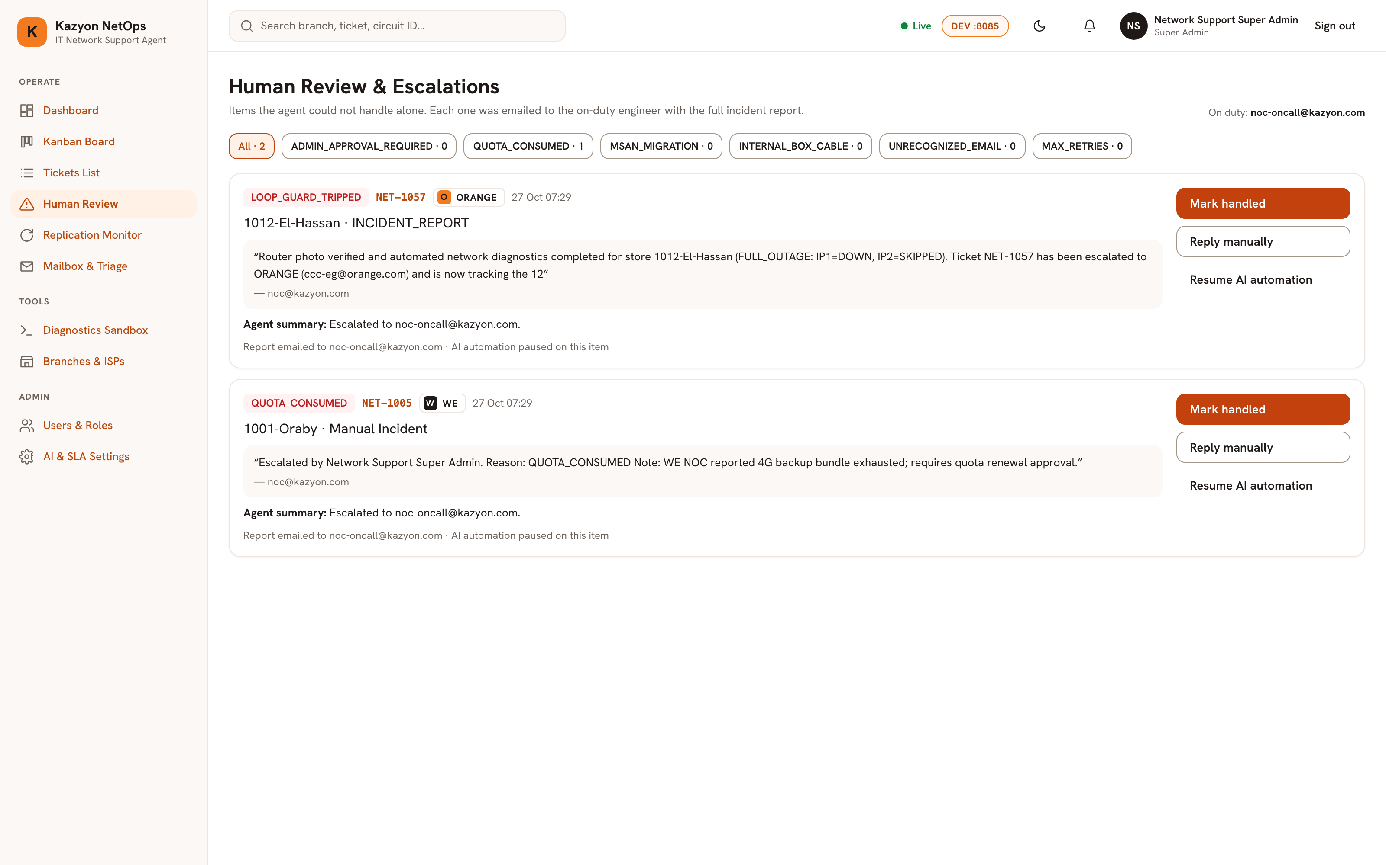
STEP 8 · HUMAN-IN-THE-LOOP QUEUE
KAZYON NETOPS · AI HARNESS
Page 7: Human Review & Out-of-Flow Escalations
Decryption of HumanReviewView.tsx & /api/v1/escalations — Handling non-standard ISP blockers, loop guards, and approvals.
STEP 8A
10 Automated Escalation Triggers
● ● ● LIVE RUNNING SYSTEM · page_07_human_review.png
Contractual/Physical Blockers: Flags QUOTA_CONSUMED (4G bundle exhausted), MSAN_MIGRATION, and INTERNAL_BOX_CABLE.
Safety Guardrails: Catches LOOP_GUARD_TRIPPED (2 blocked mails/hr), MAX_RETRIES, UNRECOGNIZED_EMAIL, and LLM_UNAVAILABLE.
STEP 8B
Auto-Pause AI & On-Call Alerting
Pauses Autonomous Loop: Sets ai_automation_enabled=False immediately so the agent never conflicts with human engineers.
On-Duty Notification: Emails noc-oncall@kazyon.com with the verbatim quote, branch metadata, and diagnostic summary.
STEP 8C
One-Click Resolution & Approvals
Engineer Actions: Filter by reason, click 'Mark handled', 'Reply manually', or 'Resume AI automation'.
Approval Mode Support: Provides 1-click Approve / Reject buttons when 'Ask Admin Before Acting' is enabled.
LIVE STATE: Page 7 showing NET-1057 (LOOP_GUARD_TRIPPED on ORANGE) and NET-1005 (QUOTA_CONSUMED on WE) with AI paused.
IT Network Support AI Agent & Ticketing System · Step-by-Step Sequence & Live Console
Slide 12 / 17

Slide 13
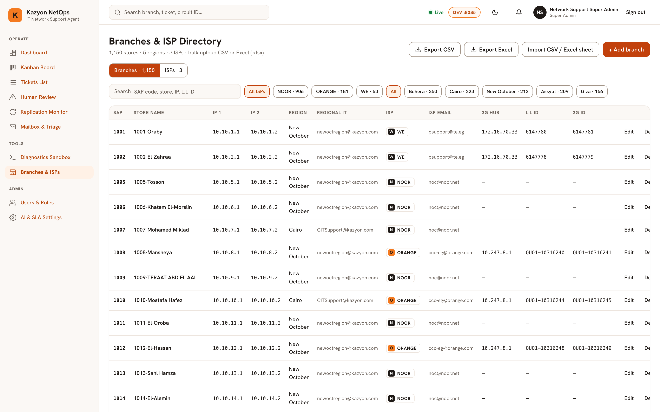
STEP 9 · MASTER STORE & ISP DIRECTORY
KAZYON NETOPS · AI HARNESS
Page 10: 1,150-Store Branches & 3-ISP Directory
Decryption of DirectoryView.tsx & directory/seeder.py — Managing store topology, circuit IDs, 4G hubs, and Excel seeding.
STEP 9A
1,150-Store Topology Registry
● ● ● LIVE RUNNING SYSTEM · page_10_branches_isps.png
Complete Store Mapping: Stores SAP Code, Name, IP1 Router, IP2 Switch, Region, Regional IT mail, ISP, L.L ID, and 3G ID.
One-Click Filter Pills: Slice by ISP (NOOR · 906, ORANGE · 181, WE · 63) or across all 5 Egyptian regions.
STEP 9B
Idempotent Excel & CSV Bulk Seeder
Dry-Run Preview: POST /api/v1/branches/seed-excel parses uploaded .xlsx/.csv sheets with dry_run preview before upsert.
Templates & Export: Download sample upload templates or export the active store directory to CSV/Excel.
STEP 9C
3-ISP Provider & Template Config
ISP Settings Tab: Manage support emails (noc@noor.net, ccc-eg@orange.com, psupport@te.eg), 4G Hub IPs, SLAs, and templates.
LIVE STATE: Page 10 showing 1,150 stores across NOOR (906), ORANGE (181), and WE (63) with derived Router/Switch IPs.
IT Network Support AI Agent & Ticketing System · Step-by-Step Sequence & Live Console
Slide 13 / 17

Slide 14
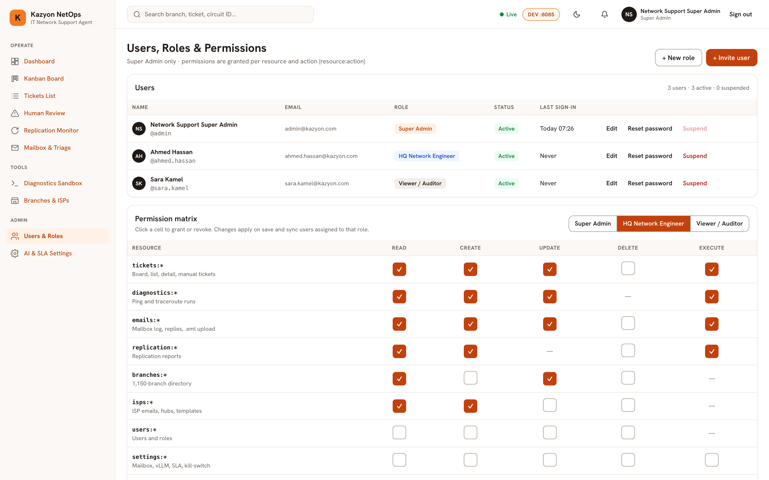
STEP 10 · GRANULAR RBAC & SECURITY
KAZYON NETOPS · AI HARNESS
Page 11: Users, Roles & 8×5 Permission Matrix
Decryption of UsersRbacView.tsx & app/auth/ — Resource-action access control, role templates, and lockout protection.
STEP 10A
8-Resource × 5-Action Matrix
● ● ● LIVE RUNNING SYSTEM · page_11_users_rbac.png
Endpoint Enforcement: Every route checks require_permission('<resource>:<action>') across 8 resources and 5 actions.
Bidirectional Mapping: PERMISSION_EQUIVALENTS links matrix cells to domain actions (e.g., tickets:execute <-> tickets:pause_ai).
STEP 10B
System Roles & Live User Sync
3 Built-In Roles: Super Admin (full access), HQ Network Engineer (operations & diagnostics), and Viewer / Auditor (read-only).
Instant Role Sync: Saving matrix edits updates all assigned users and invalidates their Redis permission cache.
STEP 10C
Lockout Guards & Audit Trail
Anti-Lockout Rules: Blocks self-suspension and prevents demoting or suspending the last active Super Admin.
Immutable Audit Log: Records every login, user creation, role update, and password reset in audit_logs.
LIVE STATE: Page 11 showing 3 active users (Super Admin, HQ Network Engineer, Viewer) and the 8×5 permission matrix.
IT Network Support AI Agent & Ticketing System · Step-by-Step Sequence & Live Console
Slide 14 / 17

Slide 15
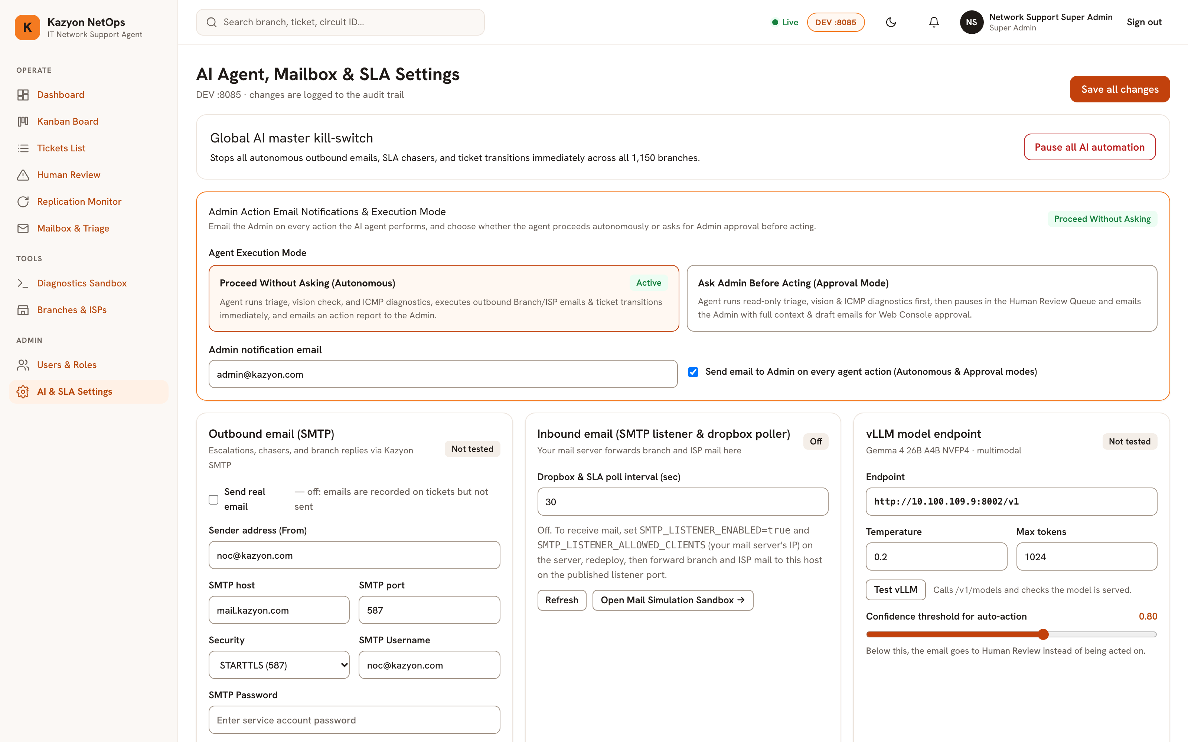
STEP 11 · RUNTIME & SAFETY SETTINGS
KAZYON NETOPS · AI HARNESS
Page 12: AI Agent, Mailbox, SLA & Master Kill-Switch
Decryption of SettingsView.tsx & /api/v1/settings — Live runtime controls, encrypted SMTP credentials, and approval mode.
STEP 11A
Master Kill-Switch & Execution Mode
● ● ● LIVE RUNNING SYSTEM · page_12_ai_sla_settings.png
Global AI Kill-Switch: Immediately pauses all autonomous emails, SLA chasers, and transitions across all 1,150 stores.
Autonomous vs Approval Mode: Run hands-free ('Proceed Without Asking') or queue actions for Admin approval ('Ask Admin Before Acting').
STEP 11B
Encrypted SMTP & Sandbox Redirect
Fernet Encryption: Encrypts SMTP credentials (mail.kazyon.com:587 STARTTLS, noc@kazyon.com) at rest using ENCRYPTION_KEY.
Safe Test Redirect: Routes all outbound Branch/ISP emails to test_redirect_email during testing so real ISPs are never emailed.
STEP 11C
Live Connection Probes & SLA Timers
Real Handshake Tests: 'Test SMTP' verifies EHLO/STARTTLS/AUTH/MAIL FROM; 'Test vLLM' checks GET /v1/models on :8002.
Configurable Guardrails: Tune 2h Welcome SLA, 5h Follow-up interval, max chasers (4), and Loop Guard limit (6/hr).
LIVE STATE: Page 12 showing Global AI Kill-Switch, Execution Mode toggle, SMTP STARTTLS config, Inbound Listener, and vLLM settings.
IT Network Support AI Agent & Ticketing System · Step-by-Step Sequence & Live Console
Slide 15 / 17

Slide 16
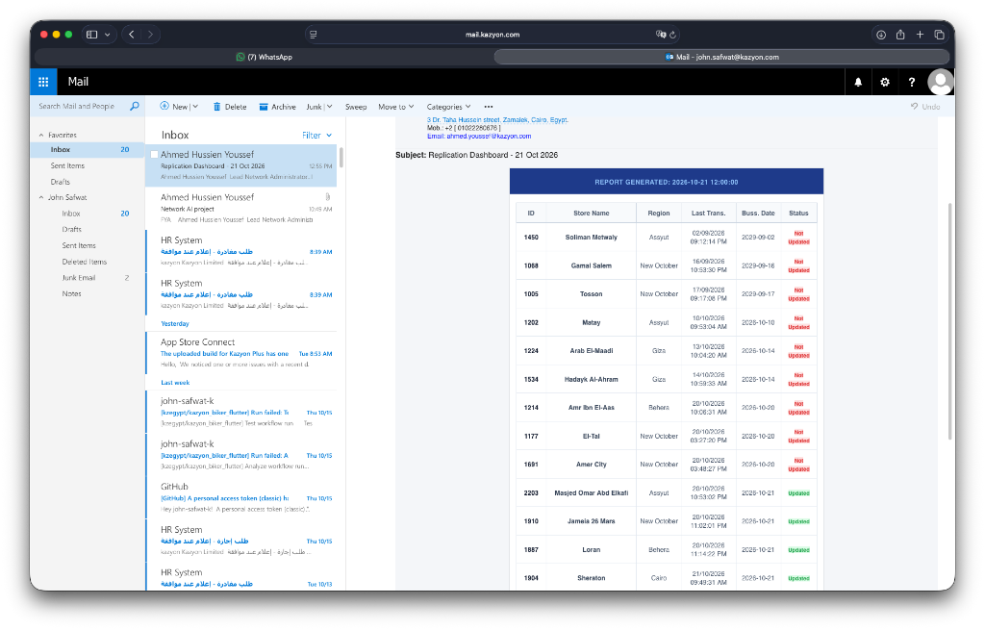
STEP 12 · PRODUCTION DATA VERIFICATION
KAZYON NETOPS · AI HARNESS
Real Production Email Samples & Golden Suite (63+ .eml)
Decryption of Info/*.eml & plans/assets/ — Verified against real Kazyon Replication reports and NOOR/ORANGE/WE threads.
DATASET 1
Corporate Replication HTML Reports
● ● ● LIVE RUNNING SYSTEM · replication_dashboard_sample.png
Live Format Match: Parses real Kazyon 'Replication Dashboard - <Date>' emails with store IDs, regions, and 'Not Updated' badges.
Automated Action: Converts 'Not Updated' rows into AWAITING_REGIONAL_IT tickets and notifies Regional IT.
DATASET 2
63 Real NOOR, ORANGE & WE Threads
NOOR NOC Threads: Tested on 'Case No_ 244010 - KAZYON - 1021- El Geish' initiation, update, and closure mails.
ORANGE & WE Threads: Tested on 'RE_ store 1800 # QUO1-10317348.eml' and 'Re_ [Request ID _##RE-8407532##]'.
DATASET 3
1,150-Store Master Excel Sheet
Production Topology: Seeded directly from 'Info/Copy of All store ISP (2).xlsx' across NOOR (906), ORANGE (181), and WE (63).
LIVE STATE: Actual Kazyon corporate webmail ('Replication Dashboard - 21 Oct 2026') parsed alongside 63 real ISP .eml threads.
IT Network Support AI Agent & Ticketing System · Step-by-Step Sequence & Live Console
Slide 16 / 17

Slide 17
COMPLETE SYSTEM REFERENCE MATRIX
KAZYON NETOPS · AI HARNESS
All 12 Console Screens, Screenshots & REST/WebSocket Endpoints
End-to-end mapping of every UI view, live screenshot, and governed backend endpoint.
CONSOLE SCREEN
LIVE SCREENSHOT
PRIMARY API / WS ROUTES
SUMMARIZED ROLE IN SEQUENCE
Page 1 · LoginView.tsx
page_01_login.png
POST /api/v1/auth/login, GET /api/health
JWT sign-in, DEV :8085 / PROD :8084 selector & health probe
Page 2 · DashboardView.tsx
page_02_dashboard.png
GET /api/v1/dashboard/summary
4-service health bar, 5 KPIs, ISP/Region/MTTR charts & watchlist
Page 3 · KanbanBoardView.tsx
page_03_kanban_board.png
GET/POST/PATCH /api/v1/tickets, /ws/tickets
8-column Kanban board, SLA timers, IP1/IP2/4G pills & drag-drop
Page 4 · TicketsListView.tsx
page_04_tickets_list.png
GET /api/v1/tickets (6 filter params)
Master incident table, 6-filter bar, MTTR & CSV/Excel export
Page 5 · TicketDetailView.tsx
page_05_ticket_detail.png
GET /api/v1/tickets/{id}, /reply, /rerun-diagnostics
360° view: Timeline, Vision & CLI logs, Branch vs ISP threads
Page 6 · ReplicationMonitorView.tsx
page_06_replication_monitor.png
GET /api/v1/replication/reports, POST /parse
Parses Replication HTML reports, deduplicates & emails Regional IT
Page 7 · HumanReviewView.tsx
page_07_human_review.png
GET /api/v1/escalations, /approve-action
Out-of-flow blockers (QUOTA, MSAN, LOOP_GUARD) & approvals
Page 8 · MailboxTriageView.tsx
page_08_mailbox_triage.png
POST /api/v1/emails/trigger, /simulate-eml
10-step role-play loop harness, 65 Info/*.eml samples & triage log
Page 9 · DiagnosticsSandboxView.tsx
page_09_diagnostics_sandbox.png
POST /api/v1/diagnostics/run, /run-suite
Single-branch Dual-Ping + 4G Traceroute & 1,150-store fleet suite
Page 10 · DirectoryView.tsx
page_10_branches_isps.png
GET/POST /api/v1/branches, /seed-excel, /isps
1,150-store & 3-ISP directory, IP derivation & Excel bulk seeder
Page 11 · UsersRbacView.tsx
page_11_users_rbac.png
GET/POST/PUT /api/v1/users, /api/v1/roles
Users & roles management + interactive 8×5 permission matrix
Page 12 · SettingsView.tsx
page_12_ai_sla_settings.png
GET/PUT /api/v1/settings, /test-smtp, /test-vllm
Global AI Kill-Switch, Approval Mode, encrypted SMTP & SLAs
IT Network Support AI Agent & Ticketing System · Step-by-Step Sequence & Live Console
Slide 17 / 17

