Slide 1

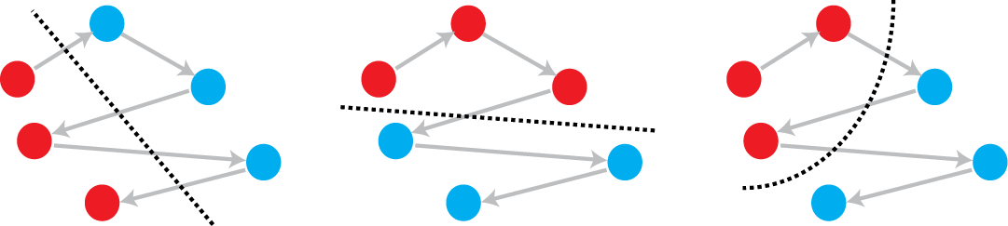
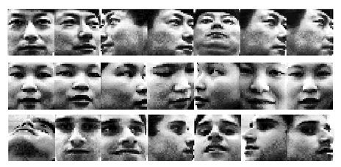
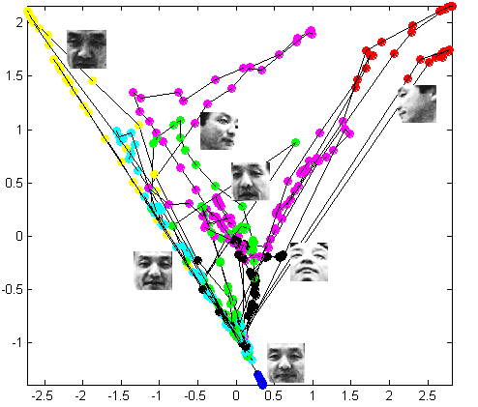
Exemplar Extraction using Spatio-Temporal Hierarchical
Agglomerative Clustering for Face Recognition in Video
Spatio-temporal HAC
  Proposed: Effective selection of exemplars by incorporating spatio-temporal information for clustering of training data
  No temporal consideration in most video-based FR using training exemplars
2 variants: Global fusion & Local perturbation
  Global method → Blends contribution of spatial and temporal distances
  Local method → Applies perturbation of spatial and temporal distances based on local neighborhood relationships
Performance & Analysis
  Outperform conventional exemplar selection methods (k-means, HAC) on tested features
  Promising results underline importance of both spatial and temporal relationships between image frames in video
John See and Chikkannan Eswaran
Faculty of Information Technology, Multimedia University, Malaysia
Poster ID:
1-18

