Slide 1

THE ICE"BREAKER"
Scan the QR Code to Begin
Notes:
50 SECONDS. SAY: "These two questions sound like the same question. Most risk dashboards treat them as the same question. Our project is essentially a test of whether that assumption holds." Point at the 0.05 card, tell them to remember it, it comes back at the end.
The core finding is that structural fragility and growth direction are different, nearly independent properties of a trade route — we measured that rather than assuming it — so a decision-maker needs both lenses, because each one catches what the other misses. IF RUNNING LONG: cut the disruption-events sentence.

Slide 2
Global Trade: Risk & Direction
Where are we exposed, and where are we heading?
[ Naga, John, Juan ]
Notes:
20 SECONDS. SAY: "We built two tools that answer two different questions about global trade risk, and then we tested whether they agree. They don't, and that turned out to be our most important finding." Do NOT read the title aloud. Hook, names, move on.

Slide 3
THE PROBLEM
Two questions that sound like one question
Is this route structurally fragile?
Which direction is it heading next year?
Backward-looking: concentration, volatility, industry exposure
Forward-looking: next-year trade growth forecast
$5.4T
47%
0.05
Trade value, latest year (2024)
Forecast error reduction vs. baseline
Correlation between the two lenses
Trade disruptions are becoming more common: 1–2 per year before 2015, 9 in 2024.
Most risk tools combine both questions into one score. We tested whether that's safe to do
Notes:
50 SECONDS. SAY: "These two questions sound like the same question. Most risk dashboards treat them as the same question. Our project is essentially a test of whether that assumption holds." Point at the 0.05 card, tell them to remember it, it comes back at the end.
The core finding is that structural fragility and growth direction are different, nearly independent properties of a trade route — we measured that rather than assuming it — so a decision-maker needs both lenses, because each one catches what the other misses. IF RUNNING LONG: cut the disruption-events sentence.

Slide 4
DATA & METHOD
Five datasets merged, then split by time
5 linked datasets merged: trade flows, shipping rates, commodity prices, disruption events, industry vulnerability​
1,250 rows = 50 corridors × 25 years, a complete panel with zero missing corridor-years​
Target variable is NEXT year's growth, so every predictor is information available at decision time
TRAIN
VALIDATE
TEST
2000–2019
2020–2021
2022–2023
1,000 observations
COVID shock
energy shock
time →
Both evaluation windows are deliberately shock periods.
HOW THE PANEL WAS BUILT
Trade flows
Shipping
Commodities
Disruptions
Industry
MASTER PANEL
1,250 rows · 58 columns
Data source: Kaggle
Notes:
60 SECONDS. SAY: "We split chronologically, never randomly, a random split would leak the future into training. And notice both evaluation windows are shock periods. We made this hard on ourselves on purpose."

Slide 5
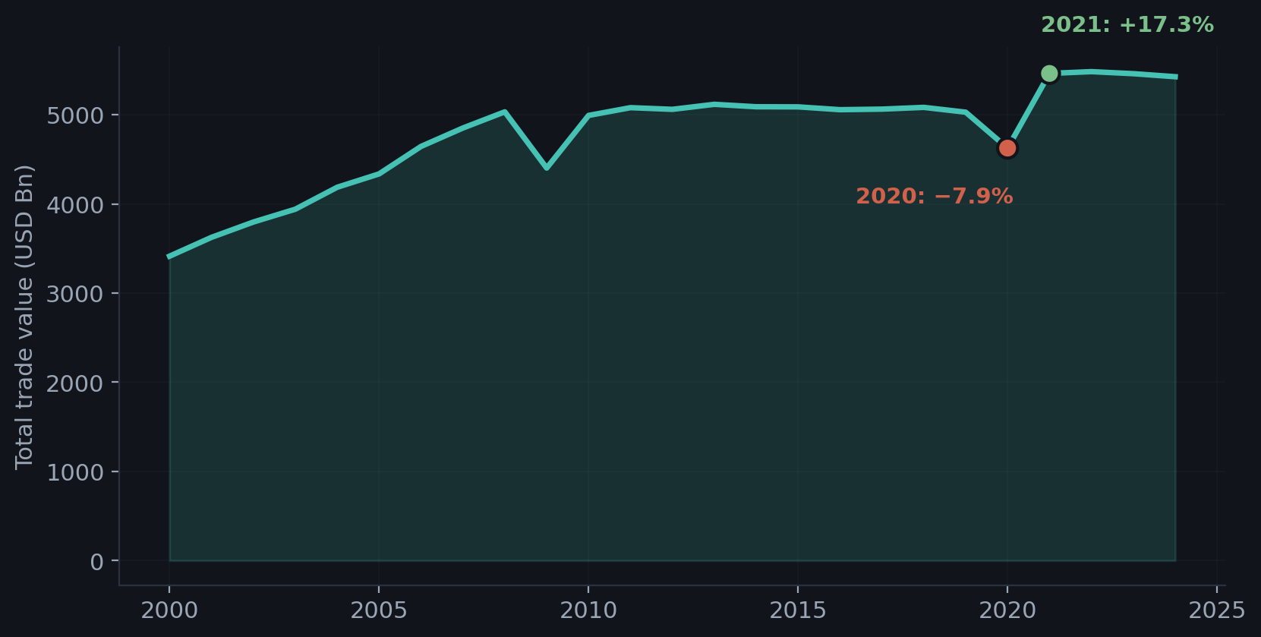
EXPLORATORY ANALYSIS
Trade Grows Steadily (Most of the time)
+0.233
Supply-chain pressure vs. growth: weak and positive
−68% → +217%
Russia → EU, 2022 then 2023
WHY THAT CORRELATION IS POSITIVE, NOT NEGATIVE
2021 had the worst congestion and the strongest growth. A global index can't tell you if one corridor is in trouble
Notes:
John
So can you just watch a global stress indicator to know which routes are in trouble? We tested it. The correlation between supply-chain pressure and trade growth is weak and it's actually positive. Meaning that higher pressure actually came with higher growth!
That's 2021: worst port congestion on record, strongest growth in the dataset, because the congestion was caused by the rebound. A global index can't tell you if one specific corridor is in trouble. That's why we built corridor-level tools.
And remember Russia to EU — down 68%, then up 217%. It comes back."

Slide 6
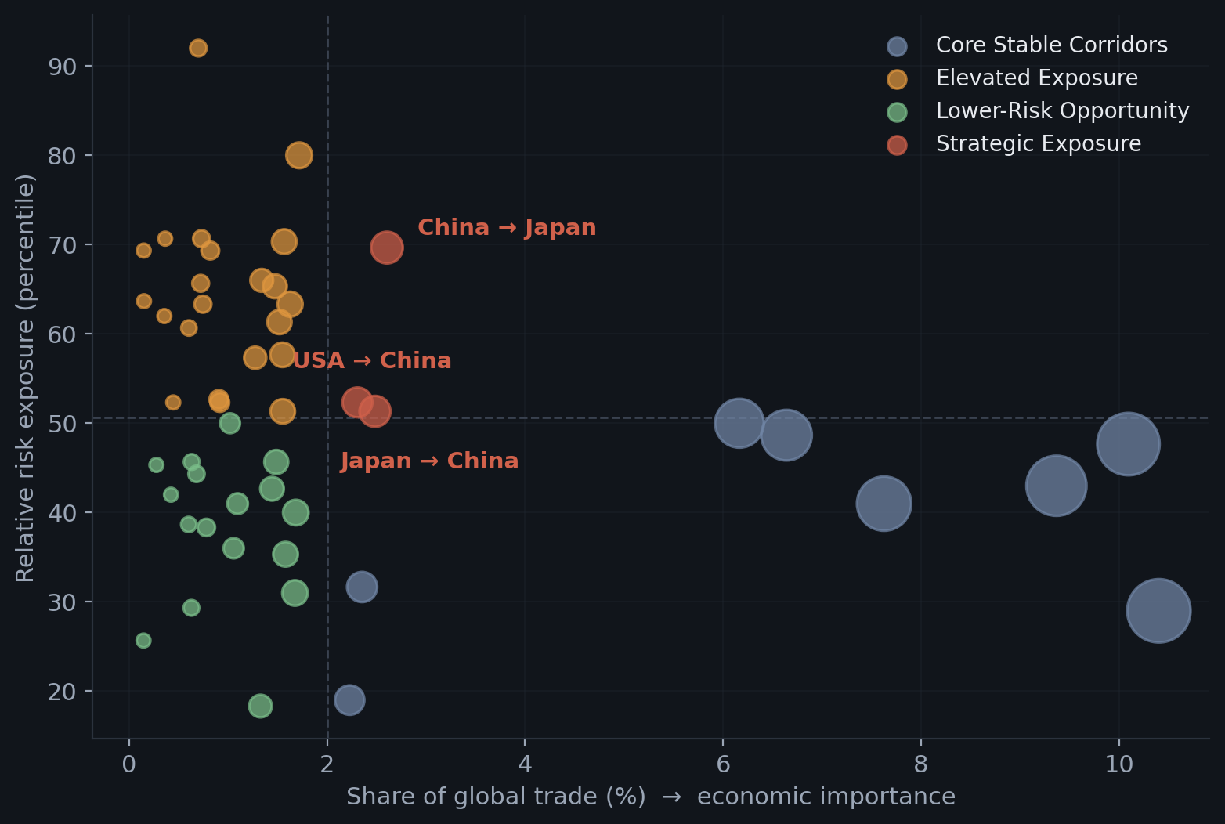
LENS 1: BACKWARD-LOOKING
Structural exposure: which routes are fragile now
Five binary risk flags → 0–5 score
Negative growth · negative momentum · high volatility · high concentration · high industry vulnerability. Thresholds are data-driven percentiles, not hand-picked.
Core Stable
8
Elevated Exposure
22
Lower-Risk Opportunity
17
Strategic Exposure
3
3 of 50 corridors are both systemically important AND structurally risky. $401B of trade.
Notes:
90 SECONDS. Second-most important slide. SAY: "This is a rule-based scorecard and we're explicit about that, it works the way credit-risk traffic-light systems work. Three corridors sit in the danger quadrant: China to Japan, Japan to China, and USA to China. That's $401 billion of trade that's both systemically important and structurally fragile." WALK TO THE SCREEN and point at the three red dots as you name them. DO NOT read the five flags aloud, say "five flags" and move on.

Slide 7
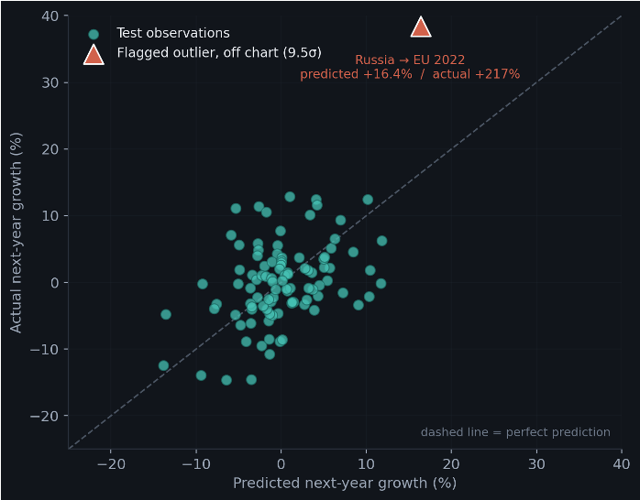
LENS 2: FORWARD-LOOKING
Growth direction: 47% better than the baseline
6.75
60%
Test MAE vs. 12.71 naive baseline
Directional accuracy on test set
Which model won? Gradient Boosting beat Ridge, Random Forest and a naive "next year repeats this year" baseline
Each route's own recent history predicts better than global indicators
All figures are TEST-set performance, not validation
Notes:
John
90 SECONDS SAY: "Our forecasts are typically off by about 6.7 percentage points, versus 12.7 if you just assume next year looks like this year — a 47% improvement."
THEN, on 60%: "We also get the direction right 60% of the time. Better than a coin flip, not reliable — which is why Slide 8 calls these directional guidance, not commitments."
THEN, on the second bullet: "The features that actually carried weight were each route's own recent history — how fast it's growing, how big it is, whether growth is speeding up or slowing down
POINT AT THE TRIANGLE: "That's the Russia to EU corridor I mentioned — our one big miss. We predicted 16%, it came in at 217%. It's off the top of the chart. One observation out of a hundred, and I'll come back to what it does to our error."
If asked about R²: it's 0.127, distorted by that single outlier. MAE is the metric we trust. Backup 03 has the numbers.

Slide 8
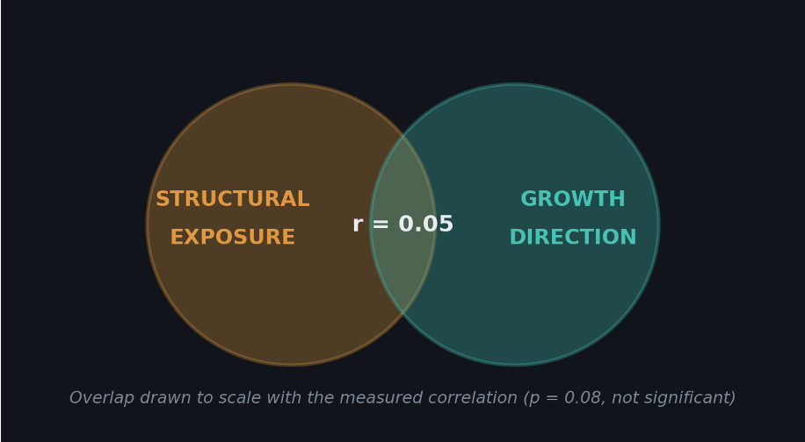
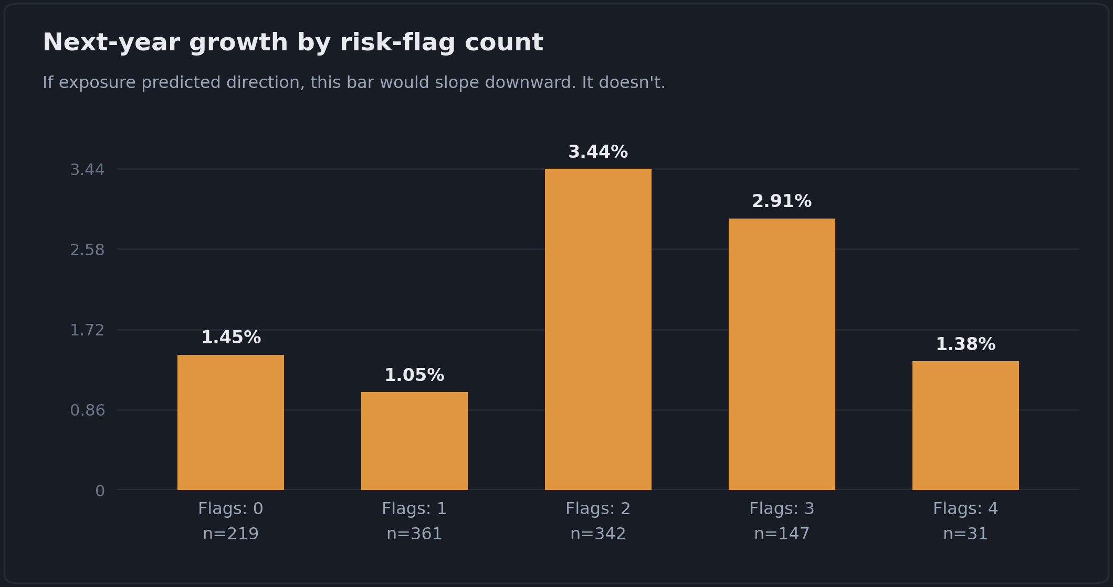
THE KEY FINDING
Structural exposure ≠ growth direction
ρ = 0.05
39%
16%
1,100
Spearman correlation: no significant relationship
Precision flagging a contraction
Recall: contractions actually caught
Historical corridor-years tested
The two lenses are complementary, not redundant. That is now measured, not assumed.
Notes:
120 SECONDS. THIS IS YOUR BEST SLIDE. SLOW DOWN. SAY: "We built this test ourselves, and the honest answer is no. Our own risk scorecard does not predict which corridors will shrink. That's not a bug we're confessing, it IS the finding. Exposure tells you where a shock would hurt most. The model tells you which way trade is moving. Those are different jobs, and collapsing them into one number would have given a false sense of security." Point at the bar chart: "If exposure predicted direction, this would slope downward. It doesn't." THEN PAUSE. Two full seconds of silence. NEVER CUT THIS SLIDE.

Slide 9
RECOMMENDATIONS & LIMITATIONS
What we'd tell a stakeholder, and what we wouldn't claim
RECOMMENDATIONS
LIMITATIONS
For executives
Small test window
Two lenses, two jobs
n = 100, across two years only.
Never blend them into one score.
One shock dominates
Prioritize the three
Russia to EU, 2022: a 9.5σ residual.
Strategic Exposure corridors get resourced first.
MAE over R²
Forecasts are directional
R² is unstable at this sample size.
A heading, not a commitment.
Features dropped
Shipping and commodity columns never entered.
For analysts
Distrust self-reported importance
Permutation-test on held-out data.
OUTLIER SENSITIVITY | MAE | RMSE
All test observations | 6.75 | 20.90
Excluding the one shock | 4.80 | 6.05
Validate before claiming
Test any risk score against real outcomes.
Two tools, tested against each other, not just against themselves.
Notes:
80 SECONDS. Lead with recommendations, then state limitations BEFORE anyone asks. It preempts the hardest Q&A. Read only the bold headers aloud and expand from memory. Do not read both lines of every row. CLOSE ON: "Two tools, tested against each other rather than just against themselves. Exposure is not direction, and that is now measured, not assumed." Then STOP. Do not add "so yeah, that's our project."

Slide 10
Questions
Thank you!
Notes:
Do not present the backup slides. Pull them up only if asked.

Slide 11
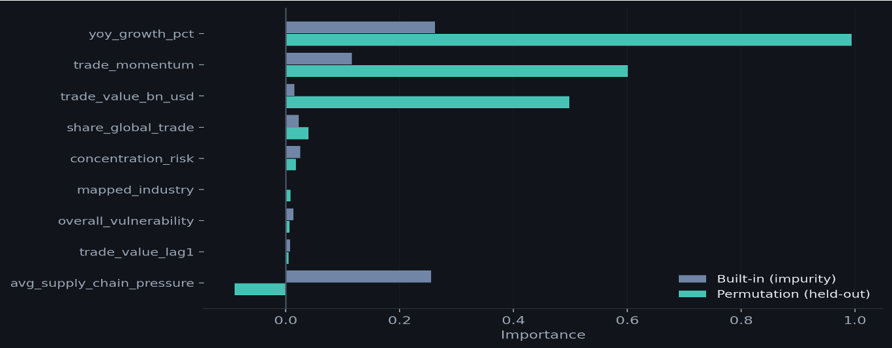
BACKUP 01 · WHY WE DISTRUST THE MODEL'S SELF-REPORT
BACKUP · NOT PRESENTED
Feature importance: built-in vs. permutation
Built-in (impurity) importance measures how often a feature was USED in training; permutation importance measures whether shuffling it HURTS predictions on unseen data
avg_supply_chain_pressure: 25.6% built-in importance, but −0.09 permutation, because it is a year-level variable identical across all 50 corridors
Notes:
Answer to: "How do you know which features mattered?" Key line: the model was memorising years, not learning corridor behaviour.

Slide 12
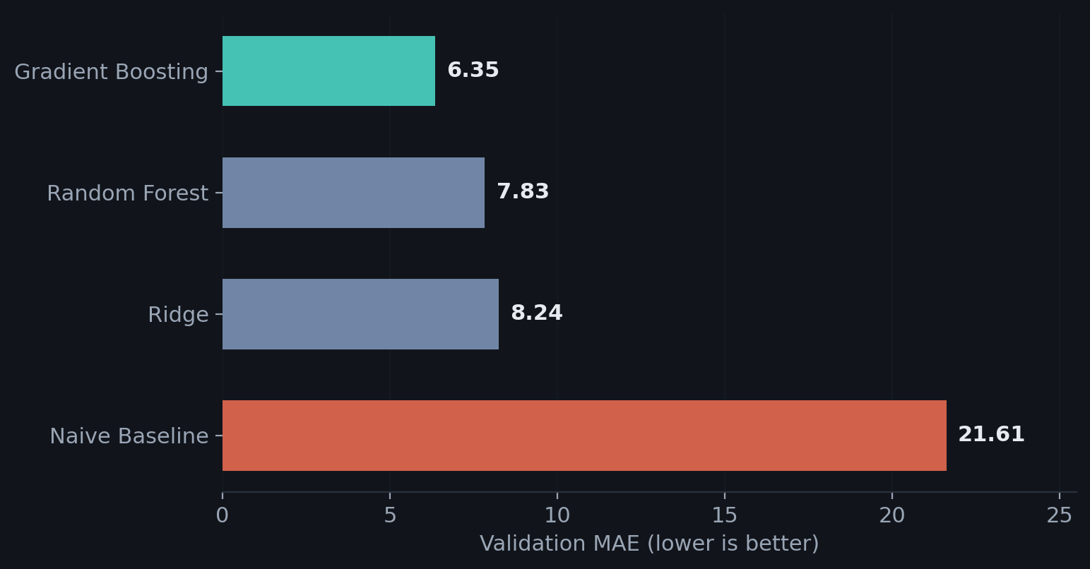
BACKUP 02 · WHY GRADIENT BOOSTING
BACKUP · NOT PRESENTED
Model selection: validation MAE
Selection was made on the 2020–2021 validation window only; the 2022–2023 test set was untouched until final evaluation
Hyperparameter search: a time-series-aware randomized search scored WORSE (MAE 7.08) than the hand-picked configuration (6.35), so performance is not riding on a lucky parameter guess
Notes:
Answer to: "Why this model?" and "Did you tune it?" The tuning result is reassuring, not a failure, it shows the config is near the sweet spot for this dataset size.

Slide 13
BACKUP 03 · THE R² QUESTION
BACKUP · NOT PRESENTED
Outlier diagnostics: one shock drives the error
 | MAE | RMSE | R²
Test: all 100 observations | 6.75 | 20.90 | 0.127
Test: excluding the flagged outlier | 4.80 | 6.05 | -0.060
9.5σ
1 of 100
+217%
Standardized residual, Russia → EU 2022
Test observations flagged as outliers
Actual growth vs. +16.4% predicted
R² becomes LESS stable after removing the outlier, not more. Once the highest-variance row is gone there is little variance left to explain, so MAE and RMSE are the reliable numbers.
Notes:
Answer to: "Your R² is only 0.127, isn't the model bad?" SAY: MAE is the metric that matters for a decision tool. R² is distorted by a single 9.5σ sanctions shock. Excluding it, MAE drops to 4.80. We report both rather than hiding the outlier.

Slide 14
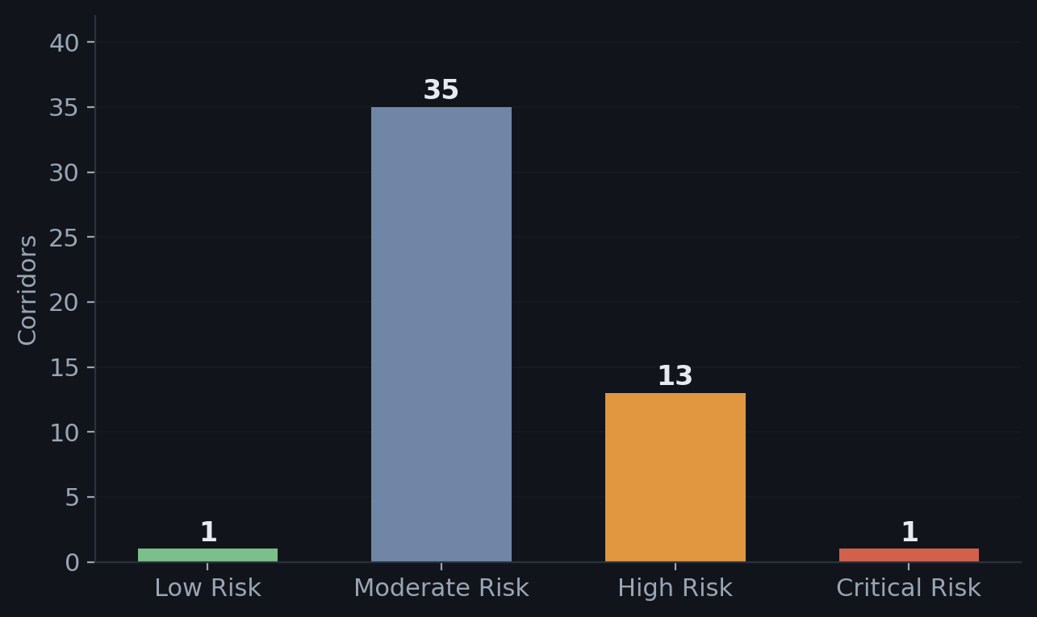
BACKUP 04 · THE SCORECARD OUTPUT
BACKUP · NOT PRESENTED
Risk category distribution
1 Critical Risk corridor (4+ flags): Sweden → EU. 13 High Risk corridors, up from 7 under the old momentum definition
Crossing risk with economic importance yields the action: Immediate Attention (5) · Protect and Maintain · Monitor or Diversify · Observe
Notes:
Answer to: "What did the scorecard actually output?"

Slide 15
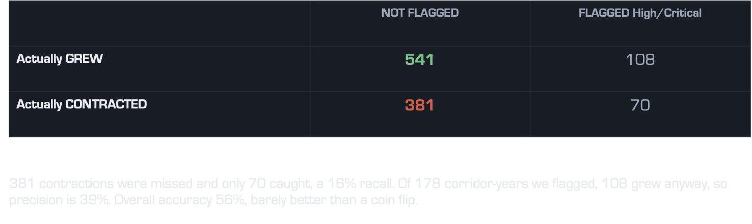
BACKUP 05 · VALIDATING THE SCORECARD
BACKUP · NOT PRESENTED
Confusion matrix: risk flag vs. actual contraction
This is why the framework is presented as a structural exposure monitor, not a growth forecaster.
Notes:
Answer to: "How exactly did you test the risk framework?" Rows = actual outcome, columns = whether we flagged High/Critical Risk. 1,100 historical corridor-years with known next-year outcomes.

