Slide 1
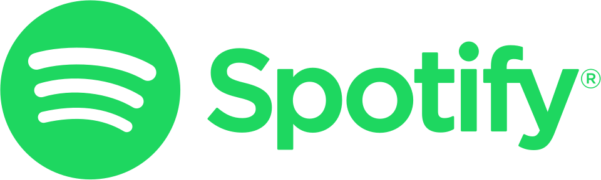
What Predicts Spotify Streams?
Most Streamed Spotify Songs 2023
John Young | MKT 282 Marketing Analytics
Notes:
I looked at the most streamed songs on Spotify in 2023, and I asked among songs that are ALREADY hits, what predicts
how much they get streamed?
Two possibilities.
What the song sounds like
Or how many playlists it is on

Slide 2
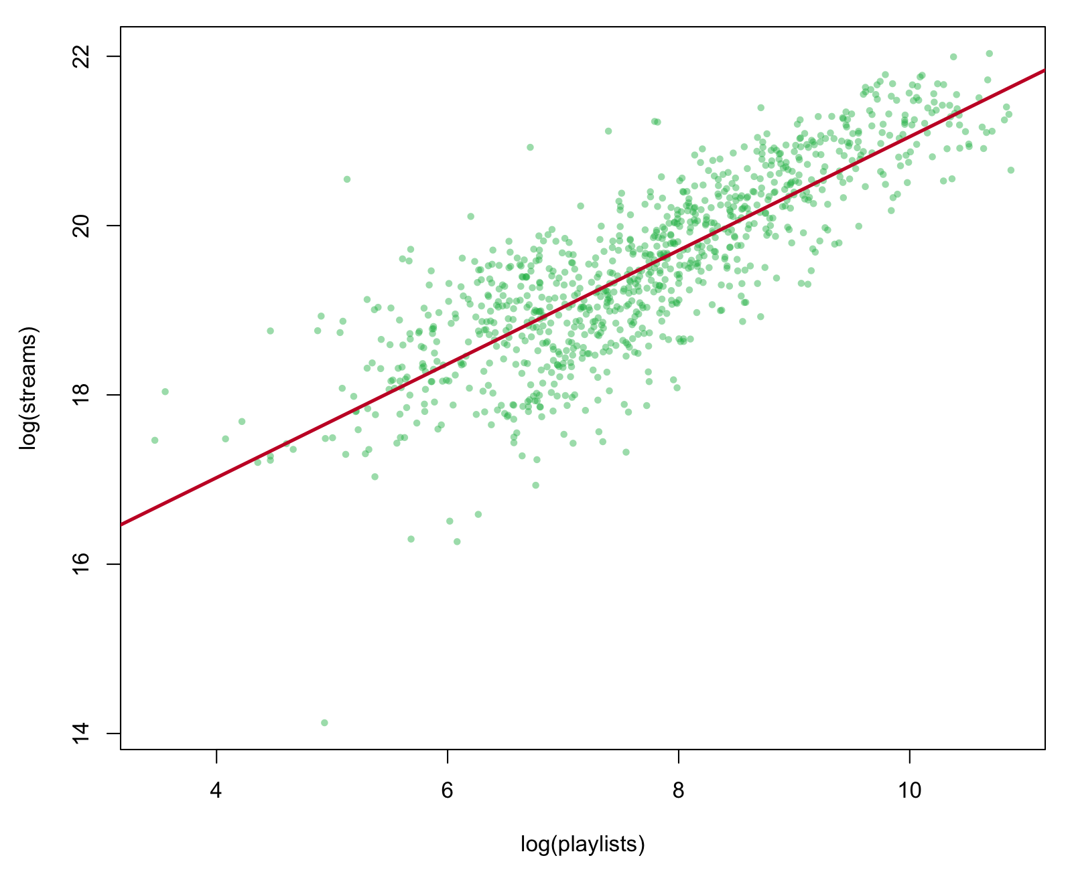
What you need to know…
Playlist count explains 68% of streaming variance. How the song sounds adds 0.09%.
Song characteristics = danceability, energy, valence
Source: Most Streamed Spotify Songs 2023 (Kaggle), n = 951
Notes:
Playlists win. It isn't close.
One variable - how many playlists a song is on - explains 68% of the variation in streams.
Add danceability, energy, and valence on top of that, and you go from 67.95% to 68.04%.
Three measures of what the song actually SOUNDS like. They buy you only nine hundredths of one percent.
- Green block = playlists
- The navy blue sliver you can barely see = everything about how the song sounds

Slide 3
How I did my analysis…
DV: Spotify Streams (log)
Most Streamed Spotify Songs 2023, Kaggle
951 songs after removing 2 broken rows
IVs:
Spotify Playlist Count (log)
Danceability %
Energy %
Valence %
Model: OLS linear regression
Predictor | b | p | β
Spotify Playlist Count (log) | 0.672 | <.001 | .83
Danceability | 0.00003 | .986 | .00
Energy | −0.0016 | .206 | −.03
Valence | 0.0013 | .196 | .03
Playlists alone: R² = 67.95%
Playlists + Song Characteristics: R² = 68.04%
Song Characteristics only add 0.09%
log(streams) = β₀ + β₁log(playlists)
+ β₂dance + β₃energy + β₄valence
Limitation: dataset does not show playlist type: Spotify-curated or user-created.
Notes:
Dependent variable is streams, logged. 951 songs after I removed two records with corrupted stream counts.
Predictors: playlist count, logged, plus the three audio features.
Because both sides are logged, that 0.672 reads as an elasticity - a 10% increase in playlists, about 6.7% more streams.
If you look at the p-values, only log of playlists is significant.
CLOSER
I can't prove playlists cause the streams. It could go the other way. But either way, it isn't the song."
------------------------------------------------------------------------------------------------------------------------------------------------------------------------------------------------------------
POTENTIAL QUESTIONS
Q: "Why don't audio features matter at all?"
A: "Every song in this dataset is already a hit. Audio features may have mattered a lot in deciding which songs got here, but once you’re a hit the song sounds doesn’t separate the big hits from the modest ones.”
Q: "Doesn't causation run both ways?"
A: "Yes. Playlists drive streams, and streams drive playlist adds.
This is correlational either way - but the variance lives in
playlists, not in how the song sounds."
Q: "Maybe audio features are just crowded out by playlists?"
A: "On their own, with playlists out of the model entirely, they
explain 0.77%. They're not crowded out. There's nothing there."
Q: "Could song attributes work indirectly, through playlists?"
A: "I checked. Audio features explain about 1% of playlist placement. Not directly, not indirectly."
Q: "What about tempo?"
A: "Tested it. Adds 0.02%, and adjusted R-squared goes down."
Q: "So playlists are the best promotional investment?"
A: "I only compared playlists against the song itself. I never tested
radio, TikTok, or sync. Can't tell you how it stacks up against those."
Q: "Isn't this just older songs having more time to accumulate?"
A: "Controlling for release year, the effect actually gets slightly
stronger - 0.672 to 0.684."

