Slide 1
Portfolio

Slide 2
Typography
Roboto
Metropolist
Montserrat

Slide 3




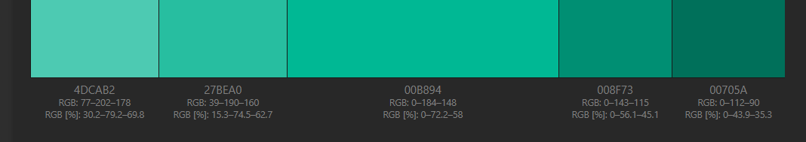

Color
#E9896A
#387C6D

Slide 4
What is it for?
To show case my experience and the portfolio

Slide 5
Pages
About
Profile picture
Short introduction
Portfolio
3-4 projects
Github
Demo
Contact page
Form and social media link
Introduction page
Software developer page

Slide 6
How to attract prospect?
Animate
Color
Clean
Make use of technology and framework

Slide 7
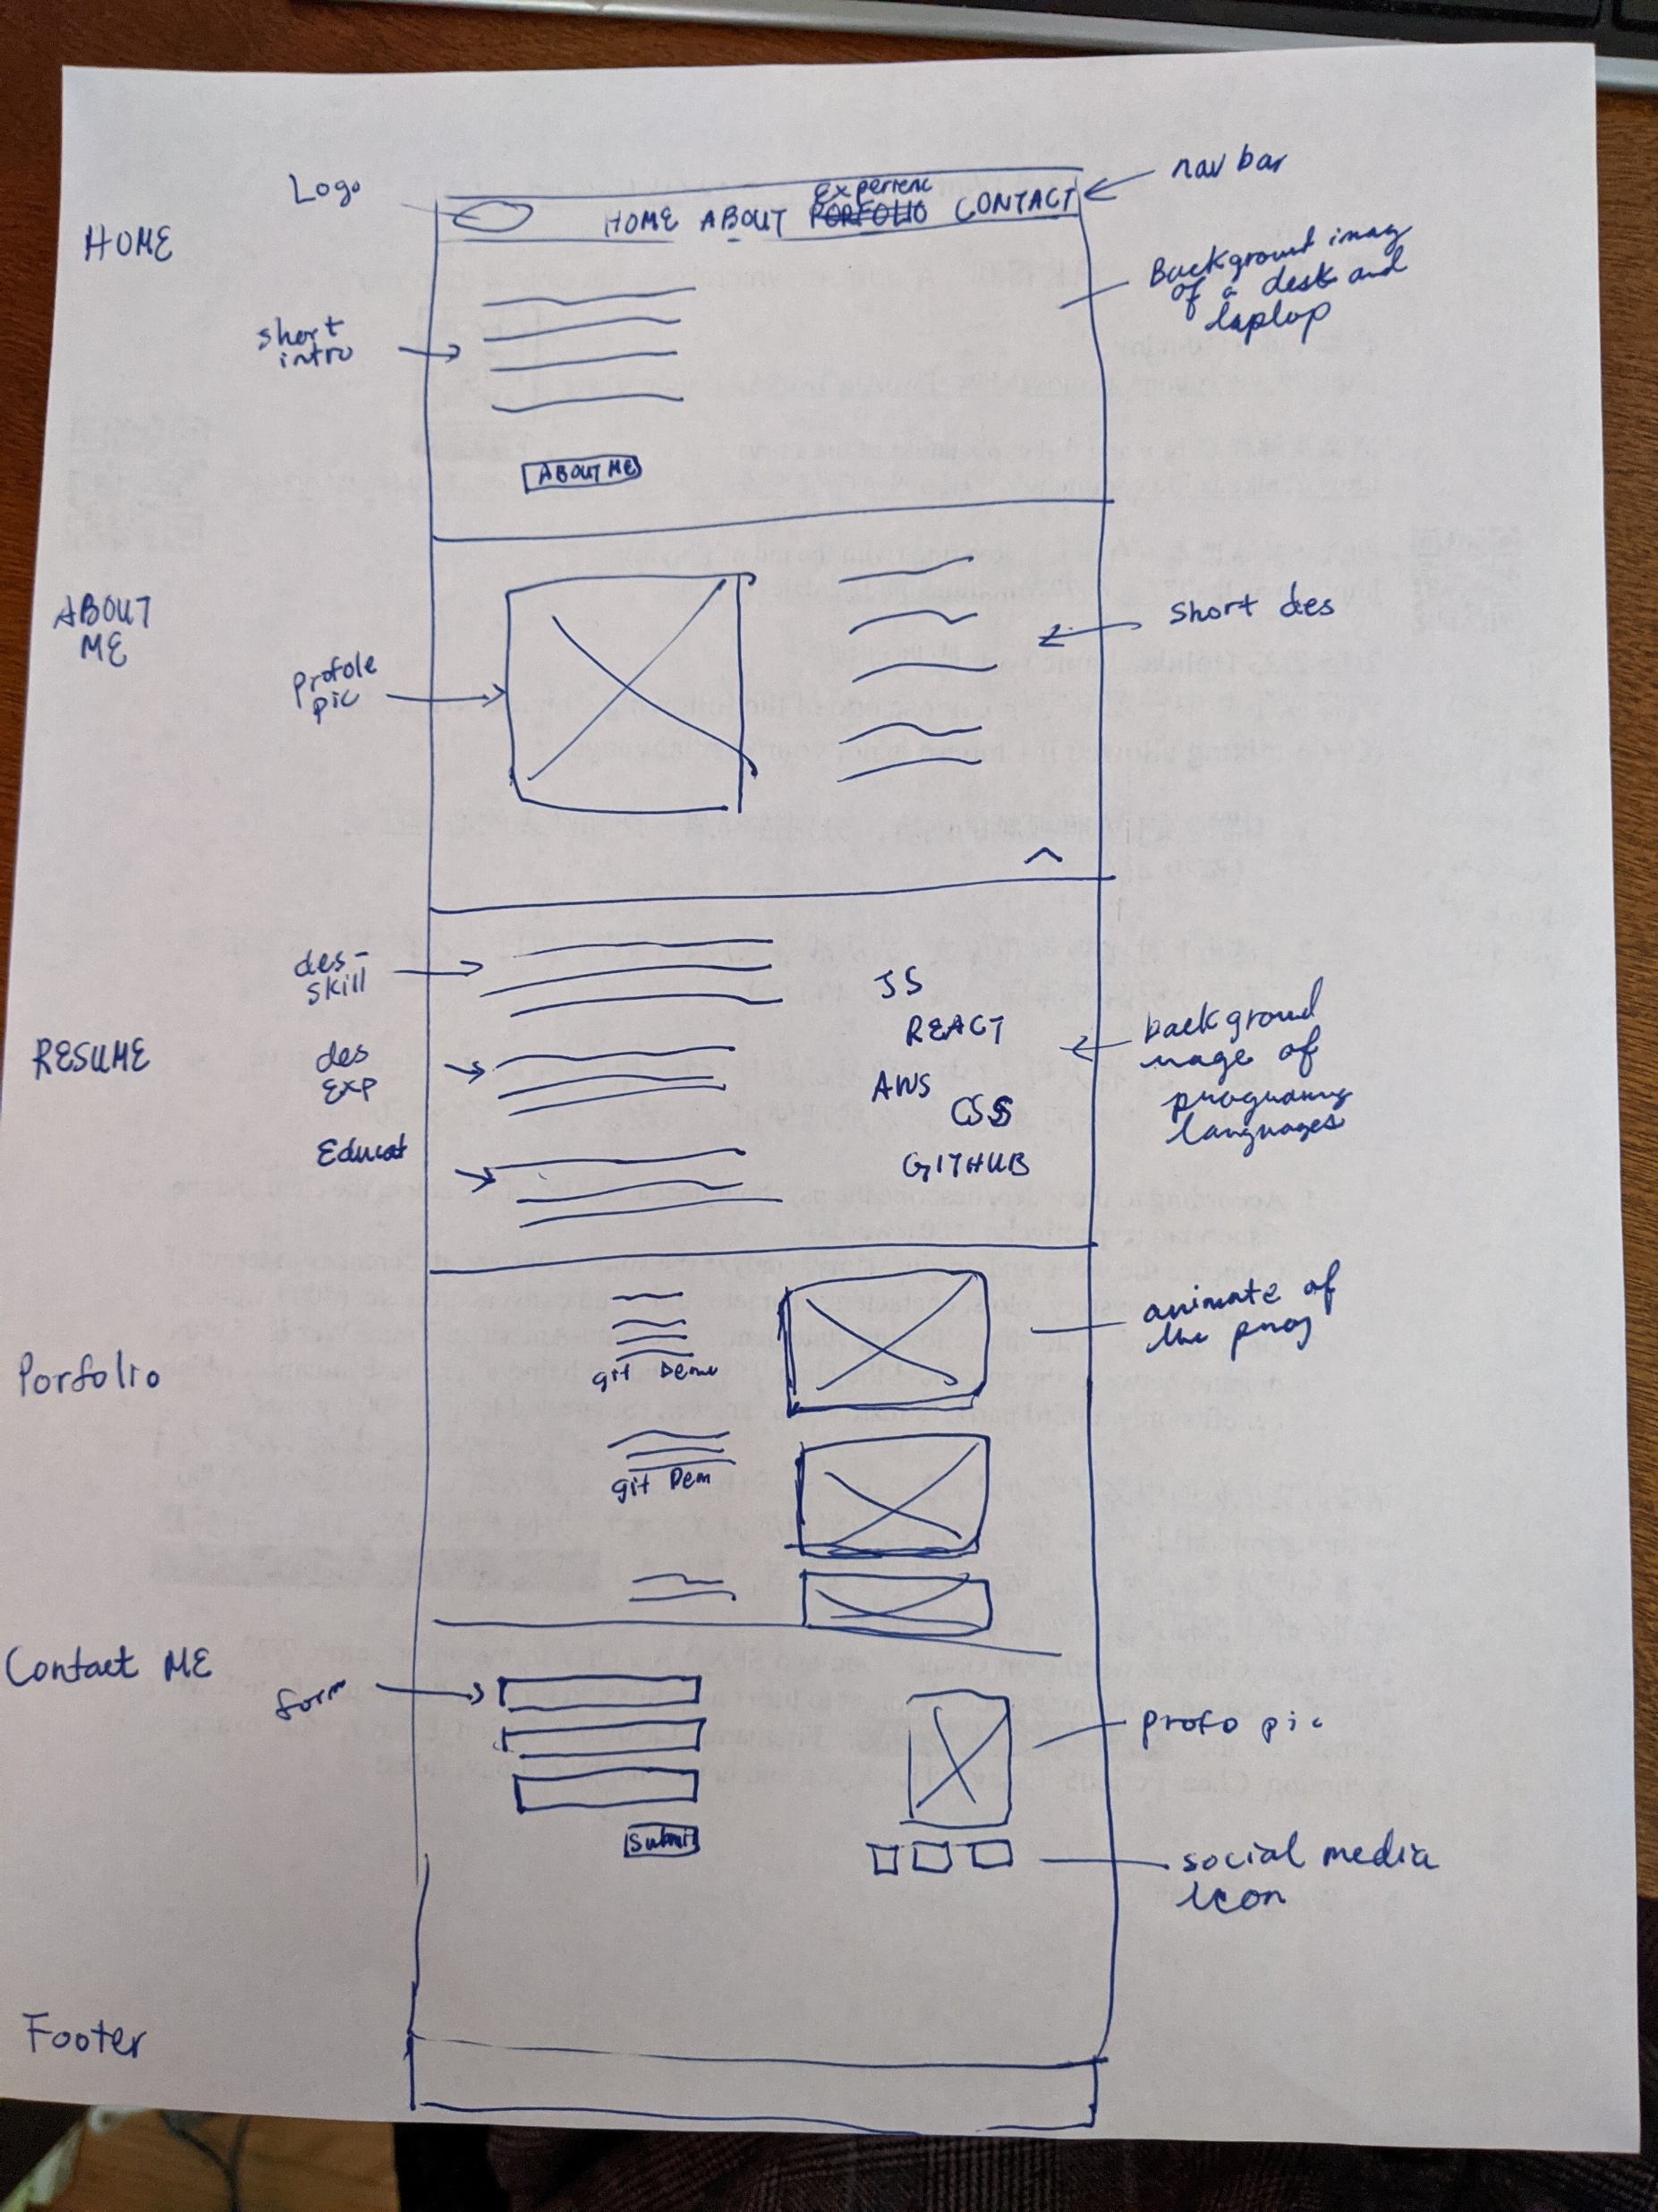
Wireframe

