Slide 1

The new Linux in town
Nitro5 Linux

Slide 2

Step 1: Getting an Linux OS.
You know about Linux so there are MANY DISTROS. Well, there is the new Linux in town, Nitro5 Linux. Also called N5, it is not there yet. It will be created soon but suprisingly, it was created on a VM.
Stats are on next slide.

Slide 3

Stats
Nitro5 is built on Ubuntu latest.
Nitro5 is created in a VM.
Nitro5 has its own cheat-sheet.
Nitro5 has a readme.

Slide 4
Step 2: GOING WILD ON APPS.
Going wild on apps helps the OS be better so we will have to suggest and collaborate.
Please note that you can use it to make a OS but will remove space on the disk.

Slide 5

Making an operating system is like discovering an new exoplanet
Linux is hard to code and making it is hard like finding exoplanets. Instead install hardware on it.

Slide 6
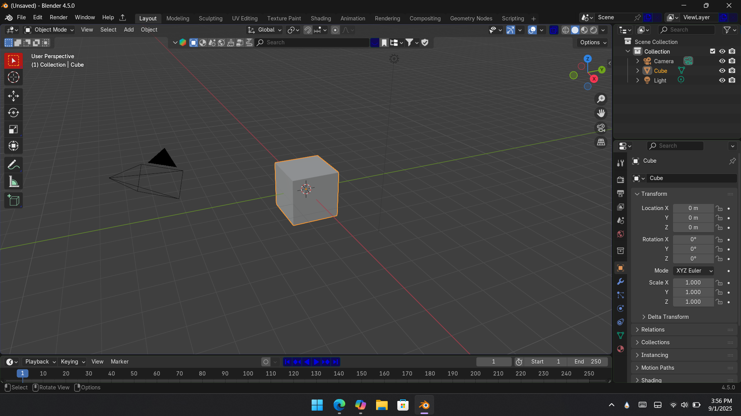
Thanks for listening to this presentation
Bye!

