Slide 1
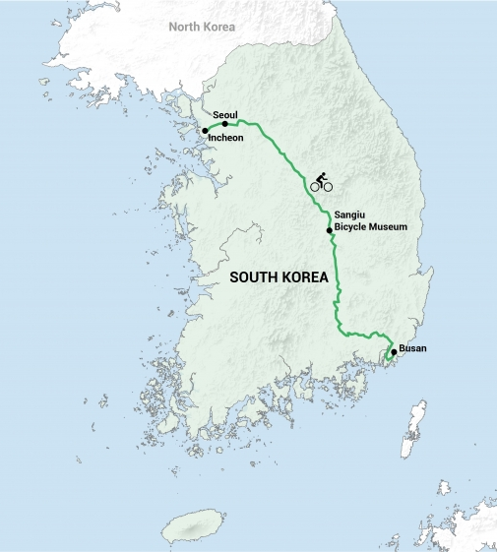


Namhanggang River
Ara Bike Trail
Saejae Bike Trail
Nakdonggang River

