Slide 1
Widget简介及基本开发方法

Slide 2
Widget (微件)
是一块可以在任何基于HTML的Web页面上执行的代码，表现形式可能是视频，地图，新闻，小游戏等。

Slide 3
Widget起源
Widget的创想来苹果公司电脑工程师Rose
  1998年，Rose在Mac操作系统使用一个可以更换皮肤的MP3播放器时突发奇想：如果桌面上运行的所有工具都能够更换皮肤或外观，将是很酷的事情，他称之为“Konfabulator”
Notes:
Rose在Mac操作系统使用一个可以更换皮肤的MP3播放器时突发奇想

Slide 4
2003年2月Konfabulator1.0正式发布
  运行在苹果操作系统上的小工具
  其中的主执行文件叫Widget
2003年7月Konfabulator1.5发布
  主执行文件Widget的开发开始流行，Konfabulator更名为Widget
2004年11月Widget1.8发布
  Widget支持Windows和Mac操作系统

Slide 5
Widget的主要特征
--《网络整合营销兵器谱》
身材微：一般尺寸很小，方便嵌入终端快速运行
功能巨：Widget能够主动从互联网获取信息
形式多：Widget有多种呈现形式，如幻灯秀、视频、地图、新闻、小游戏……
姿容丽：Widget将狭窄单调的浏览器窗口变为广阔绚丽的桌面空间
个性化：用户可以根据自己的喜好，将多个Widget重新排列组合成自己的互联网桌面
易制作： Widget制作简单，需要使用图像处理工具，具备HTML/XML和Java知识
Notes:
可以报告新闻、买东西、列出你最喜欢的乐队和最近看过的视频等
比如说一个由微件搭建个人空间，可以包括来自新浪的体育新闻，来自论坛的一个板块，来自权威财经网站的一则随时更新的股票信息——这些以往需要用户同时分别进入几个网站才能看到的信息，现在由一个个微件将其转变为用户个人空间的一部分，从而可以直接在同一个页面中并存。

Slide 6
Widget vs.普通网页
Widget 无需浏览器
  可以直接显示在桌面
Widget可以同时与多个Web服务器上的不同Web服务交互
Widget 有一个 widget 对象
  通过 JavaScript 调用该对象的函数
Widget 在本地有一个永久的存储空间
  类似于Cookies机制的保存设置和下载信息
Widget 通常有多个视图
  通过JavaScript/CSS 技术实现视图间的切换
Widget默认可以拖动
  可以指出不响应拖动的控制域
Widget默认背景是透明的
  Widget的透明部分不响应任何鼠标事件

Slide 7
典型Widget包含的文件
Widget 配置文件
  Widget 配置文件根目录，包含Widget的基本信息，如名称、尺寸、作者和安全信息。
首页文件
  类似于网页中的 index文件，给出Widget 的基本结构和内容。
图像
  所有图像文件都在名为 images 的文件夹中。
JavaScript 脚本文件
  所有脚本文件都在名为 script 的文件夹中。
Stylesheet 样式表文件
  所有样式表单都在名为 style 的文件夹中。

Slide 8
Widget开发的技术要求
Web相关技术的基础知识
Web 设计 IDE 软件或创建 JavaScript ，HTML 和 CSS 文件的文本编辑器
创建 .zip 文件的工具
发布Widget的网站

Slide 9
常见Widget
桌面Widget
  Yahoo! Widget
  Google Widget
  Opera Widget
    http://widgets.opera.com/
手机Widget
  Nokia Widget
  Samsung Widget
  JIL Widget
  Android Widget
社交网站Widget
  Facebook Widget
  人人网/开心网 Widget
  盛大 Widget

Slide 10
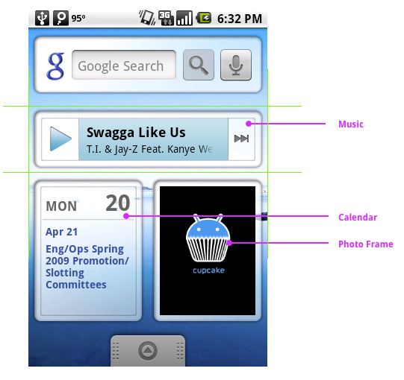

Slide 11
Android发展历史
2003年Android成立
2005年Google并购Android
2007年11月发布Android
2008年9月发布Android 1.0
2009年2月发布Android 1.1
2009年4月发布Android 1.5(Cupcake)
2009年9月发布Android 1.6(Donut)
2009年10月发布Android 2.0(Eclair)
2010年1月发布Android 2.1
2010年5月发布Android 2.2(Froyo)
2010年10月发布Android 3.0(Gingerbread)
？年？月发布Android 3.5(Honeycomb)

Slide 12
Android开发环境
开发环境
  Java运行时库(JRE)
  Android SDK 2.2
  Eclispe3.*
  ADT Plugin for Eclipse
Android API Reference链接
  http://androidappdocs-staging.appspot.com/reference/packages.html
将Widget添加到手机模拟器
  Menu->Add->Widget

Slide 13
Android Widgets
Widgets are a feature introduced in Android 1.5.
A widget displays an application's most important or timely information at a glance, on a user's Home screen.
Android widgets have three main components:
  a bounding box
  a frame
  the widget's graphical controls and other elements

Slide 14
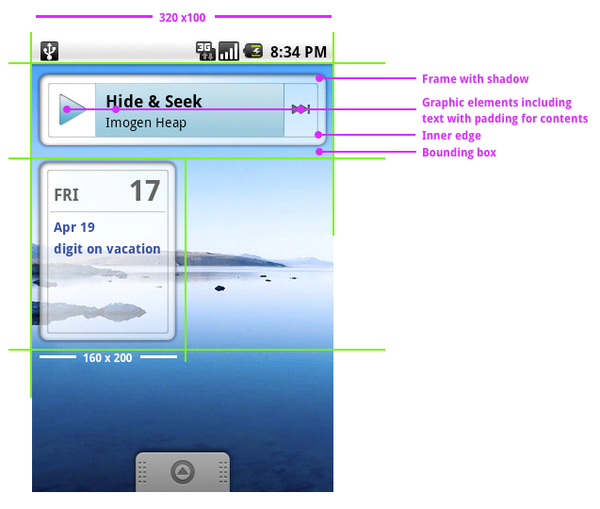

Slide 15
Android App Widgets
App Widgets are miniature application views that can be embedded in other applications and receive periodic updates.
  These views are referred to as Widgets in the user interface
  Users can publish Widgets with an App Widget provider.
An application component that is able to hold other App Widgets is called an App Widget host.

Slide 16
Basics of Android App Widgets
AppWidgetProviderInfo object
  Describes the metadata for an App Widget in XML, such as the App Widget's layout, update frequency, and the AppWidgetProvider class.
AppWidgetProvider class implementation
  Defines the basic methods that allow you to programmatically interface with the App Widget, based on broadcast events. Through it, you will receive broadcasts when the App Widget is updated, enabled, disabled and deleted.
View layout
  Defines the initial layout for the App Widget in XML.
App Widget configuration Activity implement.
  This is an optional Activity that launches when the user adds an App Widget and allows user to modify App Widget settings at create-time.

Slide 17
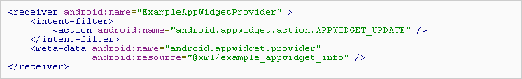
Declaring an App Widget in Manifest
Declare the AppWidgetProvider class in your application's AndroidManifest.xml file.

Slide 18
Adding the AppWidgetProviderInfo Metadata
The AppWidgetProviderInfo defines the essential qualities of an App Widget
  such as its minimum layout dimensions, its initial layout resource, how often to update the App Widget, and (optionally) a configuration Activity to launch at create-time.
Define the AppWidgetProviderInfo object in an XML resource using a single <appwidget-provider> element and save it in the project's res/xml/ folder.

Slide 19
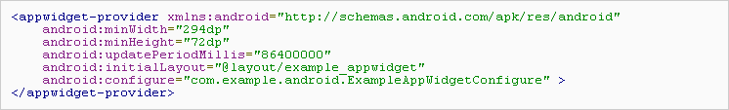

Slide 20
Creating the App Widget Layout
Define an initial layout for your App Widget in XML and save it in the project's res/layout/ directory.
  Be familiar with Declaring Layout in XML
  Be aware of RemoteViews

Slide 21
Using the AppWidgetProvider Class
The AppWidgetProvider class extends BroadcastReceiver to handle the App Widget broadcasts.
The AppWidgetProvider receives only the event broadcasts that are relevant to the App Widget
  such as when the App Widget is updated, deleted, enabled, and disabled.

Slide 22
When these broadcast events occur, the AppWidgetProvider receives the following method calls:
  onUpdate(Context, AppWidgetManager, int[])
  onDeleted(Context, int[])
  onEnabled(Context)
  onDisabled(Context)
  onReceive(Context, Intent)

Slide 23
AppWidgetProvider is a convenience class.
If you would like to receive the App Widget broadcasts directly, you can implement your own BroadcastReceiver or override the onReceive(Context, Intent) callback.
The four Intents:
  ACTION_APPWIDGET_UPDATE
  ACTION_APPWIDGET_DELETED
  ACTION_APPWIDGET_ENABLED
  ACTION_APPWIDGET_DISABLED

Slide 24
Creating an App Widget Configuration Activity
An App Widget configuration Activity is needed if users want to configure settings when he or she adds a new App Widget.
  Activity will be automatically launched by the App Widget host and allows the user to configure available settings for the App Widget at create-time, such as the App Widget color, size, update period or other functionality settings.

Slide 25

The configuration Activity should be declared as a normal Activity in the Android manifest file.
  It will be launched by the App Widget host with the ACTION_APPWIDGET_CONFIGURE action.

Slide 26

The configuration Activity must be declared in the AppWidgetProviderInfo XML file, with the android:configure attribute.

Slide 27
Implement the actual Activity
  The App Widget host calls the configuration Activity and the configuration Activity should always return a result. The result should include the App Widget ID passed by the Intent that launched the Activity (saved in the Intent extras as EXTRA_APPWIDGET_ID).
  The onUpdate() method will not be called when the App Widget is created (the system will not send the ACTION_APPWIDGET_UPDATE broadcast when a configuration Activity is launched). It is the responsibility of the configuration Activity to request an update from the AppWidgetManager when the App Widget is first created. However, onUpdate() will be called for subsequent updates—it is only skipped the first time.

Slide 28
Android网络资源
Android官方网站
  http://code.google.com/android/
Android开发网
  http://www.android123.com.cn/
eoe·Android开发社区
  http://www.eoeandroid.com/
Android开发者论坛
  http://www.androidin.com/

