Slide 1


Tripadvisor.
Hotel Reviews
Group 1
Biga, Maximiliano
Sandoval, John
Spena, Sebastian
Zanelli, Ignacio

Slide 2

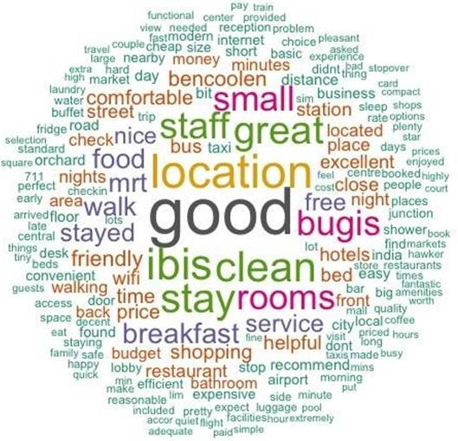

Business Case
The business model of a hotel is based on offering the greatest number of services possible under a specific pricing model, which allows each guest to have the best possible experience.
The existence of Internet 2.0 has allowed users to demand from companies what kind of experience they want to live, and then it is they themselves who capture and viralize these experiences on the web, generating a lot of exposure to providers, who can see them grow or destroy your business based on these viralizations.
That is why, currently, in order to manage businesses well, it is essential to use all possible tools to identify the level of CX and detect potential areas for improvement through what is published by users.
The objective of the analysis was to analyze the reviews obtained through TripAdvisor, in order to provide tools for the design and implementation of a business strategy aimed at improving CX, which allow building competitive advantages.

Slide 3
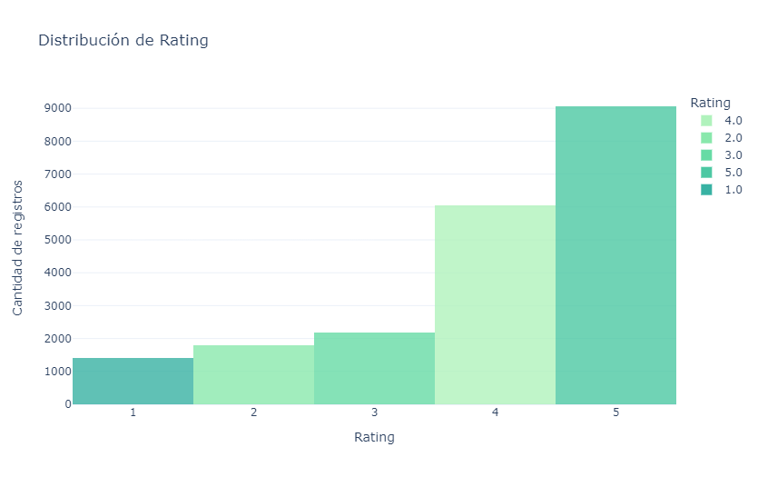
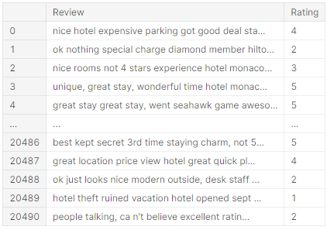
Set de Datos
‘tripadvisor_hotel_reviews.csv’

Slide 4
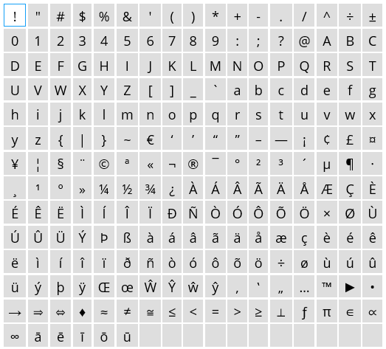
Procesamiento de Datos
Loading of the dataset..
Creation of a new target to classify by detractors and promoters.
Separation Between:
Detractors (rating 1, 2 & 3).
Promoters (rating 5 & 4).
Tokenization.
Data cleaning:
Stopwords.
Words not relevant to the analysis..
Special characters (regular expressions).
Notes:
#Elimino los numeros
#Elimino multiples espacios en blanco
# elimina espacios en blanco antes y despues del token
#elimina los caracteres especiales
# Removes punctuations

Slide 5
Classification Models
Motivation
Measurement of the customer experience during their stay at the hotel.
Do without rating to identify positive or negative experiences.
Identification of the most repeated words among the promoters, which are not within the group of detractors.
Stemmer of results.
Selection of the features that best discriminate for each class.
Creation of multiple models:
Logistic Regression.
SVM.
LightGBM.
Main problems observed/encountered:
Inability to identify neutral comments as they were very similar to the negative ones.
A training dataset with more columns than observations.

Slide 6
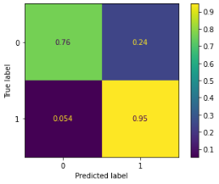
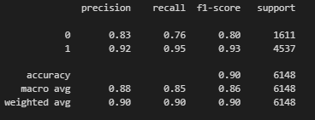
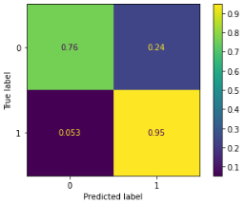
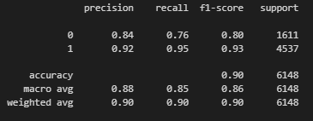
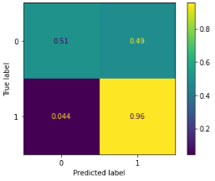
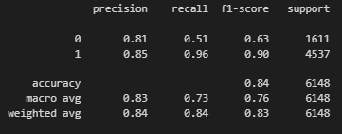
Classification Models - Results
Logistic Regression
Support Vector Machine
LightGBM
Notes:
Sin ningun tipo de optimizacion de hiperparametros SVM produce mejores resultados

Slide 7
Topic Analysis
Motivation
Identify the main aspects seen by guests as negative and positive.
Bigrams creation.
Lemmatization.
Creation of the Latent Dirichlet Allocation (LDA) model for detractors and promoters separately.
Identification of the optimal number of topics for each model.
Identification of the relevant topic for each record.
Identification of the most representative record for each topic.
Obtaining the distribution of the topics in the dataset.
Main problems observed/encountered :
As the number of topics increases, overlapping is observed between them and topics with very few words.
Keywords for classification are noise for topical analysis.
Notes:
identificar los principales topicos que surgen en el dataset, de acuerdo a cada grupo detractores/promotores , para conocer que valoran o que les molesta
A partir del dataset obtenido en la clasificacion alimentamos el modelo de TM.

Slide 8
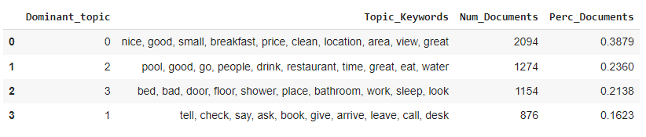
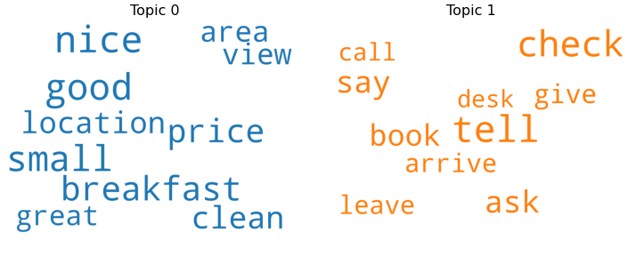
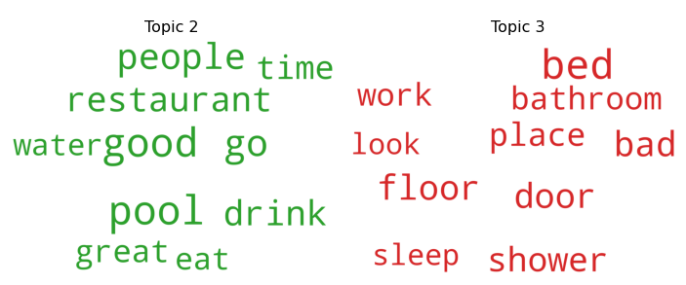
Topic Analysis - Results
Detractors
Notes:
Sin ningun tipo de optimizacion de hiperparametros SVM produce mejores resultados

Slide 9

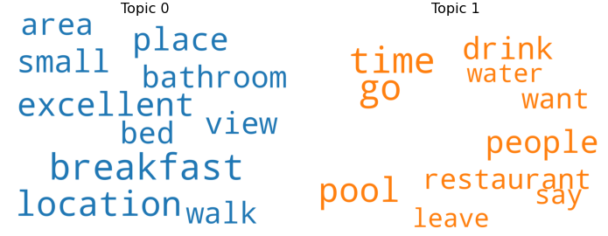
Topic Analysis - Results
Promoters
Notes:
Sin ningun tipo de optimizacion de hiperparametros SVM produce mejores resultados.
Topic 0 🡪 infraestructura.
Topic 1 🡪 servicio.

Slide 10
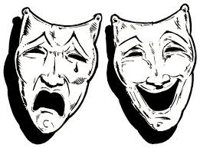
Insigths
Promoter Topics (positive reviews)::
They focus mainly on issues related to infrastructure and the service received in the establishments.
The comments are concentrated on a few topics.
Detractor Topics (negative reviews):
The topic that contains experiences related to check-in, check-out, reservations, etc., is the only one that does not overlap with any aspect of the promoter topics. From this, it is concluded that a good experience is taken for granted when entering or leaving the hotel and not obtaining it is the reason for a negative review.
It seems that issues such as the lack of comfort in the rooms cause bad reviews.
Topic 0 and 2 have many points in common with promoters.
Despite having fewer records, it was possible to extract more topics from detractors.

Slide 11
Conclussions
Classification:
Impossibility of identifying neutral comments as they were very similar to the negative ones..
A training dataset with more columns than observations.
Improvement points:
Deepen the analysis of bigrams, especially for cases in which the combination of two words changes the meaning of one of them alone ( example: “not good”).
Topic Analysis:
As the number of topics increases, overlapping is observed between them and topics with very few words.
Keywords for classification are noise for topic analysis (eg: adjectives).
Improvement points :
Deepen the cleaning of the dataset (eg: removal of adjectives).

