Slide 1





System Programming Final Project
Making an assembler and a simulated loader for simplified SIC/XE.
1063303 鄭乃榮
1072254 王亭皓
1072589 張家禎
1072919 廖亭柔
1072960 羅傳郡

Slide 2
目錄
CONTENT
03
程式碼
01
目錄
02
題目
04
執行結果
Notes:
2

Slide 3
PART.2
題目

Slide 4
題目
Please write a SIC/XE assembler program that can translate assembly language to the object code. The functionality of the assemblering is similar to Figure 2.9 in the textbook (Implement the machine-independent feature (Chapter 2.3) for EQU and literals).

Slide 5
題目
Only nine assembler directives: START, END, BYTE, WORD, RESB, RESW, BASE, EQU, LTORG, need to be considered. For simplification, it is assumed that there are only some instructions in the assembly language．

Slide 6
題目
Moreover, You have to handle error situations in the input data only for LABEL and INSTRUCTION errors as the following cases: (You should demonstrate it by modifying the original input file to add some errors) (a) Label name or op-code error (b) Unable to use both PC-relative and Base-relative modes．

Slide 7
題目要求
System
Symbol Table
Location Counter
Object Code
error situations

Slide 8
PART.3
程式碼

Slide 9
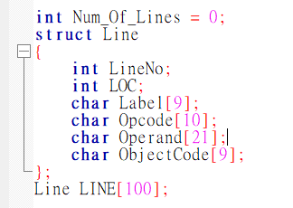
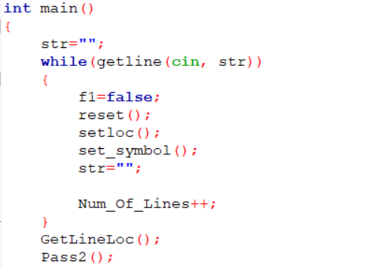
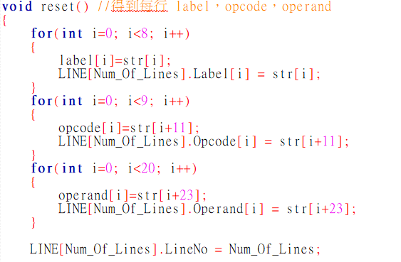
程式碼說明
／／看有沒有要備註

Slide 10
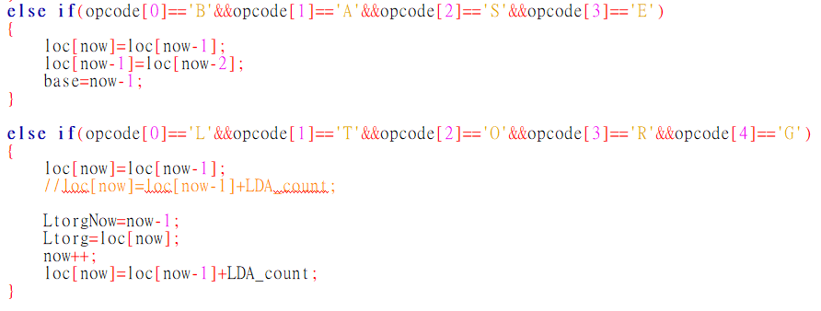
程式碼說明

Slide 11
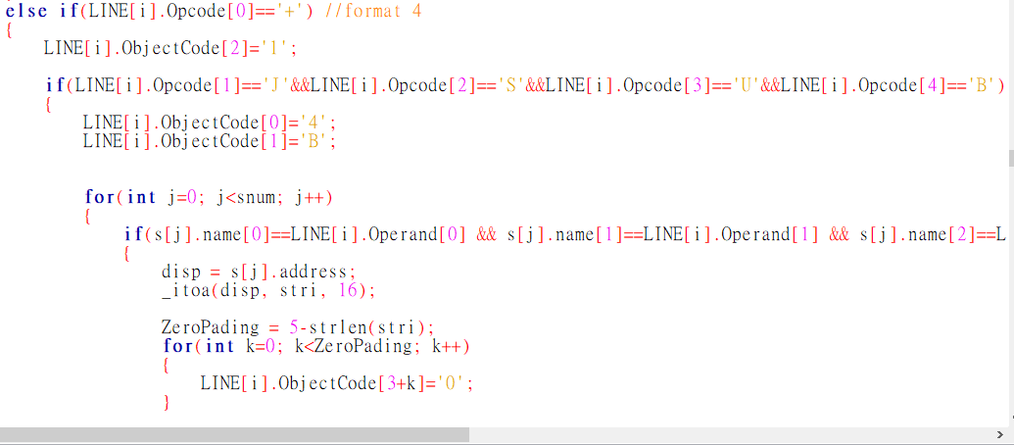
程式碼說明

Slide 12
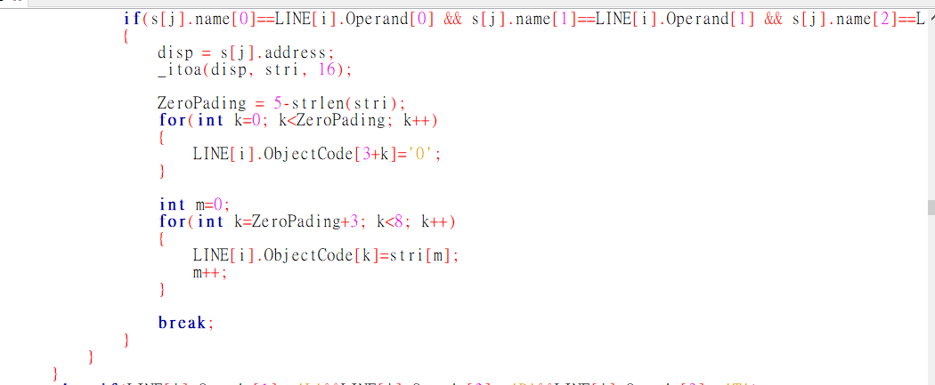
程式碼說明

Slide 13
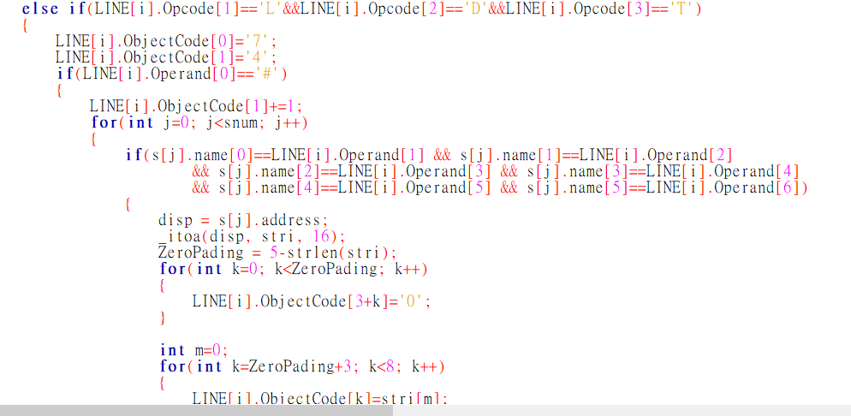
程式碼說明

Slide 14
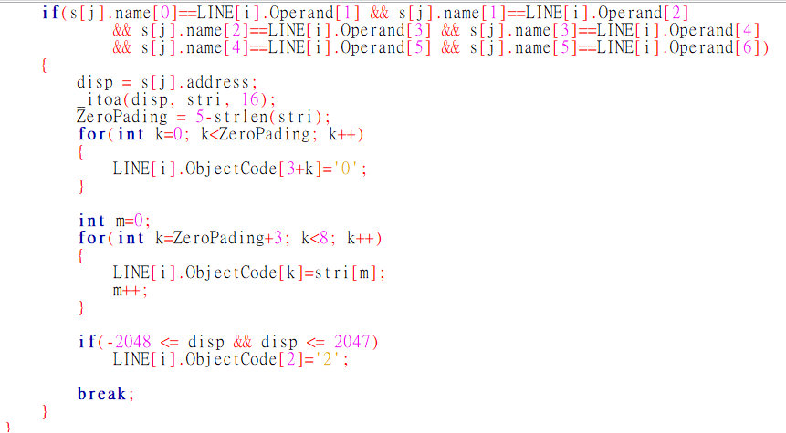

Slide 15
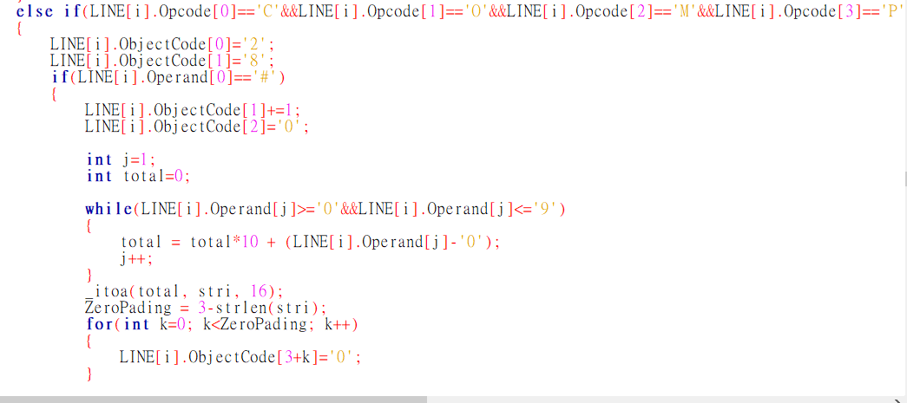
程式碼說明

Slide 16
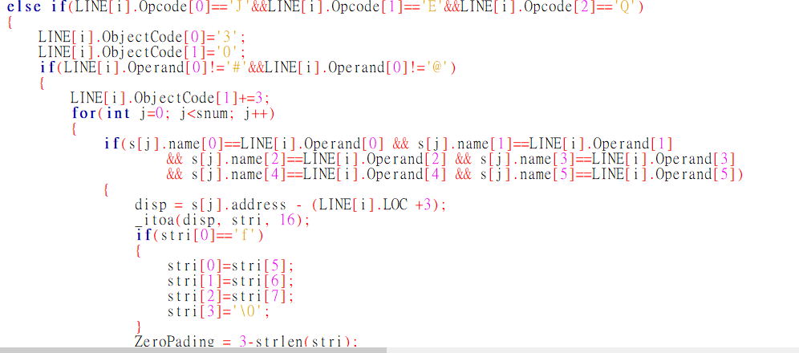
程式碼說明

Slide 17
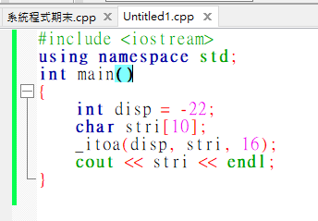
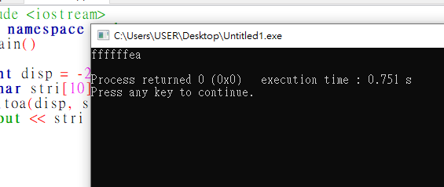
程式碼說明

Slide 18
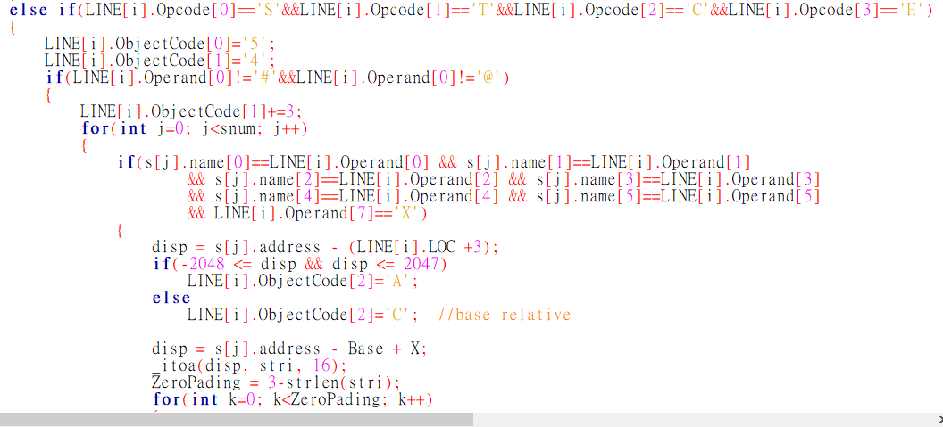
程式碼說明

Slide 19

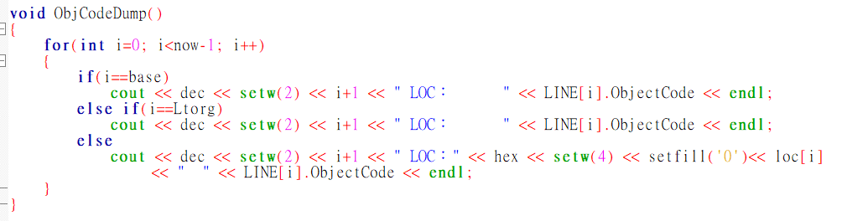
程式碼說明

Slide 20
PART.4
執行結果

Slide 21
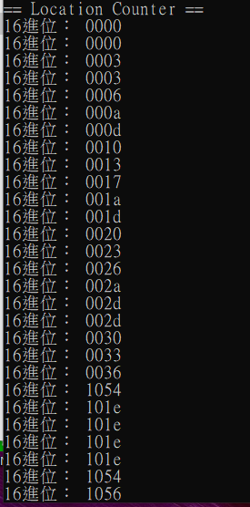
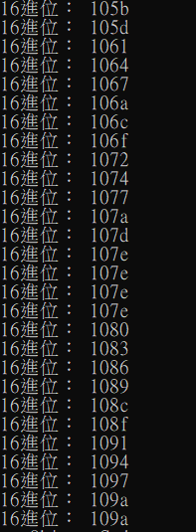
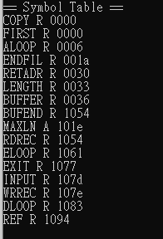
執行結果
／／備註

Slide 22
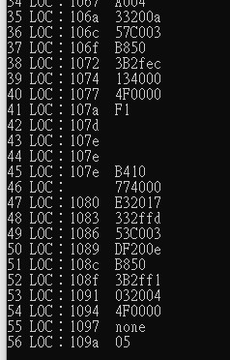
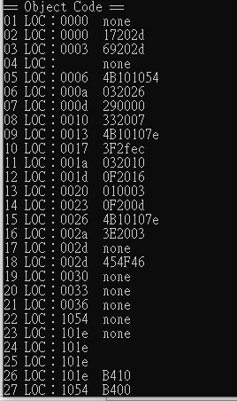
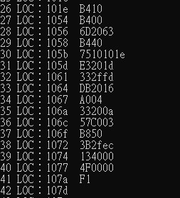
執行結果

Slide 23
謝謝聆聽！
THANKS FOR LISTENING

