Slide 1

Eir Web Application
National Technical University of Athens
School of Electrical & Computer Engineering
Appathon@NTUA 2020: Applications for people
Internet Applications
Giannis Fakinos

Slide 2
Eir Web Application
Contents of these slides:
Dataset & Initiatives
Application Structure & Technologies used
Brief description of code & its components
Working Examples

Slide 3
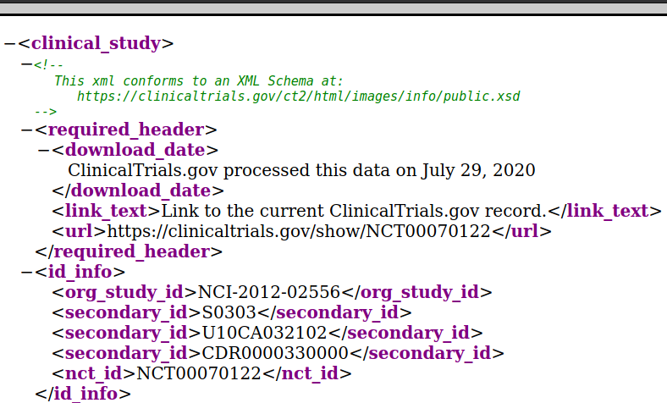
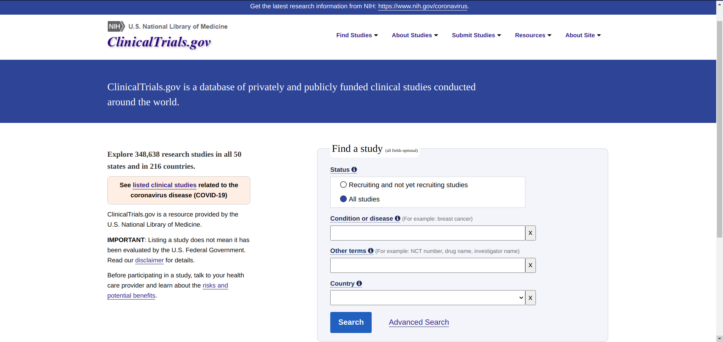
Dataset
Clinical Studies of this application are available from https://clinicaltrials.gov/ in xml format.
347,165 Studies were imported and used for this Web app, that was published on July 29, 2020

Slide 4
Dataset
Goal: Use of these data for extracting further information, not obvious at first sight
Interesting Attributes for further investigation and simple processing:
enrollment type: ‘Actual’. [Relevant to the actual number of volunteers participating in each clinical study]
enrollment type: ‘Anticipated’. [Anticipated number of participants/volunteers in each study]
study_first_submitted & last_update_submitted [Dates indicating when each study first submitted and when last updated]
Last two attributes could be used for computing the average time for requitment by a simple subtrackion.

Slide 5
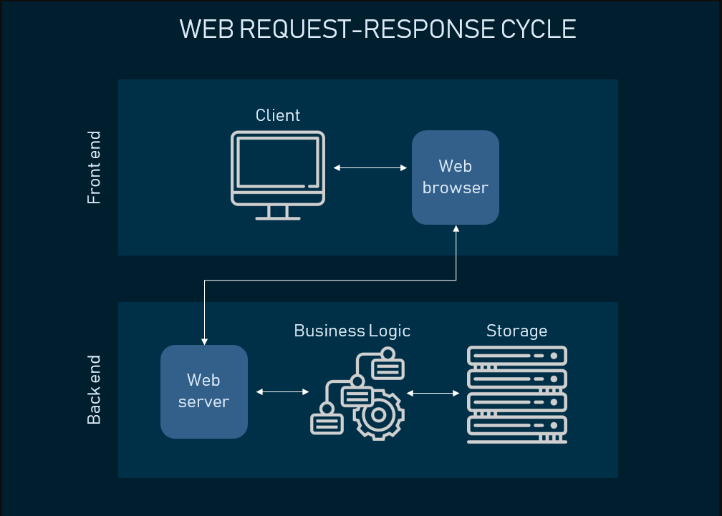
Application Structure
Front-end Server handling:
User Interface and client requests by a simple browser
Presentation of the extracted data and information in user friendly environment
Back-end Rest Service:
Processing data and basics queries about them
No concern about their presentation to the end-user
No Relational database (and its relevant server) storing downloaded documents in a more consistent way
Source of image (Last seen August 12, 2020): https://www.altexsoft.com/blog/front-end-development-technologies-concepts/

Slide 6
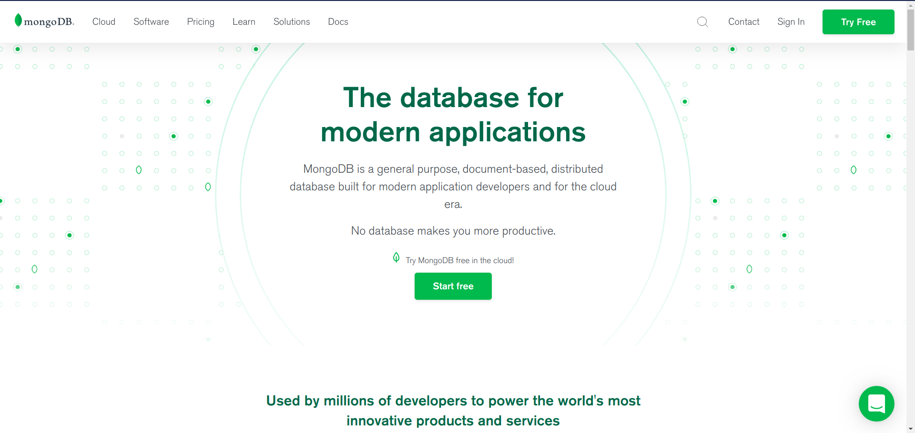
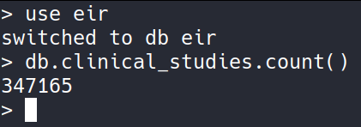
Application Structure: Database
No-SQL database was created using mongodb as a DBMS
XML formated data converted to JSON files using xmljson python Library and Gdata convention (attributes are saved under the field name type and actual field values are stored under the field $t – we later changed it, as mongo doesn’t support fields with ‘$’ in them)

Slide 7
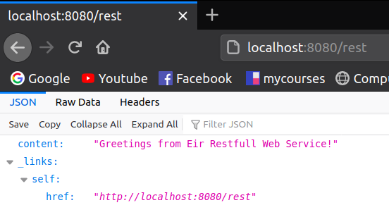


Application Structure: Back-end Rest Service
Written in Java 11 with Spring Boot Framework and Maven as a built automation tool
Connection with database established with Spring Data MongoDB module
Service is described as RESTfull (or better as Roy Fielding described R.P.C. -Remote Procedure Call), due to the fact that Spring HATEOAS library is included. It is ensure for each rest reply that includes links to it self and other components.

Slide 8
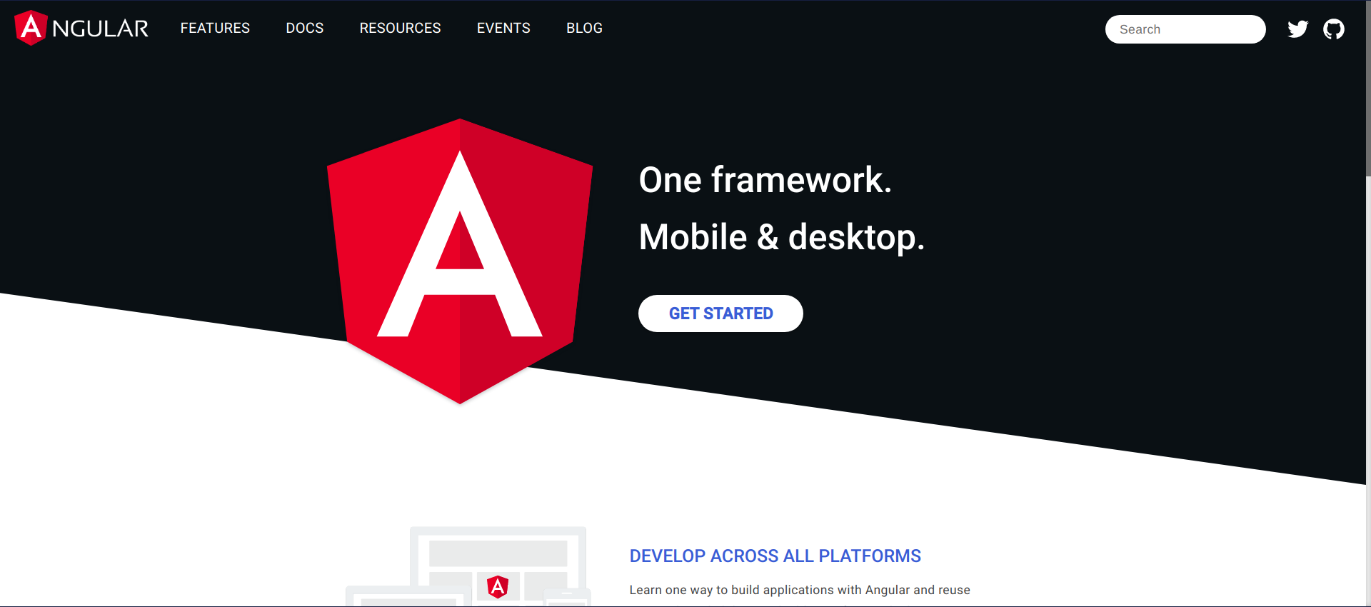


Application Structure: Front-end Server
Web site providing access to the aforamentioned service is constructed using:
Angular 9 Framework & Typescript
HTML 5 & CSS 3
Npm was used as the package manager for this application
Angular Material was used for theme purposes

Slide 9
Brief description of code: Back-end
It consists of an entity package, a repository package and a rest package:
Entity package contains classes concerning data and documents representation of the NO-SQL database (ClinicalStudies, ActualNumberOfVolunteers, AnticipatedNumberOfVolunteers e.t.c.)
Repository package contains the MyMongoCollectionRepository class, which implements mongo queries to db and the exception package for basic error handling.
Rest package consists only of the EirRestController which is responsible for handling GET Requests, listening at http://localhost:8080/
Parameters of each request are url encoded by each client and decoded by service itself. If no proper parameter was parsed, an exception is raised returning an HTTP Response with status code 400.

Slide 10
Brief description of code: Front-end
A component oriented solution was chosen:
Dataservice service-component is responsible for consuming back-end REST service and offering a simple interface for all the other components for each other component.
Home component rendering home page
Stats component offering a basic page for all the known utilities of Web App
Each component includes a .css and an html file for its appearance and a .ts file for its functionality
All calls to back-end service are done asynchronously, offering a more responsive, non-blockin ui

Slide 11
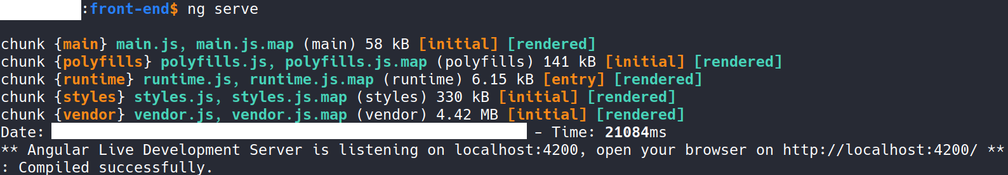
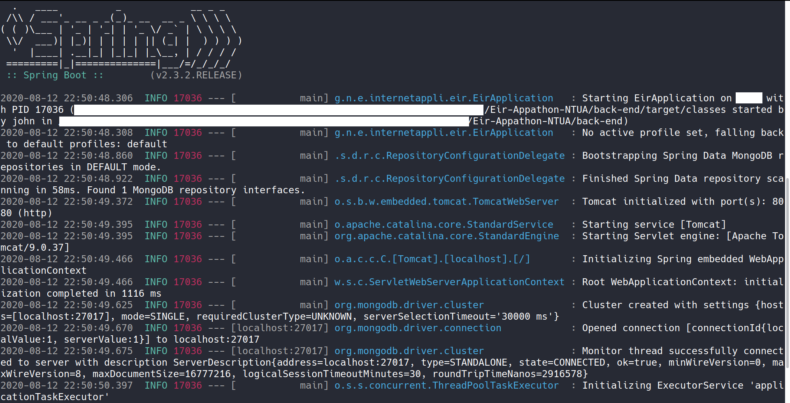
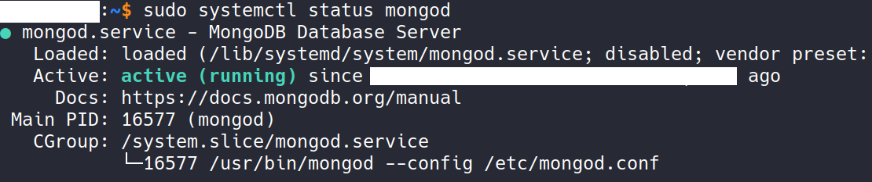
Working Examples
Running all servers in the same machine under a linux distro:
ng serve
./mvnw spring-boot:run

Slide 12
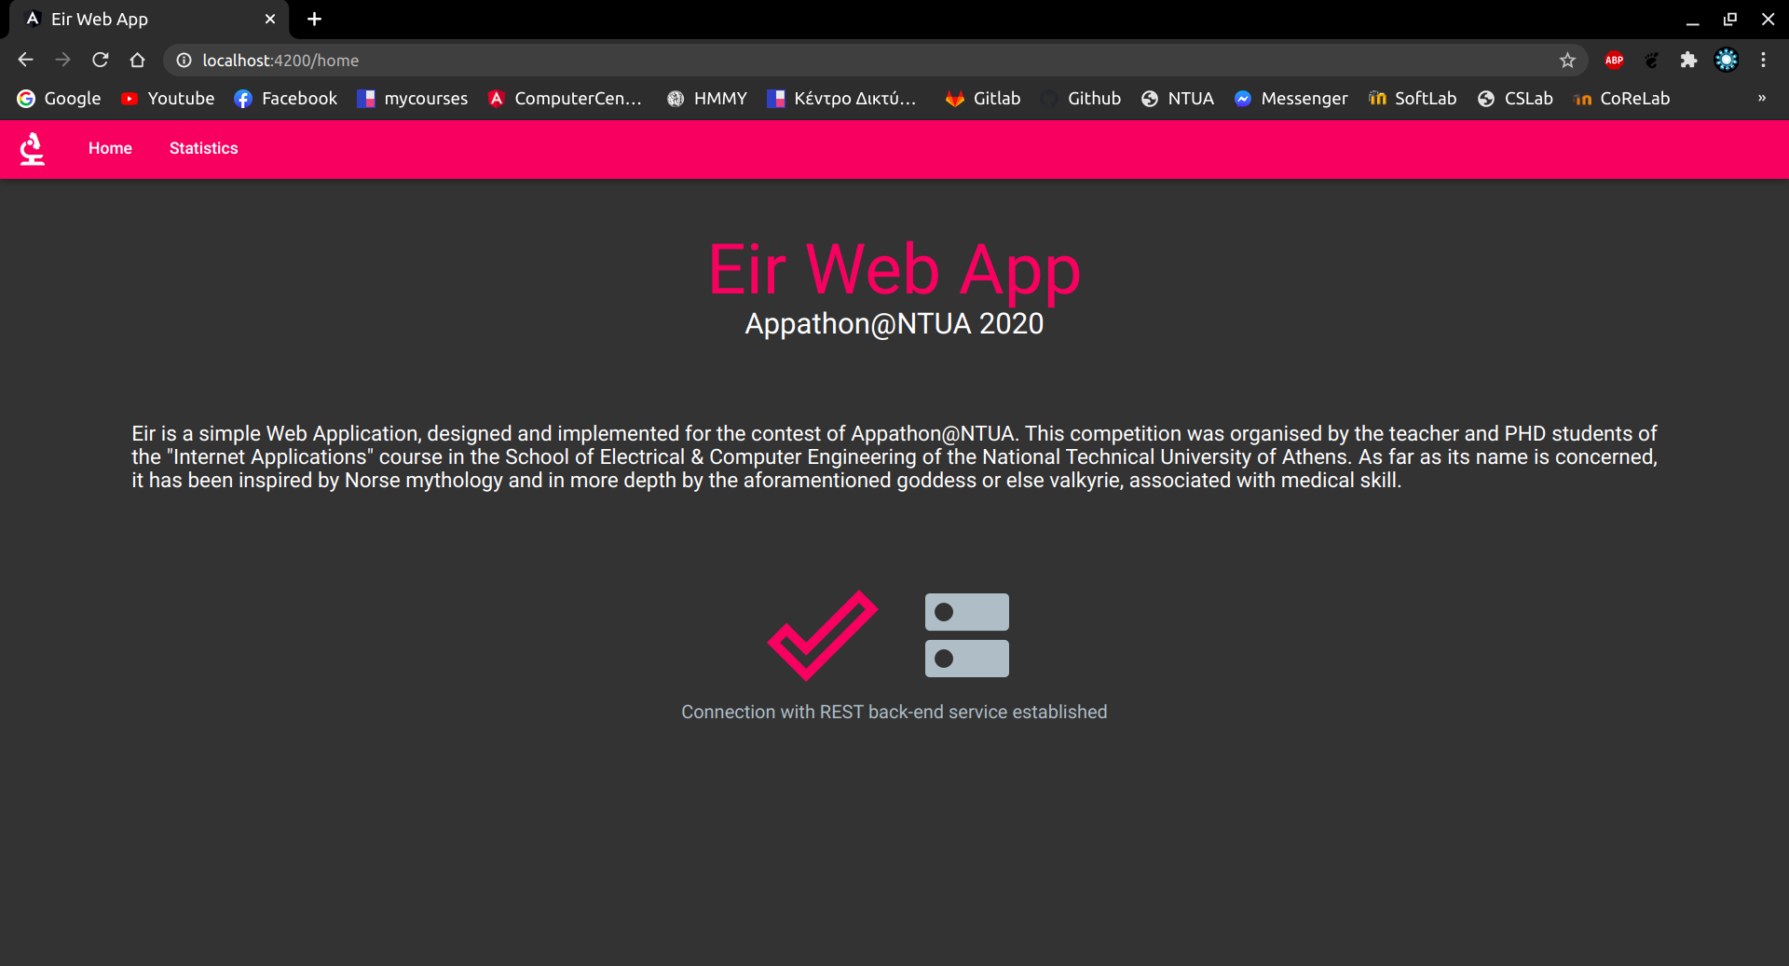
Working Examples
Home Page

Slide 13
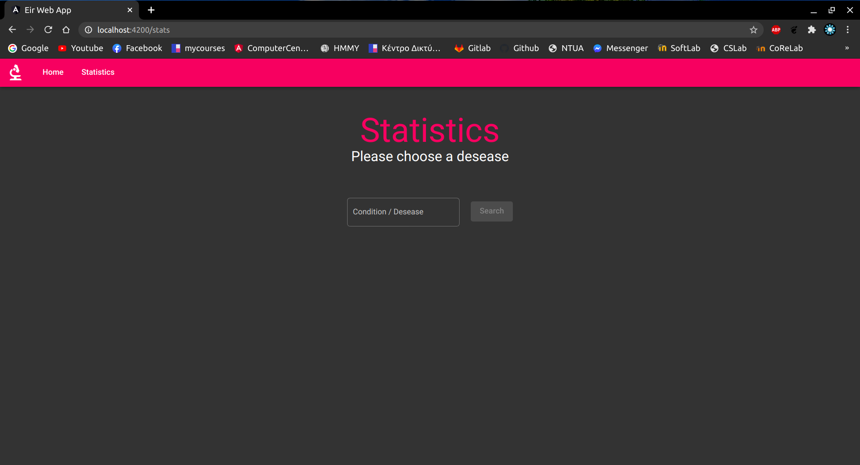
Working Examples
Statistics Page

Slide 14
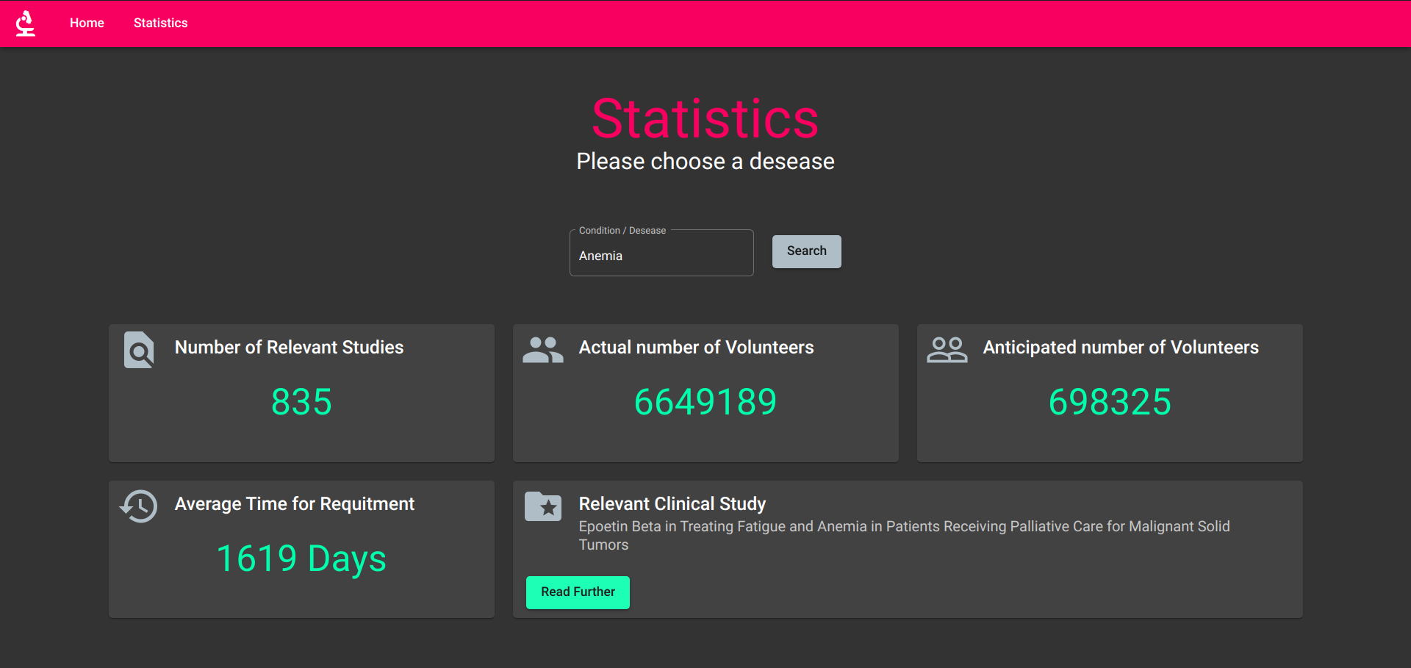
Working Examples
Statistics Page

Slide 15
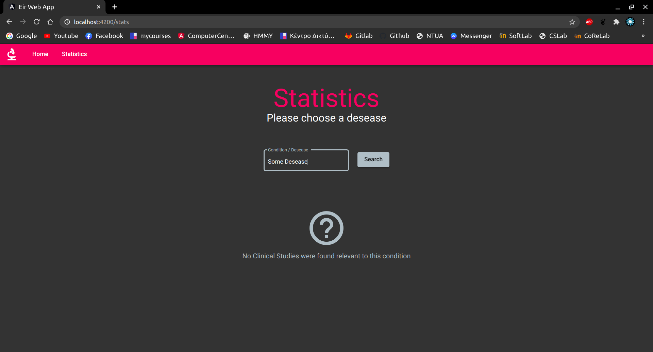
More Examples
Statistics Page

Slide 16

More Examples
Statistics Page

Slide 17
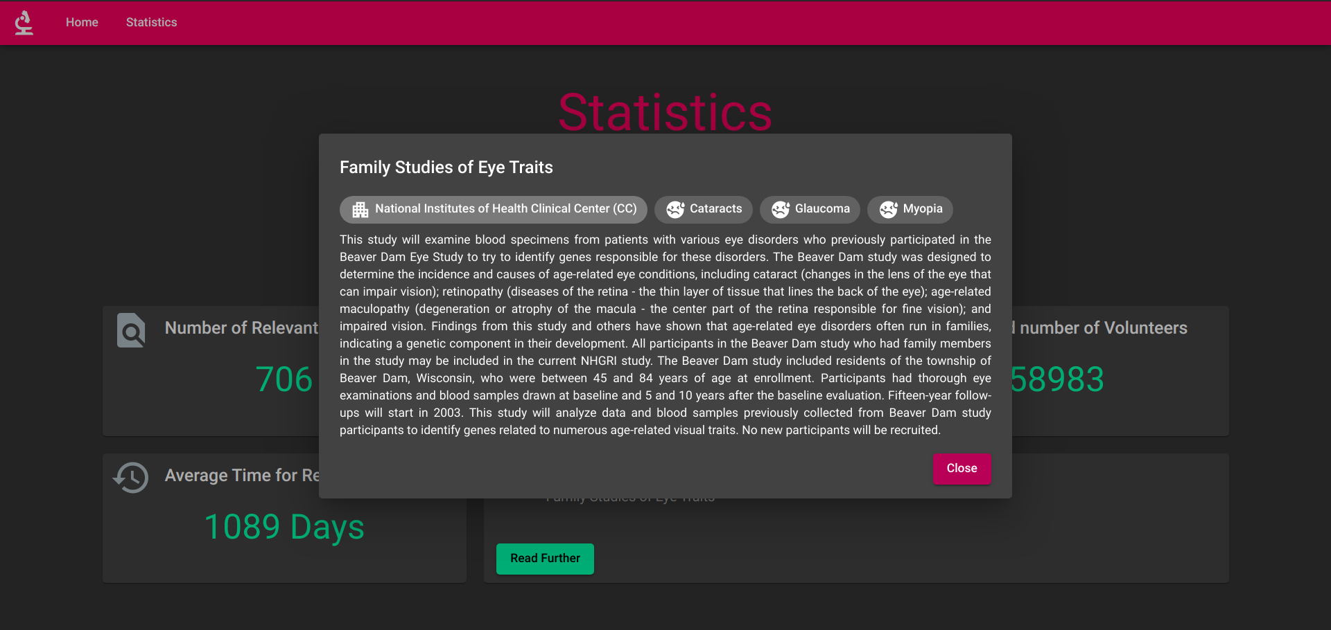
More Examples
Statistics Page

Slide 18
Further Information
GitHub Repository: https://github.com/john98nf/Eir-Appathon-NTUA
Appathon 2020 NTUA: http://147.102.19.19/wordpress (probably unavailable)
Internet Applications:https://www.ece.ntua.gr/en/undergraduate/courses/3346
School of Electrical & Computer Engineering: https://www.ece.ntua.gr/en
National Technical University of Athens: https://www.ntua.gr/en/

Slide 19
Closure
Thank you for your time!
Giannis Fakinos

