Slide 1
Making D3 Responsive The React Way
https://johnbartos.github.io/react-d3-demo/
johnbartos.io

Slide 2
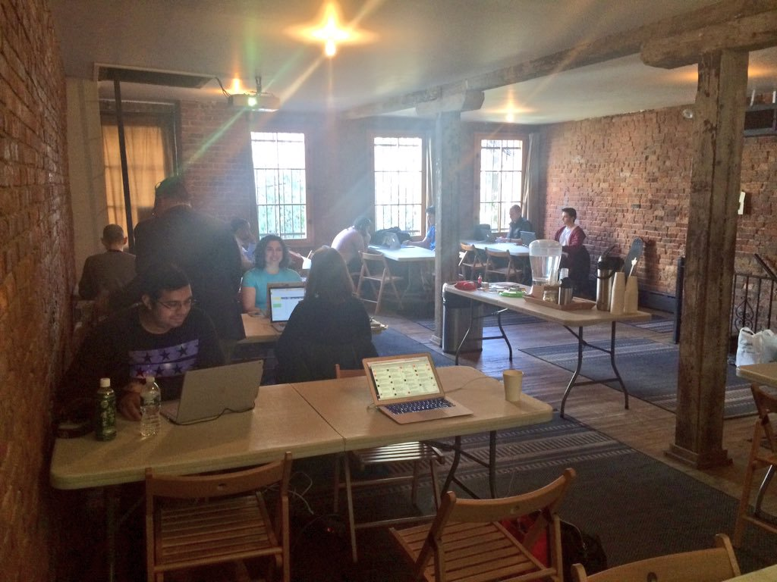
I'm John Bartos, and this is my first talk ever
Notes:
I'm John Bartos, and this is my first talk at a meetup ever. According to the JSConf code of conduct, you must clap extra loud for first-time speakers, or you'll be banned from javascript.
I'm an engineer at a company in Jersey called DataOnline, where I use javascript to put your data online. Brilliant name, right?

Slide 3
You want to make sweet D3 visualizations that just work™ on all screen sizes
(you also care about doing it properly)
Notes:
Last year, I began the creation DataOnline's first mobile application. Believe it or not, our main product is actually running on Silverlight. All I'll say about that is that it's dead for a good reason.
Originally, management wanted an iPhone app. Thankfully, I talked them out of that and convinced them that they need a responsive JS website instead.
D3 is a large part of it, and it obviously needed to work on all devices.

Slide 4
But there's a problem...
Notes:
Naively, I thought I could just stick it into a bootstrap container. That didn't work. It's guts would explode out of the container when resized. In the words of my boss: “that looks like crap”.

Slide 5
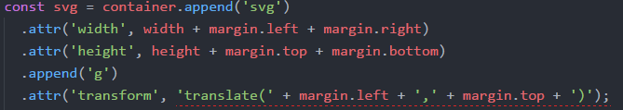
D3 needs to know its size before runtime
You don't know size until runtime
Notes:
The problem is that D3 needs to be told how large to make the SVG when you initialize it in code. You can just hard-code those numbers in - which is fine if you don't care about over 50% of the people on the web who are on mobile devices. With responsive layouts, you don't actually know the size of your element until the DOM is rendered.
Obviously, this was an issue.
And I thought to myself: React is awesome and jquery makes me want to vomit. I want to solve the problem with React itself.

Slide 6
Fortunately, there's an easy solution
Notes:
There's actually a really easy way to do this in React.

Slide 7
ReactDOM.findDOMNode()
GetBoundingClientRect()
window.addEventListener('resize', ..)
this.setState()
Notes:
When the component mounts, we find the DOM node and get it's border-box with getBoundingClientRect(). That box gives us the size of the element. We put both node and size on the state. We then add an event listener for the resize event, with our listener just repeating the above process when it fires. Every time the state changes, the component is re-rendered and we redraw our visualization.
Simple!

Slide 8

But there are two (2) things wrong with this approach!
Notes:
But this solution doesn't really gel with React

Slide 9

findDOMNode() breaks component abstraction
Notes:
First, your component is now interacting with the real DOM. The essence of a React component is that it is an abstracts away interactions with this real DOM by using a virtual DOM. You don’t program to the browser's concrete implementation. By forcing your components to care about real HTML elements, you breaks this abstraction.
That’s bad.
Your component is less testable because it’s now dependent on something that may not exist within your testing framework, including shallowRender. It’s also not as reusable because your visualization is tied to a specific element.

Slide 10
A stateless component is now stateful
Notes:
Additionally, our component is now stateful when it doesn’t need to be. D3 doesn't care about how it gets it's size, or even that the window size change. All it wants to know is how large to draw the graphic.
Now you shouldn’t be afraid of state in React, but it’s a good idea to be deliberate with it because state introduces another set of variables to worry about. Your component is no longer just reacting to data passed to it via props – state now has a say in how it’s rendered. You could pass in the same set of props twice and have two different outcomes.
Again, testability and reusability suffers.

Slide 11
You need a higher-order component! (?)
Notes:
What we need to do is make a higher-order component. A what?
I promise it's not as complicated as it sounds.

Slide 12
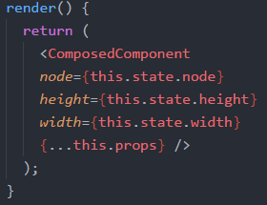
HOCs are functions which take a component and returns another component that wraps it
(thats it)
Notes:
I know I said it wasn't as complicated as it sound, but in the end HOCS are just a component which invisibly passes props to a child component. The passed in component isn't modified.
The HOC has everything that a normal component has – lifecycle methods, state, props, etc.
A HOC that you've probably seen is connect from Redux

Slide 13
Our HOC gets size exactly as before and passes it as props to its child
When 'resize' event fires, new props are passed, prompting a rerender
Notes:
Remember what we did before – get the node, get the rectangle, get the size, put it on state, listen for resize. We’re doing exactly the same thing in the HOC, but this time we’re passing them along as props.

Slide 14

The HOC encapsulates all the nastiness
Notes:
The only difference now is that the visualization no longer needs state, nor does it need to break abstraction to find its real DOM node. The HOC doesn’t render anything but the passed component. Nothing shows on the DOM indicating it's presence.

Slide 15
The wrapped component just gets props
Notes:
This approach solves the problems of reusability and testability we had before. We can reuse this HOC not just on D3, but for anything that requires a predefined size. Our visualization is also reusable – we can draw on element, and the size can be anything you want.
Testabiliy is improved because we don’t have to worry about setting the state, or finding the real node. We can just mock out our HOC to return the unresponsive component.

Slide 16
There's a small catch – children render before parents
Need to set initial state in HOC
Notes:
There's just a small catch to this approach which is worth mentioning. Children render before the parent! Make sure to set your initial state in the HOC. This makes complete sense if you don't think about it too hard.

Slide 17

(Please clap)
Notes:
That's it. Thank you! Please clap.

