Slide 1


Pneumonia is the world’s number one killer of children under 5

Slide 2
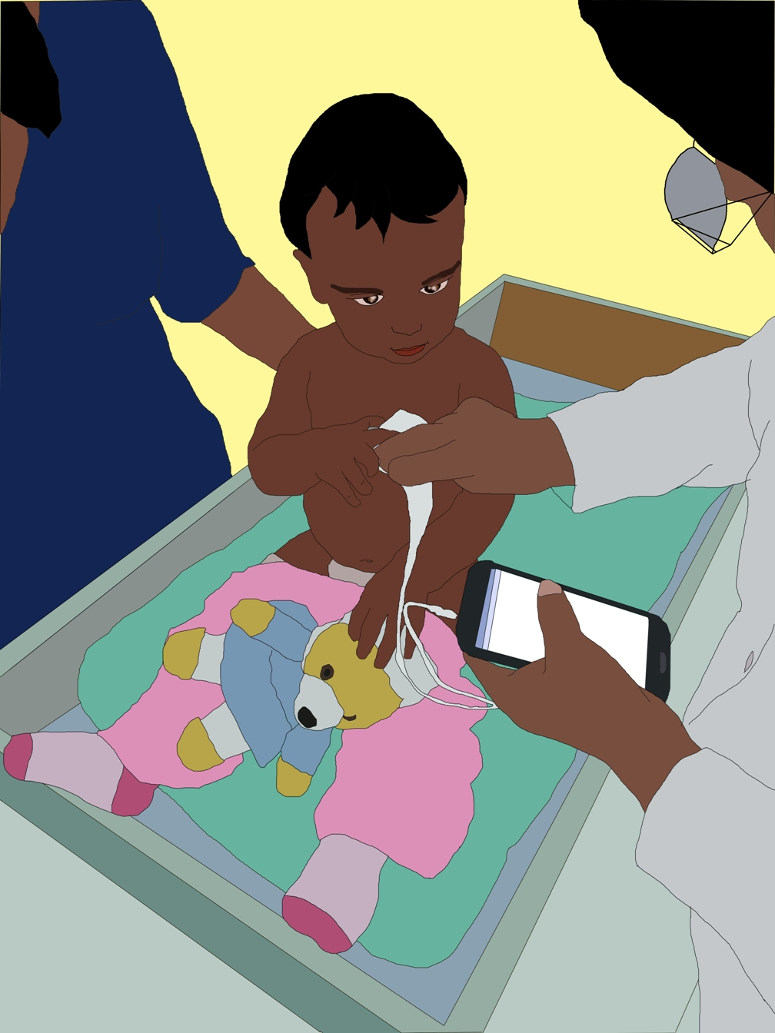
Pneumonia App Prototype

Slide 3




Screen 0
Function(s): This is the user access point.
Collect data on the user type (health worker in hospital versus CHW in community)
Gauge variability across users in terms of device use and
User Name
Options & Functionality
User name
Name of the person collecting the data
Should have auto-complete for repeat users
User location
Hospital visit versus community visit
User Type
Drop down menu
Hospital health worker, doctor, nurse, community health worker
ENTER
This follows one of two streams depending on the data provided above
Hospital stream
Community stream
User Location
User Type
ENTER

Slide 4
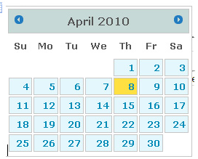
Screen 1
Function(s): Patient identification
Identify patient
Patient ID
Options & Functionality
Patient ID
Can be entered directly if available
Name
First name of child
Address
Drop down menu of possible locations
Gender
Drop down
Date of birth
Select from calendar
The four patient parameters should be linked to a unique patent ID!
Name
Address
Gender
Date of birth

Slide 5

Screen 2 (Hospital stream)
Function(s):
Take new measurements
Report results
New measurement
Options & Functionality
Hospital results
User chooses this option if they need to report X-rays & blood test on a patient whose measurements were previously taken
New measurement
This is to complete the cycle of measurement for a new patient or for a follow-up case
View previous visits
This is only available if data on the same patient was recorded in the past
Hospital results
View previous visits

Slide 6
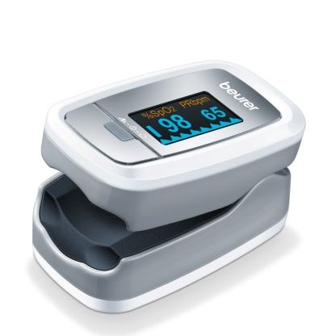

Screen 3a (Hospital stream)
Function(s): Taking measurements
Acquire new data with the available tools
Pulse oximeter
Options & Functionality
Pulse oximetry
Should take user to screen showing them how to place a probe on the child’s finger
Respiratory rate
Should take user to screen showing them how to record RR
Temperature
Should instruct user on how to measure
Digital stethoscope
Should take user to a screen that shows them where to place the stethoscope
At the end of all measurements there should a summary screen!
Respiratory rate
Temperature
Digital stethoscope

Slide 7
Screen 3b (Hospital stream)
Function(s): Reporting results
Record results acquired with advanced hospital tools
X-rays
Options & Functionality
X-rays
Record X-ray results
Blood tests
Record blood test results
Doctor’s diagnosis
Record doctor’s diagnosis
Blood tests
Doctor’s diagnosis

Slide 8
Screen 3b (Hospital stream)
Function(s): Reporting results
Record results acquired with advanced hospital tools
X-rays
Options & Functionality
X-rays
Record X-ray results
Blood tests
Record blood test results
Doctor’s diagnosis
Record doctor’s diagnosis
Blood tests
Doctor’s diagnosis

Slide 9
Screen 3c (Hospital stream)
Function(s): View summary of previous visits
Provide hospital staff with access to information from previous visits at the community or hospital
 | 01/03/2016 | 12/03/2016
RR | 44 | 50
HR | 62 | 65
SpO2 | 95 | 95
Labs | - | -
X-rays | - | -
Options & Functionality
Source
Should be able to click on each measurement and check where it was taken
Recommendations
Recommendations on what disease progression is indicative of???
Notes:
Add demographics

Slide 10
Screen 2 (Community stream)
Function(s): Taking measurements
Acquire new data with the available tools
Options & Functionality
New measurement
Acquire data for a new case
Follow-up
Depending on patient identification, if patient has already been diagnosed and requires follow-up at community level, this will be highlighted here
New measurement
Follow-up

Slide 11
Screen 2 (Community stream)
Function(s): Taking measurements
Acquire new data with the available tools
Pulse oximeter
Options & Functionality
Pulse oximetry
Should take user to screen showing them how to place a probe on the child’s finger
Respiratory rate
Should take user to screen showing them how to record RR
Temperature
Should instruct user on how to measure
Digital stethoscope
Should take user to a screen that shows them where to place the stethoscope
At the end of all measurements there should be recommendations on how to proceed!
Respiratory rate
Temperature
Digital stethoscope

