Slide 1

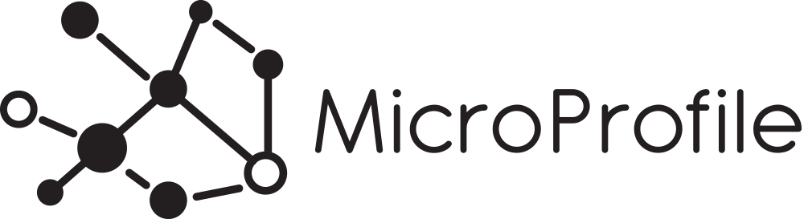
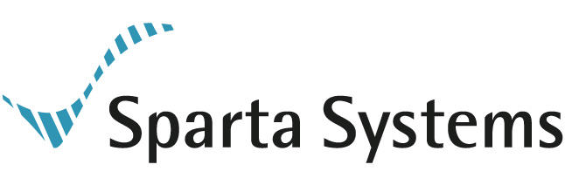
BootEE
Java EE, Microservices, Microprofile and Playing a little mix & match

Slide 2
Where to get the material?
https://github.com/johnament/bootee
https://github.com/hammock-project/hammock-examples

Slide 3
The Tech
Apache TomEE Embedded
Wildfly Swarm
Spring Boot
Jetty
DropWizard
Spark Java
Many, many more

Slide 4
What’s Important to You?
Programming Model
Platform Richness
Standards Based

Slide 5
What’s Important to You?
Use the right tools at the right time

Slide 6
Its ok to Start Simple
Sometimes, having a plain Jetty server hosting some files may make sense
A web server may not be its key component, but you want someway to reach out and touch someone

Slide 7
Building Reactive on a Servlet Container
Spark Java is an awesome little framework for building reactive REST APIs
Its nice, compact and clean to read
But it only tackles the REST API part..

Slide 8
Mixing EE and Reactive
This presentation would be pretty boring if you couldn’t make this work…
Its quite easy to take something Reactive like Spark Java, run it in a container, and leverage capabilities from the container
It may make sense to use CDI to back your API calls to perform business logic
// add arquillian tests here

Slide 9
Lets cross the train tracks
Sure, we can add components on top of an application server
We can also build EE specs on top of Spring Boot

Slide 10
&
Building Java EE applications on a Microservice runtime

Slide 11
What is Microprofile?
A simple specification for Microservices based on Java EE
JSON-P + CDI + JAX-RS
Describes capabilities, not deployment models

Slide 12
The Canonical Example
Very simple application to demonstrate the capabilities required
Extended a bit to support good API documentation

Slide 13
Using Hammock and Microprofile
A simple example, exposing an endpoint
Build it out
Swagger, CORS support
In a fully configurable manner

