Slide 1
Project 5: Hints

Slide 2
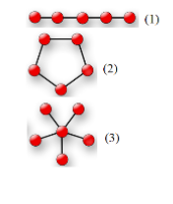
Identify a graph (i.e. network) topology
Bus
Ring
Star
None /
“Irregular”

Slide 3
Graph represented as edges in JSON
Example input:
{ “inList” : [
{ “connected” : [ “A”, “B” ] },
{ “connected” : [ “B”, “C” ] },
{ “connected” : [ “C”, “D” ] },
{ “connected” : [ “D”, “E” ] }
] }
Example output:
{ “type” : “bus” }

Slide 4
Observations / Assertions (1)
Bus & Ring Topologies
If not all vertices are connected, i.e. there are islands, the graph is irregular
In a bus, all vertices have exactly two edges, except the head & tail
A ring is like a bus where the head and tail have a connecting edge
In a ring, all vertices have exactly two edges
If it has a circularity, its not a bus or a star
If it has more than one unique circularity, its irregular

Slide 5
Observations / Assertions (2)
Star Topology
The graph is fully connected with no circularities
One vertex has |V|-1 edges
All other vertices have one edge

