Slide 1
Thermal Radiation
John Lewis

Slide 2
Outline for the Week
Day 1: Radiation Fundamentals
Intensity
Day 2: Thermal Radiation
Blackbody Radiation
Day 3: Thermal Emitters
Useful results using blackbody radiation
Day 4: Applications
Blackbodies in Astronomy

Slide 3
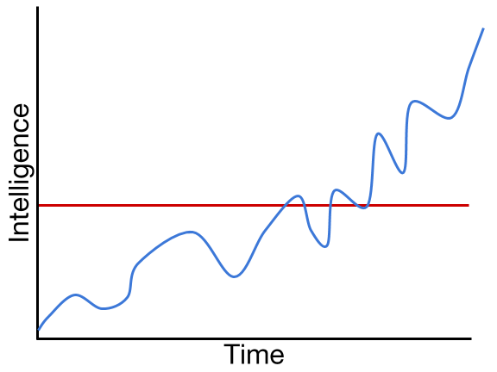
Ask Questions

Slide 4
Ask Questions
Learning
Problem
Time

Slide 5
Radiation Fundamentals

Slide 6
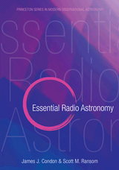
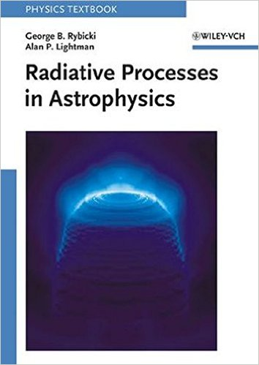
Useful resources
Essentials of Radio Astronomy, Ch. 2
Free online textbook. http://www.cv.nrao.edu/~sransom/web/Ch2.html
Rybicki & Lightman - Radiative Processes in Astrophysics
Available in Wolbach Library...amongst other sundry places

Slide 7
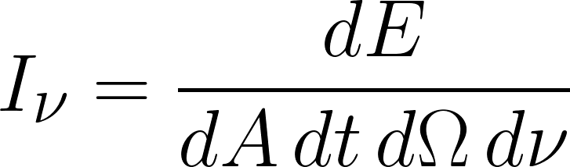
Definitions
Specific Intensity: The energy in some frequency range passing through some area into some solid angle over some period of time.
dE = I_{ν} dA dt dΩ dν
Units are:
[I_{ν}] = ergs cm⁻² s⁻¹ ster⁻¹ Hz⁻¹
dΩ
dA
Normal
Notes:
Ask about who knows vectors. Intensity is a vector quantity. If I want to know the Intensity in some direction, what vector operation do I use?
Intensity of called surface brightness, or as is the case in radio astronomy, brightness.

Slide 8

Definition w/ Non-perpendicularity
If the ray is not perpendicular to the target area, then only the projected area matters. So dA → dA cos(θ)
Units are still: ergs⁻¹ cm⁻² s⁻¹ ster⁻¹ Hz⁻¹
dA
dΩ
θ
Notes:
This is the energy

Slide 9
Definitions from different perspectives
Intensity is …. per unit time, per unit frequency
The energy emitted per unit area of the emitter into some solid angle
The energy received from some solid angle per unit area of the receiver

Slide 10
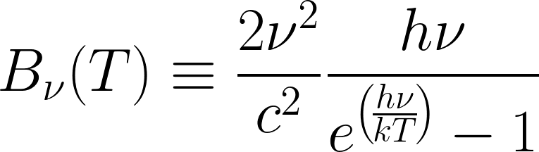
Question 1: Specific Intensity
I will introduce thermal emitters tomorrow; but for now, suffice it to say, the equation of a thermal emitter is
.
I submit to you, that this is a specific intensity. Determine the units of B_{ν}(T). Plank's constant: h = 6.623 x 10⁻²⁷ erg s Boltzmann's constant: k = 1.38 x 10⁻¹⁶ erg K⁻¹
What units do you get?
Notes:
After running through this you should get either erg cm⁻² or g/s² (equivalent after dimensional reduction).
What happened? Well, steradians are dimensionless, and the s⁻¹ Hz⁻¹ cancels itself.

Slide 11
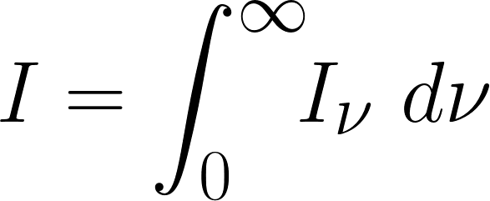
Specific Intensity
Specific intensity describes the intensity of electromagnetic waves with frequency between ν ± dν.
We can remove this dependence by integrating over frequency.

Slide 12
Quick note on Spherical Coordinates
Coordinate directions
Radial
Azimuthal
angle from z-axis to x-y plane
Polar
(counter-clockwise) angle around z-axis in x-y plane
Conventions* (radial, azimuthal, polar)
Mathematics (r,θ,ϕ)
Maintains consistency with polar and cylindrical coordinates. θ has same definition.
Physics and Astronomy (r,ϕ,θ)
Maintains consistency with language. The angle we care most about we usually call θ, and since we often have azimuthal symmetry, we make the polar angle θ.
*See Wolfram MathWorld for an exhaustive comparison of conventions.

Slide 13
Question 2: Solid Angle
Intensity is measured per "steradian" (pronounces "stair-radian"), which is a unit of solid angle. Solid what? A solid angle is a differential element of the surface of a sphere, measured in spherical coordinates. The units are steradians, but they are actually unitless in cgs, like radians.
Draw a diagram illustrating this differential element of solid angle, and write down the definition of dΩ.
Notes:
Diagram on next page.

Slide 14
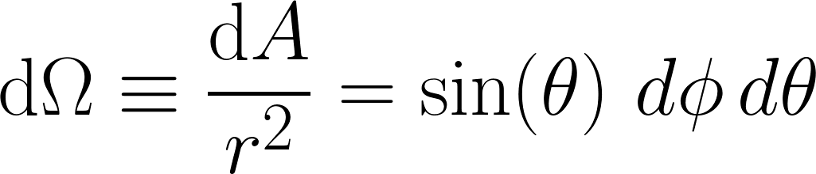
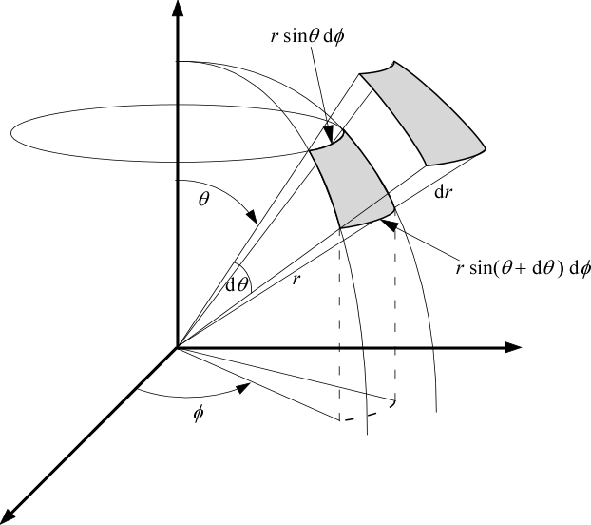
Blackboard Solution 2: Solid Angle

Slide 15
Why is Solid Angle so Important?

Slide 16
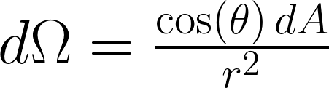
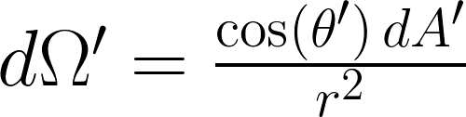
Proof that Intensity is Conserved
Suppose we have a universe with a single emitter and a single detector, then, by conservation of energy, the power emitted into the solid angle of the detector equals the power received from the solid angle of the emitter
dA
dA'
θ
θ'
r
Emitter
Detector
Modified from AstroBaki

Slide 17
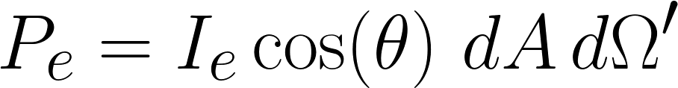
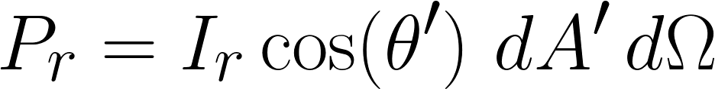
Proof that Intensity is Conserved
Suppose we have a universe with a single emitter and a single detector, then, by conservation of energy, the power emitted into the solid angle of the detector equals the power received from the solid angle of the emitter
dA
dA'
θ
θ'
r
Emitter
Detector
Modified from AstroBaki

Slide 18
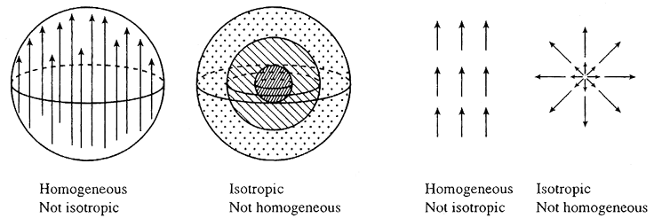
Isotropic point sources
Isotropic sources, even non-point sources, have the same appearance from any angle.
Notes:
Isotropic: Now matter where I look, from where I am, everything looks the same
Homogeneous: No matter where I go, if I look the same direction, everything looks the same
Isotropic and homogeneous: No matter where I go, wherever I look, everything looks the same.

Slide 19
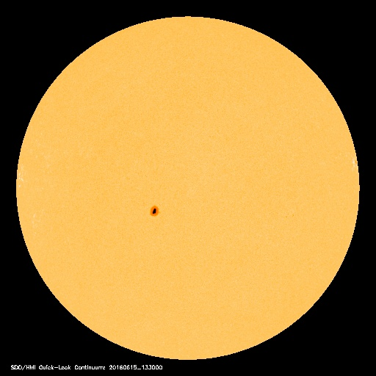
Isotropic sources
An isotropic source looks the same from any angle. This means all rays leaving the source have the same intensity. In physics, an isotropic radiator is a point radiation source. Spherical sources with uniform brightness are approximately isotropic radiators at a distance.
As we will discuss later, blackbodies are uniform emitters

Slide 20

Moments of Intensity

Slide 21
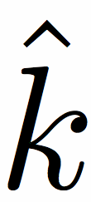


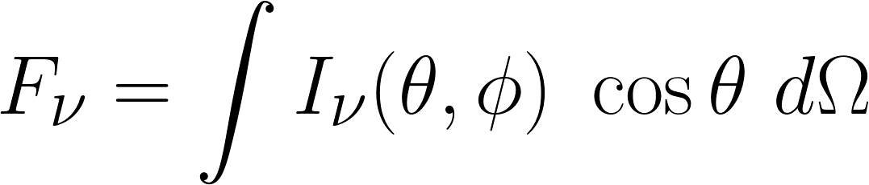
1st Moment - Specific Flux
Specific flux, in radiation, is a quantity with units of
energy per time per frequency per area
We must remember that intensity is a directional quantity, but it's emitting area is not. While we can describe intensity from the point of view of either the emitter or the detector, we must always include in the description the relative angle between the EM-wave ( ) and the detector or emitting direction ( ).
Notes:
P_\nu = \int I_\nu\, \cos\theta\ dA\, d\Omega
If you take an flat object that is isotropically emitting and tilt it with respect to you, then you will receive less energy than if it is face on because you have projected out some of the area

Slide 22

Question 3: Flux from Patch
There is a uniformly, isotropically emitting patch. This means in every direction the intensity is constant, B.
What is the flux, F_{𝜈} , emitted into space?
Notes:
If I have a patch of finite area that is emitting isotropically (i.e. independent of angle), how much area does an emitter on the surface of the hemisphere see per unit area?

Slide 23
Question 3: Flux from Patch
There is a uniformly, isotropically emitting patch. This means in every direction the intensity is constant, B.
What is the flux, F_{𝜈} , emitted into space?
Things to think about:
Units of flux: erg s⁻¹ cm⁻² Hz⁻¹
What area does a small patch of sky see?
Notes:
If I have a patch of finite area that is emitting isotropically (i.e. independent of angle), how much area does an emitter on the surface of the hemisphere see per unit area?

Slide 24
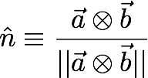
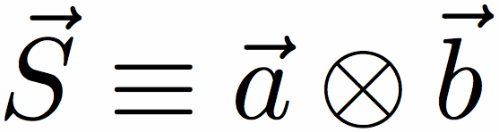


Projected area of a patch
The magnitude of an area vector is the area. We often work with normal vectors, which are normalized area vectors
The area projected area is the magnitude of area vector projected along the line of sight
detector sees area = |S| cos(θ)
line of sight
θ
Notes:
The far field approximation r >> R, is equivalent to approximating the emitter as an infinitesimal point.

Slide 25
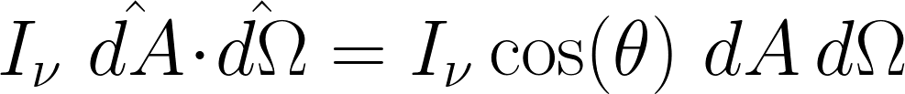
Flux from Patch
"detector" sees
being emitted from the patch. So the intensity it sees is: I_{ν} cos(θ)
Integrated this over the entire sky.
Notes:
If I have a patch of finite area that is emitting isotropically (i.e. independent of angle), how much area does an emitter on the surface of the hemisphere see per unit area?

Slide 26
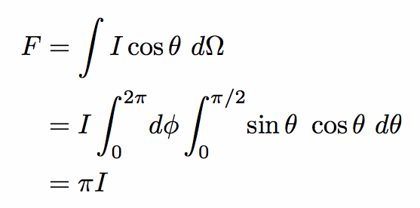
Flux from Patch
"detector" sees
being emitted from the patch. So the intensity it sees is: I_{ν} cos(θ)
Integrated this over the entire sky.
Notes:
If I have a patch of finite area that is emitting isotropically (i.e. independent of angle), how much area does an emitter on the surface of the hemisphere see per unit area?

Slide 27

Switching perspectives…

Slide 28

Question 4: Flux from Sphere
Calculate the flux received from the solid angle of a sphere. The sphere has uniform brightness I and as such is isotropic (all rays leaving the sphere have the same brightness).
θ
r
R
θ_{c}
Notes:
*Thanks Rachel Gilchrist for the perspective flip for this problem.
The next slide explains this problem a little better

Slide 29
Question 4: Flux from Sphere
Calculate the flux received from the solid angle of a sphere. The sphere has uniform brightness I and as such is isotropic (all rays leaving the sphere have the same brightness).
How much energy is being emitted towards our direction from a patch on the surface?
θ
r
R
θ_{c}
Notes:
Each little patch is itself an isotropic emitter. Think of it like a hot peice of metal. Very hot metal is an isotropic emitter (think of a hot metal ball, and the way it glows). If you think of a thin slab as just a chunk taken off, it is still emitting isotropically. The amount of energy we get from it though depends on how I tilt the slab. I will see less light if it is steeply tilted and more if it is face on.
We are not concerned right now with what makes it through. So all that is left for us is to determine how much solid angle the surface subtends.

Slide 30
So what is the solid angle of a Sphere?
This must be done far away from the sphere so that we can consider parallel rays
The question boils down to, what is the projected solid angle of a sphere?
R
Notes:
Each little patch is itself an isotropic emitter. Think of it like a hot peice of metal. Very hot metal is an isotropic emitter (think of a hot metal ball, and the way it glows). If you think of a thin slab as just a chunk taken off, it is still emitting isotropically. The amount of energy we get from it though depends on how I tilt the slab. I will see less light if it is steeply tilted and more if it is face on.
This means, for an observer looking at this object, they are guaranteed to have a beam on brightness I shining into their eye. So all that is left for us is to determine how much solid angle the surface subtends.

Slide 31
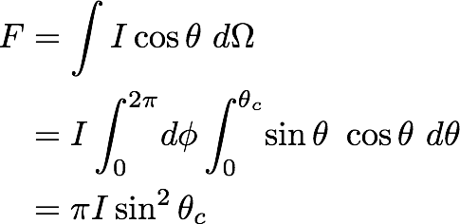
So what is the solid angle of a Sphere?
This must be done far away from the sphere so that we can consider parallel rays
The question boils down to, what is the projected solid angle of a sphere?
R
Notes:
Each little patch is itself an isotropic emitter. Think of it like a hot peice of metal. Very hot metal is an isotropic emitter (think of a hot metal ball, and the way it glows). If you think of a thin slab as just a chunk taken off, it is still emitting isotropically. The amount of energy we get from it though depends on how I tilt the slab. I will see less light if it is steeply tilted and more if it is face on.
This means, for an observer looking at this object, they are guaranteed to have a beam on brightness I shining into their eye. So all that is left for us is to determine how much solid angle the surface subtends.

Slide 32
Question 3: Flux
Flux is the amount of energy passing through a surface. Calculate the flux from a sphere of uniform brightness B. Such a source is isotropic (all rays leaving the sphere have the same brightness).
θ
r
R
θ_{c}
Notes:
F &= \int I\cos\theta\ d\Omega \\
&= I \int_0^{2\pi}\!d\phi \int_0^{\theta_c}\! \sin\theta\ \cos\theta\ d\theta \\
&= \pi I \sin^2\theta_c

Slide 33
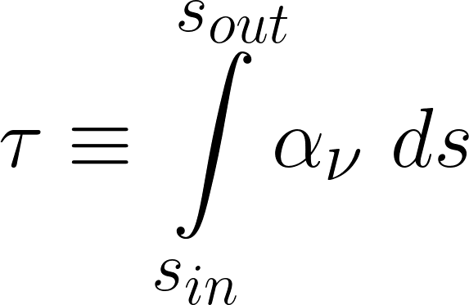
Optical depth

Slide 34
Blackbody Radiation

Slide 35
stopped here

Slide 36
Radiative Transfer

Slide 37
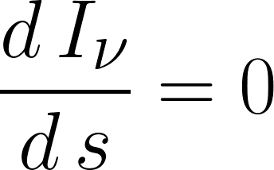
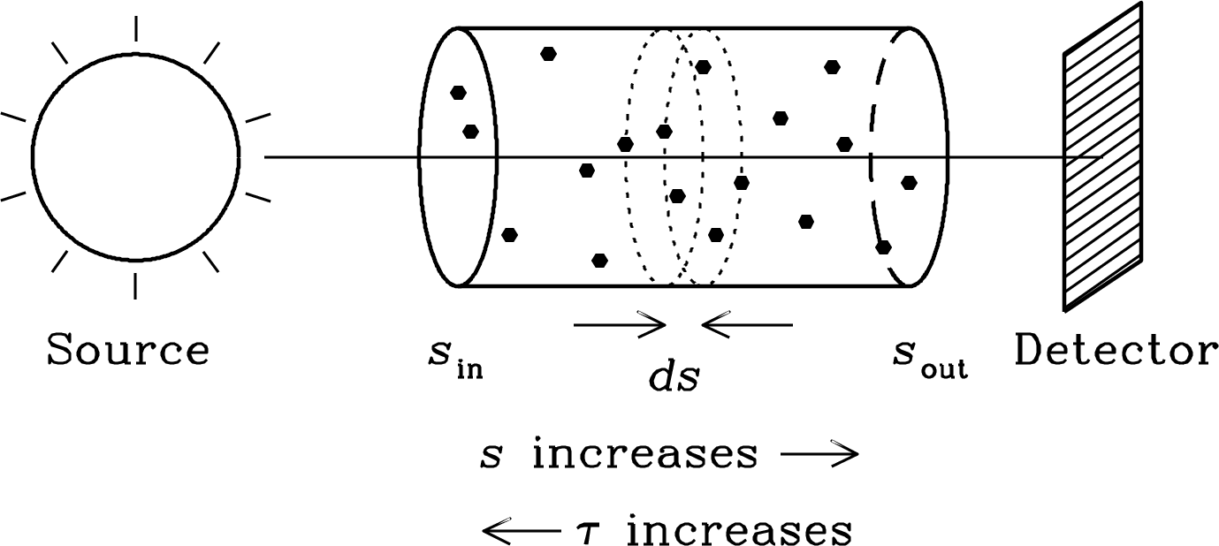
Radiative Transfer
In free space, intensity is conserved along a ray
But what if there is stuff in-between us and the source...

Slide 38
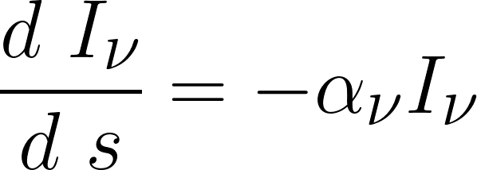
Absorption
If the material has some linear absorption coefficient 𝜅 (cm⁻¹), the probability of being absorber per unit length, then we add a sink term

Slide 39
Question 4: 1D Radiative Transfer with Absorption
Solve the 1D radiative transfer equation for the propogation of a ray through a medium with

Slide 40
Thermal Radiation I
Thermal radiation is electromagnetic radiation generated by the thermal motion of charged particles in matter. The energy distribution follows the Planck distribution, also known as the blackbody distribution.
An object is a blackbody if it is opaque to its own radiation. They are also defined as perfect emitters and perfect absorbers. It has previously been known as cavity radiation.

Slide 41
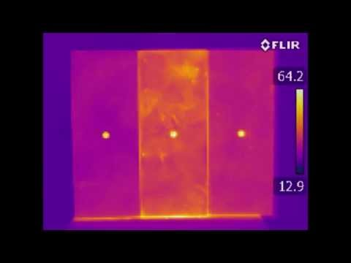

Slide 42
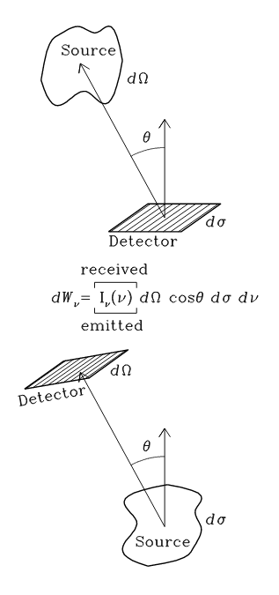
Specific Intensity
We can think of intensity from two points of view
Emission
The energy emitted from a small patch into some solid angle on the sky
Detection
The energy received on a small patch from some solid angle on the sky

