Slide 1
MVC training
fundamentals

Slide 2
Objetivo
70-486

Slide 3
Session objectives
Understand SoC in asp.NET MVC
Be able to implement views correctly, considering their limitations and capabilities
Understand how the controllers process http requests and how they interact with the model and the views.
Be able to decide when to go for server or client processing and design architectures accordingly to those decisions.
Identify the implications and concerns on the architecture design for creating highly and easily scalable applications

Slide 4
Design PAtterns
Solve commonly occurring problems in software development
High level solutions
Façade
Repository
MVC

Slide 5
Separation of concerns
Design principle
Separation for distinct features
Less possible overlapping
High cohesion Loose coupling

Slide 6
Planning data access
Where is the existent data?
Is new data being created?

Slide 7
Data ACcess
O/RM
Custom access component

Slide 8
Design aPproaches
Model first
Code first
Database first

Slide 9
Repository pattern
This is the default pattern for accessing data
Breaks dependencies between data acess layer and business logic layer
Helps testing since easily you can change the conenction to well-known data repositories

Slide 10
What is ASP.NET MVC
Sites
Services
Web forms
Web pages
Single page Apps
Web forms
MVC
Web API
ASP.NET MVC

Slide 11
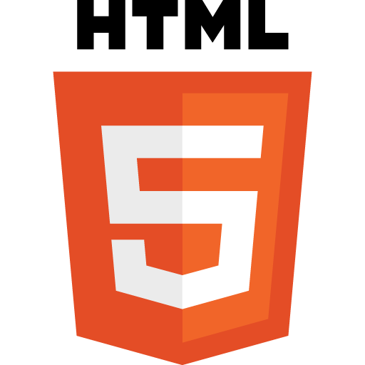

How MVC Works?
Request
Controller
Model
Response
View

Slide 12
Why?
Gives a structure to the application form the beginning
Easy to stay organized

Slide 13
What is a model?
A class
Manipulates data
Business logic

Slide 14
How to model?
Domain model
View model
Input model
IModelBinder
DefaultModelBinder

Slide 15
Model Attributes
Decorator for the runtime to deal better with data
DataType Attribute
Display Attribute
Validation Attributes
Required
MaxLength
Regular Expression
Compare (password confirmation)

Slide 16
Controller
Another class
Derived from Controller class
Execute Application logic
Never manipulates data
Separates functionality

Slide 17
Actions & Action Results
How the application helps user to achieve intentions
Highly correlated with interactions
Commonly an Action Result is a View or a Partial View
Some Action Results are Json or XML or binary data
Some Actions are user independent

Slide 18
Routing
Define url mapping to handle controllers and actions
Request comes in
Routing engine analyze url
Route handler extracts controller information
IControllerFactory instantiates controller
MVCHandler
IHttpHandler

Slide 19
Async controller
Long running processes (remember unicorn?)
Non-CPU bound requests
public async Task<ActionResult> LoadTimeLine()
{
//Do Something that may take an unknown amount of time
var results = new List<Status>();
return PartialView("TimeLine", results);
}

Slide 20
View
What the users see
Where the users fulfill intentions

Slide 21
View
Strongly typed
View specific model
Layout
Partial View
Scaffold template

Slide 22
View Engine
Reduces the amount of code within a view
Razor y Web Forms
@{...}
<%…%>
Supports layout

Slide 23
Extending View Engine
Deviate from conventions of default engine
Create HTML helpers (controls)
VirtualPathProviderViewEngine
BuildManagerViewEngine
MyCustomEngine

Slide 24
Tip
SoC is one of the primary reasons why ASP.NET MVC exists
Framework is not stricit, so violating rules is easy
There are differences in the logic within a View, ina controller and within a Model
Use of inline code in Views should be limited to presentation
Controllers do not manipulate data
Business logic is within a model

Slide 25
Client-side server-side
Client-side when work stays within the client
Pure client-side is rare
Server-side if the work needs information from server
Performance
Ux
Business requirements

Slide 26
Scalability
Consider since design
Horizontal
Physical/Virtual
Session handling, File Access
Vertical
Limited by design
Risky
Threading, I/O
Database distribution
Azure

