Slide 1


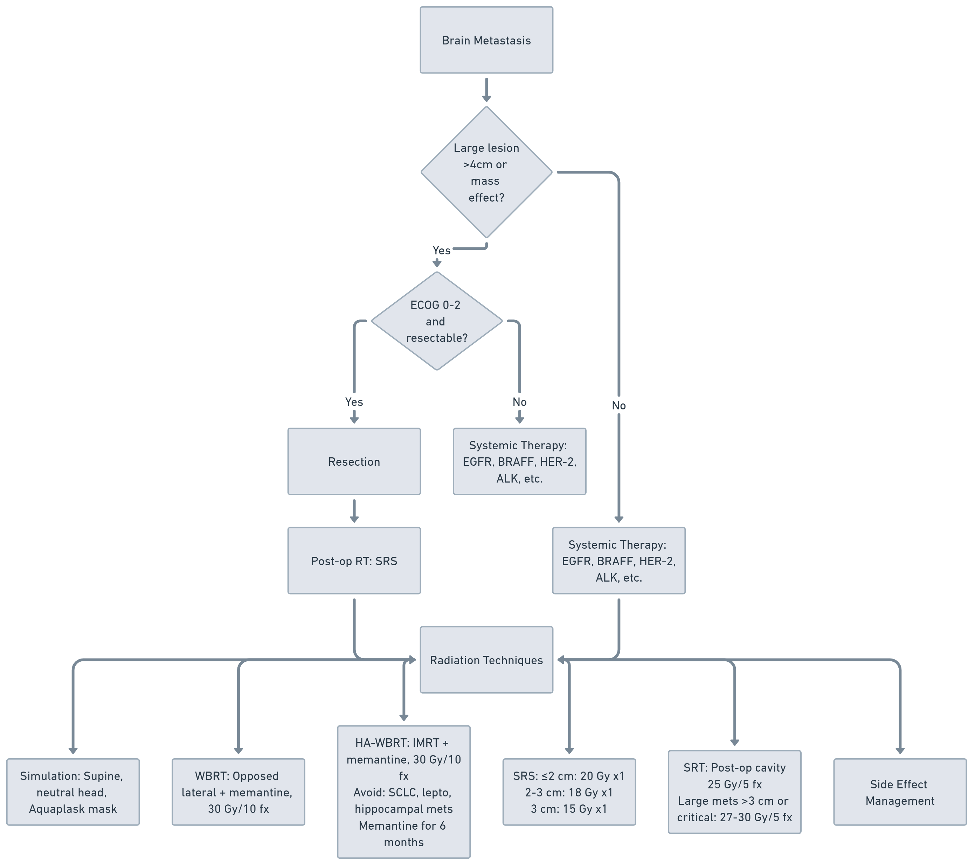
Palliative Radiation for Brain Metastasis
Vera A, Dias Neto, Medina, A, A, Freret, M.. Radiation Oncology On-Call Handbook: CNS emergencies. Association of Residents in Radiation Oncology. December 2025.
Chief complaint: Nausea, vomiting, seizures, focal neurologic deficits, changes in vision
Triage:
Seizures, bradycardia, hypertension, changes in vision
Workup:
History: Headache, nausea, vomiting, seizures, focal neurologic deficits, changes in vision
Physical: Mental status, strength/sensation, CN, Gait,
Imaging: MRI Brain + C, CT CAP (new cancer diagnosis), MRI Spine (LMDsuspected)
Treatment:
Surgery: Confirm pathologic diagnosis, largest brain lesion > 4 cm or mass effect -> Resection if ECOG 0-2, and mass is resectable
Systemic Tx: Consider high-CNS activity (e.g., EGFR, BRAF/MEKi, HER-2, ALK, etc.)
Principles of Radiation:
WBRT: Opposed laterals/IMRT + memantine
WBRT: IMRT +/- memantine, cautionin SCLC, lMD, or mets near hippocampus (30 Gy/10 Fx) + memantine
Consider 20 Gy in 5 Fractions base on KPS
SRS: Consider for limited metastatic disease, RTOG 90-05 dosing : ≤2 cm: 20 Gy x1 - 2-3 cm: 18 Gy x1 - 3 cm: 15 Gy x1
SRT: 25 Gy/5 fractions - Large mets (>3 cm) or critical locations: 27-30 Gy/3-5 fractions
Key Radiologic Features: Bleeding/T1-pre bright mets: Choriocarcinoma, Thyroid, Melanoma, Renal (mnemonic: CT MR)
Enhancing lesion Ddx: Metastasis, Glioma, Lymphoma, Abscess, Demyelinating disease

Slide 2
Palliative Radiation for Brain Metastasis
Vera A, Dias Neto, Medina, A, A, Freret, M.. Radiation Oncology On-Call Handbook: CNS emergencies. Association of Residents in Radiation Oncology. December 2025.
SUPPORTIVE CARE
Management:
Acute seizure: Lorazepam 2- 4 mg IV or diazepam 10 mg IV.
Maintenance: Initiate antiepileptic drug (e.g., levetiracetam 500-1,000 mg BID). Avoid routine prophylaxis unless seizures occur.
Increase ICP (Nausea, vomiting, changes in vision, headache)
Dexamethasone (PPI)
Antiemetics -> Zofran 4-8 Mg q8 Hrs
Steroid Dosing:
Steroid starting dose and taper schedule can be tailored to severity of symptoms and response
High symptom burden: 10 mg IV once, 4 mg po q6h or 8 mg bid
Moderate symptom burden: 4-6 mg po bid Low symptom burden 2-4 mg po q12-24h
Titration (Example for High Symptom Burden):
Week 1: 4 mg PO Q6 hours
Week 2: 4 mg PO q12 hours
Week 3: 4 mg Q AM then 2 mg QPM
Week 4: 2 mg Q12 hours, Week 5: 2 mg QD then stop
Neurocognitive decline prevention:
Memantine (RTOG 0614):
Week 1: 5mg PO qD
Week 2: 5 mg PO BID
Week 3: 10 mg PO Qam/5 mg Qpm
Week 4-24: 10mg Qam/10 mg QPM (by 1 month) x 6mo
SUPPORTIVE CARE
Proton Pump Inhibitors:
Omeprazole 20–40 mg PO once daily, or
H2 blockers (if PPI not tolerated): Famotidine 20 mg PO BID, or
Pantoprazole 40 mg PO once daily, or
Esomeprazole 20–40 mg PO once daily
PCP Prophylaxis:
prolonged high-dose steroids (≥20 mg prednisone equivalent ≥4 weeks)
or immunosuppression
First-line:
Trimethoprim-Sulfamethoxazole (TMP-SMX)
1 single-strength tablet (80/400 mg) PO daily
1 double-strength tablet (160/800 mg) PO three times per week (Mon/Wed/Fri)
Alternatives if sulfa-allergic or intolerant:
Dapsone 100 mg PO daily (check G6PD)
Atovaquone 1500 mg PO daily with food
Aerosolized pentamidine 300 mg via nebulizer monthly
Steroid-Induced Hyperglycemia
Glucose Management Monitoring
Check glucose fasting daily for all patients on steroids.
If glucose >180 mg/dL, monitor before meals + bedtime (AC/HS).
Coordinate with PCP/Endocrinology insulin
Consider endocrinology if insulin-naïve and glucose >300 mg/dL.

Slide 3
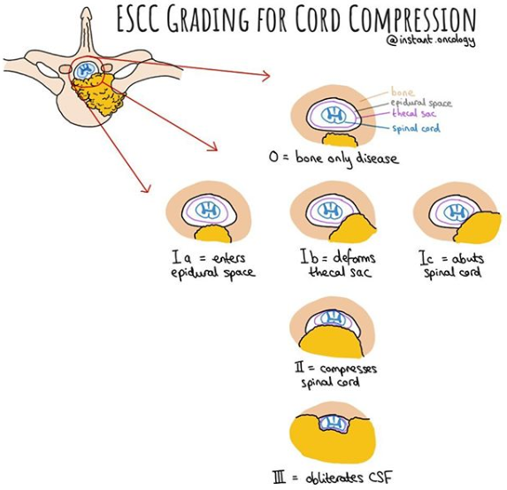
Palliative Radiation for Spinal Cord Compression
Vera A, Dias Neto, Medina, A, A, Freret, M.. Radiation Oncology On-Call Handbook: CNS emergencies. Association of Residents in Radiation Oncology. December 2025.
Chief complaint: Neurologic Exam including dermatome eval, DRE, duration of symptoms
Triage: Pain, numbness, paresthesia, weakness, urinary/bowel dysfunction, Ataxia, Cauda Equina
Treatment:
Surgery:
Laminectomy, corpectomy, Separation Op, Kyphoplasty
Radiation Therapy:
EBRT: 30 Gy /10 Fx, 20 Gy /5 Fx, 8Gy/1Fx
SBRT: 18 Gy/1 Fx, 24 Gy/2 Fx, 27Gy/3Fx, 35Gy/5fx
Side Effects:
Esophagitis:
Dietary Modification (Soft diet), magic mouthwash/lidocaine, pain control
Nausea:
Zofran 4 mg PO 20 minutes before treatment
Diarrhea:
Imodium titrating to 8 pills max/day -> Lomotil
Cystitis:
Rule out UTI/Cranberry juice/phenazopyridine
Vertebral Body Fracture:
Risk related to dose/fraction, SINS, and preexisting fracture
Initial Workup:
H&P: Neurologic Exam, including dermatome eval, DRE, duration of sx
Pain: Biological and mechanical Important Information: hx of Trauma, Osteoporosis, Spinal Surgery, RT, Systemic Therapy
Diff Dx: Trauma, LMD, Abscess, Degenerative spine disease, Intradural tumor.
Bilsky (ESCC) Scale:
ESCC Grades 0-1b can be good candidates for RT alone, including SBRT.
Grade 2-3 usually need surgical decompression in good surgical candidates.
Grade 1c is considered indeterminate.
SINS (Spinal Instability Classification)
Score:
0-6: Stable Spine
7-12: Possible Instability → Surgery consult
13-18 – Instability → Likely Stabilization
Nicholas Zaorsky, MD MS
@NicholasZaorsky
Imaging:
MRI Spine (whole-spine) w/ Contrast
T1 and T2 (anatomy and cord health)
STIR or T2 fat-sat (marrow involvement)
T1-Post fat-sat (tumor extension)
MRI Expected Signal Patterns
T1: CSF dark, spinal cord gray
T2: CSF bright, spinal cord light gray
CT C/A/P – For Staging as Needed
CT Spine – Best for Bony Retropulsion

Slide 4
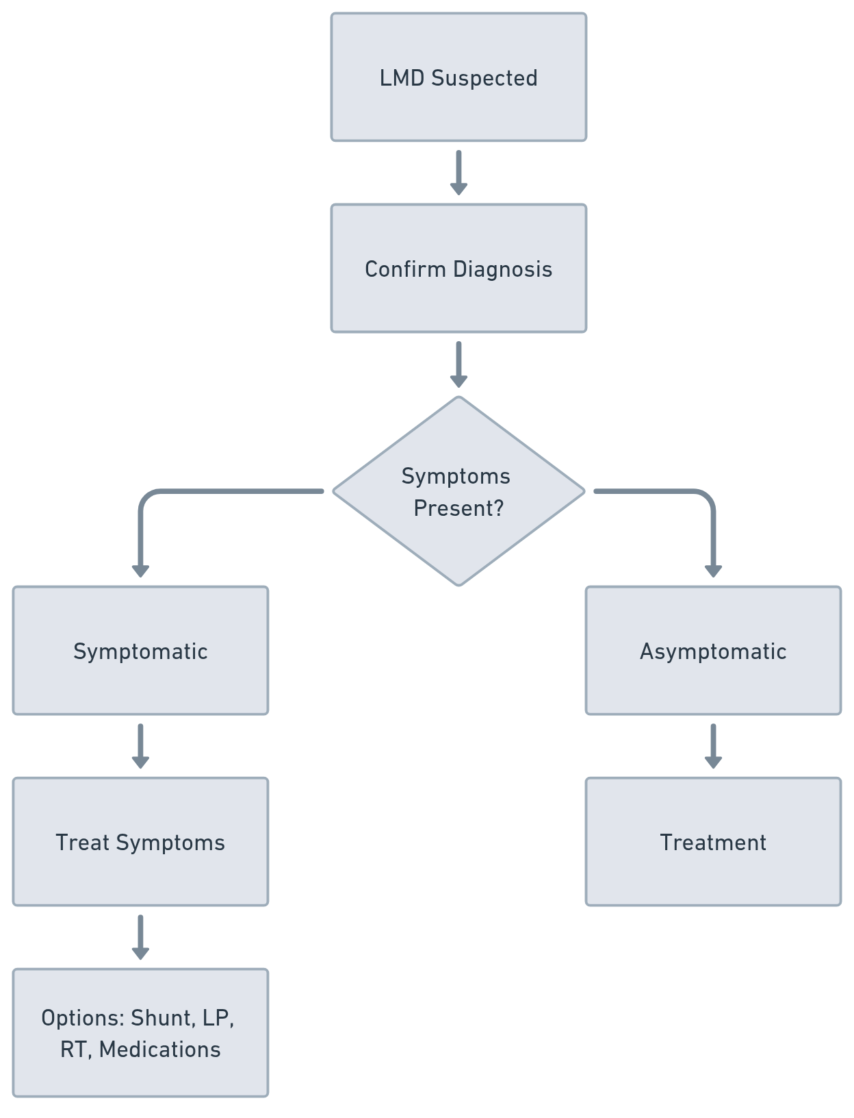
Leptomeningeal Disease
Vera A, Dias Neto, Medina, A, A, Freret, M.. Radiation Oncology On-Call Handbook: CNS emergencies. Association of Residents in Radiation Oncology. December 2025.
Chief complaint: Nausea, vomiting, headache, cranial nerve deficits, seizures, and changes in mental status, cerebellar dysfunction, changes in
vision radiculopathy, cauda equina syndrome.
Signs: Papilledema, CN Neuropathies, Upper and Lower motor neuron pattern, Cauda Equina, Conus medullary
Physical Exam:
Neuro exam ( Mental status, CN, MS, Sensation,
Cerebellar signs (pronator drift, gait)
Labs:
CBC w/diff, CMP, PT/INR (LP), LP with CSF analysis.
CSF analysis:
>16 mmH2O, WBC, Xanthochromia, Protein, Glucose,
Flow cytometry, tumor markers
Imaging:
CT head w/o contrast: R/O bleeding
MRI Brain: T1 post contrast MPRAGE/T2 Flair
MRI Spine: Leptomeningeal Protocol (w/wo contrast)
Treatment:
Elevated ICP/Edema:
Dexamethasone 10 mg IV x 1, followed by 4 mg Q6 hrs
Seizures:
Ativan 2-4 mg IV -> followed by maintenance antiepileptics
Pain:
WHO scale for pain (careful with NSAIDS if bleeding)
MRI brain findings:
T1C: Leptomeningeal
enhancement (sugarcoating)
Bloomy Rind Sign T2 Flair (Abnormally elevated
signal within sulci)

Slide 5
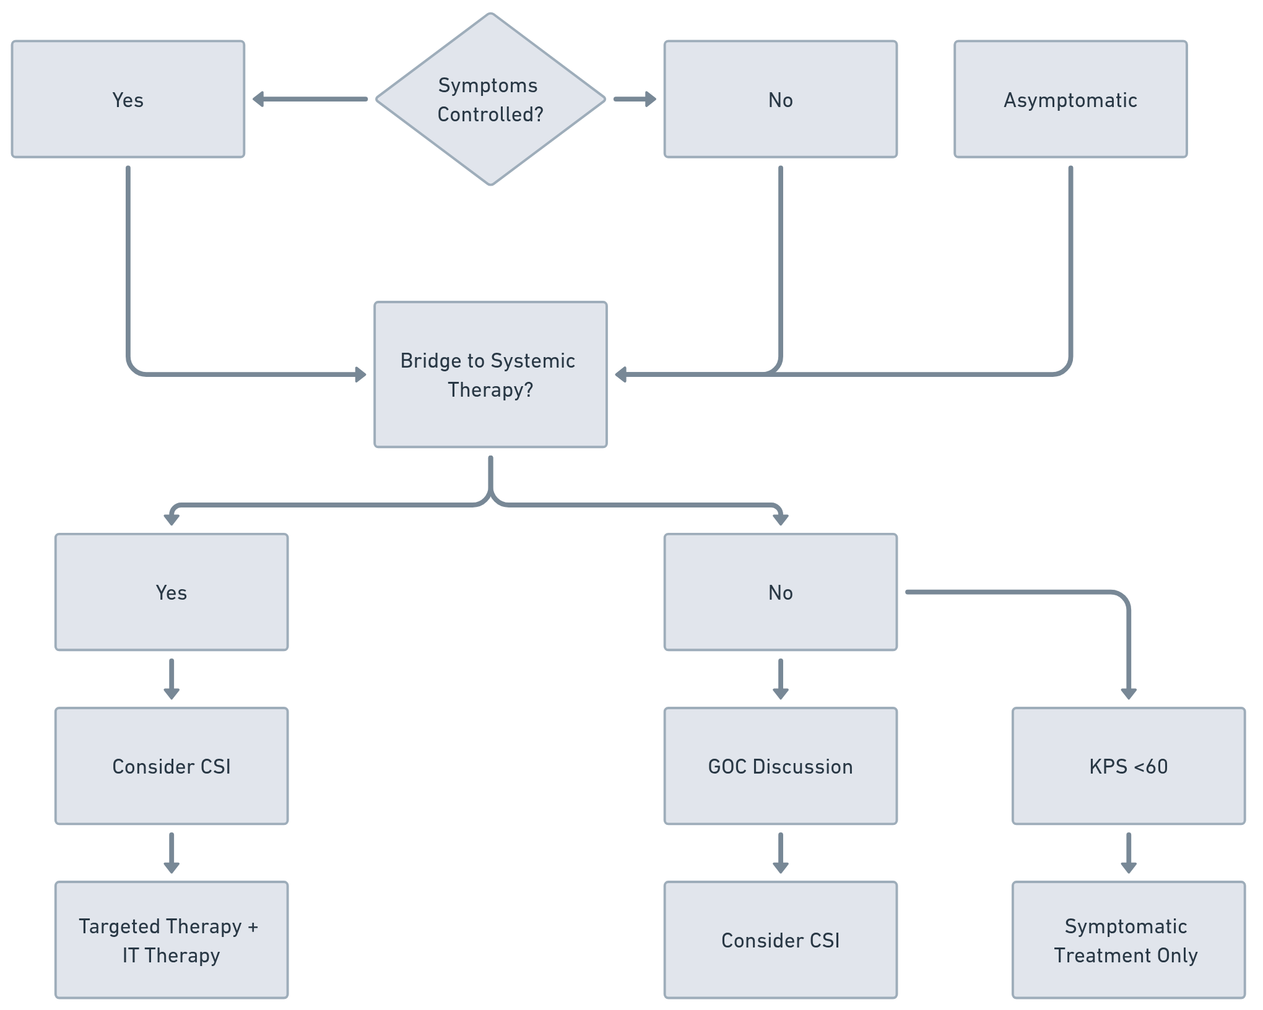
Leptomeningeal Disease
Vera A, Dias Neto, Medina, A, A, Freret, M.. Radiation Oncology On-Call Handbook: CNS emergencies. Association of Residents in Radiation Oncology. December 2025.
Consults:
Neuro Onc
Neurosurgery
Radiation Oncology
Treatment:
Always discuss the goals of therapy first
LMD-directed therapy:
Genomics and treatment history
Systemic Therapy for LMD (examples):
Nivolumab + Ipilimumab (melanoma)
Tucatinib, Capecitabine, and Trastuzumab (breast)
Osimertinib or alectinib (lung)
Dabrafenib (BRAF-mutant tumor)
Intrathecal Therapy
Omaya:
IT methotrexate, thiotepa, cytarabine, trastuzumab
Candidates for IT therapy:
No bulky disease, no hydrocephalus, absence of parenchymal Mets
RT:
CSI or WBRT: 30 Gy/10 Fx using IMRT/VMAT or IMPT

