Slide 1


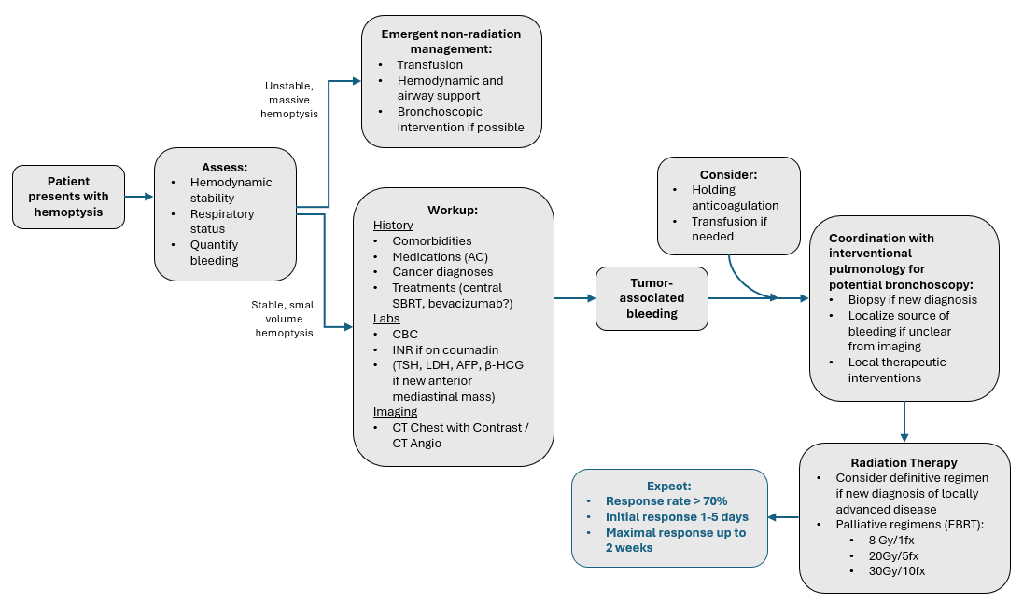
Hemoptysis
Arthur M, Doss VL, Kozono D. Radiation Oncology On-Call Handbook: Hemoptysis. Association of Residents in Radiation Oncology. January 23rd, 2026.
Chief complaint: coughing up blood
Triage:
Assess hemodynamic stability and respiratory status (pulse ox, blood pressure, ability to clear airway on own).
Massive hemoptysis typically involves tumor invasion of a major vessel and is often dramatic and quickly fatal.
More frequently, seen as a small amount of bleeding in mucous or with coughing, representing tumor eroding into small intrapleural vessel or friable endobronchial tumor.
Workup:
History with attention to comorbidities, anti-coagulation (AC), cancer history, treatment history (central SBRT?, bevacizumab?), recent interventions (bronchoscopic biopsy). Quantify amount of bleeding, duration, progression. Lab work with CBC. CT Chest with contrast / CT Angio. Focused clinical exam.
Management:
Medical: Transfusion > fluids if anemic or hemodynamically unstable, consider holding AC.
Non-Radiation Intervention: If non-life-threatening hemoptysis, then bronchoscopy (coordinate with interventional pulmonology team) is often required to establish diagnosis and exact location of bleeding.
Able to obtain path if new diagnosis
Local therapeutic interventions available during bronchoscopy
Radiation Treatment:
Once acute bleeding is stabilized, RT can offer more durable control with aim of reducing risk of future bleeding.
Dose and Fractionation: Definitive regimens if appropriate. Consider palliative regimens such as 8 Gy in 1 fx, 20 Gy in 5 fx, 30 Gy in 10 fx.
Expected Response and Durability: Response rates > 70% within period of days to weeks.
Sense of Urgency:
Massive hemoptysis → emergent (non-radiation) management
Stable, but requiring inpatient management and transfusions or increasing volume of hemoptysis → urgent
Small volume (blood-tinged mucous), stable, outpatient setting → non-urgent, typical outpatient timeline

Slide 2
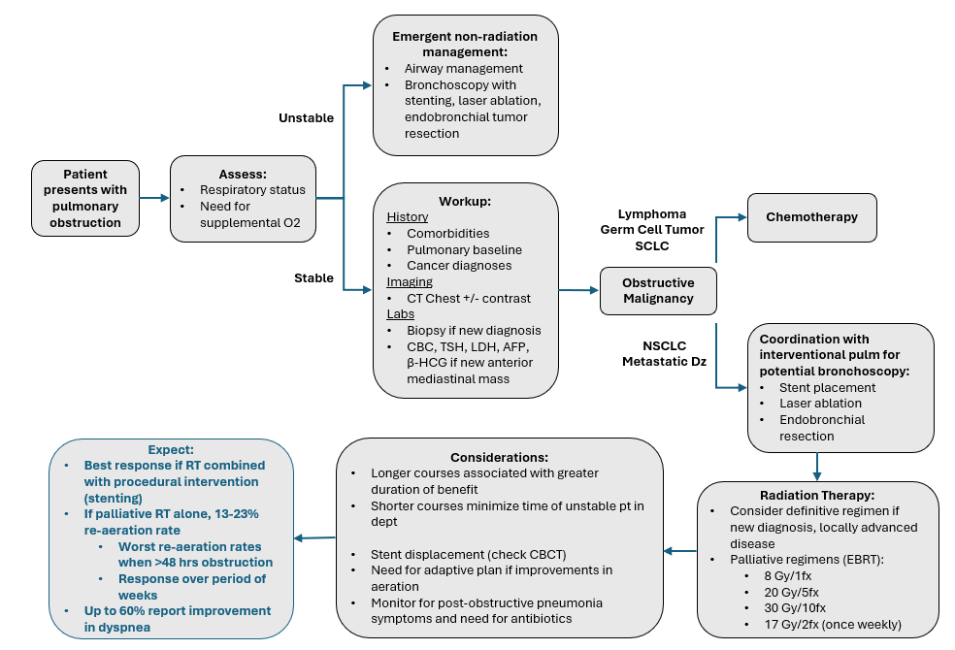
Airway Obstruction
Arthur M, Doss VL, Kozono D. Radiation Oncology On-Call Handbook: Airway Obstruction. Association of Residents in Radiation Oncology. January 23rd, 2026.
Chief complaint: shortness of breath, dyspnea with exertion, increased supplemental oxygen requirements, chest pain, post-obstructive pneumonia
Triage:
Assess respiratory status (need for supplemental oxygen).
Workup:
History with attention to comorbidities and baseline pulmonary status, cancer history. Imaging with CT Chest +/- contrast. Focused physical exam. If new diagnosis, then (bronchoscopic) biopsy, consider lab work (CBC, LDH, AFP, β-HCG) if anterior mediastinal mass.
Management:
Medical:
Chemotherapy is the primary initial treatment for lymphomas, germ cell tumors, and SCLC.
Non-Radiation Intervention:
Patients with unstable respiratory status often require initial procedural intervention, such as bronchoscopy with stenting or laser ablation as a faster means of intervention.
In non-emergent airway situations, discuss multidisciplinary care with interventional pulmonology for possible airway stenting, endobronchial tumor resection/laser ablation prior to RT.
Radiation Treatment:
Most effective after primary intervention (stenting, laser ablation) for reducing risk of re-obstruction from tumor progression.
Dose and Fractionation: Definitive regimens if appropriate (new diagnosis, localized). Consider palliative regimens such as 8 Gy in 1 fx, 20 Gy in 5 fx, 30 Gy in 10 fx, 17 Gy in 2 fx (once weekly).
Additional considerations: Monitor for change in positioning of stent throughout treatment (seen on CBCT), consider adaptive plan if improvement in aeration during treatment.
Expected Response and Durability: Palliative interventions without stenting/laser ablation have low rates of re-aeration (13 – 23%), especially if obstruction >48 hours. However, up to 60% experience improvement in dyspnea.
Obstructive Thoracic Mass Oncology Differential: Primary lung cancer (NSCLC, SCLC), metastatic disease, other mediastinal tumors (lymphoma, thyroid, thymoma, teratoma)
Symptoms most significant when there is obstruction of proximal airways (primary and secondary bronchi)

