Slide 1


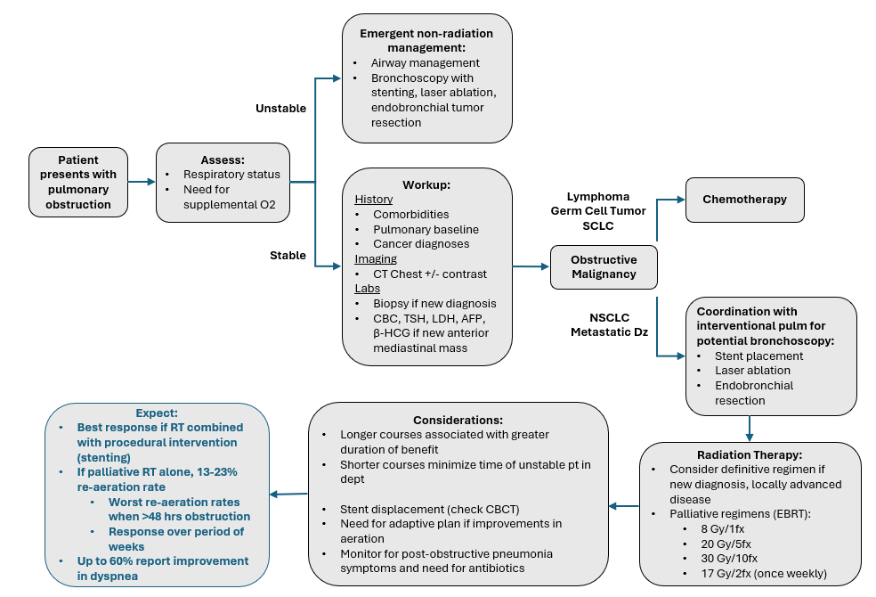
Airway Obstruction
Arthur M, Doss VL, Kozono D. Radiation Oncology On-Call Handbook: Airway Obstruction. Association of Residents in Radiation Oncology. January 23rd, 2026.
Chief complaint: shortness of breath, dyspnea with exertion, increased supplemental oxygen requirements, chest pain, post-obstructive pneumonia
Triage:
Assess respiratory status (need for supplemental oxygen).
Workup:
History with attention to comorbidities and baseline pulmonary status, cancer history. Imaging with CT Chest +/- contrast. Focused physical exam. If new diagnosis, then (bronchoscopic) biopsy, consider lab work (CBC, LDH, AFP, β-HCG) if anterior mediastinal mass.
Management:
Medical:
Chemotherapy is the primary initial treatment for lymphomas, germ cell tumors, and SCLC.
Non-Radiation Intervention:
Patients with unstable respiratory status often require initial procedural intervention, such as bronchoscopy with stenting or laser ablation as a faster means of intervention.
In non-emergent airway situations, discuss multidisciplinary care with interventional pulmonology for possible airway stenting, endobronchial tumor resection/laser ablation prior to RT.
Radiation Treatment:
Most effective after primary intervention (stenting, laser ablation) for reducing risk of re-obstruction from tumor progression.
Dose and Fractionation: Definitive regimens if appropriate (new diagnosis, localized). Consider palliative regimens such as 8 Gy in 1 fx, 20 Gy in 5 fx, 30 Gy in 10 fx, 17 Gy in 2 fx (once weekly).
Additional considerations: Monitor for change in positioning of stent throughout treatment (seen on CBCT), consider adaptive plan if improvement in aeration during treatment.
Expected Response and Durability: Palliative interventions without stenting/laser ablation have low rates of re-aeration (13 – 23%), especially if obstruction >48 hours. However, up to 60% experience improvement in dyspnea.
Obstructive Thoracic Mass Oncology Differential: Primary lung cancer (NSCLC, SCLC), metastatic disease, other mediastinal tumors (lymphoma, thyroid, thymoma, teratoma)
Symptoms most significant when there is obstruction of proximal airways (primary and secondary bronchi)

Slide 2
Emergent non-radiation management:
Airway management
Bronchoscopy with stenting, laser ablation, endobronchial tumor resection
Unstable
Patient presents with pulmonary obstruction
Assess:
Respiratory status
Need for supplemental O2
Workup:
History
Comorbidities
Pulmonary baseline
Cancer diagnoses
Imaging
CT Chest +/- contrast
Labs
Biopsy if new diagnosis
CBC, TSH, LDH, AFP, β-HCG if new anterior mediastinal mass
Chemotherapy
Lymphoma
Germ Cell Tumor
SCLC
Stable
Obstructive Malignancy
NSCLC
Metastatic Dz
Coordination with interventional pulm for potential bronchoscopy:
Stent placement
Laser ablation
Endobronchial resection
Expect:
Best response if RT combined with procedural intervention (stenting)
If palliative RT alone, 13-23% re-aeration rate
Worst re-aeration rates when >48 hrs obstruction
Response over period of weeks
Up to 60% report improvement in dyspnea
Considerations:
Longer courses associated with greater duration of benefit
Shorter courses minimize time of unstable pt in dept
Stent displacement (check CBCT)
Need for adaptive plan if improvements in aeration
Monitor for post-obstructive pneumonia symptoms and need for antibiotics
Radiation Therapy:
Consider definitive regimen if new diagnosis, locally advanced disease
Palliative regimens (EBRT):
8 Gy/1fx
20 Gy/5fx
30 Gy/10fx
17 Gy/2fx (once weekly)

