Slide 1


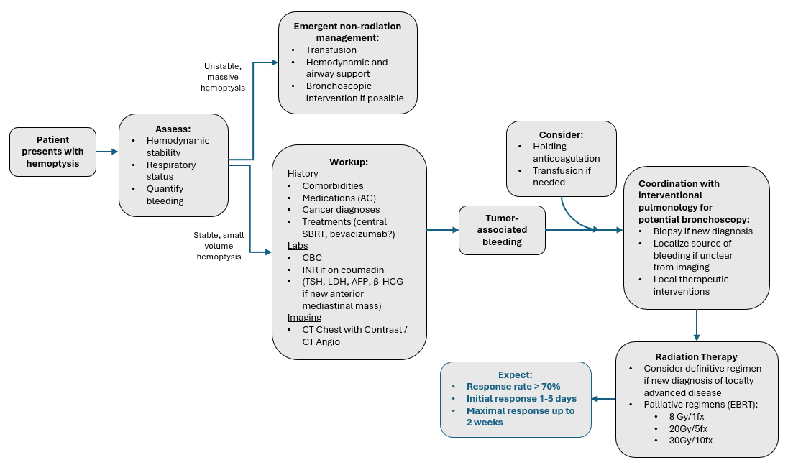
Hemoptysis
Arthur M, Doss VL, Kozono D. Radiation Oncology On-Call Handbook: Hemoptysis. Association of Residents in Radiation Oncology. January 23rd, 2026.
Chief complaint: coughing up blood
Triage:
Assess hemodynamic stability and respiratory status (pulse ox, blood pressure, ability to clear airway on own).
Massive hemoptysis typically involves tumor invasion of a major vessel and is often dramatic and quickly fatal.
More frequently, seen as a small amount of bleeding in mucous or with coughing, representing tumor eroding into small intrapleural vessel or friable endobronchial tumor.
Workup:
History with attention to comorbidities, anti-coagulation (AC), cancer history, treatment history (central SBRT?, bevacizumab?), recent interventions (bronchoscopic biopsy). Quantify amount of bleeding, duration, progression. Lab work with CBC. CT Chest with contrast / CT Angio. Focused clinical exam.
Management:
Medical: Transfusion > fluids if anemic or hemodynamically unstable, consider holding AC.
Non-Radiation Intervention: If non-life-threatening hemoptysis, then bronchoscopy (coordinate with interventional pulmonology team) is often required to establish diagnosis and exact location of bleeding.
Able to obtain path if new diagnosis
Local therapeutic interventions available during bronchoscopy
Radiation Treatment:
Once acute bleeding is stabilized, RT can offer more durable control with aim of reducing risk of future bleeding.
Dose and Fractionation: Definitive regimens if appropriate. Consider palliative regimens such as 8 Gy in 1 fx, 20 Gy in 5 fx, 30 Gy in 10 fx.
Expected Response and Durability: Response rates > 70% within period of days to weeks.
Sense of Urgency:
Massive hemoptysis → emergent (non-radiation) management
Stable, but requiring inpatient management and transfusions or increasing volume of hemoptysis → urgent
Small volume (blood-tinged mucous), stable, outpatient setting → non-urgent, typical outpatient timeline

Slide 2
Emergent non-radiation management:
Transfusion
Hemodynamic and airway support
Bronchoscopic intervention if possible
Unstable, massive hemoptysis
Assess:
Hemodynamic stability
Respiratory status
Quantify bleeding
Consider:
Holding anticoagulation
Transfusion if needed
Patient presents with hemoptysis
Workup:
History
Comorbidities
Medications (AC)
Cancer diagnoses
Treatments (central SBRT, bevacizumab?)
Labs
CBC
INR if on coumadin
(TSH, LDH, AFP, β-HCG if new anterior mediastinal mass)
Imaging
CT Chest with Contrast / CT Angio
Coordination with interventional pulmonology for potential bronchoscopy:
Biopsy if new diagnosis
Localize source of bleeding if unclear from imaging
Local therapeutic interventions
Tumor-associated bleeding
Stable, small volume hemoptysis
Radiation Therapy
Consider definitive regimen if new diagnosis of locally advanced disease
Palliative regimens (EBRT):
8 Gy/1fx
20Gy/5fx
30Gy/10fx
Expect:
Response rate > 70%
Initial response 1-5 days
Maximal response up to 2 weeks

