Slide 1


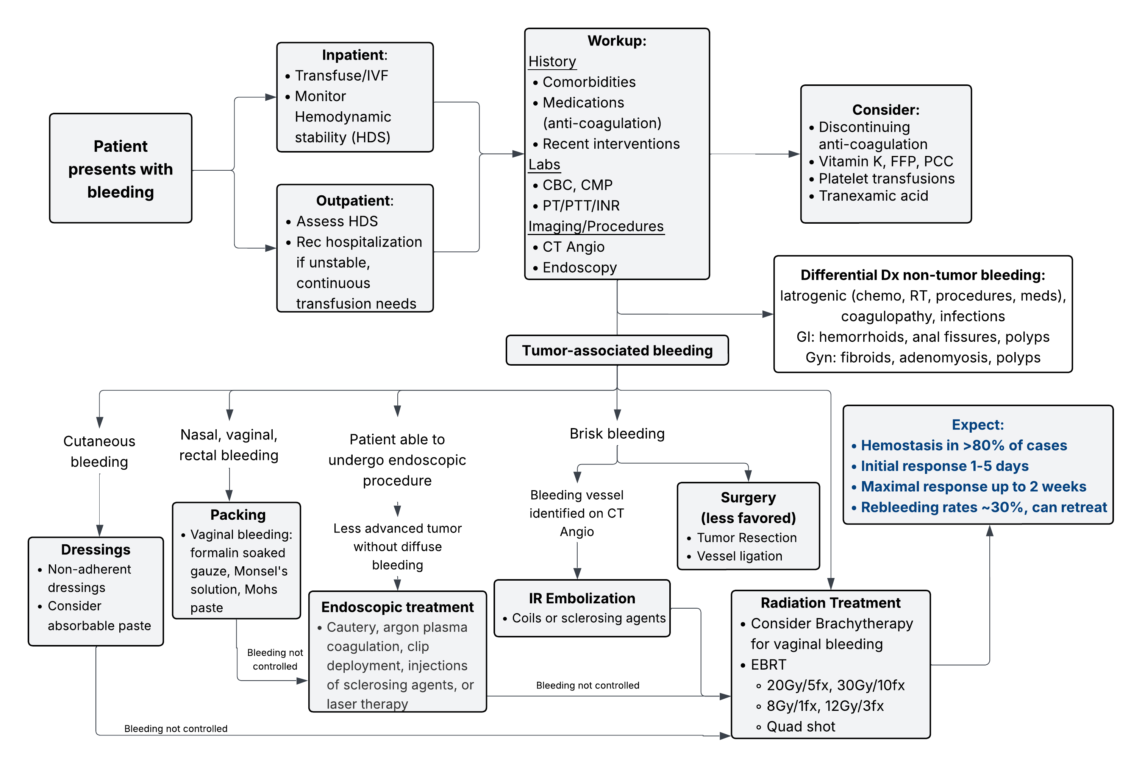
Palliative Radiation for Tumor Bleeding
Zhao S, Neibart SS, Turner, BE.. Radiation Oncology On-Call Handbook: Palliative Radiation for Tumor Bleeding. Association of Residents in Radiation Oncology. September 15th, 2025.
Chief complaint: Epistaxis, hemoptysis, hematemesis, melena, hematochezia, hematuria, vaginal, cutaneous bleeding or unexplained anemia
Triage:
Assess hemodynamic stability, CBC. Hospitalization for instability or continuous transfusion needs
Workup:
History with attention to comorbidities, anti-coagulation (AC), treatment history, recent interventions/surgeries. Lab work with CBC, CMP, coagulation panel. Focused clinical exam (e.g., rectal exam). Consider IR consult.
Identify bleeding source: CT Angio, endoscopy (EGD, colonoscopy, bronchoscopy, cystoscopy, hysteroscopy)
Management:
Medical: Transfusions > fluids, correct coagulopathy, consider holding AC, consider tranexamic acid
Local hemostasis: Dressings/packing and hemostatic agents for cutaneous, nasal, rectal, vaginal bleeding
Non-Radiation Intervention: Endoscopic intervention, IR embolization, operative intervention in select cases
Radiation treatment:
Consider plan to receive definitive therapy
Dose and fractionation): Various recommendations by site. Consider 20 Gy in 5 fx, 30 Gy in 10 fx, 14 Gy in 4 fx bid (Quad Shot), more limited evidence for 8 Gy in 1 fx
Expected response and durability: bleeding resolution may take up to a few weeks. Rebleeding ~30%, median time to rebleeding 5-8 months.
Follow-up: monitor CBC, transfusion requirements.

