Slide 1


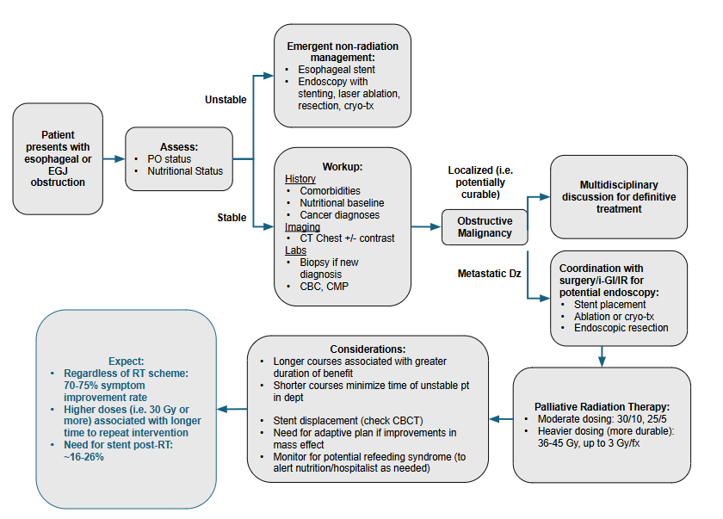
Dysphagia
***Insert citation here
Chief complaint: Trouble swallowing, food/drink “getting stuck”, vomiting/regurgitating w/wo aspiraiton
Triage:
Assess obstruction status (partial vs full). Assess nutritional status. Hospitalization for PO intolerance, feeding tube, TPN, etc.
Workup:
History with attention to comorbidities, anti-coagulation (AC), treatment history, recent interventions/surgeries.
Lab work with CBC, CMP, coagulation panel.
Imaging: CT-Chest w/contrast
Endoscopy: EGD
Consults:
Surgery
(Trauma, Surg-Onc, Thoracic for esophageal mass, etc.)
G-tube, Ex-lap, etc.
Interventional GI (i-GI), Interventional Radiology (IR)
Esophageal Patency: Stenting
Tumor-directed: Resection, ablation, cryotherapy
Nutrition
Address nutritional status (G-tube, TPN, etc.)
Severity:
Acute obstruction (cannot take PO, aspiration risk)
Intervention: Stenting, ablation, cryo-tx, etc.
Address nutritional status (G-tube, TPN, etc.)
Non-acute
Inpatient or outpatient RT
Radiotherapy:
Definitive regimens as part of multidisciplinary therapy if appropriate (new diagnosis, localized).
Conventional fractionation, w/wo chemo
Palliative
Range from moderate dose (20/5, 30/10, 25/5) to heavier dose (36-45Gy total dose in ~3 Gy/fx)
Tips:
Monitor for change in positioning of stent throughout treatment (seen on CBCT), consider adaptive plan if improvement in aeration during treatment.
Obstructive Esophageal Mass Oncology Differential: Most likely primary esophageal malignancy (AdenoCa, SCC)

Slide 2
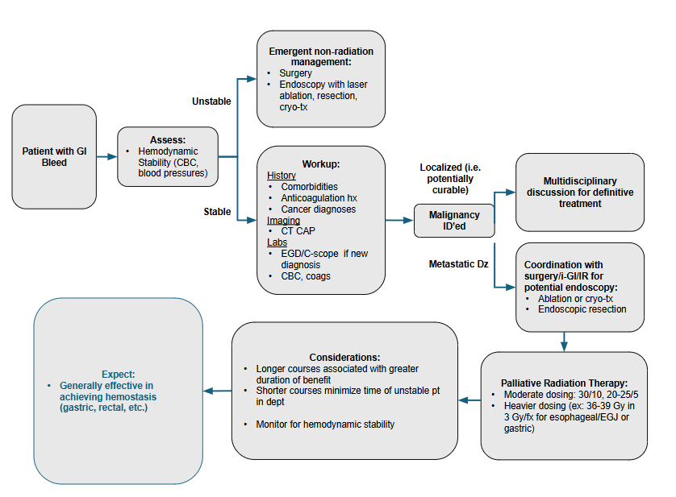
GI Bleeding
***Insert citation here
Chief complaint: Hematemesis/Hematochezia/Melena, signs of anemia/hypotension (lightheaded/syncope, etc.)
Triage:
Assess hemodynamic stability (BP’s, CBC); hospitalize if hemodynamically unstable or transfusion-dependent
Locate source of bleeding (upper GI vs lower GI)
Upper GI: Hematemesis
Lower GI: Hematochezia, melena
Workup:
History with attention to onset/duration of sx’s, types of sx’s to determine location (Upper vs Lower GI), comorbidities, anti-coagulation (AC), treatment history, recent interventions/surgeries.
Lab work with CBC, coagulation panel.
Imaging: CT-CAP w/contrast
Endoscopy: EGD & Colonoscopy
Consults:
Surgery
(Trauma, Surg-Onc, Thoracic for esophageal mass, Colorectal, etc.)
Ex-lap, etc.
Interventional GI (i-GI), Interventional Radiology (IR)
Tumor directed: Cauterization/ablation/cyro-tx of bleed
Severity:
Hemodynamically unstable (hypotensive) or Severe anemia (Hgb<7)
Interventional consults as above
Blood transfusions until stable
Non-acute
Inpatient or outpatient RT
Radiotherapy:
Definitive regimens as part of multidisciplinary therapy if appropriate (new diagnosis, localized).
Palliative
Moderate dose: 20/5, 30/10, 25/5 (especially for esophageal/EGJ or rectal)
Site specific: Consider 36-39 Gy in 3Gy/fx for Esophageal/Gastric tumors
GI Bleed Differential: Upper vs Lower GI (primary GI tumors vs metastases), non-oncologic causes (esophageal varices, bleeding from anticoagulation, hemorrhoids, etc.)

Slide 3
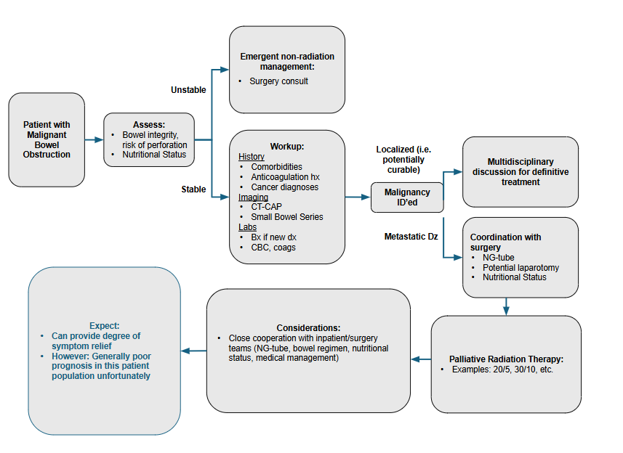
Bowel Obstruction
***Insert citation here
Chief complaint: Lack of bowel movements, nausea/vomiting
Triage:
Assess obstruction status (partial vs full), ask about last BM, passing gas, etc. Assess nutritional status. Hospitalization for PO intolerance, feeding tube, TPN, etc.
Workup:
History with attention to onset/duration of sx’s, types of sx’s to determine location (Upper vs Lower GI), comorbidities, anti-coagulation (AC), treatment history, recent interventions/surgeries.
Lab work with CBC, coagulation panel.
Imaging: CT-CAP w/contrast
Endoscopy: EGD & Colonoscopy
Consults:
Surgery
NG-tube; ex-lap in urgent cases
Nutritional: TPN, etc.
Palliative care: Medical Management
Severity:
Complete obstruction, bowel perforation/ischemia, etc.
Urgent Surgical Consult
Non-acute
Inpatient or outpatient RT
Radiotherapy:
Definitive regimens as part of multidisciplinary therapy if appropriate (new diagnosis, localized).
Palliative
Variable (20/5, 30/10, etc.)
Bowel Obstruction: Malignant (primary GI tumors vs pelvic tumors vs metastases), non-oncologic causes (bowel dysmotility, constipation, etc.)

Slide 4


Overview of Gastrointestinal Emergencies
Ho, A.. Radiation Oncology On-Call Handbook: Gastrointestinal Emergencies. Association of Residents in Radiation Oncology. September 15th, 2025.
Chief complaints: Dysphagia, Bleeding (hematemesis or hematochezia), bowel obstruction, pain
Triage:
Bleeding: Assess hemodynamic stability, CBC. Hospitalization for instability or continuous transfusion needs
Dysphagia or Bowel Obstruction: Assess obstruction status (partial vs full), ask about last BM, passing gas, etc. Assess nutritional status. Hospitalization for PO intolerance, feeding tube, TPN, etc.
Pain: Assess degree of pain. Hospitalization for pain control
Workup:
History with attention to comorbidities, anti-coagulation (AC), treatment history, recent interventions/surgeries.
Lab work with CBC, CMP, coagulation panel.
Focused clinical exam (e.g. DRE, palpation of painful mass)
Imaging: CT mainly (consider small bowel series for obstruction, etc.)
Endoscopy: EGD, colonoscopy
Consults: (ALWAYS have surgical/interventional consult on board for acute management)
Surgery (Trauma, Surg-Onc, Thoracic for esophageal mass, Colorectal, etc.)
NG-tube, Ex-lap, etc.
Interventional GI (i-GI), Interventional Radiology (IR)
Cauterization of bleeds, stenting, etc.
(IR only: Nerve blocks)
Dysphagia: In setting of known esophageal tumor or metastatic disease in esophagus
Dose and Fx Heavier (more durable): 30/10 to 39/13, 25/5
Lighter: 20/5, 8/1 (less favored)
CC: Dysphagia, (Vomiting)
H&P
Cachexia / Nutrition Status Weight Loss over 3 mo. Basic Labs 🡪 Albumin
Consults
i-GI (stent), Surgery
Diagnostics
CT w/contrast EGD
Bleeding: In setting of known primary lesion (e.g. rectal), or metastatic lesion involving bowel
Dose and Fx Heavier: 30/10, 25/5, 36/12 (if stomach)
Lighter: 20/5
CC: Bleeding (distinguish upper vs lower)
H&P
Acute vs. chronic sx’s
Hgb trend
Pre vs post transfusion Hgb
Consults
i-Gi or IR (cauterization, ablation), Surgery
Diagnostics
CT w/contrast EGD and/or Colonoscopy
CT-Angio
Bowel Obstruction: In setting of primary lesion (e.g. colon) or metastatic lesion
Dose and Fx Heavier: 30/10, 25/5
Lighter: 20/5
CC: Nausea, vomiting, no BM’s
H&P
Last BM, passing gas (partial vs full BO)
Consults
Surgery (NG-tube, ex-lap, etc.)
Diagnostics
Small Bowel Series
CT w/contrast Colonoscopy
Pain: Usually soft tissue mass effect, could be nerve involvement as well
Dose and Fx (SBRT for celiac plexus involvement, pain is challenging to manage)
Standard: 30/10, 20/5 to 25/5
CC: Pain
H&P
Acute vs. chronic, duration, location, etc.
Physical Exam! (palpation)
Consults
Palliative
IR (nerve block)
Diagnostics
CT

