Slide 1
Introduction to batch correction and evaluation
Johnathan Lo, 2020

Slide 2
Why batch correction?
Experiments are designed to isolate and test the effects of treatments independently
however, practicality imposes limits
Data must sometimes be collected in batches, and differences may result from temporal, climactic, seasonal, technological, and other differences from batch to batch
And what about data from different experiments?
Data often is labeled differently and exists in a different feature space with unknown correspondence

Slide 3
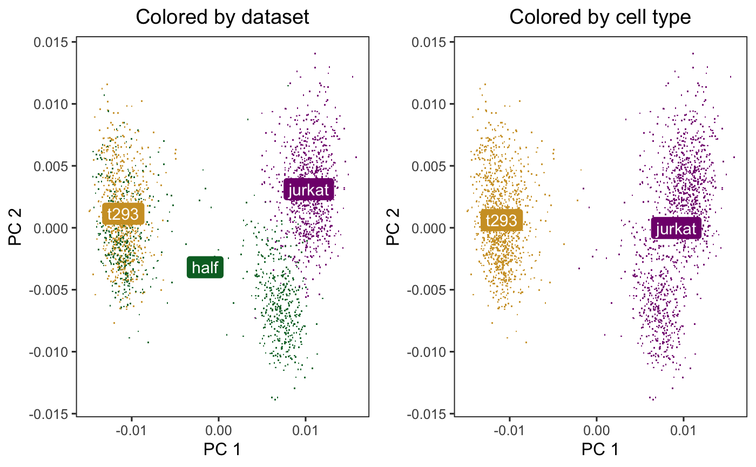
An illustration
3 datasets (which we will later explore on our own in Python) – t293, jurkat and half.
T293 and jurkat are samples from pure cell lines, half is a 50:50 admixture.
Only two cell types so we expect 2 clusters, but PCA reveals 3 distinct clusters – batch effect

Slide 4
Methods for batch correction
Harmony
Korsunsky, I., Millard, N., Fan, J. et al. Fast, sensitive and accurate integration of single-cell data with Harmony. Nat Methods 16, 1289–1296 (2019). https://doi.org/10.1038/s41592-019-0619-0
UnionCom
Kai Cao, Xiangqi Bai, Yiguang Hong, Lin Wan, Unsupervised topological alignment for single-cell multi-omics integration, Bioinformatics, Volume 36, Issue Supplement_1, July 2020, Pages i48–i56, https://doi.org/10.1093/bioinformatics/btaa443
MMD-ResNet
Shaham U, Stanton KP, Zhao J, et al. Removal of batch effects using distribution-matching residual networks. Bioinformatics (Oxford, England). 2017 Aug;33(16):2539-2546. DOI: 10.1093/bioinformatics/btx196.
Will cover each of these from a (very basic) theoretical perspective and then implementation

Slide 5
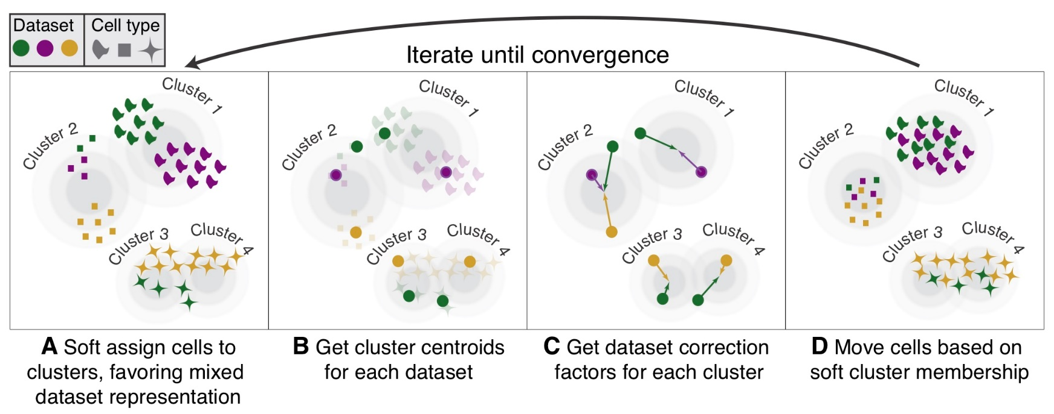
Harmony
2 step, iterative linear method
Use PCA to cluster and rank by proportionate distribution of cells across datasets (from well mixed to disproportionate)
Define cluster centroids for each dataset and correct datasets by cluster to reduce distance between centroids
Assumes independence between cluster and batch assignment (which is usually the case, but not necessarily so)

Slide 6
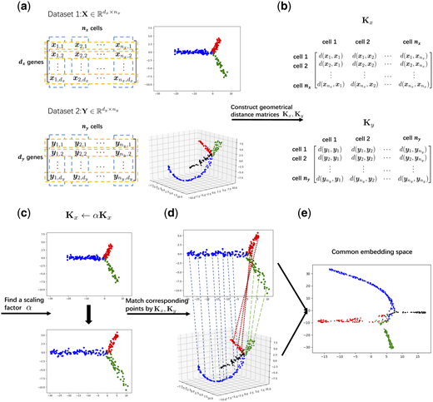
UnionCom
Expressly designed for data integration, not batch correction
Does not require correspondence between cells or features
Constructs low-dimn distance matrix for each dataset and aligns manifold by matching the distance matrices across datasets

Slide 7
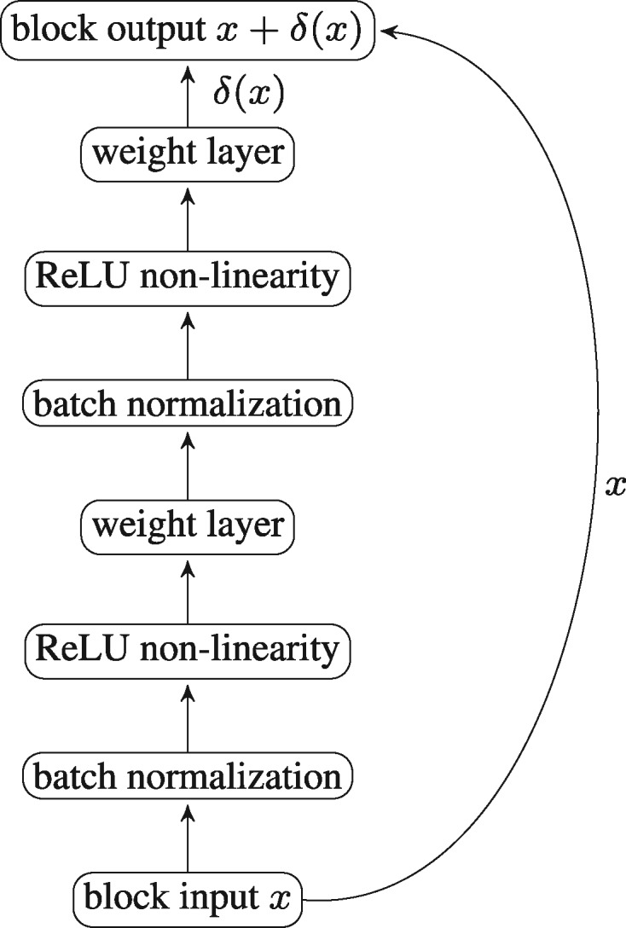
MMD-ResNet
Deep learning approach, uses residual neural network to minimize MMD (maximum mean discrepancy)
MMD is a measure of the “difference” between probability distributions
ResNets are formed from blocks that iteratively conduct batch normalization and non-linear corrections
Map dataset A to dataset B by maximizing the likelihood that the data in A comes from the distribution of B

Slide 8
Evaluation methods
How do we determine if batch correction is successful?
Visual (heuristic) inspection
Quantitative metrics
Visualizations
PCA, t-SNE, UMAP
Intrinsically dimensionality reduction but can be used as technique to make clusters visible to humans
Quantitative metrics
ASW, ARI, LISI, kBET

Slide 9
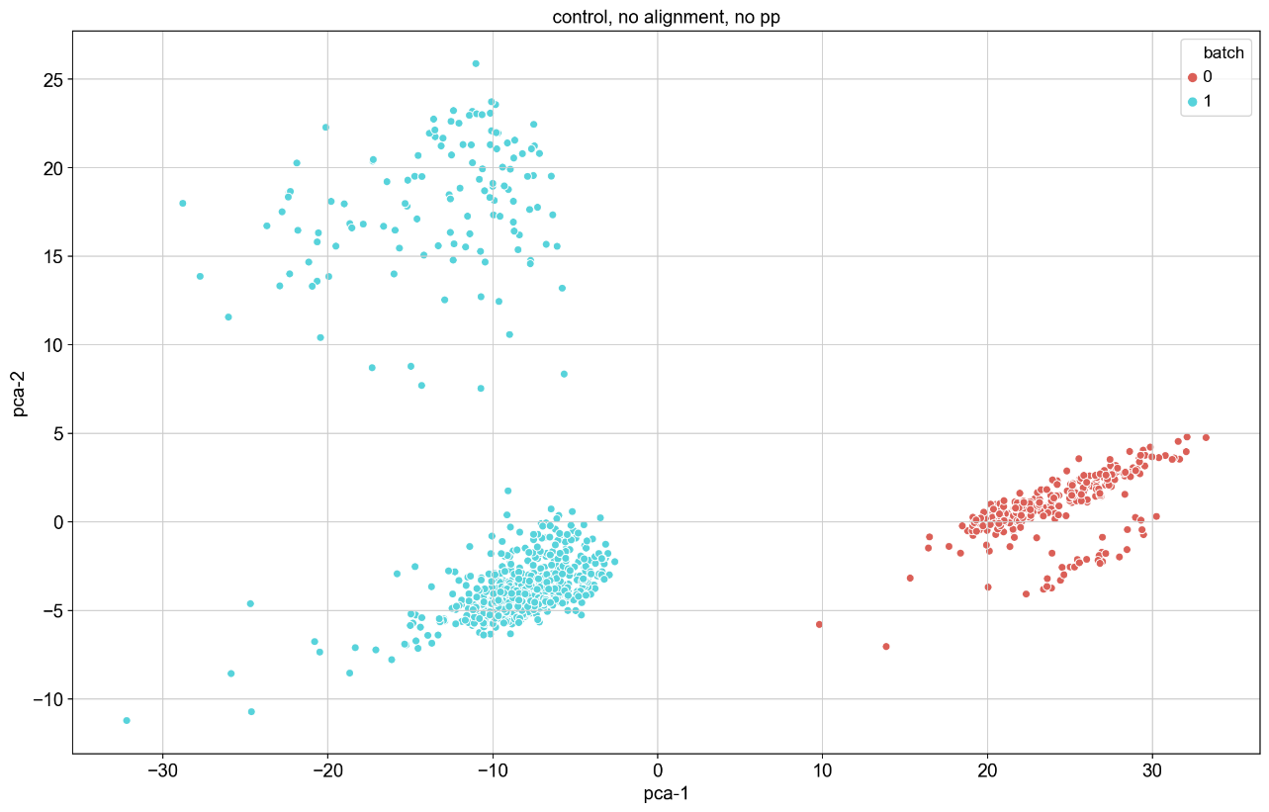
PCA – Principal component analysis
Good old technique from linear algebra that we are all familiar with
Iteratively finds linear combinations of original bases that account for the greatest variance to produce a new set of orthogonal bases
Bases that account for less variance in data can be discarded
Example from a dataset that we will look at later

Slide 10
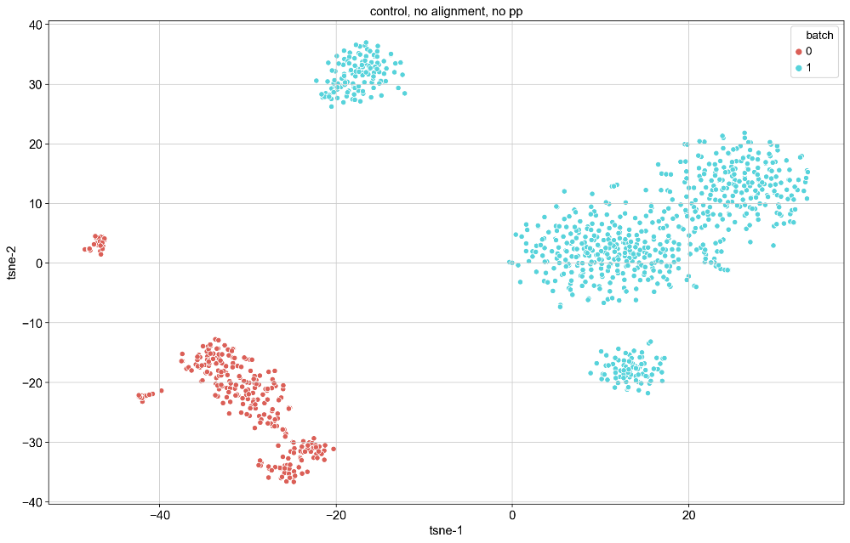
t-SNE (t-distributed stochastic neighbor embeddings)
Graph-based method for visualization
Preserves local geometry by computing a similarity matrix for data points
Reduces space down to set number of dimensions (2 or 3 for visualization) and places points randomly in the space
Computes new similarities between points and gradually transforms the new space so that this second similarity matrix is as close as possible to the first.
Similarity scores are computed based on the normal distribution for the first similarity matrix and the t-distribution for the second
Use cost function based on KL-divergence (measure of difference between distributions)
Same dataset as previous slide, visualized with t-SNE

Slide 11
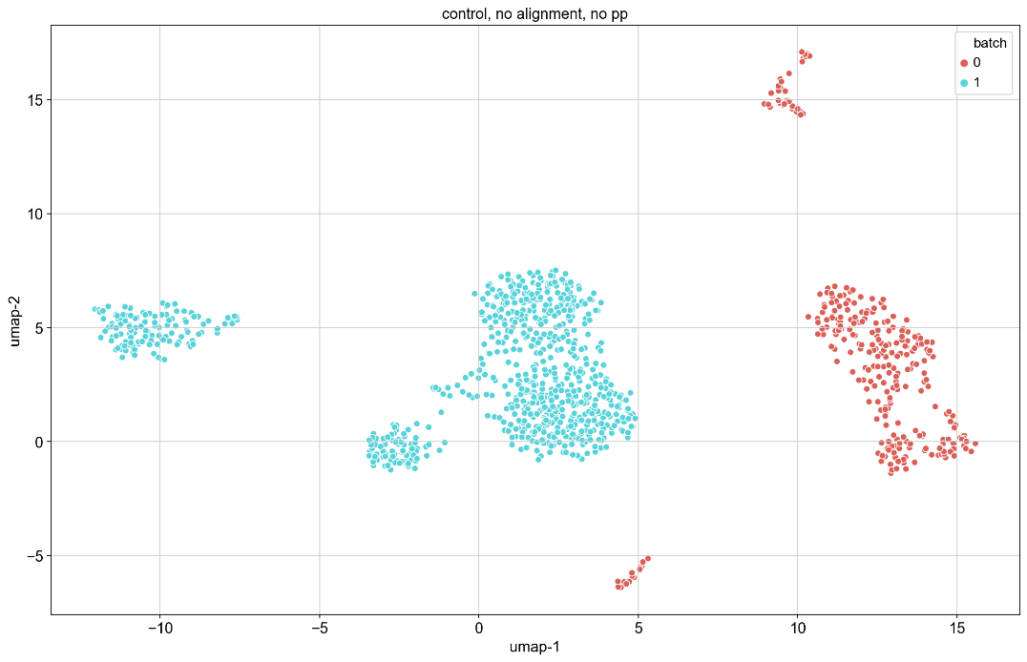
UMAP – Uniform Manifold Approximation and Projection
Graph based method using simplicial complexes
Cover a manifold by altering distance metric to ensure connectivity
Preserves both local and global structure
Cost function based on cross entropy from information theory
UMAP version of dataset from previous slide

Slide 12
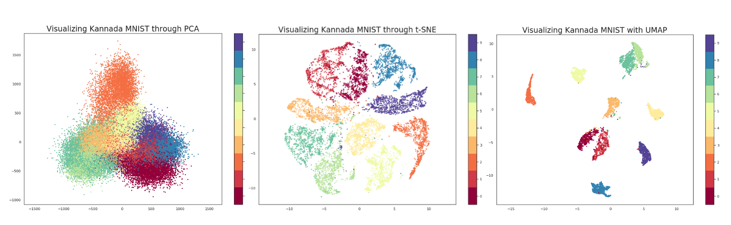
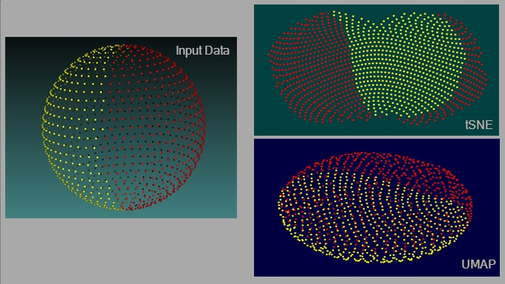
t-SNE vs UMAP vs PCA
Credit: Parul Pandey
Credit: James X. Li

Slide 13
t-SNE vs UMAP vs PCA
t-SNE does not capture global structure well – in other words, the distances between clusters on the resulting projection is not informative; UMAP and PCA preserve global structure
UMAP and t-SNE capture non-linear correlations between variables, but PCA does not
All three use different cost functions; KL-divergence used by t-SNE results in low to no cost for points that are distant in high dimension becoming close in lower dimension, while CE used by UMAP has a large penalty for both close points becoming distant and distant points becoming close.

Slide 14
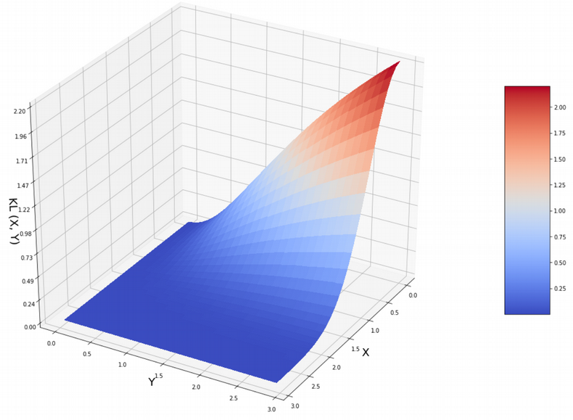
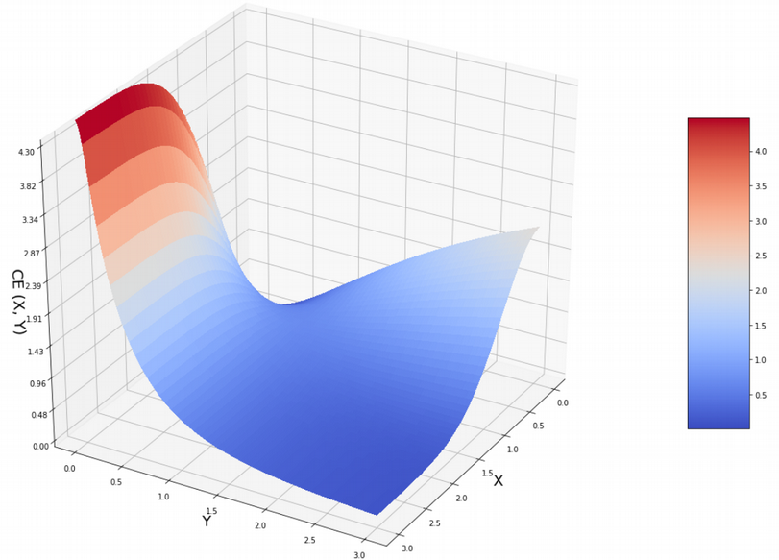
t-SNE vs UMAP vs PCA
KL-divergence on left, CE on right, X is distance in high dim’n, Y is distance in low dim’n. Credit: Nikolay Oskolkov

Slide 15
t-SNE vs UMAP vs PCA
Conflicting opinions on use of alternative initialization parameters for t-SNE to overcome difficulty in preserving global structure
See https://towardsdatascience.com/why-umap-is-superior-over-tsne-faa039c28e99, https://doi.org/10.1038/s41467-019-13056-x, https://www.biorxiv.org/content/10.1101/2019.12.19.877522v1

Slide 16
kBET: k-nearest neighbor batch effect test
https://doi.org/10.1038/s41592-018-0254-1
Measure batch mixing on local level by taking the k-nearest neighbors of a random data point (a random neighborhood) and counting the number of neighbors from each batch.
Assumes that the batches are from repetitions of the same experiment and that major differences are only in technical covariates
Performs χ²-based test on each random neighborhood to determine if difference from overall batch distribution is significant at some level
Low rejection = good mixing

Slide 17
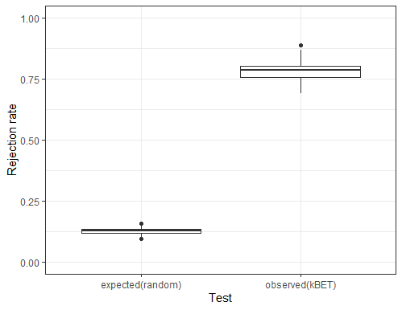
kBET - example
For the dataset to the left, kBET shows that clusters do not exhibit nearly as much homogenization as expected under the null.

Slide 18
LISI: local inverse Simpson’s index
https://doi.org/10.1038/s41592-019-0619-0
Addresses both issues with kBET raised above
For local diversity, neighborhoods are described by Gaussian kernel-based distributions using a fixed perplexity
To deal with datasets composed of differing cell types, the inverse Simpson’s index is used: (1/Σ_{b=1}^{B}p(b)).
Gives the expected number of cells to sample from a local neighborhood before two are drawn from the same batch
Knowing number of batches in a neighborhood allows users to incorporate their knowledge of dataset composition when determining which integration method works best

Slide 19
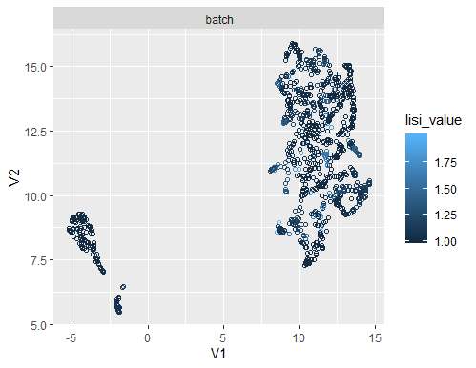
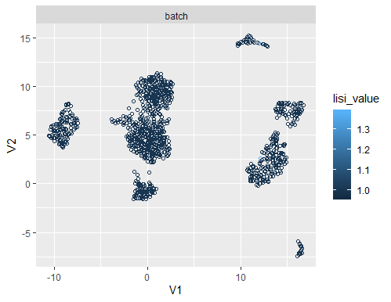
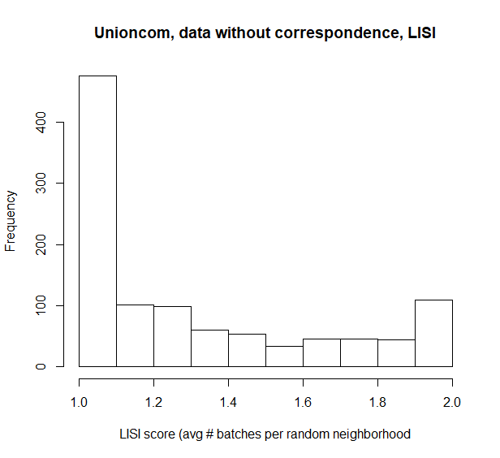
LISI - example
Top left shows good mixing, with many random neighborhoods showing high local diversity, bottom left shows poor mixing.
Bottom shows LISI results displayed as a histogram

Slide 20
ASW – average silhouette width
https://doi.org/10.1016/0377-0427(87)90125-7
Constructs “silhouettes” of each cluster that differentiate the data points within the cluster based on how close they are to the others
Average width of a silhouette shows how closely clustered data is
Range = [-1,1]
For cells by cell type (or other biological effect), we expect ASW to be high
For batch effects, we want ASW to be close to 0
Negative ASW indicates incorrect clustering (observations are closer to another cluster than their own)

Slide 21
ARI – adjusted rand index
https://doi.org/10.1007/BF01908075
Assess the congruence of two proximity matrices using a simple cross-product measure
If two partitions correspond, ARI -> 1. If the partitions are random, ARI -> 0
Similar to ASW

