Slide 1
Evaluation methods

Slide 2
Motivation
We have multiple methods for integrating datasets
We have multiple situations where integration is required
Datasets may occupy completely disjoint spaces or spaces may intersect.
We want to understand which method is “best” under different situations

Slide 3
How to evaluate integration methods
Artificially divide a single dataset into 2 or more, and change variable names
Run integration algorithm, find clusters, compare to results from unmodified data
Do the same cells cluster together? Do the clusters share the same local and global geometry?
How admixed are the data points from each batch?

Slide 4
Methods
Visualization
We want an accessible heuristic for quickly determining if the integration process worked
t-SNE, UMAP, PCA
Evaluation metrics
Need something more concrete to quantify differences between methods
kBET, LISI, ASW, ARI

Slide 5
t-SNE – t-distributed Stochastic Neighbor Embedding
Graph-based method for visualization
Preserves local geometry by computing a similarity matrix for data points
Reduces space down to set number of dimensions (2 or 3 for visualization) and places points randomly in the space
Computes new similarities between points and gradually transforms the new space so that this second similarity matrix is as close as possible to the first.
Similarity scores are computed based on the normal distribution for the first similarity matrix and the t-distribution for the second
Use cost function based on KL-divergence (measure of difference between distributions)

Slide 6
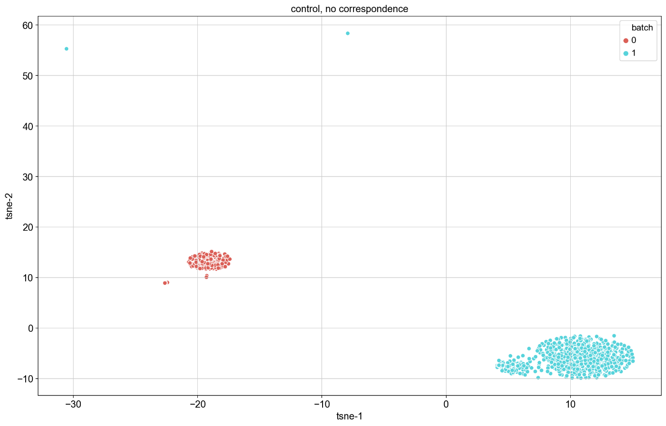
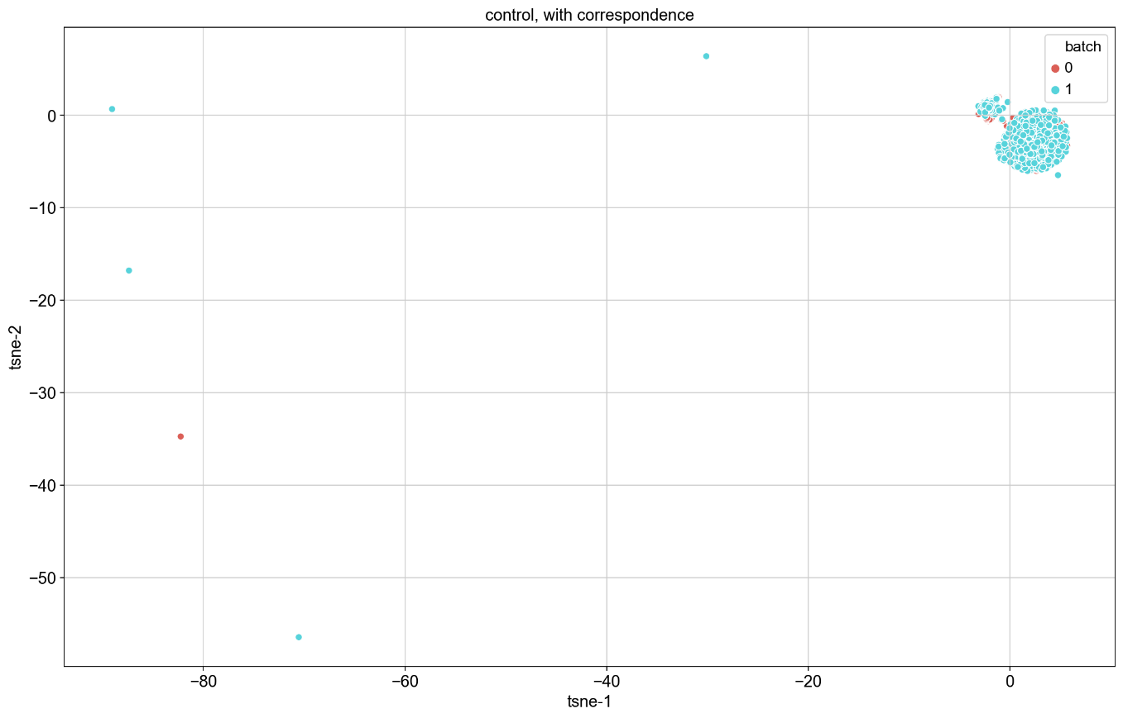
t-SNE results - Controls

Slide 7
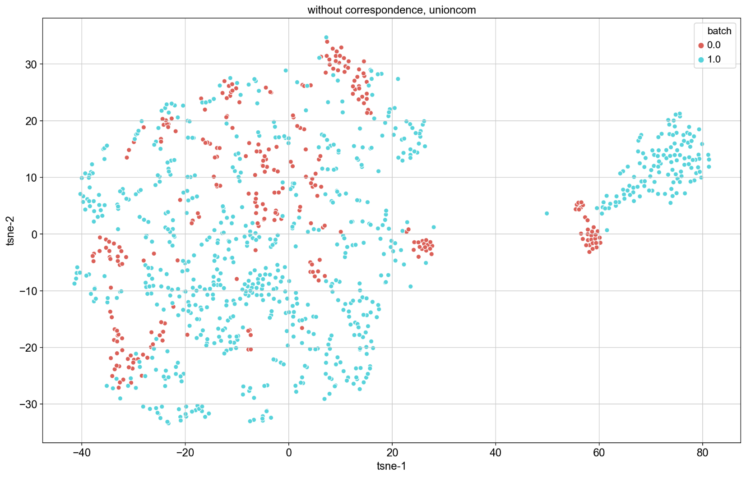
t-SNE results - UnionCom

Slide 8
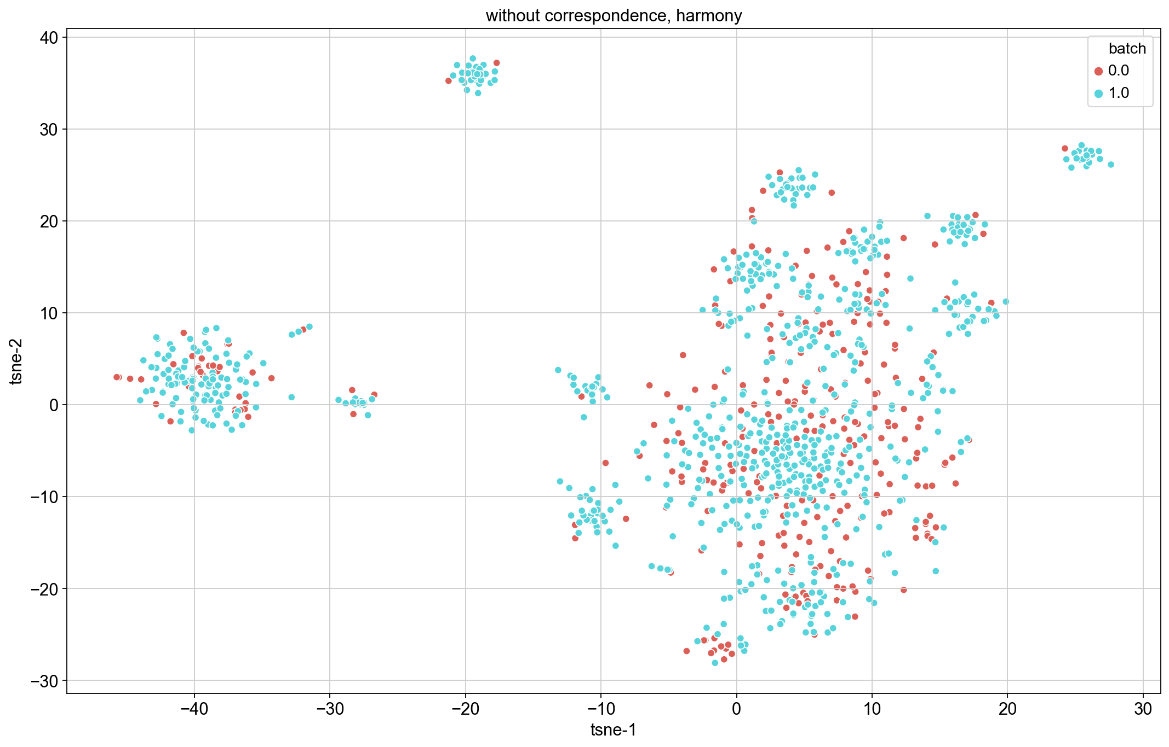
t-SNE results - Harmony

Slide 9
PCA – principle component analysis
Good old technique from linear algebra that we are all familiar with
Iteratively finds linear combinations of original bases that account for the greatest variance to produce a new set of orthogonal bases
Bases that account for less variance in data can be discarded

Slide 10
UMAP – Uniform Manifold Approximation and Projection
Graph based method using simplicial complexes
Cover a manifold by altering distance metric to ensure connectivity
Preserves both local and global structure
Cost function based on cross entropy from information theory

Slide 11
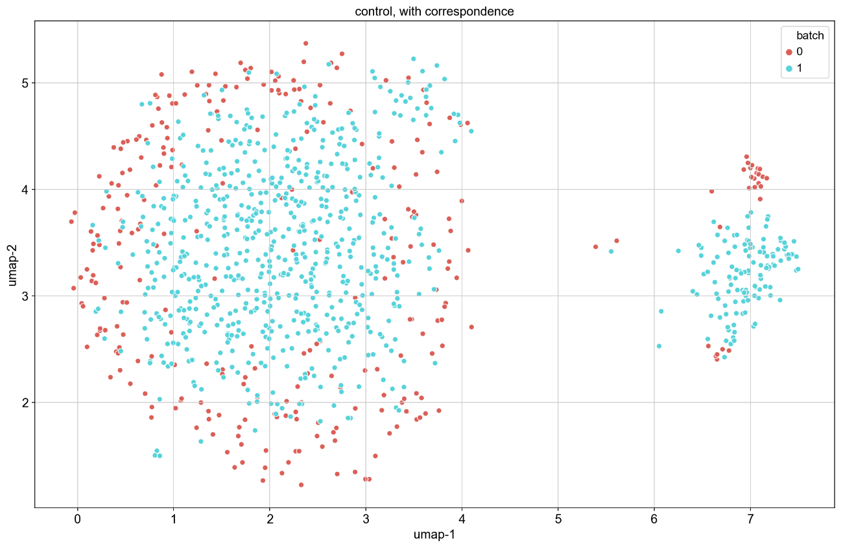
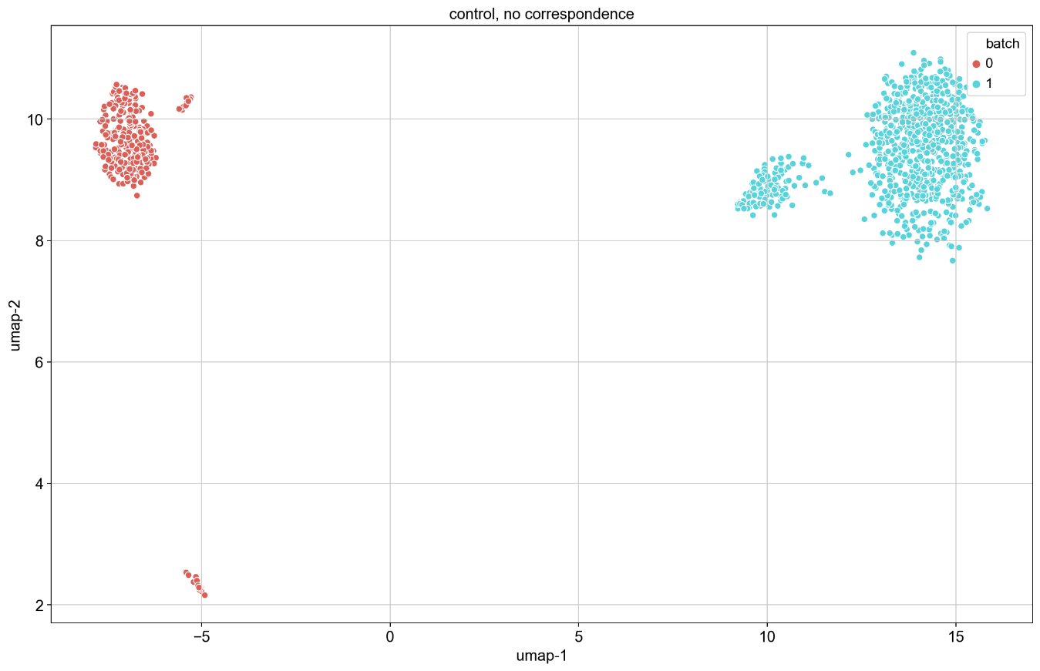
UMAP - controls

Slide 12
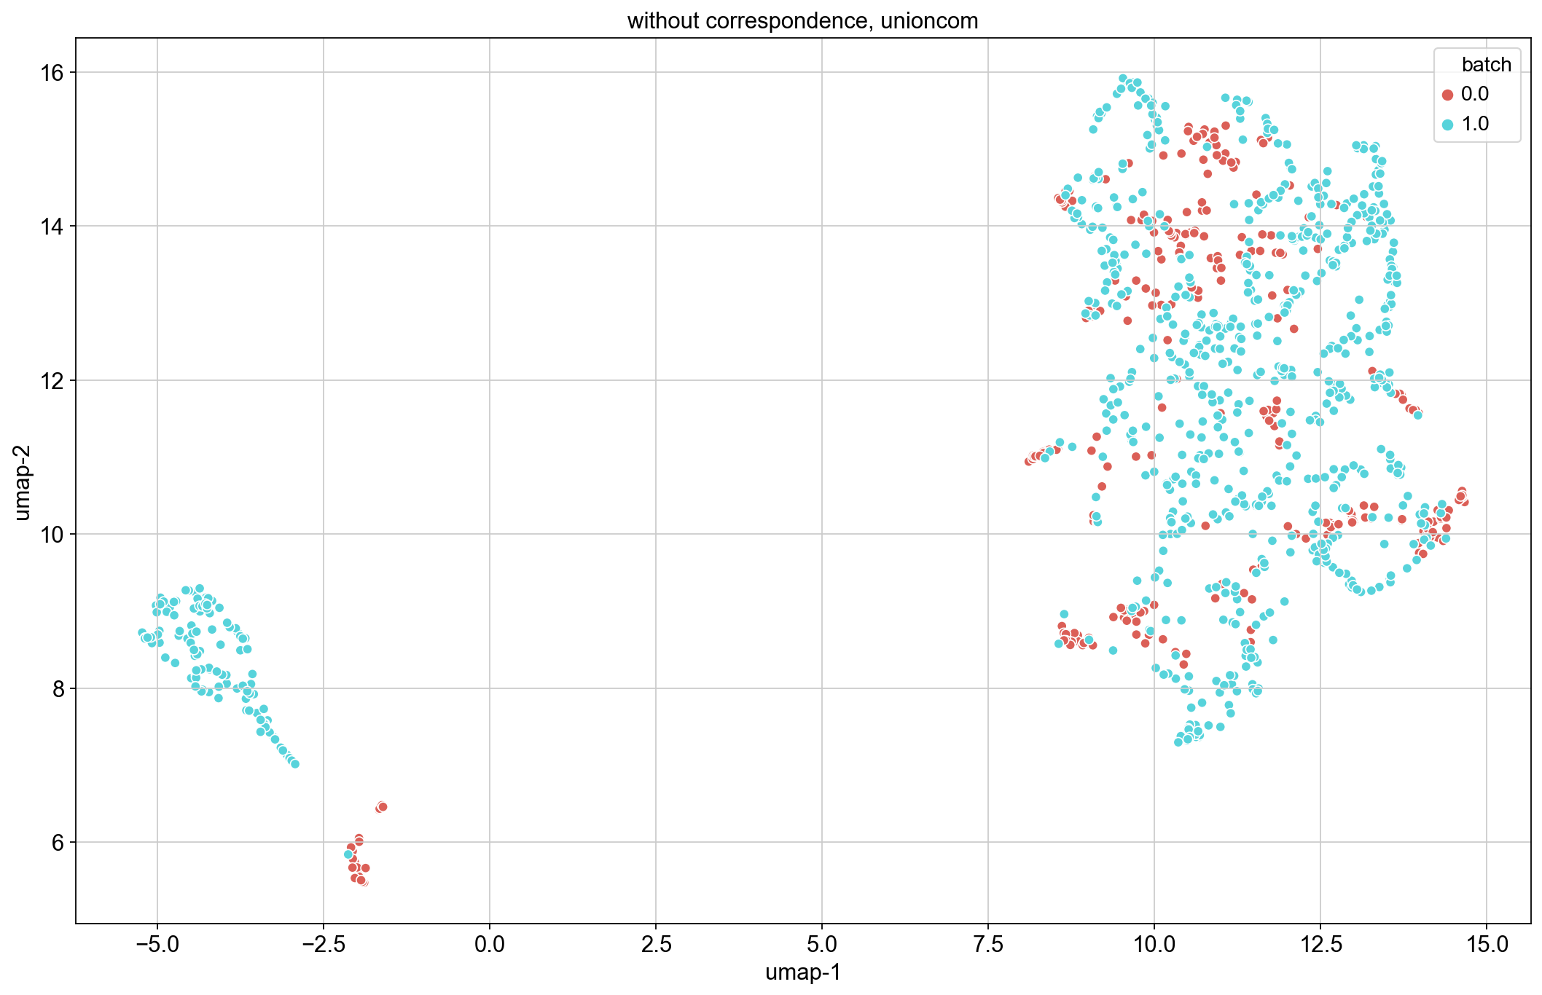
UMAP - UnionCom

Slide 13
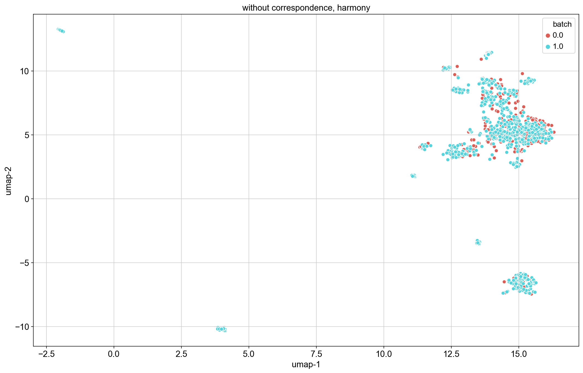
UMAP - Harmony

Slide 14
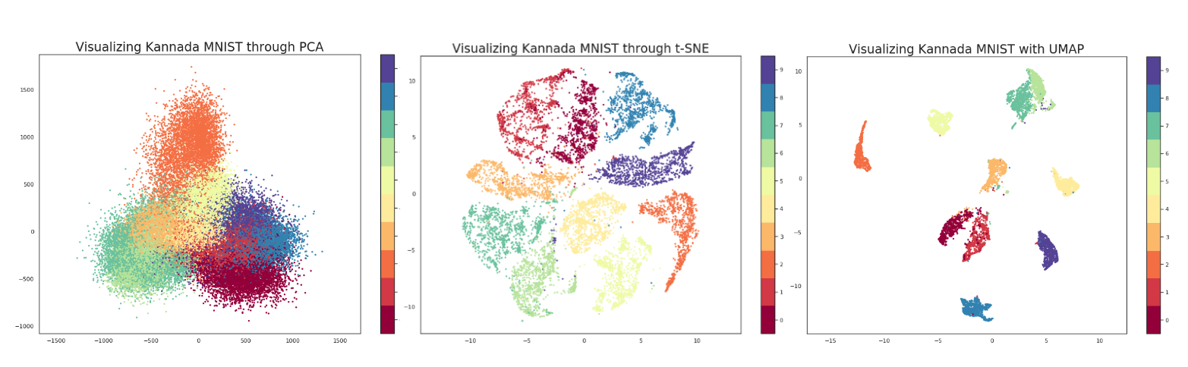
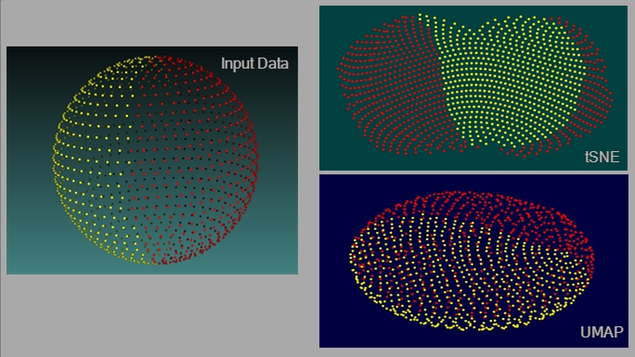
t-SNE vs UMAP vs PCA
Credit: Parul Pandey
Credit: James X. Li

Slide 15
t-SNE vs UMAP vs PCA
t-SNE does not capture global structure well – in other words, the distances between clusters on the resulting projection is not informative; UMAP and PCA preserve global structure
UMAP and t-SNE capture non-linear correlations between variables, but PCA does not
All three use different cost functions; KL-divergence used by t-SNE results in low to no cost for points that are distant in high dimension becoming close in lower dimension, while CE used by UMAP has a large penalty for both close points becoming distant and distant points becoming close.

Slide 16
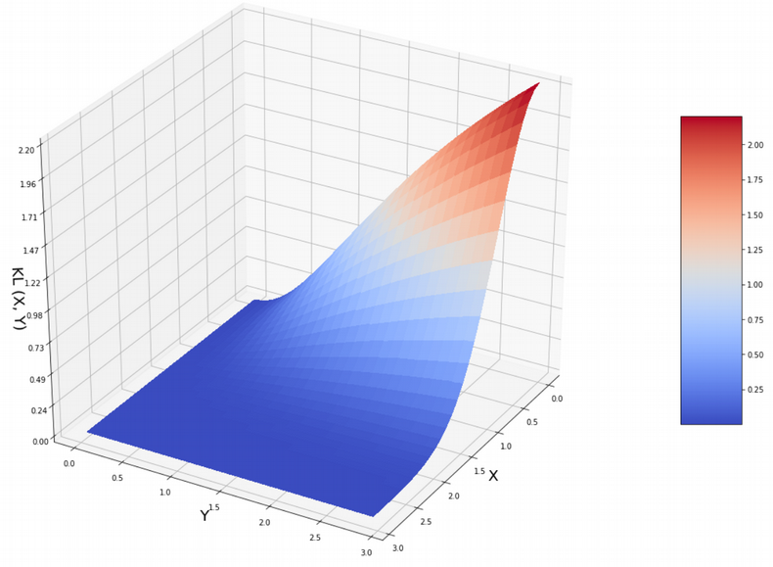
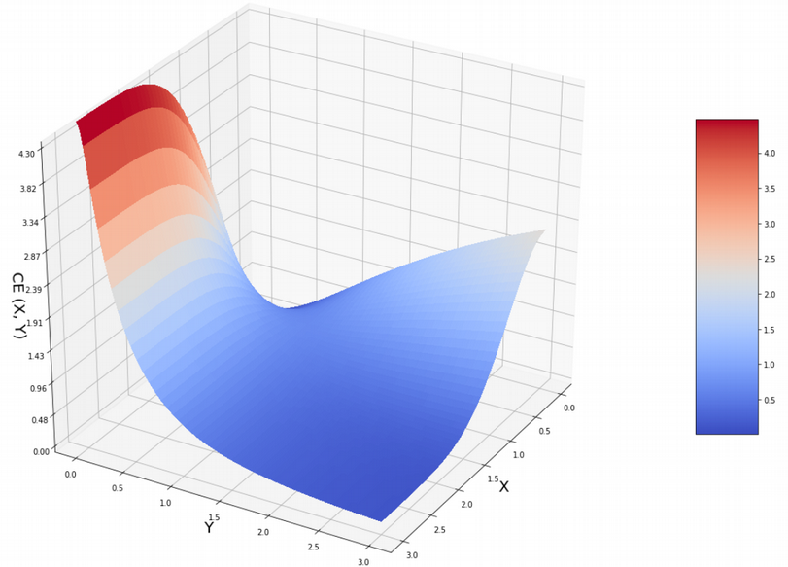
t-SNE vs UMAP vs PCA
KL-divergence on left, CE on right, X is distance in high dim’n, Y is distance in low dim’n. Credit: Nikolay Oskolkov

Slide 17
t-SNE vs UMAP vs PCA
Conflicting opinions on use of alternative initialization parameters for t-SNE to overcome difficulty in preserving global structure
See https://towardsdatascience.com/why-umap-is-superior-over-tsne-faa039c28e99, https://doi.org/10.1038/s41467-019-13056-x, https://www.biorxiv.org/content/10.1101/2019.12.19.877522v1

Slide 18
kBET: k-nearest neighbor batch effect test
https://doi.org/10.1038/s41592-018-0254-1
Measure batch mixing on local level by taking the k-nearest neighbors of a random data point (a random neighborhood) and counting the number of neighbors from each batch.
Assumes that the batches are from repetitions of the same experiment and that major differences are only in technical covariates
Performs χ²-based test on each random neighborhood to determine if difference from overall batch distribution is significant at some level
Low rejection = good mixing

Slide 19
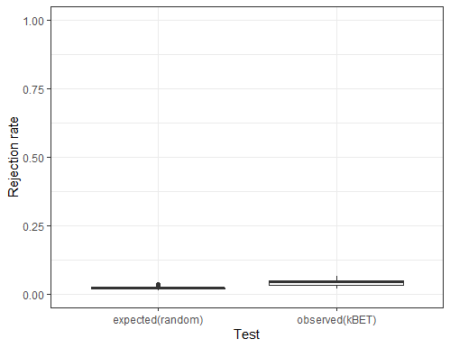
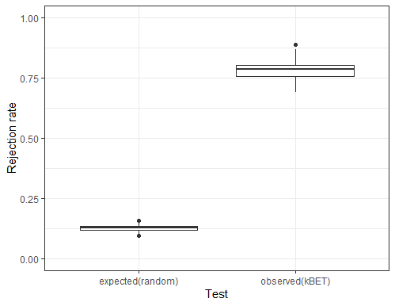
kBET - controls
With correspondence
Without correspondence

Slide 20
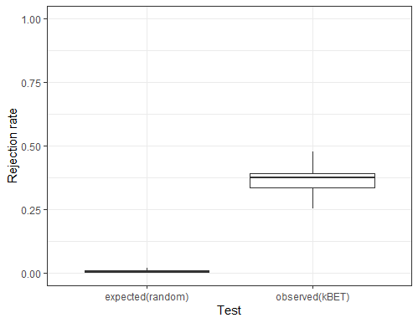
kBET - UnionCom

Slide 21
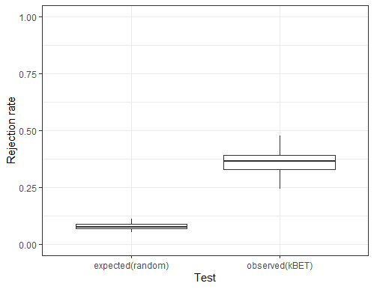
kBET - Harmony

Slide 22
kBET: potential drawbacks
I could not determine if this test has any built in contingency for dealing with datasets whose spaces overlap but are not necessarily the same. E.g. if one were to combine a dataset of epidermal tissue from different areas of the body.
Most likely, if one or more datasets contains cell types not found in other datasets, kBET will return high rejection rate even if the data is appropriately mixed
Sensitive to choice of number of neighbors: what if number of neighbors is too high? Could mask clumping of data points by batch within the neighborhood

Slide 23
LISI: local inverse Simpson’s index
https://doi.org/10.1038/s41592-019-0619-0
Addresses both issues with kBET raised above
For local diversity, neighborhoods are described by Gaussian kernel-based distributions using a fixed perplexity
To deal with datasets composed of differing cell types, the inverse Simpson’s index is used: (1/Σ_{b=1}^{B}p(b)).
Gives the expected number of cells to sample from a local neighborhood before two are drawn from the same batch
Knowing number of batches in a neighborhood allows users to incorporate their knowledge of dataset composition when determining which integration method works best

Slide 24
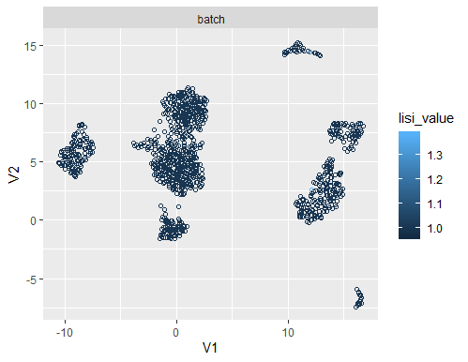
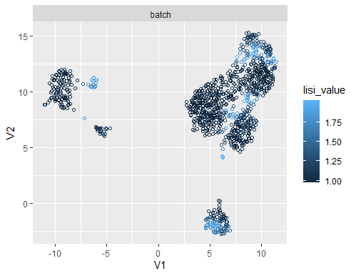
LISI - controls
With correspondence
Without correspondence

Slide 25
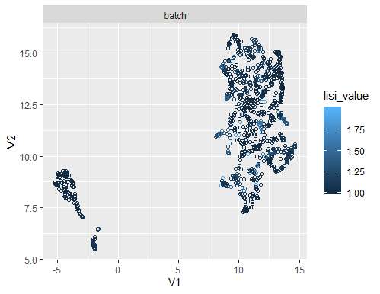
LISI - UnionCom

Slide 26
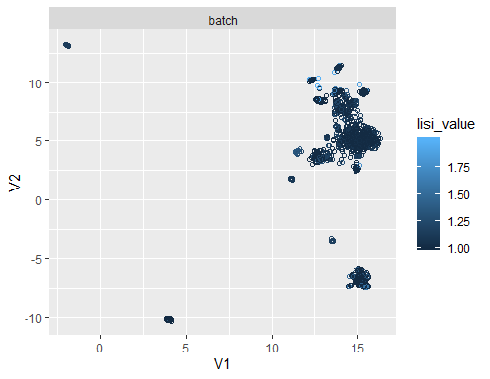
LISI - Harmony

Slide 27
ASW: average silhouette width
https://doi.org/10.1016/0377-0427(87)90125-7
Constructs “silhouettes” of each cluster that differentiate the data points within the cluster based on how close they are to the others
Average width of a silhouette shows how closely clustered data is
Range = [-1,1]
For cells by cell type (or other biological effect), we expect ASW to be high
For batch effects, we want ASW to be close to 0
Negative ASW indicates incorrect clustering (observations are closer to another cluster than their own)

Slide 28
ASW - controls
Without correspondence = .639
With correspondence = .0297

Slide 29
ASW - UnionCom
ASW = -.0095

Slide 30
ASW - Harmony
-.055

Slide 31
ARI: adjusted rand index
https://doi.org/10.1007/BF01908075
Assess the congruence of two proximity matrices using a simple cross-product measure
If two partitions correspond, ARI -> 1. If the partitions are random, ARI -> 0
Similar to ASW

Slide 32
ARI - controls
Without correspondence = 1.0
With correspondence = -.0293

Slide 33
ARI - UnionCom
-.0289

Slide 34
ARI - Harmony
-.0375

