Slide 1
Guide to preprocessing scRNA-seq data
Johnathan Lo, 2020

Slide 2
What is scRNA-seq?
sc = single cell, seq = sequencing
scRNA-seq helps characterize gene expression on a cellular level, providing finer-grained and more nuanced data compared to bulk expression sequencing.
Ex: two different cell types may exhibit the same mean bulk expression but vastly different distributions for some gene X – scRNA can distinguish the different types but bulk-seq cannot
Applications: developmental biology, cancer genomics, infectious disease

Slide 3
What does scRNA-seq data look like?
Raw data from sequencing machines is first processed to human-readable and easily manipulated format
Pipelines for initial processing: Cell Ranger, indrops, SEQC, zUMIs
Our analyses will use Cell Ranger (10x Genomics) MEX-formatted output
After initial processing, the data consists of 3 files:
barcodes.tsv, features.tsv, matrix.mtx
MEX-format datasets can be found at https://support.10xgenomics.com/single-cell-gene-expression/datasets
Data is shaped with cells (observations) in columns and features (genes) as rows
Data values represent count depth

Slide 4
Why preprocessing?
Data contains variation from unwanted sources
Technical covariates, biological noise, sampling artefacts, batch effects
Make the data useful for downstream analyses without undermining the integrity of its structure
Be careful to avoid data peeking

Slide 5
Preprocessing overview
Loading data
AnnData objects, object-oriented programming
Exploratory statistics
Avg count depth, empirical distributions, mitochondrial expression
QC
Thresholding for burst “cells”, doublets, and ambient expression
Normalization
Scaling gene expression to account for technical effects
Makes the cell population more “homogenous”
Correction
Use regression to remove unwanted confounding effects (either biological or technical
Includes batch correction

Slide 6
Preprocessing overview (cont’d)
Feature selection
Highly variable genes
Dimensionality reduction
PCA, t-SNE, UMAP, etc.

Slide 7
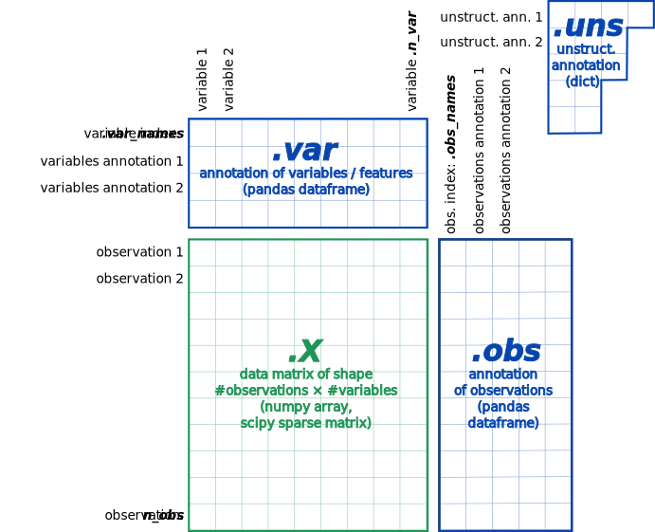
Loading data
Data is loaded as AnnData objects
Access various attributes with AnnData.var, .X, .obs, etc.
We will mostly work with AnnData.obsm (multivariate observations)
Keep object oriented principles in mind when working with these objects, also keep in mind that Python does shallow copy by default in assignment operations on objects

Slide 8
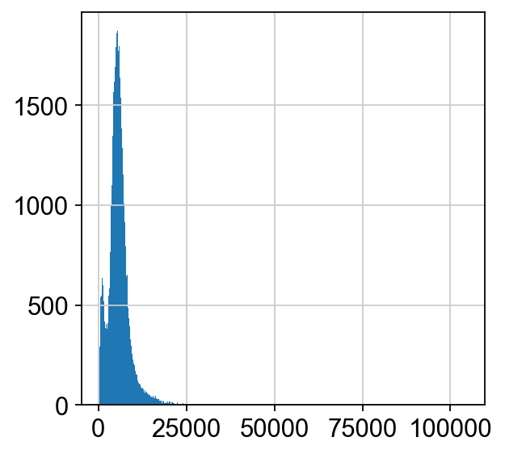
Data Exploration
Explore data first by visualizing various statistics
Empirical count depth distribution, estimated moments (mean, var)
Mitochondrial counts and proportions
Histogram of count depth distribution for cells – X-axis: count depth, Y-axis: # cells

Slide 9
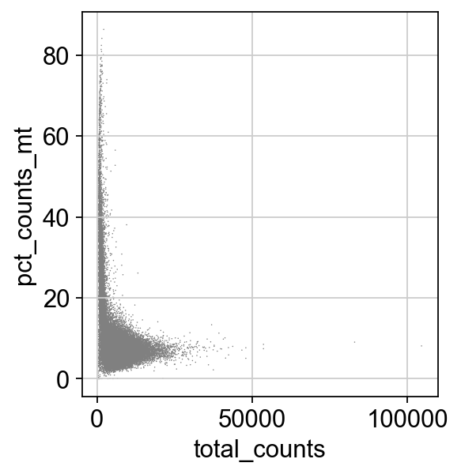
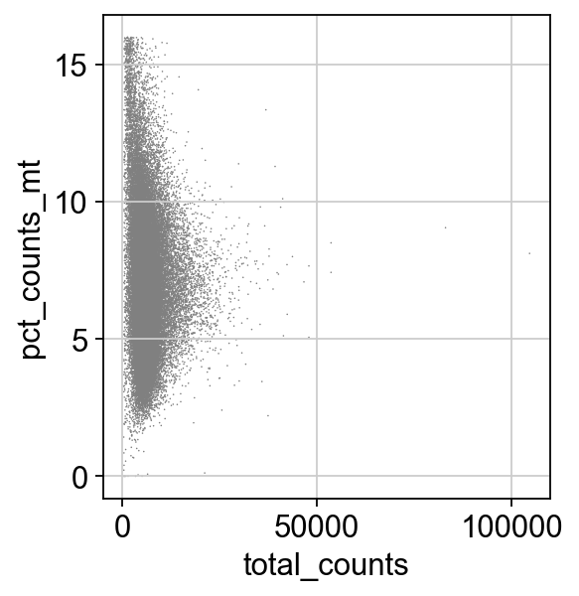
QC
Use thresholding to remove unwanted technical and biological effects
Too many counts = potential doublet
Too few counts and high MT proportion = potential burst cell
% MT expression before QC
% MT expression after QC

Slide 10
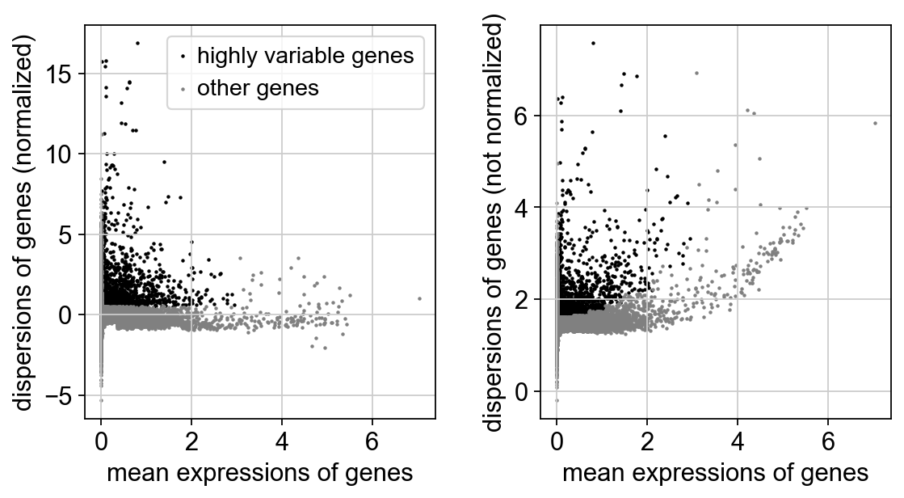
Normalization
Use scaling to balance gene expression across cells
Whereas QC eliminates overtly high or low total counts, count depth within a cell may still be artificially skewed by technical covariates for specific genes
Most common method: CPM normalization - linear
Assumes that all cells contained equal # of mRNA molecules upon sampling
Nonlinear methods may use parametric modelling

Slide 11
Correction
Regress on cell cycle features to remove cell cycle effects (if desired)
Regress out count depth scaling and mt percentage effects
Impute values for potential dropouts
Align data from different batches on the same manifold (covered in other ppts)

Slide 12
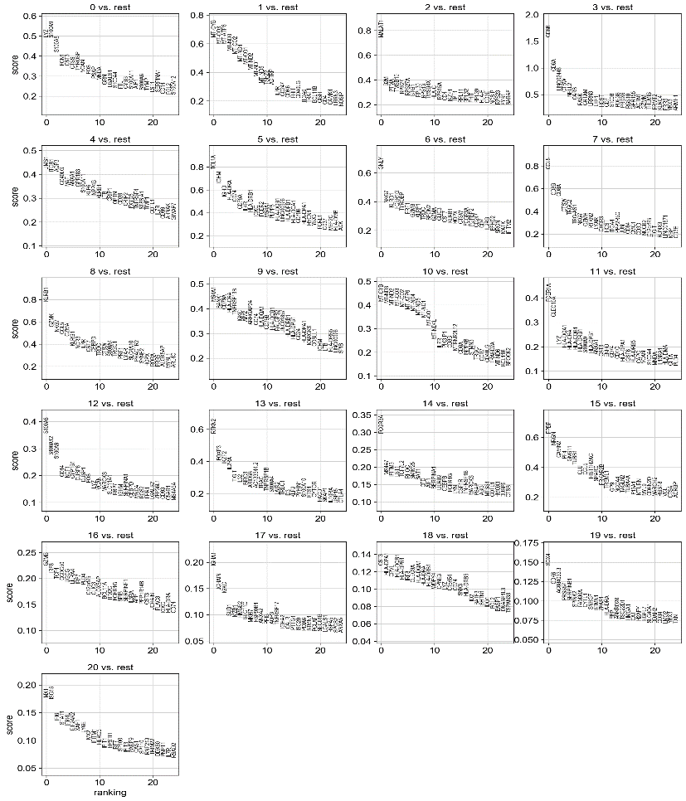
Feature selection
Select HVGs (highly variable genes) using mean-variance ratio
Using ranked tests to select notable features

Slide 13
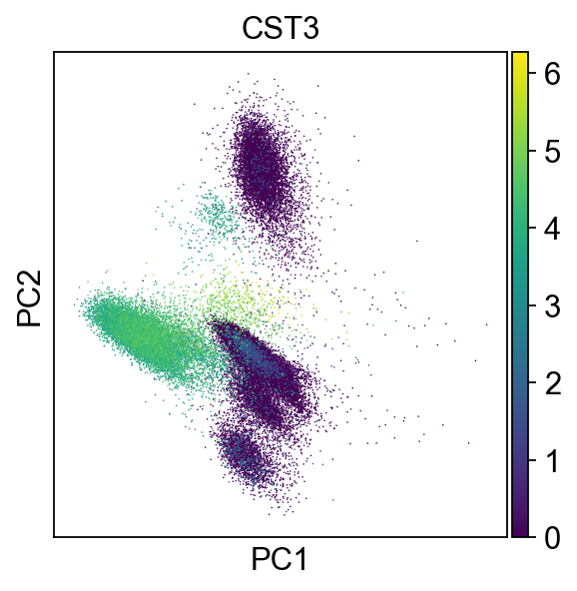
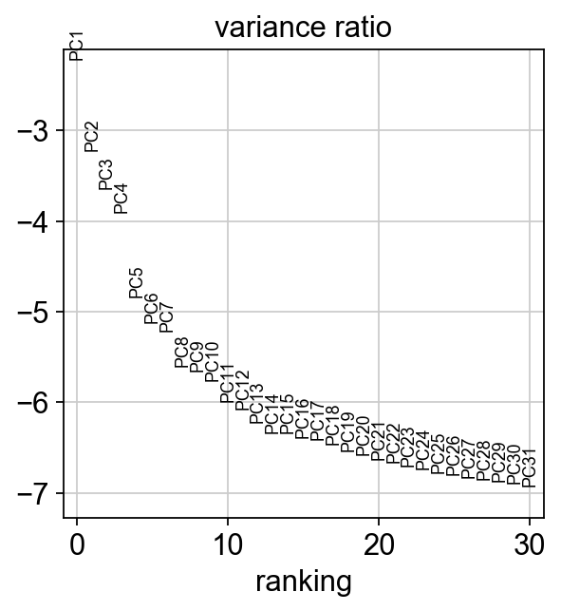
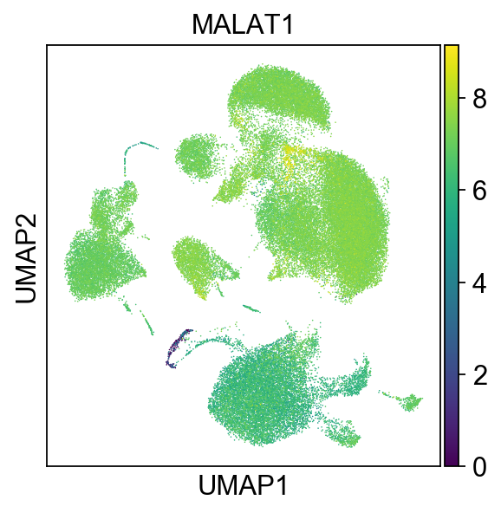
Dimensionality reduction
Reduce selected features using linear (PCA) and nonlinear(t-SNE, UMAP) combinations of variables

Slide 14
References
Luecken MD, Theis FJ. Current best practices in single-cell RNA-seq analysis: a tutorial. Mol Syst Biol. 2019;15(6):e8746. Published 2019 Jun 19. doi:10.15252/msb.20188746

