Slide 1
Overview of scRNA preprocessing and batch correction using scanPy and harmony

Slide 2
Data format
Raw data should first be processed using CellRanger
The following analysis uses MEX formatted data
Tri-partite dataset –barcodes.tsv, genes.tsv, matrix.mtx
Full pipeline in Python 3.7.3
MEX-format datasets can be found at https://support.10xgenomics.com/single-cell-gene-expression/datasets

Slide 3
Required libraries
The following libraries (modules) should be installed: numpy, pandas, scanpy, harmony, and matplotlib. Only scanpy and harmony will be absent from a standard python installation.
Harmony requires PyTorch, which may need installation as well

Slide 4
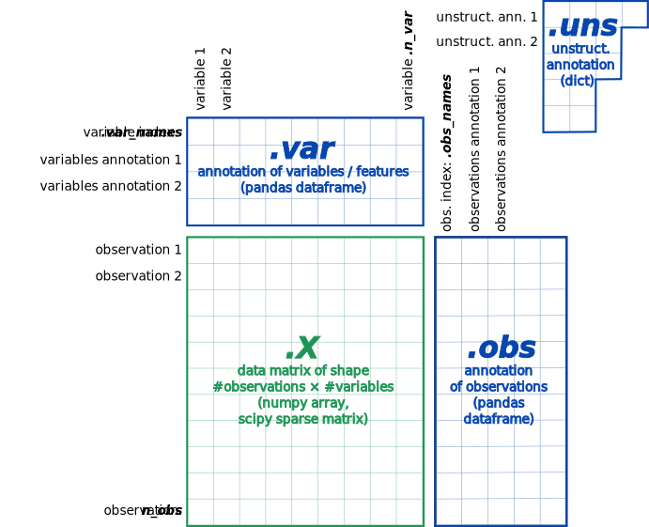
Loading the data into Python
Scanpy uses objects called AnnData that inherit from numpy arrays.
.X attribute accesses raw data
.var, .obs, and .uns are dictionaries
Generally, can take operations that work for nparrays

Slide 5
Using Scanpy
Have documentation open at all times!!
Three separate sub-modules – scanpy.pp (preprocessing), scanpy.tl (tools), scanpy.pl (plotting)
https://scanpy.readthedocs.io/en/stable/api/index.html

Slide 6
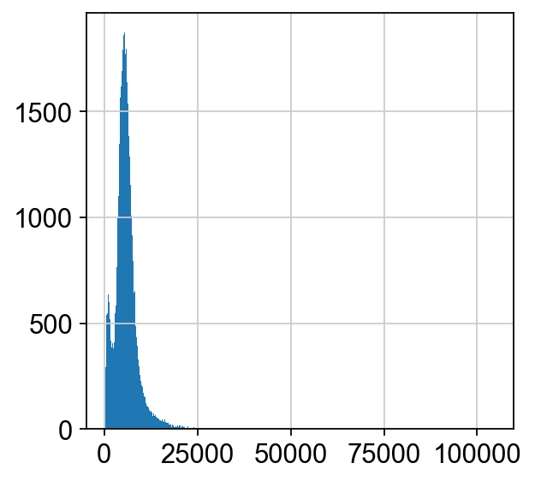
Data exploration
After loading the data, a few basic exploratory statistics can be calculated and visualized; for example, the avg count depth by cell, and avg count depth by gene, and their empirical distributions.
Many summary statistics are calculated as part of QC, so would recommend running calculate_qc_metrics first, and then working from there.
Histogram of count depth distribution for cells

Slide 7
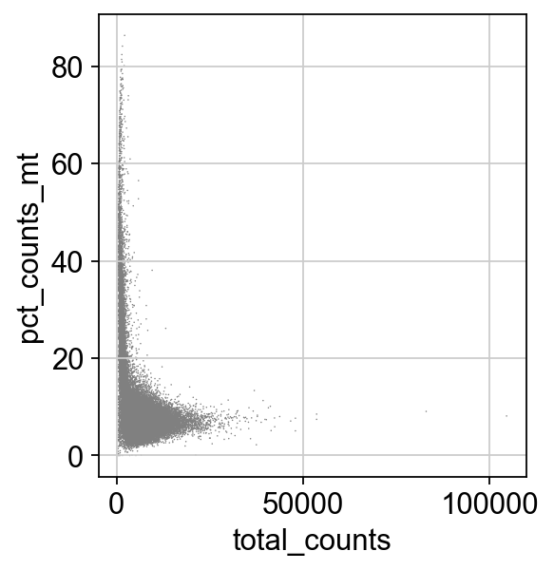
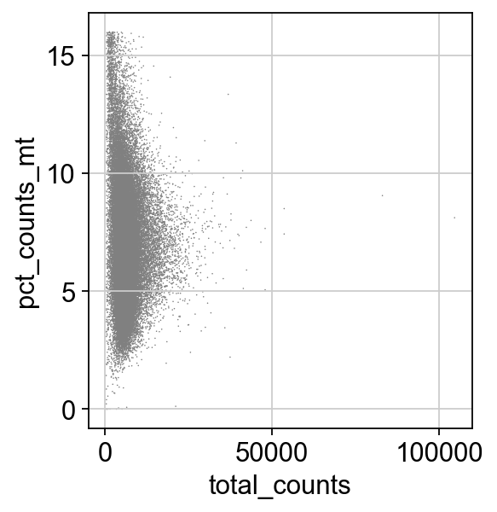
QC – scanpy.pp
Mt pct before QC
QC consists of two parts: controlling for “burst” cells, and doublets
Burst cells are signified by high mt gene % and low count depth
Doublets are signified by high count depth and high number of genes
Inexplicably, scanpy tutorial only uses univariate thresholding, not multivariate, as suggested in Luecken and Theis 2019.
Can use visual heuristic to determine thresholds – use scanpy plotting functionality visualize before and after
Mt pct after QC

Slide 8
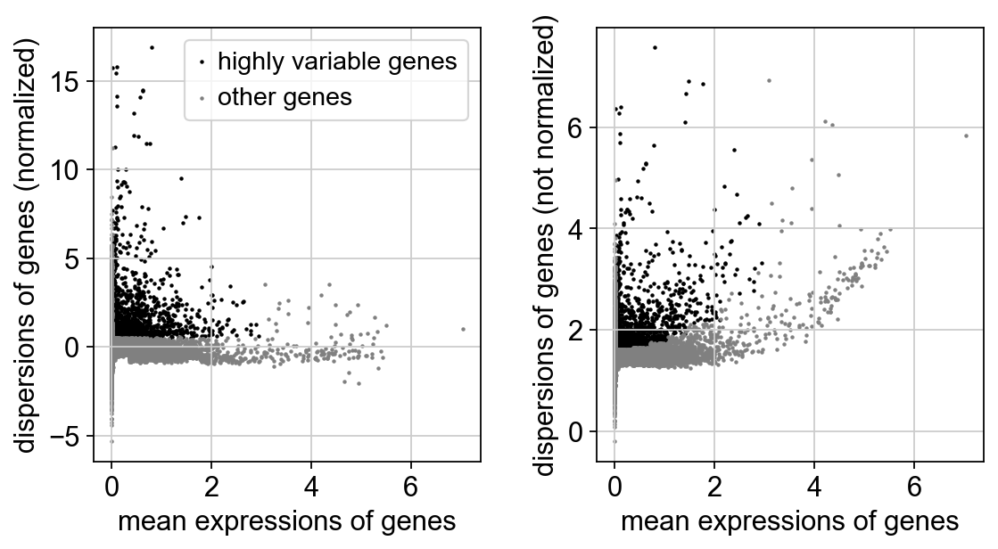
Normalization & correction – scanpy.pp
Normalization in scanpy is done with total count normalization, not sure about what heuristic to use for choosing parameters.
HVGs are selected
Variance of gene expression can be scaled
Regress out unwanted sources of variation

Slide 9
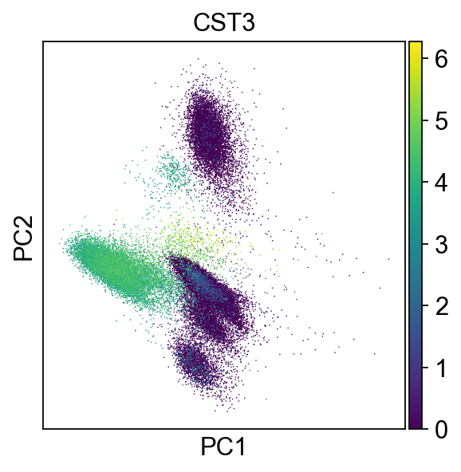
Dimensionality reduction with PCA- scanpy.tl
Selecting HVGs is not enough (almost 10,000 features remain)
Conduct PCA and visualize by genes of interest

Slide 10
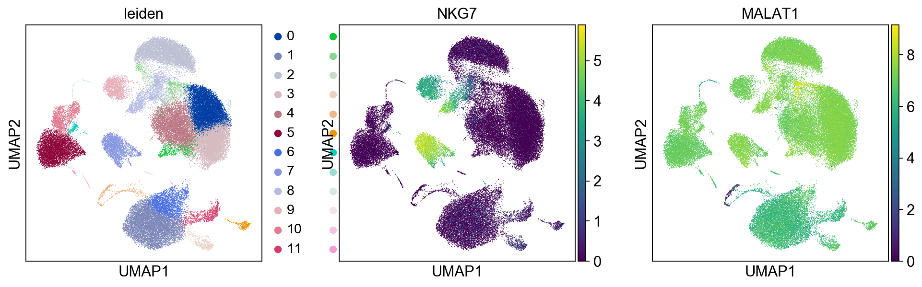
Clustering – scanpy.tl
General workflow here is to compute graphs and then embed them within the AnnData object
Construct and embed neighborhood graph
Cluster using Leiden or Louvain algorithm, as suggested in Luecken and Theis 2019
How to pick parameters?

Slide 11
Harmony
Harmony is an algorithm for batch correction
Takes reduced data from PCA
Iteratively clusters similar cells from different batches but maximizes the diversity of batches within each cluster
Uses cluster membership to calculate correction factor for each cell
High performance algorithm for mixed datasets using identical cell types but different technologies, different cell types, or multiple batches
Poorer performance on large datasets (>100,000 cells)

Slide 12
Harmony - software
R version: https://portals.broadinstitute.org/harmony/articles/quickstart.html
Python version: https://pypi.org/project/harmony-pytorch/

Slide 13
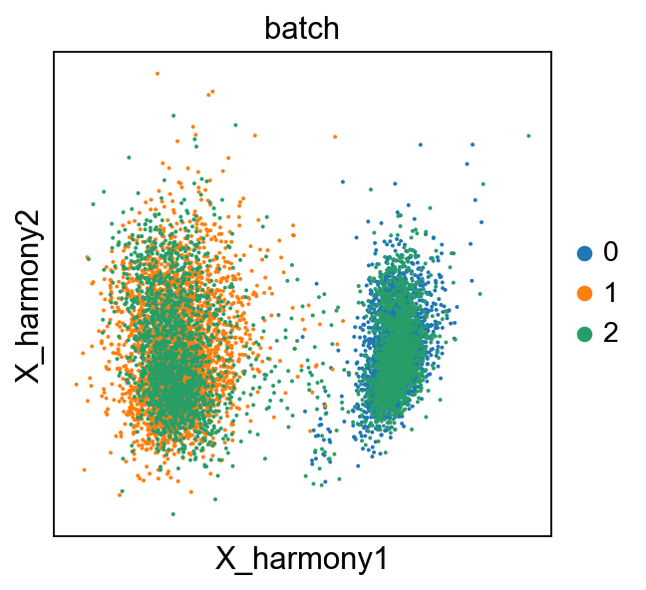
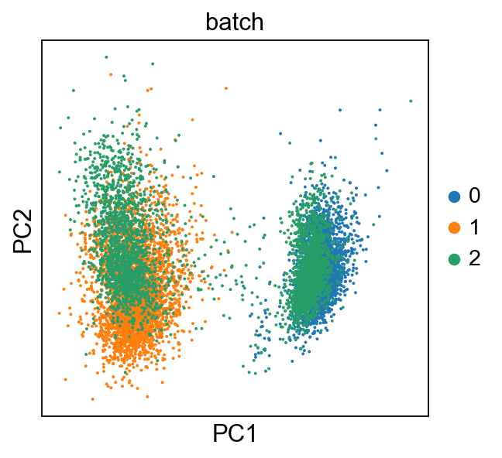
Implementing Harmony on different cell types with different batches
Combined 3 datasets: Jurkat, 293t, and Jurkat/293t 50:50, found on 10x genomics website
Combine datasets using concatenate method for AnnData objects
Conduct QC and PCA as outlined above
Run harmony and embed in AnnData object
Before
After

