Slide 1
Comparing 3 methods of integration:
Manifold alignment without correspondence (MAWC), UnionCom, MMD-ResNet

Slide 2
Background
We want to integrate datasets that may or may not have correspondence along its variables or features
observations are assumed to arise from the same generating process
Want to know: how do these algorithms perform when datasets have correspondence? How they perform when datasets do not have correspondence?
We evaluate this performance by taking datasets with correspondence and artificially removing correspondence – then we can see how well an algorithm is able to map features from each dataset into the same space

Slide 3
Method
Two datasets were taken from the 10x genomics dataset repository: https://support.10xgenomics.com/single-cell-gene-expression/datasets/1.1.0/frozen_pbmc_donor_a, https://support.10xgenomics.com/single-cell-gene-expression/datasets/1.1.0/frozen_pbmc_donor_b
Datasets contain the same features and same cell types but extracted from separate patients on separate occasions
Datasets were combined in two ways: control – correspondence is maintained, experimental – correspondence is removed

Slide 4
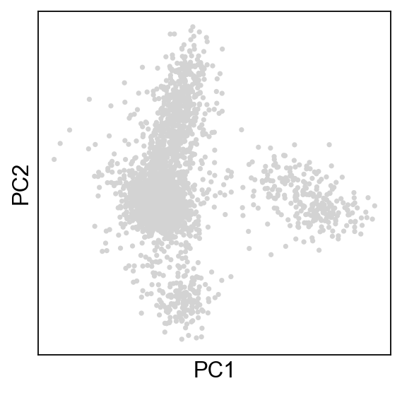
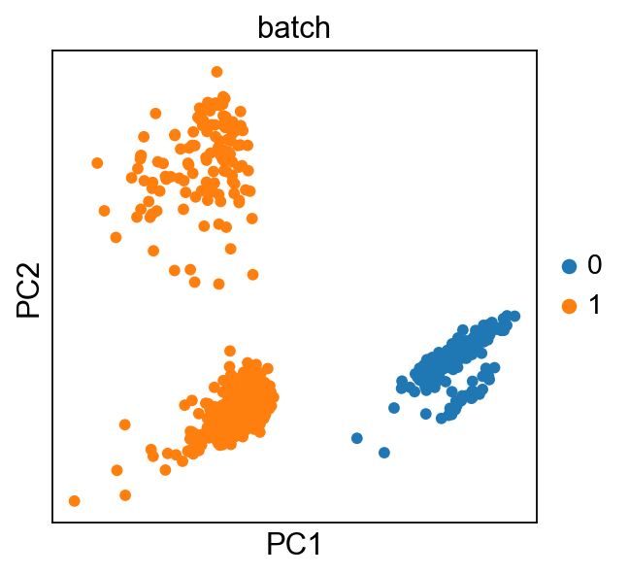
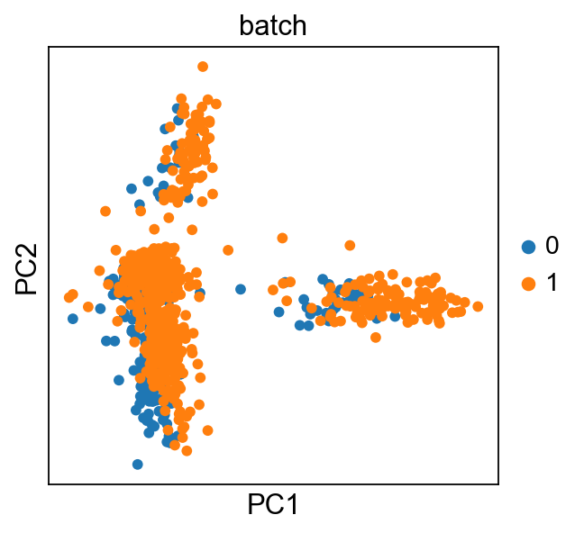
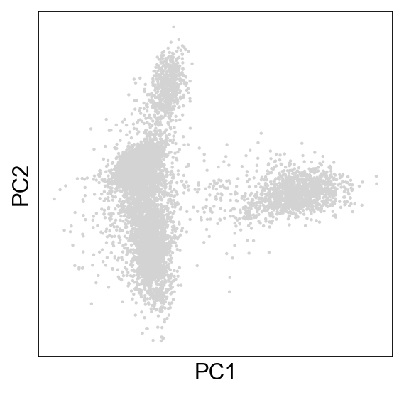
No correspondence
unmerged
With correspondence

Slide 5
MAWC

Slide 6
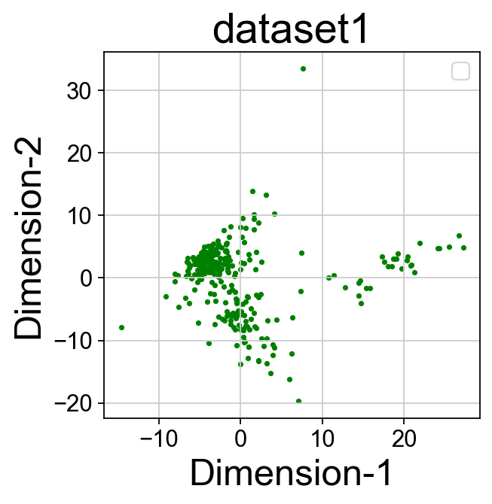
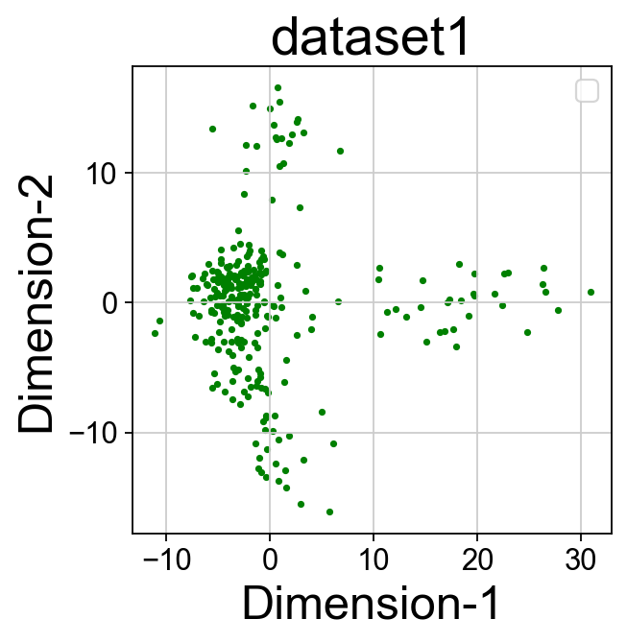
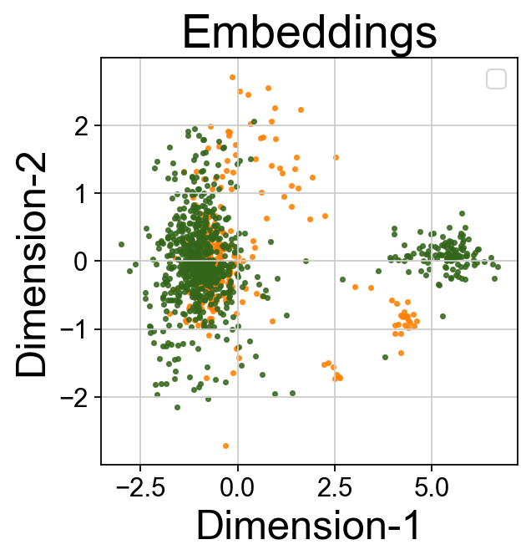
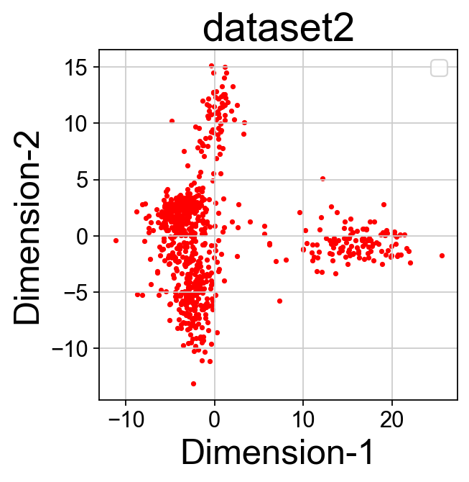
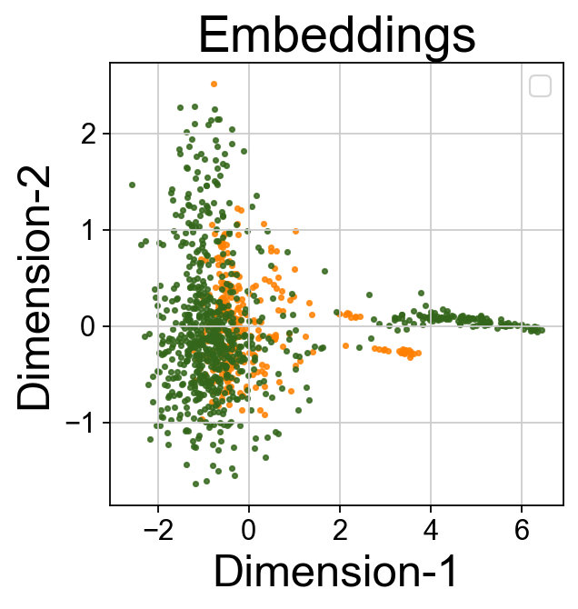
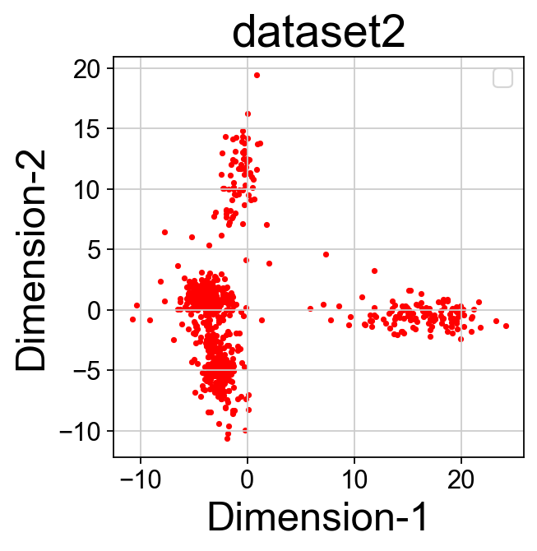
UnionCom
For datasets without correspondence (preprocessed separately)
For datasets with correspondence (merged and preprocessed with correspondence)

Slide 7
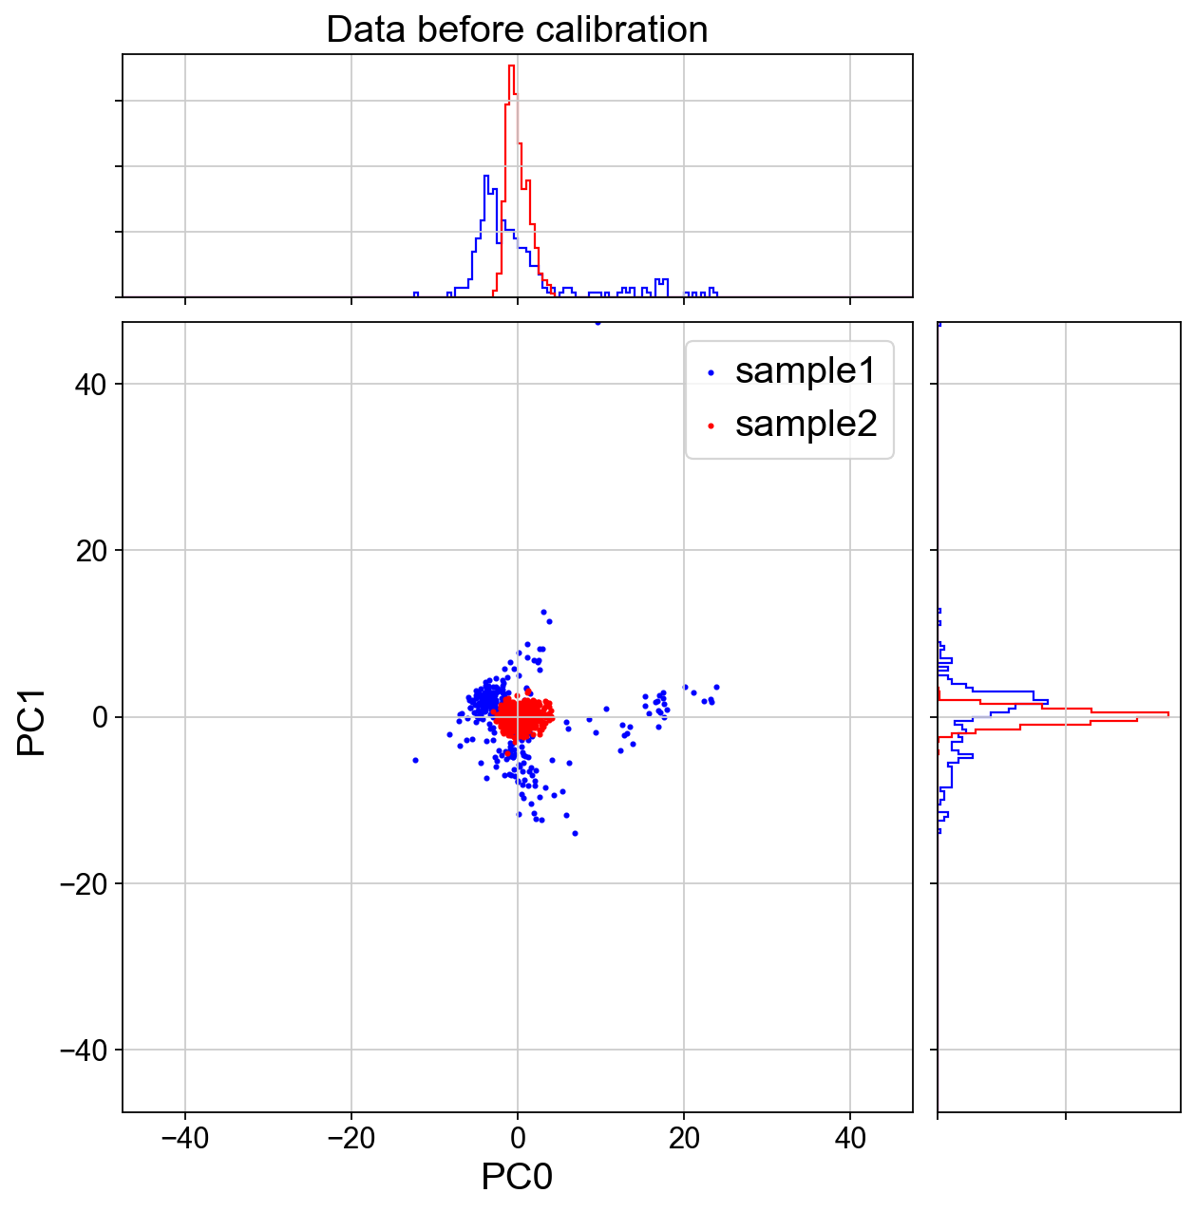
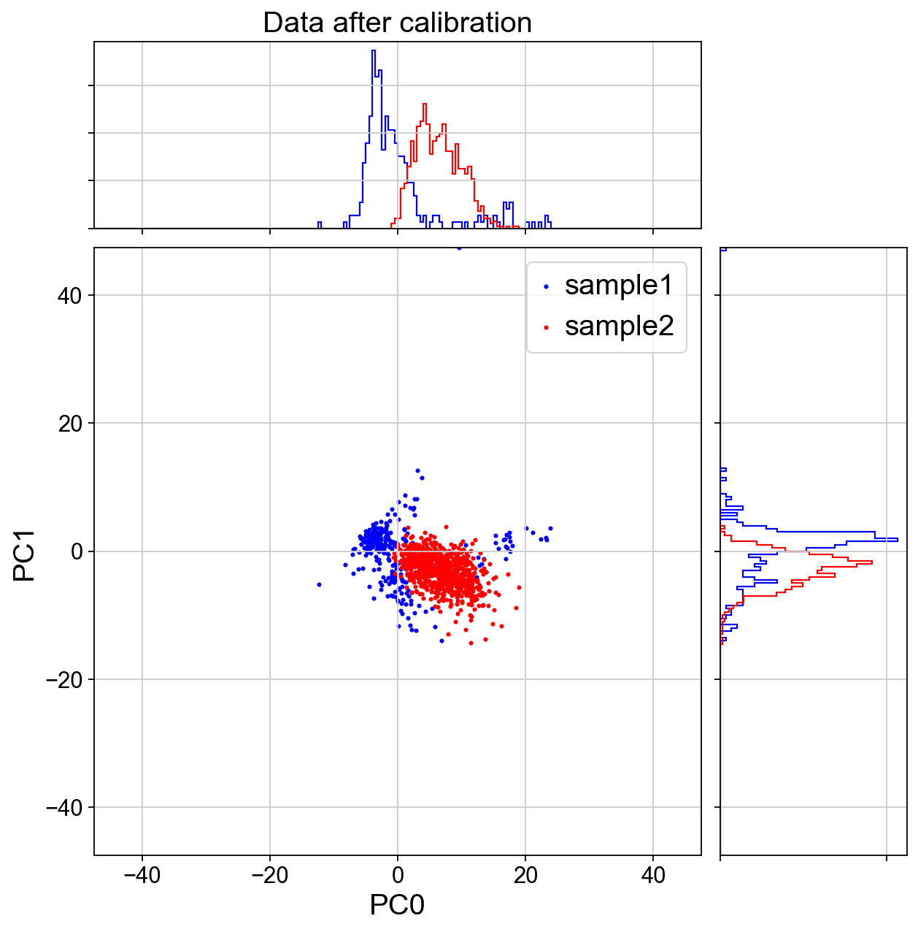
MMD-ResNet

