Slide 1
Evaluation methods

Slide 2
Motivation
We have multiple methods for integrating datasets
We have multiple situations where integration is required
Datasets may occupy completely disjoint spaces or spaces may intersect.
We want to understand which method is “best” under different situations

Slide 3
How to evaluate integration methods
Artificially divide a single dataset into 2 or more, and change variable names
Run integration algorithm, find clusters, compare to results from unmodified data
Do the same cells cluster together? Do the clusters share the same local and global geometry?
How admixed are the data points from each batch?

Slide 4
Methods
Visualization
We want an accessible heuristic for quickly determining if the integration process worked
t-SNE, UMAP, PCA
Evaluation metrics
Need something more concrete to quantify differences between methods
kBET, LISI, ASW, ARI

Slide 5
t-SNE – t-distributed Stochastic Neighbor Embedding
Graph-based method for visualization
Preserves local geometry by computing a similarity matrix for data points
Reduces space down to set number of dimensions (2 or 3 for visualization) and places points randomly in the space
Computes new similarities between points and gradually transforms the new space so that this second similarity matrix is as close as possible to the first.
Similarity scores are computed based on the normal distribution for the first similarity matrix and the t-distribution for the second
Use cost function based on KL-divergence (measure of difference between distributions)

Slide 6
PCA – principle component analysis
Good old technique from linear algebra that we are all familiar with
Iteratively finds linear combinations of original bases that account for the greatest variance to produce a new set of orthogonal bases
Bases that account for less variance in data can be discarded

Slide 7
UMAP – Uniform Manifold Approximation and Projection
Graph based method using simplicial complexes
Cover a manifold by altering distance metric to ensure connectivity
Preserves both local and global structure
Cost function based on cross entropy from information theory

Slide 8
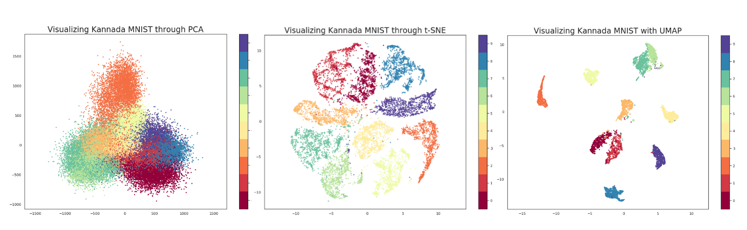
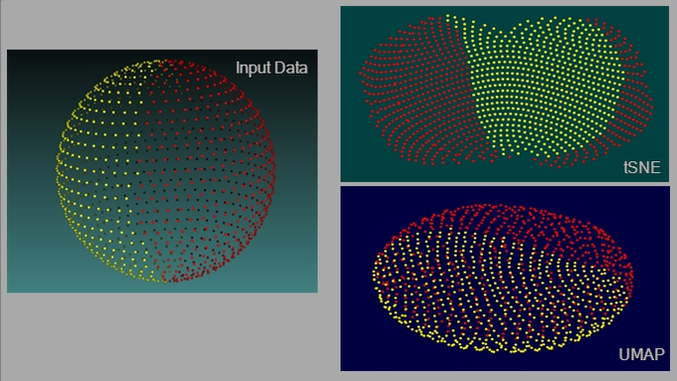
t-SNE vs UMAP vs PCA
Credit: Parul Pandey
Credit: James X. Li

Slide 9
t-SNE vs UMAP vs PCA
t-SNE does not capture global structure well – in other words, the distances between clusters on the resulting projection is not informative; UMAP and PCA preserve global structure
UMAP and t-SNE capture non-linear correlations between variables, but PCA does not
All three use different cost functions; KL-divergence used by t-SNE results in low to no cost for points that are distant in high dimension becoming close in lower dimension, while CE used by UMAP has a large penalty for both close points becoming distant and distant points becoming close.

Slide 10
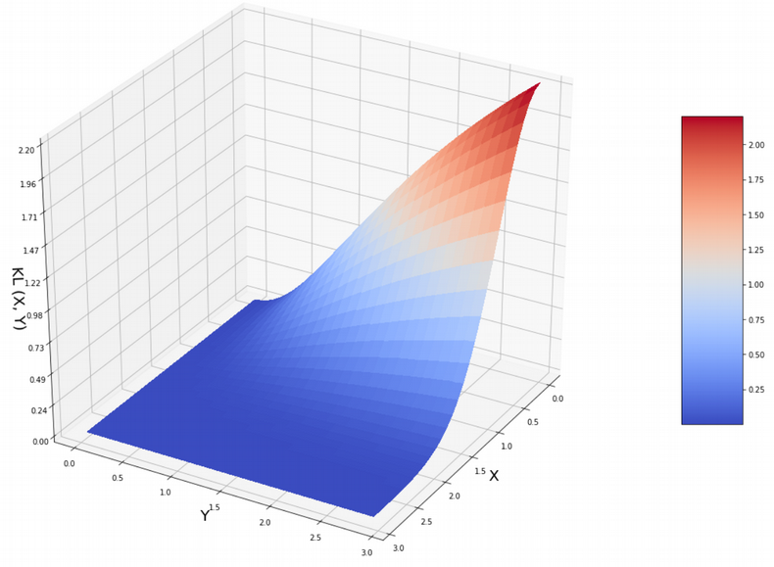
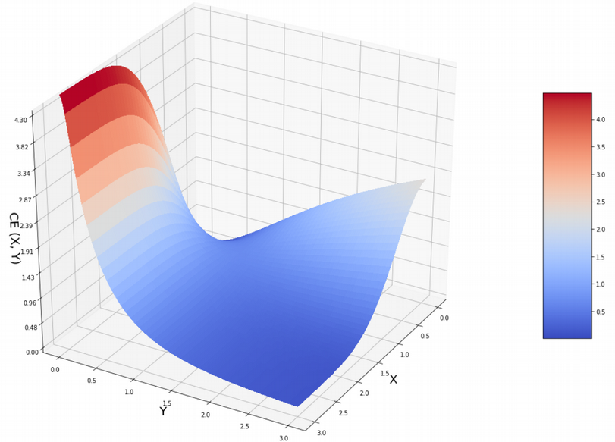
t-SNE vs UMAP vs PCA
KL-divergence on left, CE on right, X is distance in high dim’n, Y is distance in low dim’n. Credit: Nikolay Oskolkov

Slide 11
t-SNE vs UMAP vs PCA
Conflicting opinions on use of alternative initialization parameters for t-SNE to overcome difficulty in preserving global structure
See https://towardsdatascience.com/why-umap-is-superior-over-tsne-faa039c28e99, https://doi.org/10.1038/s41467-019-13056-x, https://www.biorxiv.org/content/10.1101/2019.12.19.877522v1

Slide 12
kBET: k-nearest neighbor batch effect test
https://doi.org/10.1038/s41592-018-0254-1
Measure batch mixing on local level by taking the k-nearest neighbors of a random data point (a random neighborhood) and counting the number of neighbors from each batch.
Assumes that the batches are from repetitions of the same experiment and that major differences are only in technical covariates
Performs χ²-based test on each random neighborhood to determine if difference from overall batch distribution is significant at some level
Low rejection = good mixing

Slide 13
kBET: potential drawbacks
I could not determine if this test has any built in contingency for dealing with datasets whose spaces overlap but are not necessarily the same. E.g. if one were to combine a dataset of epidermal tissue from different areas of the body.
Most likely, if one or more datasets contains cell types not found in other datasets, kBET will return high rejection rate even if the data is appropriately mixed
Sensitive to choice of number of neighbors: what if number of neighbors is too high? Could mask clumping of data points by batch within the neighborhood

Slide 14
LISI: local inverse Simpson’s index
https://doi.org/10.1038/s41592-019-0619-0
Addresses both issues with kBET raised above
For local diversity, neighborhoods are described by Gaussian kernel-based distributions using a fixed perplexity
To deal with datasets composed of differing cell types, the inverse Simpson’s index is used: (1/Σ_{b=1}^{B}p(b)).
Gives the expected number of cells to sample from a local neighborhood before two are drawn from the same batch
Knowing number of batches in a neighborhood allows users to incorporate their knowledge of dataset composition when determining which integration method works best

Slide 15
ASW: average silhouette width
https://doi.org/10.1016/0377-0427(87)90125-7
Constructs “silhouettes” of each cluster that differentiate the data points within the cluster based on how close they are to the others
Average width of a silhouette shows how closely clustered data is

Slide 16
ARI: adjusted rand index
https://doi.org/10.1007/BF01908075

