Slide 1
Java Programming
Alpha-토
21700287 박은찬
21700406 신홍원

Slide 2
Contents
1.
2.
3.
4.
게임 설명
코드 작성
장단점
출력 화면

Slide 3
01
게임 설명

Slide 4
Alpha-토

Slide 5
1) Class Design - Swing
maintester
Tab
player
user
ai
JFrame
JPanel
Extends:
ActionListener
Implements:

Slide 6
02
코드 작성

Slide 7
Class Main
Main 클래스
Tab 클래스를 호출

Slide 8
Java Code – Class Main
public static void main (String[] args) { new Tab(); }
new Tab();

Slide 9
Class Tab
Tab 클래스
Jframe 클래스를 상속받음
frame을 설정함
tabbedPane을 이용해서 화면을 이동함

Slide 10
Java Code – Class Tab
import java.awt.*; import javax.swing.*; import java.awt.event*; public class Tab extends JFrame{ private static final long serialVersionUID = 1L; final static String Mode1 = "1P-Mode"; final static String Mode2 = "2P-Mode"; JFrame frame = new JFrame("Tic-Tae-Toe"); public Tab() { frame.pack(); frame.setSize(600,800); frame.setVisible(true); frame.setDefaultCloseOperation(JFrame.EXIT_ON_CLOSE); JTabbedPane tabbedPane = new JTabbedPane(); frame.add(tabbedPane, BorderLayout.CENTER); JPanel card1 = new JPanel(new GridLayout(4,3)); JPanel card2 = new JPanel(new GridLayout(0,3)); card1.add(new player(card1, true)); card2.add(new player(card2, false)); tabbedPane.add(Mode1, card1); tabbedPane.add(Mode2, card2); } }
import java.awt.*;
import javax.swing.*;
import java.awt.event*;
frame.*
JTabbedPane tabbedPane = new JTabbedPane();
tabbedPane.add(Mode1, card1);

Slide 11
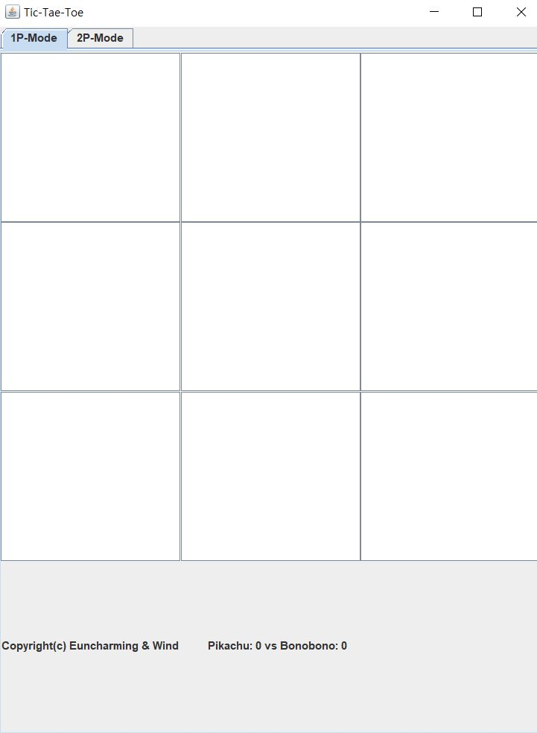
Screen

Slide 12
Class Player
Player 클래스
JPanel 클래스를 상속받음
Tic Tac Toe 게임을 돌리면서 필요한 메소드들을 만듬
마우스 클릭을 인지해서 사진들을 등록함
tabbedPane을 이용해서 화면을 이동함
Implemets - ActionListener

Slide 13
Java Code – Class Player(1)
private static final long serialVersionUID = 1L; user pTic=new user(); ai ai= new ai(); int currentPlayer=1, aiNum=2, score1=0, score2=0; boolean needAI; JButton [] btn = new JButton [9]; JPanel panel1 = new JPanel(new BorderLayout()); JPanel panel2 = new JPanel(new BorderLayout()); ImageIcon Bono = new ImageIcon(this.getClass().getResource("Bono.png")); ImageIcon Pika = new ImageIcon(this.getClass().getResource("Pikachu.png")); ImageIcon White = new ImageIcon(this.getClass().getResource("Whi.png")); JLabel copyright = new JLabel("Copyright(c) Euncharming & Wind"); JLabel score = new JLabel(" Pikachu: "+score1+" vs "+"Bonobono: "+score2);
user pTic=new user();
ai ai= new ai();
JPanel panel1 =
new JPanel(new BorderLayout());
ImageIcon White = new ImageIcon(this.getClass().getResource("Whi.png"));
JLabel copyright = new JLabel("Copyright(c) Euncharming & Wind");

Slide 14


Players’ image

Slide 15
Java Code – Class Player(2)
public player(JPanel panelC, boolean plymode) { for(int i=0; i < 9; i++){ btn[i] = new JButton(i+""); panelC.add(btn[i]); btn[i].setIcon(White); btn[i].addActionListener(this); } panel1.add(copyright); panel2.add(score); panelC.add(panel1, "South"); panelC.add(panel2, "South"); needAI=plymode; }
new JButton(i+"");
addActionListener(this);
needAI=plymode;

Slide 16
Java Code – Class Player(3)
private void resetButton() { for(int i=0; i < 9; i++){ btn[i].setIcon(White); } } private void toggleCurrentPlayer(int i) { if(currentPlayer==1) btn[i].setIcon(Pika); else if(currentPlayer==2) btn[i].setIcon(Bono); if(currentPlayer==1) currentPlayer=2; else if(currentPlayer==2) currentPlayer=1; }
btn[i].setIcon(Pika);
currentPlayer=2;

Slide 17
Screen & Players’ image

Slide 18
Java Code – Class Player(4)
@Override public void actionPerformed(ActionEvent e){ if(pTic.checkWinCondition()!=0) { if(pTic.checkWinCondition()==1) score1++; else if (pTic.checkWinCondition()==2) score2++; score.setText("Pikachu: "+score1+"vs"+"Bonobono:"+score2); resetButton(); pTic.resetindex(pTic.index); aiTurn(); return; } int i; for(i=0; i<9; i++) { if(e.getSource().equals(btn[i])) break; } if(pTic.userInput(currentPlayer, i)) toggleCurrentPlayer(i); if(pTic.checkWinCondition()!=0) { pTic.showMessage(pTic.checkWinCondition()); return; } aiTurn(); if(pTic.checkWinCondition()!=0) pTic.showMessage(pTic.checkWinCondition()); }
public void actionPerformed(ActionEvent e){
if(e.getSource().equals(btn[i]))
pTic.showMessage(pTic.checkWinCondition());

Slide 19
Java Code – Class Player(5)
private void aiTurn() { if(!needAI) return; int aiChoice = ai.isItMe(currentPlayer, pTic.index, aiNum); if(aiChoice != -1) { pTic.userInput(aiNum, aiChoice); toggleCurrentPlayer(aiChoice); } }
if(!needAI) return;
int aiChoice
pTic.userInput(aiNum, aiChoice);

Slide 20
Class User
User 클래스
Tic Tac Toe 판을 1d-array로 만듬
승리조건을 체크해서 게임을 돌림
승리 시에 승리 메시지를 띄움

Slide 21
Java Code – Class User(1)
int index[]= {0,0,0,0,0,0,0,0,0}; JFrame frame = new JFrame(); public int resetindex(int index[]){ for(int a=0; a<9; a++) { index[a] = 0; } return 0; } public boolean userInput(int usrNum, int buttonNum) { if(index[buttonNum]!=0) { return false; } index[buttonNum]=usrNum; return true; }
int index[]= {0,0,0,0,0,0,0,0,0};
index[a] = 0;
if(index[buttonNum]!=0)

Slide 22
Java Code – Class User(2)
public int checkWinCondition() { if(diff3()!=0) { return diff3(); } else if(diff1()!=0) { return diff1(); } else if(diffOther()!=0) { return diffOther(); } for(int i=0; i<9; i++) { if(index[i]==0) { return 0; } } return 3; }
public int checkWinCondition()
diff3();
diff1();
diffOther();

Slide 23
Java Code – Class User(3)
void showMessage(int num) { if(num==1) JOptionPane.showMessageDialog(frame, "Pikachu Win!!!"); else if(num==2) JOptionPane.showMessageDialog(frame, "Bonobono Win!!!"); else if(num==3) JOptionPane.showMessageDialog(frame, "--- Tie ---"); }
JOptionPane.showMessageDialog
(frame, "Pikachu Win!!!");

Slide 24
Java Code – Class User(4)
private int diff3() { for(int i=0; i<3; i++) { if(index[i] != 0 && index[i] == index[i+3] && index[i+3] == index[i+6]) return index[i]; } return 0; } private int diff1() { for(int i=0; i<8; i+=3) { if(index[i] != 0 && index[i] == index[i+1] && index[i+1] == index[i+2]) return index[i]; } return 0; } private int diffOther() { if(index[0]==index[4]&&index[4]==index[8]) return index[0]; if(index[2]==index[4]&&index[4]==index[6]) return index[2]; return 0; }
if(index[i]!=0 &&
index[i]==index[i+3] &&
index[i+3]==index[i+6])
0 | 1 | 2
3 | 4 | 5
6 | 7 | 8

Slide 25
Class AI
AI 클래스
AI의 차례인지 판단
이기기 위한 수를 계산

Slide 26
Java Code – Class AI(1)
public int isItMe(int usrNum, int []index, int myNum) { if(usrNum!=myNum) return -1; else return tryToWin(index, myNum); } private int tryToWin(int []index, int myNum) { int []indexValue=new int[9]; for(int i=0; i<3; i++) route123(index, myNum, indexValue, i); for(int i=0; i<8; i+=3) route456(index, myNum, indexValue, i); route7(index, myNum, indexValue); route8(index, myNum, indexValue); return checkRValue(indexValue, index); }
public int isItMe(int usrNum, int []index, int myNum) {
route123();
route456();
route7();
route8();

Slide 27
Java Code – Class AI(2)
private int checkRValue(int []indexValue, int []index) { int max=-1, maxValue=-1, randcount=0; int []randArr=new int[4]; for(int i=0; i<9; i++) { if(index[i]!=0) continue; if (indexValue[i]>maxValue) { max=i; maxValue=indexValue[i]; } } for(int i=0; i<9; i++) { if(index[i]!=0) continue; if(indexValue[i]==maxValue) { randArr[randcount]=i; randcount++; } } max=randomness(randArr, randcount); return max; }
int []randArr=new int[4];

Slide 28
Java Code – Class AI(3)
private int randomness(int []randArr, int count) { Random rand = new Random(); int n = rand.nextInt(count); return randArr[n]; } private int checkRoute(int index[], int num1, int num2, int num3, int myNum) { int me=0, opp=0; if(index[num1]==myNum) me++; else if(index[num1]!=0) opp++; if(index[num2]==myNum) me++; else if(index[num2]!=0) opp++; if(index[num3]==myNum) me++; else if(index[num3]!=0) opp++; if(me==opp) return 1-me; else if(me==1||opp==1) return 2; else if (me==2)return 100; else return 50; }

Slide 29
Java Code – Class AI(4)
private void route123(int []index, int myNum, int []indexValue, int indNum) { if(index[indNum] != 0 && index[indNum+3] != 0 && index[indNum+6] != 0) return; int increase = checkRoute(index, indNum, indNum+3, indNum+6, myNum); indexValue[indNum] += increase; indexValue[indNum+3] += increase; indexValue[indNum+6] += increase; } private void route456(int []index, int myNum, int []indexValue, int indNum) { if(index[indNum]!=0&&index[indNum+1]!=0&&index[indNum+2]!=0) return; int increase = checkRoute(index, indNum, indNum+1, indNum+2, myNum); indexValue[indNum]+=increase; indexValue[indNum+1]+=increase; indexValue[indNum+2]+=increase; } private void route7(int []index, int myNum, int []indexValue) { if(index[2]!=0&&index[4]!=0&&index[6]!=0) return; int increase = checkRoute(index, 2, 4, 6, myNum); indexValue[2]+=increase; indexValue[4]+=increase; indexValue[6]+=increase; } private void route8(int []index, int myNum, int []indexValue) { if(index[0]!=0&&index[4]!=0&&index[8]!=0) return; int increase = checkRoute(index, 0, 4, 8, myNum); indexValue[0]+=increase; indexValue[4]+=increase; indexValue[8]+=increase; }

Slide 30
Java Code – Class AI(4)
Explanation
2 | 1 | 1
X | 2 | 2
2 | 1 | 1
 | X
 | X
 | 100
2 | 2 | 2
2 | X | 2
2 | 2 | 2
X | 2 | 2
2 | 2 | 1
2 | 1 | 2
 | O
 | O
 | 50

Slide 31
03
코드 장단점

Slide 32
Java Code – Class AI(4)
단점
옵션 적음
애니메이션 X
소리 X
AI 난이도 X
PVP 시간제한 X
1p에서 캐릭터선택 X
장점
깔끔한 main
Tab을 이용(창)
1p mode
Random
Score
247줄
인간승리

Slide 33
04
출력 화면

Slide 34
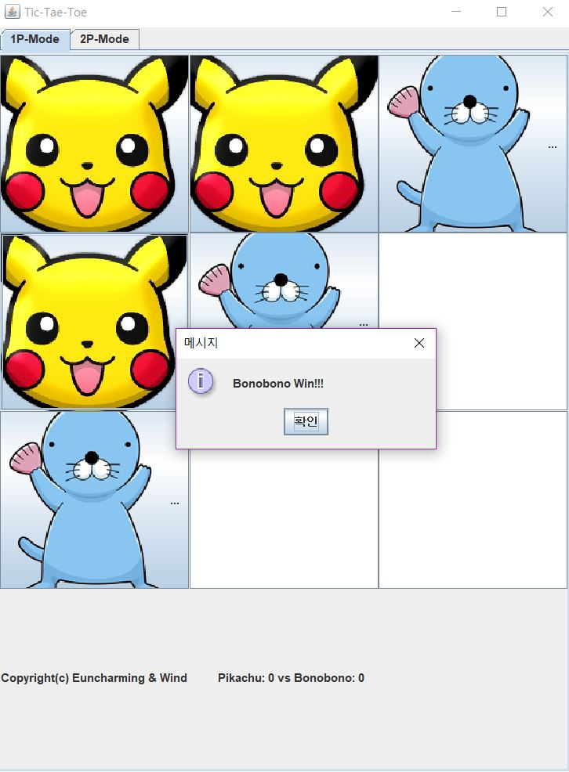
출력화면

Slide 35
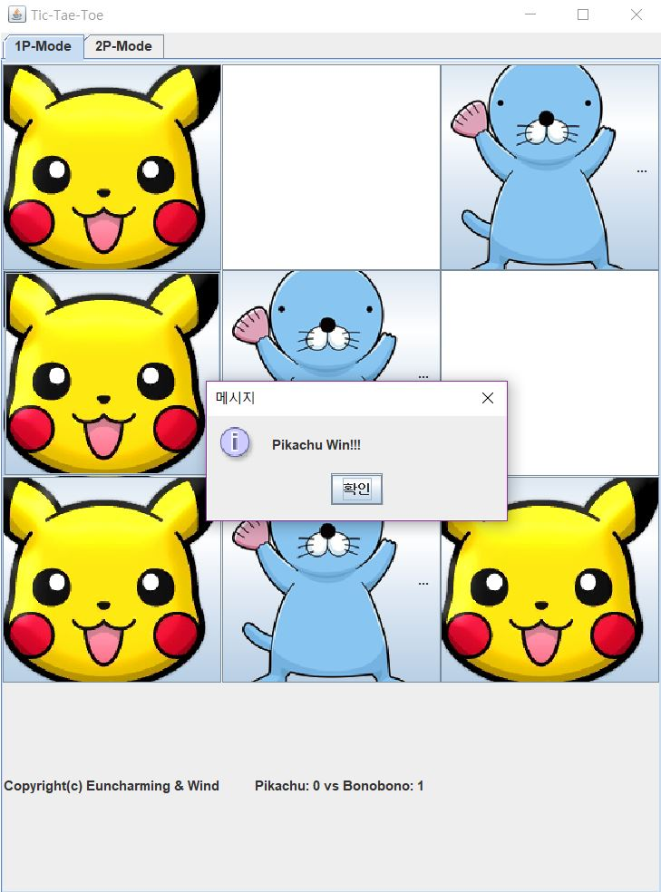
출력화면

Slide 36
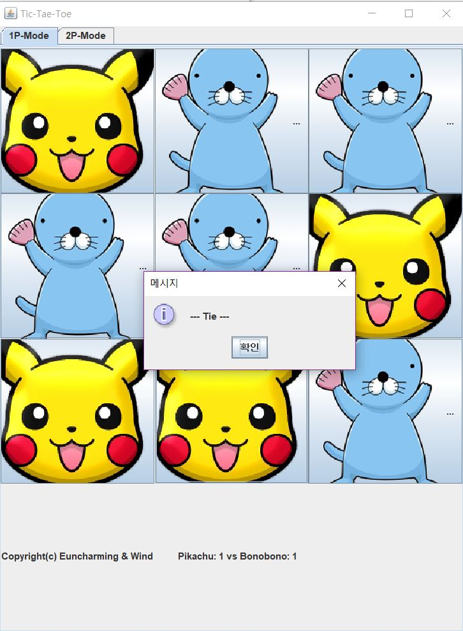
출력화면

Slide 37
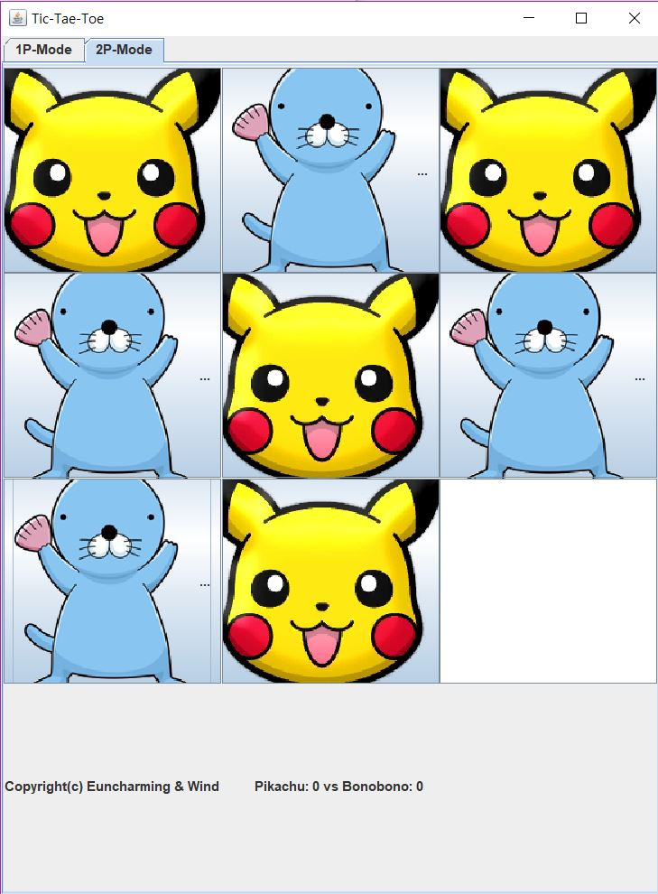
출력화면

Slide 38
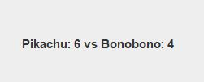
출력화면

Slide 39
Thank You
Copyright(c) Euncharming & Wind

