Slide 1
Lecture 2:
Metaphor (CONTD) and Its Figurative Friends:
Simile, Metonymy, Hyperbole and Irony
John Barnden, Visiting Professor
Emeritus Professor of AI
University of Birmingham, UK
Course on
“Metaphor: Its Depth, Breadth and Weight”
University of Cagliari, May 2017

Slide 2
METAPHOR continued

Slide 3
“Image Metaphor”
An important and common type of metaphor, illustrated by:
  “In the sun, the waves on the sea were [like] the strings of a harp.”
  A computer “mouse”.
  “He’s [like] a big bear.”
  “He could see a camel in the clouds.”
  “The children were like a swarm of bees round him.”
  “He could hear the trombone notes of the seals lying on the sand.”
So, some sort of perceptual similarity.
Cases discussed in the literature are mostly visual.

Slide 4
Effects/Purposes of Metaphor

Slide 5
Metaphor’s Effects/Purposes
They Include:
  Economy of language (or picturing, …)
  Ease of generating/understanding language
  Vividness, interestingness, …
  Forcefulness
  Communication of emotional attitudes & value judgments
  Binding of people in a (micro-)community
  Framing
  Persuasion

Slide 6
Metaphor Effects/Purposes: Examples
Evaluative connotations (value judgments, emotional colour, etc.), in examples such as:
  Poverty is a disease.
  The head of my department is a dictator.
  The head of my department is a saint.
  The president was being chased by reporters.
  There was a flood of immigrants.
  This situation stinks.
  Blue-sky thinking
  Thinking outside the box

Slide 7
Metaphor Effects/Purposes: Examples, contd
Framing:
It is claimed (with some experimental backing) that different metaphorical views of something T can seriously affect one’s reasoning about T, not just one’s evaluations about T.
  Viewing a MARRIAGE AS A JOURNEY versus as a BUSINESS.
  Viewing CRIME AS A WILD ANIMAL versus as a DISEASE.
  Viewing POVERTY AS A DISEASE IN SOCIETY versus as A PIT A PERSON HAS FALLEN INTO.
  Viewing CANCER AS A JOURNEY INTO UNKNOWN TERRITORY versus viewing it as A BATTLE TO BE WON.

Slide 8
Metaphor Effects/Purposes: Examples, contd
Persuasion:
Evaluative connotations and framing effects can be deliberately used
(by, e.g., politicians, lawyers, advertisers, etc., …)
to influence/persuade people to approve of desired policies etc.

Slide 9
Metaphor Effects/Purposes: Examples, contd
Therapy / Counselling / Psychological Self-Help:
Bereavement counsellors and therapists often try to change the metaphorical views people apply to themselves or their circumstances.
Again: exploiting framing and evaluative effects.
E.g. re agoraphobia:
replace OUTSIDE-AS-ALIEN-TERRITORY
by OUTSIDE-AS-HOME-EXTENSION

Slide 10
Metaphor Effects/Purposes: Examples, contd
Community Building:
It has been claimed that use of particular sorts of metaphorical view in a particular community (e.g. doctors, a protest movement, etc.) helps cement a feeling of togetherness or common purpose/interest.

Slide 11
Simile and Metaphor

Slide 12
Simile Examples
An academic department is like (/similar to / resembles / …) a solar system.
The internet is like a drug.
America under Trump will become like Russia.
Just as a mother protects her children, my boss protects his employees.
This new aircraft flies like a bird.
This new aircraft flies in the same way as a bird.
This hammer is as useful as a chocolate teapot. (?)

Slide 13
Simile versus(?) Metaphor
Traditionally, people have distinguished between simile and metaphor. The main contrast is between “A is like B” and “A is B”.
So traditional theorists, and many current ones, would not regard similes as metaphors (though figurative).

Slide 14
Simile versus(?) Metaphor, contd
Another view, held by some contemporary theorists:
similes are one of many forms of metaphor
BUT:
This does NOT by itself imply that, say, “The internet is like a drug” MEANS (exactly or even approximately) the same as “The internet is a drug.”
There may be differences of meaning, in some contexts at least,
and there may be differences in vividness, force, etc.

Slide 15
Simile versus(?) Metaphor, contd
A simile-is-metaphor view helps with the (typically neglected) issue of qualified/intermediate forms,
where it’s not clear whether they’re more like “A is like B” or more like “A is B”.
“My department is in all respects like a solar system.”
“My department is just the same as a solar system.”
“My department is almost a solar system.”
“My department is virtually a solar system.”
“My department is a sort of solar system.”
“My car is sort of on holiday.”
“The car is a super-horse.”

Slide 16
Conventional and Novel Metaphor;
Open-Ended Elaboration;
Conceptual Metaphor & Metaphorical Views

Slide 17
Conventional Phrasing
Much metaphorical language consists of “conventional” metaphorical phraseology, or more exactly: common, familiar phrases and regular variants:
  at the back of X’s mind,
  In a corner of X’s mind,
  bring [event X] forward,
  prices soared,
  a ghost of a smile, …
Some such phrases tend to be called “idioms,” and then I would call them “metaphorical idioms”, but
  Not all idioms are based on metaphor
  The word “idiom” tends to be regarded as the more appropriate the more that the meaning is unpredictable/unsystemactic in certain ways.

Slide 18
Variation and Open-Endedness
Metaphor is NOT a matter just of:
specific words/phrases with no underlying system.
There are many related phrases conforming to a given particular metaphorical way of looking at things. E.g.
About human relationships, using a JOURNEY view:
  They seem to be going on different paths, taking them further apart.
  They’re at a crossroads in their marriage.
  He has travelled a long way in understanding her, but still has a long way to go.
  She branched off in another direction.
  She used to be the shy one but has now overtaken him when it comes to parties.

Slide 19
Variation and Open-Endedness, contd
About financial matters, using a LIQUID view:
  Money flows easily between countries in the European Union.
  Brexit will erect barriers to the flow of money.
  She is awash with money. He’s drowning in debt.
  These assets are not very liquid.
  Money runs through his fingers.
  She topped up her bank account.
  The new law plugs a hole in the tax system.

Slide 20
Variation and Open-Endedness, contd
MOREOVER, the variations are “open-ended” – there’s no fixed set of words/phrases, and new ones can be invented.
E.g., anything about the way liquids flow, holes in containers are formed, etc. could be used to talk about money:
  We hope to punch a hole in the barriers [that Brexit will erect].
  There was already a massive, jagged hole in his finances, and his new lifestyle has pulled/ripped/torn/prised/drilled/… it even wider.
Anything about the obstacles in a path, straightness, alternative paths etc. could be used to talk about human relationships:
  On either side of the path he could see green fields and woods with attractive though muddy tracks going off into them.

Slide 21
Open-Ended Variation, contd
Variants of “a corner of X’s mind” [a common phrase]:
  in a dim corner of X’s mind
  in an unlit corner of X’s mind
  in a distant corner of X’s mind
  in a cobwebby corner of X’s mind [only a few Google hits]
  AND SO ON
There is no restriction on the red wording relevant to corners.

Slide 22
Creativity of open-ended elaborations/variations
[underlining shows the more creative bits]
the words “How could he? How could he?” jumping about her wearied brain
The idea was buried in the outback of Katy’s mind”
I don’t think strings are attached. If there are any, they’re made of nylon: I can’t see them.
A problem about the regulation of banking in Europe] seems to have been kicked right over the long grass into the junkyard down the road[.])
The weather is settling into a drier/fickle/benevolent frame of mind.

Slide 23
Another Example
“the car wants to move but something is stopping it. …
Sounds like the car thinks it's on holiday, all the snow, freezing temps and Christmas boozing has confused our cars into thinking they are Talbot horizons!! get her out today and show her a good time.”
[ http://forums.m3cutters.co.uk/archive/index.php/t-25414.html ]

Slide 24
METAPHORS as CONCEPTUAL
The existence of so much variation, especially as it is open-ended, has strongly suggested that metaphor is primarily a CONCEPTUAL matter, not a LINGUISTIC matter.
That is,
In some way, we can think of one subject matter in terms of another – we can and often do bring the two subject-matters together in our MINDS
And we can do this independently of the needs of external communication
and the appearance of metaphor also in pictures, gestures, music, dance, etc. is a reflection of its use in our minds.

Slide 25
“CONCEPTUAL METAPHORS”
This has led to a particular, famous notion: Conceptual Metaphors. Hence: Conceptual Metaphor Theory (CMT).
  SEE MORE in Ervas & Gola (2016).
A Conceptual Metaphor: A particular sort of structure in the mind (present either now or only historically) that relates two subject matters by analogical correspondences (“mappings”).
E.g., in LOVE IS A JOURNEY, the “mappings” could include (expressed in my own terms, clearer than those often used!):
  TWO LOVERS ←→ TWO CO-TRAVELLERS
  THEIR RELATIONSHIP ←→ THE VEHICLE THEY ARE IN
  THE CHANGING STATE of the RELATIONSHIP ←→ THE JOURNEY’s ROUTE

Slide 26
METAPHORICAL VIEWS
However, the general point is that we can take metaphorical views of things in our minds, e.g. of a love as a journey,
and there could be may different theories about the structure, etc. of those views,
and in particular about the nature of any mappings involved.
NB: the existence and specific contents of the metaphorical views can be influenced by communication experience and hence cultural factors.

Slide 27
Novelty (and Not) in Metaphor
“Image metaphors” are often novel.
This is perhaps because they are relatively easy to understand even when novel.
Aside from image metaphor,
completely novel metaphor is rare in ordinary discourse,
and relatively unusual even in literary discourse ….

Slide 28
Novelty (and Not) in Metaphor, contd
[Lakoff & Turner (1989): ]
[Even] most creative poetic metaphor is creative NOT because of radically novel pairings of subject matters
but because of the exploitation of familiar, mundane metaphorical views and phraseology by, e.g.,
  Open-ended elaborations much as on earlier slides
  Compounding [combination] of different metaphorical views
One famous literary metaphor that was highly novel when first created:

Slide 29

A Highly Novel Metaphor
“Why is a raven like a writing desk?”
asks the Mad Hatter in
Alice’s Adventures in Wonderland
A raven is a writing desk.
EX. NOW: Why/How?

Slide 30
Possible Answers
( http://www.wisegeek.org/why-is-a-raven-like-a-writing-desk.htm )
Lewis Carroll’s intention was to pose a nonsensical riddle, it seems, but one can see similarities…
Desks and ravens both come with inky quills.
They both stand on sticks.
  [both quoted by above webpage]
They both loom in a corner of the room.
  [an interpretation that I suggest]

Slide 31
Why / How Exactly Was it Novel?
Probably, no-one had previously compared a desk with a raven before
  But what if someone had compared a desk to some other bird or to generic bird?
  or had compared other domestic furniture to birds??
  or …??.
The nature of the novelty may lie partly in what sort of message is intended/extracted,
not necessarily in (just) the particular “pairing” of subject matters.

Slide 32


(How Exactly) Are These Novel?
[courtesy of Elisabeth El Rafaie, 2013]

Slide 33
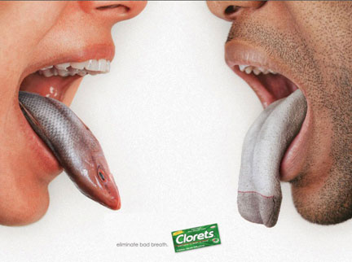
(How Exactly)Is This Novel?
[Slide is courtesy of Marianna Bolognesi, 2013]

Slide 34
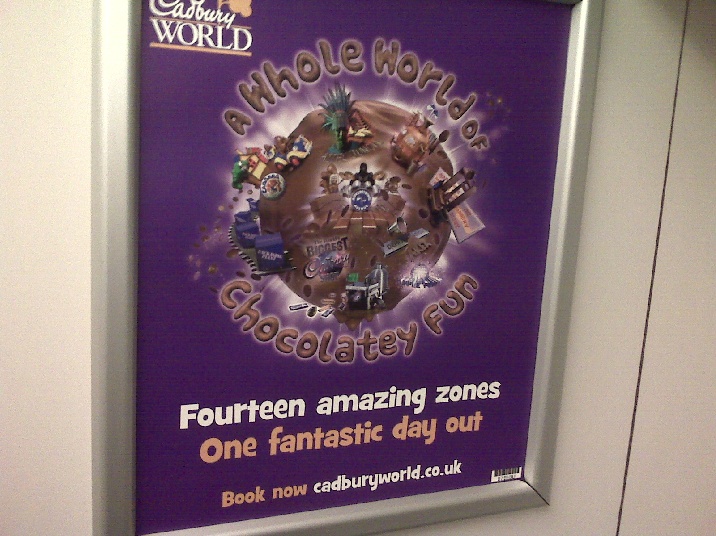
(How Exactly)Is This Novel?

Slide 35
Two Types of Novel Pairing
In raven/desk, the novel pairing can itself give a new view of the target, etc. It is a direct conduit for the message.
The cigarette/cell-bar pairing is novel, but is incidental to the underlying, familiar pairing of addiction/prison.
The creativity/novelty lies in how the message is conveyed: finding an incidental pairing that is so vivid and leads indirectly but forcefully to the message.
EVEN IN Raven/desk: in my interpretation above, leads to standardly-paralleled emotional reactions. Detailed intrinsic similarity (e.g. of colour or material) is NOT the main point.

Slide 36
METONYMY

Slide 37
Metonymy
Less well known (to non-specialists) than metaphor, and less studied in academia,
but strongly related to metaphor in a number of ways, and sometimes difficult to distinguish from metaphor.
Generally considered to be less complex and interesting than metaphor, but this may be an illusion.
Metonymy = [roughly] = indirectly communicating about something by more directly communicating about something else that has a salient connection to it.
  The “somethings” can be physical things, people, abstract entities, events, situations, times, thoughts, …, …, ….

Slide 38
Examples of Metonymy
Mary likes Mozart / Mary plays Mozart .
  [could mean: … the music of Mozart]
Mary reads Plato.
You’ll find Plato on the top shelf.
  [ can’t he climb down?! ]
She drank the whole bottle.
  [ she didn’t melt the glass and drink that! ]
England scored three goals.
  [the team playing for England did so]

Slide 39
Examples of Metonymy
This book is very interesting.
  [would usually mean: the content of the book is interesting]
John washed his car.
  [would usually mean: John washed the outside bodywork of the car]
Peter passed the sugar to Marina.
  [ did he take it out of the bowl first??! ]
There are only twenty hands on that ship. .
  [ twenty (not ten!) sailors ]
Susan is parked in the main square.
  [ Won’t she get bored standing there?!
  NB: also has a metaphorical sense.]

Slide 40
Examples of Metonymy
Sally bought a Ford.
  [would usually mean: she bought a car made by the Ford company]
She was wearing Dior / Primark / ...
Sally bought a newspaper.
  [COULD mean: she bought a newspaper company]
John broke the window.
  [would usually mean: John broke the glass part of the window]
John opened the window.
  [more was moved than just some of the glass in the window]
Long nose won the race.

Slide 41
Examples of Metonymy
Three suits walked into the room.
It’s time for the coffee break.
I need a red pen to correct the mistakes in this document.
How did I get here? I flew to Cagliari.
How did Mike get to the restaurant? He waved down a taxi in the street.
After she’d eaten her lunch, she fell asleep.
Tommy is looking forward to Wednesday.

Slide 42
Examples of Metonymy
My boss has scheduled our meeting for 9am.
  [actually the boss’s secretary scheduled it]
England’s bid is now worried about the impact of an investigation into FIFA .
The White House has made some ridiculous statements.
Number 10 refused to clarify what Brexit means.
The Daily Mirror believes it has solved the mystery .

Slide 43
Common Metonymic Types
(Metonymic Schemata)
Most metonymy relies on a set of particular relationships that are salient (= they are things we easily notice) in ordinary life, such as
  From a container to its contents
  From a (geographical) location to the people who live there.
Thus, researchers have given labels to such types of metonymy: e.g.:
  CONTAINER FOR CONTENTS
  PLACE FOR INHABITANTS

Slide 44
Common Metonymy Types:
Some Important Ones that have been Proposed
[LOOSELY adapted from various authors]
PART FOR WHOLE
The perfect set of wheels
WHOLE FOR PART
The car is green
CATEGORY FOR MEMBER/SUBCATEGORY
Do you want to come round for a drink?
MEMBER/SUBCATEGORY FOR THE CATEGORY
I need to take an aspirin
MATERIAL FOR OBJECT
I’ll pay by plastic.
OBJECT FOR MATERIAL
Mike put some apple in the casserole

Slide 45
Common Metonymy Types, contd
SUBEVENT / EVENT-PARTICIPANT FOR EVENT (or special case of PART FOR WHOLE?)
Jay and Denise are to walk up the aisle.
The meal was most enjoyable –great atmosphere.
TIME FOR EVENT
They summered in Sardinia.
PRESENT FOR NEAR FUTURE
I’m out of here / You’re dead.
CONTAINER FOR CONTENTS / CONTAINER FOR CONTENTS+CONTAINER
He drank a little of the glass to celebrate / Please pass me the sugar bowl
CONTENTS FOR CONTENTS+CONTAINER
Please pass me the sugar
.

Slide 46
Common Metonymy Types, contd
PLACE FOR INHABITANTS
The whole town is starving.
PLACE FOR RELEVANT REPRESENTATIVE (e.g. ARMY, SPORTS TEAM)
England lost the match.
Did Russia invade Crimea?
INSTITUTION FOR BOSS/REPRESENTATIVE(S)
The Government / The football club thinks that the problem will go away
INSTUTUTION PLACE FOR BOSS/REPRESENTATIVE(S)
The White House said that the moon is fake news.
No. 10 wants to bypass Parliament.
.

Slide 47
Common Metonymy Types, contd
PRODUCER FOR PRODUCT (incl. ARTIST FOR ARTWORK(S))
She bought a Mercedes.
She has a lot of Picasso on her walls
CONTROLLER FOR CONTROLLED
At this stage in the war, Hitler was in retreat.
He overtook me on the main road
CONTROLLED FOR CONTROLLER
That car thinks it can pass me
REPRESENTATION FOR THING REPRESENTED
That white blob on the left of the picture is a sheep.
Daniel Craig saved the world again
THING REPRESENTED FOR REPRESENTATION
My aunt is on the right-hand side of the painting.
James Bond visited Cagliari yesterday.
Mike’s holiday was at the back of his mind.
.

Slide 48
Ad Hoc (or Novel) Metonymy
There is evidence that, in a suitable context,
a sufficiently salient link of any type between things can support metonymy,
even if the link is temporary or dependent on a very specific context.
Real examples:
  That student is me.
  [meaning that the student is one of my students]
  I’ll put Marcia in the other room
  [where Marcia herself is not staying in the house]
  [meaning I’ll put Marcia’s boxes that she stored with us in the other room]
  Where are you?
  [In a changing room, meaning: where is your clothes locker?]
  5 checks.
  [meaning that the representatives of the local bus company that runs the No.5
  line do often check that people on those buses have tickets]
  Could be a chaining of a few metonymic links, one of which is an ad hoc (??)
  metonymic link going from the number 5 to the No. 5 bus line.
.

Slide 49
Polysemy “versus” Metonymy
It could be that, say, “window” just has several closely related direct meanings (i.e., it is polysemous), e.g.
  (a) the glass of the window
  (b) a movable frame+glass,
rather than one direct meaning used to provide indirect construction of other meanings during understanding.
But in the polysemy case one could still say that some meanings are “metonymically motivated” by others, and perhaps historically there was indirect construction of meaning during understanding.
So “metonymy” often covers both cases.
.

Slide 50
Metonymy Effects/Purposes
[recall those for metaphor]
They Include:
  Economy of language
  Ease of speaking and understanding
  Vividness
  Forcefulness
  Evaluation
  …

Slide 51
Economy and Ease
In, say, “The White House said that …”, the speaker may not know exactly who made the statement, and/or may not think it’s important for the hearer to know that detail.
Simpler than saying
“A representative of the staff at the White House said that …”
And actually the link between source (White House) and target (representative(s)) is itself an important part of the message,
so the full statement should be
“A representative of the staff at the White House, in his/her capacity as representative, said that …”

Slide 52
Evaluative Connotations
[recall the metaphor case]
Pretty nose won the beauty competition.
Pretty nose outlined her new theory of quantum gravity.
Some suits visited our TV studio today.
This newspaper believes that Trump is dangerous.
[For much more, see Littlemore (2015), and also Barnden (forthcoming)]

Slide 53
Metonymy
in Pictures etc.:
OUTSIDE EXERCISE!

Slide 56
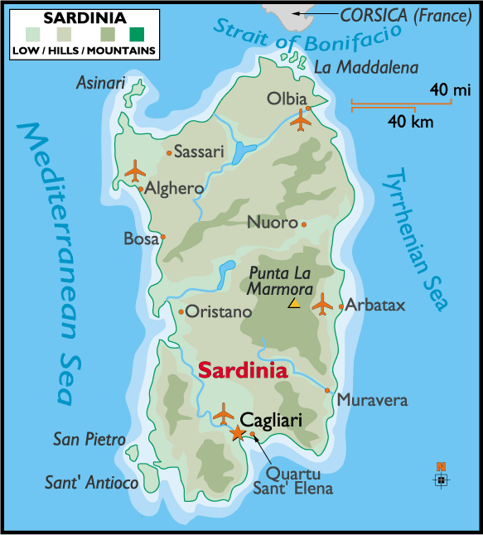

Slide 57
HYPERBOLE
[brief]

Slide 58
Hyperbole
My own view, drawing from other researchers:
Hyperbole = exaggeration that is non-deceptive and is used to convey (an increased intensity of) emotion or evaluation.

Slide 59
Examples of Hyperbole
Mary has millions of pets in her apartment.
This suitcase weighs a ton.
The whole meal was ruined.
Fine food can be found in every part of Sardinia.
I’ve lived everywhere in the USA.
This is the worst day of my life.
My bedroom is freezing cold / boiling hot.
He’s a giant .
She’s a genius / a lunatic.
Your garden pond is a real lake / just a puddle!
America will be so, so great you won’t be able to believe it.

Slide 60
IRONY
[brief]

Slide 61
Verbal Irony
There is also situational irony and dramatic irony, not described in these slides.
Verbal Irony = [roughly] = saying or implying something that is somehow opposed to what one believes to be true in order to point out that the truth violates some expectation, claim, hope, etc. and/or to criticize someone for not seeing the truth.
  The criticism can be mild (even friendly) or severe (very mocking, insulting, etc.)
  The violation is typically a source of disappointment in some way.
  Notice the significant evaluative/emotional dimensions.

Slide 62
Examples of Verbal Irony
Oh great, nice and hot today!
  [when it’s cold]
Sure, Mike’s a genius.
  [when Mike has been claimed to be or is expected to be clever]
Yeah, you’re an idiot.
  [when the hearer has claimed to be stupid; here the criticism can be friendly]
Thanks for holding the door open.
  [when someone has not held the door open]
Thanks for letting the door close in my face.
  [when someone has not held the door open]
He’s such a good guest I want to invite him back, wash his dirty socks all day, and then cook him a feast.

Slide 63
RELATIONSHIPS BETWEEN THE FIGURES

Slide 64
Hyperbole as a Common Thread
Metaphor, metonymy and irony are often (also) hyperbolic.
Metaphor:
  My department head is a dictator / a little Hitler
  Washington DC is a [political] swamp
  There’ll be a flood of immigrants.
  She’s an angel.
  William kicked the problem over the long grass and into the junkyard on the other side.
Metonymy:
  Big nose won the race
  The UK has expressed its desire to leave the EU
Irony:
  Mike’s a genius.
  Thanks for letting the door slam in my face.
  He’s such a good guest I want to invite him back, wash his dirty socks all day, and then cook him a feast.

Slide 65
Mixtures of Different Figures
Metaphor and Metonymy:
  Washington DC is a swamp
  She tore John’s paper to shreds. [meaning she destroyed its argument]
Metaphor and Irony:
  This train is such a rocket.
  I’m overflowing with gratitude for your kind words.
Irony and Metonymy:
  Washington DC is such an honest place.
  Your dress is so Dior.
Irony, Metaphor and Metonymy:
  I’ll be sure to keep your drycleaning arrangements right at the front of my mind during my maths exam tomorrow.

Slide 66
Alternative Analyses
Metaphor versus Metonymy:
  England wants to leave the EU at the moment.
  England wants to leave the EU at the moment, but may be punished for it.
  I like that snake in the middle of the painting.
  Mary tore John’s proposal to pieces.
(Hyperbolic) Metaphor versus (Just) Hyperbole
  Peter is a giant.

Slide 67
Slippery Metaphor/Metonymy Distinction
[See Barnden 2010 for more.]
Why shouldn’t the similarity relationships that arise in metaphor give us simply a particular type of metonymy, just as parthood relationships, containment relationships, etc. etc. do? What’s so special about similarity?
So then “beanpole” would be metonymic (as well as metaphorical):
  She’s going to marry that beanpole

Slide 68
Slippery Metaphor/Metonymy Distinction, contd
Many researchers try to say that metaphor crosses between different “domains”
  e.g., the domain of human relationships and the domain of journeys
whereas metonymy stays within a single domain
  e.g., the music world.
But while this may be to some extent true, especially of more typical cases of metaphor and metonymy,
the notion of a domain is very vague and changeable, the domains in metaphor can overlap or be arbitrarily close, and the same pair of domains can sometimes support either metaphor or metonymy.
  “This week, Tuesday is honorary Monday.”
  “The snake in the middle of the painting is pleasing.”

Slide 69
END for TODAY
but please read extra slides
on (non-)novelty and compounding of metaphor

Slide 70
References
Barnden, J.A. (2010). Metaphor and metonymy: Making their connections more slippery. Cognitive Linguistics, 21 (1), pp.1—34.
Barnden, J.A. (2016a). Mixed metaphor: Its depth, its breadth, and a pretence-based approach. In Gibbs (2016), pp.75—111.
Barnden, J.A. (2016b). Communicating flexibly with metaphor: A complex of strengthening, elaboration, replacement, compounding and unrealism. Review of Cognitive Linguistics, 14 (2), pp.442—473.
Barnden, J.A. (forthcoming). Some contrast effects in metonymy. In O. Blanco, A. Barcelona & R. Pannain (Eds), Describing Conceptual Metonymy in Languages: From Morpheme to Discourse. John Benjamins.
Demjen, Z. (2011). Language and mind: How language can convey mental states, with special reference to Sylvia Plath's “Smith Journal.” PhD Thesis, Lancaster University, UK.
Gibbs, Jr., R.W. (Ed.) (2016). Mixing metaphor. Amsterdam: John Benjamins.
Littlemore, J. (2015). Metonymy: Hidden shortcuts in language, thought and communication. Cambridge University Press.

Slide 72
EXTRA SLIDES

Slide 73
METAPHOR
continued:
More on (Non-)Novelty

Slide 74
Types/Degrees of [Non-]Novelty
(examples of points on the spectrum)
Completely non-novel:
familiar source term, target term, metaphorical view and message:
Standard, unvaried metaphorical phraseology: “conventional metaphors” and metaphorical idioms.
Wording AND metaphorical view are both non-novel.
Meaning extracted about the target is standard (non-novel).
Some people like to say such phraseology is “entrenched”.

Slide 75
Types/Degrees of [Non-]Novelty, contd
Familiar metaphorical view, message and source term,
but new target:
There’s a source word/phrase S that’s is commonly used metaphorically with a particular standard meaning M to describe various targets T (e.g. S = “rat”, as in “He’s a rat”, “Criminals are rats”)
but is now used to apply M to a new target T (possibly: “Opponents of Brexit are rats”).
The particular whole linguistic metaphor is new but the metaphorical use of the source term with meaning M is not (so that usage could be said to be “entrenched”)

Slide 76
Types/Degrees of Novelty, contd
Familiar metaphorical view and partly standard message, but wording (partly) new and message augmented/modified (in many different possible ways):
many of the examples earlier of open-ended variation.
New special case of a familiar metaphorical view (hence novel wording) and variation of standard message :
e.g.: “The idea was buried somewhere in the savannah of her mind”.
= Special, novel(?) case of the familiar practice of viewing people’s minds as geographical terrain.

Slide 77
Types/Degrees of Novelty, contd
Novel compounds of familiar metaphorical views:
SEE LATER SLIDES on compounding
Entirely new metaphorical view (novel pairing of subject matters), not usefully regarded as a special case of some familiar view:
ravens as writing desks
“Compassion is a sloth.”

Slide 78
Novelty/Subtlety of some Pictorial cases
Cadbury’s world: fun viewed as a world, (fantastically) elaborated/distorted as being made of chocolate.
  Part of message: fun is intrisincally chocolatey – chocolatiness not incidental or just what the fun is about
Smelly tongues: two people are interacting, emphasizing the problem that the smelliness raises.
Smoking addiction/danger:
  Cigarettes as prison bars: message of lack of intention by the smoker, doing something risky
  Cigarettes as bullets: message of intention, or at least knowingness, or at least: strongly-should-have-known

Slide 79
METAPHOR
CONTINUED:
Compounding

Slide 80
Compound Metaphor
“The NHS problem is the bedrock of Labour’s election campaign. It has been rolling on remorselessly.”
This uses three different metaphorical views for the NHS problem:
  the problem as bedrock
  the problem as a physical object that can roll
  the problem as a cognitive agent that can act remorselessly.
Compounding of three different views.
Because one target X is being viewed as three different sources,
I say that the compounding is [source-]parallel.

Slide 81
Compound Metaphor, contd
“The thought of her step-mother's arrival hung over her mind like a dark angry cloud.”
Chaining of THOUGHT-AS-CLOUD and CLOUD-AS-PERSON.
I call such chaining “serial compounding”.

Slide 82
Compound Metaphor, contd
“We do not have a chocolate army that fades away at the first sign of trouble.”
Serial compounding of
SOLDIERS-AS-CHOCOLATE-TOYS and MELTING-AS-FADING.

Slide 83
Compound Metaphor, contd
“This worry was a corrosive chemical that was nibbling at her self-esteem.”
[closely adapted from an example in a Sylvia Plath diary,
cited by Demjen 2011]
  Serial compounding of WORRY-AS-CHEMICAL and CHEMICAL-AS-ANIMAL …
  … then parallel compounding with SELF-ESTEEM AS NIBBLABLE OBJECT.

Slide 84
Compound Metaphor, contd
[a sort of parallel compound of two metaphors of a tongue as something smelly;
NB: different tongues]

Slide 85
Compound Metaphor, contd
FUN AND PHYSICAL/ABSTRACT ENVIRONMENT AS WORLD,
en serial compounding with WORLD-AS-CHOCOLATE-BALL.

Slide 86
Compound Metaphor, contd
QUESTION: “… the car wants to move but something is stopping it.”
ANSWER: “Sounds like the car thinks it's on holiday, all the snow, freezing temps and Christmas boozing has confused our cars into thinking they are Talbot horizons!! get her out out today and show her a good time.”
[ http://forums.m3cutters.co.uk/archive/index.php/t-25414.html ]
Parallel compound(?) of
a view of the car as a thinking agent, with
a view of its state of not operating normally as being on holiday.

Slide 87
Compound Metaphor: A Complex Case!
“ the words `How could he? How could he?’ jumping about her wearied brain. Senseless, leaving her empty, cold, helpless. Another voice, angry and vindictive, shouted in her ear, …”
[from an earlier slide]
Parallel compound of IDEAS AS EXTERNAL UTTERANCES, IDEAS AS INTERNAL UTTERANCES, and BRAIN AS CONTAINER OF IDEAS,
with the IDEAS AS INTERNAL UTTERANCES component serially compounded with UTTERANCES AS ANIMATE CREATURES.

Slide 88
“Compound” versus “Mixed” Metaphor
“Mixed” metaphor:
Typically taken to be where some sort of combination of usually-separate bits of metaphorical phraseology,
based on different metaphorical views,
makes the resulting sentence sounds ridiculous or funny, usually because of some sort of clash:
  “It’s as easy as falling off a piece of cake.”
  [and many others on http://www.jimcarlton.com/my_favorite_mixed_metaphors.htm]

Slide 89
“Compound” versus “Mixed” Metaphor
Some researchers take a broader view, and include cases where there is phraseology combination based on different metaphorical views but no resulting humorous/ridiculous effect.
  See range of papers in Gibbs (2016).
  In my own paper in Gibbs (2016), i.e. Barnden (2016a), I use “mixing” in this broader way.

Slide 90
“Compound” versus “Mixed”, contd
My current, more careful view/terminology:
  “MIXED” metaphor = the surface-linguistic phenomenon of metaphorical phraseology resting on different metaphorical views being adjacent or intertwined in discourse [irrespective of whether there are good or bad communicative effects]
  “COMPOUND” metaphor = the cognitive phenomemon of different metaphorical views being cognitively used in cooperation with each other in some way.
Compounding tends to cause mixing (as in all the above examples).
But mixing need not reveal compounding:
instead, one metaphorical view may simply replace another, or compete with it, rather than cooperate with it.
[More on such issues in Barnden 2016b]

Slide 91
END

Slide 92


Slide 93
IGNORE
following slides

Slide 94
Ellipsis
Ellipsis.
  John wanted strawberry ice-cream, but Mary chocolate.
  John loves his wife. Bill too. [but whose wife?!]

Slide 95
Open-Ended Variation, contd
Variants of “a corner of X’s mind” [a common phrase]:
  in a dim corner of X’s mind
  in an unlit corner of X’s mind
  in a distant corner of X’s mind
  in a cobwebby corner of X’s mind [only a few Google hits]
  AND SO ON
Difficult to see how to understand the effect of the red qualifiers without reasoning about the nature of
physical corners, physical darkness, physical distance, etc.
There is no restriction on the red wording relevant to corners.

Slide 96
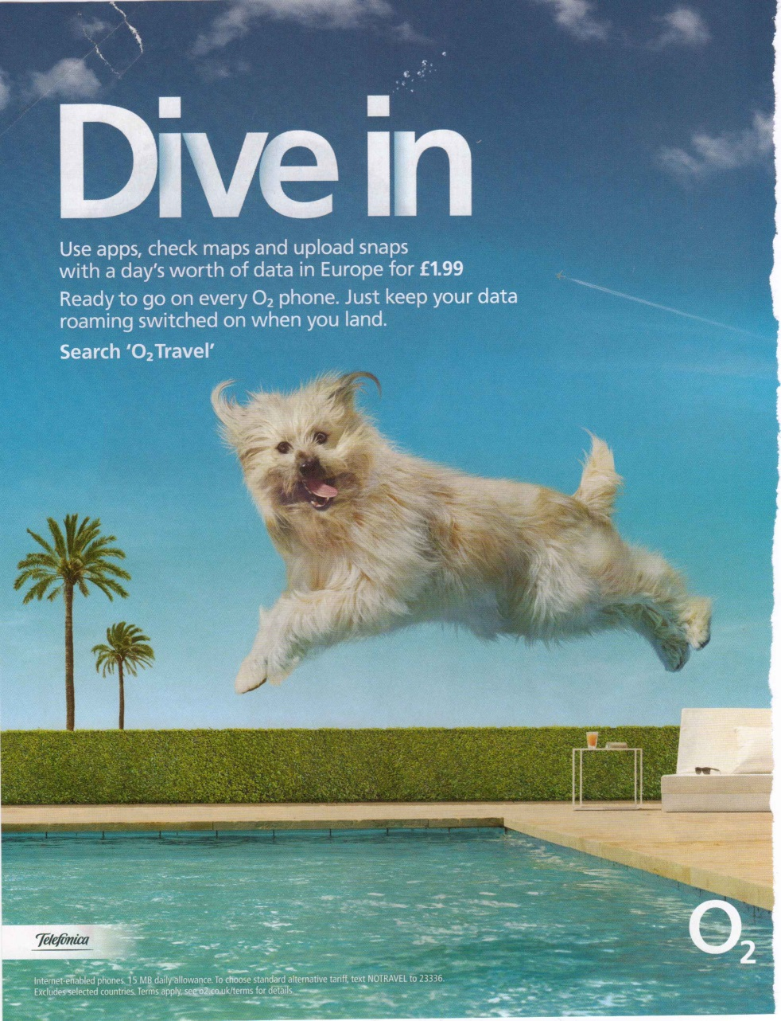
Advertising
mobile apps

Slide 97


Slide 98
[Advertisement in a London Midland train in UK in 2014]]

Slide 101
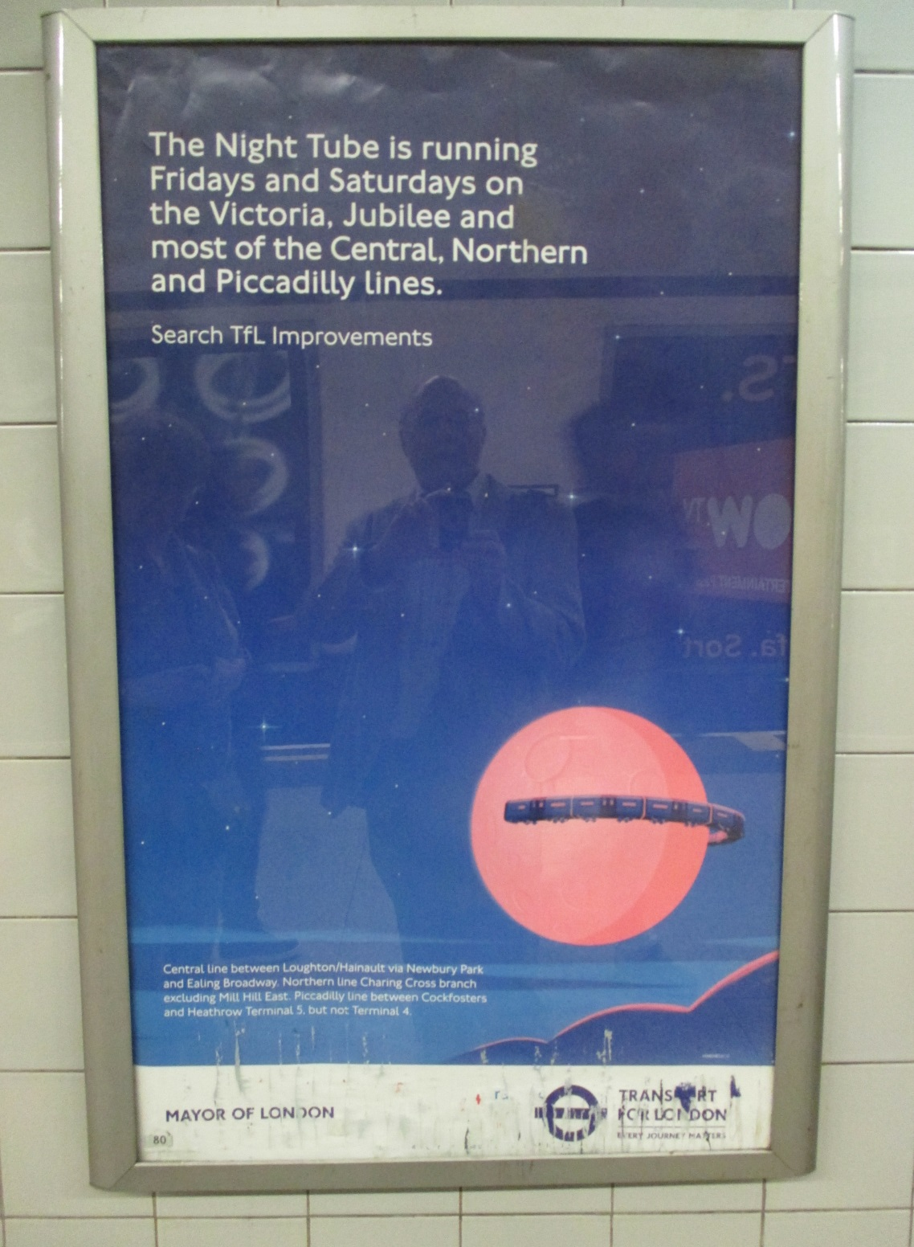

Slide 102
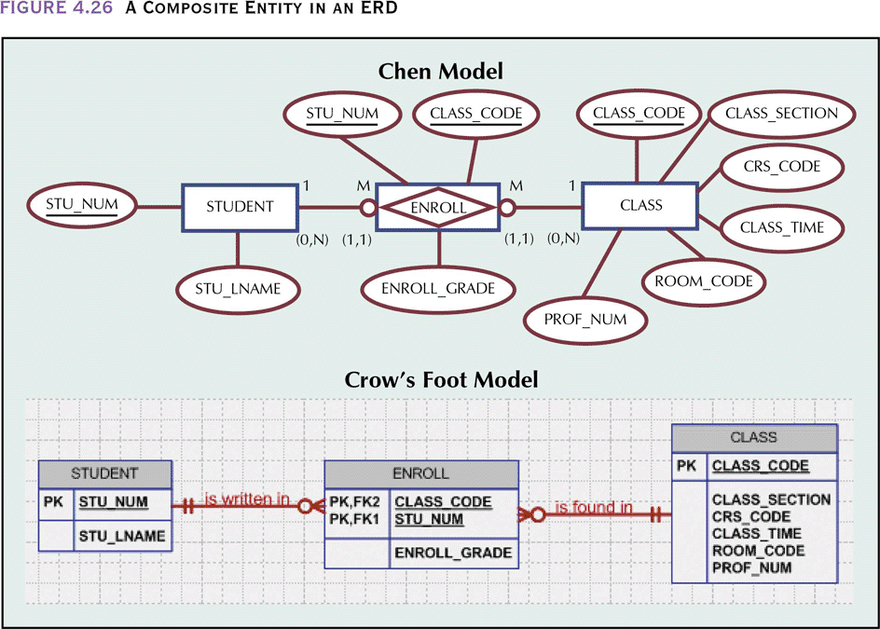
Quick Flavour of Two Styles of Database Diagram

Slide 103
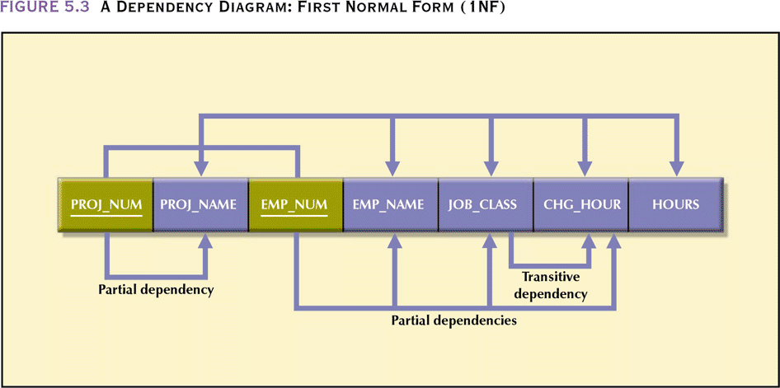
Partial and Transitive Dependencies

Slide 104
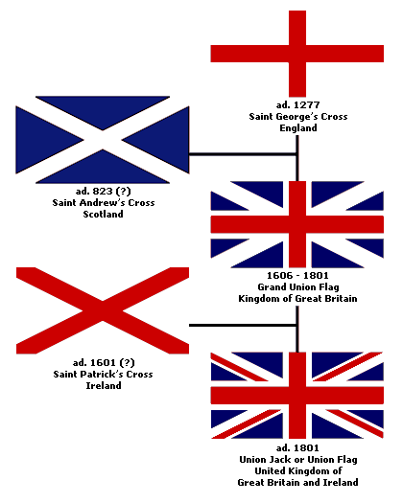
Union Jack

Slide 105
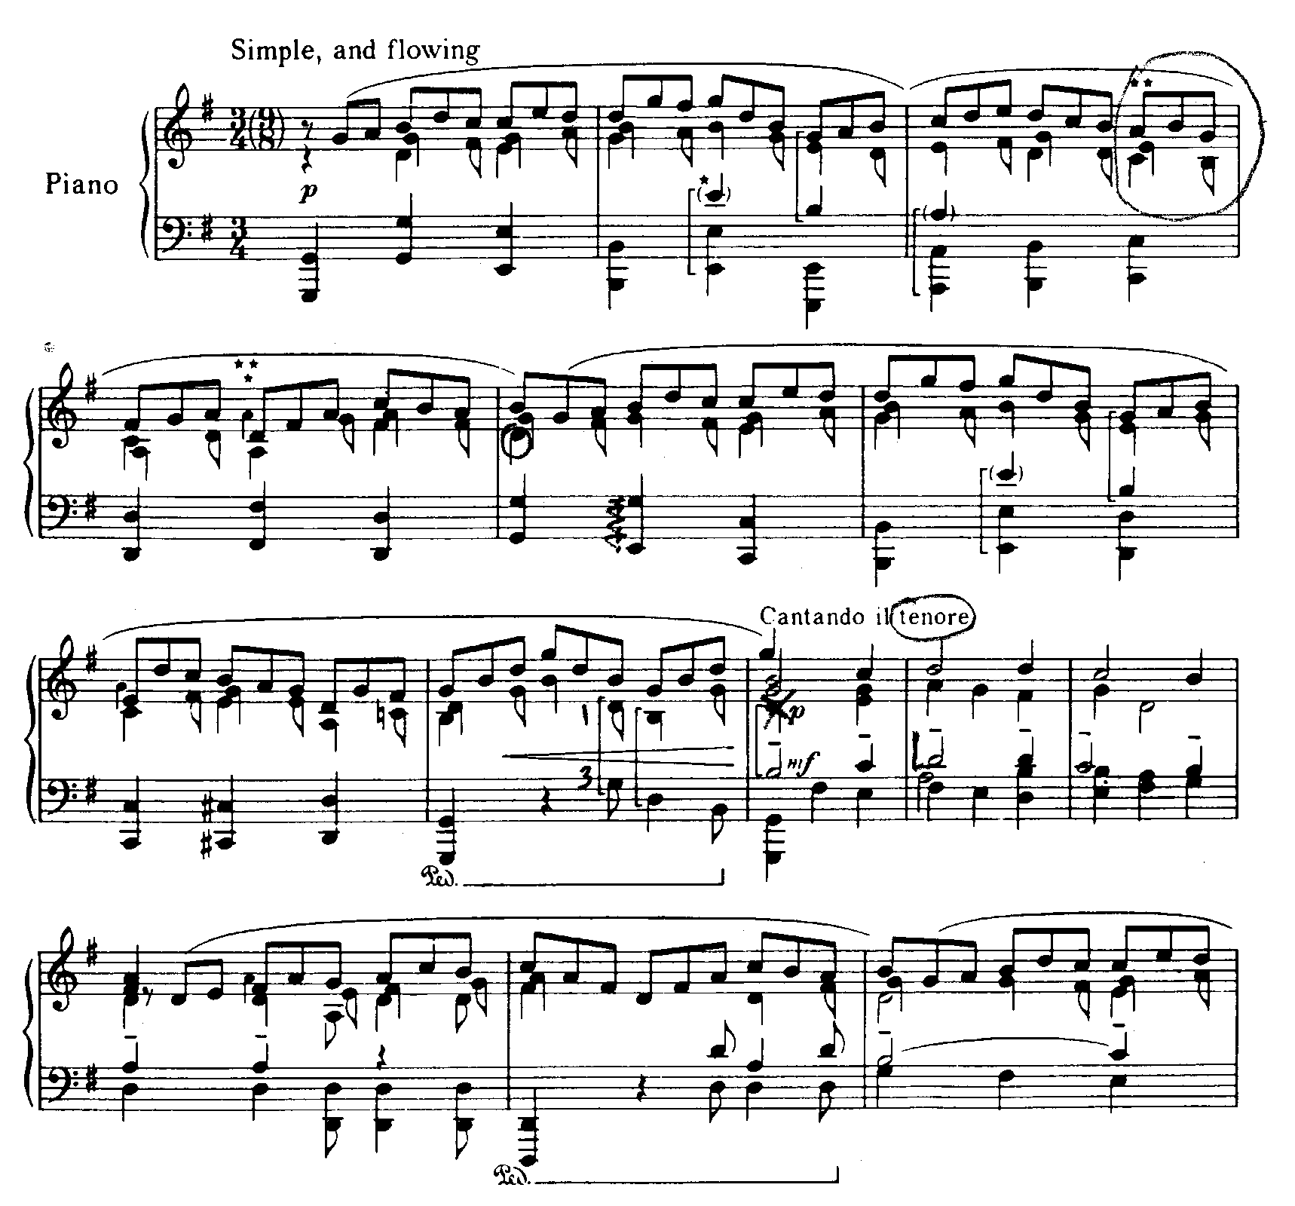
Music
Notation

