Slide 1
Lecture 3:
More on the How:
Approaches to the Mechanics of Metaphor
(after overflow from Lecture 2)
John Barnden, Visiting Professor
Emeritus Professor of AI
University of Birmingham, UK
Course on
“Metaphor: Its Depth, Breadth and Weight”
University of Cagliari, May 2017

Slide 2
Overflow(!) from
Lecture 2

Slide 3
METONYMY
continued

Slide 4
Polysemy “versus” Metonymy
[READ OUTSIDE]
It could be that, say, “window” just has several closely related meanings directly stored ( “stored meanings”, typically but not necessarily “literal” meanings) in an external or mental lexicon (i.e., it is polysemous), e.g.
  (a) the glass of the window
  (b) a movable frame+glass,
rather than a stored meaning used to provide construction of other meanings during understanding.
But in the polysemy case one could still say that some meanings are “metonymically motivated” by others, and perhaps historically there was indirect construction of meaning during understanding.
So “metonymy” often covers both cases.
.

Slide 5
Caution: “Synecdoche”
[READ OUTSIDE]
Along with many other modern researchers, I take “metonymy” to include some phenomena that used to be regarded as separate, notably “synecdoche”.
“Synecdoche” has been used to cover metonymy that rests on WHOLE/PART links (in either direction), or links between CATEGORIES and their MEMBERS/SUBCATEGORIES.
  A problem here: people have different views of what a “part” is. E.g., Oxford Dictionary Online’s definition of synecdoche implies that the England football team is part of England, whereas I find that a bit odd.
  Also, descriptions of synecdoche often (at least implicitly) assume that the member/category and subcategory/category relationships are versions of part/whole. (OUTSIDE EXERCISE: What do you think about that?)
  One prominent current researcher in metonymy (Ruiz de Mendoza Ibánez) takes the notion of part/whole so broadly that all metonymy becomes PART→WHOLE, WHOLE→PART or PART→PART. And he bases this on parts of concepts rather than directly on parts of things.
.

Slide 6
Metonymy Effects/Purposes
[recall those for metaphor]
They Include a spectrum of things:
  Economy of language
  Ease of speaking and understanding
  Vividness
  Forcefulness
  Evaluation
  …

Slide 7
Economy and Ease
In, say, “The White House said that …”, the speaker may not know exactly who made the statement, and/or may not think it’s important for the hearer to know that detail.
Simpler, more inclusive of possibilities, and more confidently accurate than saying something like
“An official representative of the staff at the White House said that …”
And actually the link between source (White House) and target (representative(s)) is itself an important part of the message,
so the above statement should be filled out to:
“An official representative of the staff at the White House, in his/her capacity as representative, said that …”

Slide 8
Evaluative Connotations
[OUTSIDE EXERCISE]
Pretty nose won the beauty competition.
Pretty nose outlined her new theory of quantum gravity.
Some suits visited our TV studio today.
This newspaper has solved the mystery.
[said by the newspaper itself]
[For much more, see Littlemore (2015), and also Barnden (forthcoming)]

Slide 9
Metonymy
in Pictures etc.:
OUTSIDE EXERCISE:
can you see any metonymy, and of what types?

Slide 10
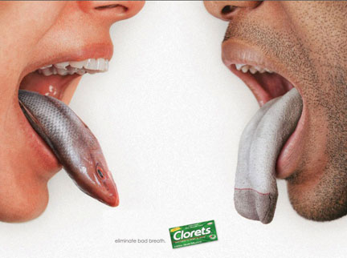

Slide 11



Slide 12
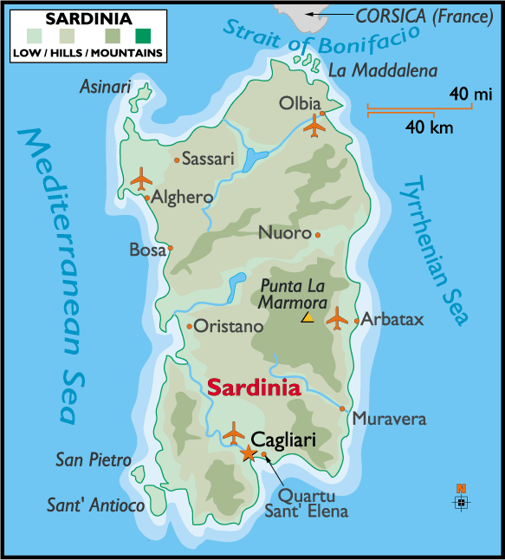

Slide 13
HYPERBOLE
[the briefest possible discussion !! ]

Slide 14
Hyperbole
My own view, drawing/learning from many other researchers:
Hyperbole =
exaggeration that is
non-deceptive and is
used to convey (an increased intensity of)
affect (emotion, mood, evaluation, etc.).

Slide 15
Examples of Hyperbole
Mary has millions of pets in her apartment.
This suitcase weighs a ton.
The whole meal was ruined.
Fine food can be found in every part of Sardinia.
I’ve lived everywhere in the USA.
This is the worst day of my life.
My bedroom is freezing cold / boiling hot.
He’s a giant .
She’s a genius / a lunatic.
Your garden pond is a real lake / just a puddle!
America will be so, so great you won’t be able to believe it.

Slide 16
IRONY
[now this will be such a complete discussion!]

Slide 17
Examples of Verbal Irony
(but there is also situational irony and dramatic irony)
Oh great, nice and hot today!
  [when it’s cold]
Sure, Mike’s a genius.
  [when Mike has been claimed to be, or is expected to be, clever]
Yeah, you’re an idiot.
  [when the hearer has claimed to be stupid; here the criticism can be friendly]
Thanks for holding the door open.
  [when someone has not held the door open]
Thanks for letting the door close in my face.
  [again, when someone has not held the door open]
He’s such a good guest I want to invite him back, wash his dirty socks all day, and then cook him a feast.

Slide 18
Description of Verbal Irony
[OUTSIDE EXERCISE: READ & relate it to the examples]
Verbal Irony =[roughly]= non-deceptively saying or implying something, O, that is somehow in conflict with what one believes to be true,
where O is, or is closely related to, some expectation, claim, hope, etc.
in order to point out and convey an attitude about reality violating that expectation etc.
and/or to criticize someone (even oneself) for having such an expectation, etc. or otherwise not seeing the truth.
  The expectation may have been recently stated or may be something that’s part of our background culture or anything in between
  The criticism can be mild (even friendly) or severe (very mocking,, etc.)
  The violation is often a source of disappointment.

Slide 19
Verbal Irony & Sarcasm
[READ OUTSIDE]
Sarcasm is variously defined, with some dictionaries (e.g. Oxford online) casting it as a special case of irony and others (e.g. Chambers) implying that it merely overlaps irony.
Under the overlap view, sarcasm =roughly= saying something in a biting or contemptuous way. [But we may need to say more for a good definition.]
  Examples of non-ironic sarcasm are rarely given in my experience, but I could suggest things like “You think you’re so clever don’t you” to someone, Peter, when in fact Peter is clearly clever; the contemptuous attack is on Peter’s attitude towards his own cleverness, not on his cleverness.
Under the special-case view, sarcasm is for example “The use of irony to mock or convey contempt”. [Oxford online]
There is no sharp dividing line between sarcastic forms of irony and non-sarcastic ones.
non-deceptively saying or implying something that is somehow opposed to what one believes to be true, in order to point out that the truth violates some expectation, claim, hope, etc. (which may be explicitly and recently made or something that’s part of our background culture or anything in between) and/or to criticize someone for having such an expectation, etc. or otherwise not seeing the truth.
  The criticism can be mild (even friendly) or severe (very mocking, insulting, etc.)
  The violation is typically a source of disappointment in some way.
  Notice the significant affective dimensions.

Slide 20
RELATIONSHIPS BETWEEN THE FIGURES

Slide 21
Hyperbole as a Common Thread
metaphor, metonymy and irony are often (also) hyperbolic
Metaphor:
  My department head is a dictator / a little Hitler
  Washington DC is a [political] swamp
  There’ll be a flood of immigrants.
  She’s an angel.
  William kicked the problem over the long grass and into the junkyard on the other side.
Metonymy:
  Big nose won the race [exaggerating the role of her nose within her appearance]
  The UK has expressed its desire to leave the EU [only 52% of voters wanted this!!]
Irony:
  Mike’s a genius.
  Thanks for letting the door slam in my face.
  He’s such a good guest I want to invite him back, wash his dirty socks all day, and then cook him a feast.

Slide 22
Mixtures of Different Figures
[READ OUTSIDE]
Metaphor and Metonymy:
  Washington DC is a swamp
  She tore John’s paper to shreds. [meaning she destroyed its argument]
Metaphor and Irony:
  This train is such a rocket.
  I’m overflowing with gratitude for your kind words.
Irony and Metonymy:
  Washington DC is such an honest place.
  Your dress is so Dior.
Irony, Metaphor and Metonymy:
  I’ll be sure to keep your drycleaning right at the front of my mind during my maths exam tomorrow.

Slide 23
Alternative Analyses
[READ OUTSIDE]
Metaphor versus Metonymy:
  England wants to leave the EU at the moment.
  England wants to leave the EU at the moment, but may be punished for it.
  I like that snake in the middle of the painting.
  Mary tore John’s proposal to pieces.
(Hyperbolic) Metaphor versus (Just) Hyperbole
  Peter is a giant.

Slide 24
Slippery Metaphor/Metonymy Distinction
[see Barnden 2010 for more; also Fauconnier 2009]
It is often claimed that metaphor rests on similarity but metonymy rests on “contiguity”.
  [“Contiguous” = “touching”; another metaphor for what can be described in terms of “links” or “connections”.]
But the term “contiguity” is so vague and metaphorical, and so much a matter of our view of the world, that we should ask why similarity shouldn’t be regarded as just a articular type of contiguity. (What’s so special about similarity?)
So then “lamppost” would be metonymic as well as metaphorical in:
  She’s going to marry that lamppost.

Slide 25
Slippery Metaphor/Metonymy Distinction, contd
Many researchers try to say that metaphor crosses between different “domains”
  e.g., the domain of human relationships and the domain of journeys
whereas metonymy stays within a single domain
  e.g., the music world, when we go f rom a composer to his/her works.
But while this may be to some extent true, especially of more typical cases of metaphor and metonymy,
the notion of a domain is very vague and changeable, the domains in metaphor can overlap or be arbitrarily close, and the same pair of domains can sometimes support either metaphor or metonymy.
  “This week, Tuesday is honorary Monday.”
  “The snake in the middle of the painting is pleasing.”

Slide 26
END
Overflow from Lec 2

Slide 27
BACK to METAPHOR:
essential background for theories about the mechanisms

Slide 28
Conventional Phrasing
Much metaphorical language consists of “conventional” metaphorical phraseology, or more exactly: common, familiar phrases and regular variants:
  at the back of X’s mind,
  In a corner of X’s mind,
  bring [event X] forward,
  prices soared,
  a ghost of a smile, …
Some such phrases tend to be called “idioms,” and then I would call them “metaphorical idioms”, but
  Not all idioms are based on metaphor
  The word “idiom” tends to be regarded as the more appropriate the more that the meaning is unpredictable/unsystemactic in certain ways.

Slide 29
Variation and Open-Endedness
Metaphor is NOT a matter just of:
specific words/phrases with no underlying system.
There are many related phrases conforming to a given particular metaphorical way of looking at things. E.g.
About human relationships, using a JOURNEY view:
  They seem to be going on different paths, taking them further apart.
  They’re at a crossroads in their marriage.
  He has travelled a long way in understanding her, but still has a long way to go.
  She branched off in another direction.
  She used to be the shy one but has now overtaken him when it comes to parties.

Slide 30
Variation and Open-Endedness, contd
[READ OUTSIDE]
About financial matters, using a LIQUID view:
  Money flows easily between countries in the European Union.
  Brexit will erect barriers to the flow of money.
  She is awash with money. He’s drowning in debt.
  These assets are not very liquid.
  Money runs through his fingers.
  She topped up her bank account.
  The new law plugs a hole in the tax system.

Slide 31
Variation and Open-Endedness, contd
MOREOVER, the variations are “open-ended” – there’s no fixed set of words/phrases, and new ones can be invented.
E.g., anything about the way liquids flow, holes in containers are formed, etc. could be used to talk about money:
  We hope to punch a hole in the barriers [that Brexit will erect].
  There was already a massive, jagged hole in his finances, and his new lifestyle has pulled/ripped/torn/prised/drilled/… it even wider.
Anything about the obstacles in a path, straightness, alternative paths etc. could be used to talk about human relationships:
  On either side of the path he could see green fields and woods with attractive though muddy tracks going off into them.

Slide 32
Creativity of open-ended elaborations/variations
[the underlining shows the more creative bits]
[READ OUTSIDE]
the words “How could he? How could he?” jumping about her wearied brain
The idea was buried in the outback of Katy’s mind”
I don’t think strings are attached. If there are any, they’re made of nylon: I can’t see them.
A problem about the regulation of banking in Europe] seems to have been kicked right over the long grass into the junkyard down the road[.])
The weather is settling into a drier/fickle/benevolent frame of mind.

Slide 33
Another Example
[READ OUTSIDE]
“the car wants to move but something is stopping it. …
Sounds like the car thinks it's on holiday, all the snow, freezing temps and Christmas boozing has confused our cars into thinking they are Talbot horizons!! get her out today and show her a good time.”
[ http://forums.m3cutters.co.uk/archive/index.php/t-25414.html ]

Slide 34
METAPHORS as CONCEPTUAL
The existence of so much systematic variation, especially as it is open-ended, has strongly suggested that metaphor is primarily a GENERAL CONCEPTUAL matter, not a LINGUISTIC matter.
That is,
In some way, we can think of one subject matter in terms of another – we can and often do bring the two subject-matters together in our MINDS
And we can do this independently of the needs of external communication
and the appearance of metaphor also in pictures, gestures, music, dance, etc. is a reflection of its use in our minds.

Slide 35
“CONCEPTUAL METAPHORS”
This has led to a particular, famous notion: Conceptual Metaphors. Hence: Conceptual Metaphor Theory (CMT).
  Originated largely with Lakoff & Johnson (1980); SEE MORE in course text: Ervas & Gola (2016).
A Conceptual Metaphor: A particular sort of structure in the mind (present either now or only historically) that relates two subject matters (“domains”) by analogy, i.e. systematic correspondences (“mappings”) between some aspects of one subject matter and some aspects of the other.
E.g., in LOVE RELATIONSHIP AS A JOURNEY, the “mappings” could include something like the following:
  THE LOVERS ←→ TRAVELLERS
  THEIR LOVE RELATIONSHIP ←→ THEIR TRAVELLING TOGETHER
  THEIR LIFE EVENTS AS A COUPLE ←→ EVENTS ON THE JOURNEY
  DIFFICULTIES IN THER LIFE TOGETHER ←→ OBSTACLES TO THE JOURNEY

Slide 36
Conceptual Metaphors, contd
That conceptual metaphor can be seen as a special case of another one, PROCESS AS MOVEMENT ON A PATH, which has huge general applicability. The mappings could include something like:
  THE PROCESS AS A WHOLE ←→ MOVEMENT ALONG A PATH
  ENTITIES ENGAGED IN THE PROCESS ←→ THE MOVING OBJECTS
  INITIAL STATE OF THE PROCESS ←→ BEGINNING OF THE PATH
  FINAL STATE OF THE PROCESS ←→ END OF THE PATH
  DIFFICULTIES IN THE PROCESS ←→ OBSTACLES TO THE MOVEMENT

Slide 37
METAPHORICAL VIEWS
However, the general point is that we can take metaphorical views of things in our minds, e.g. of a love relationship as a journey, based on some form of analogy,
and there could be may different theories about the structure, etc. of those views,
and in particular about the nature of any mappings involved.
Conceptual Metaphors as in the literature are the most influential proposal in that general framework.

Slide 38
Metaphorical Views, Culture and Communication
A common claim is that (some) conceptual metaphors arise from universal, common experience with, e.g., moving around physically in the world, and then somehow each of us our establishing (perhaps partly through innate brain wiring) analogies with other domains of life.
But the specific contents and even the very existence of a particular conceptual metaphor (or metaphorical view in general) can be influenced by communication experience and hence cultural factors.
  To say that metaphor is conceptual does not mean it is isolated from external influences, notably through language.
  We might in principle entirely learn a particular metaphorical view that way.

Slide 39
Novelty (and Not) in Metaphor
“Image metaphors” are often novel.
This is perhaps because they are relatively easy to understand even when novel.
Aside from image metaphor,
completely novel metaphor is rare in ordinary discourse,
and relatively unusual even in literary discourse ….

Slide 40
Novelty (and Not) in Metaphor, contd
[Lakoff & Turner (1989): ]
[Even] most creative poetic metaphor is creative NOT because of radically novel pairings of subject matters
but because of the exploitation of familiar, mundane metaphorical views and phraseology by, e.g.,
  Open-ended elaborations much as on earlier slides
  Compounding [combination] of different metaphorical views
  [SEE EXTRA SLIDES on compounding]
One famous literary metaphor that was highly novel when first created:

Slide 41

A Highly Novel Metaphor
“Why is a raven like a writing desk?”
asks the Mad Hatter in
Alice’s Adventures in Wonderland
A raven is a writing desk.
EX. NOW: Why/How?

Slide 42
Possible Answers
( http://www.wisegeek.org/why-is-a-raven-like-a-writing-desk.htm )
Lewis Carroll’s intention was to pose a nonsensical riddle, it seems, but one can see similarities…
Desks and ravens both come with inky quills.
They both stand on sticks.
  [both quoted by above webpage]
They both loom in a corner of the room.
  [an interpretation that I suggest]

Slide 43
Why / How Exactly Was it Novel?
Probably, no-one had previously compared a desk with a raven before
  But what if someone had compared a desk to some other bird or to generic bird?
  or had compared other domestic furniture to birds??
  or …??.
The nature of the novelty may lie partly in what sort of message is intended/extracted,
not necessarily in (just) the particular “pairing” of subject matters.

Slide 44
(How Exactly) Are These Novel?
[courtesy of Elisabeth El Rafaie, 2013]

Slide 45
(How Exactly)Is This Novel?
[OUTSIDE EXERCISE]
[Slide is courtesy of Marianna Bolognesi, 2013]

Slide 46
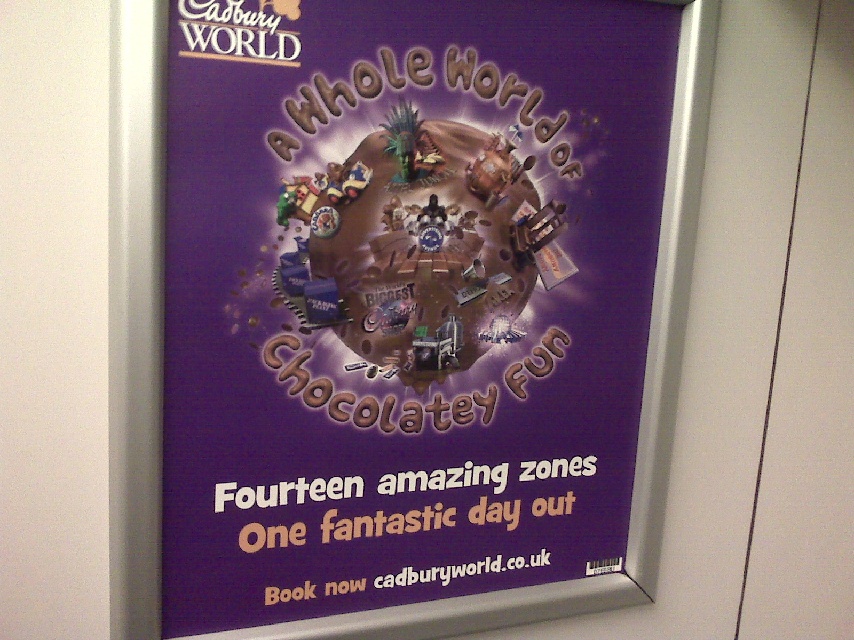
(How Exactly)Is This Novel?
[OUTSIDE EXERCISE]

Slide 47
Two Types of Novel Pairing
In raven/desk, the novel pairing can itself give a new view of the target, etc. It is a direct conduit for the message.
The cigarette/cell-bar pairing is novel, but is incidental to the underlying, familiar pairing of addiction/prison.
The creativity/novelty lies in how the message is conveyed: finding an incidental pairing that is so vivid and leads indirectly but forcefully to the message.
EVEN IN Raven/desk: in my interpretation above, leads to standardly-paralleled emotional reactions. Detailed intrinsic similarity (e.g. of colour or material) is NOT the main point.

Slide 48


Slide 49
Lexicalized Metaphorical Meanings

Slide 50
Lexicalized Meanings
Many, many words are commonly used with standard metaphorical meanings
  i.e., they are “conventional” or “familiar” or “entrenched” linguistic metaphors
as in for example:
  support, attack, kill, embrace, grasp, marriage, beast, dictator, contain, content, in, outside, tasty, loud, loudly, big, deep, shallow, ……
they do / can/could have
  those meanings stored in an external dictionary (on a library shelf or on the web) for human use
  those meanings stored in an internal dictionary or “lexicon” in a computer program that processes language
  those meanings stored in human memory / language-handling ability

Slide 51
Lexicalized Meanings, contd
The above observations extend to many, many phrases or phrasal templates:
  be under the weather, hold the fort, see the light, …, …, …,
  kick [X] out, take [X] up, open the door to [X], in the back of [X’s] mind, …., …, …,
NOTE: Such expressions (words/phrases/templates) often also have useful literal meanings, and some may have multiple metaphorical meanings.
The practical problem of getting the right meaning of such expressions, in a given context, is then no different from the practical problem of dealing with words with multiple literal meanings (e.g., ball, bank, …).

Slide 52
Lexicalized and Literal Meanings:
Some Quick but Big Observations
[READ OUTSIDE]
When a word/phrase/template has several meanings stored, it may not be worth distinguishing, at least for ordinary practical purposes, which meanings are “literal” and which are “metaphorical” (or otherwise figurative).
The notion of “literal” is in fact very difficult and controversial. Does it depend on physicality, historical age, familiarity, frequency, … ???
A given expression may be used metaphorically much more commonly than literally (e.g.: “torrent”).

Slide 54
REMAINING SLIDES:
GOING BEYOND LEXICALIZED METAPHOR

Slide 56
Simile versus Metaphor Again: and the Abbreviated-Simile Theory of Metaphor

Slide 57
Abbreviated (or Elliptical) Simile Theory of (A-is-B) Metaphor
The theory is: The metaphorical meaning of a linguistic metaphor of form “A is B” (or “An A is a B”, “As are Bs”, etc.) is THE SAME AS the corresponding simile “A is like B” (etc.).
  [see notably Fogelin 2011]
So “Company bosses are dictators”, when taken metaphorically, means the same as “Company bosses are like dictators.”
To the extent that this theory is true, it may help us reduce our theoretical apparatus and simplify AI systems for language understanding.
There is both evidence that the equation does often hold but also that there are circumstances when it does not.
  [see Barnden 2016a for discussion and references]

Slide 58
Abbreviated Simile Theory, contd
The theory is often called “the comparison theory”,
  but this is misleading because many theories of metaphors rest on forms of (cognitive) comparison operation. “The explicit-comparison theory” might be acceptable.
The theory is often unfairly criticized on the grounds that anything A is like anything B in some way.
But obviously the speaker means the hearer to grasp particular, often contextually-dependent , grounds for likeness, so “A is like B” does not just “mean” A is like B in some way or other—
  except in some impoverished notion of core meaning, and the theory is not forced to rest on such a notion.
  BUT of course the theory does not help us with how the hearer grasps particular grounds for comparison.

Slide 59
Abbreviated Simile Theory, contd
Another (incorrect) complaint about the theory:
“A is like B” is symmetrical in that it means the same as “B is like A”,
but metaphorical “B is A” often has different meaning from metaphorical “A is B”.

Slide 60
Abbreviated Simile Theory, contd
Answer:
“B is A” clearly does means something different from “A is B”, as it says something about B rather than about A, even if the same likenesses are in play.
But the likenesses can also change: compare “Trump is Putin,” which could mean Trump is undemocratic and truth-avoiding, and “Putin is Trump”, which could mean Putin appeals to a certain nationalist type of person. It depends on what issues are raised in the doscourse context and what strikes the hearer as important about the two men.
And the same points apply to “Trump is like Putin,” and “Putin is like Trump.”
Part of the point here is that the simile form does NOT just mean that the two things are alike in some way or other.

Slide 61
Abbreviated Simile Theory, contd
A problem few people point out is that simile takes many forms [see earlier slides]
so why should any one form be elevated to be the corresponding simile?
[OUTSIDE EX: Amend the theory to account for this??]
Relatedly, there are intermediate/mixed forms between A-is-like-B and A-is-B [see earlier slides].

Slide 63
A General Note about what
Metaphor Theories Need to be About
All theories of simile and/or metaphor need to pay attention to the following issue:
In saying either “A is B” or “A is like B”, what is the speaker’s aim? To say something useful about A, merely using B as a route towards doing that, or to point out some interesting relationship (be it likeness or something else) between A and B?? Does this vary according to circumstances? Might a speaker aim to do both? Does “is” versus “is like” affect the issue?
Presentation or discussion of theories is often biased to one or the other speaker-aim, but the issue has seen little explicit attention overall.
  [See Barnden 2016a for further comment]

Slide 65
Another/Additional Approach:
Feature Transfer

Slide 66
Feature-Transfer Approach to Metaphor
This approach clearly does assume that the speaker is trying to say something about the target (A in A-is-B), not (just) conveying an impression of likeness between target and source.
  But that doesn’t mean that’s not also a speaker aim, or assumed by hearers!
The approach says: we pick salient features of the source concept (e.g., the concept of a dictator, in “Company bosses are dictators”, or of rocketing in “John rocketed into the room”) and assert them as holding on the target (company bosses, John’s action).
So perhaps:
  Dictators do not tolerate opposition, so the metaphor asserts (amongst other things, possibly) that company bosses do not.
  Rocketing is an especially fast way of moving, so the metaphor asserts (amongst …) that John’s movement was especially fast.

Slide 67
Feature-Transfer Approach, contd
A main version of the approach says that the process involves salience imbalance [Ortony 1979]. That is, the features transferred are relatively salient in the source but not so salient in the target.
Iconic example: “Billboards are warts [on the landscape].”
Being-very-ugly is a highly salient feature of warts, but less so of billboards (even though when asked we might agree they are ugly). So one (and perhaps the only) feature transferred is being-very-ugly.
OUTSIDE EXERCISE: Consider the following:
  There could well normally be salience imbalance, but if you already think billboards are very ugly you can still understand the metaphor, and realize the speaker agrees with you!! And you might even think that billboards are obviously uglier than warts, and take the speaker’s statement as too weak. So the theory is far from being a complete theory of metaphor meaning.

Slide 68
Feature-Transfer Approach (and others) :
Further Problems
Examples given are usually very simple and hide big issues:
E.g., one iconic example is “Richard is a lion,” meaning that Richard is (very) brave, on the understanding that lions are (very) brave.
But is Richard (a person) brave in exactly the same way as a lion is? How do we transfer just the appropriate quality to Richard?

Slide 69
Feature-Transfer Approach (and others):
Further Problems, contd
Similarly, as many researchers have pointed out, there is a danger of saying that in “Sally is a block of ice”, talking about Sally’s personality, a feature of being very cold is transferred.
But of course the metaphor is NOT ascribing temperature-coldness to Sally. So how do we suitably transform features, if we do?
Really, the example rests on a further, more general metaphorical view of certain personality traits as qualities of ice. These may rest on deeper feature transfer, such as that a person’s can be difficult to change, just as the shape of a lump of ice is difficult to change.

Slide 70
Feature-Transfer Approach (and others):
False Stereotype and Circularity Issues
Many metaphors rest on possibly false stereotypes about the source. E.g., in saying that someone is a “gorilla” we may mean they’re normally aggressive, but in fact gorillas are not like this.
Equally, are lions really brave, or just strong? Aren’t we applying a personification metaphor to lions in the first place??
So perhaps, at least in many cases, the source term S should be understood as S as it is culturally held to be.

Slide 72
Another Approach:
Using Familiar Mappings
(Familiar Analogies)

Slide 73
Using Conceptual Metaphors?
A conceptual metaphor of, say, IDEAS AS PHYSICAL OBJECTS may consist of the following correspondences or mappings, held somehow in human memory or computer memory:
  IDEA ← → PHYSICAL OBJECT
  UNDERSTANDING an IDEA ← → GRASPING the PHYSICAL OBJECT
  DISCUSSING an IDEA ← → KICKING the PHYS OBJECT AROUND
  CRITICIZING an IDEA ← → THROWING the PHYS OBJECT OUT
  BELIEVING (? etc.) an IDEA ← → HOLDING ONTO the PHYS OBJ
  STOPPING BELIEVING (etc.) an IDEA ← → LETTING GO OF the PHYS OBJ
The left and right hand sides above reflect common phrases, but indicate concepts rather than phrases. Any phrase that means something like throwing the physical object out, or implies it, could potentially be understood as criticizing, arguing against, … the idea.

Slide 74
Using Conceptual Metaphors, contd
So when a person/program encounters, say, the sentence
“Peter and Mary dropped the idea / let the idea drop”
the person/program could understand that Peter and Mary stopped believing the idea (or stopped taking it as a serious possibility).
CAUTION: There may be historically-arising restrictions/modifications. E.g., although “grasping” a physical object implies holding onto it for a while, “grasping an idea” does not imply believing it or taking it seriously even for a short while.

Slide 75
Using Conceptual Metaphors, contd
[READ OUTSIDE]
There is considerable dispute about the extent to which people actually use conceptual metaphor mappings “online”, i.e. during understanding.
But in recent years psychological evidence has been put forward to support the claim that we do sometimes/often use them online.
AND NOTE: even if an expression has a lexicalized meaning, so that this can just be retrieved during understanding, a person might ALSO use a more general mechanism such as a CM mapping.

Slide 76
Another Caution
[READ OUTSIDE]
My own view is as follows: Standardness of being-used-metaphorically DOES NOT IMPLY standardness-or-clarity-of-meaning-when-so-used.
The fact that an expression is frequently used in familiar ways with a metaphorical meaning
DOES NOT IMPLY
That the metaphorical meaning can be clearly described or indeed is itself completely standard. There may be subtle connotations that are difficult to capture in a lexical entry and/or may be highly sensitive to context.
E.g., “The plan has been frozen.” ----
Physical objects that are frozen generally take a considerable length of time to unfreeze and considerable effort may be needed to unfreeze it. So usually there will be an implication that the inhibition of the plan will last a considerable time, and there may be implication that changing this situation will require much effort. But these connotations may be either supported or defeated by context.

Slide 77
Towards Fewer, More General Mappings
[READ OUTSIDE]
Conceptual Metaphors as standardly described involve many specific mappings, as in the IDEAS AS PHYSICAL OBJECTS example. But we may not need so many specific mappings, and the mappings we do have could be more general.
This was notably proposed in one form by Joe Grady [REF]. He decomposed various conceptual metaphors into more basic “primary metaphors”, each of which is essentially a mapping such as the following, which has very general application
    PERSISTING ← → REMAINING STANDING
  Suitable use of one or more of such mappings can get the same effect as a more elaborate and more specific conceptual metaphors such as THEORIES ARE BUILDINGS.
  I agree with his basic insight but have my own version, which I will describe later. The basic claim for IDEAS AS PHYSICAL OBJECTS is that we rarely need to go beyond one specific mapping:
    THINKING ABOUT/WITH an IDEA ← → PHYSICALLY OPERATING on THE PHYS OBJ

Slide 79
Another Approach:
Building Structured Analogies during Metaphor Understanding

Slide 80
Constructing Analogical Mappings “From Scratch”, contd.
E.g., consider “The internet is crack cocaine” or “The internet is like crack cocaine.”
Perhaps a person does/can/should (and perhaps a computer program should) WORK OUT that
  Accessing the internet ←→ consuming crack.
  Pleasure caused by using the internet ←→pleasure caused by consuming crack.
  Strong compulsion to incessantly access the internet ←→addiction to crack.
  Buying internet time ←→ buying crack.
Etc.? Should we infer that using the internet is illegal?

Slide 81
Constructing Analogical Mappings “From Scratch”, contd.
The best known theory and computer system for such analogy construction is the Structure Mapping Theory and Structure Mapping Engine [Gentner 1983; Bowdle & Gentner 2005].
The following (very old) diagrams illustrate the basic ideas.

Slide 82
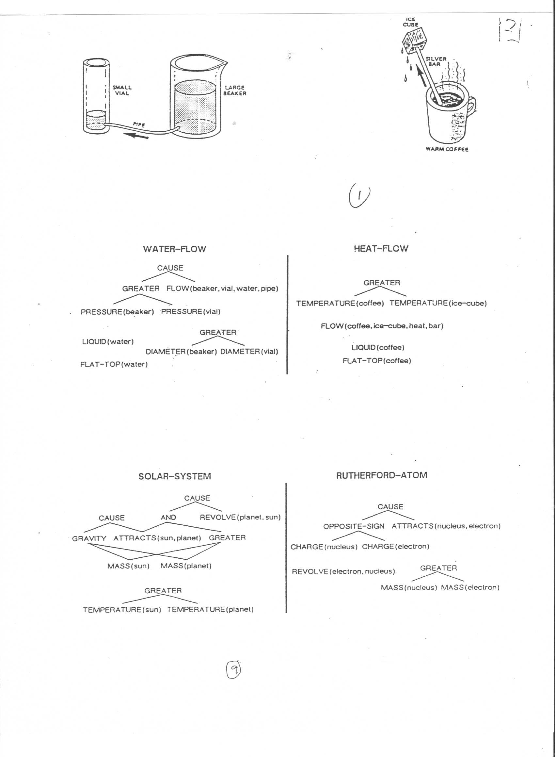

Slide 83
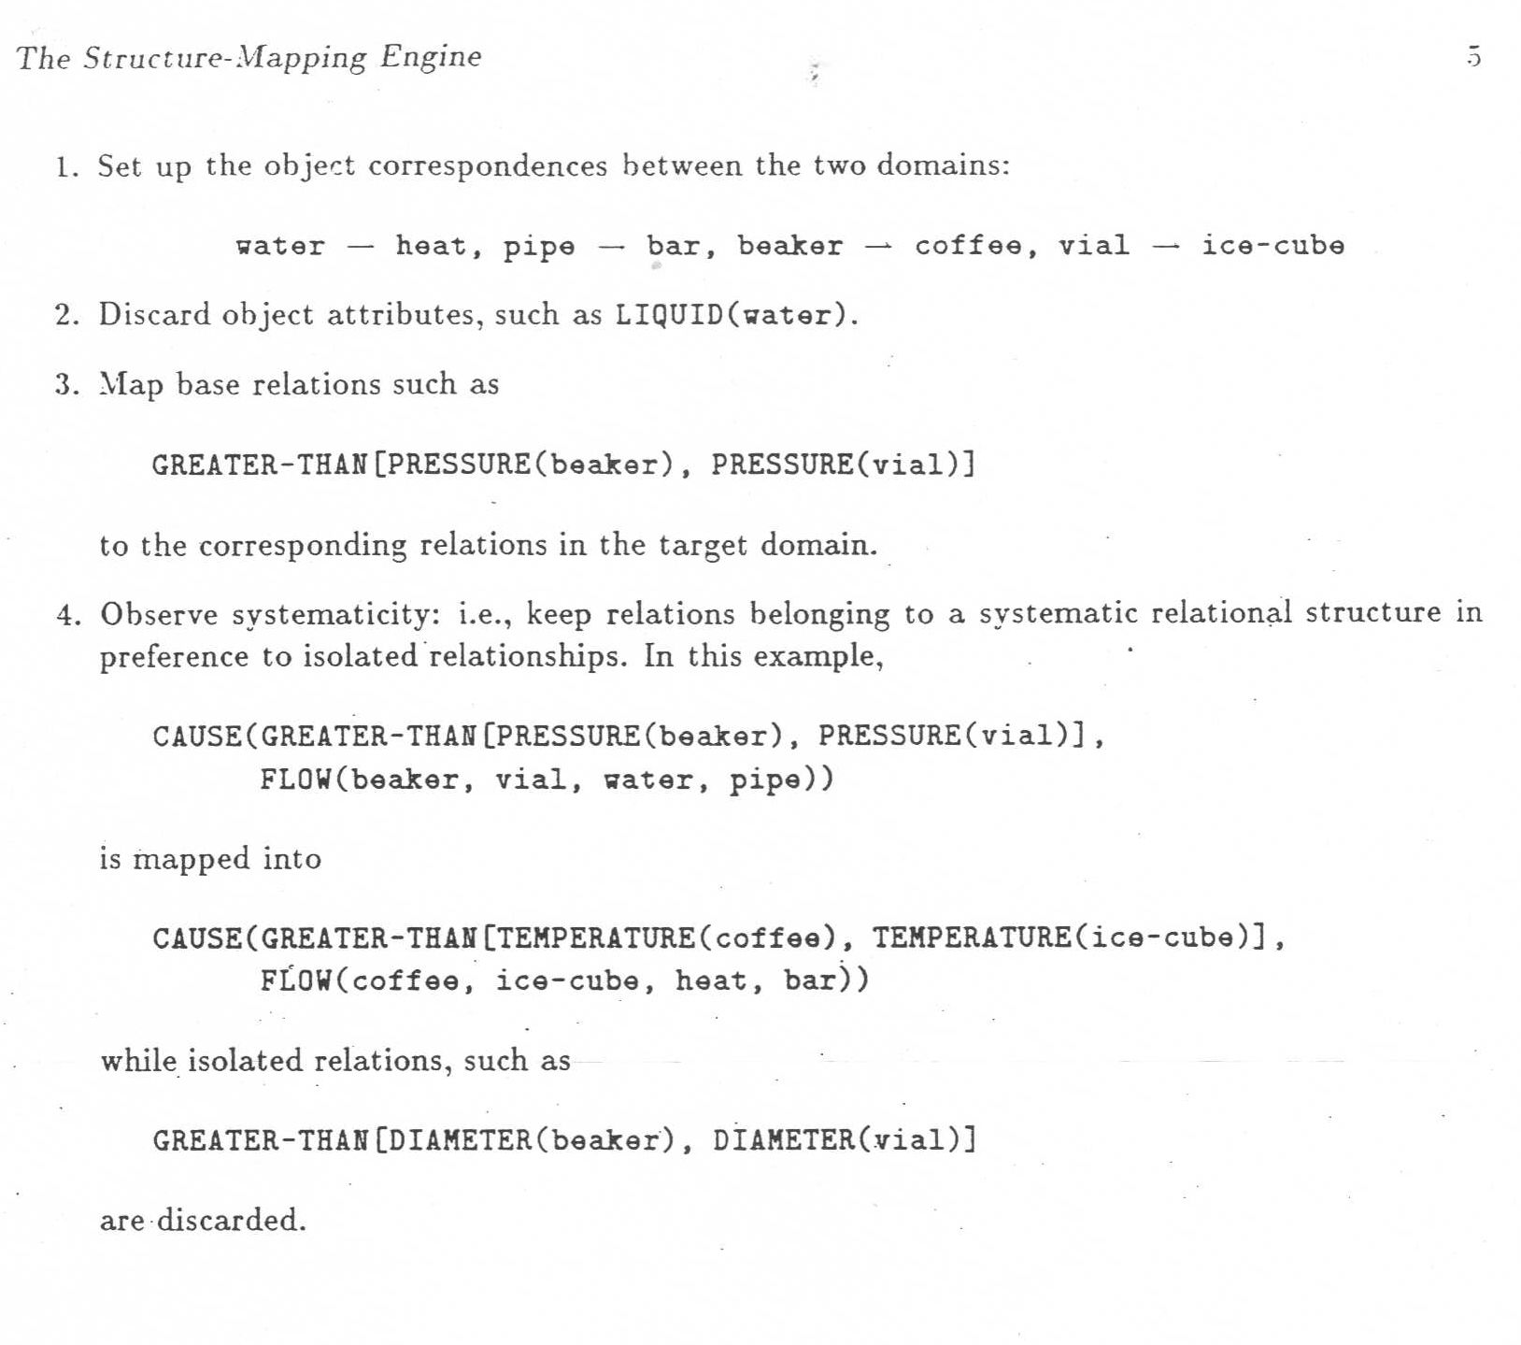

Slide 84
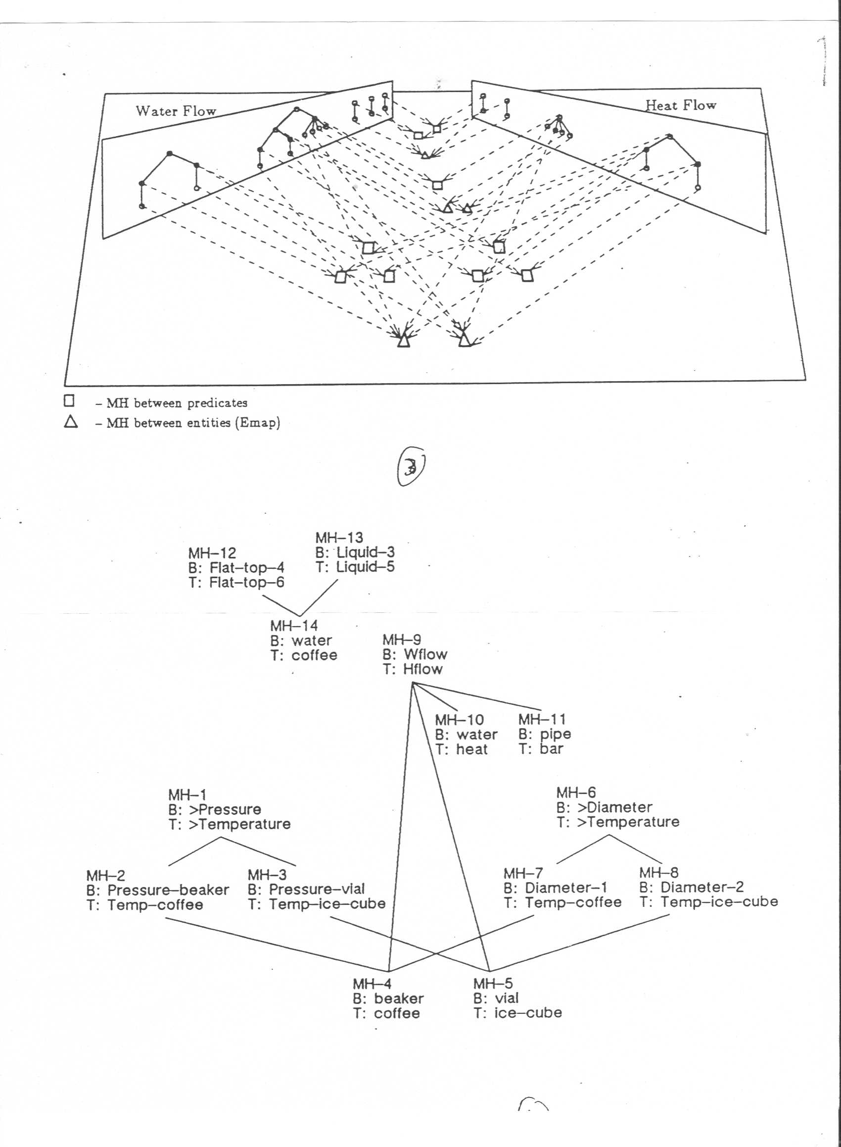

Slide 85
Constructing Analogical Mappings “From Scratch”, contd.
Once a sufficiently good set of analogical correspondences (mappings) has been chosen,
create candidate inferences:
  Find pieces of structure on the source side that are not yet mapped to the target, but that are sufficiently strongly connected to things that are: namely, as/by higher-order relationships such as CAUSE.
  Transfer these extra pieces of structure to the target, …
  and in doing so, replace source elements that do have mapping correspondents by those correspondents, leaving other elements as they are.
  Check the resulting candidate information about the structure for validity.

Slide 86
Analogical Candidate Inferences, contd.
In the liquid-flow/heat-example above, as it stands, the CAUSE relationship from the Liquid Flow situation can be transferred to the Heat Flow situation, joining together the TEMPERATURE DIFFERENCE and the FLOW substructures there.
But also: if the Heat Flow situation did not yet have the FLOW substructure, both it and the above CAUSE relationship could be added as candidate inferences.

Slide 87
Symmetrical?
Recall the discussion about “Trump is Putin” and “Putin is “Trump.”
Clearly the SMT approach can give different meaning, as the candidate inferences go in a different direction, and could be very different in content, even if the same mappings are found for both cases.
And SMT as usually described does deliver the same correspondences for both orders.
HOWEVER, analogy construction NEED NOT have this quality. Simple refinements/limitations that are probably needed anyway would give asymmetry. [See Barnden 2016a]

Slide 89
Another Approach:
Choosing/Building Superordinate Categories during Metaphor Understanding

Slide 90
Choosing/Constructing Superordinate Categories
There are various versions, notably the class inclusion theory
[Glucksberg 2001]
( = the “property attribution” theory)
and (part of) and approach proposed within Relevance Theory [Sperber & Wilson 2008; Carston & Wearing 2015]
A basic standard example: “[A / my / Peter’s ] job is a jail.”
Treat this as saying that the job is within a certain category (= class = type of thing), but not the category of literal jails but instead within a broader (= more general = “superordinate”) category that can also fit jobs (or the particular job in question) and otherwise fits with the discourse context.

Slide 91
Choosing/Constructing Superordinate Categories, contd
“Peter’s job is a jail.”
FOR EXAMPLE, the category chosen/constructed could be
  the category of situations that severely reduce one’s liberty, OR:
  the category of situations that are difficult to get out of, OR:
  the category of situations that are unpleasant over a long period, OR:
  the category of situations that are imposed as punishments, OR:.
  A category with more than one of those qualities.

Slide 92
Choosing/Constructing Superordinate Categories, contd
Often, the literal source category should first be restricted to a prototypical /culturally famous version:
There are many types of jail, including “open” prisons that are not particularly unpleasant or limiting, and from which one will soon depart. So the category of literal jails in general would force the superordinate category to include these “soft” possibilities, so it is unclear how the message of something very unpleasant, very limiting, etc. could be conveyed.
Can solve this problem by first narrowing the literal category to that of a stereotypical sort of jail, with small cells, where one has to stay quite a long time, etc.

Slide 93
Choosing/Constructing Superordinate Categories, contd
[READ OUTSIDE]
Similarly:
“Carita is a princess.”:
Can convey that Carita is selfish and “spoilt” (i.e., is angry when she doesn’t get what she wants). But not all literal princesses are like this. So the category of selfish, spolit women does not include the full literal category of princesses.
We can first narrow the literal category to that of a negative stereotype of princesses, appearing in some literature.

Slide 94
Choosing or Building? ((MOD))
[Superordinate Categories, contd]
The literature is very unclear as to the extent to which one may have to build [invent] a new category or can rely instead on an existing category one knows about.
  But the Relevance Theory version of the approach often talks of the superodinate catgeory as being an “ad hoc” category, implying context-sensitive category invention.
The possibility of creating the category by combining (e.g., intersecting, unioning) various known categories is little discussed.

Slide 96
Another Approach:
“Conceptual Integration” theory
(“Blending” theory)

Slide 97
Blending Theory
[Fauconnier & Turner 1998; Fauconnier 2009]
The basic idea is that as well having or creating mappings between some of one’s knowledge of the source and some of one’s knowledge of the target,
In metaphor interpretation or metaphorical cognition more generally we recall or build a “blend space” that combines and elaborates those two bunches of knowledge, which are called “input spaces”.
And this can give rise to “emergent” inferences in the blend that can lead to transfers to the target; sometimes these may be more difficult to explain by other theories.

Slide 98
Blending Theory, contd
Suppose Alice hears, “John and Mary are at a complicated motorway intersection in their relationship,” where it is clear from context that the relationship is a love relationship.
Then the structure on the next slide might arise in Alice’s mind, partly based on recall of knowledge of a LOVE RELATIONSHIP AS JOURNEY metaphorical view and of a known resulting blend, and partly based on using the particular sentence to extend the blend.
  Caution: The example sentence and the following illustrative diagrams were invented by me: other authors may use different details.
  A problem: accounts of blending theory do not give enough detail about the process a hearer might go through, as opposed to specifying the resulting mental structure.

Slide 99
GENERIC (SEE NEXT SLIDE)
SPACE
John
Traveller 1
Mary
Traveller 2
Their rel’p
travelling together
rel’p event seq.
journey event sequence
rel’p difficulties
Journey difficuties
John/Trav1
Mary/Trav2
love rel’p/trav-together
TARGET
INPUT SPACE
relp-ev-seq/journey-ev-seq
SOURCE
INPUT SPACE
relp-diffics/journey-diffics
J&M at motorway junction
not all needed blue arrows are shown
BLEND
SPACE

Slide 100
GENERIC SPACE:
SOME POSS. DETAILS
Entity 1
Entity 2
a relationship between them
John
Traveller 1
Mary
Sequence of changes
Traveller 2
their love rel’p
Their travlling together
Sequence of rel’p events
GENERC
SPACE
Sequence of journey events
not all blue arrows or space contents are shown
TARGET
INPUT SPACE
SOURCE
INPUT SPACE
BLEND
SPACE

Slide 101
Blending Theory, contd
But now Alice can elaborate the blend by inferring from J & M being at a complicated motorway junction that
  they are having journey difficulties, about which road to go
Then, bringing in the fact that they are in a love relationship, Alice might also infer that
  J & M decide consensually on which road to take.
Crucially, this second inference depends on BOTH target-input-space AND source-input-space info (inherited by the blend). So this inference is “emergent” in an important, blending-dependent way.
So we have following (mainly showing just the new elements):

Slide 102
GENERIC
SPACE
John
Traveller 1
Mary
Traveller 2
Their rel’p
travelling together
joint life event seq.
journey event sequence
rel’p difficulties
Journey difficuties
HAVE journey-diffics
TARGET
INPUT SPACE
difficult to choose road
decide consensually on road
SOURCE
INPUT SPACE
J&M at
junction
J&M in
loooove
BLEND
SPACE

Slide 103
Blending Theory, contd
Now Alice can notice the blending of difficulty types (relationship vs. journey)—
i.e. essentially the mapping of difficulty types between the two input spaces—
and, using other mappings, add further elements to the structure,
if we make certain natural assumptions …..
(OUTSIDE EXERCISE: think about what we need to assume to get the right things to happen)

Slide 104
GENERIC
SPACE
Traveller 1
HAVE relp diffics
Traveller 2
travelling together
journey event sequence
diffic choose rel’p action
Journey difficuties
decide consensually
on action
HAVE relp-diffics/& jrny-diffics
MODIFIED
TARGET SPACE
diffic choose rel’p action /& road
SOURCE
INPUT SPACE
decide consensually:
rel’p/action /& road
BLEND
SPACE

Slide 105
Blending Theory:
Metonymy
[READ OUTSIDE]
It has been proposed by one of the originators of blending theory [Fauconnier 2009] that metonymy can be handled by blending the two related things into one thing within the blend.
  E.g., the White House and its representative become one thing within the blend.
I don’t know if this approach has been extensively explored, and I have worries about whether it would work in general.

Slide 107
References
Barnden, J.A. (2010). Metaphor and metonymy: Making their connections more slippery. Cognitive Linguistics, 21 (1), pp.1—34.
Barnden, J.A. (2016a). Metaphor and simile: Categorizing and comparing categorization and comparison. In Gola, E. & Ervas, F. (Eds), Metaphor and Communication, pp.25—46. John Amsterdam: John Benjamins.
Barnden, J.A. (2016b). Mixed metaphor: Its depth, its breadth, and a pretence-based approach. In Gibbs (2016), pp.75—111.
Barnden, J.A. (2016c). Communicating flexibly with metaphor: A complex of strengthening, elaboration, replacement, compounding and unrealism. Review of Cognitive Linguistics, 14 (2), pp.442—473.
Barnden, J.A. (forthcoming). Some contrast effects in metonymy. In O. Blanco, A. Barcelona & R. Pannain (Eds), Describing Conceptual Metonymy in Languages: From Morpheme to Discourse. John Benjamins.
Bowdle, B.F. \& Gentner, D.~(2005). The career of metaphor. Psychological Review, 112 (1), pp.193—216.
Carston, R. & Wearing, C. (2011). Metaphor, hyperbole and simile: A pragmatic approach. Language and Cognition, 3(2): pp.283—312.

Slide 108
References, contd
Demjen, Z. (2011). Language and mind: How language can convey mental states, with special reference to Sylvia Plath's “Smith Journal.” PhD Thesis, Lancaster University, UK.
Fauconnier, G. (2009). Generalized integration networks. In V.~Evans \& S.~Pourcel (Eds), New Directions in Cognitive Linguistics, pp.147--160. Amsterdam: John Benjamins.
Fauconnier, G. & Turner, M. (1998). Conceptual integration networks. Cognitive Science, 22 (2), pp.133—187.
Gentner, D. (1983). Structure-mapping: a theoretical framework for analogy. Cognitive Science, 7 (2), 95—119.
Gibbs, Jr., R.W. (Ed.) (2016). Mixing metaphor. Amsterdam: John Benjamins.
Glucksberg, S. (2001). Understanding figurative language: From metaphors to idioms. New York: Oxford University Press.
Littlemore, J. (2015). Metonymy: Hidden shortcuts in language, thought and communication. Cambridge University Press.
Ortony, A. (1979). The role of similarity in similes and metaphors. In A. Ortony (Ed.), Metaphor and Thought, pp.186—201. Cambridge, U.K.: Cambridge University Press.

Slide 109
References, contd
Sperber, D. & Wilson, D. (2008). A deflationary account of metaphor. In R.W. Gibbs, Jr. (Ed.), The Cambridge Handbook of Metaphor and Thought, pp.84—105. Cambridge, U.K.: Cambridge University Press.

Slide 111
EXTRA SLIDES

Slide 112
METAPHOR
continued:
More on (Non-)Novelty

Slide 113
Open-Ended Variation, contd
Variants of “a corner of X’s mind” [a common phrase]:
  in a dim corner of X’s mind
  in an unlit corner of X’s mind
  in a distant corner of X’s mind
  in a cobwebby corner of X’s mind [only a few Google hits]
  AND SO ON
There is no restriction on the red wording relevant to corners.

Slide 115
Types/Degrees of [Non-]Novelty
(examples of points on the spectrum)
Completely non-novel:
familiar source term, target term, metaphorical view and message:
Standard, unvaried metaphorical phraseology: “conventional metaphors” and metaphorical idioms.
Wording AND metaphorical view are both non-novel.
Meaning extracted about the target is standard (non-novel).
Some people like to say such phraseology is “entrenched”.

Slide 116
Types/Degrees of [Non-]Novelty, contd
Familiar metaphorical view, message and source term,
but new target:
There’s a source word/phrase S that’s is commonly used metaphorically with a particular standard meaning M to describe various targets T (e.g. S = “rat”, as in “He’s a rat”, “Criminals are rats”)
but is now used to apply M to a new target T (possibly: “Opponents of Brexit are rats”).
The particular whole linguistic metaphor is new but the metaphorical use of the source term with meaning M is not (so that usage could be said to be “entrenched”)

Slide 117
Types/Degrees of Novelty, contd
Familiar metaphorical view and partly standard message, but wording (partly) new and message augmented/modified (in many different possible ways):
many of the examples earlier of open-ended variation.
New special case of a familiar metaphorical view (hence novel wording) and variation of standard message :
e.g.: “The idea was buried somewhere in the savannah of her mind”.
= Special, novel(?) case of the familiar practice of viewing people’s minds as geographical terrain.

Slide 118
Types/Degrees of Novelty, contd
Novel compounds of familiar metaphorical views:
SEE LATER SLIDES on compounding
Entirely new metaphorical view (novel pairing of subject matters), not usefully regarded as a special case of some familiar view:
ravens as writing desks
“Compassion is a sloth.”

Slide 119
Novelty/Subtlety of some Pictorial cases
Cadbury’s world: fun viewed as a world, (fantastically) elaborated/distorted as being made of chocolate.
  Part of message: fun is intrisincally chocolatey – chocolatiness not incidental or just what the fun is about
Smelly tongues: two people are interacting, emphasizing the problem that the smelliness raises.
Smoking addiction/danger:
  Cigarettes as prison bars: message of lack of intention by the smoker, doing something risky
  Cigarettes as bullets: message of intention, or at least knowingness, or at least: strongly-should-have-known

Slide 120
METAPHOR
CONTINUED:
Compounding

Slide 121
Compound Metaphor
“The NHS problem is the bedrock of Labour’s election campaign. It has been rolling on remorselessly.”
This uses three different metaphorical views for the NHS problem:
  the problem as bedrock
  the problem as a physical object that can roll
  the problem as a cognitive agent that can act remorselessly.
Compounding of three different views.
Because one target X is being viewed as three different sources,
I say that the compounding is [source-]parallel.

Slide 122
Compound Metaphor, contd
“The thought of her step-mother's arrival hung over her mind like a dark angry cloud.”
Chaining of THOUGHT-AS-CLOUD and CLOUD-AS-PERSON.
I call such chaining “serial compounding”.

Slide 123
Compound Metaphor, contd
“We do not have a chocolate army that fades away at the first sign of trouble.”
Serial compounding of
SOLDIERS-AS-CHOCOLATE-TOYS and MELTING-AS-FADING.

Slide 124
Compound Metaphor, contd
“This worry was a corrosive chemical that was nibbling at her self-esteem.”
[closely adapted from an example in a Sylvia Plath diary,
cited by Demjen 2011]
  Serial compounding of WORRY-AS-CHEMICAL and CHEMICAL-AS-ANIMAL …
  … then parallel compounding with SELF-ESTEEM AS NIBBLABLE OBJECT.

Slide 125
Compound Metaphor, contd
[a sort of parallel compound of two metaphors of a tongue as something smelly;
NB: different tongues]

Slide 126
Compound Metaphor, contd
FUN AND PHYSICAL/ABSTRACT ENVIRONMENT AS WORLD,
en serial compounding with WORLD-AS-CHOCOLATE-BALL.

Slide 127
Compound Metaphor, contd
QUESTION: “… the car wants to move but something is stopping it.”
ANSWER: “Sounds like the car thinks it's on holiday, all the snow, freezing temps and Christmas boozing has confused our cars into thinking they are Talbot horizons!! get her out out today and show her a good time.”
[ http://forums.m3cutters.co.uk/archive/index.php/t-25414.html ]
Parallel compound(?) of
a view of the car as a thinking agent, with
a view of its state of not operating normally as being on holiday.

Slide 128
Compound Metaphor: A Complex Case!
“ the words `How could he? How could he?’ jumping about her wearied brain. Senseless, leaving her empty, cold, helpless. Another voice, angry and vindictive, shouted in her ear, …”
[from an earlier slide]
Parallel compound of IDEAS AS EXTERNAL UTTERANCES, IDEAS AS INTERNAL UTTERANCES, and BRAIN AS CONTAINER OF IDEAS,
with the IDEAS AS INTERNAL UTTERANCES component serially compounded with UTTERANCES AS ANIMATE CREATURES.

Slide 129
“Compound” versus “Mixed” Metaphor
“Mixed” metaphor:
Typically taken to be where some sort of combination of usually-separate bits of metaphorical phraseology,
based on different metaphorical views,
makes the resulting sentence sounds ridiculous or funny, usually because of some sort of clash:
  “It’s as easy as falling off a piece of cake.”
  [and many others on http://www.jimcarlton.com/my_favorite_mixed_metaphors.htm]

Slide 130
“Compound” versus “Mixed” Metaphor
Some researchers take a broader view, and include cases where there is phraseology combination based on different metaphorical views but no resulting humorous/ridiculous effect.
  See range of papers in Gibbs (2016).
  In my own paper in Gibbs (2016), i.e. Barnden (2016b), I use “mixing” in this broader way.

Slide 131
“Compound” versus “Mixed”, contd
My current, more careful view/terminology:
  “MIXED” metaphor = the surface-linguistic phenomenon of metaphorical phraseology resting on different metaphorical views being adjacent or intertwined in discourse [irrespective of whether there are good or bad communicative effects]
  “COMPOUND” metaphor = the cognitive phenomemon of different metaphorical views being cognitively used in cooperation with each other in some way.
Compounding tends to cause mixing (as in all the above examples).
But mixing need not reveal compounding:
instead, one metaphorical view may simply replace another, or compete with it, rather than cooperate with it.
[More on such issues in Barnden 2016c]

