Slide 1
Lecture 4 :
Metaphor Theories, Fiction and Artificial Intelligence, Part 1
[title changed]
John Barnden, Visiting Professor
Emeritus Professor of AI
University of Birmingham, UK
Course on
“Metaphor: Its Depth, Breadth and Weight”
University of Cagliari, May 2017

Slide 2
BACK to METAPHOR:
essential background for theories about the mechanisms
(contd)

Slide 3
METAPHORICAL VIEWS
However, the general point is that we can take metaphorical views of things in our minds, e.g. of a love relationship as a journey, based on some form of analogy,
and there could be may different theories about the structure, etc. of those views,
and in particular about the nature of any mappings involved.
Conceptual Metaphors as in the literature are the most influential proposal in that general framework.

Slide 4
Towards Fewer, More General Mappings
Conceptual Metaphors as standardly described involve many specific mappings, as the LOVE RELATIONSHIP AS JOURNEY example and IDEAS AS PHYSICAL OBJECTS examples [next slide] suggest. BUT
  we may not need so many specific mappings, and
  the mappings we do have could be more general.
This was notably proposed in one form by Joe Grady (1997). He decomposed various conceptual metaphors into more basic “primary metaphors”, each of which is essentially a mapping such as:
    PERSISTING ← → REMAINING STANDING
  Suitable use of one or more of such mappings can get the same effect as a more elaborate and more specific conceptual metaphors such as THEORIES ARE BUILDINGS.

Slide 5
Conceptual Metaphors: Another Example
A conceptual metaphor of, say, IDEAS AS PHYSICAL OBJECTS may consist of the following correspondences or mappings, held somehow in human memory or computer memory:
  IDEA ← → PHYSICAL OBJECT
  UNDERSTANDING an IDEA ← → GRASPING the PHYSICAL OBJECT
  DISCUSSING an IDEA ← → KICKING the PHYS OBJECT AROUND
  CRITICIZING an IDEA ← → THROWING the PHYS OBJECT OUT
  BELIEVING (? etc.) an IDEA ← → HOLDING ONTO the PHYS OBJ
  STOPPING BELIEVING (etc.) an IDEA ← → LETTING GO OF the PHYS OBJ

Slide 6
Towards Fewer, More General Mappings, contd
  In my own AI-centred approach to metaphor (ATT-Meta), I loosely follow Grady’s basic insight but have my own version.
  The basic claim for IDEAS AS PHYSICAL OBJECTS is that we rarely need to go beyond one VIEW-SPECIFIC mapping:
    THINKING ABOUT/WITH an IDEA ← → PHYSICALLY OPERATING on THE PHYS OBJ
  Such a mapping is supplemented by the use of many VIEW-NEUTRAL mappings, capturing huge similarities between the way that different metaphorical views operate.
  I get even more economy in specific mappings than Grady does.

Slide 7
Metaphorical Views, Culture and Communication
A common claim is that (some) conceptual metaphors arise from universal, common experience with, e.g., moving around physically in the world, and then somehow each of us our establishing (perhaps partly through innate brain wiring) analogies with other domains of life.
But the specific contents and even the very existence of a particular conceptual metaphor (or metaphorical view in general) can be influenced by communication experience and hence cultural factors.
  To say that metaphor is conceptual does not mean it is isolated from external influences, notably through language.
  We might in principle entirely learn a particular metaphorical view that way.

Slide 8
Novelty (and Not) in Metaphor
“Image metaphors” are often novel.
This is perhaps because they are relatively easy to understand even when novel.
Aside from image metaphor,
completely novel metaphor is rare in ordinary discourse,
and relatively unusual even in literary discourse ….

Slide 9
Novelty (and Not) in Metaphor, contd
[Lakoff & Turner (1989): ]
[Even] most creative poetic metaphor is creative NOT because of radically novel pairings of subject matters
but because of the exploitation of familiar, mundane metaphorical views and phraseology by, e.g.,
  Open-ended elaborations much as on earlier slides
  Compounding [combination] of different metaphorical views
  [SEE EXTRA SLIDES on compounding]
However, the elaboration part has one important special case:

Slide 10
Novelty by Distortion of the Source Subject Matter: a type of (Fantastic) Fiction
Prof. Charles Forceville in his Lecture 2 (Wed 17 May) quoted this example:
“A novel is a mirror walking down a road.”
This is a vivid illustration of a common general phenomenon where the source-side scenario used in metaphor often involves distortion of reality, sometimes to a fantastic extent.
Other examples:
  metaphorically viewing a neuron in a complex neural network as an OCTOPUS with tens of thousands of tentacles
  viewing the EU as a MARRIAGE of 28(?!) countries
  use of untrue stereotypes e.g. about animals [discussed later]

Slide 11

A Highly Novel Metaphor
“Why is a raven like a writing desk?”
asks the Mad Hatter in
Alice’s Adventures in Wonderland
A raven is a writing desk.
EX. NOW: Why/How?

Slide 12
Possible Answers
( http://www.wisegeek.org/why-is-a-raven-like-a-writing-desk.htm )
Lewis Carroll’s intention was to pose a nonsensical riddle, it seems, but one can see similarities…
Desks and ravens both come with inky quills.
They both stand on sticks.
  [both quoted by above webpage]
They both loom in a corner of the room.
  [an interpretation that I suggest]

Slide 13
Why / How Exactly Was it Novel?
Probably, no-one had previously compared a desk with a raven before
  But what if someone had compared a desk to some other bird or to generic bird?
  or had compared other domestic furniture to birds??
  or …??.
The nature of the novelty may lie partly in what sort of message is intended/extracted,
not necessarily in (just) the particular “pairing” of subject matters.

Slide 14
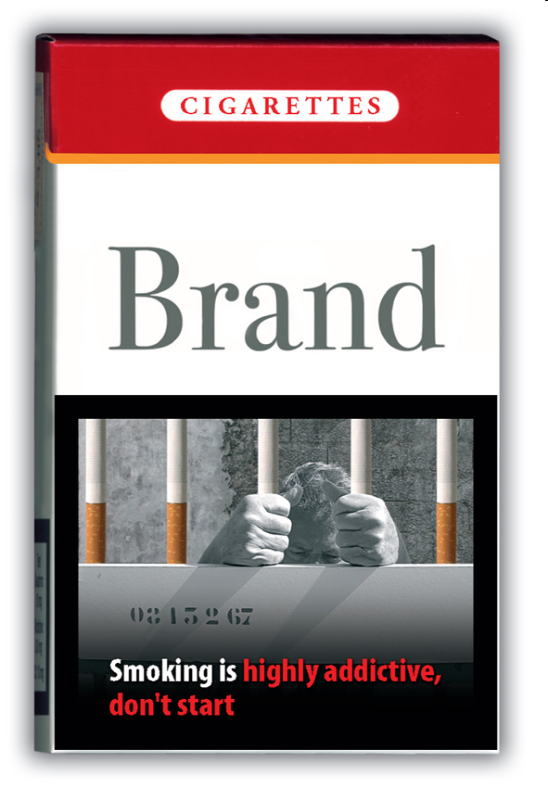

(How Exactly) Are These Novel?
[courtesy of Elisabeth El Rafaie, 2013]

Slide 15
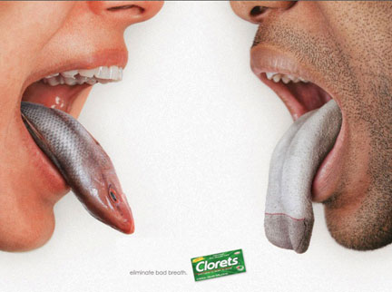
(How Exactly)Is This Novel?
[OUTSIDE EXERCISE]
[Slide is courtesy of Marianna Bolognesi, 2013]

Slide 16
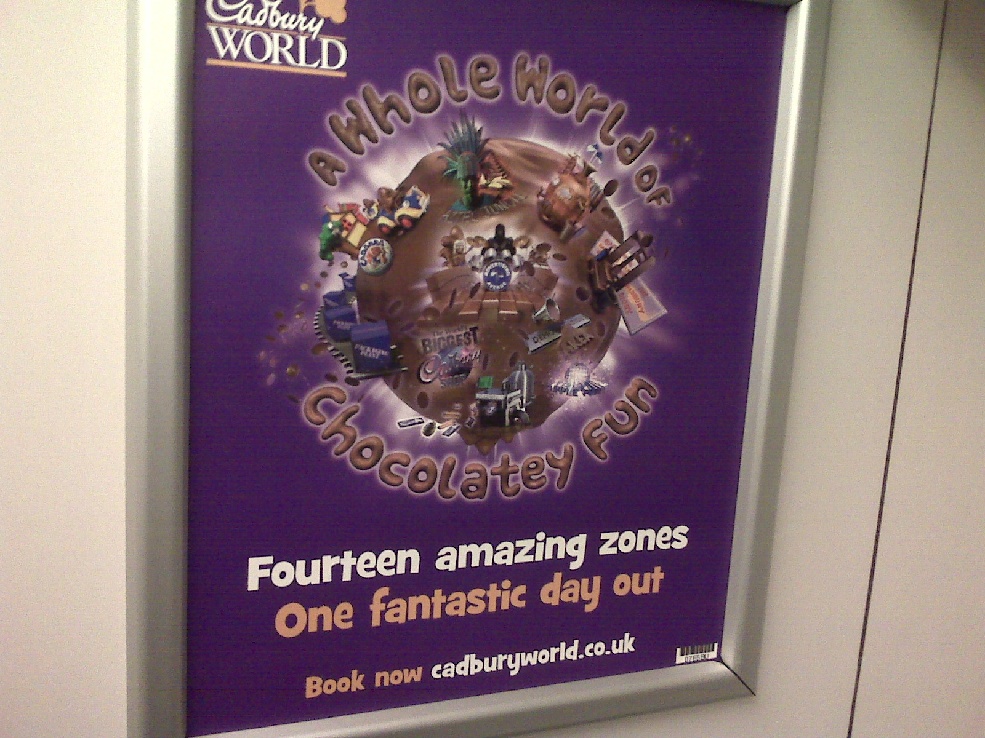
(How Exactly)Is This Novel?
[OUTSIDE EXERCISE]

Slide 17
Two Types of Novel Pairing
In raven/desk, the novel pairing can itself give a new view of the target, etc. It is a direct conduit for the message.
The cigarette/cell-bar pairing is novel, but is incidental to the underlying, familiar pairing of addiction/prison.
The creativity/novelty lies in how the message is conveyed: finding an incidental pairing that is so vivid and leads indirectly but forcefully to the message.
EVEN IN Raven/desk: in my interpretation above, leads to standardly-paralleled emotional reactions. Detailed intrinsic similarity (e.g. of colour or material) is NOT the main point.

Slide 18


Slide 19
Lexicalized Metaphorical Meanings

Slide 20
Lexicalized Meanings in Mind and AI Systems
Many, many words are commonly used with standard metaphorical meanings
  i.e., they are “conventional” or “familiar” or “entrenched” linguistic metaphors
as in for example:
  support, attack, kill, embrace, grasp, marriage, beast, dictator, contain, content, in, outside, tasty, loud, loudly, big, deep, shallow, ……
they do / can/could have
  those meanings stored in an external dictionary (on a library shelf or on the web) FOR HUMAN USE
  those meanings stored in an internal dictionary or “lexicon” in an AI SYSTEM that processes language
  those meanings stored in HUMAN MEMORY / language-handling ability

Slide 21
Lexicalized Meanings, contd
The above observations extend to many, many phrases or phrasal templates:
  be under the weather, hold the fort, see the light, …, …, …,
  kick [X] out, take [X] up, open the door to [X], in the back of [X’s] mind, …., …, …,
  NOTE: Such expressions (words/phrases/templates) often also have useful literal meanings, and some may have multiple metaphorical meanings.
The practical problem of getting the right meaning of such expressions, in a given context, is then in many/most cases no different from the (big!) practical problem of dealing with words with multiple literal meanings (e.g., ball, bank, …).

Slide 22
Lexicalized and Literal Meanings:
Some Quick but Big Observations
[READ OUTSIDE]
When a word/phrase/template has several meanings stored, it may not be worth distinguishing, at least for ordinary practical purposes, which meanings are “literal” and which are “metaphorical” (or otherwise figurative).
The notion of “literal” is in fact very difficult and controversial. Does it depend on physicality, historical age, familiarity, frequency, … ???
A given expression may be used metaphorically much more commonly than literally (e.g.: “torrent”).

Slide 24
REMAINING SLIDES:
GOING BEYOND LEXICALIZED METAPHOR in Minds and AI Systems

Slide 26
Simile versus Metaphor Again: and the Abbreviated-Simile Theory of Metaphor

Slide 27
Abbreviated (or Elliptical) Simile Theory of (A-is-B) Metaphor
The theory is: The metaphorical meaning of a linguistic metaphor of form “A is B” (or “An A is a B”, “As are Bs”, etc.) is THE SAME AS the corresponding simile “A is like B” (etc.).
  [see notably Fogelin 2011]
So “Company bosses are dictators”, when taken metaphorically, means the same as “Company bosses are like dictators.”
To the extent that this theory is true, it may help us reduce our theoretical apparatus and simplify AI systems for language understanding.
There is both evidence that the equation does often hold but also that there are circumstances when it does not.
  [see Barnden 2016a for discussion and references]

Slide 28
Abbreviated Simile Theory, contd
The theory is sometimes called “the comparison theory”,
  but this is misleading because many theories of metaphors rest on forms of (cognitive) comparison operation. “The explicit-comparison theory” might be acceptable.
The theory is often unfairly criticized on the grounds that anything A is like anything B in some way.
But obviously the speaker means the hearer to grasp particular, often contextually-dependent , grounds for likeness, so “A is like B” does not just “mean” A is like B in some way or other—
  except in some impoverished notion of core meaning, and the theory is not forced to rest on such a notion.
  BUT of course the theory does not help us with how the hearer grasps particular grounds for comparison.

Slide 29
Abbreviated Simile Theory, contd
Another (incorrect) complaint about the theory:
“A is like B” is symmetrical in that it means the same as “B is like A”,
but metaphorical “B is A” often has different meaning from metaphorical “A is B”.
Answer:

Slide 30
Abbreviated Simile Theory, contd
“B is A” clearly does means something different from “A is B”, as it says something about B rather than about A, even if the same likenesses are in play.
But the likenesses can also change: compare “Trump is Putin,” which could mean Trump is undemocratic and truth-avoiding, and “Putin is Trump”, which could mean Putin appeals to a certain nationalist type of person. It depends on what issues are raised in the discourse context and what strikes the hearer as most salient about the two men.
Recall also Forceville’s discussion (his Lec 2) of “my surgeon is a butcher” and “my butcher is a surgeon”.
And the same points apply to “Trump is like Putin,” and “Putin is like Trump.”

Slide 31
Abbreviated Simile Theory, contd
A problem few people point out is that simile takes many forms [see earlier slides]
so why should any one form be elevated to be the corresponding simile?
[OUTSIDE EX: Amend the theory to account for this??]
Relatedly, there are intermediate/mixed forms between A-is-like-B and A-is-B [see earlier slides].

Slide 32
Simile/Metaphor/Metonymy, contd
Charles Forceville used a Shrek film for an example, in which there is a donkey who deliberately takes the wrong meaning from a metaphor used by the ogre Shrek (“an ogre is an onion”).
Charles then referred to this general practice (which is used in real-world discourse to subvert or at least amend other people’s arguments) as “doing a donkey”.
  This follows a general idiomatic construction in English in which “doing an X” means doing something similar to what entities of type X do / or specific entity X does.
  But the particular case was completely novel to me.
OUTSIDE EXERCISE: is “Donald Trump did a donkey” a metaphor or a simile, with “did” elliptical for “did something like”? Or is it both, under an abbreviated-simile view of metaphor? Or is “donkey” metonymic for “action typical of the donkey in Shrek”, so there’s no simile or metaphor? (There may be no single right answer!)

Slide 34
A General Note about what
Metaphor Theories Need to be About
All theories of simile and/or metaphor need to pay attention to the following issue:
In saying either “A is B” or “A is like B”, what is the speaker’s aim? To say something useful about A, merely using B as a route towards doing that, or to point out some interesting relationship (be it likeness or something else) between A and B?? Does this vary according to circumstances? Might a speaker aim to do both? Does “is” versus “is like” affect the issue?
Presentation or discussion of theories is often biased to one or the other speaker-aim, but the issue has seen little explicit attention overall. It interacts with a currently-discussed notion of “deliberate metaphor” [Steen REF]
  [and see Barnden 2016a for further comment]

Slide 36
Another/Additional Approach:
Feature Transfer

Slide 37
Feature-Transfer Approach to Metaphor
This approach clearly does assume that the speaker is trying to say something about the target (A in A-is-B), not (just) conveying an impression of likeness between target and source.
  But that doesn’t mean that’s not also a speaker aim, or assumed by hearers!
The approach says: we pick salient features of the source concept (e.g., the concept of a dictator, in “Company bosses are dictators”, or of rocketing in “John rocketed into the room”) and assert them as holding on the target (company bosses, John’s action).
So perhaps:
  Dictators do not tolerate opposition, so the metaphor asserts (amongst other things, possibly) that company bosses do not.
  Rocketing is an especially fast way of moving, so the metaphor asserts (amongst …) that John’s movement was especially fast.

Slide 38
Feature-Transfer Approach, contd
A main version of the approach says that the process involves salience imbalance [Ortony 1979]. That is, the features transferred are relatively salient in the source but not so salient in the target.
Iconic example: “Billboards are warts [on the landscape].”
Being-very-ugly is a highly salient feature of warts, but less so of billboards (even though when asked we might agree they are ugly). So one (and perhaps the only) feature transferred is being-very-ugly.
OUTSIDE EXERCISE: Consider the following:
  There could well normally be salience imbalance, but if you already think billboards are very ugly you can still understand the metaphor, and realize the speaker agrees with you!! And you might even think that billboards are obviously uglier than warts, and take the speaker’s statement as too weak. So the theory is far from being a complete theory of metaphor meaning.

Slide 39
Feature-Transfer Approach (and others) :
Further Problems
Examples given are usually very simple and hide big issues:
E.g., one iconic example is “Richard is a lion,” meaning that Richard is (very) brave, on the understanding that lions are (very) brave.
But is Richard (a person) brave in exactly the same way as a lion is? How do we transfer just the appropriate quality to Richard?

Slide 40
Feature-Transfer Approach (and others):
Further Problems, contd
Similarly, there is a danger of saying that in “Sally is a block of ice”, talking about Sally’s personality, a feature of being very cold is transferred.
But of course the metaphor is NOT ascribing temperature-coldness to Sally. So how do we suitably transform features, if we do?
Do we first go to a more abstract property that cvovers both temperature coldness and certain personality features?
Or perhaps the example rests on a further, more general metaphorical view of certain personality traits as qualities of ice. These may rest on deeper feature transfer, such as that a person’s can be difficult to change, just as the shape of a lump of ice is difficult to change.

Slide 41
Feature-Transfer Problems, contd
Similar/same issues arise with some examples quoted by Prof. Forceville:
  Transferring “layers” from onions to ogres. But we need to go from physical layers to more abstract layers or to something about people that can metaphorically be viewed as physical layers.
  Black-people/white-people as coffee/milk [a metaphor by the black revolutionary Malcolm X]: a feature of “weakness” was transferred. But not the exact type of weakness that milk gives to coffee!
    NB: My first reaction to the metaphor was that it was something about racial mixing leading to intermediate skin colour. By the way, “coffee coloured” has often been used in English to described some black people’s skin colour.
  A VW engine being perfectly “tuned” [word/concept implied by a picture]: but of course the sense changes.
  There is an appeal here to the entrenched metaphor of engine/situation/etc. .. tuning as musical-instrument tuning;
  cf also someone being “attuned” to something.

Slide 42
Feature-Transfer Approach (and others):
False Stereotype and Circularity Issues
Many metaphors rest on possibly/partly false (or at least highly over-simplifying) stereotypes about the source. E.g., in saying that someone is a “gorilla” we may mean they’re normally aggressive, but in fact gorillas are not like this.
  Also note that black people don’t have literally absolutely black skin and white people don’t have literally white skin! Most coffee isn’t absolutely black! Much red wine isn’t red, no white wine is white.
Equally, are lions really brave, or just strong? Aren’t we applying a personification metaphor to lions in the first place?? [Circularity]
So perhaps, at least in many cases, the source term S should be understood as S as it is culturally/metaphorically/fictionally (or at least simplifyingly) held to be or described as being.

Slide 43
Aside:
Another General Observation about Metaphor
Researchers have sometimes pointed out that it is not just the similarities that are an important part of the message of a metaphor, but also (sometimes) the contrasts or dissimilarities.
This issue has received not nearly enough attention, whether in philosophy, linguistics, psychology or AI.
  [But one AI approach, “meta5” (later “met*”) [Fass REF], did bring it in in a detailed way.]
Nice example: the cigarette/bullet multimodal metaphor in Forceville lecture 2: the bullet is “quick” but [through metonymy] smoking “slow” in killing you.
Part of the point of the metaphor is precisely to convey this contrast. In fact, it’s the main new point. Also, more subtly, cigarettes are therefore worse than the stereotypically-very-bad being-shot.

Slide 45
Another Approach:
Using Familiar Mappings
(Familiar Analogies)

Slide 46
Using Conceptual Metaphors?
REMINDER: A conceptual metaphor of, say, IDEAS AS PHYSICAL OBJECTS may consist of the following correspondences or mappings, held somehow in human memory or computer memory:
  IDEA ← → PHYSICAL OBJECT
  UNDERSTANDING an IDEA ← → GRASPING the PHYSICAL OBJECT
  DISCUSSING an IDEA ← → KICKING the PHYS OBJECT AROUND
  CRITICIZING an IDEA ← → THROWING the PHYS OBJECT OUT
  BELIEVING (? etc.) an IDEA ← → HOLDING ONTO the PHYS OBJ
  STOPPING BELIEVING (etc.) an IDEA ← → LETTING GO OF the PHYS OBJ
The left and right hand sides above reflect common phrases, but indicate concepts rather than phrases. Any phrase that means something like throwing the physical object out, or implies it, could potentially be understood as criticizing, arguing against, … the idea.

Slide 47
Using Conceptual Metaphors, contd
So when a person/AI-system encounters, say, the sentence
“Peter and Mary dropped the idea / let the idea drop”
the person/system could understand that Peter and Mary stopped believing the idea, or stopped taking it as a serious possibility.
[READ OUTSIDE:]
  Notice the ambiguity, even though “holding” an idea means believing it, and “holding onto” an idea implies doing so despite some problem.
  There may be historically-arising restrictions or modifications. E.g., although “grasping” a physical object implies holding onto it for a while, “grasping an idea” does NOT imply believing it or even taking it seriously even for a short while. It’s more as if we can just look at it because of grasping it.
  This reveals major complications that have seen little serious, detailed attention in psychological/AI accounts of metaphor understanding.

Slide 48
Using Conceptual Metaphors, contd
[READ OUTSIDE]
There is considerable dispute about the extent to which people actually use conceptual metaphor mappings “online”, i.e. during understanding.
But in recent years psychological evidence has been put forward to support the claim that we do sometimes/often use them online.
AND NOTE: even if an expression has a lexicalized meaning, so that this can just be retrieved during understanding, a person might ALSO use a more general mechanism such as a CM mapping.

Slide 49
Another Caution
[READ OUTSIDE]
My own view is as follows: Standardness of being-used-metaphorically DOES NOT IMPLY standardness-or-clarity-of-meaning-when-so-used.
The fact that an expression is frequently used in familiar ways with a metaphorical meaning
DOES NOT IMPLY
That the metaphorical meaning can be clearly described or indeed is itself completely standard. There may be subtle connotations that are difficult to capture in a lexical entry and/or may be highly sensitive to context.
E.g., “The plan has been frozen.” ----
Physical objects that are frozen generally take a considerable length of time to unfreeze and considerable effort may be needed to unfreeze it. So usually there will be an implication that the inhibition of the plan will last a considerable time, and there may be implication that changing this situation will require much effort. But these connotations may be either supported or defeated by context.

Slide 51
Another Approach:
Building Structured Analogies during Metaphor Understanding

Slide 52
Constructing Analogical Mappings “From Scratch”, contd.
E.g., consider “The internet is crack cocaine” or “The internet is like crack cocaine.”
Perhaps a person does/can/should (and perhaps a computer program should) WORK OUT that
  Accessing the internet ←→ consuming crack.
  Pleasure caused by using the internet ←→pleasure caused by consuming crack.
  Strong compulsion to incessantly access the internet ←→addiction to crack.
  Buying internet time ←→ buying crack.
Etc.? Should we infer that using the internet is illegal?

Slide 53
Constructing Analogical Mappings “From Scratch”, contd.
The best known psychological/AI theory and computer system for such analogy construction is the Structure Mapping Theory (SMT) and Structure Mapping Engine (SME) [Gentner 1983; Bowdle & Gentner 2005l; recent new release of SME].
The following (very old) diagrams illustrate the basic ideas.

Slide 55
References to Some of My Work
(arranged chronologically)
Barnden, J.A., Glasbey, S.R., Lee, M.G. & Wallington, A.M. (2004). Varieties and directions of inter-domain influence in metaphor. Metaphor and Symbol, 19 (1), pp.1—30.
Barnden, J.A. (2008). Metaphor and artificial intelligence: Why they matter to each other. In R.W. Gibbs, Jr. (Ed.), The Cambridge Handbook of Metaphor and Thought, pp.311--338. Cambridge, U.K.: Cambridge University Press.
Barnden, J.A. (2009). Metaphor and context: A perspective from artificial intelligence. In A. Musolff & J. Zinken (Eds), Metaphor and Discourse, pp.79-94. Basingstoke, UK: Palgrave Macmillan.
Barnden, J.A. (2010). Metaphor and metonymy: Making their connections more slippery. Cognitive Linguistics, 21(1), pp.1-34.
Barnden, J.A. & Wallington, A.M. (2010). “Metaphor and its unparalleled meaning and truth.” In A. Burkhardt & B. Nerlich (Eds), Tropical Truth(s), pp.85-121. Berlin / New York: De Gruyter.
Barnden, J.A. (2012). Metaphor and simile: Fallacies concerning comparison, ellipsis and inter-paraphrase. Metaphor and Symbol, 27 (4), pp.265-282.

Slide 56
References to Some of My Work, contd
Barnden, J.A. (2015a). Metaphor, simile, and the exaggeration of likeness. Metaphor and Symbol, 30 (1), 41--62.
Barnden, J.A. (2015b). Open-ended elaborations in creative metaphor. In Besold, T.R., Schorlemmer, M. & Smaill, A. (Eds,) Creativity Research: Towards Creative Machines, pp.217--242. Atlantis Press (Springer). [Includes an overview of the ATT-Meta approach.]
Barnden, J.A. (2016a). Metaphor and simile: Categorizing and comparing categorization and comparison. In Gola, E. & Ervas, F. (Eds), Metaphor and Communication, pp.25—46. John Amsterdam: John Benjamins.
Barnden, J.A. (2016b). Mixed metaphor: Its depth, its breadth, and a pretence-based approach. In Gibbs (2016), pp.75—111. [Includes an overview of the ATT-Meta approach.]
Barnden, J.A. (2016c). Communicating flexibly with metaphor: A complex of strengthening, elaboration, replacement, compounding and unrealism. Review of Cognitive Linguistics, 14 (2), pp.442—473.
Barnden, J.A. (forthcoming, a). Some contrast effects in metonymy. In O. Blanco, A. Barcelona & R. Pannain (Eds), Describing Conceptual Metonymy in Languages: From Morpheme to Discourse. John Benjamins.
Barnden, J.A. (forthcoming, b). Irony, pretence and fictively-elaborating hyperbole. In A. Athanasiadou & H. Colston (Eds.), Irony in Language Use and Communication.} Amsterdam: John Benjamins

Slide 57
References (except to my own work)
Bowdle, B.F. & Gentner, D.~(2005). The career of metaphor. Psychological Review, 112 (1), pp.193—216.
Carston, R. & Wearing, C. (2011). Metaphor, hyperbole and simile: A pragmatic approach. Language and Cognition, 3(2): pp.283—312.
Davidson, D. (1979). What metaphors mean. In S. Sacks (Ed.), On Metaphor, pp.29--45. U. Chicago Press.
Demjen, Z. (2011). Language and mind: How language can convey mental states, with special reference to Sylvia Plath's “Smith Journal.” PhD Thesis, Lancaster University, UK.
Fauconnier, G. (2009). Generalized integration networks. In V.~Evans \& S.~Pourcel (Eds), New Directions in Cognitive Linguistics, pp.147--160. Amsterdam: John Benjamins.
Fauconnier, G. & Turner, M. (1998). Conceptual integration networks. Cognitive Science, 22 (2), pp.133—187.
Forbus, K. D., Ferguson, R. W., Lovett, A. and Gentner, D. 2016. Extending SME to handle large-scale cognitive modelling. Cognitive Science. doi:10.1111/cogs.12377
Gentner, D. (1983). Structure-mapping: a theoretical framework for analogy. Cognitive Science, 7 (2), 95—119.

Slide 58
(Non-Barnden) References, contd
Gibbs, Jr., R.W. (Ed.) (2008). The Cambridge Handbook of Metaphor and Thought. Cambridge, U.K.: Cambridge University Press.
Gibbs, Jr., R.W. (Ed.) (2016). Mixing metaphor. Amsterdam: John Benjamins.
Glucksberg, S. (2001). Understanding figurative language: From metaphors to idioms. New York: Oxford University Press.
Grady, J.E. (1997). THEORIES ARE BUILDINGS revisited. Cognitive Linguistics, 8 (4), pp.267--290.
Langlotz, A. (2006). Idiom creativity: A cognitive-linguistic model of idiom-representation and idiom-variation in English. Amsterdam/Philadelphia: John Benjamins.
Levin, S.R. (1993). Language, concepts, and worlds: three domains of metaphor. In A. Ortony (Ed.), Metaphor and Thought, 2nd edition, pp.112--123. New York and Cambridge, U.K.: Cambridge University Press. Littlemore, J. (2015). Metonymy: Hidden shortcuts in language, thought and communication. Cambridge University Press.
Ortony, A. (1979). The role of similarity in similes and metaphors. In A. Ortony (Ed.), Metaphor and Thought, pp.186—201. Cambridge, U.K.: Cambridge University Press.
Sperber, D. & Wilson, D. (2008). A deflationary account of metaphor. In R.W. Gibbs, Jr. (Ed.), The Cambridge Handbook of Metaphor and Thought, pp.84—105. Cambridge, U.K.: Cambridge University Press.

Slide 59
(Non-Barnden) References, contd
Utsumi, A. (2011). Computational exploration of metaphor comprehension processes using a semantic space model. Cognitive Science, 35, pp.251--296.
Veale, T. (2012). Exploding the creativity myth: The computational foundations of linguistic creativity. London, New Delhi, New York, Sydney: Bloomsbury.
Walton, K. (2004/1993). Metaphor and prop oriented make-believe. In E. John & D.M. Lopes (Eds), Philosophy of Literature—Contemporary and Classic Readings: An Anthology, pp.239--247. Oxford: Blackwell, 2004. Reprinted from European J. of Philosophy, 1, pp.39-42, 45-49, 51-57.

Slide 61
EXTRA SLIDES

Slide 62
METAPHOR
continued:
More on (Non-)Novelty

Slide 63
Open-Ended Variation, contd
Variants of “a corner of X’s mind” [a common phrase]:
  in a dim corner of X’s mind
  in an unlit corner of X’s mind
  in a distant corner of X’s mind
  in a cobwebby corner of X’s mind [only a few Google hits]
  AND SO ON
There is no restriction on the red wording relevant to corners.

Slide 65
Types/Degrees of [Non-]Novelty
(examples of points on the spectrum)
Completely non-novel:
familiar source term, target term, metaphorical view and message:
Standard, unvaried metaphorical phraseology: “conventional metaphors” and metaphorical idioms.
Wording AND metaphorical view are both non-novel.
Meaning extracted about the target is standard (non-novel).
Some people like to say such phraseology is “entrenched”.

Slide 66
Types/Degrees of [Non-]Novelty, contd
Familiar metaphorical view, message and source term,
but new target:
There’s a source word/phrase S that’s is commonly used metaphorically with a particular standard meaning M to describe various targets T (e.g. S = “rat”, as in “He’s a rat”, “Criminals are rats”)
but is now used to apply M to a new target T (possibly: “Opponents of Brexit are rats”).
The particular whole linguistic metaphor is new but the metaphorical use of the source term with meaning M is not (so that usage could be said to be “entrenched”)

Slide 67
Types/Degrees of Novelty, contd
Familiar metaphorical view and partly standard message, but wording (partly) new and message augmented/modified (in many different possible ways):
many of the examples earlier of open-ended variation.
New special case of a familiar metaphorical view (hence novel wording) and variation of standard message :
e.g.: “The idea was buried somewhere in the savannah of her mind”.
= Special, novel(?) case of the familiar practice of viewing people’s minds as geographical terrain.

Slide 68
Types/Degrees of Novelty, contd
Novel compounds of familiar metaphorical views:
SEE LATER SLIDES on compounding
Entirely new metaphorical view (novel pairing of subject matters), not usefully regarded as a special case of some familiar view:
ravens as writing desks
“Compassion is a sloth.”

Slide 69
Novelty/Subtlety of some Pictorial cases
Cadbury’s world: fun viewed as a world, (fantastically) elaborated/distorted as being made of chocolate.
  Part of message: fun is intrisincally chocolatey – chocolatiness not incidental or just what the fun is about
Smelly tongues: two people are interacting, emphasizing the problem that the smelliness raises.
Smoking addiction/danger:
  Cigarettes as prison bars: message of lack of intention by the smoker, doing something risky
  Cigarettes as bullets: message of intention, or at least knowingness, or at least: strongly-should-have-known

Slide 70
METAPHOR
CONTINUED:
Compounding

Slide 71
Compound Metaphor
“The NHS problem is the bedrock of Labour’s election campaign. It has been rolling on remorselessly.”
This uses three different metaphorical views for the NHS problem:
  the problem as bedrock
  the problem as a physical object that can roll
  the problem as a cognitive agent that can act remorselessly.
Compounding of three different views.
Because one target X is being viewed as three different sources,
I say that the compounding is [source-]parallel.

Slide 72
Compound Metaphor, contd
“The thought of her step-mother's arrival hung over her mind like a dark angry cloud.”
Chaining of THOUGHT-AS-CLOUD and CLOUD-AS-PERSON.
I call such chaining “serial compounding”.

Slide 73
Compound Metaphor, contd
“We do not have a chocolate army that fades away at the first sign of trouble.”
Serial compounding of
SOLDIERS-AS-CHOCOLATE-TOYS and MELTING-AS-FADING.

Slide 74
Compound Metaphor, contd
“This worry was a corrosive chemical that was nibbling at her self-esteem.”
[closely adapted from an example in a Sylvia Plath diary,
cited by Demjen 2011]
  Serial compounding of WORRY-AS-CHEMICAL and CHEMICAL-AS-ANIMAL …
  … then parallel compounding with SELF-ESTEEM AS NIBBLABLE OBJECT.

Slide 75
Compound Metaphor, contd
[a sort of parallel compound of two metaphors of a tongue as something smelly;
NB: different tongues]

Slide 76
Compound Metaphor, contd
FUN AND PHYSICAL/ABSTRACT ENVIRONMENT AS WORLD,
en serial compounding with WORLD-AS-CHOCOLATE-BALL.

Slide 77
Compound Metaphor, contd
QUESTION: “… the car wants to move but something is stopping it.”
ANSWER: “Sounds like the car thinks it's on holiday, all the snow, freezing temps and Christmas boozing has confused our cars into thinking they are Talbot horizons!! get her out out today and show her a good time.”
[ http://forums.m3cutters.co.uk/archive/index.php/t-25414.html ]
Parallel compound(?) of
a view of the car as a thinking agent, with
a view of its state of not operating normally as being on holiday.

Slide 78
Compound Metaphor: A Complex Case!
“ the words `How could he? How could he?’ jumping about her wearied brain. Senseless, leaving her empty, cold, helpless. Another voice, angry and vindictive, shouted in her ear, …”
[from an earlier slide]
Parallel compound of IDEAS AS EXTERNAL UTTERANCES, IDEAS AS INTERNAL UTTERANCES, and BRAIN AS CONTAINER OF IDEAS,
with the IDEAS AS INTERNAL UTTERANCES component serially compounded with UTTERANCES AS ANIMATE CREATURES.

Slide 79
“Compound” versus “Mixed” Metaphor
“Mixed” metaphor:
Typically taken to be where some sort of combination of usually-separate bits of metaphorical phraseology,
based on different metaphorical views,
makes the resulting sentence sounds ridiculous or funny, usually because of some sort of clash:
  “It’s as easy as falling off a piece of cake.”
  [and many others on http://www.jimcarlton.com/my_favorite_mixed_metaphors.htm]

Slide 80
“Compound” versus “Mixed” Metaphor
Some researchers take a broader view, and include cases where there is phraseology combination based on different metaphorical views but no resulting humorous/ridiculous effect.
  See range of papers in Gibbs (2016).
  In my own paper in Gibbs (2016), i.e. Barnden (2016b), I use “mixing” in this broader way.

Slide 81
“Compound” versus “Mixed”, contd
My current, more careful view/terminology:
  “MIXED” metaphor = the surface-linguistic phenomenon of metaphorical phraseology resting on different metaphorical views being adjacent or intertwined in discourse [irrespective of whether there are good or bad communicative effects]
  “COMPOUND” metaphor = the cognitive phenomemon of different metaphorical views being cognitively used in cooperation with each other in some way.
Compounding tends to cause mixing (as in all the above examples).
But mixing need not reveal compounding:
instead, one metaphorical view may simply replace another, or compete with it, rather than cooperate with it.
[More on such issues in Barnden 2016c]

