Slide 1
Lecture 5 :
Metaphor Theories, Fiction and Artificial Intelligence, Part 2
[title changed]
John Barnden, Visiting Professor
Emeritus Professor of AI
University of Birmingham, UK
Course on
“Metaphor: Its Depth, Breadth and Weight”
University of Cagliari, May 2017

Slide 2
Another Approach:
Building Structured Analogies during Metaphor Understanding

Slide 3
Constructing Analogical Mappings “From Scratch”, contd. (REMINDER)
E.g., consider “The internet is crack cocaine” or “The internet is like crack cocaine.”
Perhaps a person does/can/should (and perhaps a computer program should) WORK OUT that
  Accessing the internet ←→ consuming crack.
  Pleasure caused by using the internet ←→pleasure caused by consuming crack.
  Strong compulsion to incessantly access the internet ←→addiction to crack.
  Buying internet time ←→ buying crack.
Etc.? Should we infer that using the internet is illegal?

Slide 4
Constructing Analogical Mappings “From Scratch”, contd. (REMINDER)
The best known psychological/AI theory and computer system for such analogy construction is the Structure Mapping Theory (SMT) and Structure Mapping Engine (SME) [Gentner 1983; Bowdle & Gentner 2005l; recent new release of SME].
The following (very old) diagrams illustrate the basic ideas.

Slide 5
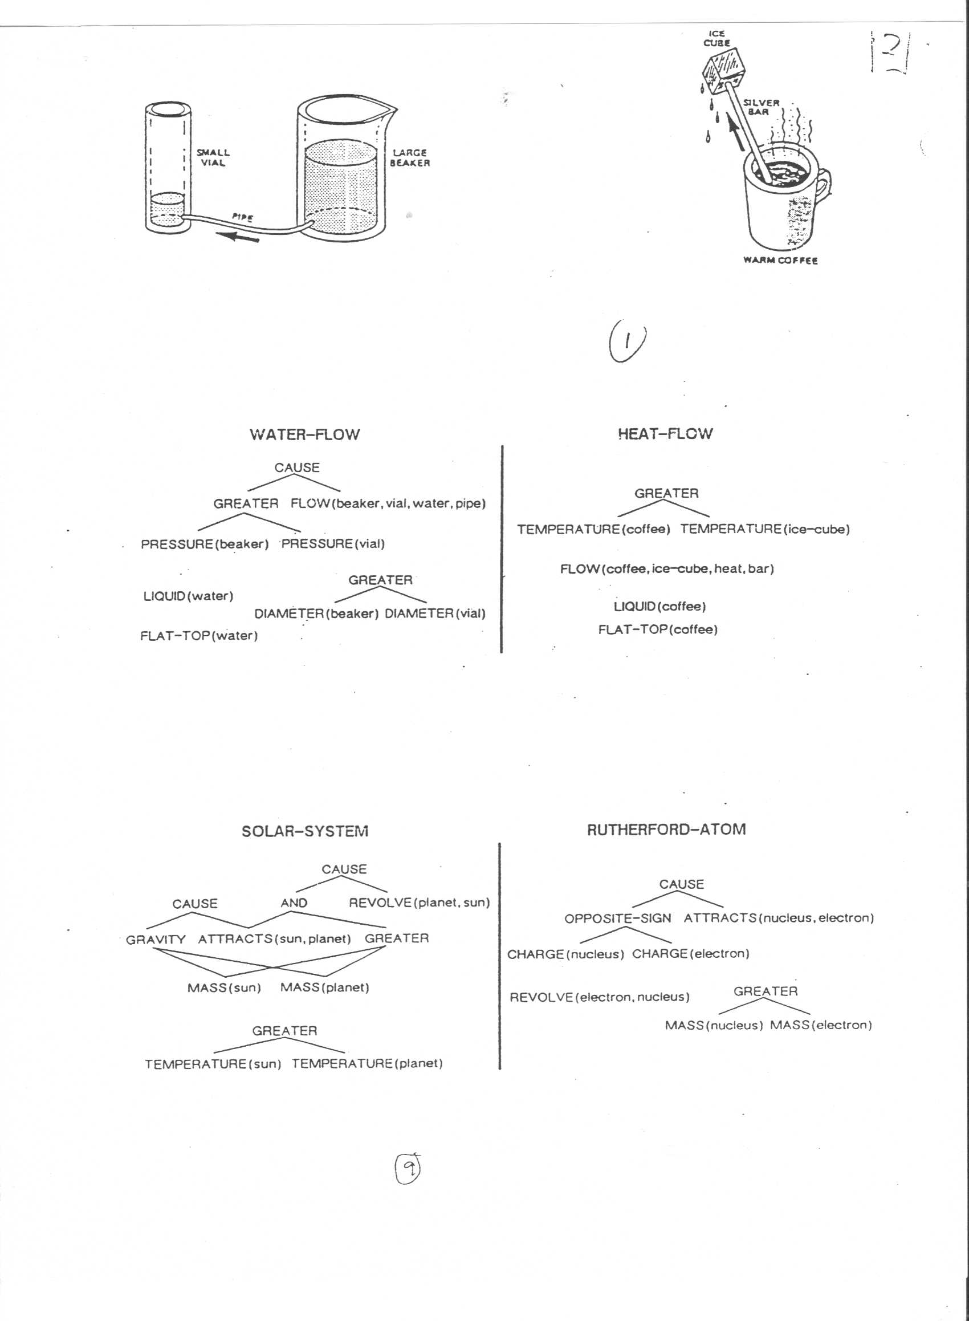

Slide 6
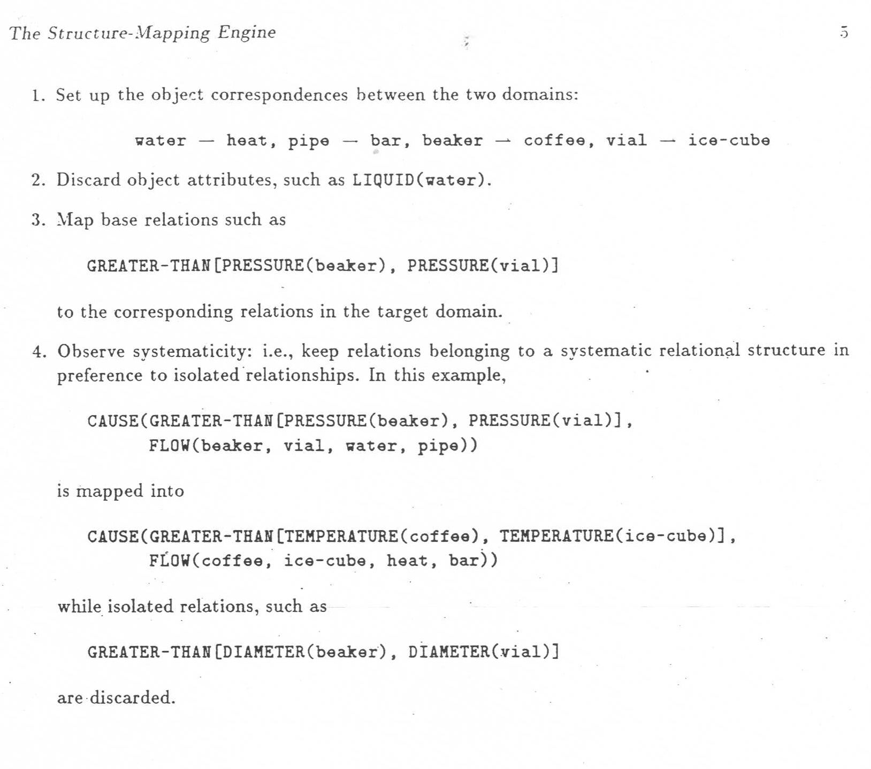

Slide 7
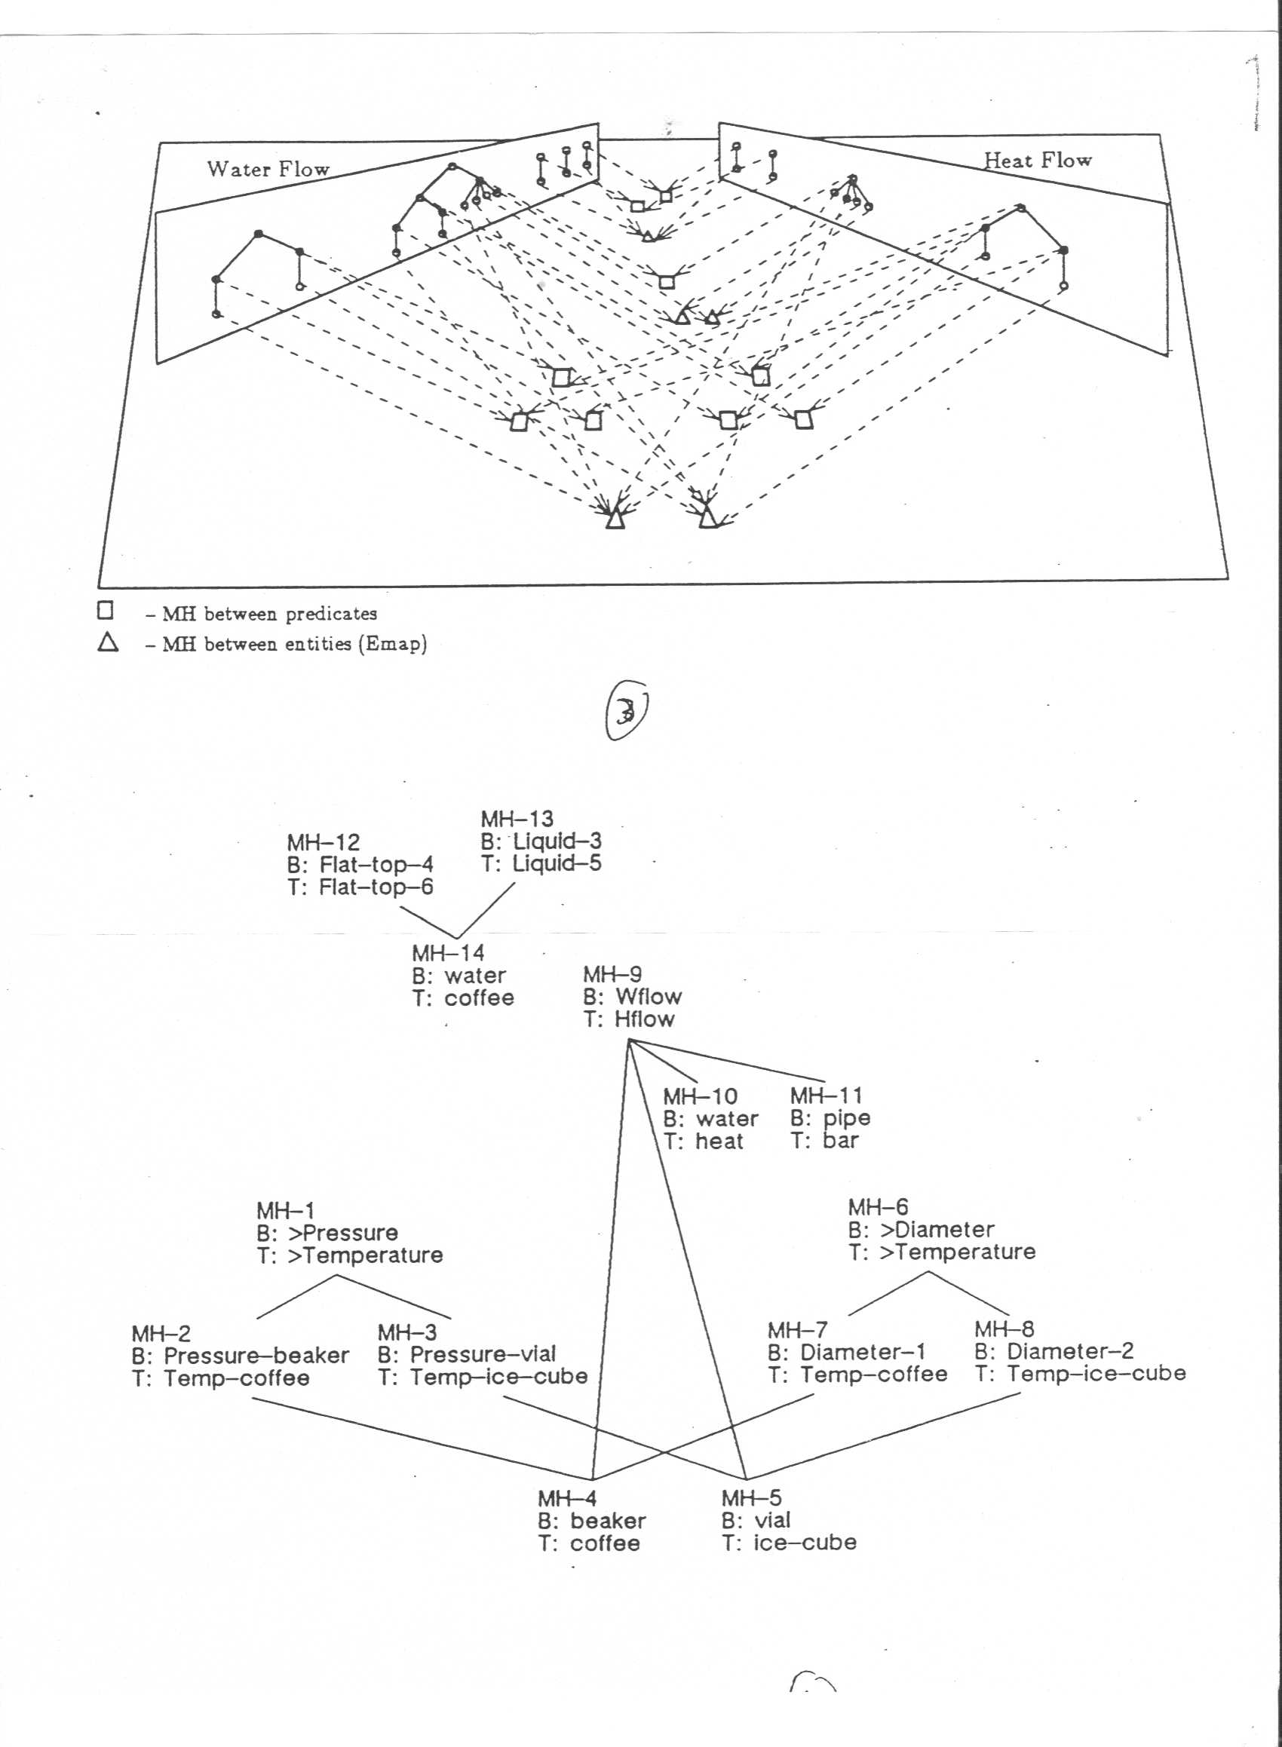

Slide 8
Constructing Analogical Mappings “From Scratch”, contd.
Once a sufficiently good set of analogical correspondences (mappings) has been chosen,
create candidate inferences:
  Find pieces of structure on the source side that are not yet mapped to the target, but that are sufficiently strongly connected to things that are: namely, as/by higher-order relationships such as CAUSE.
  Transfer these extra pieces of structure to the target, …
  and in doing so, replace source elements that do have mapping correspondents by those correspondents, leaving other elements as they are.
  Check the resulting candidate information about the structure for validity.

Slide 9
Analogical Candidate Inferences, contd.
In the liquid-flow/heat-example above, as it stands, the CAUSE relationship from the Liquid Flow situation can be transferred to the Heat Flow situation, joining together the TEMPERATURE DIFFERENCE and the FLOW substructures there.
But also: if the Heat Flow situation did not yet have the FLOW substructure, both it and the above CAUSE relationship could be added as candidate inferences.

Slide 10
Symmetrical?
Recall the discussion about “Trump is Putin” versus “Putin is Trump”
or about “Mys surgeon is a butcher” versus “My butcher is a surgeon.”
  (I label the fact that the meaning changes as “asymmetry” rather than “irreversibility”)
Clearly the SMT candidate inferences go in a different direction and so involve different pieces of structure, even if the same mappings are found for both cases. So it is ASYMMETRICAL AS REGARDS TRANSFERRED MEANING.
But SMT as usually described delivers the same correspondences for both orders, i.e.it is SYMMETRICAL as regards SIMILARITY.
HOWEVER, analogy construction NEED NOT have this quality.
Simple refinements/limitations that are probably needed anyway would give asymmetry. [See Barnden 2016a]

Slide 11


Slide 12
Another Approach:
Choosing/Building Superordinate Categories during Metaphor Understanding

Slide 13
Choosing/Constructing Superordinate Categories
There are various versions, notably the class inclusion theory
[Glucksberg 2001]
( = the “property attribution” theory)
and (part of) and approach proposed within Relevance Theory [Sperber & Wilson 2008; Carston & Wearing 2015]
A basic standard example: “[A / my / Peter’s ] job is a jail.”
Treat this as saying that the job is within a certain category (= class = type of thing), but not the category of literal jails but instead within a broader (= more general = “superordinate”) category that can also fit jobs (or the particular job in question) and otherwise fits with the discourse context.

Slide 14
Choosing/Constructing Superordinate Categories, contd
“Peter’s job is a jail.”
FOR EXAMPLE, the category chosen/constructed could be
  the category of situations that severely reduce one’s liberty, OR:
  the category of situations that are difficult to get out of, OR:
  the category of situations that are unpleasant over a long period, OR:
  the category of situations that are imposed as punishments, OR
  A category with more than one of those qualities.

Slide 15
Choosing/Constructing Superordinate Categories, contd
Often, the literal source category should first be restricted to a prototypical /culturally famous version:
  There are many types of jail, including “open” prisons that are not particularly unpleasant or limiting, and from which one will soon depart.
  So the category of literal jails in general would force the superordinate category to include these “soft” possibilities, so it is unclear how the message of something very unpleasant, very limiting, etc. is conveyed.
Can solve this problem by first narrowing the literal category to that of a stereotypical sort of jail, with small cells, where one has to stay quite a long time, etc.

Slide 16
Choosing/Constructing Superordinate Categories, contd
[READ OUTSIDE]
Similarly:
“Carita is a princess.”:
Can convey that Carita is selfish and “spoilt” (i.e., is angry when she doesn’t get what she wants). But not all literal princesses are like this. So the category of selfish, spolit women does not include the full literal category of princesses.
We can first narrow the literal category to that of a negative stereotype of princesses, appearing in some literature.

Slide 17
In These Slides
To cover in the lecture:
Important metaphor theories, contd.
My own theory, “ATT-Meta”.
For you to read outside:
More on (non-)novelty/creativity in metaphor.
Compounding/mixing of metaphor.
Metaphor compounding in ATT-Meta.
Notes on other AI work on metaphor.

Slide 18
Choosing or Building Afresh or Combining?
[Superordinate Categories, contd]
The (psychology and AI) literature is very unclear about the extent to which one may have to build [invent] a new category or can rely instead just on an existing category one knows about.
  But the Relevance Theory version of the approach often talks of the superordinate catgeory as being an “ad hoc” category, implying context-sensitive category invention.
The possibility of creating the category by combining (e.g., intersecting, unioning) various already known categories is little discussed.
In building an AI system based on the theory one would need to get to grips with such problems … and this illustrates part of the value of AI !

Slide 20
Another Approach:
“Conceptual Integration” theory
(“Blending” theory)

Slide 21
Blending Theory
[Fauconnier & Turner 1998; Fauconnier 2009]
The basic idea is that as well having or creating mappings between some of one’s knowledge of the source and some of one’s knowledge of the target,
In metaphor interpretation or metaphorical cognition more generally we recall or build a “blend space” that combines and elaborates those two bunches of selected knowledge, which are called “input spaces”.
And this can give rise to “emergent” inferences in the blend that can lead to transfers to the target;
where sometimes these may be more difficult to explain by other theories.

Slide 22
Blending Theory, contd
Suppose Alice hears,
“John and Mary are at a complicated motorway intersection in their [love] relationship.”
Then the mental-space structure on the next slide might arise in Alice’s mind, partly based on recall of knowledge of a LOVE RELATIONSHIP AS JOURNEY metaphorical view and of a known resulting blend, and partly based on using the particular sentence to extend the blend.
  Caution: The example sentence and the following illustrative diagrams were invented by me: other authors may use different details.
  A problem: accounts of blending theory do not give enough detail about the process a hearer might go through, as opposed to specifying the resulting mental structure. So not a detailed psychological theory or AI framework.

Slide 23
GENERIC (SEE NEXT SLIDE)
SPACE
John
Traveller 1
Mary
Traveller 2
Their rel’p
travelling together
rel’p event seq.
journey event sequence
rel’p difficulties
Journey difficuties
John/Trav1
Mary/Trav2
love rel’p/trav-together
TARGET
INPUT SPACE
relp-ev-seq/journey-ev-seq
SOURCE
INPUT SPACE
relp-diffics/journey-diffics
J&M at motorway junction
not all needed blue arrows are shown
BLEND
SPACE

Slide 24
GENERIC SPACE:
SOME POSS. DETAILS
Entity 1
Entity 2
a relationship between them
John
Traveller 1
Mary
Sequence of changes
Traveller 2
their love rel’p
Their travlling together
Sequence of rel’p events
GENERC
SPACE
Sequence of journey events
not all blue arrows or space contents are shown
TARGET
INPUT SPACE
SOURCE
INPUT SPACE
BLEND
SPACE

Slide 25
Blending Theory, contd
But now Alice can elaborate the blend by inferring from J & M being at a complicated motorway junction that
  they are having journey difficulties, about which road to take
Then, bringing in the fact that they are in a love relationship, Alice might also infer that
  J & M decide consensually on which road to take.
Crucially, this second inference depends on BOTH target-input-space AND source-input-space info (inherited by the blend). So this inference is “emergent” in an important, blending-dependent way.
So we have following (mainly showing just the new elements):

Slide 26
GENERIC
SPACE
John
Traveller 1
Mary
Traveller 2
Their rel’p
travelling together
joint life event seq.
journey event sequence
rel’p difficulties
Journey difficuties
HAVE journey-diffics
TARGET
INPUT SPACE
difficult to choose road
decide consensually on road
SOURCE
INPUT SPACE
J&M at
junction
J&M in
loooove
BLEND
SPACE

Slide 27
Blending Theory, contd
Now Alice can notice the existing blending of difficulty types (relationship/journey)—
i.e. essentially the mapping of difficulty types between the two input spaces—
and, using other mappings, add further elements to the structure,
if we make certain natural assumptions …..
[OUTSIDE EXERCISE: think about what we need to assume to get the right things to happen]

Slide 28
GENERIC
SPACE
Traveller 1
HAVE relp diffics
Traveller 2
travelling together
journey event sequence
diffic choose rel’p action
Journey difficuties
decide consensually
on action
HAVE relp-diffics/& jrny-diffics
MODIFIED
TARGET SPACE
diffic choose rel’p action /& road
SOURCE
INPUT SPACE
decide consensually:
rel’p/action /& road
BLEND
SPACE

Slide 29
Blending Theory and Metonymy
[READ OUTSIDE]
Fauconnier (2009 ) has proposed that METONYMY can be handled by blending the two related things into one thing within the blend.
  E.g., the White House and its representative become one thing within the blend.
I don’t know if this approach has been extensively explored, and I have worries about whether it would work in general because of conflating considerations of similarity and non-similarity:
Similarity and non-similarity relationships, despite the slippery relationship of metaphor and metonymy, and despite some “continguity” relationships involving some extent of hidden similarity [Barnden 2010],
are themselves different!

Slide 31
My Own Approach:
“Att-Meta”: based on pretences/fictions

Slide 32
The ATT-Meta Approach
“ATT-Meta” = “[propositional] attitudes” + “metaphor”
ATT-Meta general theoretical approach to some metaphor, and a working AI computer program that partially realizes the theory.
As with many other approaches, if a metaphorical word or phrase is conventional/familiar enough then its meaning may be in a mental/system lexicon.
  Possible examples: milestone, attack, dead, back of X’s mind
  And possibly: overflow
The interesting cases are (at least) the remainder. I claim these are handled by pretence/fiction.

Slide 33
Aside: Using Pretence/Fiction for Irony
Pretence is the basis of one of the main approaches to irony.
I have my own pretence-based approach to irony, conceived as an extension of the ATT-Meta approach to metaphor.
The approach explicitly casts the pretence scenarios as dramatic scenarios that the speaker is theatrically acting in.
thereby linking pretence yet more to fiction.
See Barnden (forthcoming, b), including for references to other accounts.

Slide 34
Using Pretence/Fiction for Metaphor
Pretence (in various guises!), or similarly fiction, has been to some extent proposed as the core of some other accounts of metaphor …
in various disciplines ...
  Cognitive Linguistics: “blending” theory [see previous slides]
  Philosophy: “pretences”, “games of make-believe”, “fictions”
  [Walton 2004/1993; also Yablo, Hills, Camp, Egan]
  Literary theory: “metaphoric worlds” [Levin 1993]
  Language pragmatics: RT + metarepresentations [Carston & Wearing 2011]

Slide 35
Quick Initial Example
In
  “John’s exam marking overflowed into the weekend”,
  there’s a (highly temporary) making-believe/fiction/imagining/pretence that
  the marking IS A physical liquid and that
  the relevant periods of time ARE physical containers.

Slide 36
The ATT-Meta Approach, contd
“The idea was buried in the outback of Katy’s mind”:
  The understander (as well as the speaker) momentarily pretends that Katy’s mind is literally a physical terrain that has an outback and that the idea is literally physically buried in the outback.
  Physical burying, especially in relatively inaccessible locations such as an outback, implies (by default) a high degree of current lack of physical manipulability and physical hiddenness, and a high degree of difficulty for attempts to physically manipulate it.
I claim that mind-as-physical-region metaphors involve the ancillary assumption that in the pretence
  the person’s conscious self is
  a person in a central part of the region.
So the idea in question is inferred to be (to a high degree) physically hidden to, currently physically unmanipulable by, and difficult to physically manipulate by Katy’s conscious self.

Slide 37
The ATT-Meta Approach, contd
So what??
We now need to have some way of “pulling out” some version of some information in the pretended situation
to become information about the target situation (Katy’s actual state of mind).
What I’m aiming for in the Katy example is that by pull-outs the understander derives the propositions that (to a high degree)
Katy is not aware of the idea,
cannot currently mentally use the idea, and
would find it difficult to mentally use it.

Slide 38



J = the idea
Reality (incl.
target-side)
J is buried in ...
J is a phys object
K’s mind is a phys terrain
inference
K is not aware of J
J phys’ly hidden to K’s c. self
J not phys’ly manipulable by K’s c. self
K cannot mentally use J
J would only be manipulable with difficulty by K’s c. self
K would find it difficult to mentally use J
pull-out

Slide 39
The ATT-Meta Approach, contd
For purposes of pull-out in general, there are three logical possibilities:
  Some information may be able to be copied over as-is (no transformation)
  We have known transformations of some types of information
  We work out new transformations of some information from scratch.
All three appear in various forms across metaphor theory.
New-transformation has been postponed in the ATT-Meta project: can be important, but only relatively rarely so in practice
No-transformation and known-transformation are used in ATT-Meta.
  No-transformation: largely by “View Neutral Mapping Adjuncts”
  Known-transformation: roughly following the idea of “mappings” in Conceptual Metaphor theory [Lakoff & Johnson 2003]
  But more closely the variant developed by Grady (1997).

Slide 40
Examples of Known-Transformation mappings
For the metaphorical view of IDEAS AS PHYSICAL OBJECTS, we might have the following mappings, which are therefore view-specific:
  X mentally using an idea ↔
  X’s conscious self physically manipulating the physical object that the idea is pretended to be.
  X being [consciously] aware of an idea ↔
  X’s conscious self seeing the physical object that the idea is pretended to be.

Slide 41
Examples of Known-Transformation mappings
For the metaphorical view of DISEASE AS POSSESSED OBJECT, we might have:
  X being infected by a disease D ↔
  X physically possessing the physical object that D is pretended to be.
For the metaphorical view of MIND AS CONTAINING AN INNER COMMUNITY of PERSONS, we might have:
  X believing P to be evidenced ↔
  Some pretended inner person in X believing P to be evidenced

Slide 42
Mappings as working on Pretence
In other approaches, mappings are thought to be between a source domain and a target domain (or other similar constructs), where domains are subdivisions of our knowledge of the world. E.g. human relationships; journeys; money; time; …
This rests on notions of domain (etc.) that I don’t believe.
I cast mappings as just relating two different things (no matter what “domains” these things might involve), where one thing is assumed to be in a pretended scenario and the other in a target-side scenario.
[related to Walton’s “principles of generation”]
I don’t assume any precise delineations of subject-matter.
The subject-matter in the pretence is typically from the source side of the metaphor, but can include real (non-pretend) information, and any subject matter that is relevantly connected to the source-side subject matter.

Slide 43
The ATT-Meta Approach, contd
No-transformation case: done by View-Neutral Mapping Adjuncts (VNMAs). They lead to copying of certain types of commonly-occurring information.
Example:
  IF pretend action P corresponds to target-scenario action Q
  AND IF pretend agent X corresponds to target-scenario agent Y,
  THEN ability of X to do P corresponds to ability of Y to do Q
  (by default)
That is the Ability VNMA (part of a more general VNMA).
VNMAs are parasitic on existing postulated pretence/target correspondences (mappings).
But they are independent of where those correspondences come from, and notably from what specific metaphorical views (such as IDEAS AS PHYSICAL OBJECTS) are in operation.

Slide 44
The ATT-Meta Approach, contd
VNMAs provide great economy:
E.g. No need to have a special, view-specific mapping that maps physical-manipulation-ABILITY to mental-usage-ABILITY
Or similarly to have a special mapping that maps DIFFICULTY of physical-manipulation to DIFFICULTY of mental-usage
Or similarly difficulty of continuing a journey to difficulty of continuing a love relationship.
Recall here the mentions of the central role of difficulties/impediments in the meanings of metaphors discussed by Prof. Forceville and me.

Slide 45
VNMAs for things such as …
Degrees (intensities); Uncertainty
Emotional/attitudinal qualities/value-judgments/beliefs/intentions/ …..
  Unpleasantness of someone shouting in your ear; anger of Sharon’s inner voice. Unwantedness of junk. Lack of intention of being in prison; knowingness in loading a gun.
Changes, Time Properties/Relationships and Time-Course, incl. starting, ending, smoothness/intermittence, etc. (non-numerical)
Causation/prevention/enablement/ability/ease/difficulty/helping/trying
  Non-ability to see a nylon string. Of finding and manipulating something buried.
(Normal) functioning
  Junked item no longer serves and perhaps never will serve its normal function. Car-on-holiday is not engaging in normal function.
Modality: possibility/necessity/obligation/…
Qualitative number/amount (little, much, few, many, more, …); Sets

Slide 46
ATT-Meta’s VNMAs contd
OUTSIDE EXERCISE:
Go back over metaphor examples that I have given and those that Prof. Forceville has given, and notice how much of what is transferred in metaphor is to do with
  Ease/difficulty of doing something
  Affective states (emotions, value judgments, etc.), whether of the discourse participants to the source scenario, or of the agents within those scenarios.
  Causation, change, trying, etc.
  Importance
  Time-course factors that enter into manner of movement
NB: Trying to keep your balance is a matter TRYING to PREVENT the ENDING of some ONGOING state. So can be handled by VNMAs.

Slide 47
Other No-Transformation Cases
Any type of info could, in the right specific circumstances, correspond without transformation.
  E.g., one might metaphorically cast a person as a horse because of the shape of their nose and their speed of running.
The point is that only certain types of information can be assumed to correspond when there’s no specific counter-evidence.
A person/horse metaphor would not allow one to assume that the person eats raw oats, etc., just because there’s no evidence that the person does not eat those things.
  One might of course wonder whether the person eats those things.
  And in the right context, part of the point could be that the person does eat those things.
So:
  VNMA-style info: can copy over unless there’s a reason against
  Other Info: cannot copy over unless there’s a specific reason for

Slide 48
SEE SEPARATE PDF FILE FOR
OTHER ATT-Meta EXAMPLES
“A voice inside Mary was insisting that …”
“My car thinks it’s on holiday”

Slide 49
Restrained Parallelism, and Holism

Slide 50
Restrained-Parallelism Tendency
(Anti-Analogy-Extension Thesis)
A metaphor source scenario in a pretence may usefully contain some or many things that have no parallel in the target scenario, and it may be very difficult or even impossible to provide a parallel for some such things.
Those unparalleled things may nevertheless generate consequences that DO have a parallel.

Slide 51
Restrained-Parallelism Tendency, contd
(Anti-Analogy-Extension Thesis)
“The idea was buried in the outback of Katy’s mind.”
My claim: “buried” and “outback” are merely
mental tools towards the target-side meaning ...
via mappings such as
mental usage ↔ physical operation.
There is no need to, and it could be difficult to,
discover mappings for the map-transcending notions introduced by “buried” and “outback”.
The familiar, existing parallelism (analogy) between mental matters and physical matters need not (and often cannot) be extended.

Slide 52
Restrained Parallelism in Metaphor
  “I don’t think strings are attached. If there are any they’re made of nylon”:
    made-of-nylon, or nylon and made-of separately, don’t need parallels.
  Car examples:
    the holiday state itself and the thinking have/need no parallels.
  No (necessary) target-side parallel for:
    The grassiness of the long grass; the yardiness of the junkyard:
    All that’s important is the hiddenness, the discardedness.
    The mental states underlying fickleness and benevolence.
    Sharon’s internal and external voices.

Slide 53
Restrained Parallelism in Metaphor
The need to restrain the extension of parallelism is recognized in some of the idiom literature [notably by Langlotz, 2006], but not usually in mapping-based metaphor theories.
Indeed, technical analogy-based approaches to metaphor such as SMT seek to maximize the amount of analogy on any given occasion.

Slide 54
Restrained Parallelism contd
Adapted from a novel [Nick Hornby, High Fidelity, 1995]:
  “I tried not to run down Phil too much. But it became unavoidable, when Jackie expressed doubts about him. I nurtured those doubts as if they were tiny, sickly kittens. Eventually they became sturdy, healthy grievances. These cats had their own cat-flaps. This allowed them to wander in and out of our conversation at will.”
The cat-flaps and at-willness don’t themselves need target parallels. They just emphasize, via the pretence scenario, the non-deliberateness (on the part of the conversants) with which the grievances occurred in the conversations.
Even the cat-ness in the pretence scenario has no target-side parallel. It just provides a conceptual framework for describing a process in which doubts become strong grievances.
Notice the mix of simile (“as if they were … kittens”) versus non-simile metaphor in other parts.

Slide 55
Comment on Fiction and Metaphor
Restrained parallelism increases the ability of metaphorical pretences to incorporate distortions, false stereotypes and fantastic elements. Recall examples:
Gorillas
Octopi with 30,000 tentacles
Marriage of 28 countries
Mirror walking down a road.
So ATT-Meta may facilitate the handling of animations and comic strips, which can flexibly and simply include distortions and fantasy,

Slide 57
Sources of ATT-Meta’s Flexibility
Restrained parallelism (retrained analogy).
Taking seriously the idea of source scenarios as exercises in fiction.
Factoring out much of source/target transfer in metaphor into view-neutral mapping as opposed to view-specific.
Not rigidly regimenting knowledge into domains.
Having opportunistically activated mappings that are not packaged rigidly into constructs such as conceptual metaphors.
  The IF parts of mapping rules contain “guards” that implicitly restrict what sort of metaphorical view the rules deal with. But the views themselves have no independent reality in the approach and can vary fuzzily between guards.

Slide 58
ATT-Meta’s Flexibility, contd
Handling of metaphor compounding (see EXTRA SLIDES).
“Discourse holism” and “Metaphorization of the literal “ [in slides below]
Other matters not covered in my slides:
  Focus on uncertain reasoning and especially on defaults and exceptions.
  Integrating mapping actions thoroughly into the overall flow of inference: e.g. there is no separate mapping phase.
  Treating individual, instantiated source/target correspondences (e.g. concerning Katy’s mental difficulty with a particular idea) themeselves as hypotheses that can be supported and defeated like any other.

Slide 60
Discourse Holism
“These cats had their own cat-flaps.”
This sentence does not (need to) have its own target-side meaning.
The appropriate level for metaphorical interpretation is sometimes a multi-sentence chunk of discourse
(or a chunk consisting of multiple metaphorical clauses).

Slide 61
Discourse Holism, contd
“Everyone is a moon, and has a dark side which he never shows to anybody.” [Mark Twain]
A possible variant:
“Everyone is a moon. Everyone has a dark side which he never shows to anybody.”
The clause/sentence “Everyone is a moon” does not (need to) be given its own target-side meaning.
Rather, it conspires with the other clause/sentence to convey an overall pretence scenario in holistic way, and it’s from this that the target-side info is derived in a another somewhat holistic way.
  [But my view is very different from that of Davidson 1979]
Indeed, the moon clause/sentence really just partially summarizes the info from the other segment. [Or would do if it were astronomically accurate!]

Slide 62
Metaphorization of the Literal

Slide 63
Shifting into Reverse: Metaphorization
Literal elements of a discourse may best be translated into terms of the source side to engage with the pretended scenario:
metaphorization of the literal —
— reverse of normal process assumed in metaphor understanding!
This can be desirable in order to achieve better coherence or to achieve coherence more easily (or indeed at all, perhaps).
Effectively have REVERSE TRANSFER of information
(target → source)

Slide 64
Metaphorization, contd
In the complaints-as-cats example, it is intuitively natural to build in one's mind a SOURCE-SIDE scenario capturing what’s being said across the whole paragraph, using knowledge and inference about cats, and from it extract information about the target-side scenario.
For instance, how do we get the impression of the sickly kittens growing into healthy kittens or adult cats?
  Answer: partly in “Eventually they became sturdy, healthy grievances”
  which is partly literal. Metaphorization of the “grievances” to cats is desirable, in order to enrich and be integrated with the pretence scenario.
And if we claimed that all the integration should instead happen on the target side (so in particular “sturdy” and “healthy” would be mapped to target-side concepts) then
we’d have to try to convert all sentences including “These cats had their own cat-flaps” into target terms — with great difficulty.

Slide 65
Metaphorization, contd
Integration of information may be more natural on pretence side than reality side.
  Not all metaphorical fragments are susceptible to being individually translated into target terms.
  May have greater familiarity with how the source subject matter works in detail: richer background knowledge and inference abilities; perhaps efficient, specialized inference procedures available for it.

Slide 66
Metaphorization, contd
Reverse transfer has occasionally been envisaged in various forms under other theories
But ATT-Meta is unique in proposing it as a normally arising part of in the coherent interpretation of ordinary metaphorical discourse, completely integrated with forward transfer and other operations.

Slide 68
Notes on AI work on Metaphor
Work on metaphor has proceeded in AI since quite early days in AI (late 1960s,early 1970s)
  some important names from early on: Yorick Wilks, Sylvia Weber Russell, Dan Fass, Jerry Hobbs, James Martin, James Feldman
  all still active in research.
  But metaphor has always been (misguidedly) a minority interest in AI.
Recent increased interest, largely by people applying statistical techniques and neural networks (recycled as “deep learning”).
  E.g., there have been regular “metaphor in natural language processing” workshops at the major international conferences on computational linguistics.

Slide 69
Notes on AI work on Metaphor, contd
There was fairly recently a massive multi-year grant for AI-based multi-lingual work on metaphor from IARPA, the USA’s Intelligence Advanced Research Projects Agency [intelligence in the national defence sense, not the cognitive sense]
  Because of importance of appreciating metaphor in massive piles of documents/messages from places round the world in order to extract accurate intelligence,
  especially giving cross-cultural differences in metaphor use.

Slide 70
Notes on AI work on Metaphor, contd
Most recent work on metaphor as mentioned above has been on detecting metaphorical language rather than understanding it,
  with some on deciding what Conceptual Metaphors (or domain pairs) are involved in instances of metaphor
  or even some on producing simple paraphrases of the meaning of more straightforward types of metaphor.
Remarkable successes in many ways, but (understandably) not really getting at the deeper and subtler aspects of metaphor, and concentrating on metaphor in single words and short phrases.
  Also shows little attention to the relationships with metonymy (mixes of metaphor and metonymy within sentences; need to distinguish between metaphor and metonymy, even though fuzzily)

Slide 71
Notes on AI work on Metaphor, contd
There has been some very interesting and unique work on novel metaphor understanding and generation (basically in A-is-B form) by Tony Veale at University College Dublin, using intelligent consideration of rough analogies and contrasts between types of thing
  He has even built a twitter-bot @MetaphorMagnet that generates a new metaphor every half an hour, and to some extent picks up on issues circulating on twitter.
  See [http://afflatus.ucd.ie/article.do?action=view&articleId=39]
Another interesting piece of work by Veale is automatically building a large knowledge base of common-sense knowledge about thousands of things by automatically web-mining similes of the form “X is as Y as a Z” as in “Mike is as sharp as a knife,” from which one learns that knives are prototypically sharp.
You can get a start on his work by reading his website and his very accessible book on creativity [Veale 2012].

Slide 72
Notes on AI work on Metaphor, contd [READ OUTSIDE]
The above-mentioned statistical (etc.) work on metaphor detection tries to automatically learn how to detect metaphor on the basis of a wide variety of features of language, such as
  what semantic domains words lie in (this can be determined from various automatic tools, including online electronic thesauri and ontologies such as WordNet, but also the results previous machine-learning projects that have relied on learning from manually-annotated text), since a disparity of domain suggests metaphor; often in combination with:
  what “selectional preferences” verbs, adjectives etc,. have (e.g. “eat” has the preference that its subject be animate), since a violation suggests metaphor
  the affective ratings of words to be found in various “affect” dictionaries or “sentiment” dictionaries, since metaphor often uses affective words
  the ratings of concreteness, imageability, etc. that have been collected for large numbers of words, since there may be a concreteness or imageability disparity between target and source terms
  simple aspects of the syntactic structure of sentences, found e.g. by means of “Dependency Parsing” [incl. in work by my colleague Andrew Gargett], because osme types of metaphor fall into particular patterns, and to help exploit the significance of the above features.

Slide 73
Notes on AI work on Metaphor, contd
[READ OUTSIDE]
One interesting approach (within AI and Cognitive Science more generally) is based on “word vectors”. These are numerical vectors (i.e. list of numbers), of some fixed length, one for each major word encountered in a large set of documents. (Word-vector methods are also called vector-space methods, and fall within an approach called distributional semantics.)
  Word vectors can be calculated by a number of techniques, from the long-standing Latent Semantic Analysis method to the “word2vec” algorithm supplied by Google and much used within computational linguistics for a variety of purposes.
  The methods of calculation tend to make words with similar senses have mathematically similar vectors, where the similarity between two vectors is measured by e.g. the cosine of the angle between them.
  (contd on next slide)

Slide 74
Notes on AI work on Metaphor, contd
[READ OUTSIDE]
  For one main early example of the application to metaphor see the Kintsch article in Gibbs (2008). A related study [by Utsumi 2011] involves methods for finding an approximation to a vector representing the meaning of a metaphor (e.g. a vector representing an abstraction covering both source and target) by fairly simple calculations based on the source and target vectors.
Also, it transpires that under some conditions subtracting one vector from another, where the vectors represent related concepts, produces a vector that approximates the vector for their relationship. This has application to analogy and metaphor, when the similarity between source and target rests on sets of relationship between items.

Slide 76
References to Some of My Work
(arranged chronologically)
Barnden, J.A., Glasbey, S.R., Lee, M.G. & Wallington, A.M. (2004). Varieties and directions of inter-domain influence in metaphor. Metaphor and Symbol, 19 (1), pp.1—30.
Barnden, J.A. (2008). Metaphor and artificial intelligence: Why they matter to each other. In R.W. Gibbs, Jr. (Ed.), The Cambridge Handbook of Metaphor and Thought, pp.311--338. Cambridge, U.K.: Cambridge University Press.
Barnden, J.A. (2009). Metaphor and context: A perspective from artificial intelligence. In A. Musolff & J. Zinken (Eds), Metaphor and Discourse, pp.79-94. Basingstoke, UK: Palgrave Macmillan.
Barnden, J.A. (2010). Metaphor and metonymy: Making their connections more slippery. Cognitive Linguistics, 21(1), pp.1-34.
Barnden, J.A. & Wallington, A.M. (2010). “Metaphor and its unparalleled meaning and truth.” In A. Burkhardt & B. Nerlich (Eds), Tropical Truth(s), pp.85-121. Berlin / New York: De Gruyter.
Barnden, J.A. (2012). Metaphor and simile: Fallacies concerning comparison, ellipsis and inter-paraphrase. Metaphor and Symbol, 27 (4), pp.265-282.

Slide 77
References to Some of My Work, contd
Barnden, J.A. (2015a). Metaphor, simile, and the exaggeration of likeness. Metaphor and Symbol, 30 (1), 41--62.
Barnden, J.A. (2015b). Open-ended elaborations in creative metaphor. In Besold, T.R., Schorlemmer, M. & Smaill, A. (Eds,) Creativity Research: Towards Creative Machines, pp.217--242. Atlantis Press (Springer). [Includes an overview of the ATT-Meta approach.]
Barnden, J.A. (2016a). Metaphor and simile: Categorizing and comparing categorization and comparison. In Gola, E. & Ervas, F. (Eds), Metaphor and Communication, pp.25—46. John Amsterdam: John Benjamins.
Barnden, J.A. (2016b). Mixed metaphor: Its depth, its breadth, and a pretence-based approach. In Gibbs (2016), pp.75—111. [Includes an overview of the ATT-Meta approach.]
Barnden, J.A. (2016c). Communicating flexibly with metaphor: A complex of strengthening, elaboration, replacement, compounding and unrealism. Review of Cognitive Linguistics, 14 (2), pp.442—473.
Barnden, J.A. (forthcoming, a). Some contrast effects in metonymy. In O. Blanco, A. Barcelona & R. Pannain (Eds), Describing Conceptual Metonymy in Languages: From Morpheme to Discourse. John Benjamins.
Barnden, J.A. (forthcoming, b). Irony, pretence and fictively-elaborating hyperbole. In A. Athanasiadou & H. Colston (Eds.), Irony in Language Use and Communication.} Amsterdam: John Benjamins

Slide 78
References (except to my own work)
Bowdle, B.F. & Gentner, D.~(2005). The career of metaphor. Psychological Review, 112 (1), pp.193—216.
Carston, R. & Wearing, C. (2011). Metaphor, hyperbole and simile: A pragmatic approach. Language and Cognition, 3(2): pp.283—312.
Davidson, D. (1979). What metaphors mean. In S. Sacks (Ed.), On Metaphor, pp.29--45. U. Chicago Press.
Demjen, Z. (2011). Language and mind: How language can convey mental states, with special reference to Sylvia Plath's “Smith Journal.” PhD Thesis, Lancaster University, UK.
Fauconnier, G. (2009). Generalized integration networks. In V.~Evans \& S.~Pourcel (Eds), New Directions in Cognitive Linguistics, pp.147--160. Amsterdam: John Benjamins.
Fauconnier, G. & Turner, M. (1998). Conceptual integration networks. Cognitive Science, 22 (2), pp.133—187.
Forbus, K. D., Ferguson, R. W., Lovett, A. and Gentner, D. 2016. Extending SME to handle large-scale cognitive modelling. Cognitive Science. doi:10.1111/cogs.12377
Gentner, D. (1983). Structure-mapping: a theoretical framework for analogy. Cognitive Science, 7 (2), 95—119.

Slide 79
(Non-Barnden) References, contd
Gibbs, Jr., R.W. (Ed.) (2008). The Cambridge Handbook of Metaphor and Thought. Cambridge, U.K.: Cambridge University Press.
Gibbs, Jr., R.W. (Ed.) (2016). Mixing metaphor. Amsterdam: John Benjamins.
Glucksberg, S. (2001). Understanding figurative language: From metaphors to idioms. New York: Oxford University Press.
Grady, J.E. (1997). THEORIES ARE BUILDINGS revisited. Cognitive Linguistics, 8 (4), pp.267--290.
Langlotz, A. (2006). Idiom creativity: A cognitive-linguistic model of idiom-representation and idiom-variation in English. Amsterdam/Philadelphia: John Benjamins.
Levin, S.R. (1993). Language, concepts, and worlds: three domains of metaphor. In A. Ortony (Ed.), Metaphor and Thought, 2nd edition, pp.112--123. New York and Cambridge, U.K.: Cambridge University Press. Littlemore, J. (2015). Metonymy: Hidden shortcuts in language, thought and communication. Cambridge University Press.
Ortony, A. (1979). The role of similarity in similes and metaphors. In A. Ortony (Ed.), Metaphor and Thought, pp.186—201. Cambridge, U.K.: Cambridge University Press.
Sperber, D. & Wilson, D. (2008). A deflationary account of metaphor. In R.W. Gibbs, Jr. (Ed.), The Cambridge Handbook of Metaphor and Thought, pp.84—105. Cambridge, U.K.: Cambridge University Press.

Slide 80
(Non-Barnden) References, contd
Utsumi, A. (2011). Computational exploration of metaphor comprehension processes using a semantic space model. Cognitive Science, 35, pp.251--296.
Veale, T. (2012). Exploding the creativity myth: The computational foundations of linguistic creativity. London, New Delhi, New York, Sydney: Bloomsbury.
Walton, K. (2004/1993). Metaphor and prop oriented make-believe. In E. John & D.M. Lopes (Eds), Philosophy of Literature—Contemporary and Classic Readings: An Anthology, pp.239--247. Oxford: Blackwell, 2004. Reprinted from European J. of Philosophy, 1, pp.39-42, 45-49, 51-57.

Slide 82
EXTRA SLIDES

Slide 83
METAPHOR
continued:
More on (Non-)Novelty

Slide 84
Open-Ended Variation, contd
Variants of “a corner of X’s mind” [a common phrase]:
  in a dim corner of X’s mind
  in an unlit corner of X’s mind
  in a distant corner of X’s mind
  in a cobwebby corner of X’s mind [only a few Google hits]
  AND SO ON
There is no restriction on the red wording relevant to corners.

Slide 86
Types/Degrees of [Non-]Novelty
(examples of points on the spectrum)
Completely non-novel:
familiar source term, target term, metaphorical view and message:
Standard, unvaried metaphorical phraseology: “conventional metaphors” and metaphorical idioms.
Wording AND metaphorical view are both non-novel.
Meaning extracted about the target is standard (non-novel).
Some people like to say such phraseology is “entrenched”.

Slide 87
Types/Degrees of [Non-]Novelty, contd
Familiar metaphorical view, message and source term,
but new target:
There’s a source word/phrase S that’s is commonly used metaphorically with a particular standard meaning M to describe various targets T (e.g. S = “rat”, as in “He’s a rat”, “Criminals are rats”)
but is now used to apply M to a new target T (possibly: “Opponents of Brexit are rats”).
The particular whole linguistic metaphor is new but the metaphorical use of the source term with meaning M is not (so that usage could be said to be “entrenched”)

Slide 88
Types/Degrees of Novelty, contd
Familiar metaphorical view and partly standard message, but wording (partly) new and message augmented/modified (in many different possible ways):
many of the examples earlier of open-ended variation.
New special case of a familiar metaphorical view (hence novel wording) and variation of standard message :
e.g.: “The idea was buried somewhere in the savannah of her mind”.
= Special, novel(?) case of the familiar practice of viewing people’s minds as geographical terrain.

Slide 89
Types/Degrees of Novelty, contd
Novel compounds of familiar metaphorical views:
SEE LATER SLIDES on compounding
Entirely new metaphorical view (novel pairing of subject matters), not usefully regarded as a special case of some familiar view:
ravens as writing desks
“Compassion is a sloth.”

Slide 90
Novelty/Subtlety of some Pictorial cases
Cadbury’s world: fun viewed as a world, (fantastically) elaborated/distorted as being made of chocolate.
  Part of message: fun is intrisincally chocolatey – chocolatiness not incidental or just what the fun is about
Smelly tongues: two people are interacting, emphasizing the problem that the smelliness raises.
Smoking addiction/danger:
  Cigarettes as prison bars: message of lack of intention by the smoker, doing something risky
  Cigarettes as bullets: message of intention, or at least knowingness, or at least: strongly-should-have-known

Slide 91
METAPHOR
CONTINUED:
Compounding

Slide 92
Compound Metaphor
“The NHS problem is the bedrock of Labour’s election campaign. It has been rolling on remorselessly.”
This uses three different metaphorical views for the NHS problem:
  the problem as bedrock
  the problem as a physical object that can roll
  the problem as a cognitive agent that can act remorselessly.
Compounding of three different views.
Because one target X is being viewed as three different sources,
I say that the compounding is [source-]parallel.

Slide 93
Compound Metaphor, contd
“The thought of her step-mother's arrival hung over her mind like a dark angry cloud.”
Chaining of THOUGHT-AS-CLOUD and CLOUD-AS-PERSON.
I call such chaining “serial compounding”.

Slide 94
Compound Metaphor, contd
“We do not have a chocolate army that fades away at the first sign of trouble.”
Serial compounding of
SOLDIERS-AS-CHOCOLATE-TOYS and MELTING-AS-FADING.

Slide 95
Compound Metaphor, contd
“This worry was a corrosive chemical that was nibbling at her self-esteem.”
[closely adapted from an example in a Sylvia Plath diary,
cited by Demjen 2011]
  Serial compounding of WORRY-AS-CHEMICAL and CHEMICAL-AS-ANIMAL …
  … then parallel compounding with SELF-ESTEEM AS NIBBLABLE OBJECT.

Slide 96
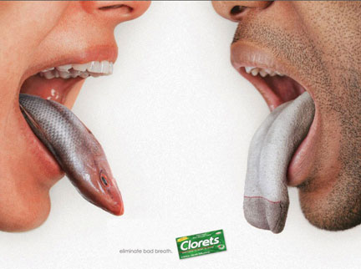
Compound Metaphor, contd
[a sort of parallel compound of two metaphors of a tongue as something smelly;
NB: different tongues]

Slide 97
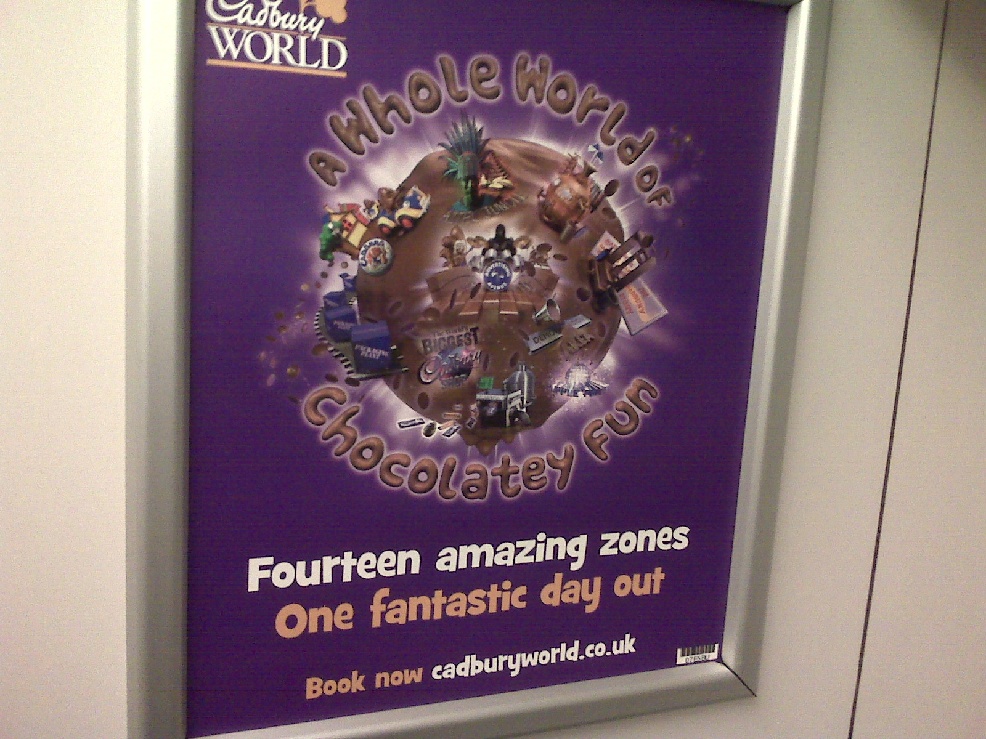
Compound Metaphor, contd
FUN AND PHYSICAL/ABSTRACT ENVIRONMENT AS WORLD,
en serial compounding with WORLD-AS-CHOCOLATE-BALL.

Slide 98
Compound Metaphor, contd
QUESTION: “… the car wants to move but something is stopping it.”
ANSWER: “Sounds like the car thinks it's on holiday, all the snow, freezing temps and Christmas boozing has confused our cars into thinking they are Talbot horizons!! get her out out today and show her a good time.”
[ http://forums.m3cutters.co.uk/archive/index.php/t-25414.html ]
Parallel compound(?) of
a view of the car as a thinking agent, with
a view of its state of not operating normally as being on holiday.

Slide 99
Compound Metaphor: A Complex Case!
“ the words `How could he? How could he?’ jumping about her wearied brain. Senseless, leaving her empty, cold, helpless. Another voice, angry and vindictive, shouted in her ear, …”
[from an earlier slide]
Parallel compound of IDEAS AS EXTERNAL UTTERANCES, IDEAS AS INTERNAL UTTERANCES, and BRAIN AS CONTAINER OF IDEAS,
with the IDEAS AS INTERNAL UTTERANCES component serially compounded with UTTERANCES AS ANIMATE CREATURES.

Slide 100
“Compound” versus “Mixed” Metaphor
“Mixed” metaphor:
Typically taken to be where some sort of combination of usually-separate bits of metaphorical phraseology,
based on different metaphorical views,
makes the resulting sentence sounds ridiculous or funny, usually because of some sort of clash:
  “It’s as easy as falling off a piece of cake.”
  [and many others on http://www.jimcarlton.com/my_favorite_mixed_metaphors.htm]

Slide 101
“Compound” versus “Mixed” Metaphor
Some researchers take a broader view, and include cases where there is phraseology combination based on different metaphorical views but no resulting humorous/ridiculous effect.
  See range of papers in Gibbs (2016).
  In my own paper in Gibbs (2016), i.e. Barnden (2016b), I use “mixing” in this broader way.

Slide 102
“Compound” versus “Mixed”, contd
My current, more careful view/terminology:
  “MIXED” metaphor = the surface-linguistic phenomenon of metaphorical phraseology resting on different metaphorical views being adjacent or intertwined in discourse [irrespective of whether there are good or bad communicative effects]
  “COMPOUND” metaphor = the cognitive phenomemon of different metaphorical views being cognitively used in cooperation with each other in some way.
Compounding tends to cause mixing (as in all the above examples).
But mixing need not reveal compounding:
instead, one metaphorical view may simply replace another, or compete with it, rather than cooperate with it.
[More on such issues in Barnden 2016c]

Slide 104
Compounding/Mixing in
Att-Meta

Slide 105
Multiple Pretences
Consider a play within a play, or a story within a story.
This involves nested fictions, i.e. nested pretences.
  Nesting of pretences/fictions in the language area also has been discussed in heterogeneous cases, as when there is an ironical statement by a character in a fictional work [Currie 2006].
But also useful for serial compounding (chaining) of metaphor:
X viewed as Y and Y viewed as Z
E.g.: “This worry was a corrosive chemical that was nibbling at her self-esteem.”
[closely adapted from an example in a Sylvia Plath diary]
The worry (X) is viewed as a chemical (Y);
the chemical (Y) is viewed as an animal (Z).
the second view is typically expressed as acids, etc. “eating [into]” things.
[Also, her self-esteem is viewed as a nibblable physical object.]

Slide 106

The worry-chemical-ANIMAL is nibbling at her self-esteem-object
The WORRY is slowly affecting her self-esteem negatively
The worry-chemical-ANIMAL is slowly eating her self-esteem-object
The worry-CHEMICAL is slowly physically-damaging her self-esteem-object

Slide 107
Multiple Pretences, contd
Multiple (but non-nested) pretences also useful for
Parallel compounding of metaphor:
X is viewed as both Y and Z
where Y is not itself (on this occasion) viewed as Z,
and Y and Z are difficult to combine within one pretence.
“Marriage is both a business and a journey”.
There are sometimes complex combinations of parallel and serial compounding.

Slide 108
BUSINESS info
MARRIAGE info
JOURNEY info

Slide 110
More on Att-Meta

Slide 111
Notes on Pretence
The word “pretence” has a number of different meanings, and people have different intuitions about what it covers.
The relevant notion in this talk does not imply any sort of deception or insincerity.
Rather it is honest pretence, usually but not necessarily as part of a communication with someone else. Some cases:
  Children’s pretend play
  Fancy-dress balls
  Drama
  Fiction in general
  Counterfactual statements: “If I were the head of the Football Association I’d set up a new world governing body for football and sew up a certain person whose initials are SB into a large pig’s bladder.”

Slide 112
Honest Pretence, contd
Any sort of imagining (conscious or not) of a situation you think is unreal, and is presented in that spirit to yourself or others, is honest pretending-that.
This isn’t to say that it’s immediately obvious to another person that you’re engaging in pretence, or that there are clear signals that pretence is going on.

Slide 113
Pretence Holism
Holism with respect to the pretence:
It's pretended scenarios as wholes that are important, rather than every component of them.
While specific mapping actions do act on specific bits of the pretended scenario,
  many bits may be involved directly in any one such action,
  and many parts of the scenario may have contributed to those bits arising.

Slide 114
Unparalleled Metaphor in Mind
Many theorists (including me, and especially those in Cognitive Linguistics) regard metaphor as a fundamental component of thought.
If metaphor exists within thought, then it can involve open-ended elaboration not involving analogy-creation. A thought can in part use concepts that are only from the source subject-matter, with no parallel at all in the target.
The person can know, implicitly or explicitly that those thought-parts are not proper/ordinary descriptions of the world.
Thinking about something could even be based entirely on concepts that only have a metaphorical relationship to the world.
  E.g., someone’s mental tools for thinking about electricity may be framed in terms of liquid, without her believing that electricity really is liquid, and indeed while she believes that electricity is not liquid.

Slide 115
and I have Holism in Mind!
Furthermore, individual thoughts may have no particular, isolatable relation to the world,
even a metaphorical relationship.
Rather it’s an overall thought-scenario that may represent aspects of the world.

Slide 117
Pretence Alongside another Unreality
J is a phys object
K’s mind is a phys terrain
Non-real
target-side
J is buried in ...
K is not aware of J
J phys’ly hidden to K’s c. self
J not phys’ly manipulable by K’s c. self
K cannot mentally use J
J would only be manipulable with difficulty by K’s c. self
K would find it difficult to mentally use J

Slide 120
Auto Attitude
“the car wants to move but something is stopping it. …
Sounds like the car thinks it's on holiday, all the snow, freezing temps and Christmas boozing has confused our cars into thinking they are Talbot horizons!! get her out today and show her a good time.”
[ http://forums.m3cutters.co.uk/archive/index.php/t-25414.html ]

