Slide 1
Paradoxical Uses of “literally”:
Further Developments
John Barnden and Amitash Ojha
John literally a re-tyred Prof of AI from
School of Computer Science
University of Birmingham, UK
Workshop on Figurative Language:
Experimental & Corpus-Based Studies
School of Psychology
University of Nottingham, 9 August 2018

Slide 2
The Focus of the Talk
Apparently improper, offensive-to-many, colloquial use of “literally” in language such as
  “John literally exploded with anger”,
  “Journalists are literally animals”.
  “John is literally Hitler.”
Hence, I call it “the L-Word”.
AGREE TO CLAIM BY OTHERS: The usage is in fact highly principled, NOT improper.
[Israel 2002, 2005; Nerlich & Chamizo Domínguez 2003]
ALSO HYPOTHESIZE, following assumptions of other commentators , and dictionaries, that the L-word often has an INTENSIFYING effect with metaphor.
[cf., e,g., those papers, and Oxford English Dictionary].

Slide 3
Plan of Talk
INTRODUCTION:
  including headlines of my own theory, HYPERB, as to why L-word can intensify
  (though the talk is not focussed on confirming this theory)
  MAIN PART A [with Amitash Ojha]:
  Some results of Experiments demonstrating intensification.
MAIN PART B [no blame to Amitash]:
  A new theoretical hypothesis, partly about a special form of intensification.
  Initial corpus study motivating it.

Slide 4
INTRODUCTION

Slide 5
Other Uses
ORDINARY HYPERBOLIC:
    “… working a full-time job at an arts education non-profit. I ++literally++ didn't sleep the entire Spring.”

Slide 6
Other Uses contd
LITERAL (often “literally” literally means literally, whatever that means!]:
    “Millions of years ago Britain was ++literally++ joined to the rest of Europe.” [Free movement of mammoths, etc.]
    “A great deal of [NASA’s space programme] was launched—literally—[from near here in Florida]”
    (plausibly, TWICE-MEANINGFUL:
    rockets literally launched; programme metaphorically launched.)

Slide 7
Other Uses contd
SIGNALLING OF LOW SALIENCE [Givoni, Giora & Bergerbest 2013]:
The L-word signals to the addressee to pay attention to meanings low on salience (though a high-salience meaning can survive in addition).

Slide 8
Main Competing Theory about
Metaphor Intensification by L-Word
REFRESH-MET:
[see brief discussion and attributions in Nerlich & Chamizo Domínguez 2003]
L-word encourages consideration of the metaphor AFRESH by signalling that the hearer should proceed via the LITERAL meaning of the source phraseology,
and find metaphorical meaning from scratch, as if it were a novel metaphor,
thus surpassing weakened, entrenched meanings.
((Other accounts discussed in Barnden 2017.))

Slide 9
Proposed “HYPERB” Account of How the L-Word Intensifies
WHEN
It Does Intensify
[Barnden 2017]

Slide 10
A Special Type of Hyperbole
For certain simple reasons [Barnden 2015, 2017, 2018], the literal meaning of
“A is B”
can be taken by a hearer as a hyperbole for
A being notably LIKE B (B = “B” taken literally)
(in whatever respects of likeness are appropriate in context).
So “Journalists are animals” [“animals” first taken LITERALLY] can be taken as hyperbolic for Journalists are notably like animals.
By extension, “John exploded” [“exploded” first taken LITERALLY] can be taken as hyperbolic for John did something notably like exploding.
((I call this type of hyperbole reflexive hyperbole about likeness [with a different label in Barnden 2015], and is a special case of a much more general phenomenon of reflexive hyperbole, introduced in Barnden (2018).))

Slide 11
So When the L-Word is present:
The HYPERB Account
Use of L-word in “Journalists are literally animals” and “John literally exploded” is just one way of encouraging the hearer to proceed via the literal meaning, rather than just using (say) the conventional metaphorical meaning, and therefore raising the possibility of reflexive hyperbole.
It is for the hearer to choose , given the context, whether to
  stop with a literal meaning, or
  treat the utterance as reflexively hyperbolic as to likeness
  give it another interpretation.

Slide 12
Some Observations about HYPERB
Under HYPERB, the interpreter is typically free to construct especially high likeness by taking a relevant CONVENTIONAL metaphorical meaning and intensifying or supplementing its features.
But HYPERB also applies an intensification route for NON-conventional metaphor (or non-conventional comparisons more generally).
  There is little reason to think that the normal interpretation of a non-conventional comparison in a given context delivers a notably high degree of likeness –
  it could give just whatever degree of likeness can be quickly determined to work in context.
  REFRESHMET by definition cannot work for entirely non-conventional metaphor.

Slide 13
MAIN PART A
EXPERIMENTS on INTENSIFICATION
by L-WORD
[Ojha & Barnden]

Slide 14
Examples of Metaphors Used
(32 metaphor-pairs in all)
NOUN form: Crime is a disease.
VERB form: Crime infects our cities.
N: My job is a jail.
V: My job imprisons me.
N: John is a wild cat.
V: John claws at any opponent.
N: Her smile was a flower.
V: Her smile blossomed on her lips.
N: Uneasiness is a dense fog.
V: Uneasiness blinds us.
N: The cat phenomenon is an explosion.
V: The internet exploded with videos of cats.
N: Peter's overworked brain is a creaky ruin.
V: Peter's brain creaked with the effort.
N: Crime is literally a disease.
V: Crime literally infects our cities.
N: My job is literally a jail.
V: My job literally imprisons me.
N: John is literally a wild cat.
V: John literally claws at any opponent.
ETC

Slide 15
Presentation: Isolated vs Juxtaposed
Each participant answered questions about a series of items on some web forms
each item being
EITHER
some Isolated metaphor, e.g. Crime is a disease or Crime is literally a disease
or similarly in Verb form
OR
some Juxtaposed WITHOUT-literally/WITH-literally pair of metaphors:
Crime is a disease Crime is literally a disease
or vice versa,
or similarly with both in Verb form
((The inclusion of juxtapositions is inspired by a different but thematically related contrastive series of experiments by REF Chiappe & Kennedy 2000.))

Slide 16
Some Experiment Details
Mainly looking at effect of including “literally” and at difference between Isolated and Juxtaposed, separately for Noun metaphors and Verb metaphors. (Not comparing Noun and Verb forms.)
Also did post-hoc analysis separating Conventional and Novel metaphor (as rated by participants on a scale).
22—24 participants, different for the four experiments.
  roughly equal Female and Male
  mean age: 21.2—21.8 Years
  postgrad students, mostly from India, but also US, UK, Japan, Korea
  scoring at least 90% on
  The Test of English for International Communication (TOEIC).

Slide 17
Measures (inspired by C&K 2000)
Experiment 1:
  Number of Properties Chosen as Applying to Target
  from a list of 10 derived from other participants in a pre-study.
(Experiment 2: Appropriateness of statements. OMITTED)
Experiment 3:
  Property Strength Applying to Target (1..10)
  assigned to individual properties in above list.
Experiment 4:
  Number of Freely Generated Properties for Application to Target (0..10).

Slide 18
Experiment 1
Number of Properties Chosen
from given list by participants as applying to target

Slide 19
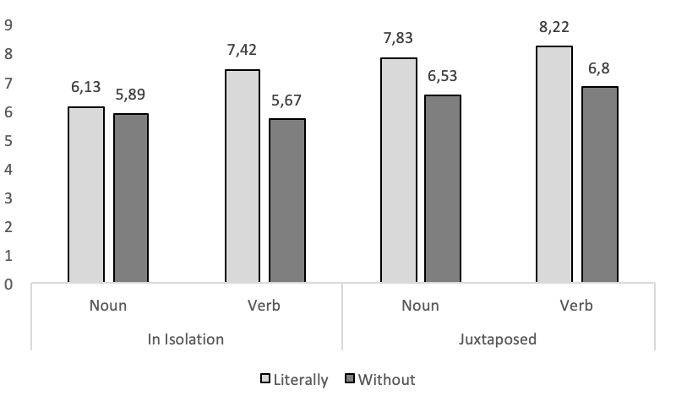
Results: Number of Properties Chosen
0.01
0.01
0.01

Slide 20
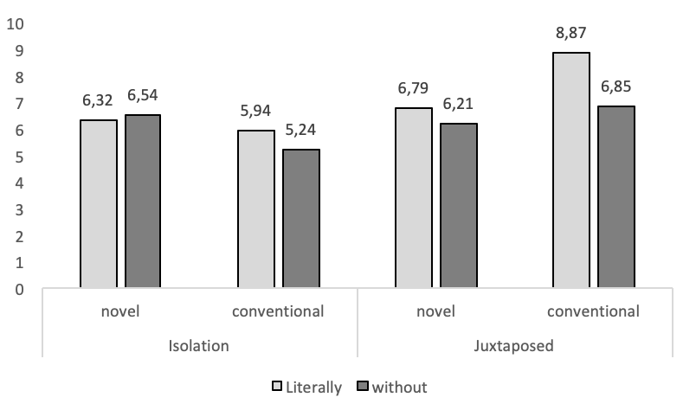
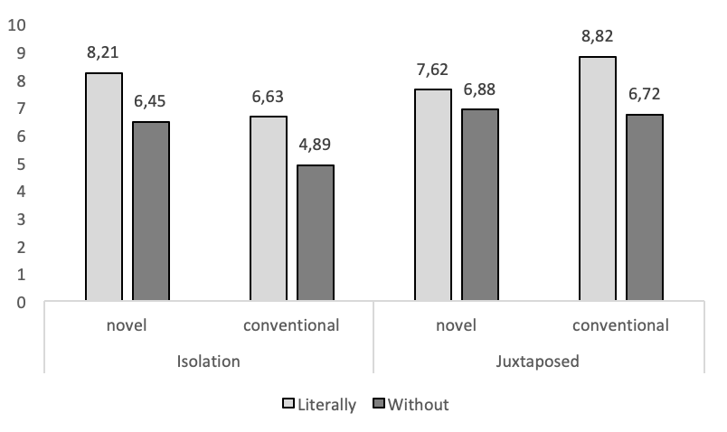
Number-of-Properties results refined:
now separating Novel and Conventional Metaphors
0.01
0.01
0.001
0.01
Noun Metaphors
Verb Metaphors

Slide 21
Experiment 3
Property Strength Applying to Target
as assigned by participants to individual properties in the given list

Slide 22
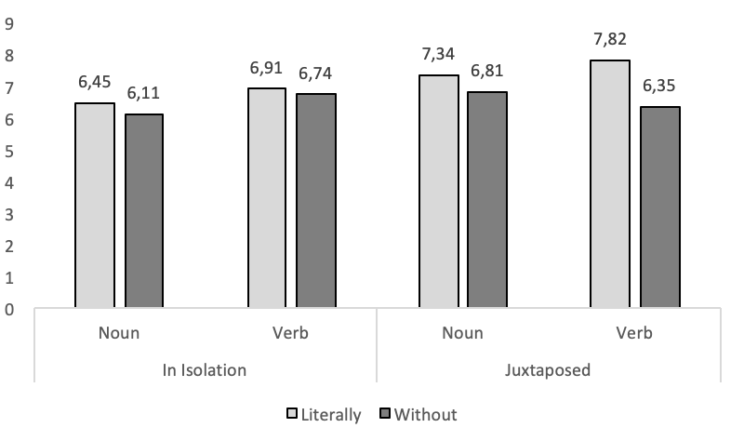
Results: Average Property Strength
0.05
0.01
0.05

Slide 23
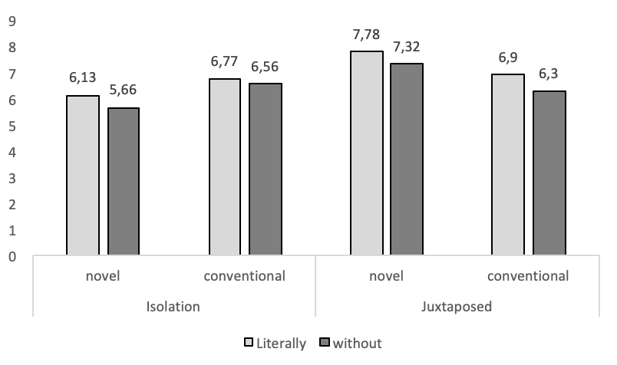
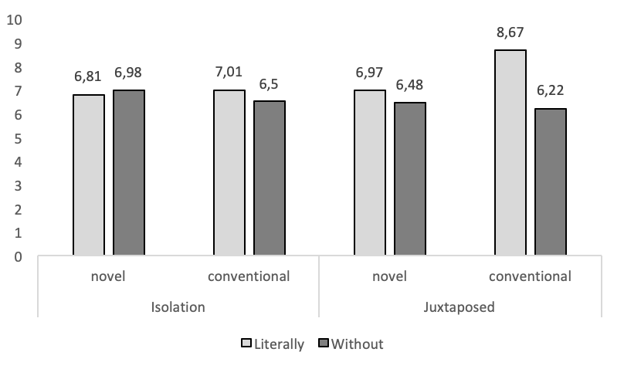
Property Strength results refined:
now separating Novel and Conventional metaphors
0.01
0.001
0.05
0.01
0.01
0.01
Noun Metaphors
Verb Metaphors

Slide 24
Experiment 4
Number of Freely Generated Properties for Application to Target

Slide 25
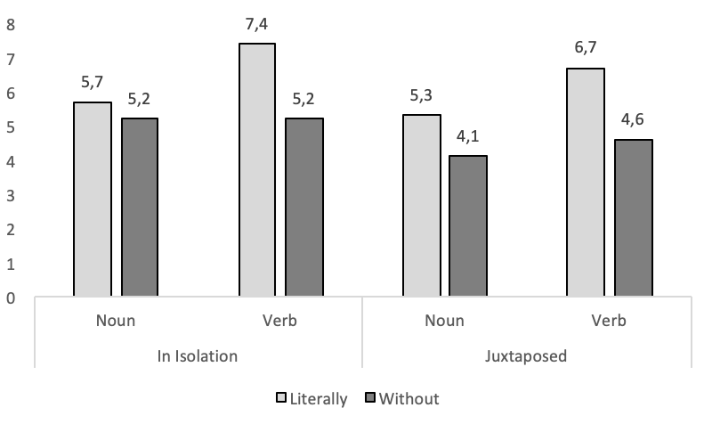
Results: Number of properties generated
0.001
0.01
0.05

Slide 26
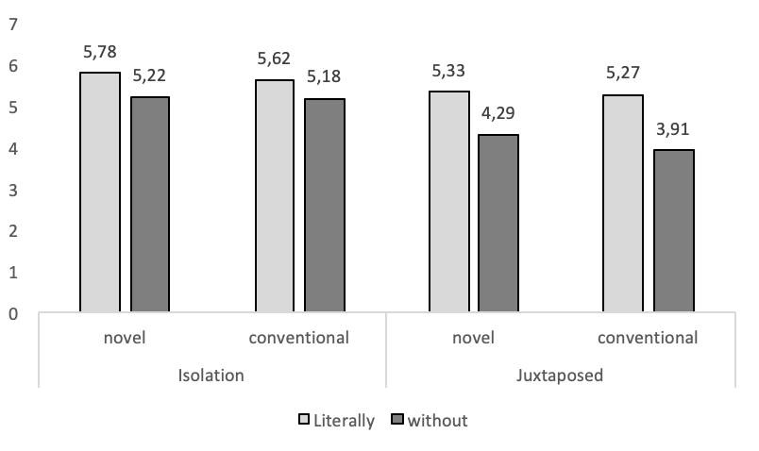
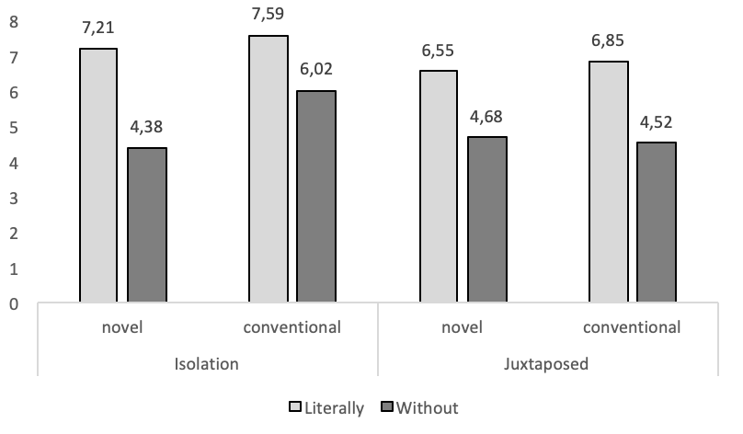
Property Generation results refined:
now separating Novel and Conventional metaphors
0.01
0.05
0.05
0.01
0.01
0.01
0.05
Noun Metaphors
Verb Metaphors

Slide 27
Result Highlights re With-/Without-Literally [Advantage for Literally Versions?]
NOUN in ISOL: no significant advantage
(but the trend looks good)
NOUN in JUXT: significant (or highly signif.) advantages (p < 0.05 or 0.01 resp.)
VERB in ISOL & JUXT: highly (or v. highly ) signif. advantages (p < 0.01 or 0.001 resp.)
NOVEL/CONVENTIONAL SEPARATION: mixed picture –
  Above highlights survive when Novel and Conventional separated, and
  Novel and Conventional largely show similar advantage pattern to each other, BUT:
  Advantages disappear in some cases for some measures and in particular
  there’s a Conventional-only advantage in VERB-JUXT.
  A new advantage arises in Conventional-NOUN-JUXT case.
  So, some sign of Conventionality providing a more reliable literally-advantage.

Slide 28
Relationship to REFRESH and HYPERB
Results are worrisome for REFRESH, which should show no L-word intensity advantage for completely novel metaphors.
BUT:
  We are ourselves suspicious of judging novelty by participant-ratings.
  The “novel” metaphors include only moderately novel ones.
The results are compatible with HYPERB in that the overall theory (not entirely presented here) predicts that in some circumstances “literally” will intensify a novel metaphor, but less reliably than conventional ones.
The lack of a significant literally-advantage in NOUN-ISOL condition raises questions for HYPERB, but …

Slide 29
Relationship to HYPERB, contd
No theory should predict that the L-word will always intensify.
HYPERB suggests that a hearer will sometimes adopt likeness-hyperbole even without the L-word, perhaps especially in NOUN case.
The problem may lie in the materials [my fault]: The NOUN versions of the metaphors were relatively obscure, given the lack of context. The VERB versions of a metaphor were usually tantamount to somewhat elaborative paraphrases of the NOUN versions. E.g.:
  My lawyer is a shark
  My lawyer tears her opponent apart
  People are closets
  People store things up inside themselves.

Slide 30
MAIN PART B
NEW HYPOTHESIS
&
PRELIMINARY CORPUS STUDY
[Barnden]

Slide 31
What the Hypothesis Addresses
“Explicit (Approximately-)Shared Features”
Concerns cases where the L-word is used for comparison, and specific source/target shared features involved in the comparison are explicitly mentioned.
Clear examples:
  “[Salmon is] ++literally like++ the butter croissant of the sea. Rich, soft, and flaky[.]”
  “[T]hat [bike] frame isn't just Satori-like, it's pretty much ++literally++ a Satori. If you look at that and the Satori frame side-by-side even some of the details are the same. … Front triangle looks indistinguishable.”
“Rich”, “soft” and “flaky” do mean the same or at least closely related things as applied to salmon and butter—no double meaning (zeugma). The following would involve majorly double meaning:
  “Aristocrats are like butter croissants—rich and flaky.”

Slide 32
The EESF Hypothesis
“Emphasis of Explicit Shared Features”
HYPOTHESIS : When there is phraseology designating features that are the same (or at least approximately the same) for target and source, the L-word is present in order (at least in part) to emphasize those features.
RIDER 1 to the hypothesis:
  The feature-designating phraseology is typically, but not necessarily, to be taken literally. The “literally” in the utterance is not indicating literalness of the phraseology but rather that the source and target are to some extent “the same thing”.
  “Rich” could be claimed to be metaphorical in application to both salmon and croissants; but the metaphorical meaning is the same.
RIDER 2:
  The EESF function of the L-word may (or may not) in itself deliver intensity of likeness, and may (or may not) be accompanied by the normal reflexive hyperbole as to likeness, but if it is so accompanied then the explicit features contribute to the intensified likeness.

Slide 33
A Preliminary Corpus Study
Obtained ~100 examples each of relevant uses of “literally” alone and “literally like” from
the iWeb corpus (The Intelligent Web-Based Corpus – 14 billion words)
at Bingham Young University (https://corpus.byu.edu/).
Used this because the L-word uses of interest are colloquial and web sites are relatively likely to be colloquial (blogs, etc.).
Got a few thousands of cases of “literally” and “literally like” by the KWIC facility,
and blindly selected ~100 examples each that were not in certain categories I excluded ((e.g.: incomprehensible to me; “like” is verb; “like” signals quasi-direct speech/thought; “like” is Valley Speak; purely numerical cases)).

Slide 34
Quantitative Questions of Interest included …
Proportions of cases of “literally [like]” that are comparisons (with or without explicit shared features)
as opposed to (mainly) literal uses or ordinary-hyperbolic uses (e.g., “My friend has a 1992 [Camry] that is literally like new”).
“literally” alone: 18% “literally like”: 88%
Proportions of COMPARISON cases that exhibit “explicit shared features”:
“literally” alone: (16%: 3 / 19) “literally like”: 49%
Proportions of COMPARISON cases that are non-conventional cases, i.e. where the comparison does not rest just on a conventional meaning. (Results below.)

Slide 35
(Non-)Conventionality
L-word comparison examples that just intensify conventional metaphor (or other conventional comparisons) are in the majority. Examples:
  “[T]he internet is ++literally++ flooded with scams.
  “The songs are kind of ++literally like++ a pat on the back[.]”
But there are many examples that are not (just) intensification of conventional comparisons:
  “… their [mattress] showroom [in NYC] - which is ++literally++ a super nice apartment … with the bed in the master bedroom.”
  “++Literally++ just having this convo with a friend! Well similar.”
  “I had a huge spot a few weeks back it was ++literally like++ another face! I squeezed it and …”
  “[Salmon is] ++literally like++ the butter croissant of the sea. Rich, soft, and flaky[.]”

Slide 36
Headline Results on Non-Conventionality
(and Figurativity)
“literally” alone: ~4 of the 19 comparisons are non-conventional.
  Within those, 3 are at also least weakly figurative.
“literally-like”: ~41—48 of the 91 comparisons are non-conventional.
  Within those, 24 are at also least weakly figurative, 18 clearly so.
Altogether: ~45—52 (~41—47%) of the 110 comparisons are non-conventional.
  Within those, 27 are at also least weakly figurative, 18 (~40%) clearly so.
Similar proportions hold for explicit-shared-feature and normal ones when taken separately (lumping bare literally and literally-like together).

Slide 37
Are Explicit-Shared-Feature Cases
Literal Comparisons?
When shared features are explicit, especially with “literally like”, one might wonder whether the comparison is a “literal comparison.”
Occasionally it is, plausibly:
  “[My friends] are literally like a family[,] Selena has been so encouraging …”
  “Reading your post above was literally like reading something I had written. I can't believe how close our symptoms are.”
But OFTEN NOT:
    “[Salmon is] literally like the butter croissant of the sea. Rich, soft, and flaky[.]”
  “[H]er emotions just flipped like that, literally like night and day.

Slide 38
Literal Comparisons, contd?
“Literal comparisons” often mentioned in the literature, but rarely with properly explored definitions. Usually presented largely by example. And the examples are always about simple, largely familiar items, e.g.:
  “Coffee is like tea”
Different criteria have been proposed, notably:
  [e.g. Bowdle & Gentner 2005, Glucksberg 2001:] S and T are close in the conceptual taxonomy.
  [Ortony 1993:] The contextually important shared features are high-salience for both S and T.
  [Israel et al. 2004:] S and T have similar domain matrices.
  [Glucksberg 2001:] literal comparisons cannot be paraphrased as identities/categorizations
  [this idea debunked in Barnden 2012]
But anyway most authors agree it’s a matter of degree.
And in the corpus sample …

Slide 39
Literal Comparisons, contd?
For EACH of the criteria of TAXONOMICALLY-CLOSE, BOTH-HIGH-SALIENCE, and SIMILAR-DOMAIN-MATRICES,
Only about a third (17, 15, 19 resp.) of the 51 explicit-shared-feature cases using “literally like” may plausibly be said to meet the criterion.
NB: the thirds are partially disjoint, so what if we disjoin the criteria?
12 of the 51 clearly fail all three criteria, with a further 8 probably doing so.
So even if took a disjunction of the criteria, at the very most 39 (76%) would fit.

Slide 40
Conclusions (Literally?)
Major intensification of metaphor demonstrated, but results call for (much) further experimentation and raise interesting theoretical questions.
Possible new function for the L-word identified and exemplified in many corpus examples: emphasis of explicit shared features.
The intensification of non-conventional metaphor as shown by the experiment and suggested by the corpus study bears in favour of HYPERB and against REFRESHMET,
Though questions remain for HYPERB.

Slide 41
References
Barnden, J.A. (2012). Metaphor and simile: Fallacies concerning comparison, ellipsis and inter-paraphrase. Metaphor and Symbol, 27 (4), pp.265-282.
Barnden, J.A. (2015). Metaphor, simile, and the exaggeration of likeness. Metaphor and Symbol, 30 (1), pp.41-62.
Barnden, J.A. (2016). Metaphor and simile: Categorizing and comparing categorization and comparison. In Gola, E. & Ervas, F. (Eds), Metaphor and Communication, pp.25--46. John Benjamins.
Barnden, J.A. (2017). A hyperbole-based account of the paradoxical usage of “literally‘”. In A. Wallington, A. Foltz & J. Ryan (Eds), Selected Papers from UK CLA Meetings, 4}, pp.111-130. ISSN 2046--9144.
Barnden, J.A. (2018). Broadly reflexive relationships, a special type of hyperbole, and implications for metaphor and metonymy. Metaphor and Symbol, 33 (3), pp.218-234.
Bowdle, B.F. & Gentner, D. (2005). The career of metaphor. Psychological Review, 112 (1), pp.193--216.
Carston, R. & Wearing, C. (2011). Metaphor, hyperbole and simile: A pragmatic approach. Language and Cognition, 3 (2): pp.283--312.

Slide 42
References, contd
Chiappe, D.L. & Kennedy, J.M. (2000). Are metaphors elliptical similes? J. Psycholing. Research, 29(4), pp.371-398.
Givoni, S., Giora, R. & Bergerbest, D. (2013). How speakers alert addressees to multiple meanings. J. Pragmatics, 48, pp.29--40.
Glucksberg, S. (2001). Understanding figurative language: From metaphors to idioms. New York: Oxford University Press.
Israel, M. (2002). Literally speaking. Journal of Pragmatics, 34, pp.423--432.
Israel, M. (2005). Common sense and `literal meaning'. In S. Coulson & B. Lewandowska-Tomaszczyk (Eds.), The Literal and Nonliteral in Language and Thought, pp.147--177. Frankfurt a. Main: Peter Lang.
Israel, M., Harding, J.R. & Tobin, V. (2004). On simile. In M. Achard & S. Kemmer (Eds), Language, Culture and Mind, pp.123--135. Stanford, CA: CSLI Publications.
Nerlich, B. & Chamizo Domínguez, P.J. (2003). The use of literally: Vice or virtue? Annual Review of Cognitive Linguistics, 1, pp.193--206.

Slide 43
References, contd
Ortony, A. (1993). The role of similarity in similes and metaphors. In A. Ortony (Ed.), Metaphor and Thought, 2nd edition, pp.342-356. Cambridge, U.K.: Cambridge University Press.

