Slide 1
Creativity in Metaphor and Mind
John Barnden
Professor of Artificial Intelligence
School of Computer Science
University of Birmingham, England
  j.a.barnden@cs.bham.ac.uk
  http://www.cs.bham.ac.uk/~jab
Funding sources have included:
  Engineering and Physical Science Research Council
  Leverhulme Trust
  European Union
at ProSecco European Contact Forum
El Escorial, Spain
February 2014

Slide 2
Maze of Talk
creativity of metaphor
role of metaphor in creativity
ATT-Meta approach/system for metaphor understanding (& generation)
metaphor creativity via fiction
reaffirm: metaphor creativity is often not about creating new analogical mapping
consequences re: creative metaphor in mind

Slide 3
Creativity in Metaphor
Lakoff & Turner (1989):
Most creative poetic metaphor is creative not because of radically novel pairings but because of manipulation of familiar, mundane metaphorical conceptions by, e.g.,
  Open-ended elaborations
  Mixing (in good ways)
I reinforce, extend and elaborate this message.

Slide 4
A Mundane but Juicy Example of Creative Elaboration!
Sharon pulled herself out of her jeans, the words “How could he? How could he?” jumping about her wearied brain. Senseless, leaving her empty, cold, helpless. Another voice, angry and vindictive, shouted in her ear, “ Serves you right, you silly fool: play with fire and watch your life go up in flames. It was all so predictable.”
[from My Story, a cheap romance magazine]

Slide 5
Creativity of open-ended elaborations/variations
Another voice, angry and vindictive, shouted in her ear,
The idea was buried in the outback of Katy’s mind”
[only a few Google hits for “outback of his/her mind”]
I don’t think strings are attached. If there are any, they’re made of nylon: I can’t see them.
A problem about the regulation of banking in Europe] seems to have been kicked right over the long grass into the junkyard down the road[.])

Slide 6
(Non-)Analogy and Metaphor
No (necessary) target-side parallel for
Outback, being buried.
The nylon itself, or the property of being made of something.
The grassiness of the long grass; the yardiness of the junkyard.
  All that’s important is the hiddenness, the discardedness.
Sharon’s internal and external voices.

Slide 7
(Non-)Analogy
Those non-paralleled things in the metaphor source scenario are there only to generate consequences that DO have a parallel,
And which moreover have a parallel by virtue of any mix of:
  standard specific parallels (idea/physical-object; mind/terrain)
  standard generic parallels (dealing with e.g. emotions, evaluations, time, causation, functioning)
As opposed to novel parallels that have to be worked out.

Slide 8
Not Just in Language!!
Metaphor arises in all media of communication/expression:
gestures, pictures, diagrams, music, dance, …
Many theorists (including me) regard metaphor as a fundamental component of thought.
Its appearance in language, pictures, music, etc. is just a reflection of that.
If metaphor exists within thought, then metaphor-based creativity within thought can involve not only analogy-creation but also open-ended elaboration not resting on it.
A (creative or other) thought can in part use concepts that are only from the source-domain, with no translation to the target domain.

Slide 9

Dramatic Novel Pairing
“Why is a raven like a writing desk?”
asks the Mad Hatter in
Alice’s Adventures in Wonderland
A raven is a writing desk.
Why?
They both loom in a dark corner of the room?

Slide 10
Less Dramatic Novel Pairing
This ghost is a mole.
From Hamlet (Act I Sc. v):
  Ghost [Beneath]: Swear.
  Hamlet: Well said, old mole! Canst work i’ the earth so fast? A worthy pioner! [= digger] …
Not so difficult; somewhat surprising/fruitful.

Slide 11
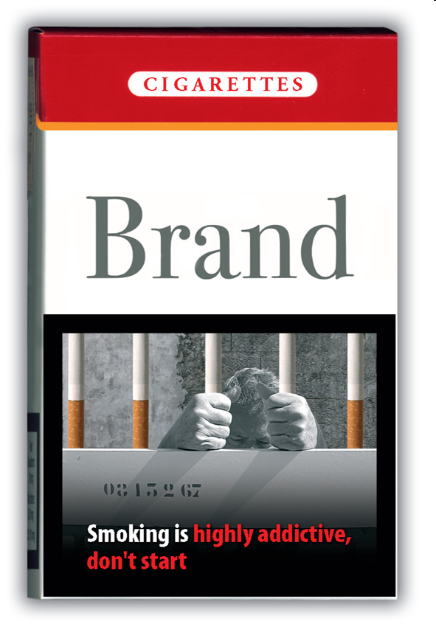
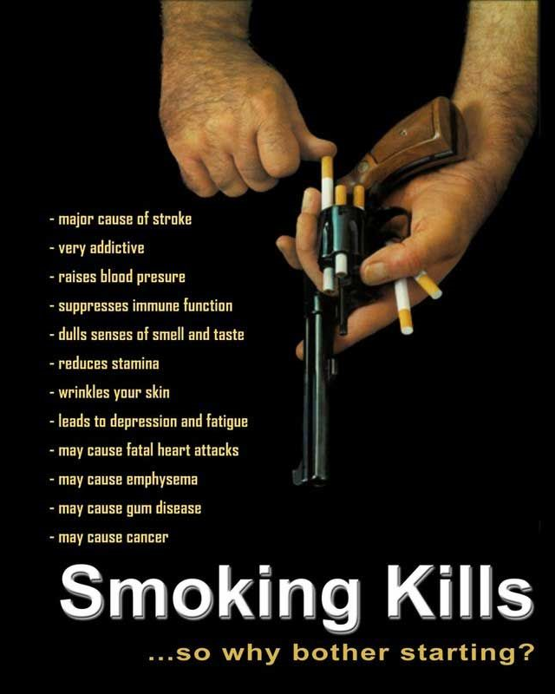
[courtesy of Elisabeth El Rafaie, 2013]

Slide 12
Two Types of Novel Pairing
In raven/desk and ghost/mole, the novel pairing can itself give a new view of the target, etc. It is a direct conduit for the message.
The cigarette/cell-bar pairing is novel, but is incidental to the underlying, familiar pairing of addiction/prison.
The creativity lies in how the message is conveyed: finding an incidental pairing that is so vivid and leads indirectly but forcefully to the message.
EVEN IN Raven/desk: in my interpretation above, leads to standardly-paralleled emotional reactions.

Slide 13
Creativity of mixed metaphor
a text about US foreign policy at
http://zioneocon.blogspot.co.uk/2004/06/bret-stephens-in-wsj-opinion-journal.html
in which we find ``Afghanistan is Vietnam,'' then some explanation of this view, and then ``But Afghanistan is not simply like Vietnam,'' some more explanation, then ``Afghanistan is Yugoslavia,'' some explanation of this, then ``But Afghanistan is not simply like Yugoslavia,'' and so forth, adding in Colombia and then Somalia in the same cumulative way.

Slide 14
Creativity of mixed metaphor
“This worry was a corrosive chemical that was nibbling at her self-esteem.”
[closely adapted from an example in a Sylvia Plath diary;
courtesy of Zsofia Demjen]
  Serial mix (= chaining) of WORRY-AS-CHEMICAL and CHEMICAL-AS-ANIMAL
  Mixed in parallel with SELF-ESTEEM AS NIBBLABLE OBJECT.

Slide 15
Creativity of mixed metaphor
“the car wants to move but something is stopping it. …
Sounds like the car thinks it's on holiday, all the snow, freezing temps and Christmas boozing has confused our cars into thinking they are Talbot horizons!! get her out out today and show her a good time.”
[ http://forums.m3cutters.co.uk/archive/index.php/t-25414.html ]
Parallel(?) mix of car as thinking agent, with the alleged thought “I’m on holiday” corresponding metaphorically to the state of not operating normally.

Slide 16
“ATT-Meta” AI Approach to Metaphor: concentrating here on open-ended elaboration and (good) mixing
[see References/Bibliography]

Slide 17
Fictions
The Att-Meta approach is based on pretences (or fictions).
Related:
  Levin’s approach in literary theory [Levin 1993]
  Fictionalist approaches in Philosophy [Walton 2004/1993].
  Blending approach [Fauconnier & Turner 2008]
  Carston and Wearing [2011]

Slide 18
An Example
“The idea was buried in the outback of Katy’s mind”
The understander (as well as the speaker) momentarily pretends that Katy’s mind is literally a physical terrain that has an outback and that the idea is literally physically buried in the outback.
So the idea in question is inferred to be
  (to a high degree) physically hidden to,
  currently physically unmanipulable by, and
  would be difficult to physically manipulate by Katy.

Slide 19



J = the idea
Reality (incl.
target-side)
J is buried in ...
inference
J is a phys object
K’s mind is a phys terrain
Fiction
J phys’ly hidden to K’s c. self
J not phys’ly manipulable by K’s c. self
K cannot mentally use J
J would only be manipulable with difficulty by K’s c. self
K would find it difficult to mentally use J
pull-out

Slide 20
Fictions are great for aspects of creativity identified above
Novel pairings between fiction entities and real things.
Open-ended elaboration
Mixing, both parallelly and serially.
Fantasy – i.e. distortion
Leading to suggestions about the real world that overturn normal expectations

Slide 21
Mixed Metaphor
Serial mixing (chaining) of metaphor:
X viewed as Y and Y viewed as Z
E.g.:
“This worry was a corrosive chemical that was nibbling at her self-esteem.”
The worry (X) is viewed as a chemical (Y);
the chemical (Y) is viewed as an animal (Z).
[Also, her self-esteem is viewed as a nibblable physical object.]
Handled by nested fictions (nested pretences).
Like a play within a play, or a story within a story.

Slide 22

SERIAL MIXING
The worry-chemical-ANIMAL is nibbling at her self-esteem-object
The WORRY is slowly affecting her self-esteem negatively
The worry-chemical-ANIMAL is slowly eating her self-esteem-object
The worry-CHEMICAL is slowly physically-damaging her self-esteem-object

Slide 23
Multiple Pretences, contd
“Marriage is both a business and a journey”.
Multiple (but non-nested) pretences also useful for
Parallel compounding of metaphor:
X is viewed as both Y and Z
where Y is not itself (on this occasion) viewed as Z,
and Y and Z are difficult to combine within one pretence.

Slide 24
PARALLEL MIXING
(one type)
VIETNAM info
AFGHANISTAN info
SOMALIA info

Slide 25
PARALLEL MIXING
(another type)
VIETNAM and SOMALIA info MIXED
AFGHANISTAN info

Slide 26
Ending
Metaphor can be creative in a variety of ways. One is in open-ended elaborations.
A fiction-based approach facilitates elaborations and distortions, liberated moreover by non-parallelism (and other useful things) in such elaborations and distortions.
Even very-creative elaborations and novel pairings work in important part by engaging standard parallels, NOT clever extension of the provided analogy. Creativity exploits the known.
If metaphor is fundamental to thought, it can provide important aspects of creativity of thought.

Slide 27
References to Some of My Work
Barnden, J.A., Glasbey, S.R., Lee, M.G. & Wallington, A.M. (2004). Varieties and directions of inter-domain influence in metaphor. Metaphor and Symbol, 19 (1), pp.1—30.
Barnden, J.A. (2008). Metaphor and artificial intelligence: Why they matter to each other. In R.W. Gibbs, Jr. (Ed.), The Cambridge Handbook of Metaphor and Thought, pp.311--338. Cambridge, U.K.: Cambridge University Press. [Includes an overview of the ATT-Meta approach.]
Barnden, J.A. (2010). Metaphor and metonymy: Making their connections more slippery. Cognitive Linguistics, 21(1), pp.1-34.
Barnden, J.A. (2009). Metaphor and context: A perspective from artificial intelligence. In A. Musolff & J. Zinken (Eds), Metaphor and Discourse, pp.79-94. Basingstoke, UK: Palgrave Macmillan.
Barnden, J.A. (2012). Metaphor and simile: Fallacies concerning comparison, ellipsis and inter-paraphrase. Metaphor and Symbol, 27 (4), pp.265-282.
Barnden, J.A. (forthcoming). Mixed metaphor: Its depth, its breadth, and a pretence-based approach. Invited chapter for volume on Mixed Metaphor edited by R.W. Gibbs, Jr. Amsterdam: John Benjamins. [Draft copy available on request.]
Lee, M.G. & Barnden, J.A. (2001). Reasoning about mixed metaphors with an implemented AI system. Metaphor and Symbol, 16 (1&2), pp.29—42. [Beginnings of ATT-Meta approach to mixed metaphor.]

Slide 28
Other References/Bibliography
Carston, R. \& Wearing, C.~(2011). Metaphor, hyperbole and simile: A pragmatic approach. Language and Cognition, 3 (2): pp.283—312.
Fauconnier, G. & Turner, M.~(2008). Rethinking metaphor. In Gibbs (2008 )—see next item—pp.53-66.
Gibbs, R.W., Jr. (Ed.) (2008). The Cambridge Handbook of Metaphor and Thought, Cambridge, U.K.: Cambridge University Press. [This counts as a “bible” on metaphor research.]
Lakoff, G. & Johnson, M. (2003). Metaphors we live by. 2nd Ed. Chicago: University of Chicago Press. [The first edition in 1980 was a highly formative book, basically initiating the cognitive linguistics approach to metaphor.]
Lakoff, G. & Turner, M. (1989). More than cool reason: a field guide to poetic metaphor. Chicago: University of Chicago Press.
Levin, S.R. (1993). Language, concepts, and worlds: three domains of metaphor. In A. Ortony (Ed.), Metaphor and Thought, 2nd edition, pp.112--123. New York and Cambridge, U.K.: Cambridge University Press.
NAACL (2013). Papers on automated metaphor identification etc. at the First Workshop on Metaphor in Natural Language Processing at the 2013 conference of the North American Chapter of the Association for Computational Linguistics (NAACL 2013), Atlanta, Georgia, USA, in June 2013. [The conference can easily be found online using “NAACL 2013”. The papers are all online.]
Walton, K. (2004/1993). Metaphor and prop oriented make-believe. In E. John & D.M. Lopes (Eds), Philosophy of Literature—Contemporary and Classic Readings: An Anthology, pp.239--247. Oxford: Blackwell, 2004. Reprinted from European J. of Philosophy, 1, pp.39-42, 45-49, 51-57.

