Slide 1
The Modern World in the Making:
and Making Technology Intelligent –
Artificial Intelligence and its Ramifications
John Barnden
School of Computer Science
University of Birmingham, England
  j.a.barnden@cs.bham.ac.uk
  http://www.cs.bham.ac.uk/~jab
Lecture for Liberal Arts & Sciences core breadth module:
The Modern World in the Making
November 2013

Slide 2
About Me
Main interest: The processing of human language, in machines and minds.
  Specialization: figurative language—mainly metaphor, but also irony, hyperbole, metonymy ...
Other interests:
  Consciousness
  Philosophy of mind.

Slide 3
Some Questions to You
How many people here tonight enjoy using computers?
How many people enjoy learning another language?
How many students are there at UoB?
Which of my aunts went to Sweden?

Slide 4
Another Question to You
What does “artificial” mean and imply?

Slide 5
AI? Eh? I?

Slide 6
AI? Eh? I?
AI = Getting artefacts to do things that would normally be thought to require intelligence in humans (???)
Can artefacts have emotions, consciousness, … ??
How May Mere Matter Make Mind? (Hmmmmm ...)
  Am I matter?
  Do I matter?!
  And do I mind?

Slide 7
AI is …
Getting artefacts to do things that would normally be thought to require intelligence in humans (???)
INCLUDING …
  Planning actions, problem-solving: expert domains & everyday life.
  Looking around, seeing where you are, seeing what’s around you
  Interacting in language [my interest]
  Interacting in other ways, incl. via gesture, facial expressions, body language, pictures, diagrams, music, …
  Robotics [involves the above]

Slide 8
Natural Language Processing:
The Art of Conversation,
& Conversational Artefacts
Natural interfaces to any sort of computer (or other) system.
Intelligent search engines.
Machine translation (automated translation of language).
Systems that read news reports, blogs, scientific documents, … and extract useful information for businesses, etc. Including …
  “sentiment analysis” / “opinion mining”, summarization, ….
Intelligent agents on the phone or web that talk with you and perhaps help you.
  Caution children!: there are more sinister varieties (malicious bots).
Assistance robots, artificial companions.

Slide 9
AI People Are …
Multiply purposed:
  Engineering goals
  Psychological goals: how do human and animal minds work?
  General/philosophical goals: what, in general, are thought, intelligence, cognition, perception, consciousness, emotion, creativity, ...

Slide 10
AI is …
Cross-disciplinary par excellence.
Links to:
  Psychology, Animal behaviour
  Philosophy
  Linguistics, Literary theory
  (Neuro)physiology
  Evolutionary theory
  Social theory, Politics, Economics
  Mathematics
  Physics
  Anthropology, Cultural studies
  OTHERS !

Slide 11
Some AI firmly embedded in
(or underneath?) the Modern World
face recognition/analysis
satnavs, robotic vacuum cleaners
web search, user sensitivity, recommender systems
Intelligent conversational agents (incl. chatbots)
translation of text and speech; sentiment analysis
credit application evaluation, fraud detection from bills
fault diagnosis in machinery and systems, including Windows!
intelligent data mining
automated financial trading
computer games, traditional-game players
movie technology
spaceship control, planet rovers (Mars as part of the Modern World!)
intelligent surveillance: of communications; by CCTV cameras
military automation

Slide 12
Some Emerging AI
(Modern World in More Making!)
intelligent purchasing agents
driverless cars
(intelligent) artificial companions
more advanced military automation
more-intelligent intelligence!
  incl. IARPA metaphor effort in the USA
intelligent viruses and other malware

Slide 13
Selected Invited Talks at a Recent Conference Cluster
(incl. 27th AAAI Conf., Seattle, 2013) http://www.aaai.org/Conferences/AAAI/2013/aaai13-program.pdf
“Grounded Language Learning.”
“Telling Stories at Internet Scale.”
“Aerial Robot Swarms.”
“Fighting the Tuberculosis Pandemic Using Machine Learning.”
“Poker AI: Algorithms for Creating Game-Theoretic Strategies for Large Incomplete-Information Games.” [not restricted to poker or even games!]
“Applying AI to Vehicle Failure Monitoring for Autonomous Vehicle Durability Testing.”
“Socially Assistive Robotics: Human-Robot Interaction Methods for Creating Robots that Care.”

Slide 14
“Grounded Language Learning”
Raymond J. Mooney (University of Texas at Austin)
Most approaches to semantics in computational linguistics represent meaning in terms of words or abstract symbols. Grounded-language research bases the meaning of natural language on perception and/or action in the (real or virtual) world. Machine learning has become the most effective approach to constructing natural-language systems; however, current methods require a great deal of laboriously annotated training data. Ideally, a computer would be able to acquire language like a child, by being exposed to language in the context of a relevant but ambiguous environment, thereby grounding its learning in perception and action. We will review recent research in grounded language learning and discuss future directions.

Slide 15
“Socially Assistive Robotics: Human-Robot Interaction Methods for Creating Robots that Care.”
Maja J. Mataric' (University of Southern California)
Socially assistive robotics (SAR) is a new field of intelligent robotics that focuses on developing machines capable of assisting users through social rather than physical interaction. … People readily ascribe intention, personality, and emotion to robots; SAR leverages this engagement stemming from noncontact social interaction involving speech, gesture, movement demonstration and imitation, and encouragement, to develop robots capable of monitoring, motivating, and sustaining user activities and improving human learning, training, performance and health outcomes. … The research will be grounded in projects involving analysis of multimodal activity data, modeling personality and engagement, formalizing social use of space and nonverbal communication, and personalizing the interaction with the user over a period of months, among others. The presented methods and algorithms will be validated on … a variety of user populations, including stroke patients, children with autism spectrum disorder, and elderly with Alzheimers and other forms of dementia.

Slide 16
Selected Symposia at AISB 2014 Convention, London http://www.aisb.org.uk/events/aisb14
(some titles abbreviated)
Computing and Philosophy: is computation observer-relative?
Consciousness without inner models: A sensorimotor account of what is going on in our heads
Computational Creativity
Computational Scientific Discovery
What could Robotics contribute to Language Sciences?
Machine Ethics in the Context of Medical and Care Agents
Intelligent Systems for Animal Welfare
Should AI be used to make kill decisions on the battlefield?
Love and Sex with Robots
AI & Games

Slide 17
Some Overarching AI Themes
Flexibility, open-ended-ness, creativity
Learning, adapting, forgetting
Reasoning
including of rough, heuristic & commonsensical sorts
Sensitivity to context,
managing relevance of knowledge & experience

Slide 18
Various Information Manipulation Approaches
Symbol manipulation, inspired by language and mathematics:
  Prototypically: bitstring manipulation inside computers, formal logical manipulation, ...
Approaches inspired by innards of biological creatures
  Notably “connectionnist” or “neural” networks
Approaches inspired by biological evolution
  Evolutionary computation, genetic algorithms
These overlap and interrelate, e.g.:
  Evolutionary computation is usually a special form of symbol manipulation
  Neural networks are usually simulated by symbol manipulation
  Evolutionary computation can evolve neural networks.

Slide 19
Another (Rough) Distinction
rule-based reasoning (RBR)
versus
case-based and/or analogy based reasoning (CBR and ABR)
  Roughly same as exemplar-based reasoning in Psychology.

Slide 20
Concerning the History of AI
See AI textbook by Russell & Norvig (2010: pp.16-29; also Ch.26) for a good, thoughtful summary.
See also detailed discussion spread through Boden (2006). Contains a lot on the philosophical, psychological and linguistic ramifications.
The official start of AI is often taken to be the “Dartmouth workshop” at Dartmouth College, USA, in 1956.
  See R&N pp.17-18 for detail.
R&N also note developments in the late 1940s.
And an important seed contribution was by Alan Turing in 1950. (See next page.)
  Turing is also crucial in the development of the general notion of and mathematics of computation.
  Famous for other scientific contributions and for code-breaking in World War II …
  … and for being persecuted for being gay.

Slide 21
Turing 1950
Turing (1950) discussed the questions of
  whether machines could do things we call thinking in humans
  why/how people argue against this
  whether machines would come to be regarded uncritically as thinking.
He proposed a type of conversational test that has now evolved into the so-called Turing Test (R&N: p.1021 and elsewhere).
  Can a machine, in a 5-minute conversation with people (“judges”), fool the judges at least 30% of the time into thinking the machine is a person? Standardly, the judge is conversing also with a person, and has to decide which conversational participant is the person, which the machine.
  There are now various versions of the test, including ones that go beyond conversational interaction.
  Many AI researchers are sceptical of the value of such tests.

Slide 22
Why is Natural Language Processing Difficult?
The Profundity of the Obvious

Slide 23
NLP
WHY DIFFICULT?
CONTEXT-SENSITIVITY: to surrounding discourse, prevailing circumstances and culture, what bits of the world are like, …
WE FILL IN AT LOT without (usually) realizing:
  An utterance is really just a CLUE to some intended message, not a faithful representation of the whole message.

Slide 24
Those Questions again …
How many students are there at UoB?
  What did you do to answer me?
How many people here tonight enjoy using computers?
  What did you do in this case?
How many people enjoy learning another language?
  Did I say “here tonight”?

Slide 25
Those Questions again …
Which of my aunts went to Sweden?
  What DIDN’T you do?
  Did you …
  Try to remember hard whether you’ve heard about my aunts?
  Try to work it out from general knowledge of old English aunts?
  Ask the person next to you?
  Pretend to know the answer?
  Etc.

Slide 26

I saw this on the M5 …
CAUTION
HORSES

Slide 27
CAUTION
HORSES
What might it mean? …
  There are horses in this van, so be careful not to hurt them.
  There are horses in this van, they might attack you.
  Horses, be careful!
  Warn some horses [about something].
  Here are horses belonging to the Caution family.
  OTHER MEANINGS??

Slide 28
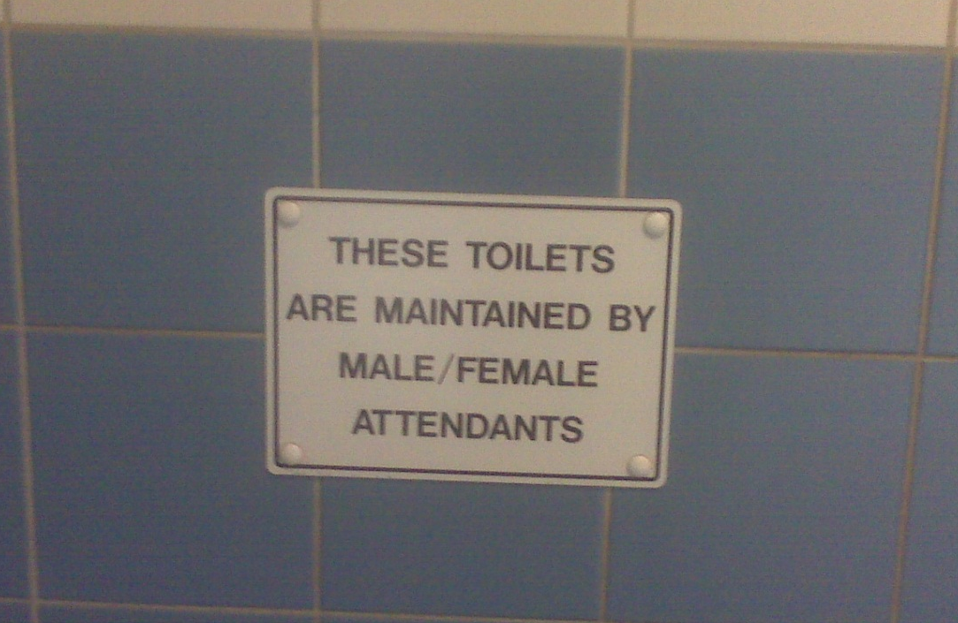
(More) Ambiguity & Context-Sensitivity
At Reading railway station:
What’s the euro / dollar exchange rate?

Slide 29
Filling Things In
“He stirred his coffee and handed the spoon to his wife.”
“When she got to her front door she found she’d lost her key. She couldn’t find an open window either. So, she booked in at a hotel.”

Slide 30
Language Parsing
A technique that I have been told is used in Google Translate is “dependency parsing”.
An example dependency parsing system, involving colleague Dr Bernd Bohnet at Birmingham:
http://barbar.cs.lth.se:8081/
http://en.sempar.ims.uni-stuttgart.de/

Slide 31
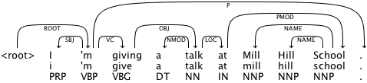
Language Parsing
“I’m giving a talk at Mill Hill School.”

Slide 32
NLP is Not an Easy Problem e.g. going by Google Translate and back

Slide 33
NLP is Not an Easy Problem e.g. going by Google Translate and back
We do not have an army that fades away at the first sign of trouble.
  [Spanish:] No tenemos un ejército que se desvanece a la primera señal de problemas.
We have an army that vanishes at the first sign of trouble.
We do not have an army that fades away at the first sign of trouble.
  [Welsh:] Nid oes gennym byddin y pylu i ffwrdd ar yr arwydd cyntaf o drafferth.
We do not have the army faded away at the first sign of trouble.

Slide 34

Per Ardua ad Alta

Slide 35

Per ardua ad alta.
The steep slope to the deep.
Per ardua altum.
By towering high.
Per aeriae.
Through the air.
Per aerem.
Through the air.

Slide 36
Metaphor

Slide 37
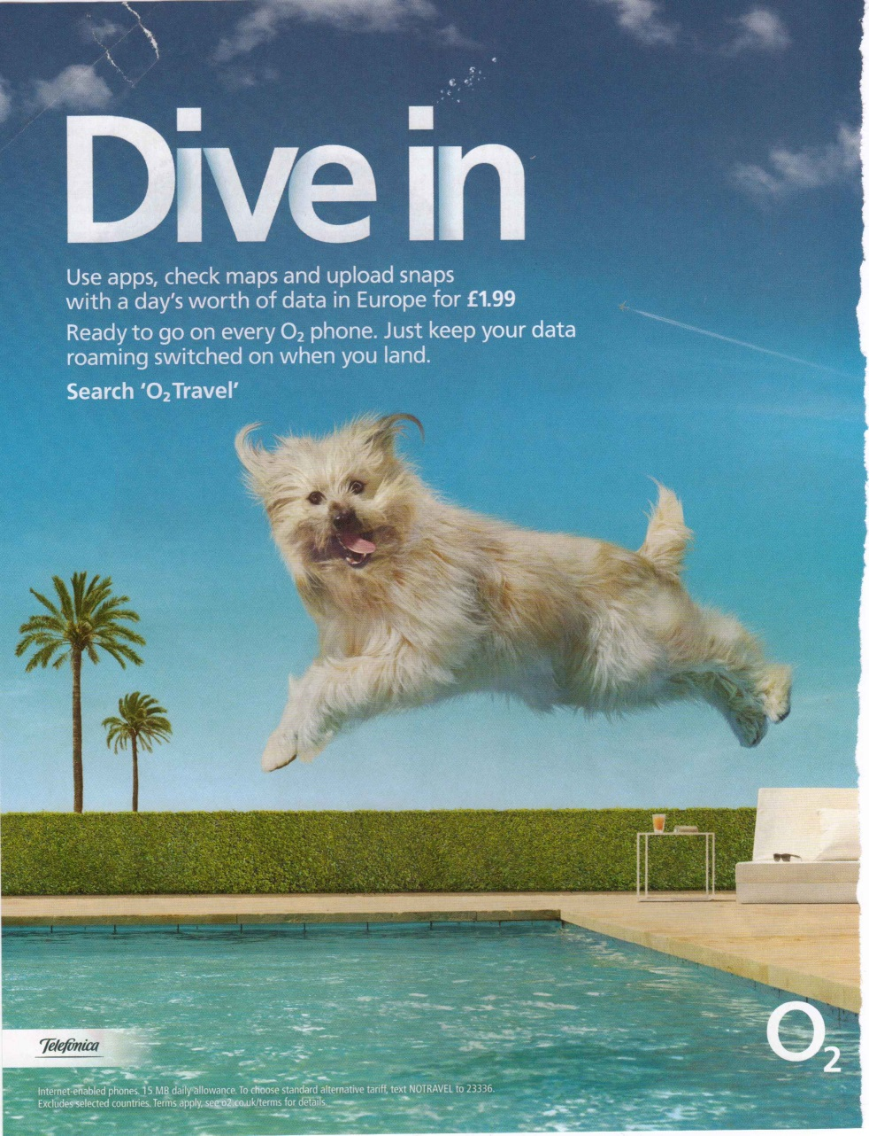
Advertising
mobile apps

Slide 38
Back to AI in General –
Some Big Arguments

Slide 39
Those Questions again …
What does “artificial” mean and imply?
  In particular, does it necessairly imply not real or not genuine?
  Think about:
    Artificial trees
    Artificial light
    Artificial smiles
  What does it mean for us to make something (an artefact)?

Slide 40
Strong AI versus Weak AI
Strong AI = “AI = real thought”
Weak AI = “AI = mere simulation”
Some arguments/considerations:
  Chinese Room argument (Searle 1980)
    Many other versions: beer cans & elastic bands; railway yard
  Tornado argument (see a version in Searle 1980)
  Detailed simulation of brain circuitry
  Turing Test

Slide 41
Some Big Arguments, contd
Turing Test
Test question: What does the test test?

Slide 42
Some Big Arguments, contd
The “CODWhWeTet” argument [my name for it!]:
  Computers Only Do What We Tell ’Em To
  So they couldn’t possibly be comparable in intelligence/creativity/... to people.

Slide 43
Discuss

Slide 44
The Modern World and Beyond
(and see R&N: Chs 26, 27)

Slide 45
Ethical/Moral Issues
Ethics of AI research, because of possible harm to humans
Moral accountability / ethical behaviour OF human-affecting AI entities: robots, medical diagnosis systems, traffic light systems, ...
Moral/ethical behaviour towards (conscious) AI entities.

Slide 46
AI -> Reduce Human Centrism/Centrality
People are afraid of AI partly because of this reduction, as well because of possible harm from robots etc
  fear of people becoming redundant
  NB: notion of a “singularity” in a few decades when AI is going to far and irredeemably surpass human intelligence (see R&N Ch.26).
  fear of human qualities such as creativity being devalued
But funnily enough people are only too ready to ascribe intelligence to things, animals, ... (and each other?!)
Why is being outperformed by robots worse than being outperformed by other people?

Slide 47
AI -> Questioning of Temporal Centrism
Will humans naturally evolve into something else?
Will we be naturally superseded by another species?
Is being taken over by robots any worse than being superseded by another species or evolving into something else?
Would being taken over, or dying out, be a bad thing, IF, say, they were much moral than we are??

Slide 48
AI -> Evolution of Nature of Agenthood
Fluidity of personhood:
  intelligent software agents (on something like the web) splitting, melding, overlapping, …
  We may (have to) become used to dealing with intelligent agents like this
  And may (want/have to) become like this??

Slide 49
Discuss

Slide 51
Metaphor (in Language)

Slide 52
Metaphor
A “liquid” use of language (or of ...).
  Roughly: talking (or …) about something as though it were something else (to which it seems or comes to seem similar).
NOT just of importance in “high” literature.
  Important also in, for example,
  news articles, classroom discourse, advertisements, doctor/patient dialogue, blogs, internet chat, mundane fiction, …
  So, an important practical matter for AI.

Slide 53
Mundane Examples of Metaphor
My work overflowed into the weekend.
Meeting life head on, grasping it with both hands.
When you come to our hotel, your car gets a holiday too.
The idea was buried in the recesses of her mind.
We do not have a chocolate army that fades away at the first sign of trouble.
The weather is settling into a drier frame of mind.
This slide is stuffed full of examples!

Slide 54
Mundane Examples of Metaphor
From Foreword, Preface and Introduction of the book Lima by James Higgins (Oxford: Signal Books, 2005):
Brasilia comes up and hits you with its modernity, …
Lima … sits there inscrutably in its sandy desert, keeping itself to itself.
Higgins delights the reader with clues about how to pierce Lima’s mysteries and riddles.
Higgins deciphers the politics that lurks behind that [decision].
Higgins brings Lima closer to non-Peruvians …
Yet if the city tends to be identified with Spanish colonialism, there are other Limas.
  [Contrast this with examples like: “Is Birmingham the Lima of England?”]
For all its size Lima is a small village and through [my friend] I got to know [other important people].

Slide 55
Partly Creative(?) Metaphor in Very Low Literature(?)!
Sharon pulled herself out of her jeans, the words “How could he? How could he?” jumping about her wearied brain. Senseless, leaving her empty, cold, helpless. Another voice, angry and vindictive, shouted in her ear, “ Serves you right, you silly fool: play with fire and watch your life go up in flames. It was all so predictable.”
[from My Story, a cheap romance magazine]

Slide 56
Not Just in Language!!
Metaphor arises in all media of communication/expression:
gestures, pictures, diagrams, music, dance, …
Many theorists (including me) regard metaphor as a fundamental component of thought.
Its appearance in language, pictures, etc. is just a reflection of that.

Slide 57
Metaphor in Advertisements etc

Slide 58
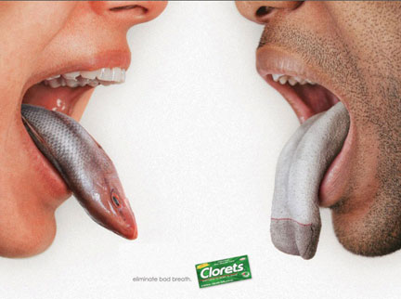
[Slide is courtesy of Marianna Bolognesi, 2013]

Slide 59
Advertising
mobile apps

Slide 60


[courtesy of Elisabeth El Rafaie, 2013]

Slide 61

[courtesy of Elisabeth El Rafaie, 2013]

Slide 62
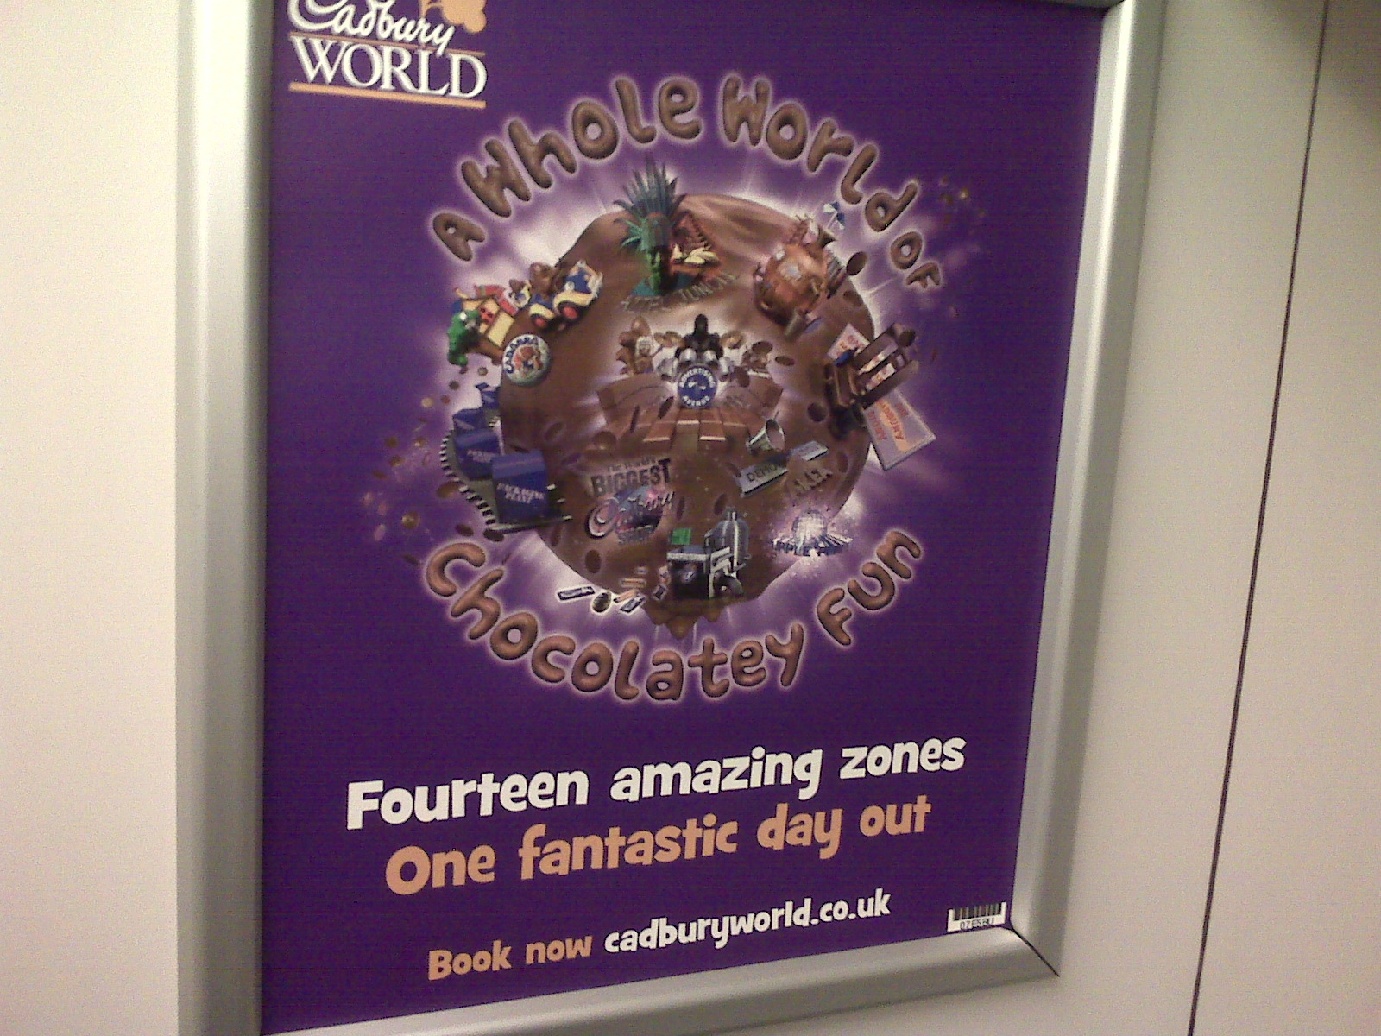

Slide 64


Slide 65


Slide 66
Describing the Abstract
Metaphor is hugely important (prevalent, useful, crucial) for describing & thinking about relatively abstract matters.
Time:
  We’re rapidly approaching Christmas.
  Christmas is galloping towards us.
Financial matters:
  Money flows across borders so easily now.
  Stock prices plummeted, soared, rocketed into space, …
Many sorts of processes, including in lives and relationships:
  They seem to be going on different paths, taking them further apart.
Computing:
  web, window, navigating, surfing, spiders, viruses, kill a process, dump the memory, trees, loops, arrays, heaps, …

Slide 67
My “ATT-Meta” AI Approach to Metaphor: concentraing on open-ended elaboration (and (good) mixing)
[see References/Bibliography]

Slide 68
Conventional Metaphor & Variants
Much metaphorical language consists of conventional phraseology, or more exactly: common, familiar phrases and regular variants:
  at the back of X’s mind,
  bring [event X] forward,
  prices soared,
  a ghost of a smile, …
Can go a long way just by storing such phrases/constructions in a mental/computer lexicon.
BUT even slight variations of certain types cause the need to to do extra processing, using common-sense knowledge of the “source” subject matter (e.g., physical objects, terrain).

Slide 69
Conventional Metaphor & Variants
“in a corner of X’s mind” could conceivably be in a lexicon as a fixed phrase.
But productive variation is possible:
  in a dim corner of X’s mind
  in an unlit corner of X’s mind
  in a distant corner of X’s mind
  in a cobwebby corner of X’s mind
  AND SO ON
Difficult to see how to understand the effect of the red qualifiers without reasoning about the nature of
physical corners, physical darkness, physical distance, etc.
There is no restriction on the red wording relevant to recesses.

Slide 70
Fictions
The Att-Meta approach is based on pretences (or fictions).
Related:
  Levin’s approach in literary theory [Levin 1993]
  Fictionalist approaches in Philosophy [Walton 2004/1993].
  Blending approach [Fauconnier & Turner 2008]
  Carston and Wearing [2011]

Slide 71
An Example
“The idea was buried in the outback of Katy’s mind”
The understander (as well as the speaker) momentarily pretends that Katy’s mind is literally a physical terrain that has an outback and that the idea is literally physically buried in the outback.
So the idea in question is inferred to be
  (to a high degree) physically hidden to,
  currently physically unmanipulable by, and
  would be difficult to physically manipulate by Katy.

Slide 72



J = the idea
Reality (incl.
target-side)
J is buried in ...
inference
J is a phys object
K’s mind is a phys terrain
Fiction
J phys’ly hidden to K’s c. self
J not phys’ly manipulable by K’s c. self
K cannot mentally use J
J would only be manipulable with difficulty by K’s c. self
K would find it difficult to mentally use J
pull-out

Slide 73
Fictions are great for various aspects of creativity
Open-ended elaboration
Novel pairings between fictional and real things.
Fantasy – i.e. distortion
Leading to suggestions about the real world that overturn normal expectations
Mixing, both parallelly and serially.

Slide 74
Non-Parallelism
Open-ended elaboration as resting much on standard types of fiction/reality parallelism (analogy).
High degree of non-parallelism (non-analogy) between fiction and real world.
  Many metaphor theories have analogy as the basis of metaphor.
  But I try to get away with the LEAST amount of analogy possible, contra the other theories, most of which tacitly assume that the task is to maximize the extent of analogy.

Slide 75
(possible
NOVEL
pairing)
SOMETHING
SOMETHING
Fiction
Reality
SOMETHING
inference
SOMETHING
SOMETHING
SOMETHING
SOMETHING
SOMETHING
SOMETHING
STANDARD
pairings/parallelism

Slide 76
(Non-)Analogy contd
No (necessary) target-side parallel for
Outback, being buried.
The nylon itself, or the property of being made of something.
The grassiness of the long grass; the yardiness of the junkyard.
  All that’s important is the hiddenness, the discardedness.
Sharon’s ear (even though she really has an ear!).

Slide 77
(Non-)Analogy contd
Those non-paralleled things in the fiction are there only to generate consequences that DO have a parallel,
And which moreover have a parallel by virtue of any mix of:
  standard specific parallels (idea/physical-object; mind/terrain)
  standard generic parallels (explained below)
As opposed to novel parallels that have to be worked out.

Slide 78
Standard Generic Parallels include …
Emotional/attitudinal qualities/value-judgments/beliefs, etc.
  Unpleasantness of someone shouting in your ear; anger of Sharon’s inner voice. Unwantedness of junk. Pleasantness of swimming in pool, excitement of diving in. Lack of intention of being in prison; knowingness in loading a gun.
Changes and Time-Course, incl. starting, ending, smoothness/intermittence, etc. (See below.)
Causation/prevention/enablement/ability/ease/difficulty.
  Bullets causing death; cell-bars preventing stopping the situation. Non-ability to see a nylon string. Of finding and manipulating something buried.
Normal functioning.
  Junked item no longer serves and perhaps never will serve its normal function. Car-on-holiday is not engaging in normal function.
Possibility/necessity/obligation/…
Qualitative number/amount (little, much, few, many, more, …)

Slide 79
Novel Pairings case
Novel pairings also often serve just to lead to connect to familiar pairings, whether of the specific or generic sort.
Cigarette/cell-bar: leads to addiction/prison.

Slide 80


Slide 81
References on AI (and Cognitive Science)
AAAI: Association for the Advancement of AI. http://www.aaai.org/
AISB (or SSAISB): Society for the Study of Artificial Intelligence and Simulation of Behaviour. http://www.aisb.org.uk/
Boden, M.A. (2006). Mind as machine: A history of cognitive science. Vols 1 and 2. Oxford: Clarendon Press.
[There are several copies in Main Library, one in the School of Computer Science’s library. I can lend one.]
Russell, S. & Norvig, P. (2010). Artificial intelligence: A modern approach. Third Ed. Upper Saddle River, N.J.: Pearson.
[There are several copies of this and earlier editions in Main Library and the School of Computer Science’s library. I have two copies of earlier editions that I can lend. It should be easy to get or order from the University bookstore as it is being used in a CS module.]
Searle, J.R. (1980). Minds, brains, and programs. Behavioral and Brain Sciences, 3, pp.417—457.
Turing, A. (1950). Computing machinery and intelligence. Mind, 59, pp.433—460.

Slide 82
Some of My Work on Figurative Language
Barnden, J.A., Glasbey, S.R., Lee, M.G. & Wallington, A.M. (2004). Varieties and directions of inter-domain influence in metaphor. Metaphor and Symbol, 19 (1), pp.1—30.
Barnden, J.A. (2008). Metaphor and artificial intelligence: Why they matter to each other. In R.W. Gibbs, Jr. (Ed.), The Cambridge Handbook of Metaphor and Thought, pp.311--338. Cambridge, U.K.: Cambridge University Press. [Includes an overview of the ATT-Meta approach.]
Barnden, J.A. (2010). Metaphor and metonymy: Making their connections more slippery. Cognitive Linguistics, 21(1), pp.1-34.
Barnden, J.A. (2009). “Metaphor and context: A perspective from artificial intelligence.” In A. Musolff & J. Zinken (Eds), Metaphor and Discourse, pp.79-94. Basingstoke, UK: Palgrave Macmillan.
Barnden, J.A. (2012). Metaphor and simile: Fallacies concerning comparison, ellipsis and inter-paraphrase. Metaphor and Symbol, 27 (4), pp.265-282.
Barnden, J.A. (forthcoming). Mixed metaphor: Its depth, its breadth, and a pretence-based approach. Invited chapter for volume on Mixed Metaphor edited by R.W. Gibbs, Jr. Amsterdam: John Benjamins. [Draft copy available on request.]
Lee, M.G. & Barnden, J.A. (2001). Reasoning about mixed metaphors with an implemented AI system. Metaphor and Symbol, 16 (1&2), pp.29—42. [Beginnings of ATT-Meta approach to mixed metaphor.]
Littlemore, J., Chen, P.T., Koester, A. & Barnden, J. (2011). Difficulties in metaphor comprehension faced by international students whose first language is not English. Applied Linguistics 2011: 32(4), pp.408-429.

Slide 83
Other References/Bibliography on Figurative Language
Carston, R. & Wearing, C. (2011). Metaphor, hyperbole and simile: A pragmatic approach. Language and Cognition, 3 (2): pp.283—312.
Fauconnier, G. & Turner, M. (2008). Rethinking metaphor. In Gibbs (2008 )—see next item—pp.53-66.
Gibbs, R.W., Jr. (Ed.) (2008). The Cambridge Handbook of Metaphor and Thought, Cambridge, U.K.: Cambridge University Press. [This counts as a “bible” on metaphor research.]
Kövecses, Z. (2000). Metaphor and emotion: Language, culture, and body in human feeling. Cambridge, U.K.: Cambridge University Press.
Lakoff, G. & Johnson, M. (2003). Metaphors we live by. 2nd Ed. Chicago: University of Chicago Press. [The first edition in 1980 was a highly formative book, basically initiating the cognitive linguistics approach to metaphor.]
Lakoff, G. & Turner, M. (1989). More than cool reason: a field guide to poetic metaphor. Chicago: University of Chicago Press.
Levin, S.R. (1993). Language, concepts, and worlds: three domains of metaphor. In A. Ortony (Ed.), Metaphor and Thought, 2nd edition, pp.112--123. New York and Cambridge, U.K.: Cambridge University Press.
Musolff, A. (2004). Metaphor and political discourse: Analogical reasoning in debates about Europe. Basingstoke, UK: Palgrave Macmillan.
NAACL (2013). Papers on automated metaphor identification etc. at the First Workshop on Metaphor in Natural Language Processing at the 2013 conference of the North American Chapter of the Association for Computational Linguistics (NAACL 2013), Atlanta, Georgia, USA, in June 2013. [The conference can easily be found online using “NAACL 2013”. The papers are all online.]
Walton, K. (2004/1993). Metaphor and prop oriented make-believe. In E. John & D.M. Lopes (Eds), Philosophy of Literature—Contemporary and Classic Readings: An Anthology, pp.239--247. Oxford: Blackwell, 2004. Reprinted from European J. of Philosophy, 1, pp.39-42, 45-49, 51-57.

Slide 85
Mundane Examples of Metaphor
We do not have a chocolate army that fades away at the first sign of trouble.
The weather is settling into a drier frame of mind.
But Ireland is also an island, divided, angry, full of old demons and old hate.
You’re a dog / cow / pig / devil / monster / baby / lunatic / angel / god / ….

Slide 86
Mundane Examples(!) of Metaphor
Sharon pulled herself out of her jeans, the words “How could he? How could he?” jumping about her wearied brain. Senseless, leaving her empty, cold, helpless. Another voice, angry and vindictive, shouted in her ear, “Serves you right, you silly fool: play with fire and watch your life go up in flames. It was all so predictable.”

Slide 87
Mundaneness
Metaphor NOT just of importance in “high” literature, college crests, etc. but also in …
  mundane fiction, news articles, classroom discourse, advertisements, doctor/patient dialogue, blogs, internet chat, …
  (So, an important practical matter for Artificial Intelligence as well as other fields)

Slide 88
Mundane Examples of Metaphor
My work overflowed into the weekend.
When you come to our hotel, your car gets a holiday too.
When your car doesn’t want to accelerate, check the fuel line.
The idea was buried in the recesses of her mind.
The news knocked me off my feet.
They’re marching ahead and will soon overtake the other political parties.
The thought of her step-mother's arrival hung over her mind like a dark angry cloud.
This slide is stuffed full of examples!

Slide 89
NLP is Not an Easy Problem e.g. going by Google Translate and back
We do not have an army that fades away at the first sign of trouble.
  No tenemos un ejército que se desvanece a la primera señal de problemas.
We have an army that vanishes at the first sign of trouble.

Slide 90

“in Karlskrona we have time to enjoy life”
From Aarlanda Express magazine, Stockholm

Slide 91

A raven is a writing desk.
Why?
“Why is a raven like a writing desk?”
asks the Mad Hatter in
Alice’s Adventures in Wonderland

Slide 92
Indeed, why??

Slide 93
Possible Answers
( http://www.wisegeek.org/why-is-a-raven-like-a-writing-desk.htm )
Lewis Carroll’s intention was to pose a nonsensical riddle, it seems, but …
They both come with inky quills.
They both stand on sticks.
  [both quoted by above webpage]
They both loom in a dark corner of the room.
  [me]

Slide 94
Novel Pairings case
Novel pairings also often serve just to lead to connect to familiar pairings, whether of the specific or generic sort.
Cigarette/cell-bar: leads to addiction/prison.
Raven/desk: in my interpretation, leads to standardly-paralleled emotional reactions.

Slide 95
References to Some of My Work ((Mill Hill))
Barnden, J.A. (2008). Metaphor and artificial intelligence: Why they matter to each other. In R.W. Gibbs, Jr. (Ed.), The Cambridge Handbook of Metaphor and Thought, pp.311--338. Cambridge, U.K.: Cambridge University Press.
Barnden, J.A. (2010). Metaphor and metonymy: Making their connections more slippery. Cognitive Linguistics, 21(1), pp.1-34.
Barnden, J.A. (2009). “Metaphor and context: A perspective from artificial intelligence.” In A. Musolff & J. Zinken (Eds), Metaphor and Discourse, pp.79-94. Basingstoke, UK: Palgrave Macmillan.
Barnden, J.A. (2011). Metonymy and its affective connotations: A preliminary look. Talk at Workshop on Metonymy, Metaphor Festival, University of Stockholm, 8-10 September 2011. [Slides available on request.]
Barnden, J.A. (2012). Metaphor and simile: Fallacies concerning comparison, ellipsis and inter-paraphrase. Metaphor and Symbol, 27 (4), pp.265-282.
Barnden, J.A. (2013). Hyperbole, metaphor, simile and irony: A constellation of connections. Talk at Workshop on Connections and Interactions between Different Types of Figures of Speech, Metaphor Festival, University of Stockholm, 29-31 August 2013. [Slides available on request.]
Barnden, J.A. (forthcoming). Mixed metaphor: Its depth, its breadth, and a pretence-based approach. Invited chapter for volume on Mixed Metaphor edited by R.W. Gibbs, Jr. Amsterdam: John Benjamins.
Littlemore, J., Chen, P.T., Koester, A. & Barnden, J. (2011). Difficulties in metaphor comprehension faced by international students whose first language is not English. Applied Linguistics 2011: 32(4), pp.408-429.

Slide 96
Other References/Bibliography ((Mill Hill))
Cohen, T. (2004/1997). Metaphor, feeling, and narrative. In E. John & D.M. Lopes (Eds), Philosophy of Literature—Contemporary and Classic Readings: An Anthology, pp.231-238. Oxford: Blackwell, 2004. Reprinted from Philosophy and Literature, 21 (1997), pp.223-225, 227-237, 239, and notes.
Gibbs, R.W., Jr. (Ed.) (2008). The Cambridge Handbook of Metaphor and Thought, Cambridge, U.K.: Cambridge University Press. [This counts as a “bible” on metaphor research.]
Kövecses, Z. (2000). Metaphor and emotion: Language, culture, and body in human feeling. Cambridge, U.K.: Cambridge University Press.
Lakoff, G. & Johnson, M. (2003). Metaphors we live by. 2nd Ed. Chicago: University of Chicago Press. [The first edition in 1980 was a highly formative book, basically initiating the cognitive linguistics approach to metaphor.]
Musolff, A. (2004). Metaphor and political discourse: Analogical reasoning in debates about Europe. Basingstoke, UK: Palgrave Macmillan.
NAACL (2013). Papers on automated metaphor identification etc. at the First Workshop on Metaphor in Natural Language Processing at the 2013 conference of the North American Chapter of the Association for Computational Linguistics (NAACL 2013), Atlanta, Georgia, USA, in June 2013. [The conference can easily be found online using “NAACL 2013”. The papers are all online.]
Savage, R. (2007). ``Disease Incarnate'': Biopolitical discourse and genocidal dehumanisation in the age of modernity. J. Historical Sociology, 20 (3), pp.404--440.
Walton, K. (2004/1993). Metaphor and prop oriented make-believe. In E. John & D.M. Lopes (Eds), Philosophy of Literature—Contemporary and Classic Readings: An Anthology, pp.239--247. Oxford: Blackwell, 2004. Reprinted from European J. of Philosophy, 1, pp.39-42, 45-49, 51-57.

Slide 97
References to Some of My Work ((Peru))
Barnden, J.A. (2008). Metaphor and artificial intelligence: Why they matter to each other. In R.W. Gibbs, Jr. (Ed.), The Cambridge Handbook of Metaphor and Thought, pp.311--338. Cambridge, U.K.: Cambridge University Press.
Barnden, J.A. (2010). Metaphor and metonymy: Making their connections more slippery. Cognitive Linguistics, 21(1), pp.1-34.
Barnden, J.A. (2009). “Metaphor and context: A perspective from artificial intelligence.” In A. Musolff & J. Zinken (Eds), Metaphor and Discourse, pp.79-94. Basingstoke, UK: Palgrave Macmillan.
Barnden, J.A. (2011). Metonymy and its affective connotations: A preliminary look. Talk at Workshop on Metonymy, Metaphor Festival, University of Stockholm, 8-10 September 2011. [Slides available on request.]
Barnden, J.A. (2012). Metaphor and simile: Fallacies concerning comparison, ellipsis and inter-paraphrase. Metaphor and Symbol, 27 (4), pp.265-282.
Barnden, J.A. (2013). Hyperbole, metaphor, simile and irony: A constellation of connections. Talk at Workshop on Connections and Interactions between Different Types of Figures of Speech, Metaphor Festival, University of Stockholm, 29-31 August 2013. [Slides available on request.]
Barnden, J.A. (forthcoming). Mixed metaphor: Its depth, its breadth, and a pretence-based approach. Invited chapter for volume on Mixed Metaphor edited by R.W. Gibbs, Jr. Amsterdam: John Benjamins.
Littlemore, J., Chen, P.T., Koester, A. & Barnden, J. (2011). Difficulties in metaphor comprehension faced by international students whose first language is not English. Applied Linguistics 2011: 32(4), pp.408-429.

Slide 98
Other References/Bibliography ((Peru))
Cohen, T. (2004/1997). Metaphor, feeling, and narrative. In E. John & D.M. Lopes (Eds), Philosophy of Literature—Contemporary and Classic Readings: An Anthology, pp.231-238. Oxford: Blackwell, 2004. Reprinted from Philosophy and Literature, 21 (1997), pp.223-225, 227-237, 239, and notes.
Gibbs, R.W., Jr. (Ed.) (2008). The Cambridge Handbook of Metaphor and Thought, Cambridge, U.K.: Cambridge University Press. [This counts as a “bible” on metaphor research.]
Kövecses, Z. (2000). Metaphor and emotion: Language, culture, and body in human feeling. Cambridge, U.K.: Cambridge University Press.
Lakoff, G. & Johnson, M. (2003). Metaphors we live by. 2nd Ed. Chicago: University of Chicago Press. [The first edition in 1980 was a highly formative book, basically initiating the cognitive linguistics approach to metaphor.]
Musolff, A. (2004). Metaphor and political discourse: Analogical reasoning in debates about Europe. Basingstoke, UK: Palgrave Macmillan.
NAACL (2013). Papers on automated metaphor identification etc. at the First Workshop on Metaphor in Natural Language Processing at the 2013 conference of the North American Chapter of the Association for Computational Linguistics (NAACL 2013), Atlanta, Georgia, USA, in June 2013. [The conference can easily be found online using “NAACL 2013”. The papers are all online.]
Savage, R. (2007). ``Disease Incarnate'': Biopolitical discourse and genocidal dehumanisation in the age of modernity. J. Historical Sociology, 20 (3), pp.404--440.
Walton, K. (2004/1993). Metaphor and prop oriented make-believe. In E. John & D.M. Lopes (Eds), Philosophy of Literature—Contemporary and Classic Readings: An Anthology, pp.239--247. Oxford: Blackwell, 2004. Reprinted from European J. of Philosophy, 1, pp.39-42, 45-49, 51-57.

