Slide 1
Reflexive Self: Why and How
Don Perlis
University of Maryland, College Park

Slide 2
But before the Why and the How…
… a brief digression concerning the WHAT

Slide 3
The What
The immediate present “I”.
An awareness/knowing that – whatever else it might know – knows itself as that same awareness/knowing.
It knows that it knows, but already as part of that momentary act of knowing, not the result of reflecting on the knowing (or anything else).

Slide 4
The What
Conscious (of) = with knowledge (of)
A (reflexive) conscious state of a subject S is one that S knows itself to be in, and where that knowing is part of that same state.
Magic? Hopefully not! But it will be something rather complex, for sure.

Slide 5
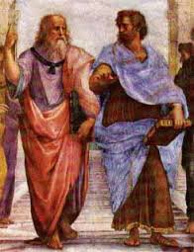
The What
Roots as far back as Aristotle
…with nurturing by Kant, Brentano, Husserl, Russell, and many more.
Can you be in pain (real experienced pain) and not know it? It seems not to make any sense. Part of the experience is the knowing one is having it.

Slide 6
Note that when our pain subsides we do not become unconscious – indeed ALL our usual sensations and thoughts can fade away and we can remain conscious – but of what?
Just of ourselves, not life-story, not plans, just the here-and-now being-ness of this moment of experience.
Ur-quale, that knows only itself knowing itself.

Slide 7
OK, we’ve actually started to slide into the Why, so let’s officially declare this to be Part A.

Slide 8
OUTLINE
The What (just finished)
Part A: The Why (just starting)
Part B: The How (tomorrow)

Slide 9
Part A: Why
That is, why interesting or plausible?
A very wide range of themes in philosophy and cognitive science more generally seem to hinge on a robust notion of (reflexive) self.
Here I will just give a tasting of a few of these, as part of a larger work in progress.

Slide 10
Again: Conscious (of) = with knowledge (of)
Of what?
Imagine pain gone, memory gone, vision gone. No perception, no input, no proprioception.
What remains?
Nothing, or a pure self, the bare “I”

Slide 11

Hume
He says no “I”
But who then is saying that?
Who is having percepts?
Percepts free-floating in space are not perceived.
Notes:
He actually gives two arguments; the first one is relevant to us: he looks and finds only a shifting sequence of percepts.

Slide 12

Fast-forward to Kripke
Naming and Necessity
Pain requires a subject, an entity that can feel, that can know the pain.
Mere C-fiber firings cannot supply that.
So pain is more than firing of C-fibers.
Notes:
Technical modal argument based on possible worlds – stipulated entities that supposedly help reveal what we can imagine based on current knowledge.

Slide 13
BUT (pace Kripke): a whole brain-full of fibers firing in the right way might be able to supply a subject.
That, after all, is (one of) the big question(s).

Slide 14
But back to KNOWING, since consciousness seems to be a kind of knowing.

Slide 15
What is it to know?
If being conscious is knowing (whatever one if conscious of), then we should ask what knowing is.
Notes:
More on that later; for now, a peek at knowing as often construed.

Slide 16
What is it to know?
If being conscious is knowing (whatever one if conscious of), then we should ask what knowing is.
Many philosophers have asked what knowledge is.
Notes:
More on that later; for now, a peek at knowing as often construed.

Slide 17
What is it to know?
If being conscious is knowing (whatever one if conscious of), then we should ask what knowing is.
Many philosophers have asked what knowledge is.
A not-uncommon view is that self-knowledge is preceded by knowledge of things more generally; we then come to know self
Notes:
More on that later; for now, a peek at knowing as often construed.

Slide 18
What is it to know?
If being conscious is knowing (whatever one if conscious of), then we should ask what knowing is.
Many philosophers have asked what knowledge is.
A not-uncommon view is that self-knowledge is preceded by knowledge of things more generally; we then come to know self (hmm…)
Notes:
More on that later; for now, a peek at knowing as often construed.

Slide 19
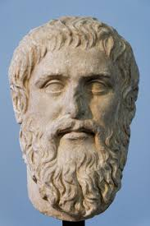
Knowledge
What is it?
Plato to Gettier: JTB or not?

Slide 20
Knowledge
What is it?
Plato to Gettier: JTB or not?
J -j-> B; but J can fail, or “-j->” can fail

Slide 21
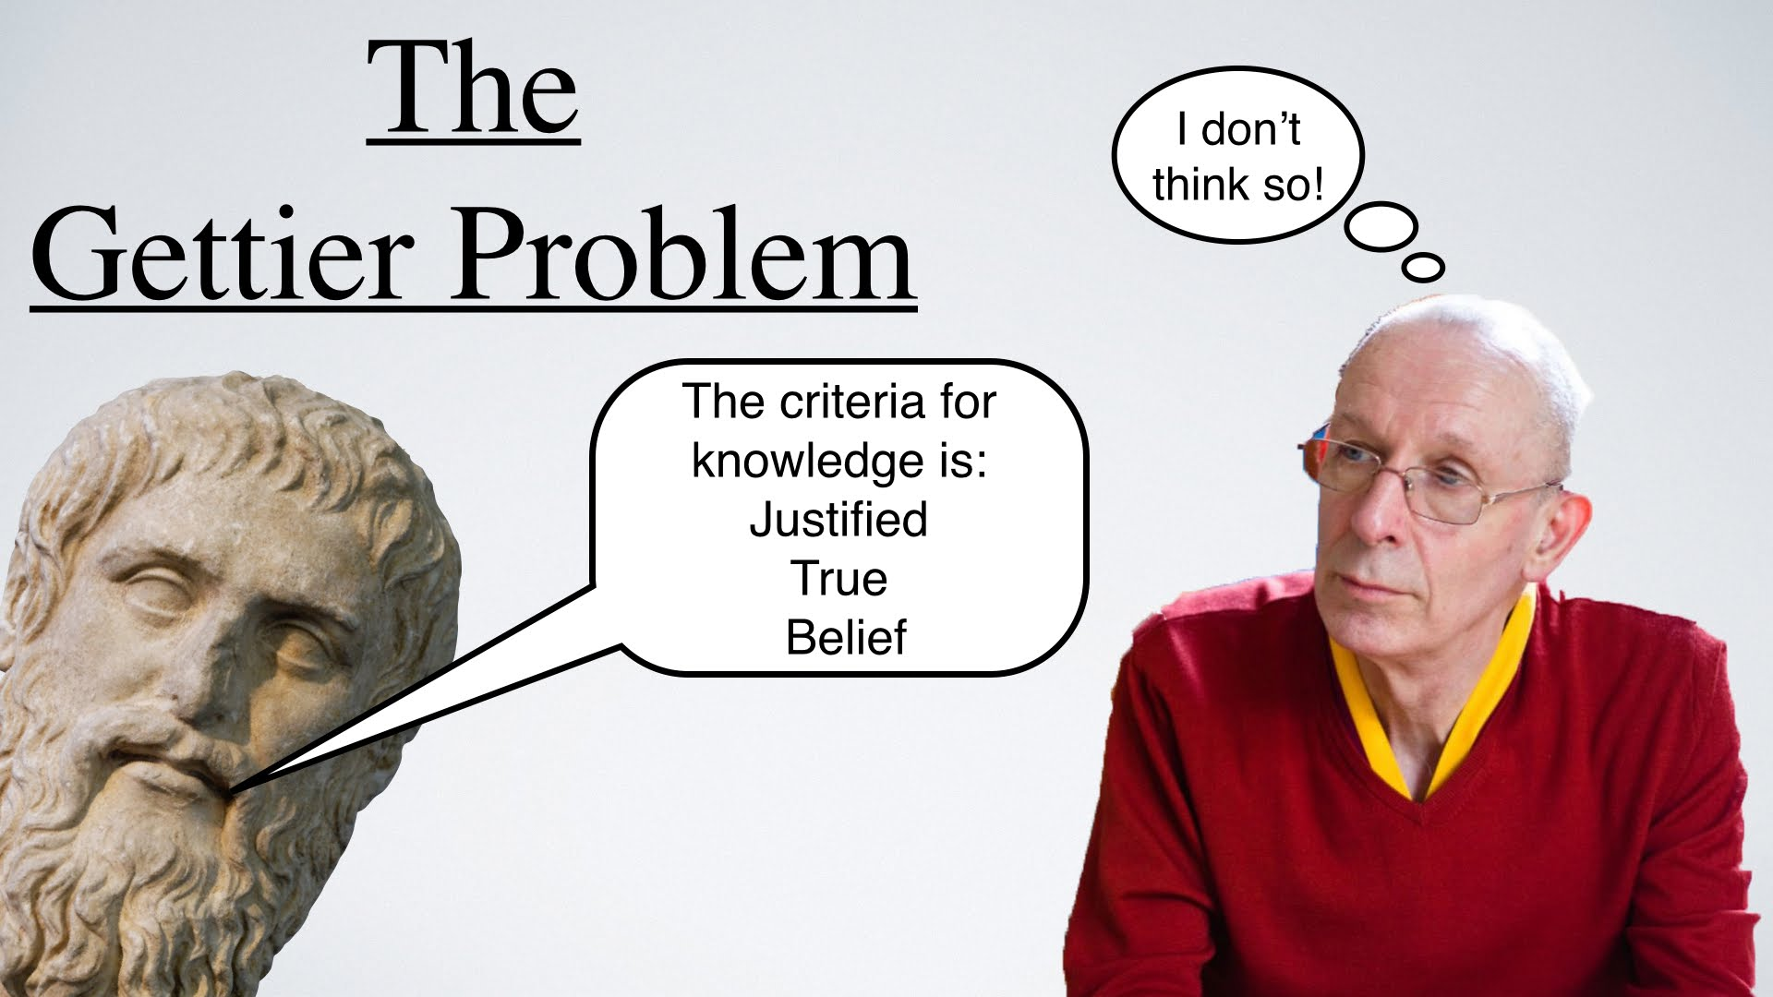

Slide 22
The landslide (Remaley)

Slide 23
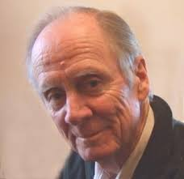
Dretske et al: perhaps there is no knowledge
Notes:
To be fair, this is not exactly what philosophers have been trying to capture. But it will do for our purposes.

Slide 24
Dretske et al: perhaps there is no knowledge
Seems convincing: how can we ever truly know anything? Isn’t all knowledge inferred, concluded on reflection? And thus potentially error-prone?
Notes:
To be fair, this is not exactly what philosophers have been trying to capture. But it will do for our purposes.

Slide 25
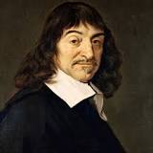
Descartes to the rescue
The only thing we can know for sure is that we are having thoughts: “I think…” and this is immediate, not inferred. Clear and distinct, cannot doubt it.
Notes:
Slides are anachronistic here: Descartes was before Hume, and Hume may have been responding to Descartes. If we don’t require knowing to be self-knowing, we get boxology. Note: this is to be distinguished from a reflective theory of mind. Reflexivity is pre-reflective, and is by definition immediate part and parcel of any kind of knowing. With Descartes, it may be all that we can really know for sure.

Slide 26
Descartes to the rescue
The only thing we can know for sure is that we are having thoughts: “I think…” and this is immediate, not inferred. Clear and distinct, cannot doubt it.
Or is it “There is thinking…”?
Notes:
Slides are anachronistic here: Descartes was before Hume, and Hume may have been responding to Descartes. If we don’t require knowing to be self-knowing, we get boxology. Note: this is to be distinguished from a reflective theory of mind. Reflexivity is pre-reflective, and is by definition immediate part and parcel of any kind of knowing. With Descartes, it may be all that we can really know for sure.

Slide 27
Descartes to the rescue
The only thing we can know for sure is that we are having thoughts: “I think…” and this is immediate, not inferred. Clear and distinct, cannot doubt it.
Or is it “There is thinking…”? (who said this?)
Notes:
Slides are anachronistic here: Descartes was before Hume, and Hume may have been responding to Descartes. If we don’t require knowing to be self-knowing, we get boxology. Note: this is to be distinguished from a reflective theory of mind. Reflexivity is pre-reflective, and is by definition immediate part and parcel of any kind of knowing. With Descartes, it may be all that we can really know for sure.

Slide 28
Descartes to the rescue
But: how can “there is thinking” be concluded (known) unless there is knowing – i.e., something that knows?
Notes:
Slides are anachronistic here: Descartes was before Hume, and Hume may have been responding to Descartes. If we don’t require knowing to be self-knowing, we get boxology. Note: this is to be distinguished from a reflective theory of mind. Reflexivity is pre-reflective, and is by definition immediate part and parcel of any kind of knowing. With Descartes, it may be all that we can really know for sure.

Slide 29
Descartes to the rescue
The only thing we can know for sure is that we are having thoughts: “I think…” and this is immediate, not inferred. Clear and distinct, cannot doubt it.
Knowing is the sort of thing that knows it is happening. And that is the “I” – a process
Notes:
Slides are anachronistic here: Descartes was before Hume, and Hume may have been responding to Descartes. If we don’t require knowing to be self-knowing, we get boxology. Note: this is to be distinguished from a reflective theory of mind. Reflexivity is pre-reflective, and is by definition immediate part and parcel of any kind of knowing. With Descartes, it may be all that we can really know for sure.

Slide 30
What sort of knowing is this I-knowing?
What is it to know that this is oneself doing the knowing?
Reflexivity-terminology is a bit weird – but hopefully not as weird as “lights-on” or “something it is like to be”.

Slide 31

Perry on “I”
What does he learn when he finally realizes (knows) that it is he himself whose cart is leaking sugar?
Notes:
De se knowledge – maybe the most basic kind.

Slide 32
Perry on “I”
What does he learn when he finally realizes (knows) that it is he himself whose cart is leaking sugar?
He learns “that it is he himself”. It is the owner of the “this, here, now” experience. It is his self.
Notes:
De se knowledge – maybe the most basic kind.

Slide 33
Perry on “I”
What does he learn when he finally realizes (knows) that it is he himself whose cart is leaking sugar?
He learns “that it is he himself”. It is the owner of the “this, here, now” experience. It is his self.
This is a primary category, not derived from other forms of knowing.
Notes:
De se knowledge – maybe the most basic kind.

Slide 34
Uh-Oh
Are we then stuck?
A fundamental irreducible “I”?
No hope for neuroscience of consciousness?
No hope for strong AI?
Keep tuned…

Slide 35
Whatever it is, from Descartes we might suspect that self-knowledge seems to precede general knowledge.
And it is a strong sort of knowledge, not mediated by reflection, inference, perception.

Slide 36
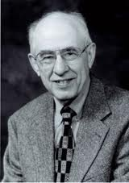
A reversal?
So, K precedes JTB (at least for self-knowing)
Belief requires meaning, reference.
On to Putnam

Slide 37
Putnam-2 against meaning
Theorem: there is no special mapping between words/sentences and the world.
For any such mapping, many others do just as well (to preserve truth).
But (pace Putnam): meaning is given by meaners. And that provides the angle into meaning, via self.
Notes:
Indeed, in earlier work, Putnam took just this line about meaners.

Slide 38
Putnam’s Theorem – reference can be assigned almost arbitrarily and still preserve truth.
Yes, but so what? Reference IS assigned by meaners – US – and we do so internally, in our imaginative realm. Maps to outside are not at our disposal, except through the body, eg hands and feet, skin, etc. And there is (normally) just one (useful) map there (sensorimotor).
The self assigns meanings to its expressions (HumptyDumpty).

Slide 39
Meaners
Putnam-1 and Kripke’s causal theory of reference.
Dubbers (meaners) initiate word-meaning.
An internal decision to map word to experiential/conceptual item.
And then: can define external mapping through body and measurement (action).

Slide 40
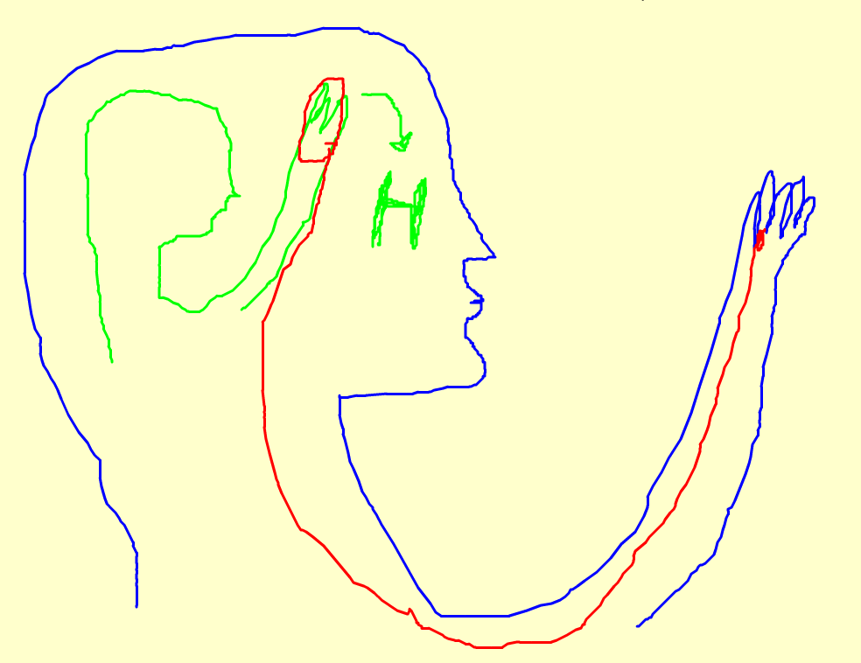
Self and world and meaning
Notes:
Meaning is relation between internal idea and internal terminology. Outer mapping might not exist, but if it does then it is canonical, by measurement covarying with inner measurement.

Slide 41
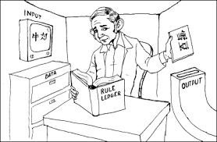
Searle
Chinese Room
Notes:
But probably not the way Searle meant

Slide 42
Searle
Chinese Room
So – GASP! – he was right in a way
Notes:
But probably not the way Searle meant

Slide 43
Searle
Chinese Room
So – GASP! – he was right in a way
Symbol processing cannot supply meaning unless it also supplies a self. And that will take a very special sort of processing (as already noted).
Notes:
But probably not the way Searle meant

Slide 44
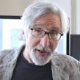
One or two views of consciousness?
From Block: subjective experience (phenomenology, lights-on) or self-knowingness (reflexivity)
He says quite distinct. Oh?

Slide 45
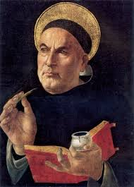
From Aquinas (taking some liberties): It is obvious what subjective experience is until we are asked to explain it – this (and how/why it arises) is the hard problem
Notes:
What was Aquinas talking about? – it wasn’t subjectivity.

Slide 46
From Aquinas (taking some liberties): It is obvious what subjective experience is until we are asked to explain it – this (and how/why it arises) is the hard problem
But reflexivity is not so easy either – and might end up being the same as subjectivity.

Slide 47
Pure Self
The Ur-quale – the bit of awareness that remains when all percepts and biographical memories and learned concepts are gone.

Slide 48
Pure Self
The Ur-quale – the bit of awareness that remains when all percepts and biographical memories and learned concepts are gone.
It would still be like something to be in such as state.

Slide 49
Pure Self
The Ur-quale – the bit of awareness that remains when all percepts and biographical memories and learned concepts are gone.
It would still be like something to be in such as state.
Or so it seems to me.

Slide 50
One last point
Reflexive self – perhaps unlike subjectivity – appears as if it can be studied fairly directly as a kind of engineering problem.

Slide 51
One last point
Reflexive self – perhaps unlike subjectivity – appears as if it can be studied fairly directly as a kind of engineering problem.
And that is where we shall go tomorrow.

Slide 52
Preview
Build it and they (insights) will come
How can a robot tell when it is talking?
The story of Julia and Alice
Efference copy
Does Mary know what red looks like?

Slide 53
End of part A

