Slide 1
Reflexive Self: How
Don Perlis
University of Maryland, College Park

Slide 2
But before the How…
… a brief digression concerning the WHAT

Slide 3
The What
The immediate present “I”.
An awareness/knowing that – whatever else it might know – knows itself as that same awareness/knowing.
It knows that it knows, but already as part of that momentary act of knowing, not the result of reflecting on the knowing (or anything else).

Slide 4
The What
Conscious (of) = with knowledge (of)
A (reflexive) conscious state of a subject S is one that S knows itself to be in, and where that knowing is part of that same state.
Magic? Hopefully not! But it will be something rather complex, for sure.

Slide 5
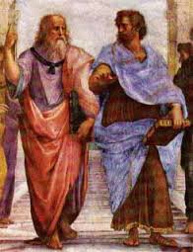
The What
Roots as far back as Aristotle
…with nurturing by Kant, Brentano, Husserl, Russell, and many more.
Can you be in pain (real experienced pain) and not know it? It seems not to make any sense. Part of the experience is the knowing one is having it.

Slide 6
OUTLINE
The What (just done)
Part A: The Why (yesterday)
Part B: The How (just coming now)

Slide 7
Part B: How
How is it that a reflexive self works, whether in the brain or in a machine?
Of course, no one knows at present – nor even whether this is what goes on at all.

Slide 8
An early AI idea:
BUILD IT AND THEY WILL COME

Slide 9
An early AI idea:
BUILD IT AND THEY (INSIGHTS) WILL COME

Slide 10
The idea is that this is an engineering problem, and that as we make AI systems more and more sophisticated, they will bear more and more on deep philosophical questions and neuroscience issues.

Slide 11
McCarthy & Hayes, 1969: Some Philosophical Problems From the Standpoint of Artificial Intelligence.

Slide 12
McCarthy & Hayes, 1969: Some Philosophical Problems From the Standpoint of Artificial Intelligence.
This led to enormous progress in AI –

Slide 13
McCarthy & Hayes, 1969: Some Philosophical Problems From the Standpoint of Artificial Intelligence.
This led to enormous progress in AI –
Powerful new reasoning methodologies, such as situation calculus

Slide 14
McCarthy & Hayes, 1969: Some Philosophical Problems From the Standpoint of Artificial Intelligence.
This led to enormous progress in AI –
Powerful new reasoning methodologies, such as situation calculus
Recognition of new technical issues such as the frame problem.

Slide 15
More on Build It…
For instance, as AI systems have more and more sophisticated treatments of “I”, we will see puzzles such as Perry’s Essential Indexical and Putnam’s Theorem resolved, and eventually even consciousness.

Slide 16
How can an agent be built, so that it has a self worthy of the name?
Metacognition may be part of the answer, forcing us back to reflexive self in order to avoid infinite regress. Also accounting for anomalies, learning

Slide 17
So, what’s been happening?

Slide 18
So, what’s been happening?
Not so great, so far; but not a total wash.

Slide 19
So, what’s been happening?
Not so great, so far; but not a total wash.
Here I will review some highlights, in a roughly historical fashion.

Slide 20
Youthful Ambitions 1960-1985

Slide 21
Youthful Ambitions 1960-1985
Situation calculus and frame problem

Slide 22
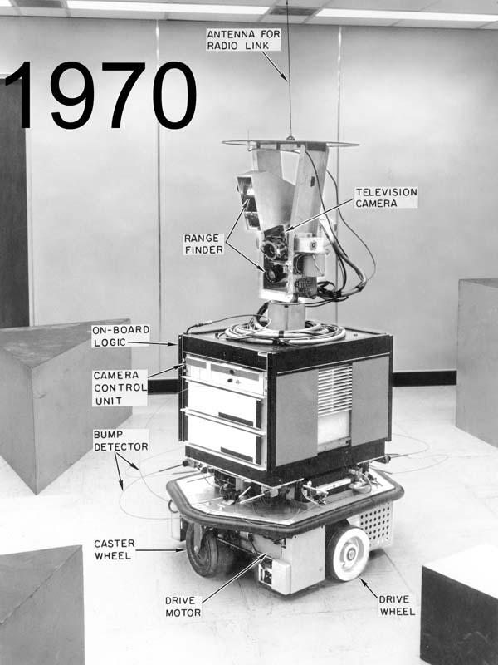
Youthful Ambitions 1960-1985
Situation calculus and frame problem
SHAKEY the robot

Slide 23
Youthful Ambitions 1960-1985
Situation calculus and frame problem
SHAKEY the robot
Nonmonotonic reasoning

Slide 24
Still a L-O-N-G way to go.

Slide 25
Still a L-O-N-G way to go.
Not real-time.
Not even computable in some cases.

Slide 26
Three Wise Men problem

Slide 27
Three Wise Men problem
Need for evolving “now”

Slide 28
Three Wise Men problem
Need for evolving “now”
Not temporal logic with fixed past-present-future

Slide 29
Three Wise Men problem
Need for evolving “now”
Not temporal logic with fixed past-present-future
Active Logic
Notes:
Same issues at more basic level, with Lunch problem

Slide 30
1985-2005: Age of Specialization

Slide 31
1985-2005: Age of Specialization
Progress and money

Slide 32
1985-2005: Age of Specialization
Progress and money
But also new ideas in metacognition, with temporal aspects.
Notes:
Miller (fixing errors on fly) and Cox (explaining errors)

Slide 33
2005-present

Slide 34
2005-present
Levesque, Langley, and others call for renewed attention to (whole) cognitive agents.
Robotics and AI start to come together
But many lessons unlearned

Slide 35
Back in the 1700’s

Slide 36
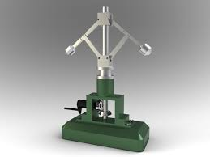
Back in the 1700’s
James Watt’s governor

Slide 37
Back in the 1700’s
James Watt’s governor
A kind of self-control
But nothing that seems
reflexive (or reflective)
Still, often taken as a
metaphor for the notion of self.
Notes:
Dual causality, a kind of surrogate refelxivity?

Slide 38
What might be an example of reflexivity?

Slide 39
What might be an example of reflexivity?
“I am now speaking English”
Notes:
Is there a hidden dual causality here? James Watt’s insights applied to NLP?

Slide 40
What might be an example of reflexivity?
“I am now speaking English”
Note the difference from
“This sentence is in English”

Slide 41
What might be an example of reflexivity?
“I am now speaking English”
Note the difference from
“This sentence is in English”
The latter has no agent, it is for anyone to interpret. The former is uttered by an agent as it reasons about that very uttering.

Slide 42
Build it and they (insights) will come

Slide 43
Build it and they (insights) will come
How can a robot tell when it is talking?

Slide 44
Build it and they (insights) will come
How can a robot tell when it is talking?
The story of Julia and Alice

Slide 45
Build it and they (insights) will come
How can a robot tell when it is talking?
The story of Julia and Alice
Efference copy

Slide 46
How to tell if one is speaking?

Slide 47
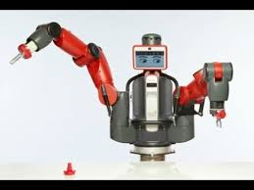
How to tell if one is speaking?
This arose by accident as a
serious issue in our robotics
work.

Slide 48
How to tell if one is speaking?
This arose by accident as a
serious issue in our robotics
work.
Taught – upon hearing “Julia”
mentioned – to look for her, point,
and say “I see Julia and am pointing at her”

Slide 49
But: often it would perform
this once, and then again a few
seconds later, and again, ad
infinitum.

Slide 50
But: often it would perform
this once, and then again a few
seconds later, and again, ad
infinitum.
Where was the loop?

Slide 51
But: often it would perform
this once, and then again a few
seconds later, and again, ad
infinitum.
Where was the loop?
In the transaction – NOT in the code!

Slide 52
But: often it would perform
this once, and then again a few
seconds later, and again, ad
infinitum.
Where was the loop?
In the transaction – NOT in the code!
It was responding to hearing itself say “Julia”

Slide 53
So again: how to tell if one is speaking?

Slide 54
So again: how to tell if one is speaking?
Recognizing ones voice?

Slide 55
So again: how to tell if one is speaking?
Recognizing ones voice?
Better: Knowing one is undertaking speaking actions, and noting the results in real time.
Notes:
Reflexivity? MCL?

Slide 56
So again: how to tell if one is speaking?
Recognizing ones voice?
Better: Knowing one is undertaking speaking actions, and noting the results in real time.
This illustrates the idea of efference copy.

Slide 57
So again: how to tell if one is speaking?
Recognizing ones voice?
Better: Knowing one is undertaking speaking actions, and noting the results in real time.
This illustrates the idea of efference copy.
We (especially my colleague Justin Brodie) are at work currently on this.

Slide 58
Efference copy
VOR most famous example – your eyes rotate in your head when you turn your head, in such as way that images stay fairly stable.

Slide 59
Efference copy
VOR most famous example – your eyes rotate in your head when you turn your head, in such as way that images stay fairly stable.
A nifty feedforward loop between real-time stored copies of motor commands being sent to neck muscles and to eye muscles.
Notes:
Later used to adjust errors – at least hypothesized in voluntary motion cases.

Slide 60
Efference copy
VOR most famous example – your eyes rotate in your head when you turn your head, in such as way that images stay fairly stable.
A nifty feedback loop between real-time stored copies of motor commands being sent to neck muscles and to eye muscles.
Hypothesized to be at work in all voluntary physical actions.

Slide 61
Still not enough
I need to stop this planning, including this planning, and get to work.

Slide 62
Still not enough
I need to stop this planning, including this planning, and get to work.
Massive metacognition

Slide 63
Still not enough
I need to stop this planning, including this planning, and get to work.
Massive metacognition
NLP – if we can get it to use “I” right we might be a lot further along.

Slide 64
Still not enough
I need to stop this planning, including this planning, and get to work.
Massive metacognition
NLP – if we can get it to use “I” right we might be a lot further along. But that’s just a start. Meaning/understanding is a lot more complex, as in Winston’s table-saw example.

Slide 65
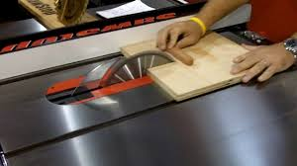

Slide 66
“Do not wear gloves when using this saw.”

Slide 67
“Do not wear gloves when using this saw.”
We visualize (imagine) what might happen, seeing in mind’s eye the glove and with it our hand being pulled into the machinery.

Slide 68
This is not your grandparents’ sort of logic.

Slide 69
This is not your grandparents’ sort of logic.
Nor even nonmonotonic logic.

Slide 70
This is not your grandparents’ sort of logic.
Nor even nonmonotonic logic.
Possibly not even formal at all.

Slide 71
This is not your grandparents’ sort of logic.
Nor even nonmonotonic logic.
Possibly not even formal at all.
A kind of perceptual reasoning/imagining.

Slide 72
This is not your grandparents’ sort of logic.
Nor even nonmonotonic logic.
Possibly not even formal at all.
A kind of perceptual reasoning/imagining.
3D, 4D, or even 5D anticipatory perceptual imagination – a world-simulating annotated inner virtual/augmented reality.
Notes:
A new special active data structure

Slide 73
Fast virtual crawlers – ourself in imaginative action – providing this inner virtuality so we can anticipate events.

Slide 74
Fast virtual crawlers – ourself in imaginative action – providing this inner virtuality so we can anticipate events.
Maybe the real work done by the so-called visual cortex.

Slide 75
Fast virtual crawlers – ourself in imaginative action – providing this inner virtuality so we can anticipate events.
Maybe the real work done by the so-called visual cortex.
Less about what is in front of us, more about anticipating/simulating possible events.

Slide 76
If so, then a reflexive-self-based process (RSBP) is (our only) real knowledge – we can’t be wrong about our ongoing current imaginative acts (Descartes).

Slide 77
If so, then a reflexive-self-based process (RSBP) is real knowledge – we can’t be wrong about our ongoing current imaginative acts (Descartes).
A so-called knowledge base (KB) is then just a storehouse of codes that can re-trigger actual knowing.

Slide 78
If so, then a reflexive-self-based process (RSBP) is real knowledge – we can’t be wrong about our ongoing current imaginative acts (Descartes).
A so-called knowledge base (KB) is then just a storehouse of codes that can re-trigger actual knowing. The mere “symbol-strings” alone are meaningless.

Slide 79

Notes:
Frank Jackson’s Mary

Slide 80
And so Frank Jackson’s color-deprived Mary will know “all physical facts” about the brain if and only if she (i) has a brain capable of that (a bit doubtful) and (ii) her brain has actually gone ahead to trigger codes for it all.
Notes:
Otherwise it is merely implicit knowledge waiting for her to discover it. A mere string is not knowledge – there has to be the grasping of it, which is an inner imaginative anticipatory act in 5D.

Slide 81
And so Frank Jackson’s color-deprived Mary will know “all physical facts” about the brain if and only if she (i) has a brain capable of that (a bit doubtful) and (ii) her brain has actually gone ahead to trigger codes for it all.
And then yes, she will already know the experience of seeing red.
Notes:
Otherwise it is merely implicit knowledge waiting for her to discover it. A mere string is not knowledge – there has to be the grasping of it, which is an inner imaginative anticipatory act in 5D.

Slide 82
Otherwise it is merely implicit knowledge codes waiting for her to discover. A mere string is not knowledge – there has to be a grasping of it, an inner imaginative anticipatory act in 5D.

Slide 83
“Be nice to your fine-feathered friend, since a duck may be somebody’s mother…

Slide 84
“Be nice to your fine-feathered friend, since a duck may be somebody’s mother…
“You may think that this is the end –

Slide 85
“Be nice to your fine-feathered friend, since a duck may be somebody’s mother…
“You may think that this is the end –
– well, it is

Slide 86
“Be nice to your fine-feathered friend, since a duck may be somebody’s mother…
“You may think that this is the end –
– well, it is
And now I must stop lecturing – including this plan of stopping – and actually stop.

Slide 87
Thanks for listening!

