Slide 1
Embedded Irony
by Mihaela Popa
[but delivered and slightly edited by John Barnden]
School of Computer Science
University of Birmingham, UK
Supported by: Leverhulme Trust
Metaphor Festival, Stockholm, Aug 2013

Slide 2

Outline
  1 The problem of embedded irony
  2 Does ironic attitude embed e.g. in belief-reports?
  3 Two solutions
    H1: irony embeds as some form of said-content
    H2: irony embeds as a type of proto-speech act
Notes:
The distinction between what speakers say and what they implicate is a useful distinction we should try to preserve. One way the distinction is drawn in current debates is through embedding such that said-content embeds because it is the kind of content that can enter into compositionality, whereas implicated-content does not embed because it is not a matter of compositionality but of free inference. But this neat way of explaining the distinction has come under pressure from a phenomenon of so-called embedded implicature whereby implicatures of parts enter compositionally into the overall content of the whole. EI is one type of this problem.
Possible solutions that try to explain how the ironic implicature of a part –antecedent of a conditional - enters compositionally into the overall content of the compound sentence, if the implicatures are not the kind of thing that goes into compositionality. One route would be to deny that irony is implicature and try to absorb it into compositionality, and thus include it into said-content. there are two possible ways one could do this: one is to say that the implicature is weak pragmatic effect that is syntactically constrained. Another way is to say that the implicature is a strong pragmatic effect of free enrichment that affects truth-conditions. I’ll argue that both ways of solving the problem stretch the notion of said-content to the point where the distinction has little value. A second route is to maintain that irony is implicature and that it embeds as such. This leaves us with both types of content and compositionality, but compositionality is now polluted with the pragmatic inference required to support implicature. Finally I’ll suggest one could abandon accept a modified form of compositionality that allows implicated content to feed into said content of larger units of language via compositionality. I’ll show that one can achieve this by adopting a compositionality of speech-acts—where sentence-level speech-acts are built up out of sub-sentential speech-acts irrespective of whether they are vehicles of content that is non-truth-conditional.

Slide 3

Irony: two views
Grice There are two types of speaker meaning:
  (1) In uttering σ speaker (U) said P ≈
  U meant P, & P “fits” the meaning of σ
  (2) In uttering σ, U “implicated” Q ≈
  U meant Q, but didn’t say Q
  Irony: (making as if) saying P and implicating Q (often an opposite of P)
Attitude theories: Echoic (Relevance theorists) and pretence theories
  Irony is essentially expressing an implicit attitude (disapproval) about (a version of) the overt meaning of the sentence
  P is a thought implicitly attributed to someone else U* (via echo or pretence)
  U is showing how ridiculous it would be (of U*) to think/assert P
Notes:
Whatever proposition S means when speaking figuratively could in principle be said

Slide 4

The question of embedded irony
What if an ironically used sentence σ occurs as part of a larger utterance?
(1) “Bill is such a fine friend.”
“If Bill is such a fine friend, he shouldn’t be trusted.”
Descriptive question:
  If (1) has both ironic content and attitude, which of these is contributed to the meaning of the sentence (2)?
Theoretical question:
  How shall we explain simple (unembedded) and embedded irony in a unified way?

Slide 5

Problem for implicature theories
  If ironic content of the antecedent in (2) is implicature, then how can it enter compositionally into the said-content of the conditional? This would violate an aspect of Gricean theory.
Grice responds: No embedding!
  U says a false conditional (L) and implicates a true conditional (G)
(L) If Bill is such a fine friend, he shouldn’t be trusted.
(G) If Bill is a lousy friend, he shouldn’t be trusted.
Problem: According to mainstream Gricean theory, U can deny a particularized conversational implicature such as (G):
  i.e. U should be able to say:
  “…(2)… but I don’t mean to imply that Bill should not be trusted if he is a lousy friend”
  Implausible. And what can she claim to have meant? Clearly not (L).

Slide 6

Problem for attitude theories
What sort of content is ironic attitude (attitudes in general)?
  manifesting evaluative mental states (here disapproval)
  not by saying or implicating that U has the attitude
  but rather by showing the attitude.
  Truth-assessment is not a relevant dimension to evaluate attitudes—i.e. evaluate the conditions under which the hearer (H) judges that she can accept/agree with U’s attitude.
Ironic attitude is expressed by the speaker, as a commitment in the case of simple irony, but note …

Slide 7



John thinks that Bill is such a fine friend
Sue
John

Slide 8

Embedding in Belief Reports
  The attitude is perspective-dependent – i.e. the evaluation may be shifted to another’s perspective.
  John thinks that Bill is such a fine friend.
A broad-strokes view of the space of possible interpretations:
1 – Narrow scope: Both ironic content and attitude embed: ascribed to the reportee (John)
2 – Wide scope: Both ascribed to the reporter (Sue)
3 – Mixed scope: Ironic content embeds but attitude scopes out
(not vice-versa)
    Ironic Content = Bill is a bad friend
    Ironic Attitude = It would be ridiculous to to believe Bill is a good friend

Slide 9
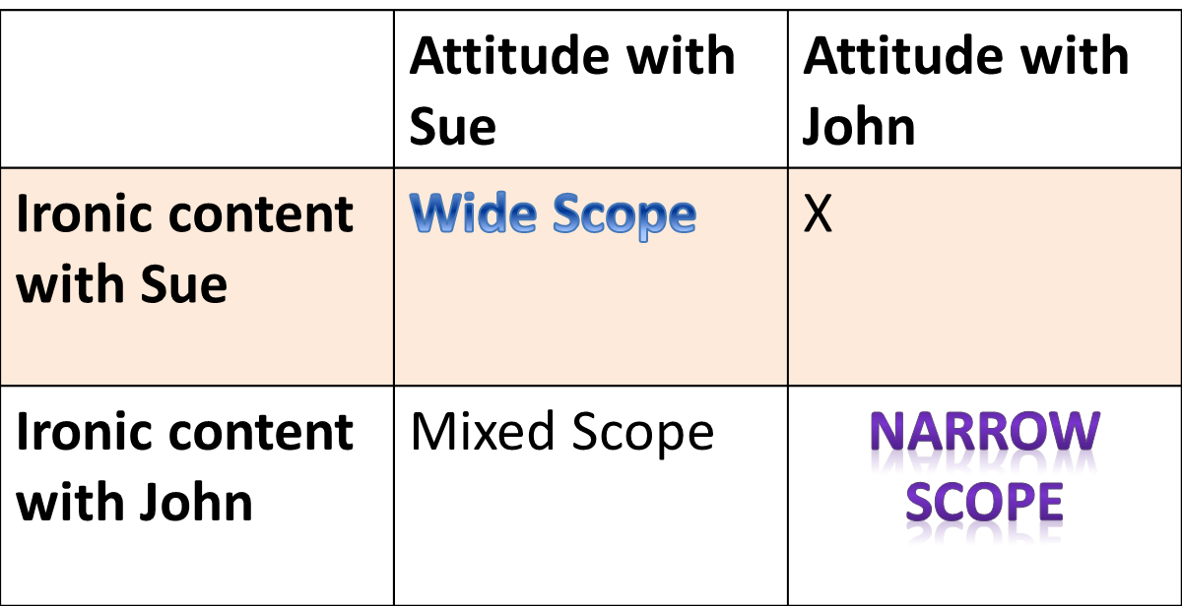

  Ironic Content = Bill is a bad friend
  Attitude = It would be ridiculous to to believe Bill is a good friend

Slide 10

Ironic attitude and content embed
Ironic attitude does not embed alone but together with ironic content.
Even if attitude is the primitive (as in echoic and pretence theories) why not make room for ironic content?
    U finds P ridiculous when she is disposed to think that some extreme opposite of P holds: Q
    Unembedded: In addition to expressing an attitude, U may (though need not) communicate Q.
    Embedded: Ironic content Q is what embeds primarily, the attitude providing ‘color’
We want a theory that explains how both ironic content and attitude embed.

Slide 11

Two Possible Avenues
Route 1 – explain all irony as said-content.
  H1: the implicature in irony is a ‘strong’ pragmatic effect, i.e. of a type that various theorists have already folded into said-content and an enriched notion of compositionality (forms of “pragmatic compositionality”).
Route 2 – maintain that irony as implicated-content but allow for a much more radically modified form of compositionality that allows all sorts of implicated content of parts to feed into the said-content of the whole. Our version:
  H2 : Irony embeds as a speech-act carrying implicated-content, including attitude as necessary.

Slide 12
H1: A Multi-Proposition View
Echoic theory: higher-order explicature affecting truth-conditions.
  E1: thought-attribution: U* (might) think/assert P
  E2: attitude-expression: E1 is ridiculous
E2 is the most relevant but not clear what it means for it to affect agreement.
Question of how to deal with pejoratives, slurs, etc.:
    “Charles is a pom.”
  [Said-content:] Charles is English
  [Conventional Implicature:] Disapproval of the English—Charles is undesirable.

Slide 13

Problem for H1
What is for expression of an attitude to be correct—i.e. what’s the
condition/judgment such that its obtaining entitles H to accept the utterance
and possibly re-issue it herself?
Not:
  Speaker U has the attitude
  Population/group x has the attitude
  An ideal agent would have the attitude
There is no condition of correctness (as an absolute matter) that involves the attititude being instantiated in the speaker, population/group, ideal agent:
    Charles is a pom is correct iff
    Charles is English & [according to …] the English are undesirable.

Slide 14



Promising avenue: go expressivist
Basic judgment is correctness, not truth.
Explain: Intersubjective Dimension for evaluation of speech-acts
  You say something and I evaluate it from my perspective!
H judges correct U’s utterance of O is a pom (produced on the basis of U’s Π, Δ) iff H believes O is English (Π) and H disapproves of English (Δ).
Π, Δ
^{Charles is a pom.}
Π, Δ
^{Correct!}

Slide 15

H2: Irony as an Expressive Speech Act
Proposal-develop Barker’s (2011; p.c.): two kinds of expressing
  Saying-speech-acts used to ‘defend’ mental states (i.e. providing reasons)
  Implicating-speech-acts are used to ‘manifest’ (express) mental states without defending them.
Irony is a dramatic act and essentially pretensive.
  X is such a genius.
Speaker is impersonating someone believing that X is a genius so as to
lampoon/criticize/disparage that stance, etc.
  distinct from negation or statements of the contrary:
    X is the very opposite of a genius.
  distinct from assertion (defending) of the attitude:
    Thinking X is a genius is ridiculous.

Slide 16

Irony is Non-Defending
U expresses non-defendingly a disparaging attitude towards someone who would assert (defend) that X is a genius:
In uttering σ, U presents herself as defending (or proto-asserts) that <X; genius>
  e.g. by impersonating an individual who would assert that X is a genius;
By proto-asserting that <X; genius>, U brings to the foreground the possibility of speech-acts of defending that <X; genius> in order to draw a contrast with information from common ground—e.g. <X; moron>
  Pragmatic presupposition: U makes as if <X; moron> is already part of the common ground (or can be easily accommodated), and that it would be ridiculous to defend <X; genius>
U indicates she believes <X; moron> while mocking any assertion of <X; genius> , without defending either the belief or the mocking.

Slide 17


Disagreements about irony
That talk was
great
Π, Δ
Π, Δ
I disagree.

Slide 18

What can embed is proto-indication of attitude
A proto-act such as proto-assertion is an act in which U advertises a speech-act intention but which is neutral as to whether U has the intention.
  If Fred is such a genius, why don’t you sack him?
  U presents herself as being ironic while signaling that she lacks the mental state that grounds her ironic intention.
An embedded ironic speech-act has the following structure:
  U uses a sentence σ to “proto-assert” P while indicating that she lacks the belief that P.
  U is “proto-indicating” non-defendingly that she has a disparaging attitude towards P and believes Q. But actually …
  U lacks the belief Q and the disparaging attitude towards P.

Slide 19

Irony embedded in antecedents of conditionals
“If Fred is such a genius, why don’t you sack him?”
Stipulate that it is permissible to perform an ironic-proto-act of
advertising non-defensively that Fred is a lousy friend,
mocking those who think he is a good friend.
Stipulate that it follows that it is permissible to perform the proto-question:
Why don’t you sack him?

Slide 20

Summing Up
Embedded irony involves embedding of a proto-indication of a disparaging attitude, for which existing solutions do not work.
Against H1: ironic content (and attitude?) as strong pragmatic effect.
For H2: irony embeds as a non-defending speech-act carrying a form of implicated-content
  Can embed attitude and implicated-content.
  Fits with compositionality, in a modified form:
  compositionality of speech-acts.
Notes:
By switching from a classical compositionality of said content to a compositionality of speech acts we can explain that implicated content and attitude can embed. This perhaps provides us with a tool we can use to explain wide variety of phenomena in language more easily, rather than just embedded irony.

Slide 21

Some References
Barker, S. (2003). Truth and conventional implicature. Mind, 112 (445), 1-33.
Barker, S. (2004). Renewing meaning. (Oxford University Press)
Barker, S. (2005). Towards a pragmatic theory on ‘if.’ Philosophical Studies, 72(2). 185-211.
Barker, S. (2011). Bearers of Truth and the Unsaid. (In K. Turner (Eds.), Making Semantics pragmatic. CRiSPI, Volume 24, (pp. 81-102). Emerald.)
Camp, E. (2012). Sarcasm, pretence, and the semantics-pragmatics distinction. Noûs 46: 4.

Slide 22
Thank you!
Awkward questions to:
popa.michaela@gmail.com

