Slide 1

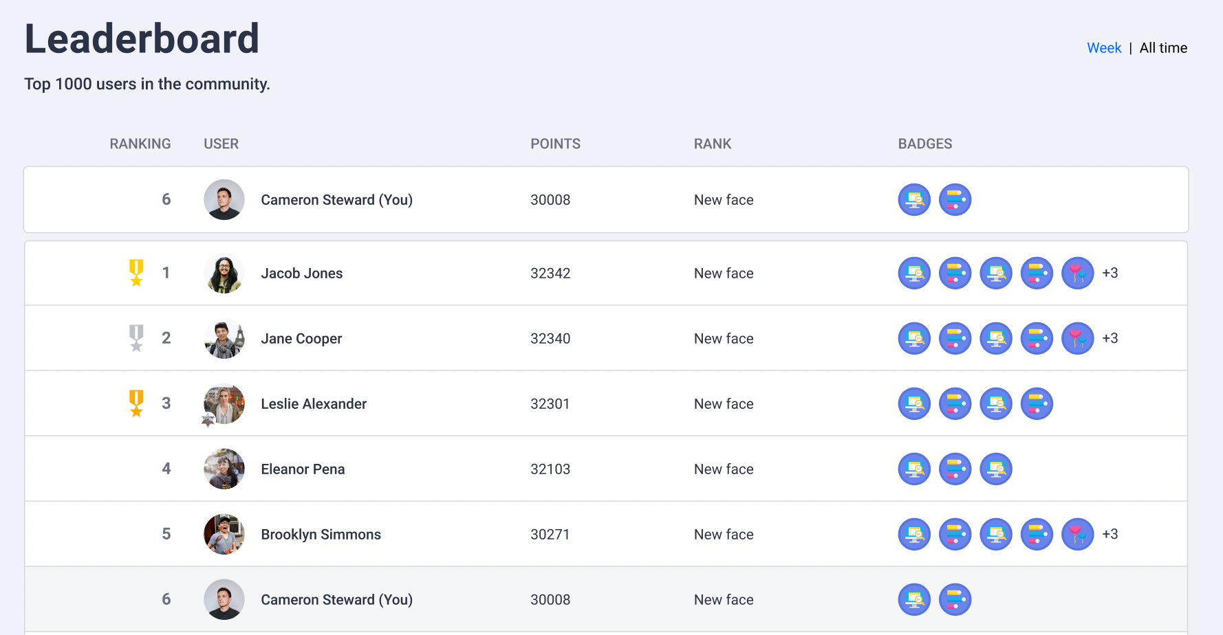
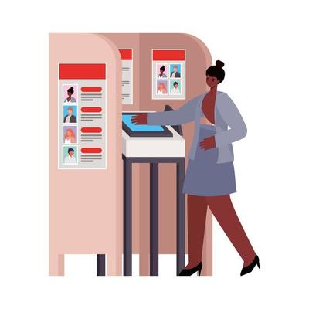
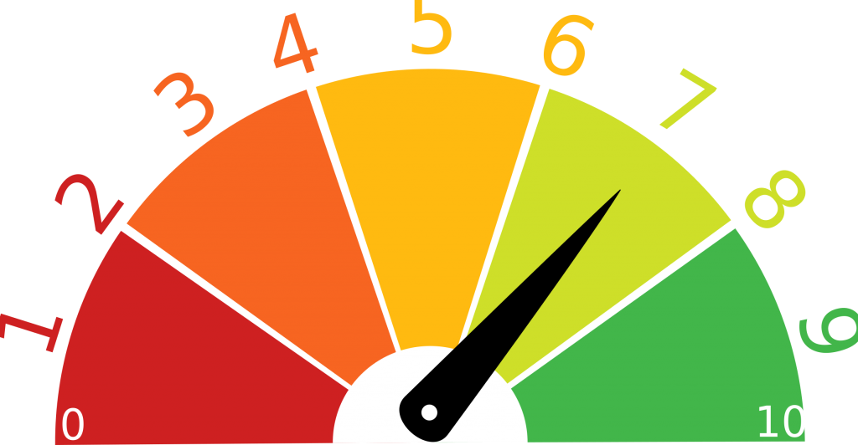
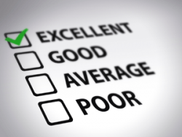
Meeting Effectiveness Tracker Planning and structuring effective meetings
Leaderboard
Voting Booth
Effectiveness Trend
Personal Scorecard

Slide 2
What is the Future?

