Slide 1

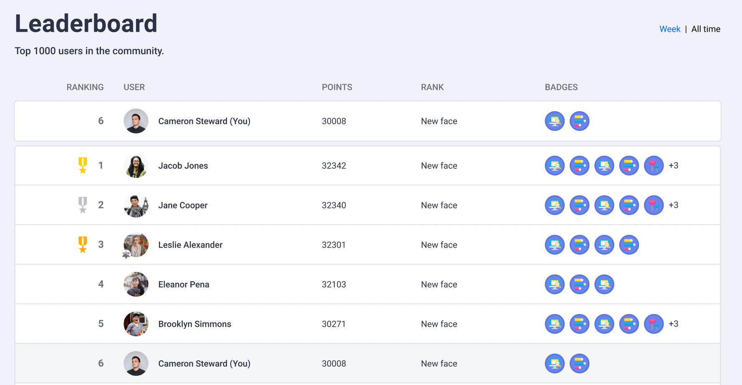
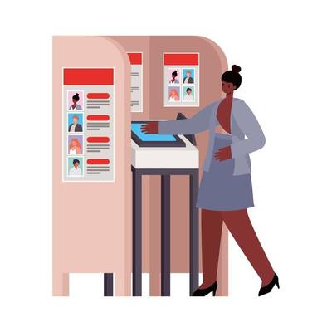
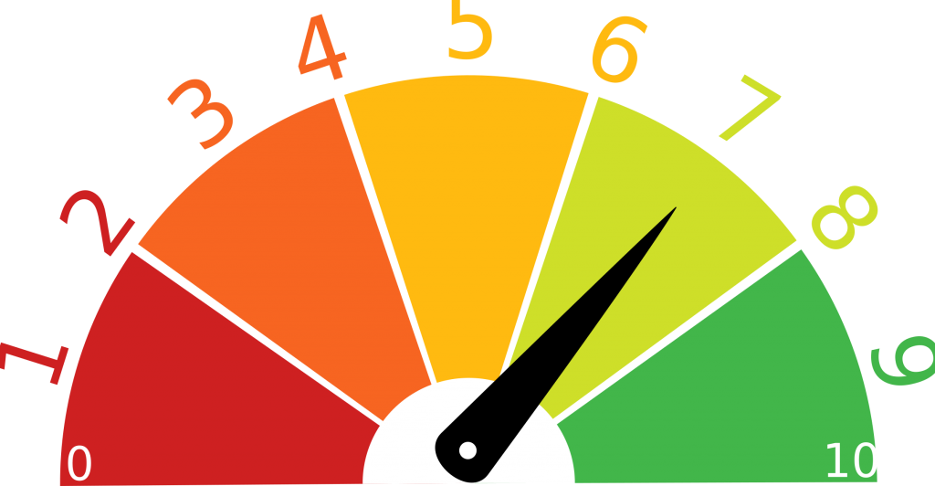
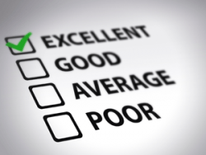
Meeting Effectiveness Tracker Planning and structuring effective meetings
Time spent in meetings has been rising by 8% to 10% annually since 2000..
Dates shows the majority (about 83%) spend up to a third of the workweek in meetings!
Leaderboard
Voting Booth
Effectiveness Trend
Personal Scorecard

Slide 2
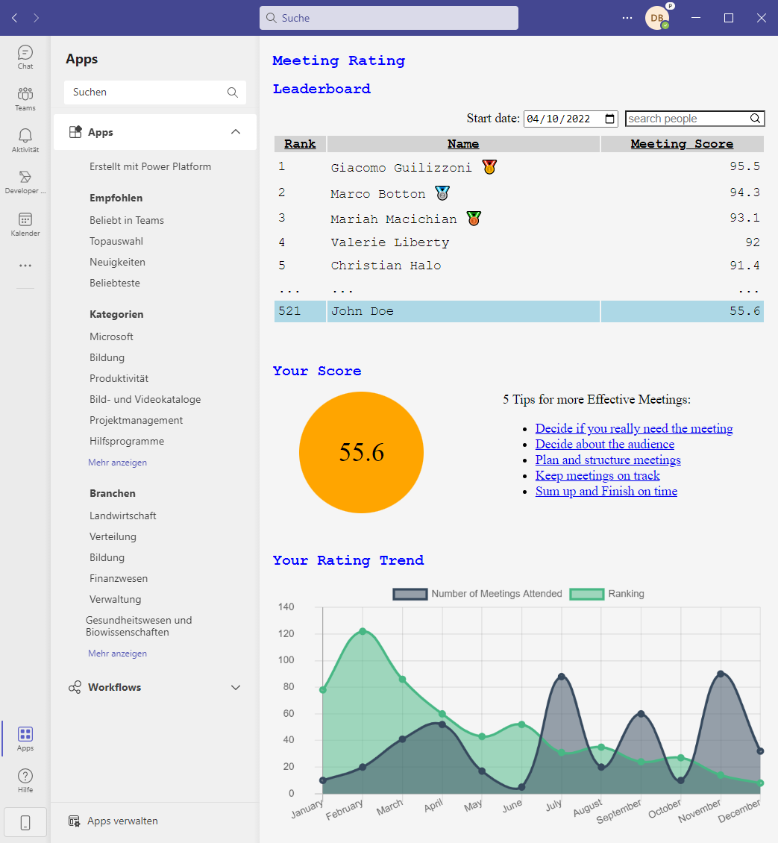
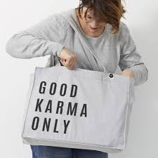
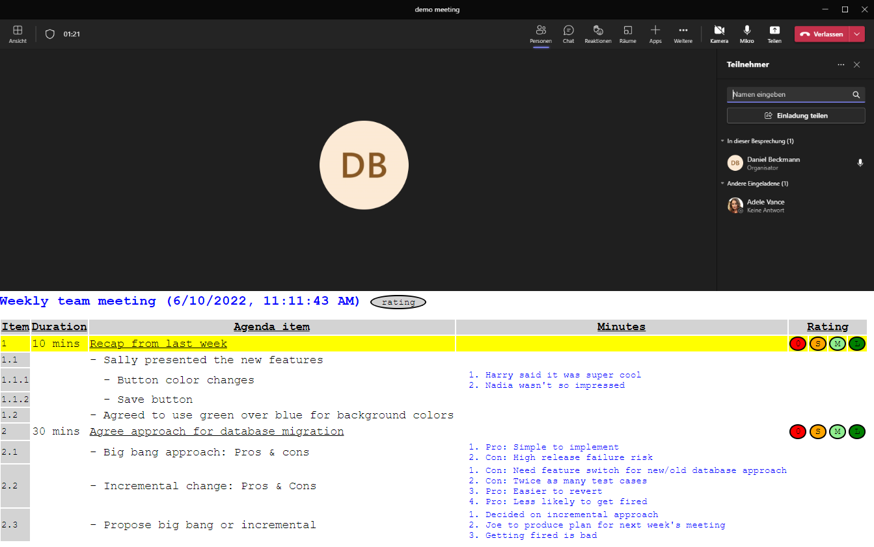

Next Steps….
Outlook and Microsoft Teams Integration
Socialize within DB. Promote not as penalty,
but as a badge of honour.
DB Meeting Karma Index: 8

