Slide 1

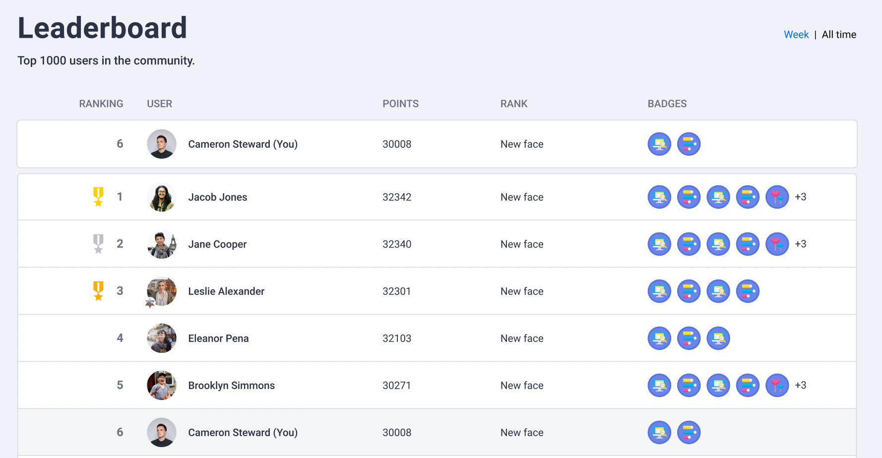
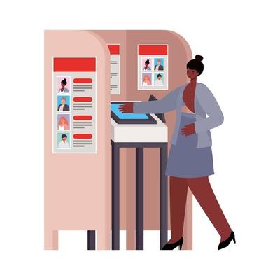
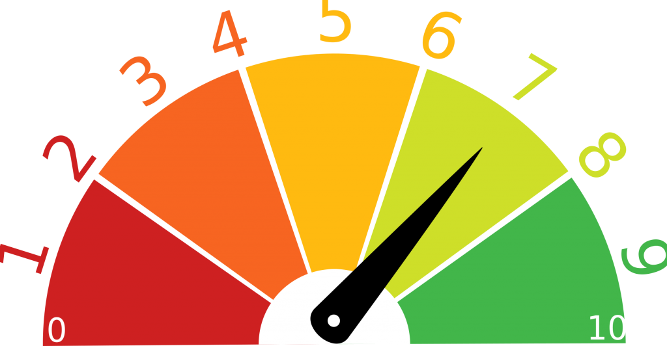
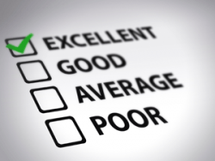
Meeting Effectiveness Tracker Planning and structuring effective meetings
LeaderBoard
Voting Booth
Efectiveness Trend
Personal scorecard

