Slide 1











Flash-based Course Authoring and Content
WebELS Server
Web Server
Content Server
Streaming Server
Presentation
Online/Offline Self-Learning
Slide Document
(ppt, pdf)
Flash Media Content
Video
(mp4, avi, mpg)
Slide and Video Clip
Synchronization
Course Authoring

Slide 2



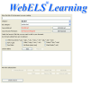

Java-based Course Authoring
WebELS Server
Web Server
Content Server
Streaming Server
Presentation
Online/Offline Self-Learning
Slide Document
(ppt, pdf)
Java-based Content
Audio (wav)
Audio &
Cursor Recording
Course Authoring

Slide 3









Distribute a Video
WebELS Meeting Server
Lecture/Speech
Remote Viewers
WebELS Client
(Presenter)
WebELS Client
(Group Listener)
WebELS Client
(Individual Listener)

Slide 4
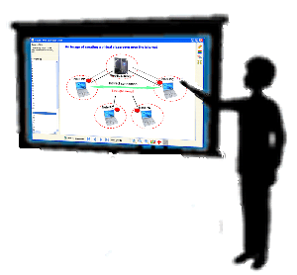
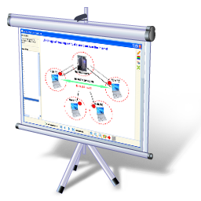


Distribute Video & Presentation
WebELS-SSB Server
Remote Viewers
Presentation
WebELS Client
(Presenter)
WebELS Client
(Group Listener)
WebELS Client
(Individual Listener)

Slide 5
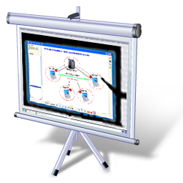

Distribute Presentation as Video
WebELS Meeting Server
Remote Viewers
Presentation
WebELS Client
(Presenter)
WebELS Client
(Group Listener)
WebELS Client
(Individual Listener)

