Slide 1


Convergence Panel
John Beverley
Assistant Professor, University at Buffalo
Co-Director, National Center for Ontological Research
Affiliate Faculty, Institute of Artificial Intelligence and Data Science

Slide 2
“Never throw caution to the wind. It could whip back into your eyes and blind you.”
-Stephen Colbert

Slide 3
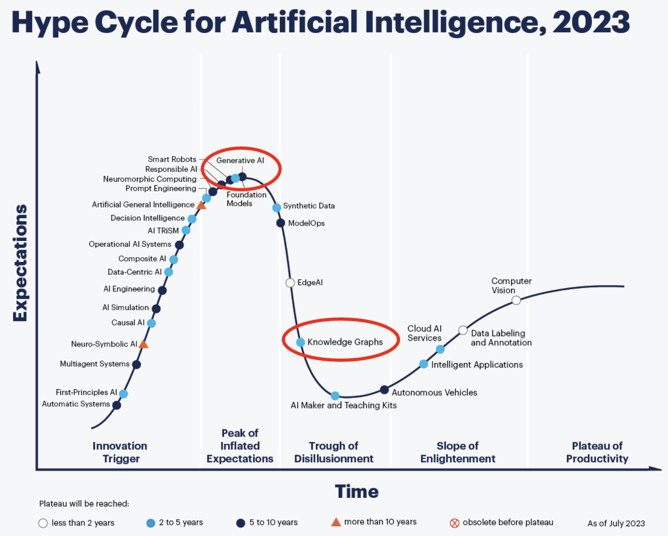
Present Summer
The current summer is one of big data, cheaper & faster computing, generative techniques, knowledge graph integration, and neuro-symbolic systems
But also hype and overpromising

Slide 4
Cause for Caution
Barry used to receive requests for talent about once a month; we now receive requests for talent almost daily...
We must expand the scope of training and research or we run the risks of being victims of our own successes
Training in applied ontology circles is not adequate to take advantage of the promises of neuro-symbolic methods

Slide 5
We need to establish consensus around training, i.e. what is trained and how, who is training and who is trained

Slide 6
Optimistic Caution
Fidelity (Knowledge Representation Group)
University of Michigan (Bioinformatics)
Florida State University (Information)
Johns Hopkins Applied Physics Lab
University of Virginia (Data Science)
Department of Homeland Security
Customs and Border Protection
Knowledge Graph Alliance
Syracuse University (CSE)
Air Force Research Labs
CUBRC
KadSci
George Mason University (C4l & Cyber)
Northwestern University (Philosophy)
University of Maryland (Physics)
Industrial Ontologies Foundry
Colgate University (Philosophy)
UB (Bioinformatics Department)
Ohio State University (Logic)
UB (CSE Department)
Bloomberg (HR)
Aerospace
Scania

Slide 7
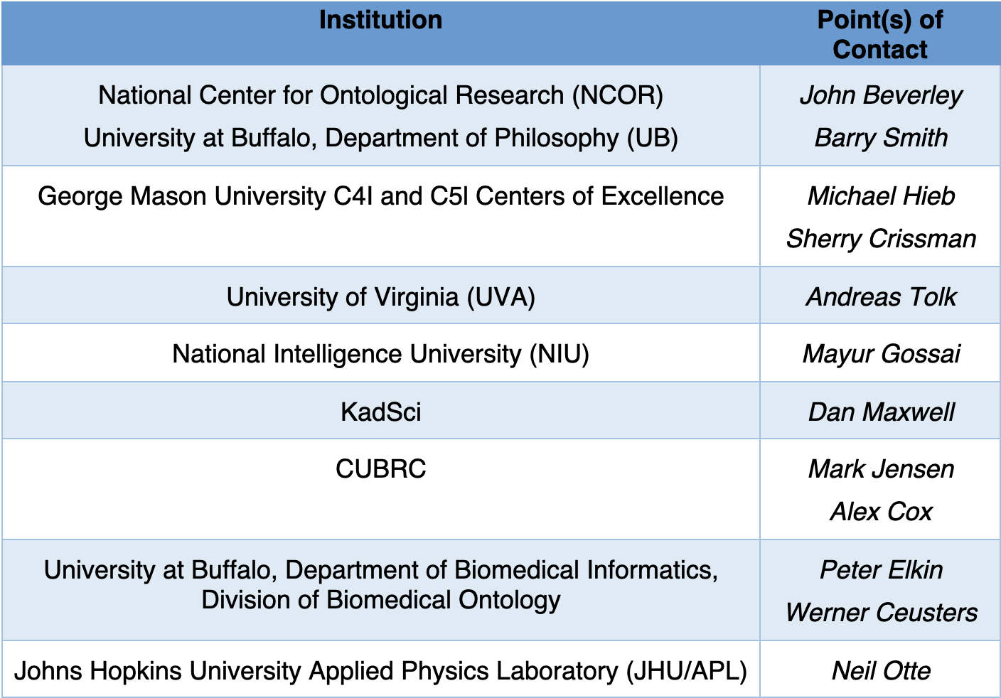
Optimistic Caution
Create a training consortium
Whose members may:
Enter articulation agreements
Supervise new ontologists
Host tutorials, bootcamps, certificates, full programs, etc.
Provide internships
Disseminate training material and documentation for existing and future ontology training

Slide 8
NCOR Trainings
Ontology & Intelligence Analysis – Tuesdays 1 – 4pm (starting Sept)
Introduction to Ontological Philosophy – Online (starting Sept)
Ontology of Economics – Monday 1 – 4pm (starting Sept)
Logic for Ontologists – Thursdays 1 – 4pm (starting Sept)
BFO/Common Core Office Hours – Fridays 10 – 11am (ongoing)
Common Core Ontologies – Thursdays 2 – 3pm (ongoing)
Ontology 101 – Wednesdays 11am – 12pm (ongoing)
Semantic Mapping – Fridays 1 – 2pm (ongoing)
Open to the public
Remote, recorded, minutes online
https://johnbeve.github.io/NCOR-Test

Slide 9
Knowledge representation researchers must expand their horizons, learn to integrate existing and novel AI technologies

Slide 10
Summary
I am an optimist about the future, but while history doesn’t repeat, it often rhymes
Our fields are on fire, but if we’re to avoid burning out we need to seriously re-evaluate who, what, why, and how we train
This is as much a matter of advancing and integrating research as it is a matter of administration

