Slide 1

Applied Ontology Development
How it relates to AI / ML, & LLM’s
Daniel T. Maxwell, Ph.D.
President, KaDSci LLC
dmaxwell@kadsci.com

Slide 2
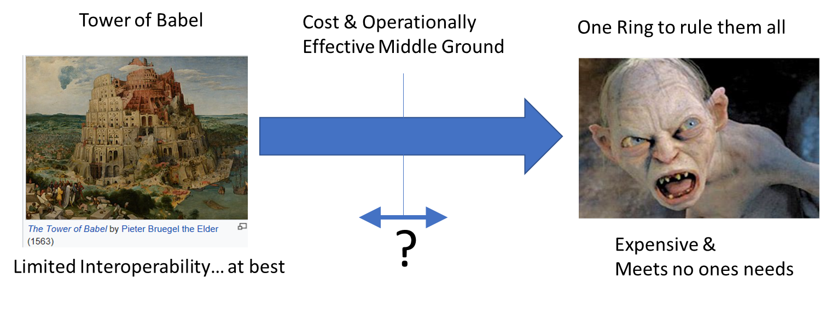
Context
I am not an ontologist.. I am an operations research analyst / decision & data scientist.
My focus is on applied problems -- wrote my first AI programs in 1992
The problem with LLM’s (machine learning in general) is found in data and language
“Fact”
Webster says – A true piece of information
Computer Science says – A data element that is fed into a Machine Learning model
“Ambiguity” in language
One million words in the English language (give or take 20%)
Most have more than one definition
Over 8,000 Languages

Slide 3
Key Points for Today
Things you know:
We are drowning in data
The “N” V’s of data are an overwhelming challenge
Things you should know:
Analytics and AI that are not grounded in the information, decision, and statistical sciences are dangerous. (There are charlatans and naïve practitioners out there.)
Data is not ubiquitous, “Free”, or always relevant. It must be curated to assess its evidential value and managed to keep it relevant / useful for inference and analysis.
Things I hope you will take away:
Ontologies only matter if there are:
Multiple stakeholders / organizations
Multiple disparate sources of data
Multiple analysts, software developers,…
There is hope
It will be a marathon, not a sprint
You can help
Your Perspective matters
Hype
AI / Computing Power
Capability
Science and Technology
Always True
Time

Slide 4
Imperatives if we are to make progress
Things you know:
We are drowning in data
The “N” V’s of data are an overwhelming challenge
Things you should know:
Analytics and AI that are not grounded in the information, decision, and statistical sciences are dangerous. (There are charlatans and naïve practitioners out there.)
Data is not ubiquitous, “Free”, or always relevant. It must be curated to assess its evidential value and managed to keep it relevant / useful for inference and analysis.
Things I hope you will take away:
Ontologies only matter if there are:
Multiple stakeholders / organizations
Multiple disparate sources of data
Multiple analysts, software developers,…
There is hope
It will be a marathon, not a sprint
You can help
Your Perspective matters
Hype
AI / Computing Power
Capability
Science and Technology
Always True
Time
Decisions, whether manual or automated, should be Problem Owner / Goal Oriented and Evidence Informed vs. Data Driven
Ontologies are an essential part of the solution.
This will be a marathon; not a sprint

Slide 5




How Ontologies Complement Analytic Modeling
Ontologists organize / describe the world – reduce ambiguity, increase clarity
Top level ontology
Mid level ontologies
Domain Ontologies
gap gap gap gap gap gap gap gap gap gap gap
Problem Owners
Application Ontology(ies)
Data bases
AI Systems Models
Dashboards
Knowledge Graph(s)
Intersection of data and “formal” ontologies
Data Collectors Observe the world
Analysts / Software Developers
Operationalize data into models, tools
Credit to Jon Vajda for an assist on this visualization

Slide 6
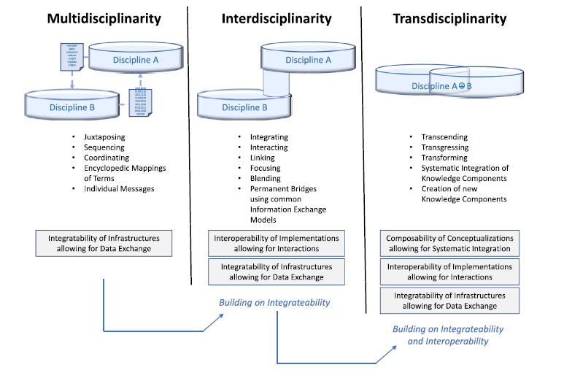
Task Organizing for Success
We need this approach
From Tolk, A., et.al
Hybrid models as transdisciplinary research enablers - ScienceDirect

Slide 7
Causes of failure
Failure to keep sight of the Fundamental Objectives (The reason the project exists)
Best Available Data (BAD)
Failure to consider sound input from different perspectives
Deploying “data science quality” software without proper testing for other usability / reliability considerations
Construction of logically inconsistent underlying models (Let’s add 100 feet to 4 miles plus or minus a mile)
Imbalance in the team’s culture / process(es) and the resulting friction
“Ontologists move too slow, and their models are too brittle for my analysis”
“The data scientists aren’t managing their software so I can use it for production”
“These configuration control requirements are slowing me down badly”
“Nobody listens to me” – Not unique to our challenge
“I can’t use this. I can’t follow the code and don’t know what the data means”
And # 1 – “All these meetings are killing me”
Note: I have observed or participated in all of these – Feel free to add

Slide 8
Applied Research / Empirical Approach
Outcomes:
Applications
Analysis Results
Tools /
Methods
Applied Science
Domain Expertise
Data / Evidence
Data / Evidence
Engineering
Theory / Basic Science

Slide 9
You can’t forget the thinking part!!!
Questions???
You can’t forget the thinking part!!!
Comments

