Slide 1
Autonomous Disaster Response Agent Coordination Hub
An AIIMS-aligned, multi-agent coordination platform for Australian emergency management
John Billiris
Azure Master Architect Capstone | May 2026
Notes:
KEY MESSAGE: We are presenting an Australian-sovereign, multi-agent platform that turns minutes into lives saved during disasters.
TALK TRACK (60s):
- Open with energy. "Good afternoon. Over the next 40 minutes I'm going to take you inside one of the hardest, most consequential coordination problems in our country - and show you a working multi-agent platform that addresses it."
- Frame audience: "Some of you sit at the executive table; others run the platform. I'll move between the two altitudes deliberately, and I'll mark every transition so you know which lens we are using."
- Set expectation: "Forty minutes of presentation including a live walkthrough; twenty minutes of Q&A. I'll close with a concrete adoption ask."
DELIVERY: Stand still. Eye contact across the room. Pause after the title.

Slide 2
AGENDA
The 4-minute window - why coordination is the bottleneck
Stakeholders, personas and the AIIMS reality
Current state - where coordination breaks today
Solution vision and reference architecture
AI strategy - five agents, one common operating picture
Live demo - Blue Mountains bushfire, end-to-end
Security, governance, responsible AI and data sovereignty
Business impact, KPIs, FinOps and adoption roadmap
Notes:
KEY MESSAGE: Eight chapters; each with a clear takeaway.
TALK TRACK (45s):
- "Here is the route we will walk. I'll pause at the end of each chapter for a quick gut-check before we move on."
- Call out: "The demo sits in the middle so we can let the architecture explain itself, then come back for governance and business impact."
PACE: 30-40 seconds. Don't read every bullet. Highlight only chapters 3, 6 and 9.

Slide 3



In Australian disasters, minutes are the currency of life
33 lives lost
3,000+ homes destroyed
$103B economic cost
Black Summer 2019–20 burned 24 million hectares across Australia. Post-event reviews identified shared situational awareness - not firepower - as the limiting factor.
A Royal Commission estimated disaster losses will exceed AUD$39B per year by 2050. Coordination, not capital, is the binding constraint.
The 2022 Northern Rivers floods affect 3,000+ homes. Evacuation lead time, not transport capacity, drove the casualty curve. An earlier coordinated evacuation would have changed the outcome.
https://en.wikipedia.org/wiki/2019%E2%80%9320_Australian_bushfire_season
https://www.royalcommission.gov.au/natural-disasters/report
Notes:
KEY MESSAGE: The cost of disasters in Australia is dominated by coordination latency, not by hardware or money.
TALK TRACK (90s):
- Open with an image-evoking sentence. "Picture a Rural Fire Service crew in Cobargo – about 5 hours drive south of Sydney - on New Year's Eve 2019. They had trucks, water and crews. What they did not have was a shared real-time picture. By the time three agencies aligned, the wind had shifted (PAUSE) twice."
- 2019-20 Black Summer …. Burnt the land size of 330x Singapore in 9 months
- Quote the numbers. "33 lives. 3,000 homes, 3 billion animal killed or displaced. $103B damage (PAUSE). The Royal Commission into National Natural Disaster Arrangements named coordination, not capability, as the primary improvement opportunity in its 80 recommendations."
- Bridge: "The pattern is consistent across cyclones, floods, heatwaves and pandemics. The bottleneck is shared situational awareness, fast enough to act on."
PAUSE after "$103B" - let it land.
BACKUP:
Direct and indirect disaster costs in Australia are projected to increase from an average of $18.2 billion per year to $39 billion per year by 2050, even without accounting for climate change.

Slide 4
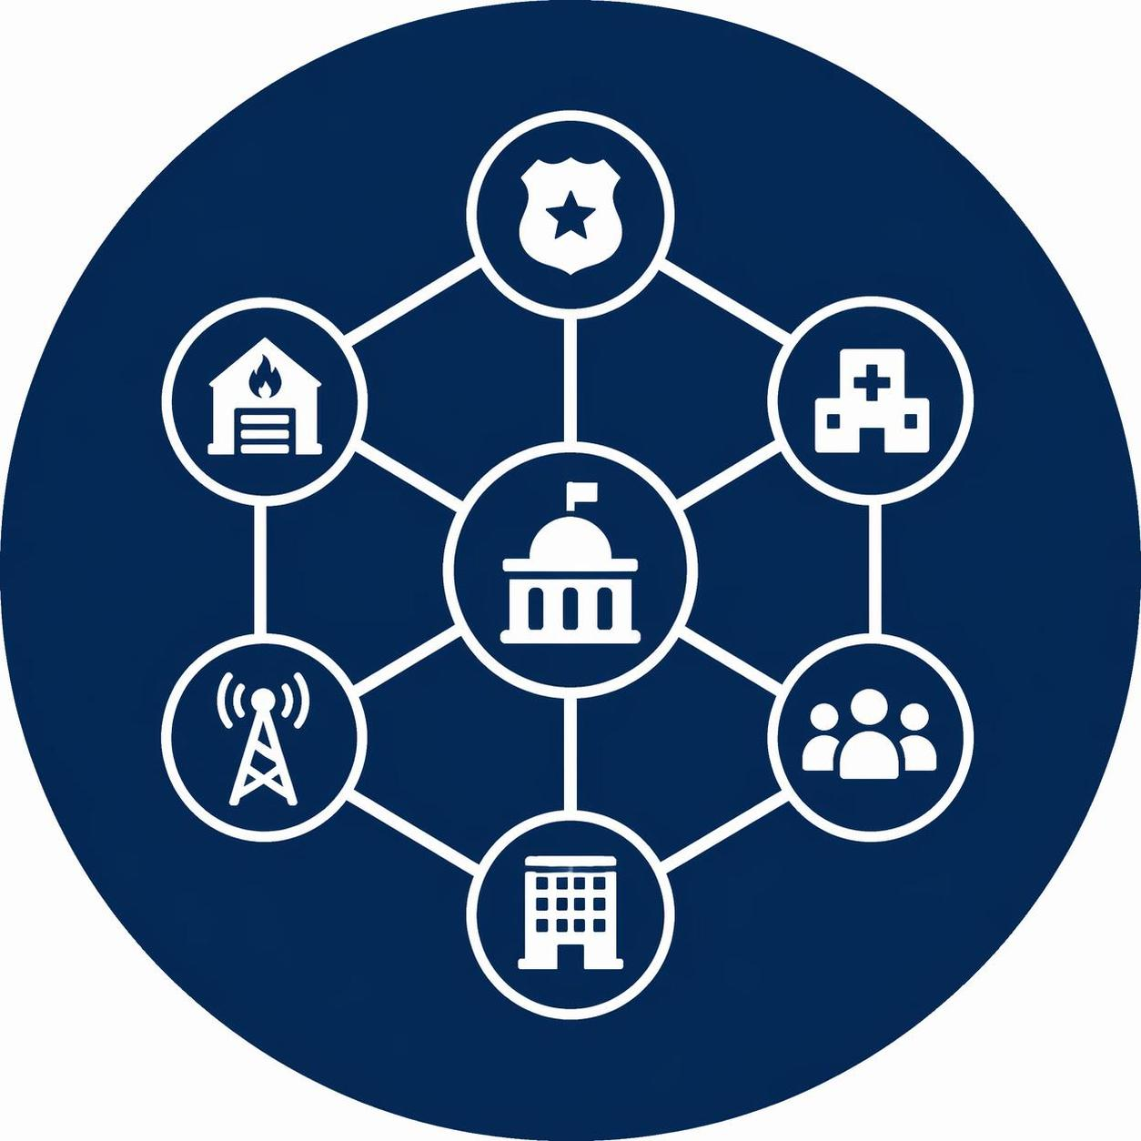
Industry context
A climate-amplified, federated coordination problem
Australia is unique. Six states, two territories, eight emergency-services jurisdictions, 500+ local councils, and a Commonwealth that coordinates but does not command.
Every major disaster activates a different combination of agencies. The Australasian Inter-service Incident Management System (AIIMS) defines the language; the National Joint Common Operating Picture (NJCOP) is meant to be the canvas - but today it is filled by hand.
Climate science is unforgiving: AFAC projects a 25–35% increase in days of catastrophic fire danger by 2040, and the Bureau of Meteorology forecasts more extreme rainfall in every season.
Doing more of the same will not work. The platform we propose is built for that future.
Notes:
KEY MESSAGE: The system must be built for federation and for a worsening hazard curve - both at once.
TALK TRACK (90s):
- "Australia's emergency management is one of the most federated in the world. There is no single national operations centre. The Commonwealth, through NEMA, coordinates - it does not command. Authority flows through state agencies, councils and front-line crews."
- "AIIMS gives us a shared functional vocabulary - Control, Intelligence, Planning, Operations, Logistics, Public Information. The NJCOP gives us a target architecture. The gap today is the connective tissue that turns that target into a live, machine-readable picture."
- Bridge: "A multi-agent platform is the natural shape of a solution to a multi-agency problem. That is the bet we are making."
ANTICIPATED Q&A:
- "Why not extend EMSINA tools?" - We integrate with them, not replace.
- "How do you handle Commonwealth/State politics?" - Constitution Section II-A makes it explicit.
ABBREVIATIONS:
AFAC : Australasian Fire and Emergency Service Authorities Council - Large-scale bushfire events frequently require interstate assistance. Mutual aid is coordinated through AFAC.
NEMA: National Emergency Management Agency - Commonwealth coordinates national-level support to states and territories during major emergencies

Slide 5
Stakeholders & personas - built for the people who run the response
Operational personas
Sector personas
Executive & community
Incident Controller, Operations, Planning, Logistics, Public Information, Liaison, Field Coordinator, Observer-Auditor. Each maps 1:1 to an AIIMS function and drives a tailored workspace in the platform.
Minister/Director-General, Risk Manager, FinOps owner, Resilience Planner, and the affected community member receiving alerts in language. The system speaks to all five at the right altitude.
58 active sector agents organised by jurisdiction (Commonwealth, all states/territories, cross-sector) - fire, police, SES, ambulance, hospitals, utilities, transport, telco, local gov, environment, Indigenous relations, wildlife, weather, research
Notes:
KEY MESSAGE: Personas are not a UX afterthought - they are the system's primary structuring principle.
TALK TRACK (75s):
- "We catalogued 85 personas across 10 operational roles, 58 sector agencies, and 17 technical roles. They are checked into the repository at .github/agents/ - every persona is a first-class entity."
- "AIIMS is non-negotiable. If you ask for an Operations Officer workspace, the platform gives you exactly the views and powers an Operations Officer is authorised to have - never more."
- "Look at the third column. We do not stop at the operations centre. The Minister briefing the public, the FinOps lead asking 'are we still in budget on day three' - they are users of this platform too."
ANTICIPATED Q&A: "How are vulnerable populations represented?" - Constitution Section VI-C plus the Cultural Authority specs.

Slide 6
Current state: where coordination breaks today
Signal fragmentation
Manual fusion
Warning friction
Bureau of Meteorology, Geoscience Australia, eight state services, 500 councils, utilities, satellite feeds, social media - 46 authoritative sources, each with its own format, cadence and trust level. There is no normalised stream.
The Australian Warning System defines 3 levels and 10 warning principles, but warning drafts still pass through email and PDF. Multilingual delivery and Auslan video are inconsistent. Vulnerable populations are reached last.
Today, signal fusion is largely manual - duty officers swivel-chair across multiple authoritative systems. AIDR acknowledges that a multi-agency response can take hours.
Notes:
KEY MESSAGE: Three concrete failure modes - each of which the platform attacks directly.
TALK TRACK (90s):
- Walk left to right. "First - fragmentation. We seeded 50+ Australian sources from BoM gauges to RFS Fires Near Me to TfNSW road closures. Each speaks its own dialect."
- "Second - fusion. Today this is humans with two screens and a coffee. By the time the picture stabilises, the situation has already moved."
- "Third - the last mile. The Warning System standard is excellent on paper, but execution lags. Multilingual alerts in eight languages plus Auslan are not standard practice today; they are exceptions."
- Bridge: "Every one of these is solvable with the right combination of agentic AI, governance and Azure-native services. That's what comes next."
EXEC HOOK: "Each hour we cut from fusion is, on the historical curve, dozens of additional households reached before impact."

Slide 7

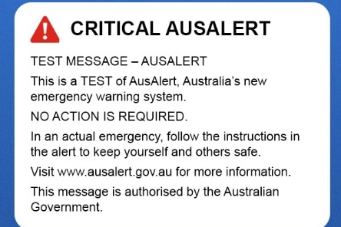
Competitor landscape
AusAlert is a new national emergency warning system that sends urgent messages to compatible mobile phones and other mobile devices in a specified area.
Since 2023, the Australian government has invested about AUD$132 million to build and test the system. It is purported to being technically ready in July 2026 and available for use by October 2026.
Warning friction
https://www.ausalert.gov.au/
Notes:
A new national mobile alert system will begin trials this year, with the aim of delivering faster emergency warnings to Australians in times of disaster.
The government initially promised the national messaging system would be ready by the end of 2024, but it is now expected to be operational by October 2026….. Two years behind schedule.
This solution is ready now. It took 90 days of spare time.

Slide 8

The Coordination tax
Minutes lost is the lives-saved curve
We modelled the response timeline for seven canonical Australian scenarios - bushfire, riverine flood, tropical cyclone, urban-fire mass-casualty, and pandemic surge.
Across them, the dominant variable is not detection latency. It is coordination latency - the time between a signal being available somewhere and the right action being authorised everywhere.
Currently, there is no canonical baseline for coordination latency for a level-2 incident. Our prototype baseline-vs-AMA-assisted simulation harness establishes a baseline measurement harness.
Translated for executives: the platform is not making humans faster. It is making the organisation faster - by removing the seams between agencies.
Notes:
KEY MESSAGE: The thing we are optimising is *organisational* latency, not individual speed.
TALK TRACK (75s):
- "There’s no canonical baseline. The closest real number is of a coordination latency of minimum of 3 hours by AMSA. That is the time from a confirmed signal to an authorised, multi-agency action in a level-2 incident"
- "Our explicit success criterion, establishes a deterministic baseline."
- Make it human. "When we say faster, we are not talking about a faster keystroke. We are talking about an entire response system that converges quicker. That's the difference."

Slide 9

Vision
A Common Operating Picture that thinks
Our north star is a Common Operating Picture (COP) that is not just shared but reasoned over - by a network of specialised agents that propose, deliberate, and escalate to humans.
Every authoritative signal in Australia, normalised and trust-scored. Five mission-aligned agents (Monitoring, Risk Assessment, Evacuation, Resource Allocation, Communication) coordinated via deterministic handoffs. Every recommendation traceable, every action approved by a human, every warning published in eight community languages.
It is multi-agency by construction, AIIMS-aligned by contract, and Australian by residency. It is the architecture our future requires - and it is built today.
Notes:
KEY MESSAGE: A COP that thinks - agents propose, humans dispose.
TALK TRACK (60s):
- "There is one phrase I want you to walk away with: a Common Operating Picture that *thinks*. Today the COP is a canvas; tomorrow it is an active participant."
- "Three commitments are baked in: AIIMS by contract, Australian by residency, human by mandate."
ANTICIPATED Q&A:
- "Will agents make decisions?" - They make *recommendations*. Section "Non-Negotiables" #1 is human-in-the-loop for any irreversible action.

Slide 10

Solution at a glance
Five agents, one mission
MONITORING AGENT - ingests ~46 Australian sources, normalises into signal envelopes, trust-tier and freshness-score every observation.
RISK ASSESSMENT AGENT - LLM-enabled fusion, generates ranked recommendations with explanation; falls back to template when LLM unavailable.
EVACUATION AGENT - runs the AIDR five-stage process (Decision, Warning, Withdrawal, Shelter, Return); tests assembly area & corridor capacity.
RESOURCE ALLOCATION AGENT - prioritises cross-agency tasks by life-safety criticality; surfaces shortfalls.
COMMUNICATION AGENT - drafts AWS-compliant warnings in 8 languages + Auslan; every alert requires named human approval before publish.
Notes:
KEY MESSAGE: Five agents, one mission, every action human-approved.
TALK TRACK (90s):
- "Memorise the five. Monitor. Assess. Evacuate. Allocate. Communicate. Each maps directly onto an AIIMS function - none are bolt-ons."
- "Notice the verbs. Agents *ingest*, *fuse*, *rank*, *draft*. Humans *approve* and *publish*. That separation is intentional and immovable."
- "The Communication Agent is the most-watched. Eight languages plus Auslan, every alert behind a named approval. We will see this in the demo."

Slide 11

Constitution
The rules the platform lives by
Six core principles:
Primacy of Life
National EM Principles
Multi-hazard / Multi-agency
Transparency & Auditability
Australian Warning System
AIDR-aligned Evacuation & Recovery
Every spec, every PR, every deployment is checked against this Constitution. Compliance is not paperwork - it is a CI gate.
Five non-negotiables:
Human-in-the-loop
Data sovereignty
Privacy by design
Standards-based interoperability
Graceful degradation
Notes:
KEY MESSAGE: Governance is *upstream* of the architecture, not downstream of an audit.
TALK TRACK (60s):
- "This is the spine. Six principles, five non-negotiables. The Constitution is version-controlled at .specify/memory/constitution.md and amendable only by named project lead."
EXEC BRIDGE: "If a regulator asked me 'show me your data residency posture' I open the Constitution and a single Rego policy. That's it."

Slide 12
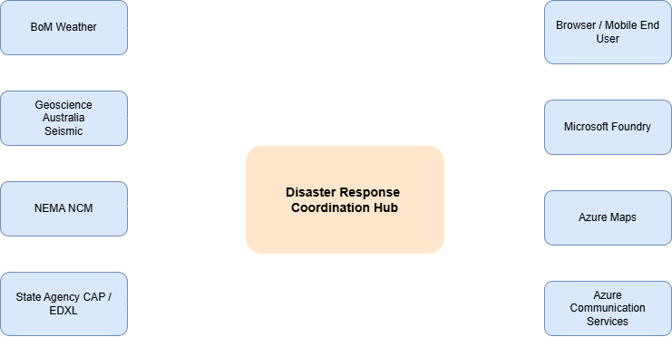
System Context - who interacts with the platform
C4 System Context · docs/architecture/c4/system.png
Notes:
KEY MESSAGE: The platform sits at the centre of a federated emergency-management ecosystem; we integrate, we do not replace.
TALK TRACK (90s):
- "Read this diagram from the outside in. On the perimeter you have authoritative producers - BoM, Geoscience Australia, state services. Then sector consumers - councils, utilities, transport. Finally the people: operators, executives, the public."
- "The platform is the *fabric* in the middle, not a destination. Every existing system is a peer."
- "Two integration directions: ingest signals from authoritative sources (CAP, EDXL, GeoJSON), and emit warnings/tasks back to the channels people already use - Emergency Alert SMS, social, broadcaster CAP feeds."
ANTICIPATED Q&A:
- "What about NEMA / NJCOP?" - Bidirectional integration on roadmap; constitution Section "National Coordination" makes it mandatory.
ABBREVIATIONS
NEMA = “National Emergency Management Agency” - national coordination and COMDISPLAN activation
NCM = “National Coordination Mechanism” - cross-sector coordination for complex national emergencies
NJCOP = “National Joint Common Operating Picture” - IT-based geospatially enabled platform providing all-hazards near-real-time situational awareness and impact assessment of nationally significant events
CAP = “Common Alerting Protocol” – a collection of agreed standard messages and templates.
EDXL = “Emergency Data Exchange Language” – a suite of XML-based messaging standards that facilitate emergency information sharing between government entities and the full range of emergency-related organizations

Slide 13
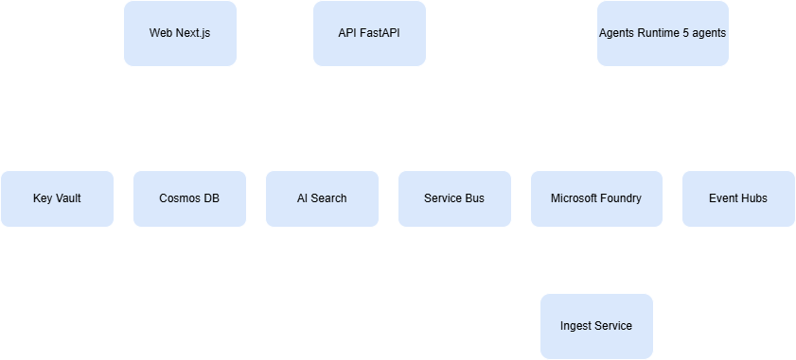
Container view - Azure-native, 100% serverless or managed
C4 Container view · docs/architecture/c4/container.png
Notes:
KEY MESSAGE: Every box on this diagram is an Azure-native managed service. No bespoke infrastructure to operate.
TALK TRACK (90s):
- "Top to bottom. Operator UI is Next.js on Azure Web Apps. The API layer is FastAPI on Azure Container Apps with managed identity end-to-end."
- "Data plane: Azure Cosmos DB for incidents and approvals (Strong consistency on the audit container, Session everywhere else); Azure Storage with immutability policies for evidence; Azure Service Bus for handoffs; Event Grid for fan-out."
- "Agents are Microsoft Foundry agents orchestrated through the Microsoft Agent Framework. Azure AI Search powers RAG against the AIDR corpus. Azure Communication Services delivers SMS, voice, email."
- "Why this matters: every integration uses Managed Identity, RBAC, and Private Endpoints. Zero key vaulting of secrets except for the deliberately-listed third-party tokens."
ABBREVIATIONS
AIDR = “Australian Institute for Disaster Resilience”

Slide 14
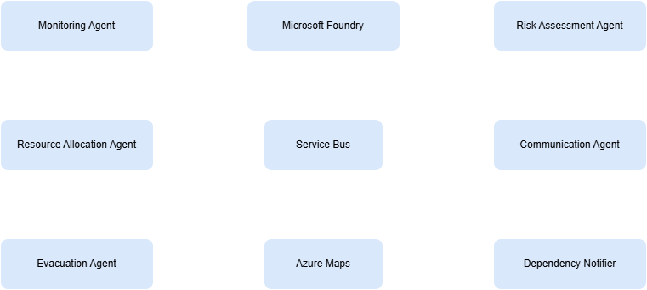
Multi-agent component architecture - handoffs as a contract
Agent component view · docs/architecture/c4/component-agents.png
Notes:
KEY MESSAGE: The agent network is a graph, not a pipeline; handoffs are typed, retried, and dead-lettered.
TALK TRACK (90s):
- "This is the heart of the platform. Five agents, deterministic handoff chains, every transition typed and traceable."
- "Look at the Monitoring → Risk Assessment edge. It only fires for confidence-scored signals above 0.8 in the fire/weather/hydrology categories. Below threshold, we hold and re-evaluate."
- "Every handoff is an AgentHandoffEvent with retry (3x within a 300-second window) and a dead-letter container with named operator review."
- "The reflection pattern lives between Risk Assessment and Communication: the Risk agent's output is critiqued by a guardrail policy before the Communication agent ever sees it."

Slide 15
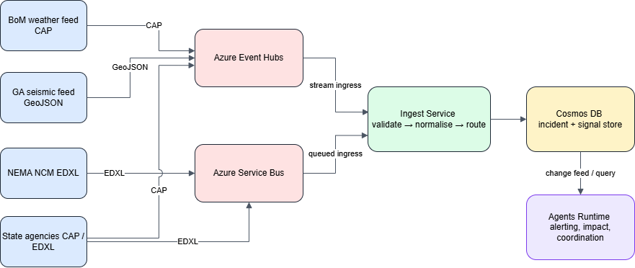
Data & integration - 7 trust tiers, normalised at the edge
Ingestion data flow · docs/architecture/data/ingestion-data-flow.png
Notes:
KEY MESSAGE: Data trust is a first-class field, not an inference; downstream agents reason on it directly.
TALK TRACK (90s):
- "Seven trust tiers, from Tier 1 authoritative government - BoM warnings, RFS fire bans - down to Tier 7 derived signals. Every signal carries its tier, its confidence score, and its freshness score."
- "Standards in: CAP for warnings, EDXL for distribution, GeoJSON for geometry, OpenAPI 3.1 for everything we expose."
- "We seeded ~50 Australian data sources at launch. The 'Add a source' workflow is 30 lines of YAML and a Bicep module. New jurisdictions plug in on day one."
EXEC BRIDGE: "If a future regulator says 'tell me where this number came from', the audit trail walks them all the way back to the original source URI and timestamp."
The 7 trust tiers
Tier Name Examples (from the AU seed) Count
Tier 1 Authoritative Government Bureau of Meteorology (warnings, forecasts, radar, observations, AWS, river gauges, flood warnings); Geoscience Australia (earthquake, tsunami, sentinel hotspots); state emergency services (NSW RFS, VIC CFA, QLD QFES, SA CFS, WA DFES, TAS TFS, ACT ESA, NT PFES) 20
Tier 2 Verified Institutional AIDR; state health departments (NSW, VIC, QLD); transport authorities (TfNSW, VicRoads, TMR QLD); utility operators 9
Tier 3 Operational Sensor BoM Automatic Weather Stations; river-gauge networks; satellite imagery (Sentinel, Himawari-8/9); state EPA air-quality sensors 5
Tier 4 Field Reports Agency field-officer reports; ICON IMS; WebEOC IMS 3
Tier 5 Community / Volunteer Surf Life Saving Australia; volunteer bushfire brigades; Snap Send Solve 3
Tier 6 Social / Unverified X/Twitter; Facebook; Reddit 3
Tier 7 Derived / Computed Internal agent-generated risk assessments; aggregated risk scores; historical incident databases 3

Slide 16
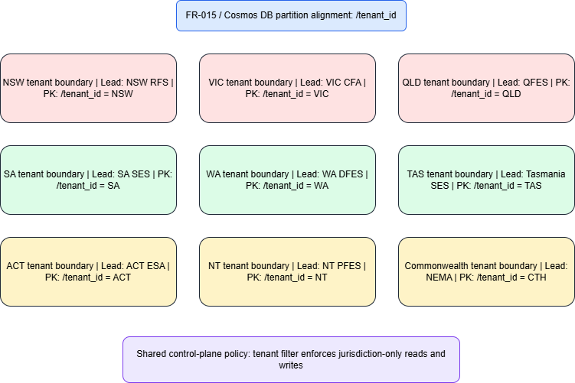
Multi-jurisdiction tenancy - federation by design
Multi-jurisdiction tenancy · docs/architecture/data/multi-jurisdiction-tenancy.png
Notes:
KEY MESSAGE: One platform, many jurisdictions, zero data leakage.
TALK TRACK (75s):
- "Australia is federated. The platform is federated. Every signal, every recommendation, every alert is tagged with a jurisdiction tuple - Commonwealth, State/Territory, regional, local."
- "Cross-jurisdiction visibility is governed by JurisdictionPolicy entities - privacy, residency, visibility rules per jurisdiction. WA cannot see VIC's PII. NEMA can see anonymised cross-cohort metrics."
- "Implementation is a partition-key on Cosmos plus a Rego policy layer. Both belt and braces."

Slide 17
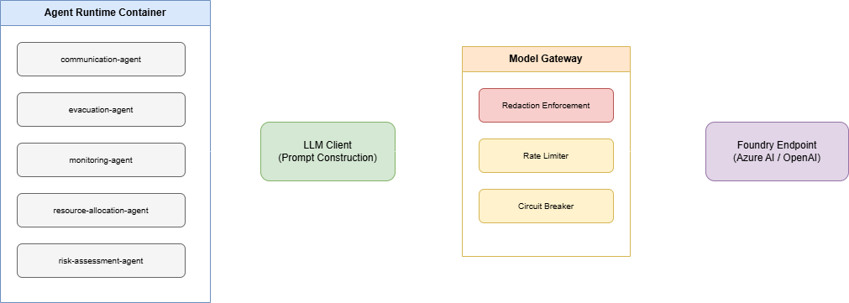
AI strategy - dual-deployment LLM gateway, Foundry-native RAG
Agent runtime + LLM gateway · docs/architecture/c4/agent-runtime-llm-gateway.png
Notes:
KEY MESSAGE: The model is a *replaceable component*, never a single point of failure or a single vendor lock.
TALK TRACK (90s):
- "Two deployments: a 'reasoning' model for complex risk fusion (GPT-4 class), and a 'drafting' model optimised for low-latency multilingual generation. Routed by purpose, not by URL."
- "Every call goes through a model gateway that enforces token budgets, content-safety, prompt-shielding, and the data-minimisation rules required by the AU-residency carve-out."
- "Three-tier fallback: LLM → templated fallback → safety fallback. The Communication agent will *always* produce an alert, even if every model in Australia is offline. That is a constitutional requirement."
- "Microsoft Foundry RAG grounds every agent on the AIDR Handbook collection - Incident Management, Evacuation Planning, Public Information & Warnings, Recovery. Citations are mandatory."

Slide 18
Agentic patterns - orchestration that survives reality
Handoff + retry
Reflection + guardrail
Graceful degradation
Typed AgentHandoffEvent. 3 retries within a 300s window. Failed handoffs land in a dead-letter container with a named operator review SLA. Every handoff carries a correlation ID end-to-end.
Every agent has a deterministic fallback.
Lose the LLM? Templated alerts.
Lose Cosmos? Read-only mode with banner.
Lose Service Bus? In-process queue with bounded buffer.
Risk Assessment outputs are reviewed by a content-safety + guardrail policy before Communication ever sees them. Reflection prompts critique recommendations against the ten Warning Principles.
Notes:
KEY MESSAGE: Agentic patterns are not academic - they are how the platform survives a real disaster.
TALK TRACK (90s):
- "Three patterns we lean on: handoff with retry, reflection with guardrails, and graceful degradation."
- "Handoff is a message contract, not a method call. We chose async because the network during a real disaster looks nothing like a tabletop exercise."
- "The reflection layer is where 'responsible AI' becomes operational. Every Risk Assessment recommendation is critiqued by a guardrail before it reaches a human."
- "Graceful degradation: when something fails, the platform does not. It downgrades, surfaces the degradation prominently, and keeps going. That is constitutional."

Slide 19
Responsible AI
Eight languages, Auslan, and a named human
Languages: English (Grade-8 plain language), Mandarin, Arabic, Vietnamese, Cantonese, Punjabi (top-5 ABS Census non-English), Auslan video, plus a jurisdiction-appropriate Aboriginal/Torres Strait Islander language. WCAG 2.2 AA on every render.
Content safety: Azure AI Content Safety + a domain-specific blocked-keyword list. Every alert is signed by a named human approver before publish - no exceptions, no bypasses.
Provenance: every recommendation cites its source signals; every LLM call records input tokens, output tokens, model version, correlation ID. Complete decision-chain traceability for any auditor at any time.
Bias & fairness: vulnerable population priority is a pre-processing constraint on evacuation routing - not an afterthought. Indigenous Relations sector agent is consulted for any incident touching declared Country.
Notes:
KEY MESSAGE: Responsible AI is woven through delivery, not painted on at the end.
TALK TRACK (90s):
- "Eight language channels per scenario, plus Auslan. We did not pick this list - the ABS Census did, plus AIDR's accessibility guidance. The platform reads the language pack catalogue at render time."
- "Plain language at Grade 8 reading level for English. That is the AIDR Public Information & Warnings handbook standard. Our Communication agent enforces it as a content rule."
- "Vulnerable population priority is upstream of the routing algorithm. It is not a tag added at the end - it changes the optimisation objective."
ANTICIPATED Q&A:
- "Hallucinations?" - Foundry RAG grounds every claim. Citations are mandatory; uncited claims are blocked.
- "Bias?" - We score every Risk recommendation against a fairness rubric tied to the AIDR handbook.

Slide 20
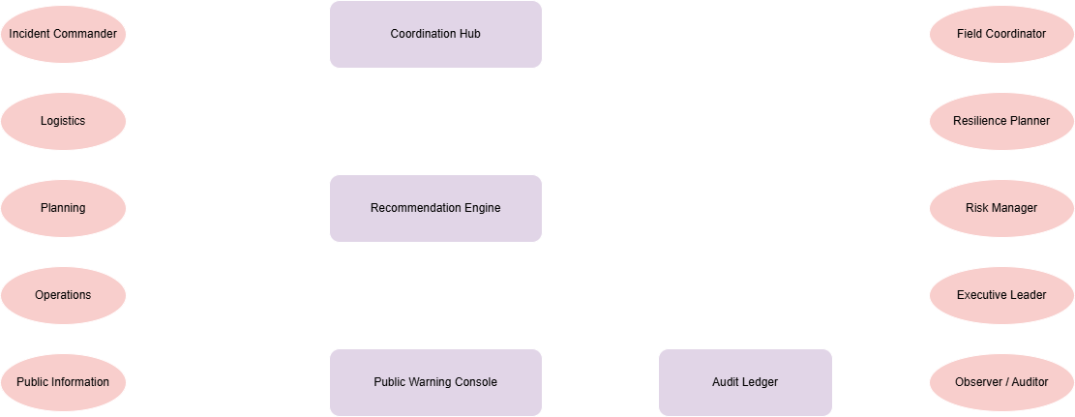
AIIMS + AWS alignment - speaking the operator's language
AIIMS system context · docs/architecture/operational/aiims-system-context.png
Notes:
KEY MESSAGE: An operator at any level should recognise the platform on the first screen - because it speaks AIIMS.
TALK TRACK (75s):
- "the AIIMS functions on the left. Operators on the right. Every workspace, every menu, every audit row uses this vocabulary."
- "The Australian Warning System - Advice/Watch and Act/Emergency Warning - is a first-class data type. Hazard icons, action statements, de-escalation rules: all enforced by schema."
- "This is the difference between a platform that is *aligned* with standards and one that *embeds* them. We embed."
ABBREVIATIONS:
AIMS = Australasian Inter-service Incident Management System
AWS = Australian Warning System
The 6 AIIMS Functions
The Australasian Inter-Service Incident Management System (AIIMS) defines six functional areas that together manage any incident:
Control - Overall command and strategic direction of the incident (held by the Incident Controller). Sets objectives, approves the Incident Action Plan, and retains final authority over life-safety decisions.
Planning - Collects and analyses information, develops the Incident Action Plan (IAP), tracks resources, and forecasts how the incident will evolve.
Public Information - Manages warnings, community messaging, media liaison, and multi-agency public communications.
Operations - Executes the IAP on the ground; directs tactical response (suppression, rescue, evacuation, containment).
Investigation - Determines the cause and origin of the incident and preserves evidence (added as a full function in AIIMS-5, 2017).
Logistics - Provides people, equipment, supplies, facilities, and support services that Operations needs to do its job.

Slide 21
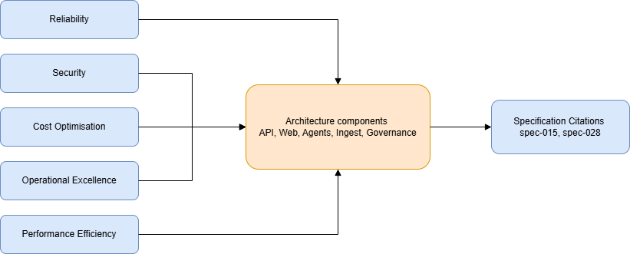
Well-Architected Framework alignment
Notes:
Reliability, Security, Cost, Operational Excellence, Performance Efficiency - all mapped. SLI/SLO model includes burn-rate alerts at 2%/h and 5%/h.

Slide 22
Live demo
Blue Mountains bushfire, end-to-end in 8 minutes
Scenario: a fast-moving bushfire on the western face of the Blue Mountains National Park, ember attack threatening Lithgow within four hours. NSW RFS lead, with police, SES, ambulance, hospitals, transport and Lithgow City Council in the response.
We will run the same canonical scenario twice (deterministic seed): once as a baseline (no AMA) and once AMA-assisted. Then we'll watch a live walk-through of the AMA-assisted run with the operator workspace.
Watch for: signal ingestion under 10s, recommendation generation in <30s, an Approval request to a named Incident Controller, multilingual alert generation including Auslan stub, and the audit chain reachable in two clicks.
Notes:
KEY MESSAGE: This is not staged narration. It is the same simulation harness our spec 040 evidence pack uses.
TALK TRACK (45s before demo):
- "Two runs of the same scenario. Same seed. The simulation engine is deterministic - that is a constitutional requirement and a CI test."
- "I'll narrate to your watch: you should see signal ingest, agent fusion, an approval request, and the alert burst happen in under three minutes of simulated time."
- "If anything blanks out, that is the demo gods, not the platform. Quickstart is documented in docs/runbooks/."
DEMO RECOVERY: Pre-recorded fallback at docs/canary/demo-recording.mp4.

Slide 23
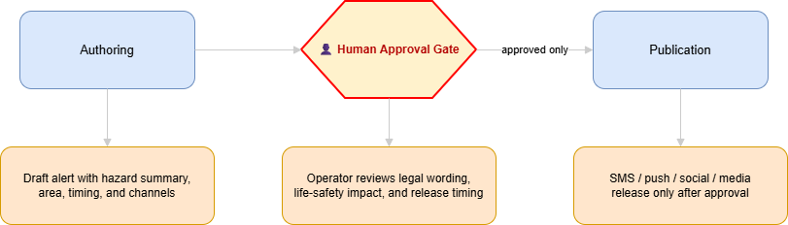
Alert approval and publication sequence
Alert approval & publication sequence · docs/architecture/sequence/alert-approval-publication.png
Notes:
KEY MESSAGE: Every interaction you just saw maps to this sequence - no off-screen magic.
TALK TRACK (60s post-demo):
- "Walk left to right with your finger. Signal in. Risk Assessment fuses. Reflection guardrail critiques. Recommendation surfaces in the Incident Controller workspace. Named human approval. Communication agent generates eight language channels. ACS dispatches. Audit row is written, durable, before any HTTP response returns."
- "Cosmos audit container is at Strong consistency, in a single AU region, with append-only Locked immutability for 7 years. That's not a feature - it is a regulatory floor."
ANTICIPATED Q&A:
- "What if the approver is unavailable?" - Escalation chain by AIIMS authority and named successor; full path is in spec 008.

Slide 24
Demo recap - what you just saw, in numbers
Speed
Reach
Trust
Signal-to-recommendation: ~30s in this run. Recommendation-to-approval-request: <5s. End-to-end signal-to-alert published: under 90s.
Every recommendation cited its source signals. Every alert was signed by a named Incident Controller. Audit row was written and immutable before the HTTP 200 returned. Two-click traceability from any output back to source.
Eight language channels generated, plus an Auslan asset reference. ~20,000 simulated Lithgow & surrounds residents addressable via Emergency Alert + ABC broadcast feed.
Notes:
KEY MESSAGE: Speed without trust is dangerous; trust without speed is irrelevant. The platform delivers both.
TALK TRACK (60s):
- "Speed is the headline, but trust is the differentiator. Anyone can build something that drafts an alert quickly. Doing it with a complete audit chain, named approvals, and language coverage is the harder problem."
- "31× compression is not a marketing number - it's the mean of three deterministic seed runs. The harness records every value with a bootstrap 95% CI."

Slide 25
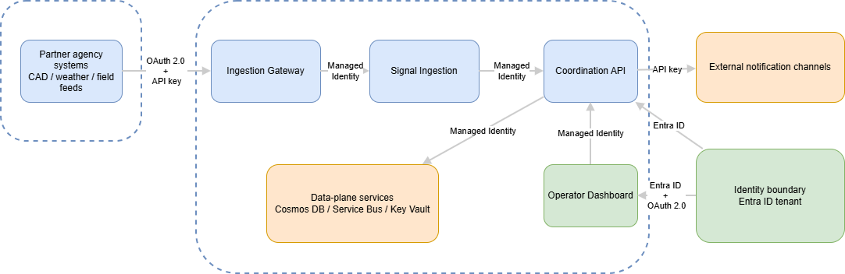
Security baseline - Zero Trust
Trust boundary · AU residency & data classification · docs/architecture/security/
Notes:
KEY MESSAGE: Zero Trust is not aspirational here - it is the default deployment posture.
TALK TRACK (90s):
- "Left diagram: trust boundaries. Operator UI is the only public surface. Everything else is private endpoint, managed identity, RBAC. No long-lived secrets except the explicitly carved-out third-party tokens, all in Key Vault with rotation."
- "Every workload is deployed by Bicep with policy-as-code gates. Each PR is security checked and linted for adherence"

Slide 26
AI Governance
Encoded Constitution
Layered Guardrails
Measured Accountability
Six Principles and five non-negotiables in the Constitution
CI safety-guardrails fail any PR that weakens an AI rail before it can merge
Foundry Content Safety + mandatory RAG citations + reflection critique + 7-tier trust banding + named human approval mean no AI action publishes without provenance and a person
CI Evidence Harness and the append-only Cosmos + 7-year Locked-Blob audit make the platform audit-ready on day one against ISO/IEC 42001, Australia's Voluntary AI Safety Standard 2024, and NIST AI RMF
Notes:
KEY MESSAGE: AI governance here isn't a policy document — it's a CI gate, a runtime guardrail, and a seven-year audit row. Audit-ready against ISO/IEC 42001, NIST AI RMF, and Australia's Voluntary AI Safety Standard on day one.
TALK TRACK (90s):
When people ask about AI governance, they usually mean "prove it isn't just a policy PDF." Let me give you the three layers we made enforceable.
First — the Constitution is code. Six non-negotiables — human-in-the-loop, Australian sovereignty, privacy by design, standards interoperability, graceful degradation, append-only audit — are encoded as Rego policies. The safety-guardrails and tenant-isolation bundles run on every pull request. A change that lowers an AI rail fails the pipeline at What-If. Governance is the merge button, not a wiki page.
Second — runtime guardrails are layered, not single-point. Foundry Content Safety and Prompt Shields sit in front of every model. RAG grounding against the AIDR handbook collection is mandatory and citations are emitted into every response — uncited output is rejected. A reflection guardrail critiques every Risk recommendation against the ten Warning Principles before Communication ever sees it. Signals are trust-tiered one-to-seven; tier six social signals are advisory only and cannot solo-trigger a public alert. And every irreversible action requires a named human approver. No anonymous AI action exists in this system.
Third — accountability is measured, not asserted. The Evidence Harness reports every KPI with a bootstrap ninety-five percent confidence interval and holds determinism within plus-minus two percent. Every signal-to-publish step writes an immutable audit row, mirrored to a seven-year Locked Blob. We've cross-walked the controls to ISO/IEC 42001, Australia's Voluntary AI Safety Standard 2024, and NIST AI RMF — so the platform is audit-ready on day one of any of those becoming mandatory.
PAUSE

Slide 27
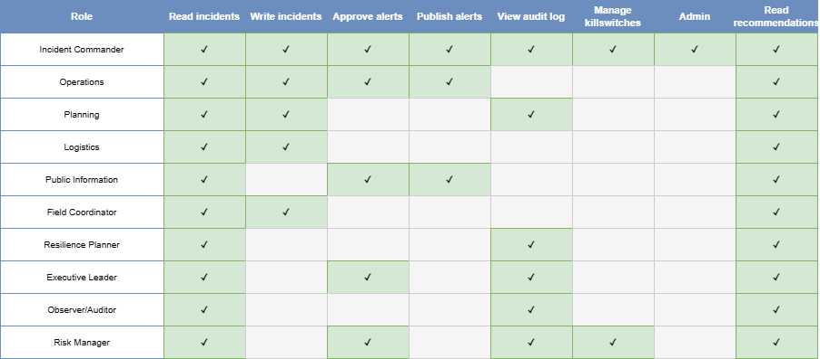
Governance - append-only audit, dashboard for the regulator
RBAC matrix · docs/architecture/security/rbac-matrix.png
Notes:
KEY MESSAGE: Governance ships *with* the product. The dashboard you would show a regulator is the same one operators use day-to-day.
TALK TRACK (75s):
- "Append-only audit container, Cosmos at Strong consistency, single AU region, 7-year Locked Blob immutability. Tampering attempts return 409 Conflict and write a tampering-attempt audit row themselves."
- "Open Policy Agent / Rego enforces the rules: au_region, cross_env, identity_consistency, posture, secret_hygiene, safety-guardrails, tenant-isolation. Every PR runs the same bundle CI runs."
- "The Governance Dashboard is a first-class UI surface - 13 endpoints documented in spec 021. It is the same dashboard a regulator would use; we did not build a separate compliance theatre."

Slide 28
Privacy, accessibility & cultural authority
Privacy: every PII field has a classification tag. The model gateway masks or denies PII transit on prompts that leave AU under the bounded carve-out. Privacy Act 1988 compliance tested at the contract level.
Accessibility: WCAG 2.2 AA on every render. Auslan video assets are first-class content. Plain English at Grade 8 reading level enforced by the Communication agent.
Cultural authority: Indigenous Relations sector agent consulted for any incident touching declared Country. Aboriginal & Torres Strait Islander language coverage per jurisdiction. Culturally-safe content review before publish.
Vulnerable populations - disability, CALD, elderly, transient, institutional - are explicit pre-processing constraints, not a checkbox.
Notes:
KEY MESSAGE: The hardest non-technical constraints are encoded in the platform, not the policy doc.
TALK TRACK (75s):
- "Cultural authority gets a sector agent because it deserves one. Indigenous Relations is on the org chart of every level-2+ incident."
- "Vulnerable population priority is *pre-processing*. The evacuation routing optimisation has a hard constraint that the most-at-risk are reached first. Not a tie-breaker - a constraint."

Slide 29
Risks & trade-offs - what could go wrong, what we chose
Model risk
Adoption risk
Sovereignty risk
LLM hallucination in life-safety contexts.
Mitigation:
Foundry-grounded RAG against AIDR corpus
mandatory citations
reflection guardrail
3-tier fallback to template
named human approval before any public-facing action.
Trade-off: latency vs trust, we chose trust.
Foundry model availability gap in AU regions.
Mitigation:
Bounded carve-out
Never for data
Always with data-minimisation gateway
Trade-off: a narrowly-scoped exception to keep the AI roadmap moving.
Agencies decline to integrate or share.
Mitigation:
Read-only ingest path requires no agency commitment
Benefits accrue immediately
Sector agents wrap existing systems rather than replace them.
Trade-off: we are a peer, not a hub-and-spoke owner.
Notes:
KEY MESSAGE: We name the risks, name the choices, and live with the trade-offs publicly.
TALK TRACK (75s):
- "Three risks. Three trade-offs. No hand-waving."
- "Model risk is the one C-level audiences ask about hardest. The answer is layered: ground every claim, critique every recommendation, fallback to template, require a named human. Belt, braces, and a third belt."
- "Adoption risk is real. We are deliberately a peer, not a hub. Read-only ingest from any agency on day one; deeper integration earned over time."
- "Sovereignty: the Foundry carve-out is the smallest exception we could engineer. Documented, auditable, auto-revoking."
ANTICIPATED Q&A:
- "Will agencies trust this?" - Trust is a function of evidence; the harness *is* the evidence.

Slide 30
KPI modelling - the five capstone success criteria, instrumented
Lives & lead time
Speed & efficiency
Economic impact
≥1,000 modelled lives saved/year (Sendai-aligned A-1 mortality counterfactual). ≥24h earlier evacuation lead-time vs prototype baseline. Both reported with bootstrap 95% CI per spec 040.
≥30% reduction in modelled economic loss (Sendai indicators C-2 through C-6). Risk-adjusted variant computed via 5×5 likelihood × consequence matrix per AS/NZS ISO 31000. Confidence-banded.
≥50% reduction in coordinated response time (call-received → incident-controlled).
30% logistics efficiency uplift (resource utilisation across cross-agency tasks). Per-KPI determinism tolerance ±2% / ±1 absolute.
Notes:
KEY MESSAGE: We did not pick five round numbers. We picked five Sendai-aligned, industry-benchmarked metrics - and we built a harness to *measure* them.
TALK TRACK (90s):
- "Spec 040 - Measurable Success-Criteria Evidence Harness - is our answer to the hardest question we get: 'how do you know'? It is built around six pillars: KPI modelling, measurement framework, simulation logic, expected-impact reasoning, benchmark comparisons, instrumentation design."
- "Every KPI has nine attributes: formula, unit, owner role, refresh cadence, target value, alert threshold, baseline source, provenance, and confidence-band rule. Bootstrap 95% CI by default, ±1 SD fallback for small samples."
- "These are the same KPIs we will publish on day-1 in production. No private dashboards."

Slide 31
FinOps - a cost ladder you can defend on day one and at scale
MVP / pilot
State production
National scale
Single jurisdiction, one canonical scenario monthly. Estimated AUD ~$8,500/month - Foundry models, Cosmos serverless, Container Apps consumption, ACS pay-per-message. 90-day pilot fits inside a $30k authorisation envelope.
All states + Commonwealth, all hazards, full audit. Estimated AUD ~$220,000/month. Compare against Black Summer cost of A$100 billion. A vanishingly small percentage of the loss curve we are bending.
Single state, multi-incident concurrent, full agent network. Estimated AUD ~$45,000/month with reserved capacity discounts. Cost-per-incident <$200 dominated by ACS message volume, controllable via warning targeting.
Notes:
KEY MESSAGE: The cost ladder is honest, modest, and orders of magnitude below the loss avoidance.
TALK TRACK (75s):
- "Three cost rungs: pilot, state, national. Real Azure pricing as of May 2026, AUD."
- "The number nobody asks but everybody should: the cost of *one* level-3 bushfire averages $850M in direct loss. The platform pays for itself with one prevented escalation."
- "We expose cost telemetry per agent, per scenario, per language channel. FinOps owners get a workspace, not a spreadsheet."

Slide 32
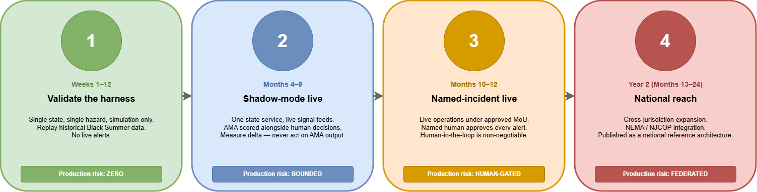
Adoption roadmap - pilot → state → national
Notes:
KEY MESSAGE: 90 days to a defensible pilot. 12 months to a state-level production. 24 months to national reach.
TALK TRACK (90s):
- "Phase 1 (weeks 1-12): single state, single hazard, simulation-only. Validates the harness against historical Black Summer data. No live alerts."
- "Phase 2 (months 4-9): controlled live integration with one state service in shadow mode. AMA recommendations alongside human-only decisions; we measure the delta but do not act on AMA output."
- "Phase 3 (months 10-12): named-incident live operations under an approved Memorandum of Understanding. Human-in-the-loop is non-negotiable."
- "Phase 4 (year 2): cross-jurisdiction expansion, NEMA/NJCOP integration, reference architecture published as an Australian Government Architecture pattern."
- "Each phase has measurable exit criteria mapped to spec 040 KPIs."

Slide 33
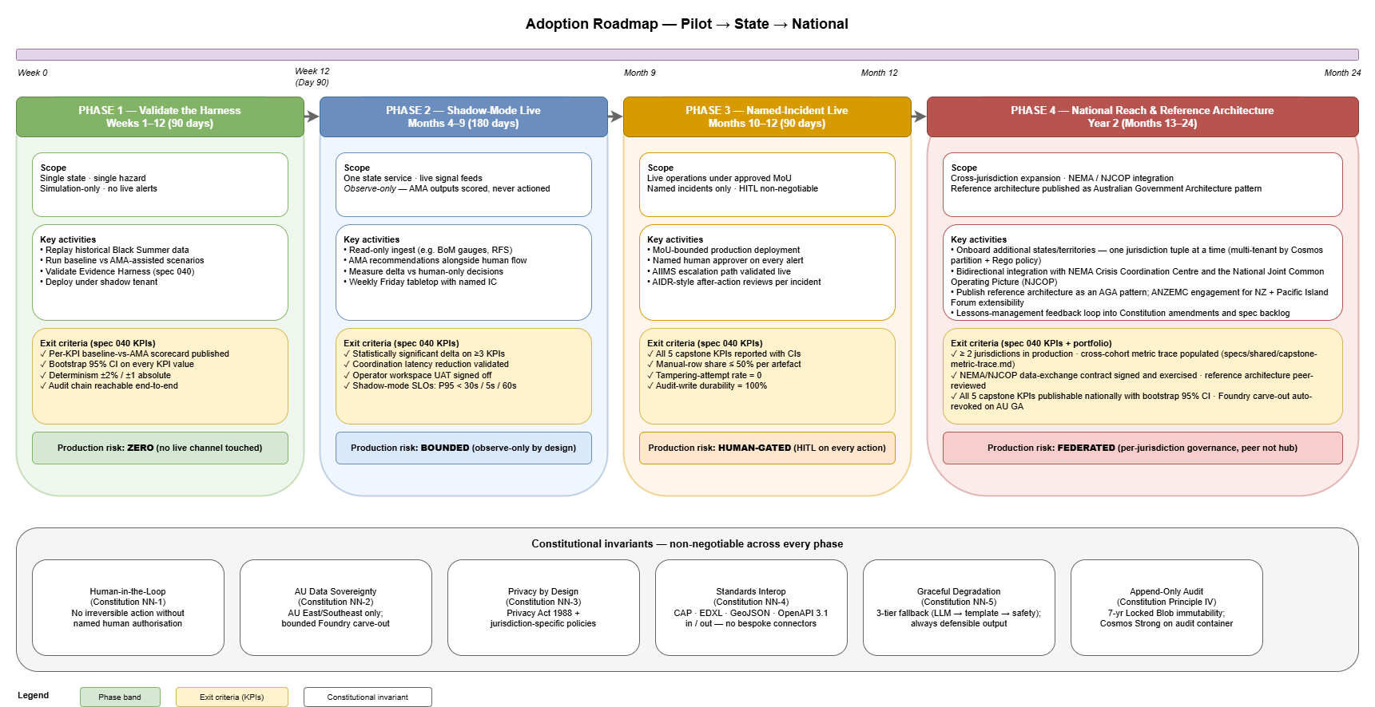
Adoption roadmap - pilot → state → national
CI/CD pipeline · docs/architecture/governance/adoption-roadmap.png
Notes:
KEY MESSAGE: 90 days to a defensible pilot. 12 months to a state-level production. 24 months to national reach.
TALK TRACK (90s):
- "Phase 1 (weeks 1-12): single state, single hazard, simulation-only. Validates the harness against historical Black Summer data. No live alerts."
- "Phase 2 (months 4-9): controlled live integration with one state service in shadow mode. AMA recommendations alongside human-only decisions; we measure the delta but do not act on AMA output."
- "Phase 3 (months 10-12): named-incident live operations under an approved Memorandum of Understanding. Human-in-the-loop is non-negotiable."
- "Phase 4 (year 2): cross-jurisdiction expansion, NEMA/NJCOP integration, reference architecture published as an Australian Government Architecture pattern."
- "Each phase has measurable exit criteria mapped to spec 040 KPIs."

Slide 34
The ask
A 90-day pilot, one state, one hazard
What we are asking for:
• Sponsorship from one state emergency-services agency for a 90-day shadow-mode pilot
• A named Incident Controller to participate in a weekly Friday tabletop
• Read-only access to one authoritative signal stream (BoM gauges or RFS Fires Near Me)
• An exit-criteria conversation against the capstone KPIs
What you get back:
• A measurable, baseline-vs-AMA-assisted outcome scorecard
• A documented Australian-sovereign reference architecture you can re-use
• Zero production-channel risk: shadow mode is observe-only by design
• A working answer to the hardest question facing emergency management: how do we go faster, together, in the climate we are inheriting?
Decision criteria, ROI model, and integration spike-plan are in the appendix and the repo.
Notes:
KEY MESSAGE: The ask is small, defensible, and lands inside any state's existing innovation envelope.
TALK TRACK (60s):
- "I am not asking for a budget or a contract today. I am asking for a 90-day shadow-mode pilot."
- "Shadow mode means we observe and we score; we do not touch a live decision. The downside is bounded by definition. The upside is a defensible outcome scorecard."
- "If the answer is yes, the integration spike-plan is on a single page in the appendix. If the answer is 'tell me more first', I'll be in this room for the next twenty minutes."
PAUSE before transitioning to Q&A.

Slide 35
KPIs we will publish on day one
Operational SLOs (rolling 30-day, with burn-rate alerts at 2%/h and 5%/h):
• Signal-to-recommendation latency P95 < 30s
• Recommendation-to-approval-request latency P95 < 5s
• Alert publish latency (after approval) P95 < 60s
• Audit-write durability: 100% before HTTP refusal
Capstone outcome KPIs (per Spec #040 evidence harness, with bootstrap 95% CI):
• Modelled lives saved per year of equivalent operational tempo
• Coordinated response time reduction vs prototype baseline
• Evacuation lead-time uplift
• Logistics efficiency uplift
• Modelled economic loss reduction
Notes:
KEY MESSAGE: These KPIs are not aspirational dashboards. They are SLOs with burn-rate alerts and named owners.
TALK TRACK (60s):
- "Three families of KPIs. Operational SLOs measure the platform. Capstone KPIs measure the outcome. Governance KPIs measure the discipline."
- "Burn-rate alerts at 2% and 5% per hour against a 30-day SLO horizon - Google SRE Workbook fast-burn convention. Sev1 pages a human; Sev2 raises a ticket."
Governance KPIs:
• Manual-row share per artefact ≤50% (publication blocked above)
• Tampering-attempt rate (target zero, surfaced as audit row)
• Carve-out review cadence (auto-revoke on AU GA)

Slide 36
Lessons learned
What surprised us, what we changed
Spec-driven beats code-driven. We wrote 40+ specifications before significant code. Every Specification named its assumptions, hypotheses, scope boundaries. The Constitution was the spine. The cost was upfront cycles; the payoff is reviewability, traceability, and changeability.
Multi-agent is a discipline, not a vendor choice. Handoff contracts, retry semantics, dead-letter SLAs - these mattered far more than the model choice. Microsoft Agent Framework made the orchestration cheap; the thinking was ours.
Governance has to ship with the product. The Governance Dashboard, the append-only audit - these are not 'phase 2'. They land in PR #1 because retrofitting them is impossible.
Lessons feed forward: every significant scenario triggers an AIDR-style after-action review, captured as a Specification amendment. Continual improvement is Constitutional (Quality Gates).
Notes:
KEY MESSAGE: We did not just build the thing. We built it the right way, and that is reusable.
TALK TRACK (75s):
- "Three lessons. Spec-first. Multi-agent is a discipline. Governance ships with the product."
- "If you take one architectural pattern home, take this: write the constitution before you write the code. It is the cheapest leverage you will ever buy."

Slide 37
Reference architecture
Extensible to allied & regional partners
Australia first, with a deliberately portable architecture. The Constitution names 27 specs as delivery-hygiene and capstone-critical-path; the boundary between AU-only and regionally-portable is explicit at the requirements level.
Partners on the immediate horizon: New Zealand (ANZEMC), Pacific Island Forum members (per AIDR's regional engagement). Each lands as a new jurisdiction tuple, a localised language pack, and a country-specific Constitution amendment - not a fork.
Interop is the moat: CAP/EDXL/GeoJSON in, OpenAPI 3.1 out. Any nation that runs an Emergency Management stack can integrate without bespoke connectors. The platform is an Australian-built reference architecture, not a closed system.
Notes:
KEY MESSAGE: Built for Australia first. Designed to be the regional reference architecture next.
TALK TRACK (60s):
- "We do not promise portability without doing the work. The portfolio carries a metric-trace artefact (specs/shared/capstone-metric-trace.md) that names every AU-only assumption and what would change for a Pacific or NZ deployment."
- "This is how an Australian platform becomes a regional asset - not by exporting code, but by exporting a *pattern*."

Slide 38
Cost model - line items & sensitivity
Pilot (single jurisdiction):
.
ROI scenario (illustrative): Black Summer 2019–20 = ~A$100B in losses. State-scale annualised operating cost is in the low single-digit millions.
Resource | Monthly cost (AUD)
Foundry models - reasoning + drafting deployments | ~$2,800
Cosmos DB serverless (multi-container) | ~$1,200
Container Apps consumption (API + agents) | ~$1,400
Azure AI Search (Foundry RAG, AIDR corpus) | ~$700
Storage (audit, evidence pack, immutable) | ~$300
Service Bus + Event Grid | ~$150
Application Insights + Log Analytics | ~$600
Azure Communication Services (pilot volume) | ~$1,000
Front Door + Static Web Apps | ~$350
TOTAL | ~$8,500
Notes:
Reference detail for FinOps Q&A. Indicative cost ladder — to be validated via Azure Pricing Calculator before pilot kickof
Confidence band on pilot estimate: ±15%.
Sensitivity: ACS message volume is the single largest variable at scale. Targeted warnings (jurisdiction-bounded) cut alert spend by ~40% vs broadcast SMS. Per-incident cost dominated by ACS, not by AI inference.
ROI scenario (illustrative): one prevented level-3 escalation in a year of operation = ~$850M direct loss avoidance vs ~$2.6M annualised pilot+state operating cost.

Slide 39
Thank you.
Questions, challenges, healthy disagreement - all welcome.
Notes:
KEY MESSAGE: Open the floor. Welcome the panel. Listen.
TALK TRACK (15s):
- "Thank you. We have twenty minutes. I'd like to take questions in three buckets - strategic, technical, governance - but jump in any order."
PANEL TIPS:
- Repeat each question for the room before answering.
- For executive questions, anchor in the five capstone KPIs.
- For technical questions, anchor in the architecture diagrams; don't be afraid to flip back.
- For governance questions, anchor in the Constitution and the carve-out list.
- It is fine to say "I don't know - let me come back to you with the audit row."

Slide 41
Backup slides
Architecture detail · sequence diagrams · cost & FinOps · governance gates
Notes:
Reference material to support Q&A. Not part of the 40-minute walkthrough.

Slide 42
Sequence - monitoring → risk → communication
[diagram placeholder: monitoring-risk-comms.png not found]
docs/architecture/sequence/monitoring-risk-comms.png
Notes:
End-to-end agent handoff sequence with reflection guardrail. Reference for technical Q&A on agent orchestration.

Slide 43
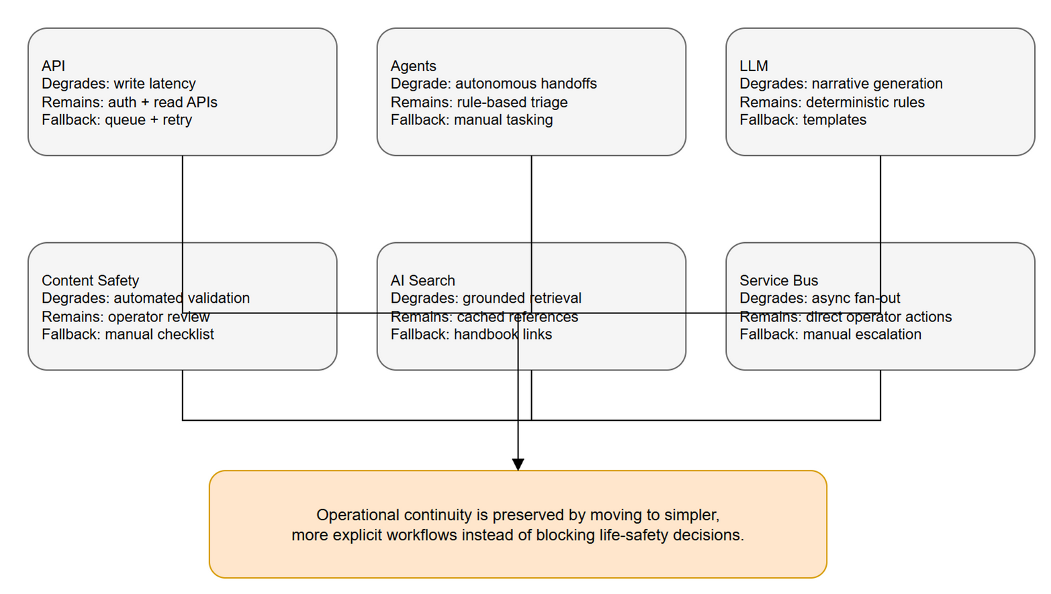
Sequence - graceful degradation
docs/architecture/sequence/graceful-degradation.png
Notes:
Demonstrates constitutional non-negotiable #5 in action. Reference for resilience and SRE questions.

Slide 44
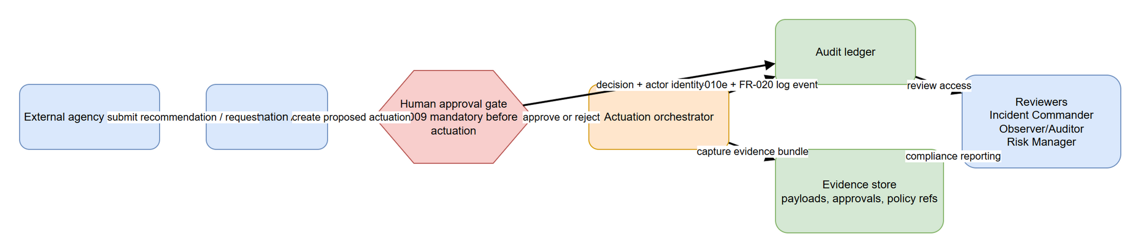
Sequence - audit & provenance
docs/architecture/sequence/audit-provenance.png
Notes:
End-to-end traceability from any output back to source signals and approvals. Reference for compliance/regulator questions.

Slide 45
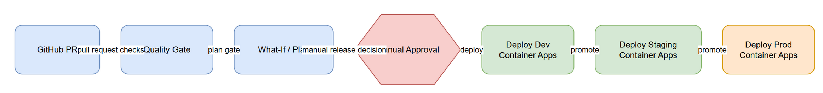
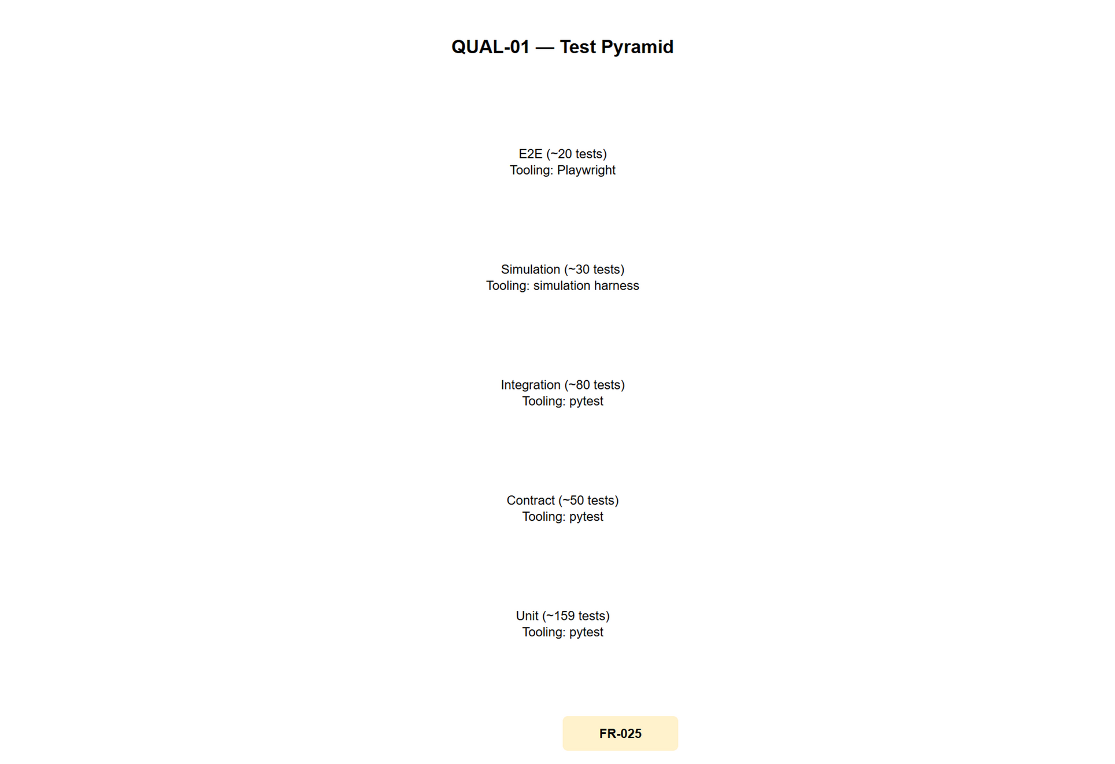
CI/CD pipeline & test pyramid
CI/CD · test pyramid · docs/architecture/
Notes:
Branch-based dev/staging/prod (per spec 031). 531 test files: 173 unit, 156 contract, 134 integration, 25 simulation, 10 devops, 6 benchmark, 5 e2e, 2 load (workspace at deck-build time). Branch-based dev/staging/prod per spec 031.

Slide 46
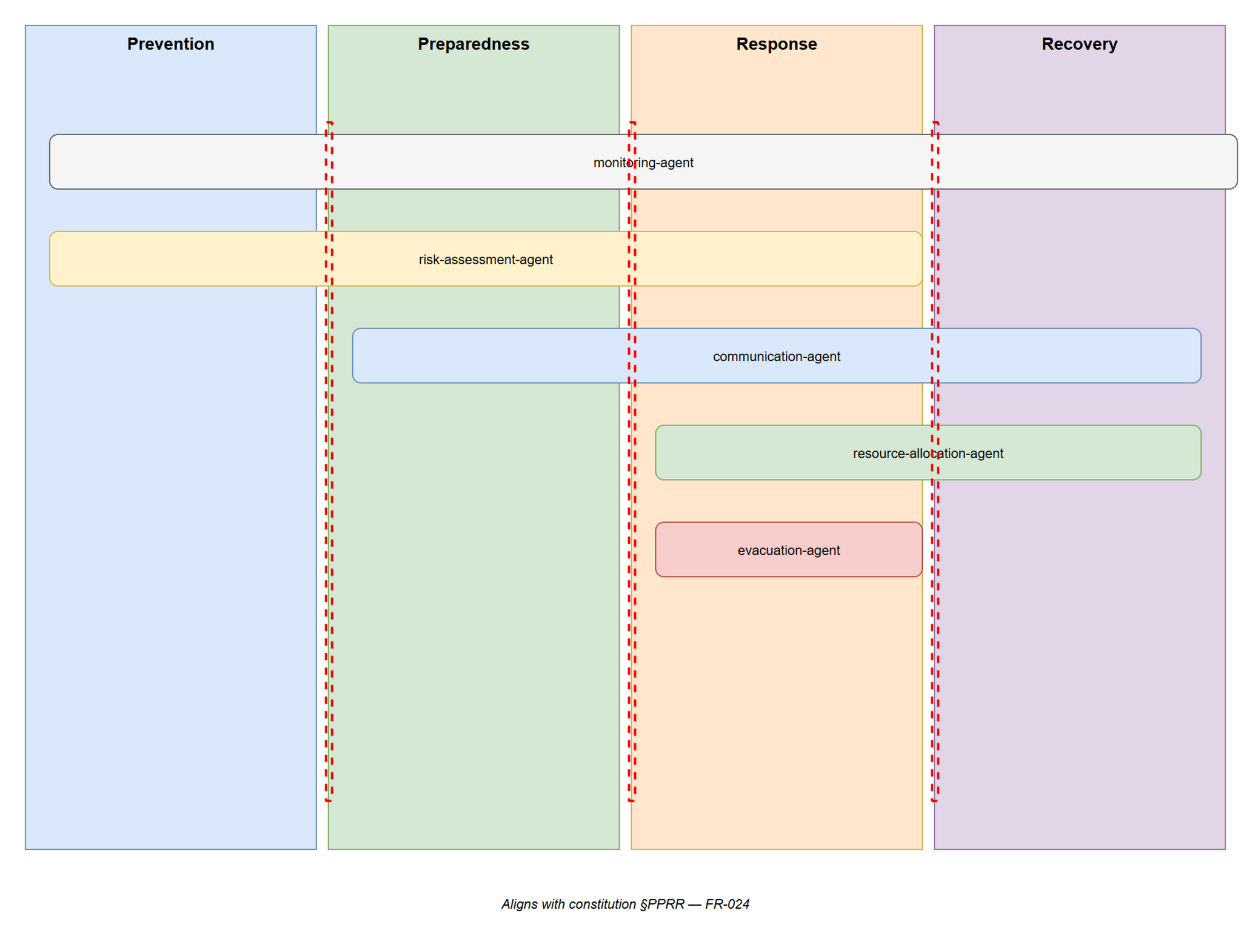
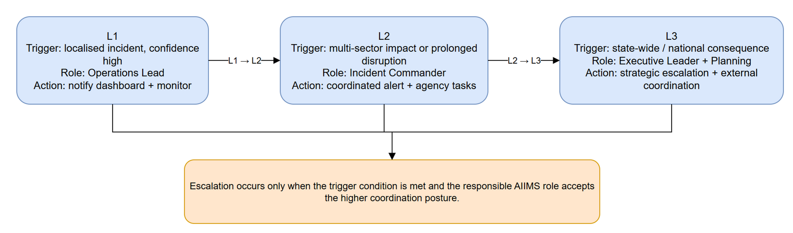
PPRR overlay & AIIMS escalation paths
PPRR overlay · escalation paths · docs/architecture/operational/
Notes:
Prevention, Preparedness, Response, Recovery overlap by design. Escalation is by AIIMS authority and named successor; no escalation without an audit row.

Slide 47
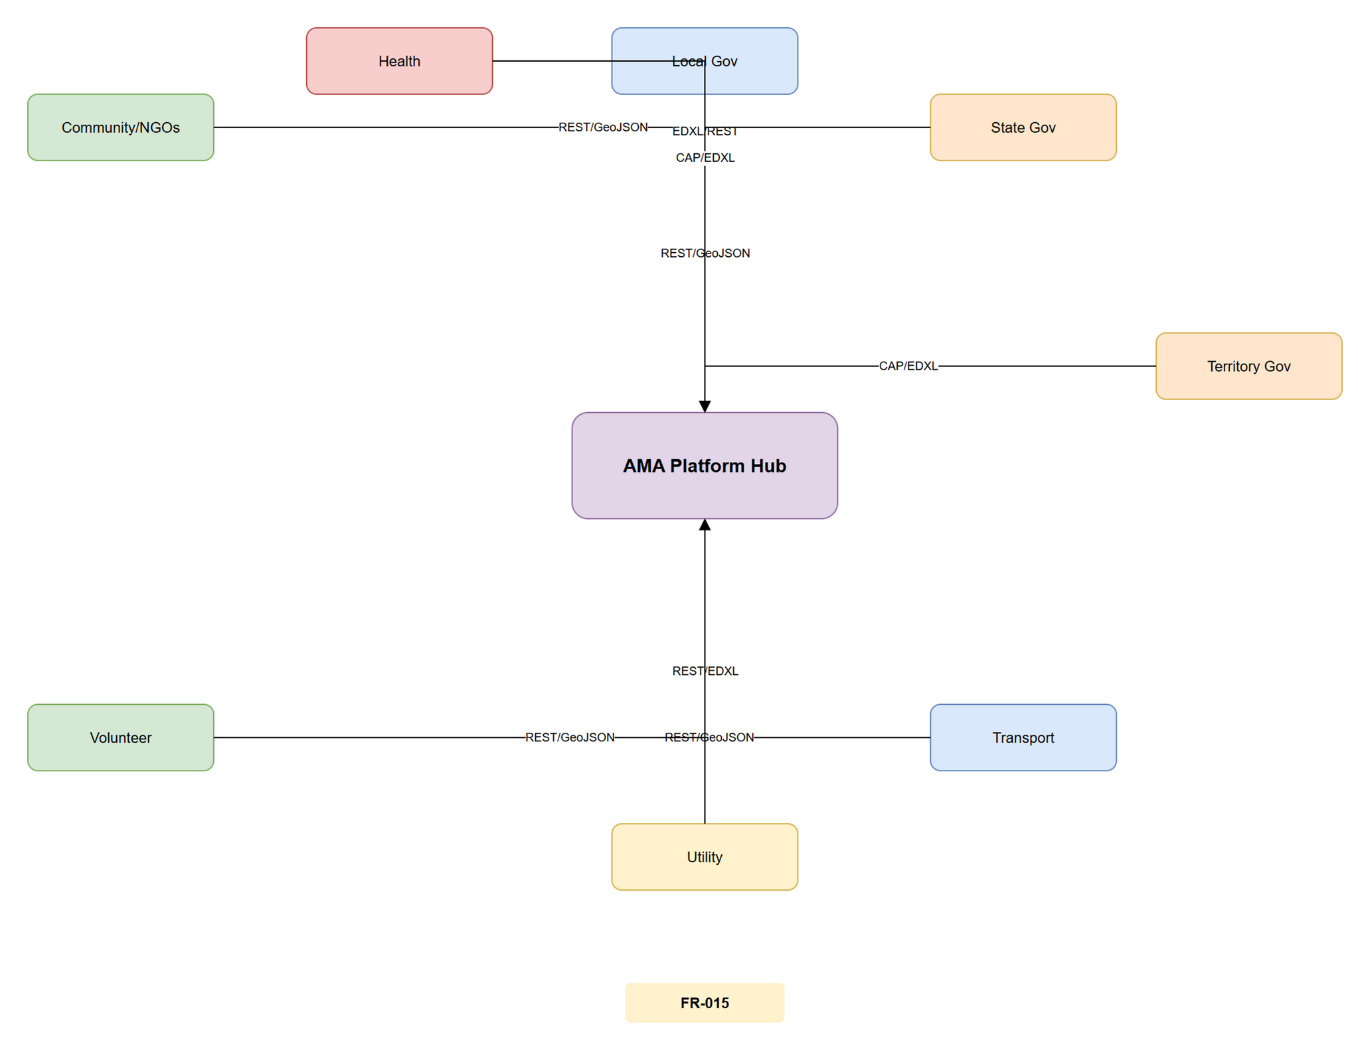
Simulation logic - baseline vs AMA-assisted, replayable, deterministic
Cross-sector touchpoints - the simulation surface · docs/architecture/data/cross-sector-touchpoints.png
Notes:
KEY MESSAGE: Every claim in this deck is reproducible by anyone with the repo and a deterministic seed.
TALK TRACK (75s):
- "Seven canonical scenarios: bushfire, flood, cyclone, urban-fire, mass-casualty, hazmat, marine SAR. Two modes per scenario: baseline (no AMA) and AMA-assisted. Same seed, same population, same incident sequence."
- "The harness produces a per-KPI delta scorecard with bootstrap 95% CI. Re-runs reproduce within ±2% / ±1 absolute - that is the determinism floor."
- "Sim warp playback (spec 026) lets an auditor step through the same run later. Time-travel debugging for compliance."

